Slide 1



IEEE NPSS SCHOOL ON ADVANCED TOPICS IN MEDICAL IMAGING
Evaluation of HyperArc SRS Treatment Plan Quality Assurance Using Point Dose Measurements on Homogeneous and Heterogeneous Phantoms
STUDENT: TRƯƠNG GIA HỶ
HO CHI MINH City – 18/08/2025

Slide 2


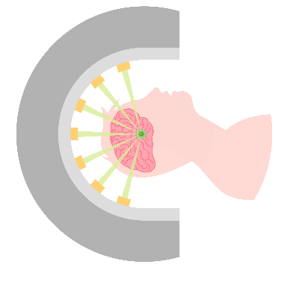


OVERVIEW
Introduction
HyperArc SRS technique
QA of treatment plan
Device and measurement methods
1

Slide 3


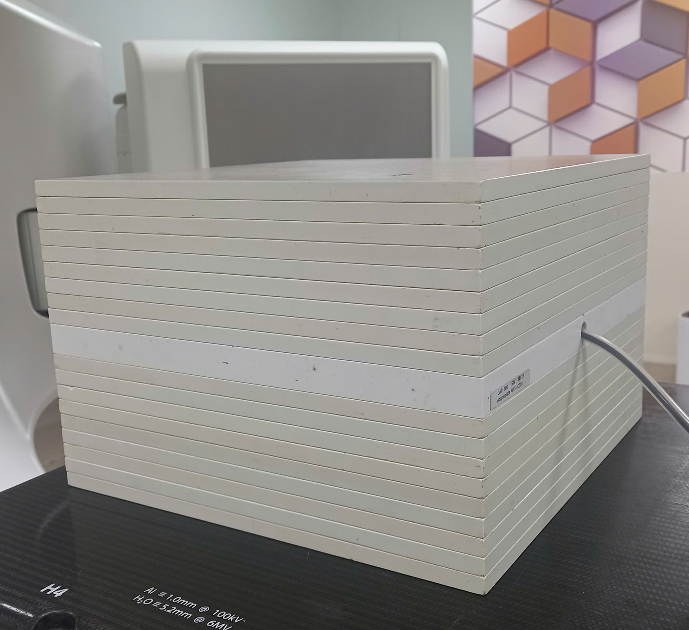
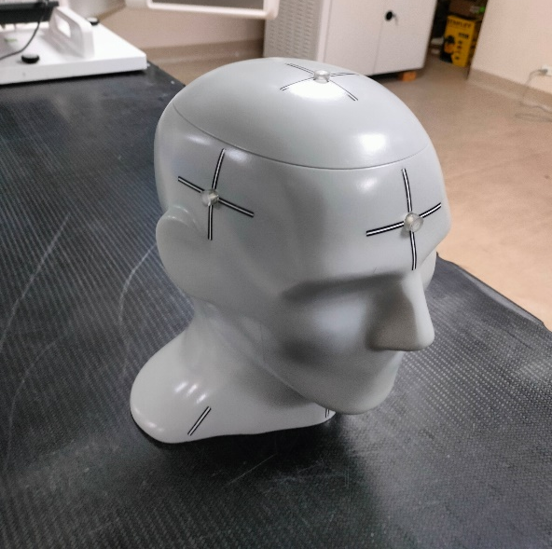
OVERVIEW
Research Objective
Perform point dose measurements at the irradiation isocenter using the HyperArc radiosurgery
Evaluate the accuracy and stability
Figure 1. Homogeneous phantom (SP34)
Figure 2. Heterogeneous phantom (STEEV)
2

Slide 4
OVERVIEW
HyperArc SRS technique
Criteria
SRS
HyperArc
Intracranial treatment
Good, individual lesions
Optimized, for multiple lesions
Field arrangement
Fixed, multiple directions
Non-coplanar arc arrangement
Automation
Manual treatment planning
Automated planning
Dose distribution
Optimized, high conformity
Good
3

Slide 5


SUBJECTS & METHODS
Subjects
31 patients with brain metastases treated with HyperArc.
Homogeneous phantom (Solid Phantom).
Heterogeneous phantom (Head-and-neck phantom).
4

Slide 6

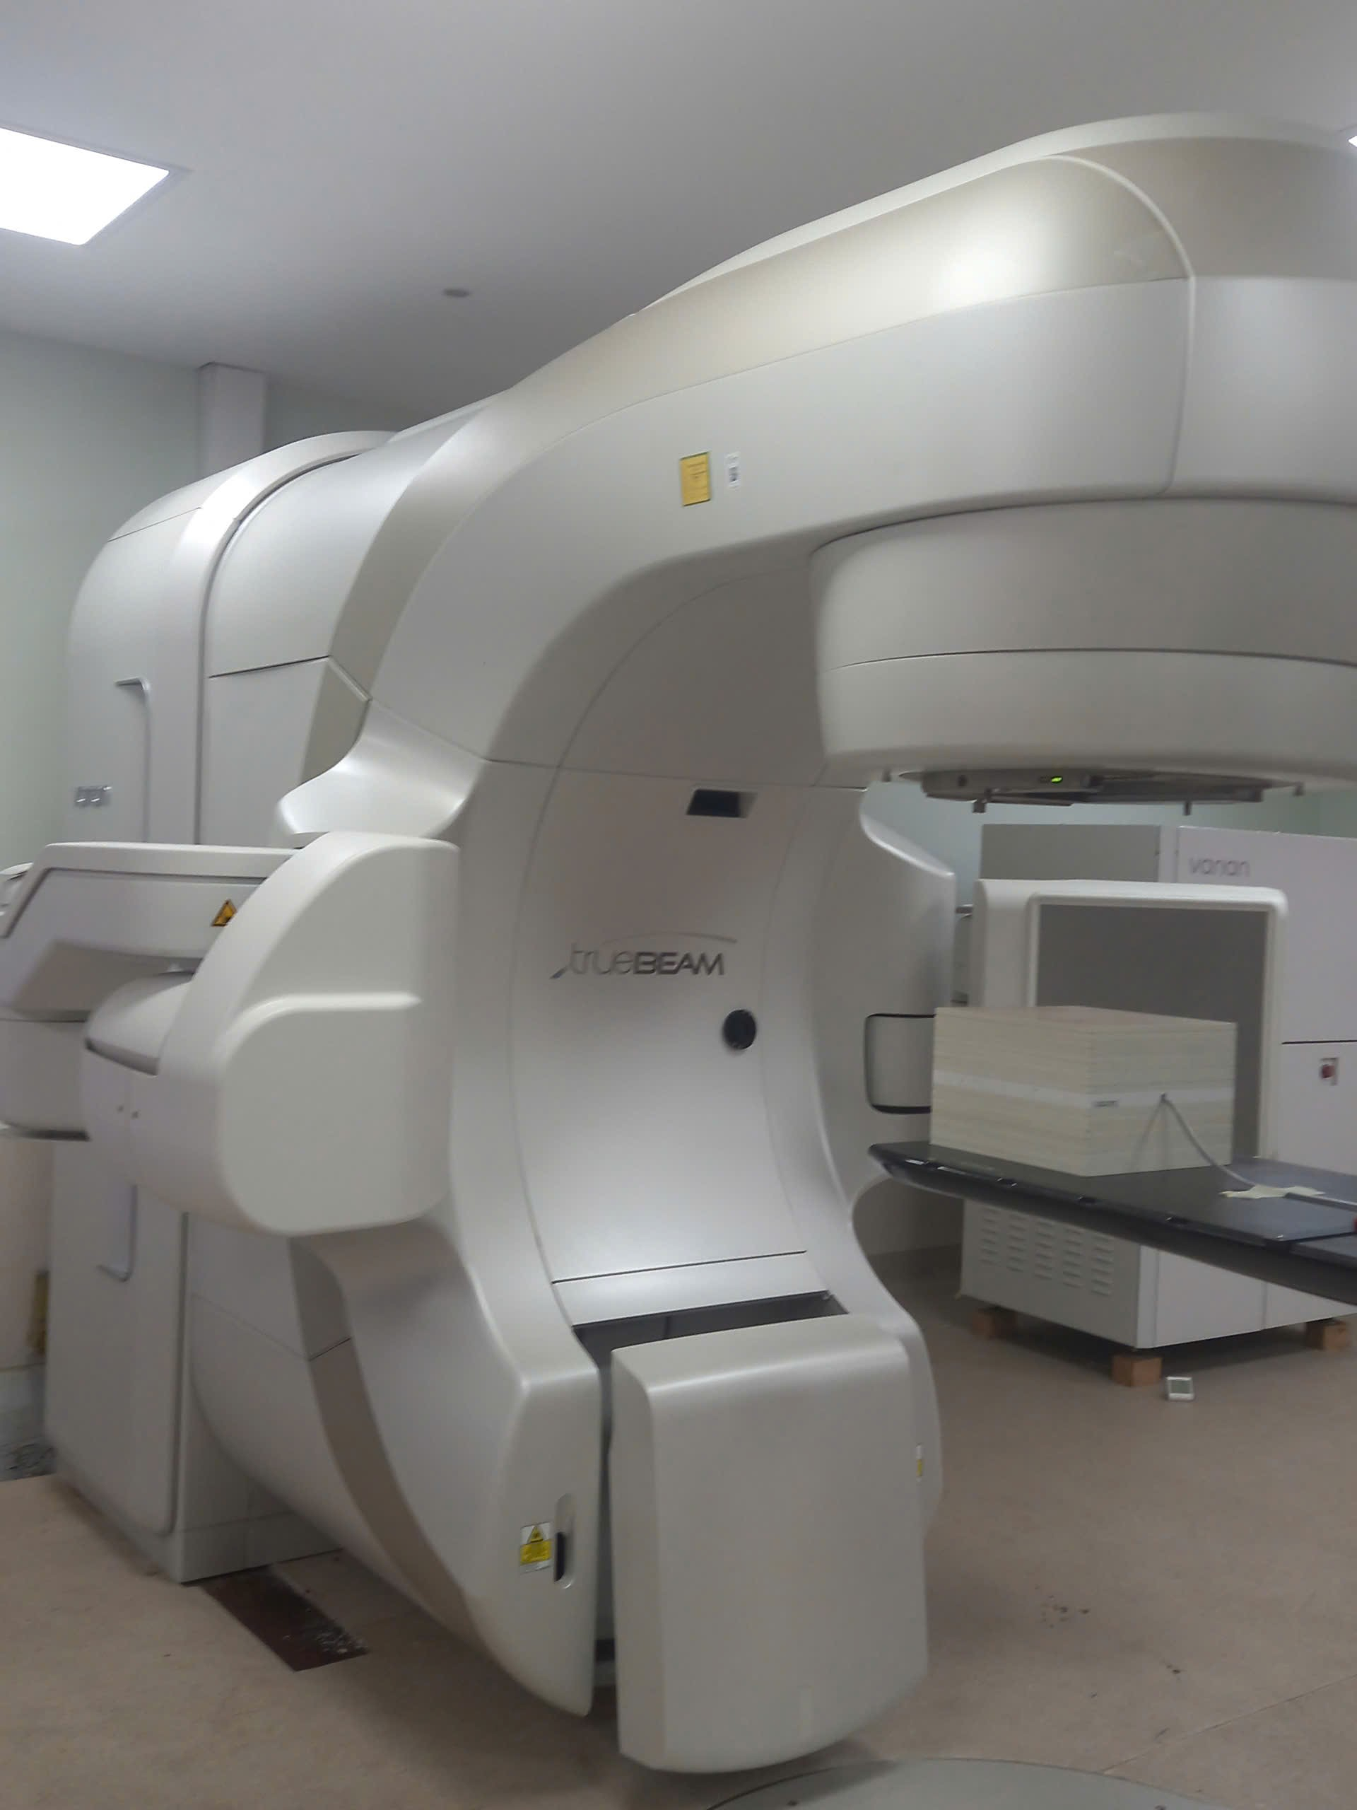
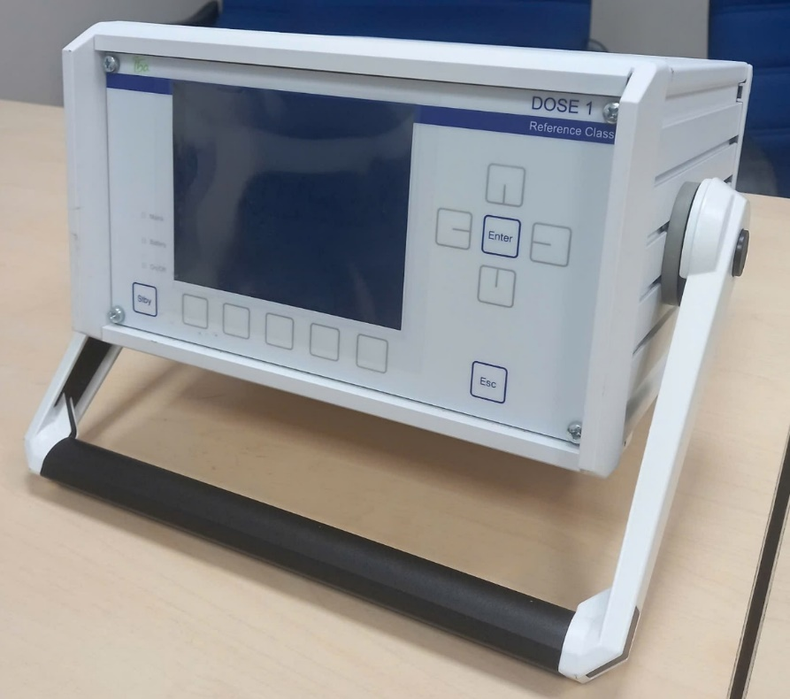
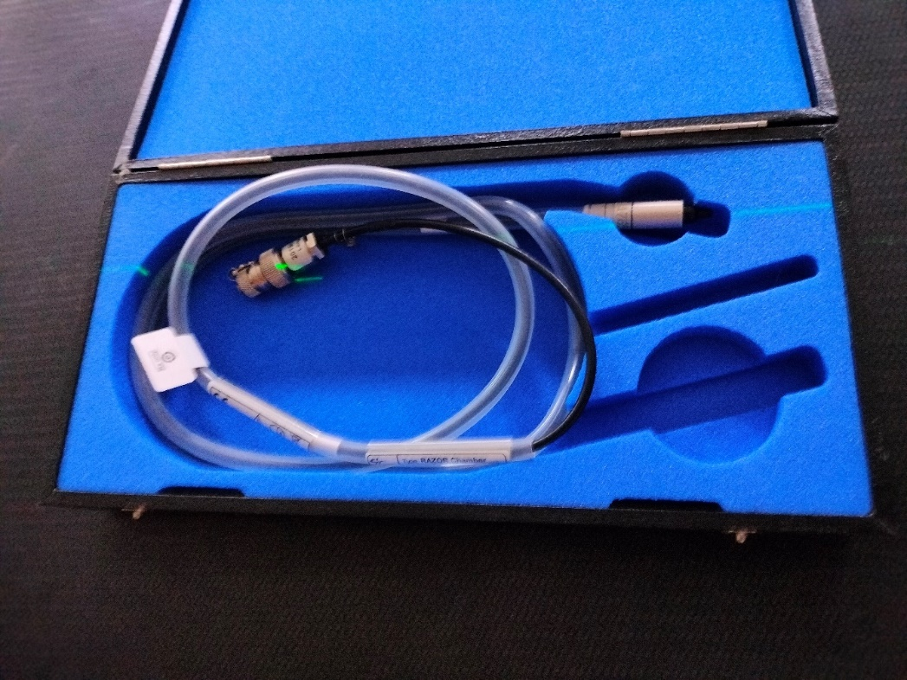
SUBJECTS & METHODS
Equipment
Figure 3. RAZOR Ionization Chamber
Figure 4. DOSE 1 Electrometer
Figure 5. TrueBeam 2.7 Linear Accelerator
5

Slide 7
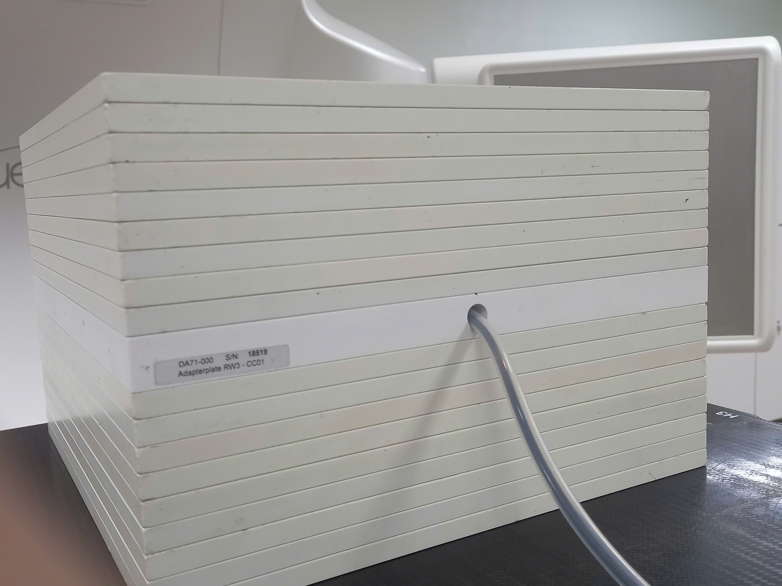
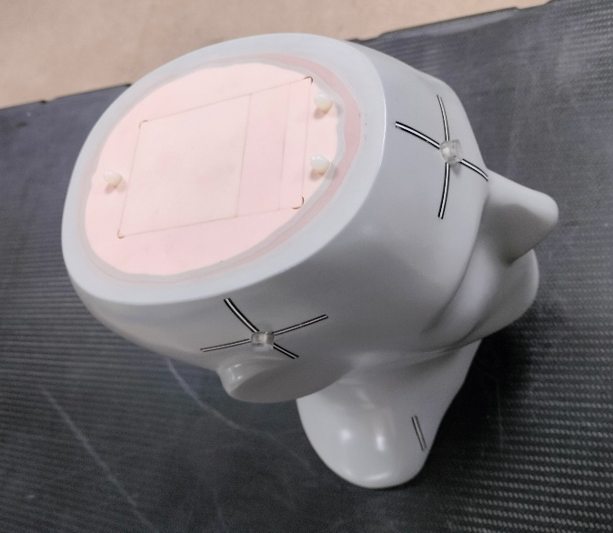
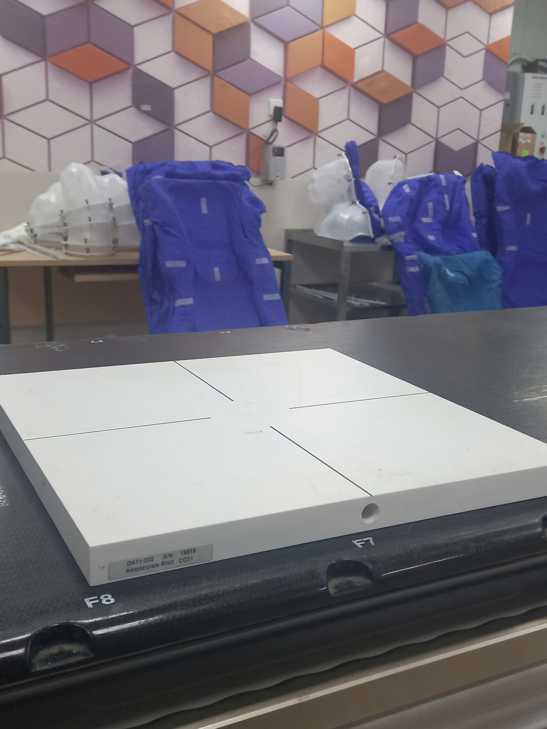
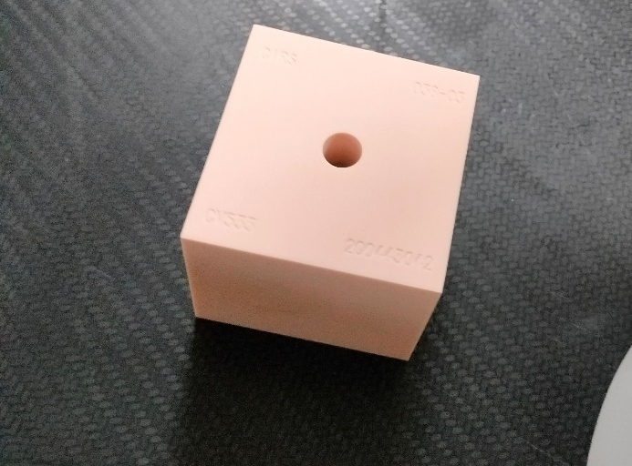
Homogeneous Phantom (Solid Phantom 34)
Heterogeneous Phantom (Head-and-neck Phantom)
Figure 6. Homogeneous phantom with layered structure and detector attachment plate
Figure 8. Heterogeneous phantom (STEEV)
Figure 7. Detector attachment plate compatible with the RAZOR ionization chamber
Figure 9. Measurement module 038–03
6

Slide 8
SUBJECTS & METHODS
Workflow of Treament Plan QA
Comparison, evaluation, and analysis of results
Data transfer from TPS to linear accelerator
Data collection
Treatment planning simulation on two phantoms
Dose measurement and recording at the irradiation isocenter
7

Slide 9
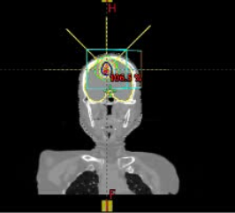
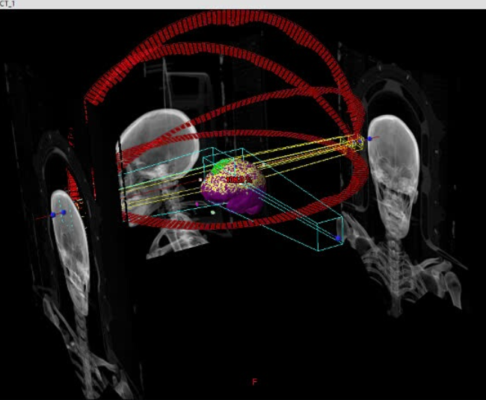
SUBJECTS & METHODS
Workflow of Treament Plan QA
Figure 10. Patient Plan Data
Figure 11. Arcs and Fields in the Patient Plan
8

Slide 10
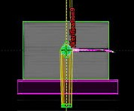
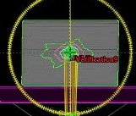
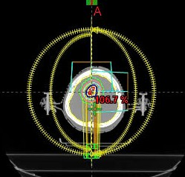
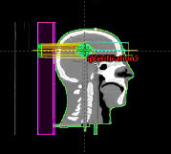
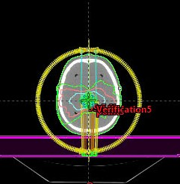
Workflow of Treament Plan QA
Figure 12.1a. Dose Recording at the Reference Point (SP34)
Figure 12.1. Dose Calculation on SP34
Figure 12. Treatment Plan Parameters
Figure 12.2. Dose Calculation on STEEV
Figure 12.2a. Dose Recording at the Reference Point (STEEV)
9

Slide 11
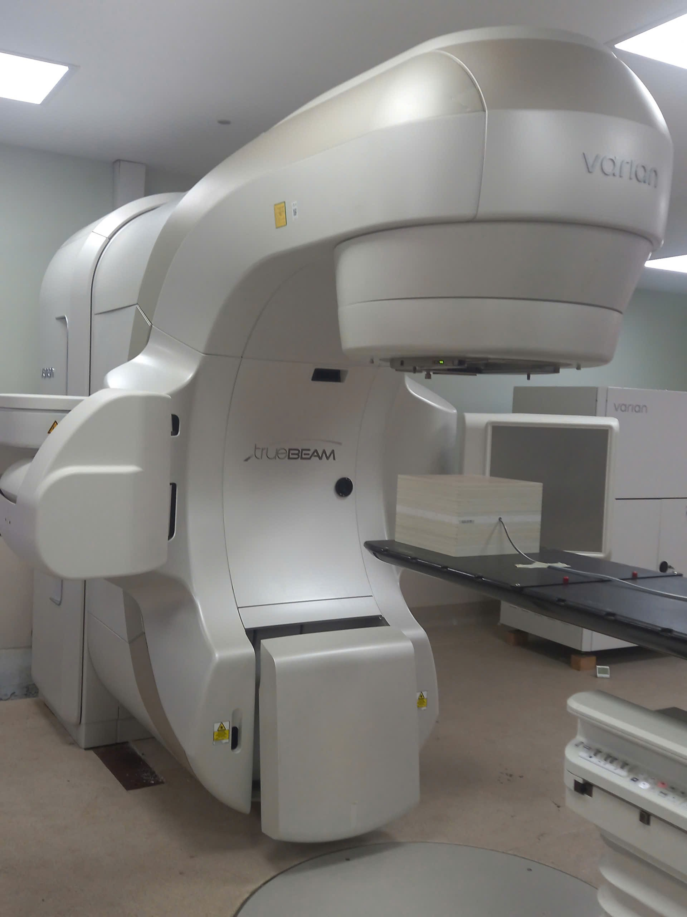
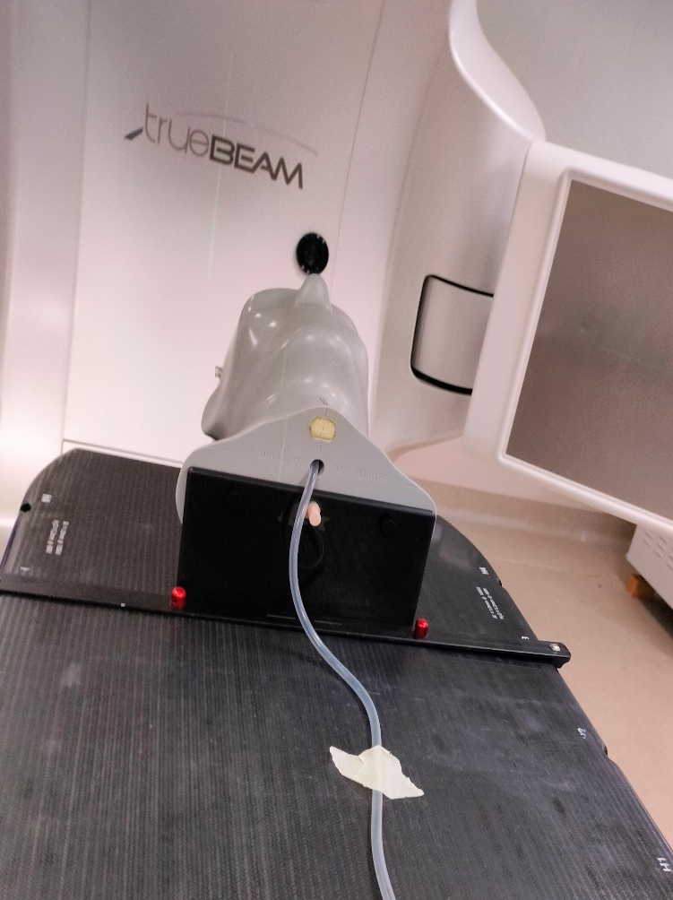
SUBJECTS & METHODS
Experimental Setup
Figure 13. Setup of SP34 phantom on the TrueBeam 2.7 linear accelerator
Figure 14. Setup of STEEV phantom on the TrueBeam 2.7 linear accelerator
10

Slide 12
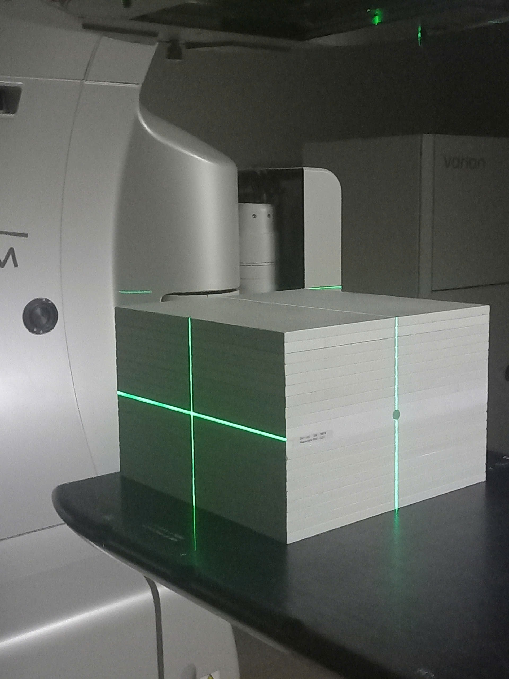
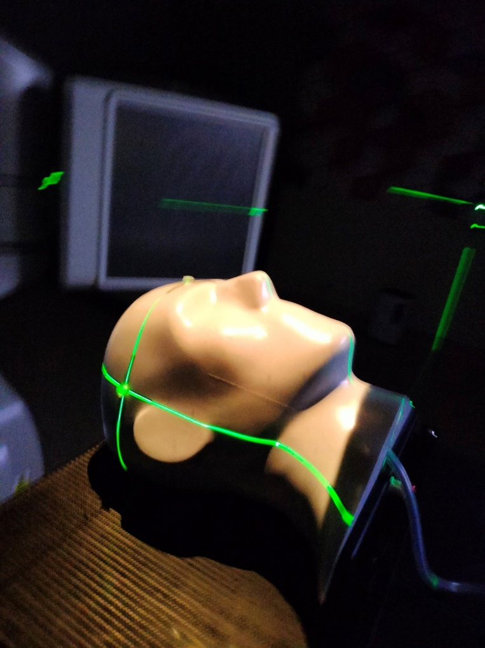
SUBJECTS & METHODS
Experimental Setup
Figure 15. SP34 Marked with the Laser Positioning System
Figure 16. STEEV Marked with the Laser Positioning System
11

Slide 13
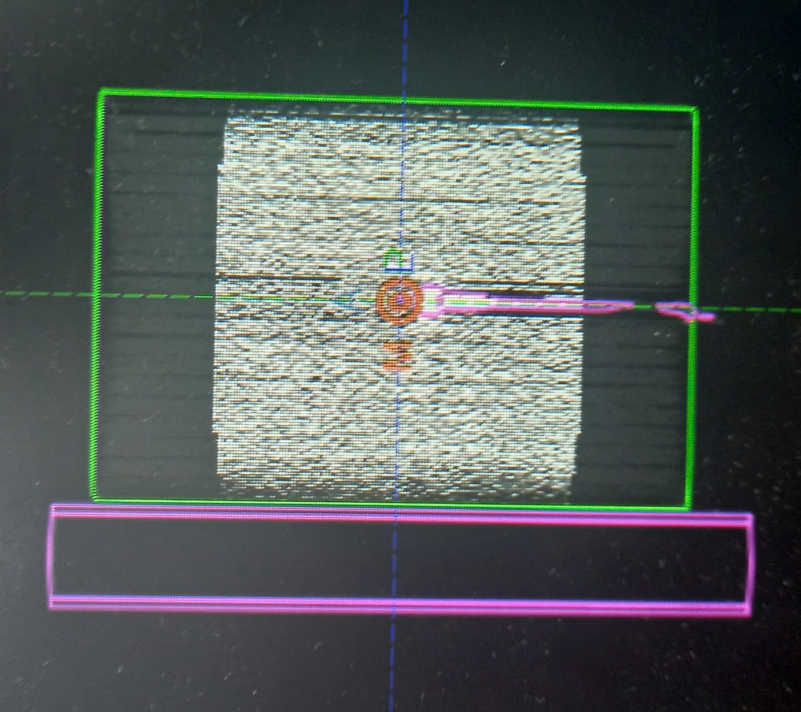
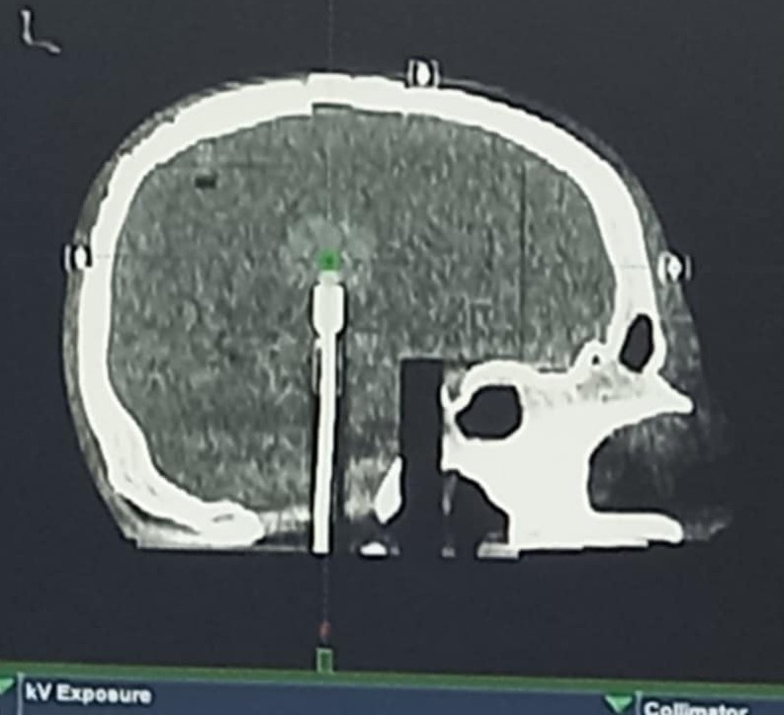
SUBJECTS & METHODS
Phantom Position Verification
Figure 17. CBCT Image of SP34
Figure 18. CBCT Image of STEEV
12

Slide 14

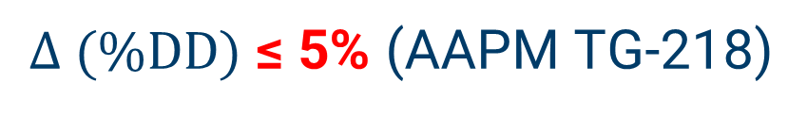
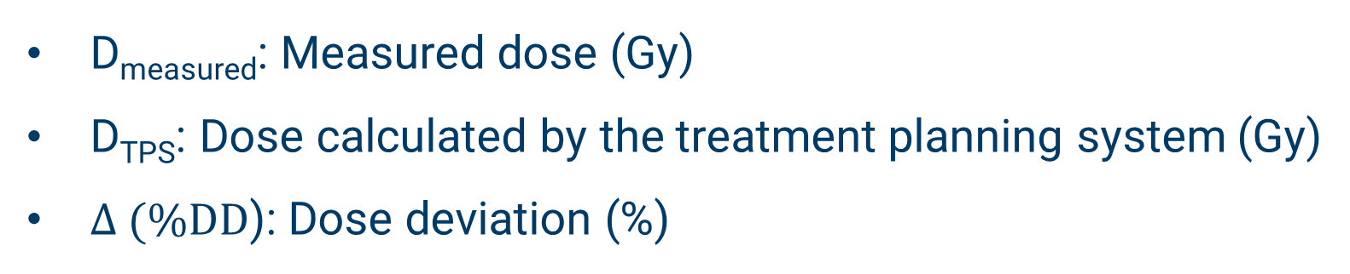
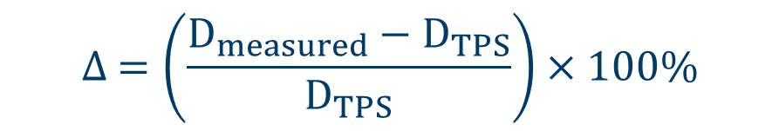
SUBJECTS & METHODS
Results Evaluation
$$∆ =\left(\frac{D_{measured}−D_{TPS}}{D_{TPS}}\right)×100\%$$
D_{measured}: Measured dose (Gy)
D_{TPS}: Dose calculated by the treatment planning system (Gy)
$∆ (\%DD$): Dose deviation (%)
Acceptance Criteria
$∆ (\%DD)$ ≤ 5% (AAPM TG-218)
13

Slide 15
EXPERIMENTAL RESULTS
Table 1. Measured Dose Results on the Homogeneous Phantom
No. | Patient | DPrescribed (Gy/frac) | DMeasured (Gy) | DTPS (Gy) | DD (%)
1 | NSH | 9 Gy/1 | 7,627 | 7,425 | 2,716
2 | LVT | 9 Gy/1 | 8,580 | 8,488 | 1,084
3 | PTTT | 9 Gy/1 | 6,697 | 6,619 | 1,173
4 | VTTH | 9 Gy/1 | 2,220 | 2,213 | 0,321
5 | NTK | 9 Gy/1 | 5,202 | 5,131 | 1,390
6 | NTLE | 6 Gy/1 | 2,425 | 2,376 | 2,070
7 | BHP | 24 Gy/1 | 21,926 | 21,005 | 4,383
8 | LTTT | 20 Gy/1 | 2,104 | 2,074 | 1,431
9 | VNH | 24 Gy/1 | 21,593 | 21,108 | 2,299
10 | BTHV | 6 Gy/1 | 5,390 | 5,299 | 1,711
11 | TVH | 20 Gy/1 | 17,648 | 17,305 | 1,980
12 | TTTN | 9 Gy/1 | 7,196 | 7,153 | 0,604
13 | NTD | 9 Gy/1 | 7,601 | 7,500 | 1,347
14 | TMT | 24 Gy/1 | 19,097 | 18,63 | 2,507
15 | LTL | 20 Gy/1 | 16,691 | 16,545 | 0,883
16 | LTKL | 9 Gy/1 | 7,699 | 7,653 | 0,605
No. | Patient | DPrescribed (Gy/frac) | DMeasured (Gy) | DTPS (Gy) | DD (%)
17 | DVD | 9 Gy/1 | 8,071 | 8,01 | 0,767
18 | NTTH | 6 Gy/1 | 2,636 | 2,599 | 1,427
19 | NTHG | 9 Gy/1 | 1,299 | 1,311 | -0,895
20 | QTD | 9 Gy/1 | 1,200 | 1,237 | -2,971
21 | VVV | 6 Gy/1 | 0,441 | 0,442 | -0,236
22 | TTH | 6 Gy/1 | 0,886 | 0,877 | 1,053
23 | NTVD | 9 Gy/1 | 8,038 | 8,008 | 0,377
24 | TVT | 6 Gy/1 | 5,636 | 5,637 | -0,023
25 | GTHO | 9 Gy/1 | 8,218 | 8,222 | -0,053
26 | NMC | 9 Gy/1 | 0,916 | 0,907 | 1,033
27 | TNL | 24 Gy/1 | 3,196 | 3,113 | 2,667
28 | LTKH | 9 Gy/1 | 8,095 | 7,968 | 1,599
29 | TMVQ | 9 Gy/1 | 8,440 | 8,42 | 0,243
30 | CVP | 6 Gy/1 | 1,035 | 1,026 | 0,859
31 | TMQ | 20 Gy/1 | 15,683 | 15,463 | 1,424
14

Slide 16
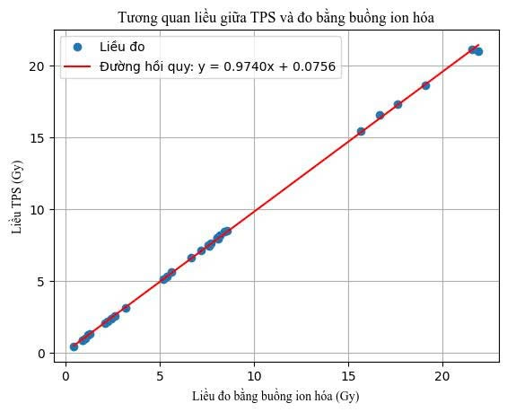
EXPERIMENTAL RESULTS
Homogeneous Phantom
Remarks
31/31 cases met the 5% acceptance criterion
Mean deviation: 1,090%
Standard deviation: 1,285%
D_{TPS} = 0,9740D_{measured} + 0,0756
Figure 19. Dose Correlation Graph between TPS and Ionization Chamber Measurement
15

Slide 17
EXPERIMENTAL RESULTS
Table 2. Measured Dose Results on the Heterogeneous Phantom
No. | Patient | DPrescribed (Gy/frac) | DMeasured (Gy) | DTPS (Gy) | DD (%)
1 | NSH | 9 Gy/1 | 10,124 | 9,869 | 2,585
2 | LVT | 9 Gy/1 | 10,821 | 10,831 | -0,089
3 | PTTT | 9 Gy/1 | 8,550 | 8,63 | -0,928
4 | VTTH | 9 Gy/1 | 2,858 | 2,871 | -0,459
5 | NTK | 9 Gy/1 | 6,168 | 6,084 | 1,386
6 | NTLE | 6 Gy/1 | 2,899 | 2,838 | 2,144
7 | BHP | 24 Gy/1 | 28,082 | 26,942 | 4,231
8 | LTTT | 20 Gy/1 | 2,777 | 2,782 | -0,176
9 | VNH | 24 Gy/1 | 27,825 | 27,399 | 1,554
10 | BTHV | 6 Gy/1 | 7,159 | 6,999 | 2,283
11 | TVH | 20 Gy/1 | 22,653 | 22,163 | 2,212
12 | TTTN | 9 Gy/1 | 9,507 | 9,434 | 0,770
13 | NTD | 9 Gy/1 | 9,810 | 9,678 | 1,363
14 | TMT | 24 Gy/1 | 24,145 | 23,501 | 2,741
15 | LTL | 20 Gy/1 | 21,489 | 21,197 | 1,377
16 | LTKL | 9 Gy/1 | 9,968 | 9,856 | 1,141
No. | Patient | DPrescribed (Gy/frac) | DMeasured(Gy) | DTPS (Gy) | DD(%)
17 | DVD | 9 Gy/1 | 10,389 | 10,241 | 1,448
18 | NTTH | 6 Gy/1 | 3,488 | 3,413 | 2,191
19 | NTHG | 9 Gy/1 | 1,578 | 1,584 | -0,359
20 | QTD | 9 Gy/1 | 1,443 | 1,498 | -3,657
21 | VVV | 6 Gy/1 | 0,531 | 0,532 | -0,123
22 | TTH | 6 Gy/1 | 1,145 | 1,122 | 2,075
23 | NTVD | 9 Gy/1 | 10,453 | 10,346 | 1,034
24 | TVT | 6 Gy/1 | 7,512 | 7,455 | 0,760
25 | GTHO | 9 Gy/1 | 11,038 | 10,936 | 0,936
26 | NMC | 9 Gy/1 | 1,127 | 1,142 | -1,334
27 | TNL | 24 Gy/1 | 4,220 | 4,019 | 5,000
28 | LTKH | 9 Gy/1 | 10,528 | 10,347 | 1,746
29 | TMVQ | 9 Gy/1 | 11,221 | 11,111 | 0,988
30 | CVP | 6 Gy/1 | 1,292 | 1,298 | -0,448
31 | TMQ | 20 Gy/1 | 20,191 | 19,883 | 1,551
16

Slide 18

EXPERIMENTAL RESULTS
Heterogeneous Phantom
Remarks
31/31 cases met the 5% acceptance criterion
Mean deviation: 1,095%
Standard deviation: 1,647%
D_{TPS} = 0,9748D_{measured} + 0,0836
Figure 20. Dose Correlation Graph between TPS and Ionization Chamber Measurement
17

Slide 19
CONCLUSIONS
Retrospective analysis of 31 brain metastasis cases
Comparison of dose deviations between TPS and actual measurements
  Homogeneous phantom: All 31/31 cases met the 5% criterion, with a mean deviation of 1.090% (0.023% – 4.383%).
  Heterogeneous phantom: All 31/31 cases met the 5% criterion, with a mean deviation of 1.095% (0.089% – 5.000%).
  The mean deviation between measured doses and TPS doses in the homogeneous phantom was significantly smaller compared to the heterogeneous phantom.
  A high linear correlation was observed between measured doses and TPS doses.
18

Slide 20
