Slide 1
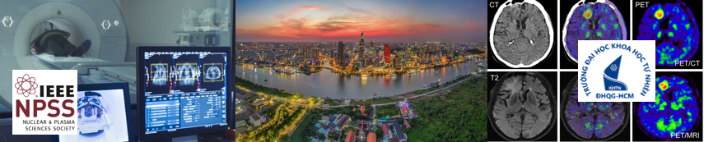


Virtual Monoenergetic Imaging from Dual sources Dual Energy CT
Presenter: Pham Nguyen Kim Ngan
Department of Medical Imaging and Radiological Sciences, Chang Gung University, Taoyuan, Taiwan.
Ho Chi Minh City, 2025

Slide 2


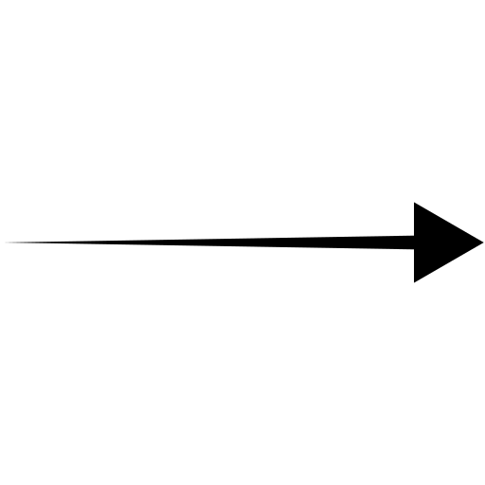


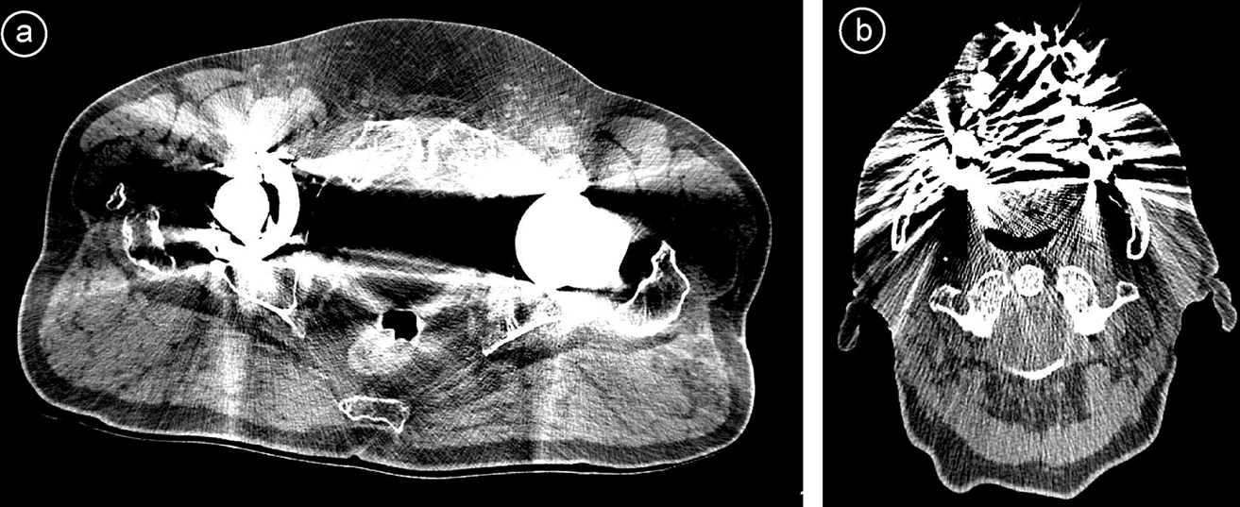
Ι. Introduction
X-rays source
Computed Tomography (CT)
Fig 1. The imaging progress of CT
μ
Pixels
Detectors
Diagnosis
Reconstruction
μ
Voxels
Oncology
Fig 2^{[1]}. These artifacts between hip replacements (1a, left), and dental implants made of high molecular weight metals. (1b, right)
[1] Wellenberg, R. H.H., E. T. Hakvoort, C. H. Slump, M. F. Boomsma, M. Maas, and G. J. Streekstra. “Metal Artifact Reduction Techniques in Musculoskeletal CT-Imaging.” European Journal of Radiology 107 (October 1, 2018): 60–69. https://doi.org/10.1016/j.ejrad.2018.08.010.
2

Slide 3
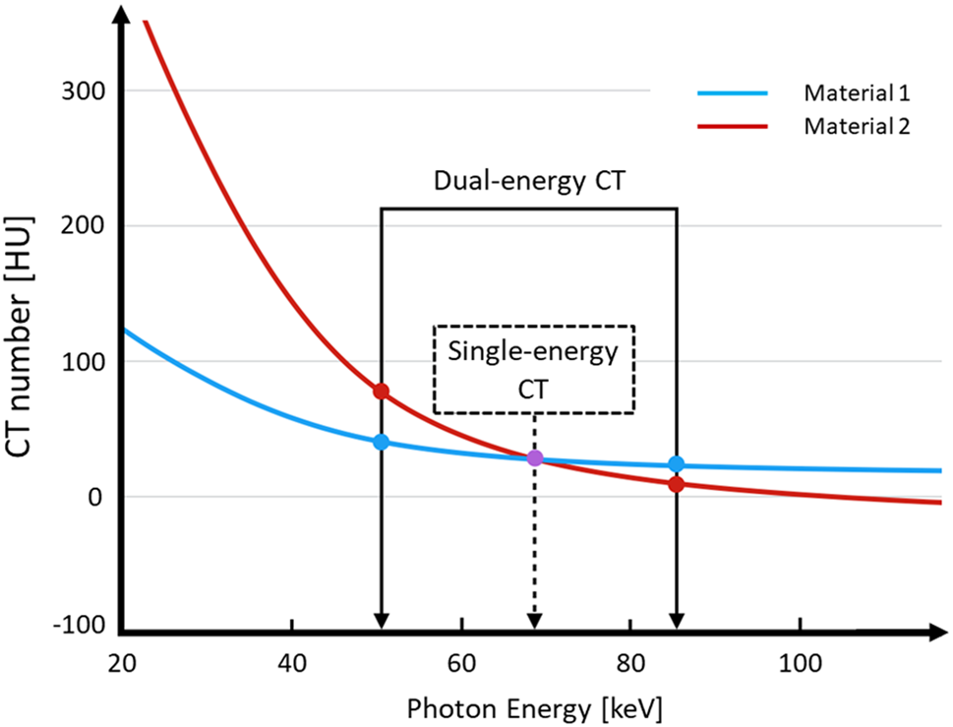



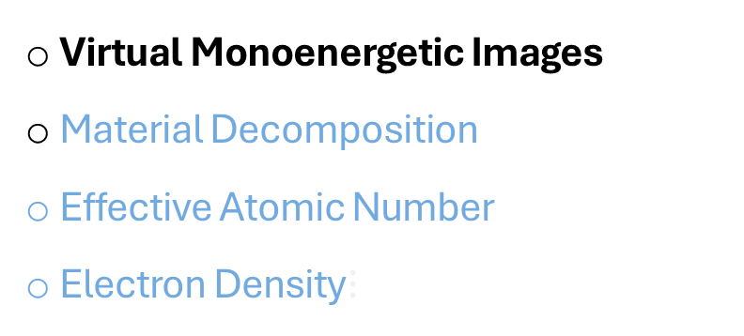
Ι. Introduction
Dual-energy Computed Tomography (DECT)
Dual-energy CT
Virtual Monoenergetic Images
Material Decomposition
Effective Atomic Number
Electron Density$⋮$
Low E spectrum
High E spectrum
[2] F. Tatsugami et al. “Dual-energy CT: minimal essentials for radiologists,” Japanese Journal of Radiology, vol. 40, no. 6, pp. 547–559, Jun. 2022.
Fig 3^{[2]}. CT number of materials representing Single-energy CT and Dual-energy CT.
Virtual Monoenergetic Image (VMI)
40 keV
Abnormal delineation
At any arbitrary energy (keV):
40-60 keV
Diagnosis
$$VMI\left(E\right)=w_{1}\left(E\right).CT^{L}+w_{2}\left(E\right).CT^{H}$$
>100 keV
Metal artefact reduction
3

Slide 4
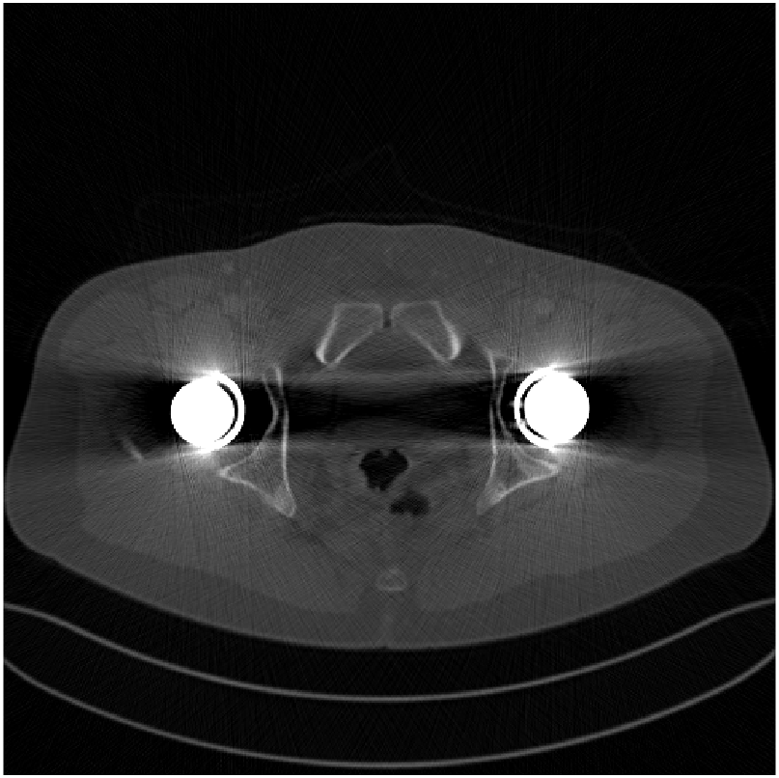
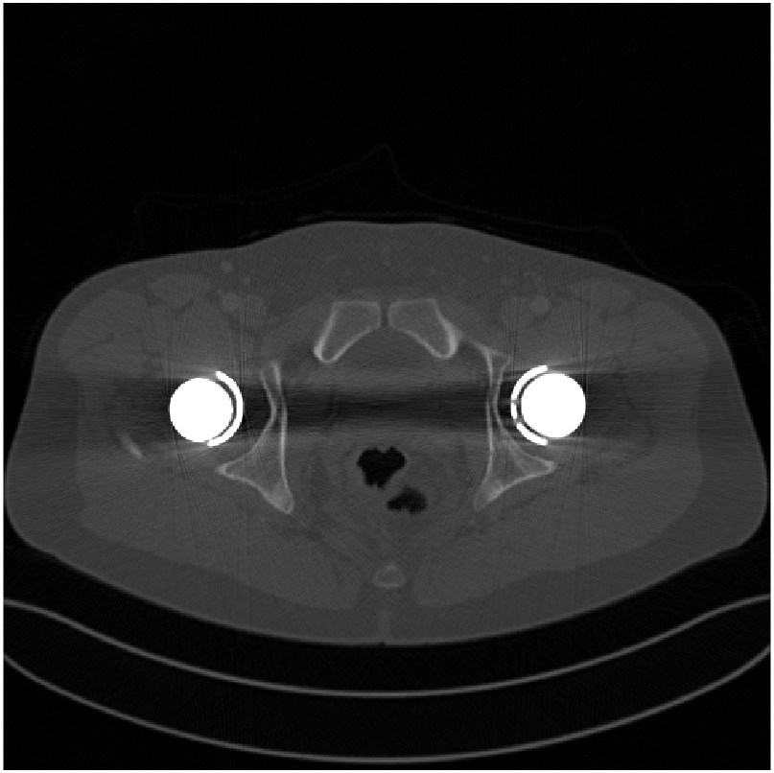
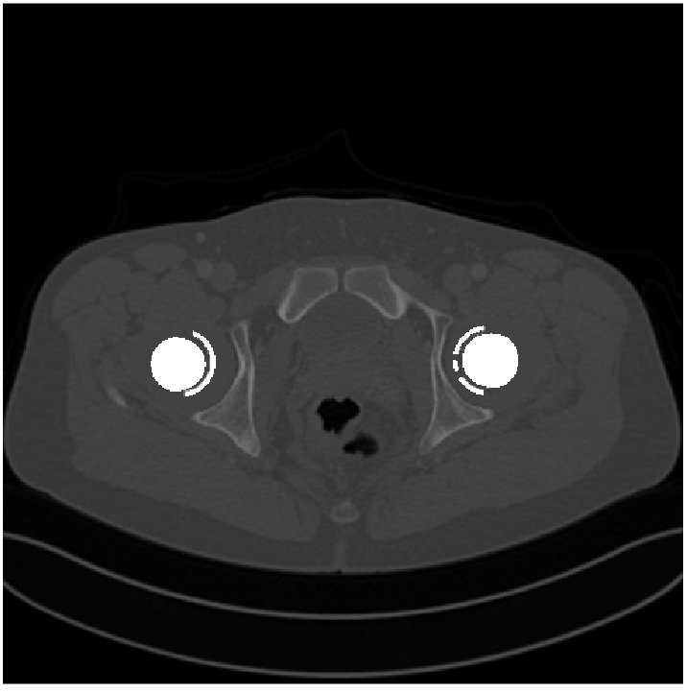
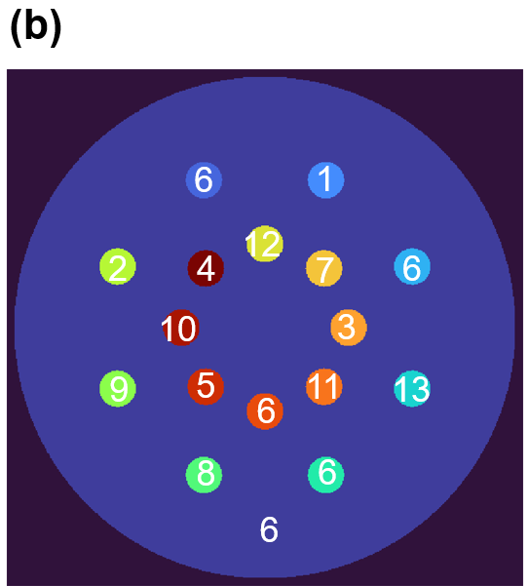
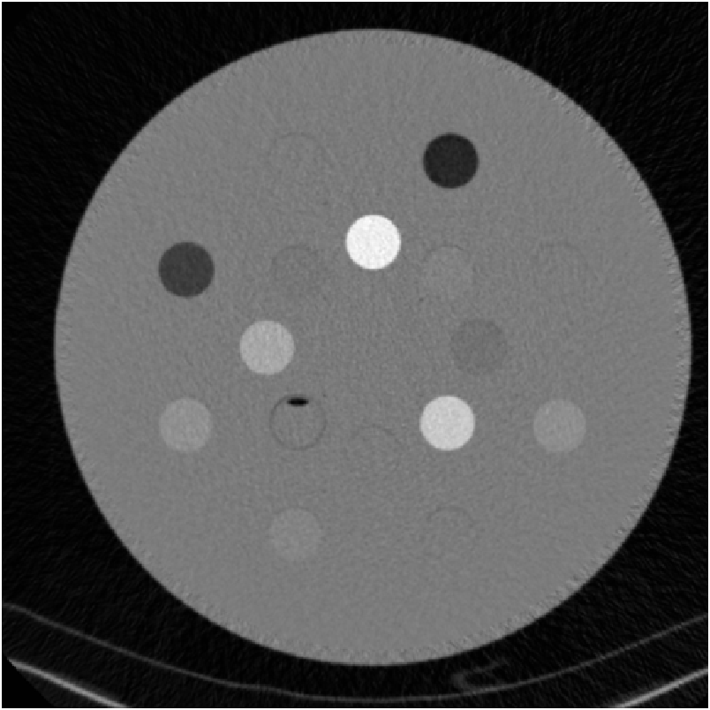
ΙΙ. Materials and methods
Patient CT images collection
Numerical simulation data^{[3]}: Mayo Clinic Database: 120 kV, 200 mAs.
80 kV
140 kV
Ideal Mono Image
Clinical data : Gammex RMI 467 phantom: masks and CT images (80kV and 140kV)
Mask
80/140 kV
Siemens VMI
+ Changhwa Christian Hospital, Taiwan.
+ Siemen Healthineers Force – Dual source (80/140kVp & VMI:40-190 keV)
[3] Y. Zhang and H. Yu, “Convolutional Neural Network Based Metal Artifact Reduction in X-Ray Computed Tomography,” IEEE Transactions on Medical Imaging, vol. 37, no. 6, pp. 1370–1381, Jun. 2018
4

Slide 5
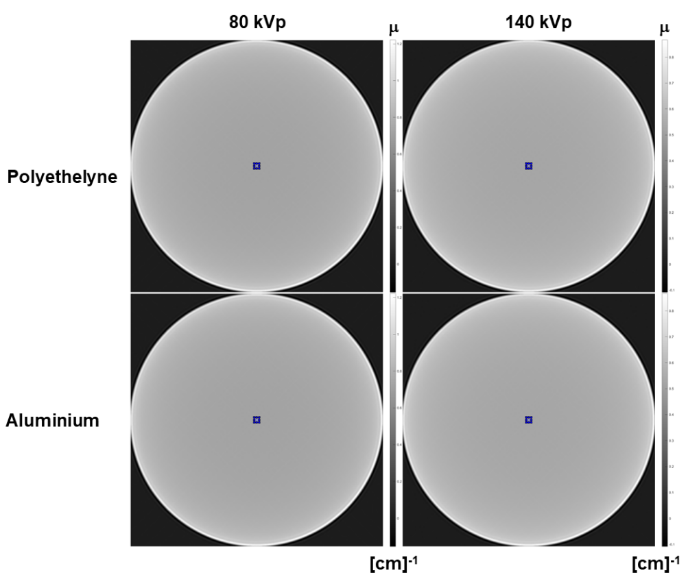
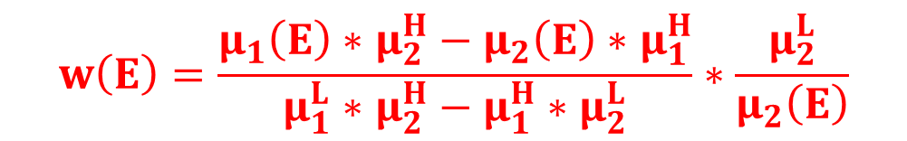
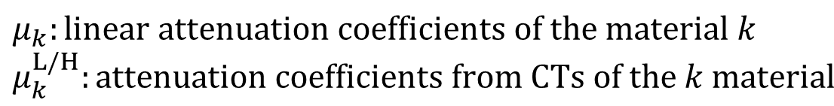
Weighting factors for simulation^{[5][6]}:
ΙΙ. Materials and methods
$$VMI\left(E\right)\text{=}w_{1}\left(E\right).CT^{L}+w_{2}\left(E\right).CT^{H}=w\left(E\right).CT^{L}+[1−w\left(E\right)].CT^{H}$$
$$w\left(E\right)=\frac{μ_{1}\left(E\right)∗μ_{2}^{H}−μ_{2}\left(E\right)∗μ_{1}^{H}}{μ_{1}^{L}∗μ_{2}^{H}−μ_{1}^{H}∗μ_{2}^{L}}∗\frac{μ_{2}^{L}}{μ_{2}\left(E\right)}$$
$μ_{k}:linear attenuation coefficients of the material k$ $μ_{k}^{L/H}:attenuation coefficients from CTs of the k material$
k =1,2: Two basic materials
L,H: Low and high energy
[4] L. Yu, S. Leng, and C. H. McCollough, “Dual-energy CT-based monochromatic imaging.,” AJR. American journal of roentgenology, vol. 199, no. 5 Suppl, 2012, doi: 10.2214/ajr.12.9121.
[5] L. Yu, J. A. Christner, S. Leng, J. Wang, J. G. Fletcher, and C. H. McCollough, “Virtual monochromatic imaging in dual-source dual-energy CT: Radiation dose and image quality,” Medical Physics, vol. 38, no. 12, pp. 6371–6379, 2011
Fig 4. Attenuation coefficient map of two basic material simulated phantoms at [80;140] kV

Slide 6
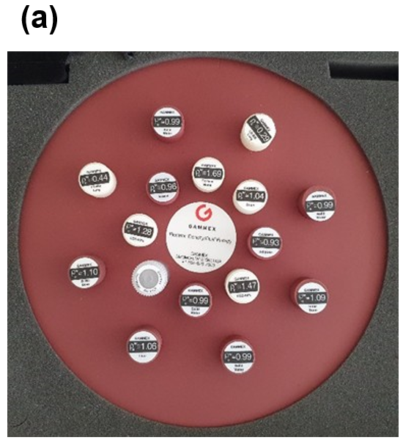


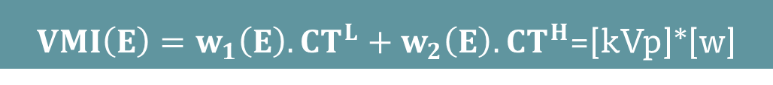
Weighting factors for clinical data:
ΙΙ. Materials and methods
$VMI\left(E\right)=w_{1}\left(E\right).CT^{L}+w_{2}\left(E\right).CT^{H}$=[kVp]*[w]
ID
1 --> LN-300 Lung
2 --> LN-450 Lung
3 --> AP6 Adipose
4 --> Breast
5 --> True Water
6 --> Solid Water
7 --> Brain
8 --> Liver
9 --> B-200 Bone
--> CB2-30%
11 --> CB2-50%
12 --> Cortical Bone
13 --> Inner Bone
Fig 5. Gammex RMI467 phantom: (a) Real image, (b) Index image
kVp_{clin}: [80,140] kVp
VMI_{clin}: [40:10:190] keV
[kVp_{clin}]\ [VMI_{clin}]
w
[kVp_{clin}]\ w
clin: clinical CT images

Slide 7
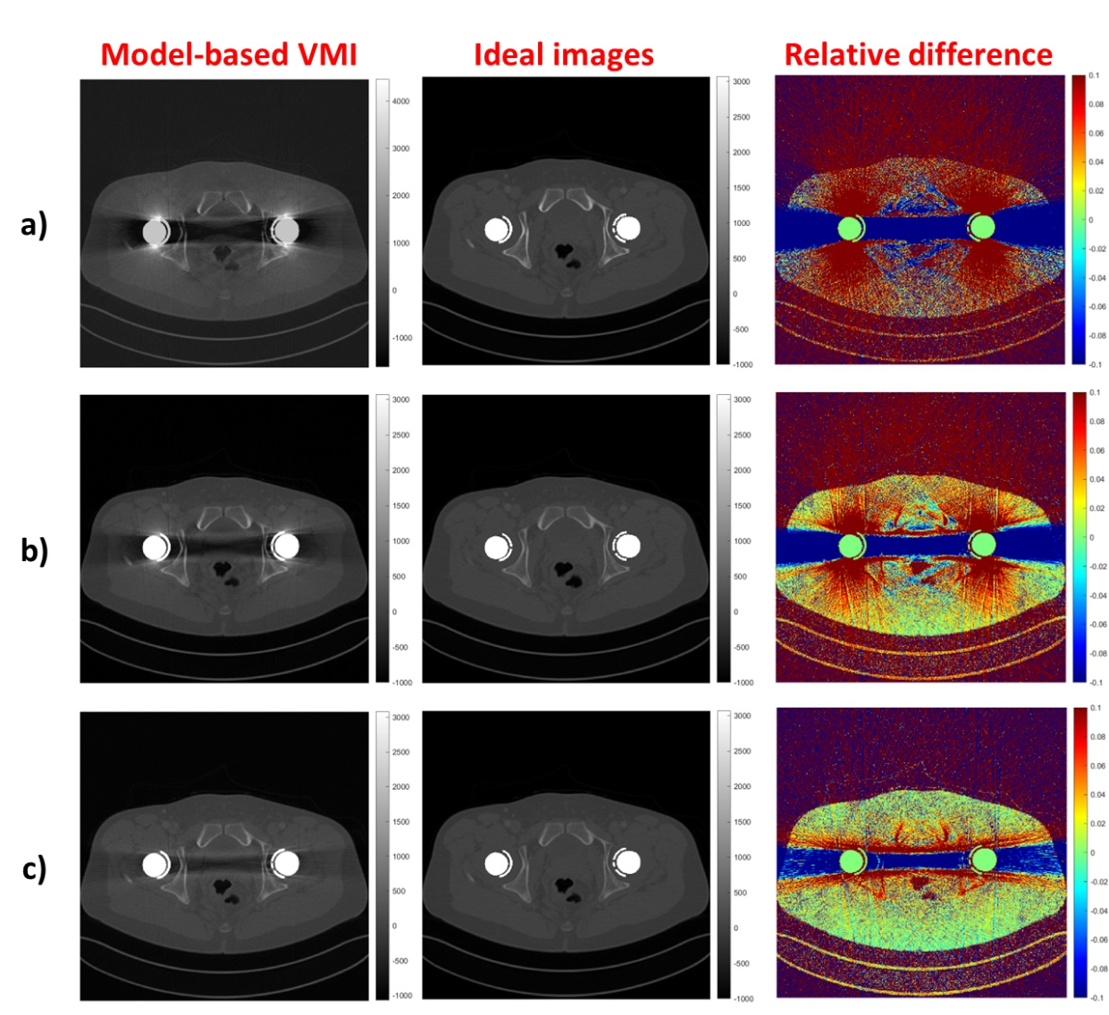
Numerical simulation data
III. Results & Discussion
VMI
Ideal Mono Image
Relative Difference
Fig 6: Patient with metal-free slice in the abdomen, comparing between VMIs and Ideal monoenergetic images at: a) 60keV, b) 90 keV and c)120 keV.

Slide 8
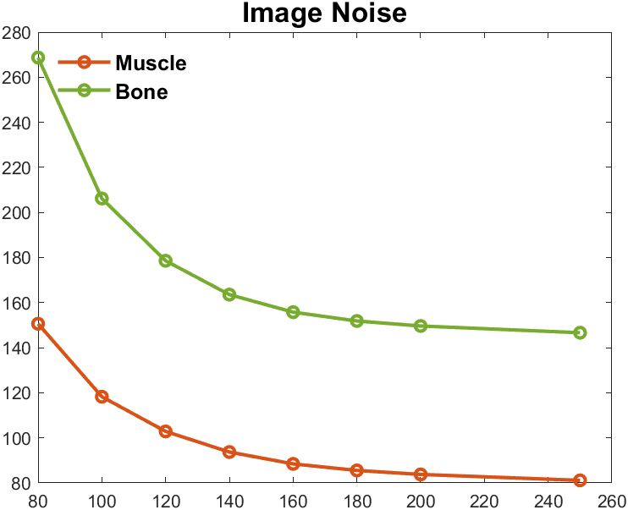
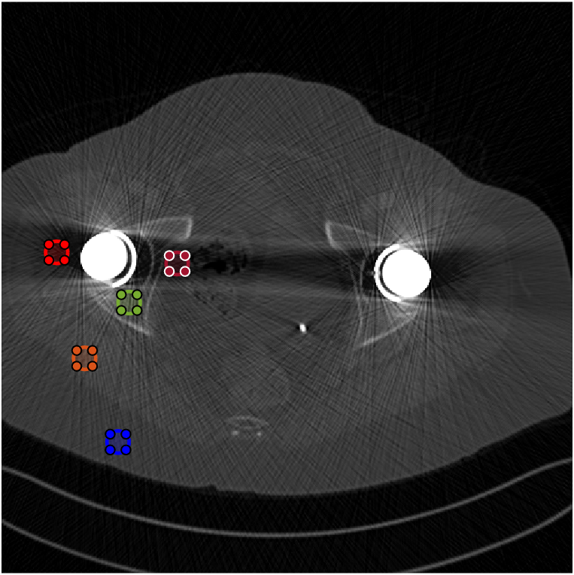
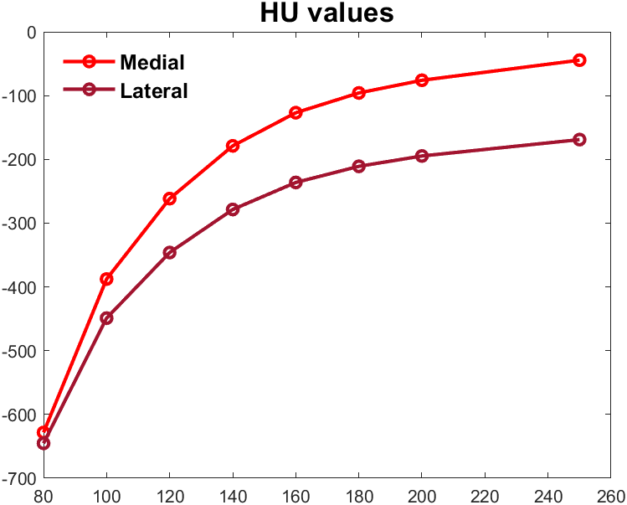
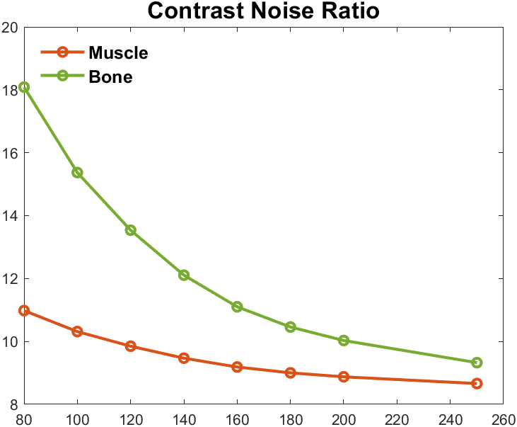

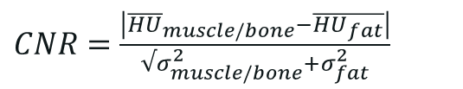

“An accurate choice of the energy level of VMI reconstruction should take into account different parameters, including the purpose of reconstructing VMI (e.g. increase vascular contrast vs reducing beam-hardening artefacts), but also patient size and optimization of the image quality” ^{[3]}
Article review
“The range between 140 to 200 keV, artifact reduction reached a plateau. Thus, it might make sense to use 140 keV as a standard reconstruction when aiming to yield a higher soft tissue contrast for the evaluation of pelvic organs. This is in line with two phantom studies examining VMI derived from SDCT and dual source technology proposing 130–150 keV as a possible standard setting for VMI reconstructions in THR case”^{[4]}
[5] Tommaso D’Angelo, et al (2019), Dual energy computed tomography virtual monoenergetic imaging: technique and clinical, Br J Radiol 92: 20180546
[6] Kai Roman Laukamp, et al (2018), CT metal artifact in patients with total hip replacements: for artifacr reduction monoenergetic reconstructions and post-processing algorithms are both efficient, but not similar , European Radiology 28:4524-4533
Image quality index
Lateral
$$Noise=σ=\left|HU_{x}−\overline{HU}\right|$$
Medial
Pubic bone
$$\overline{HU}$$
Muscle
Fat
$CNR=$ $\frac{\left|{\overline{HU}}_{muscle/bone}−\overline{HU_{fat}}\right|}{√σ_{muscle/bone}^{2}+σ_{fat}^{2}}$
8

Slide 9
Clinical data
III. Results & Discussion
Fig 8: The relative difference of Gammex RMI467 phantom VMIs derived from estimated weighting factors and commercial Siemens VMIs.
Fig 7: Weighting factors derived from simulation database and clinical database.

Slide 10


Conclusion
Efficiency of VMI in various E for both diagnosis and radiotherapy
VMI only reduces beam hardening artifact in metal artifact
DECT images w/wo metal artifacts
Low E images
PINN
Metal Artifact Resistant VMI
High E images
Physic-informed neural network (PINN)^{[8],[9]}
PINN integrate existing knowledge into deep learning models
Model performance is superior to traditional models.
More complex structures are not always necessary
[8] G. E. Karniadakis, I. G. Kevrekidis, L. Lu, P. Perdikaris, S. Wang, and L. Yang, “Physics-informed machine learning,” Nat Rev Phys, vol. 3, no. 6, pp. 422–440, May 2021.
[9] C. W. Chang et al., “Dual-energy CT based mass density and relative stopping power estimation for proton therapy using physics-informed deep learning,” Physics in Medicine and Biology, vol. 67, no. 11, Jun. 2022
10

Slide 11
THANKS FOR YOUR ATTENTION

Slide 12
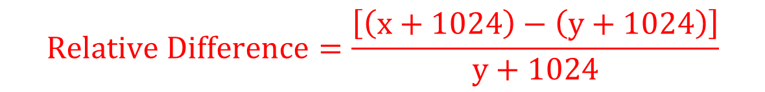
APPENDIX
Evaluation image quality
Relative Difference:
$$Relative Difference=\frac{\left[\left(x+1024\right)−\left(y+1024\right)\right]}{y+1024}$$
x: pixels in testing images
y: pixels in target images

Slide 13
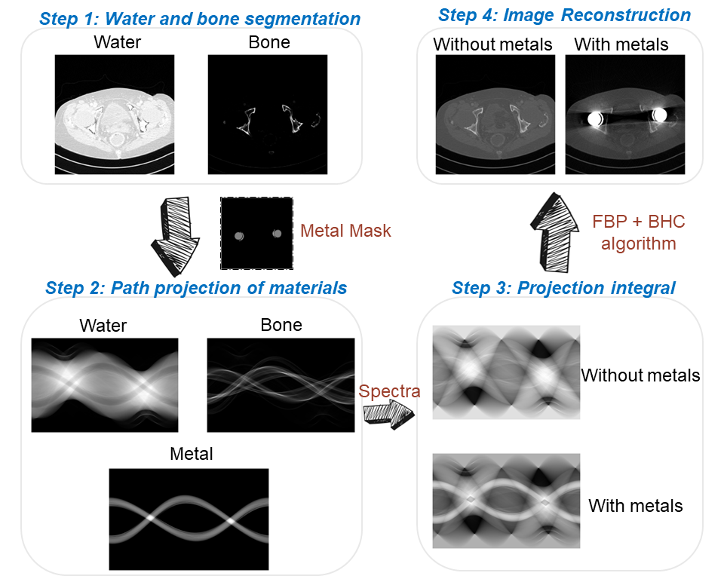
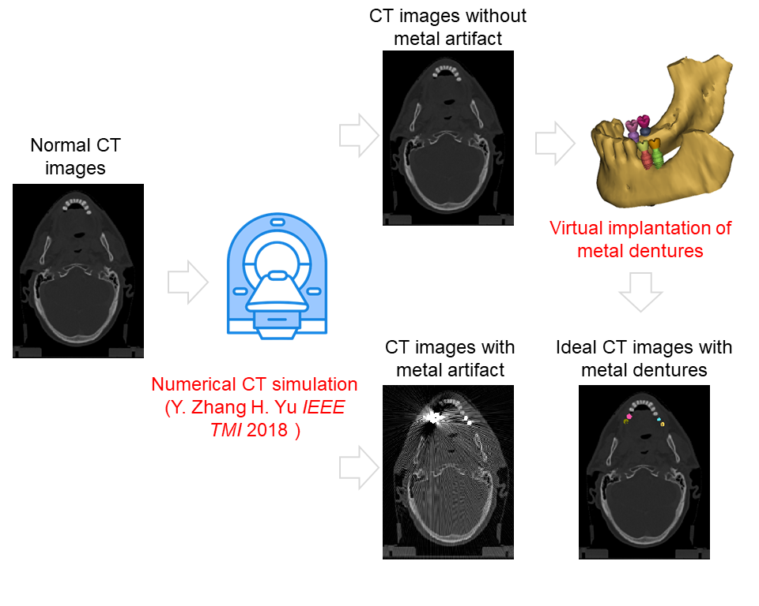
APENDIX
DECT simulation and database preparation
Fig . Database construction for training.
Fig . Numerical simulation process.
Y. Zhang and H. Yu, “Convolutional Neural Network Based Metal Artifact Reduction in X-Ray Computed Tomography,” IEEE Transactions on Medical Imaging, vol. 37, no. 6, pp. 1370–1381, Jun. 2018

