Slide 1





PET
Ha Thi Thuy Linh
PET/CT
In
Diagnostic Imaging
CT

Slide 2
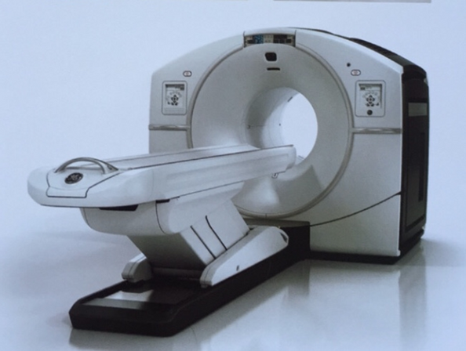
PET (Positron Emission Tomography)
PET scanner
  It is an imaging technique that uses small amounts of biologically active compounds labeled with radioactive tracers for disease diagnosis.
  The radiopharmaceutical is administered intravenously or via inhalation, and a PET scanner generates images revealing the tracer's distribution within the body.
PET scanner

Slide 3
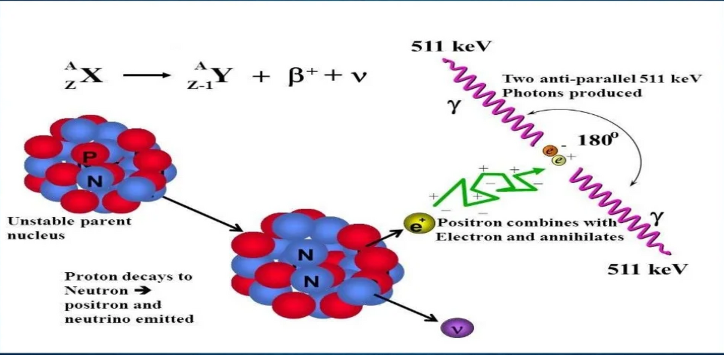
PET (Positron Emission Tomography)
The physical principle of PET
Notes:
Positron Emission Tomography (PET) relies on the detection of gamma photons produced through positron-electron annihilation. The process begins when an unstable radionuclide (e.g., ¹⁸F) undergoes β⁺ decay: a proton within the nucleus transforms into a neutron, emitting a positron (β⁺) and a neutrino. The emitted positron travels a short distance (1–3 mm in tissue) until it interacts with an electron (e⁻). During annihilation, the masses of the positron and electron convert entirely into energy, producing two 511 keV gamma photons that are emitted in precisely opposite directions (180° apart). These photons are detected simultaneously ("coincidence detection") by the PET scanner’s ring of detectors, enabling precise 3D localization of the radiotracer’s distribution.

Slide 4
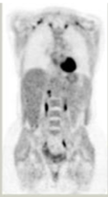
PET (Positron Emission Tomography)
  PET uses FDG – a radioactive glucose analog.
  Cancer cells typically consume more glucose than normal cells, so PET reveals "hot spots" in the neck region.
  However, PET only shows abnormal metabolic activity in the neck but cannot precisely pinpoint its anatomical location.
PET image
Notes:
Positron Emission Tomography (PET) relies on the detection of gamma photons produced through positron-electron annihilation. The process begins when an unstable radionuclide (e.g., ¹⁸F) undergoes β⁺ decay: a proton within the nucleus transforms into a neutron, emitting a positron (β⁺) and a neutrino. The emitted positron travels a short distance (1–3 mm in tissue) until it interacts with an electron (e⁻). During annihilation, the masses of the positron and electron convert entirely into energy, producing two 511 keV gamma photons that are emitted in precisely opposite directions (180° apart). These photons are detected simultaneously ("coincidence detection") by the PET scanner’s ring of detectors, enabling precise 3D localization of the radiotracer’s distribution.

Slide 5
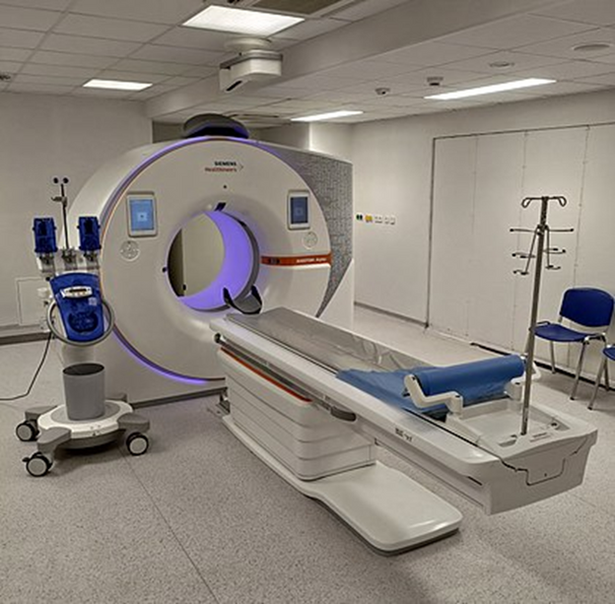
CT (Computed Tomography)
CT scanner
  It is an imaging test used to produce detailed pictures of internal organs, bones, soft tissues, and blood vessels, allowing physicians to visualize anatomy clearly.
  CT uses X-rays that pass through the body in seconds, leaving no residual radiation in the patient. The procedure is fast, painless, non-invasive, and highly accurate. In emergencies, it can quickly reveal internal injuries and bleeding, enabling life-saving interventions.
CT scanner
Notes:
Positron Emission Tomography (PET) relies on the detection of gamma photons produced through positron-electron annihilation. The process begins when an unstable radionuclide (e.g., ¹⁸F) undergoes β⁺ decay: a proton within the nucleus transforms into a neutron, emitting a positron (β⁺) and a neutrino. The emitted positron travels a short distance (1–3 mm in tissue) until it interacts with an electron (e⁻). During annihilation, the masses of the positron and electron convert entirely into energy, producing two 511 keV gamma photons that are emitted in precisely opposite directions (180° apart). These photons are detected simultaneously ("coincidence detection") by the PET scanner’s ring of detectors, enabling precise 3D localization of the radiotracer’s distribution.

Slide 6
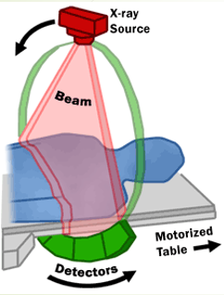
CT (Computed Tomography)
The physical principle of
  X-rays emitted from the tube pass through the body. Tissues absorb X-rays differentially based on density and atomic number (bones absorb more than muscle, fat, or lungs).
  A detector array surrounding the patient measures the remaining X-ray intensity after attenuation. Using reconstruction algorithms (filtered back projection or iterative reconstruction), the computer generates 2D cross-sectional and 3D images.
CT scanner
Notes:
Positron Emission Tomography (PET) relies on the detection of gamma photons produced through positron-electron annihilation. The process begins when an unstable radionuclide (e.g., ¹⁸F) undergoes β⁺ decay: a proton within the nucleus transforms into a neutron, emitting a positron (β⁺) and a neutrino. The emitted positron travels a short distance (1–3 mm in tissue) until it interacts with an electron (e⁻). During annihilation, the masses of the positron and electron convert entirely into energy, producing two 511 keV gamma photons that are emitted in precisely opposite directions (180° apart). These photons are detected simultaneously ("coincidence detection") by the PET scanner’s ring of detectors, enabling precise 3D localization of the radiotracer’s distribution.

Slide 7
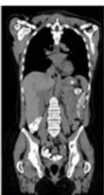
CT (Computed Tomography)
  The images reveal detailed anatomical structures (bones, muscles, blood vessels, organs) but do not provide information about tissue metabolism or biology.
  The imaging only reveals an abnormal mass in the neck region—it cannot definitively distinguish whether this is a malignant tumor or merely fibrotic scarring.
CT image
Notes:
Positron Emission Tomography (PET) relies on the detection of gamma photons produced through positron-electron annihilation. The process begins when an unstable radionuclide (e.g., ¹⁸F) undergoes β⁺ decay: a proton within the nucleus transforms into a neutron, emitting a positron (β⁺) and a neutrino. The emitted positron travels a short distance (1–3 mm in tissue) until it interacts with an electron (e⁻). During annihilation, the masses of the positron and electron convert entirely into energy, producing two 511 keV gamma photons that are emitted in precisely opposite directions (180° apart). These photons are detected simultaneously ("coincidence detection") by the PET scanner’s ring of detectors, enabling precise 3D localization of the radiotracer’s distribution.

Slide 8

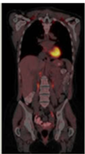
The PET/CT demonstrates a hot spot coinciding with the abnormal mass on CT, confirming this as a malignant lung tumor.
PET/CT
Fused PET/CT
image
Additionally, whole-body PET/CT reveals hot spots in mediastinal lymph nodes, indicating metastatic spread.
This exemplifies the synergy between CT's 'morphological vision' and PET's 'biological vision

Slide 9


RADIATION DOSE & SAFETY IN PET/CT
Outstanding Benefits:
  Early detection of metastases and cancer → Alters treatment plans
  Reduces unnecessary interventions (surgeries, biopsies)
  Improves diagnostic accuracy for staging (e.g., lung cancer TNM classification).
Risk: Increased radiation exposure
compared to standalone PET or CT.
The additive radiation dose (~10–20 mSv) compared to individual modalities (PET: ~5–7 mSv; CT: ~5–10 mSv)
Dose Optimization Strategies:
  Low-Dose CT Protocols: Used when only attenuation correction is required.
  Reduced FDG Dose with Advanced Detectors.
  PET/MRI as Alternative for Pediatrics.
While PET/CT increases radiation exposure, its optimized protocols and substantial clinical value ensure the benefits far outweigh the risks
.

Slide 10




Thanks for hearing me out!
THẾ LÀ XONG!

