Slide 1

My bio
Name: Hà Anh Tú
Contact: anhtuha97@gmail.com
Profession: Medical Physicist
Current Workplace: Lam Dong General Hospital, Vietnam

Slide 2
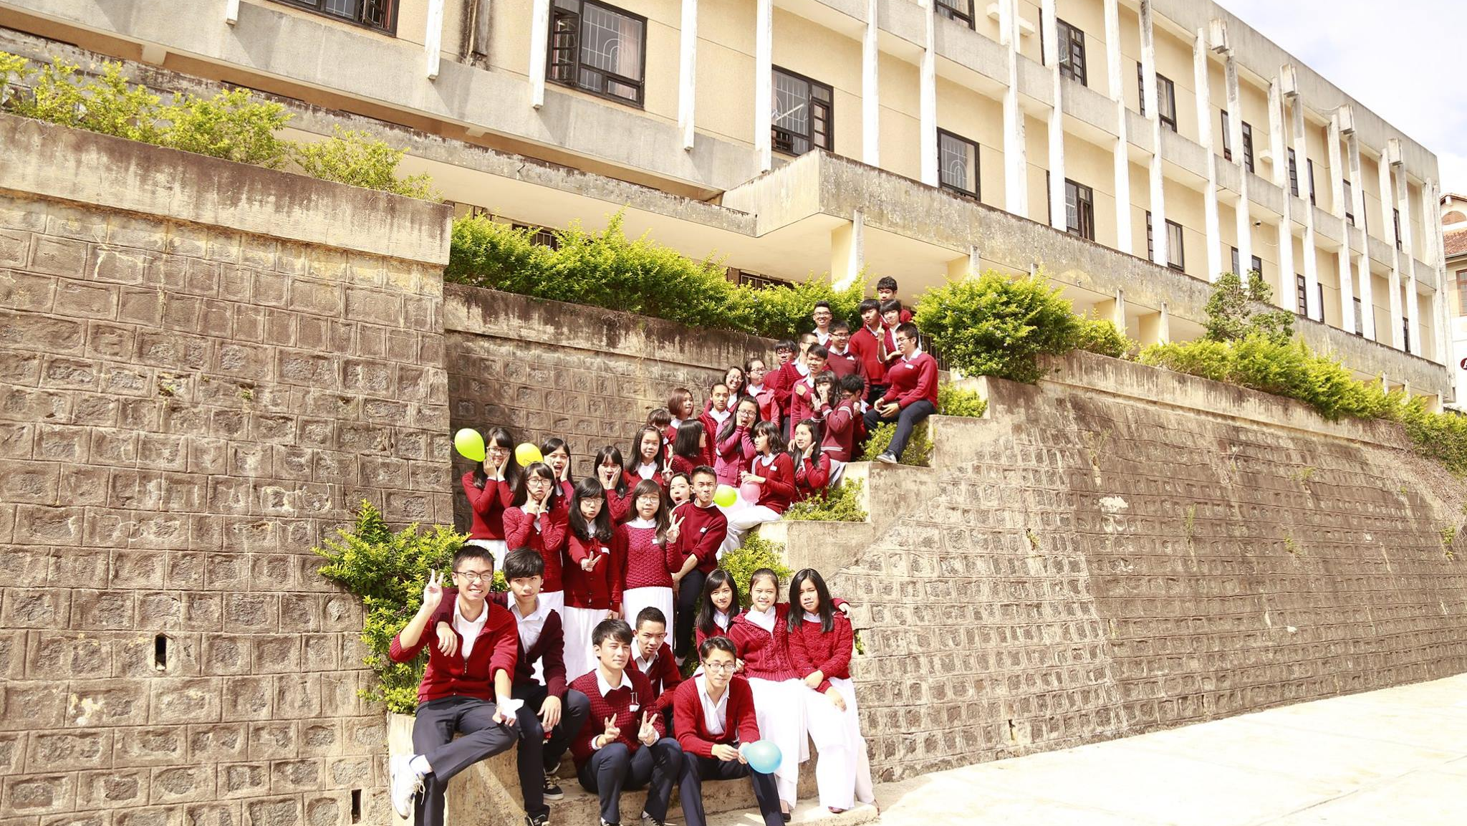
My high-school time

Slide 3
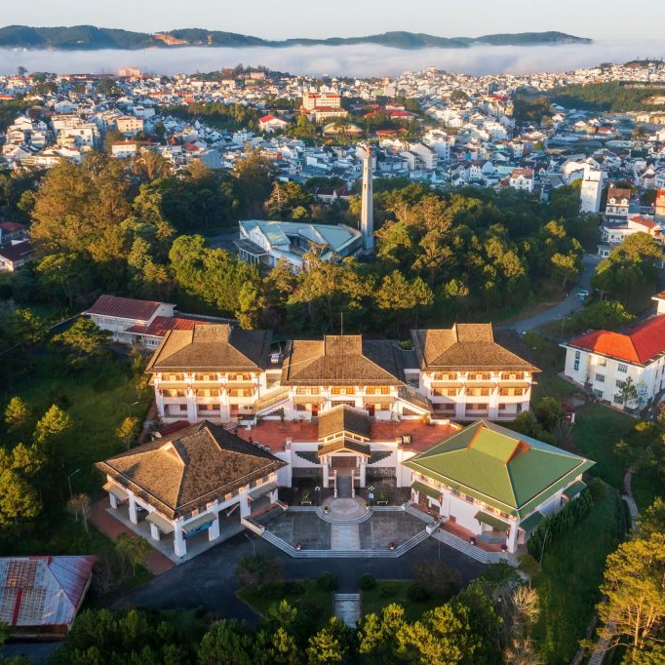
Whoa!
The campus of Dalat University covers more than 40 hectares with French-style buildings surrounded by pine forests.
With the project of the first NPP in Vietnam, the Nuclear Engineering Department in Dalat University was created.
It seemed to be interesting and challenging so...

Slide 4
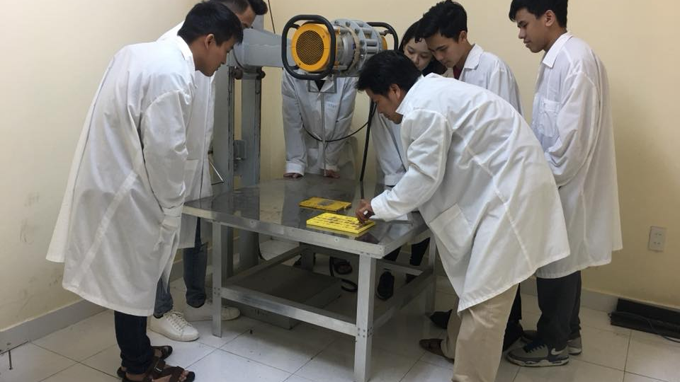
On the way of becoming a nuclear engineer...

Slide 5
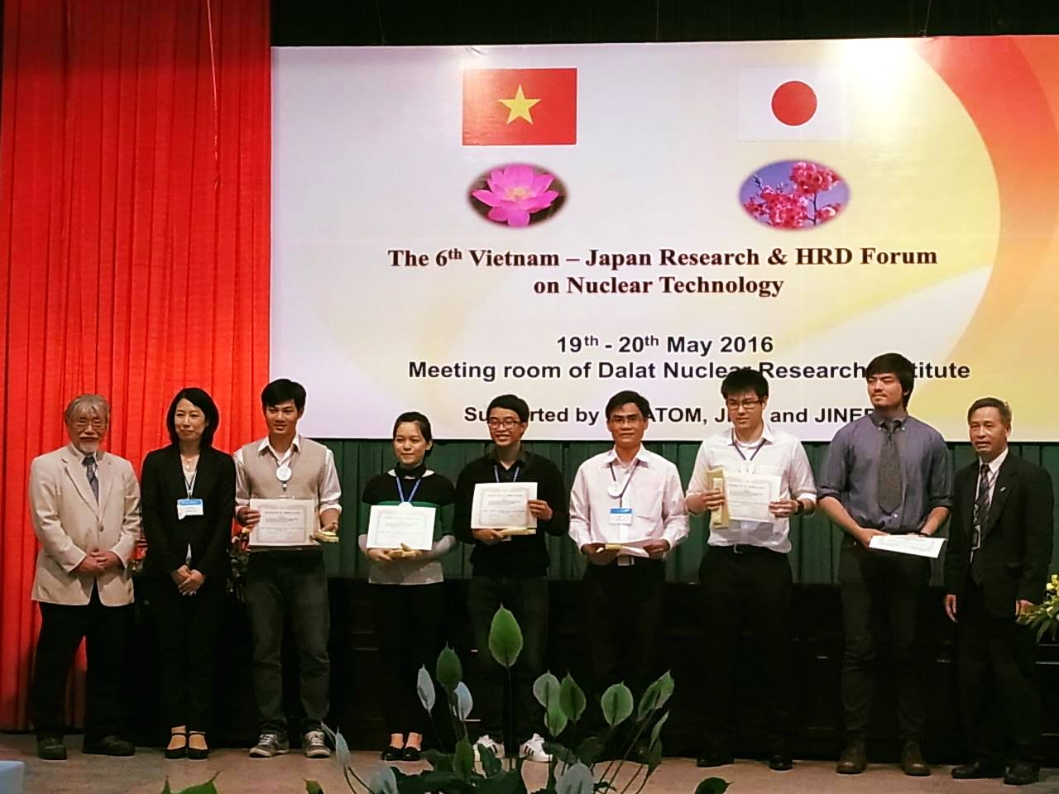

Slide 6
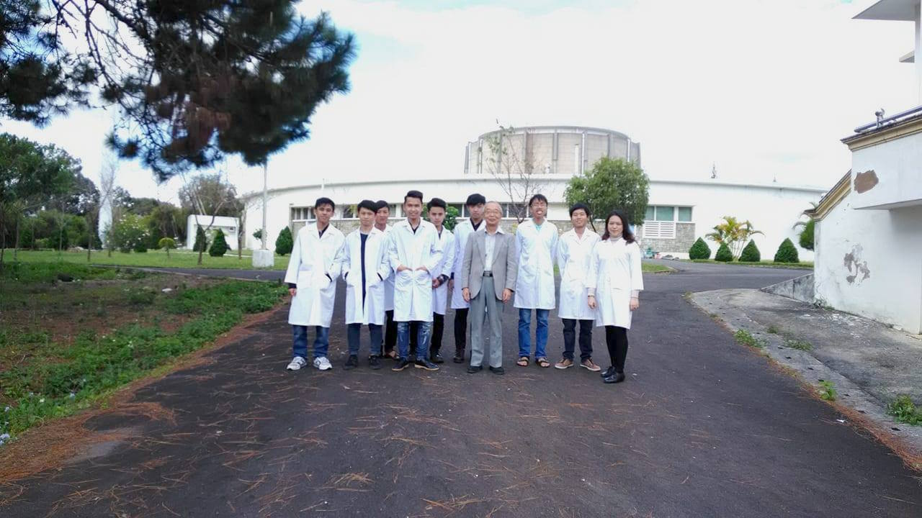

Slide 7
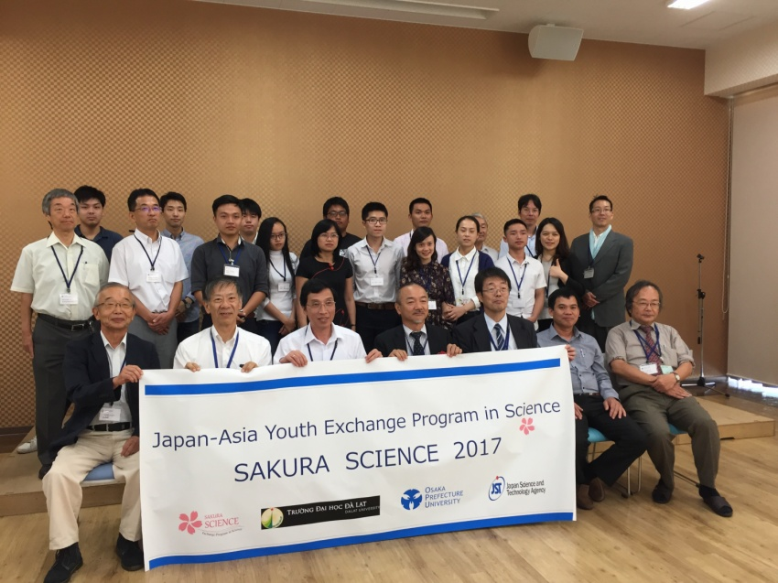

Slide 8
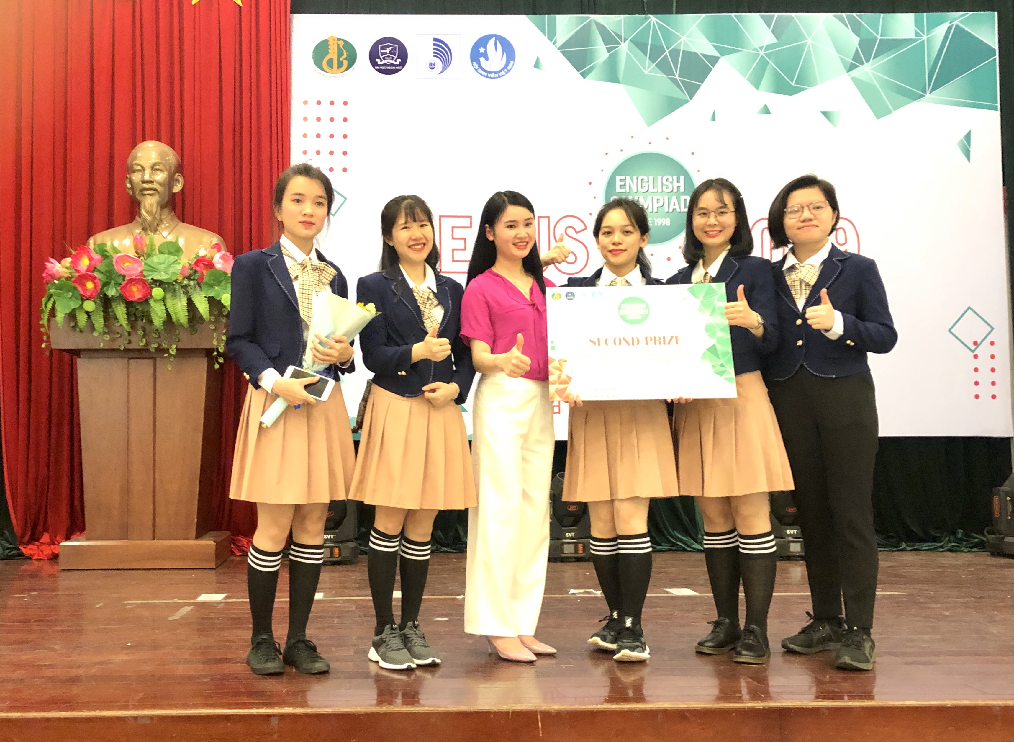
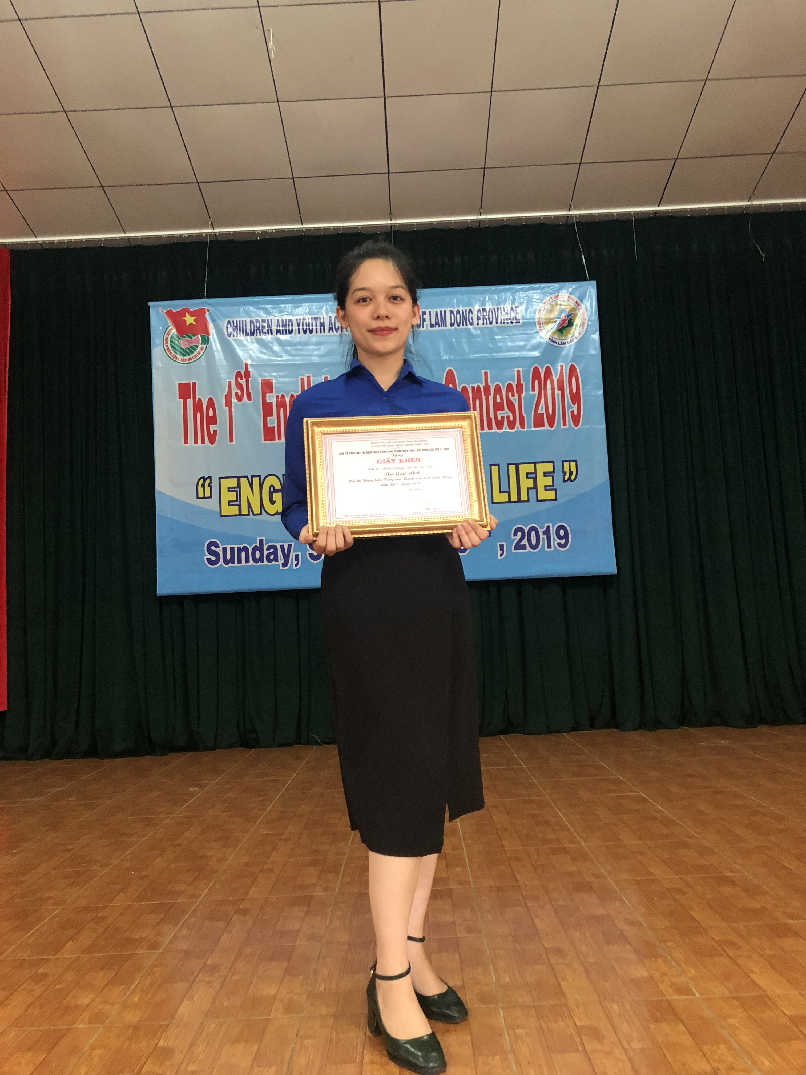

Slide 9
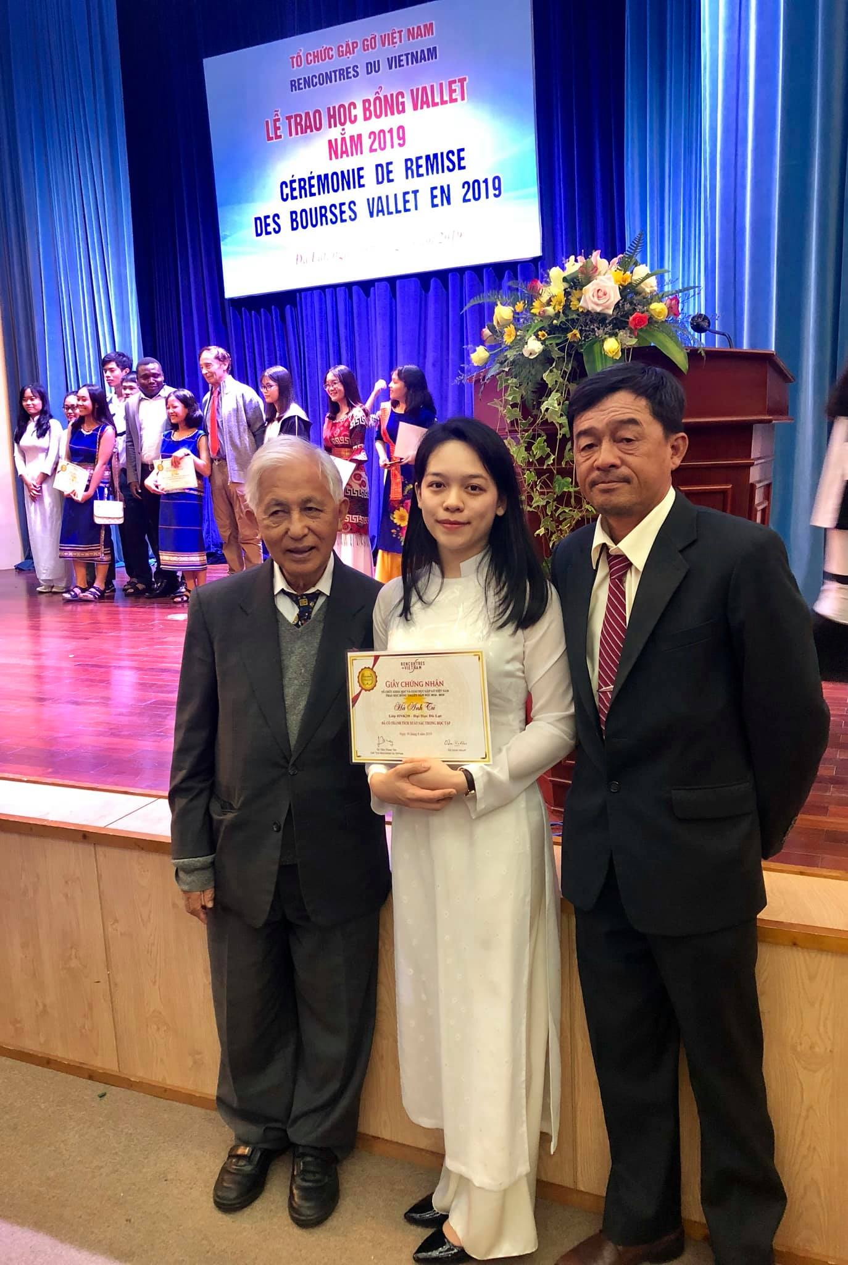
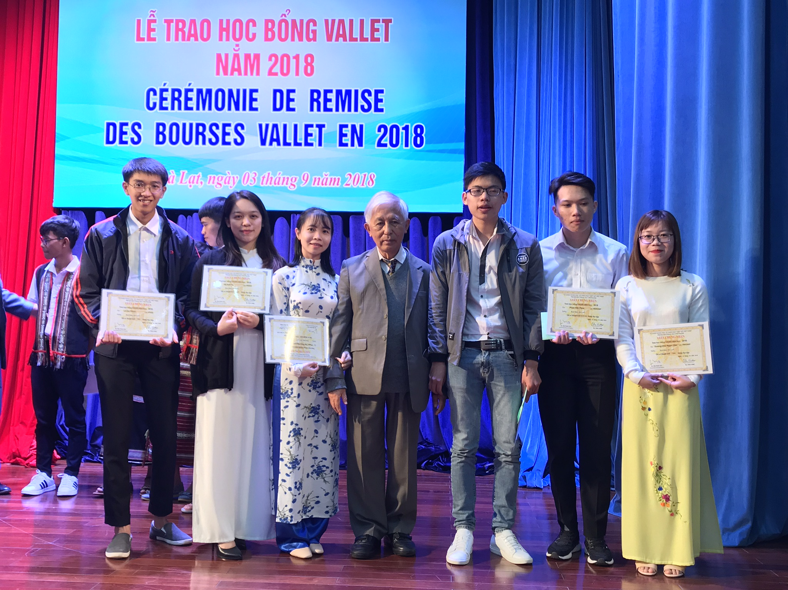

Slide 10
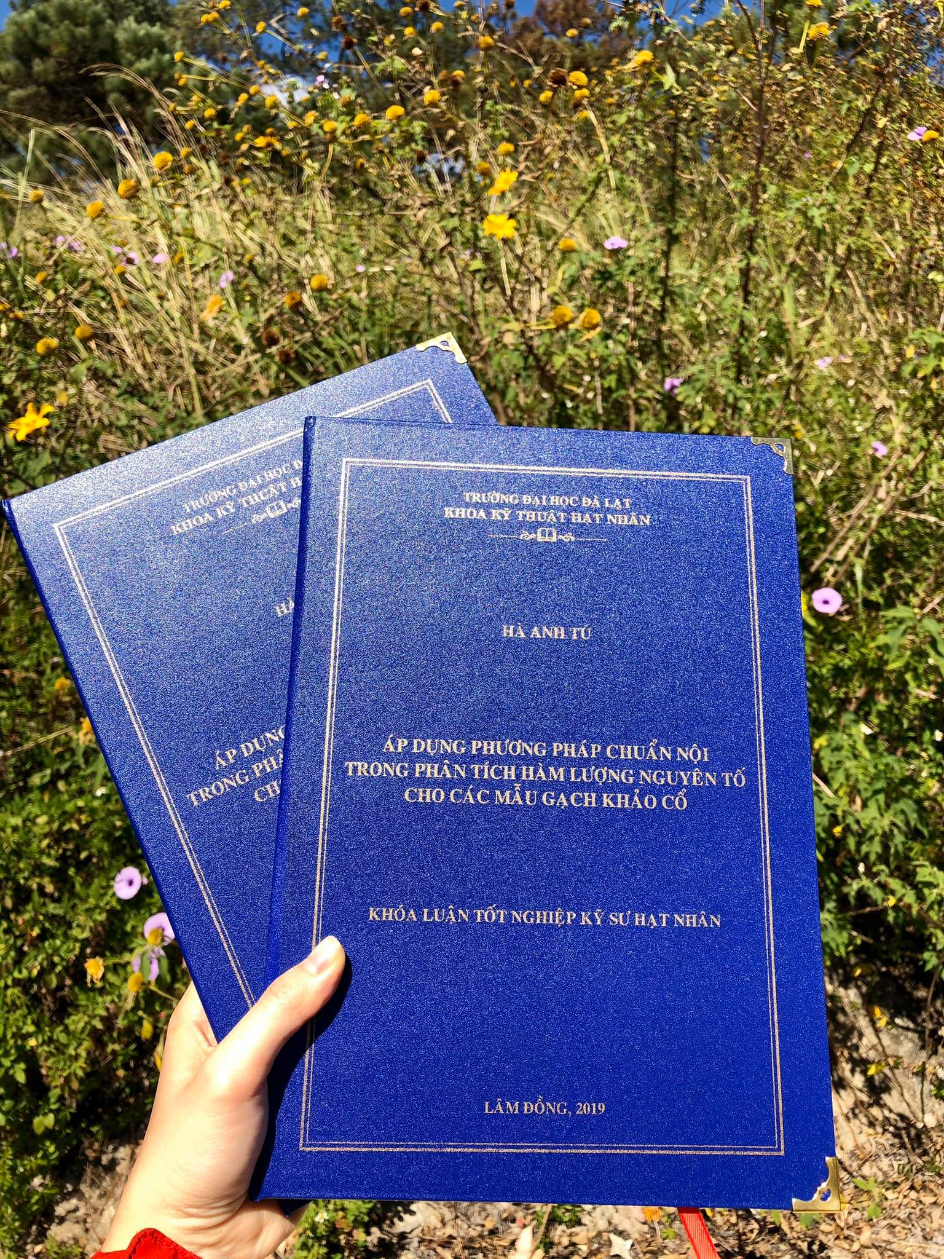
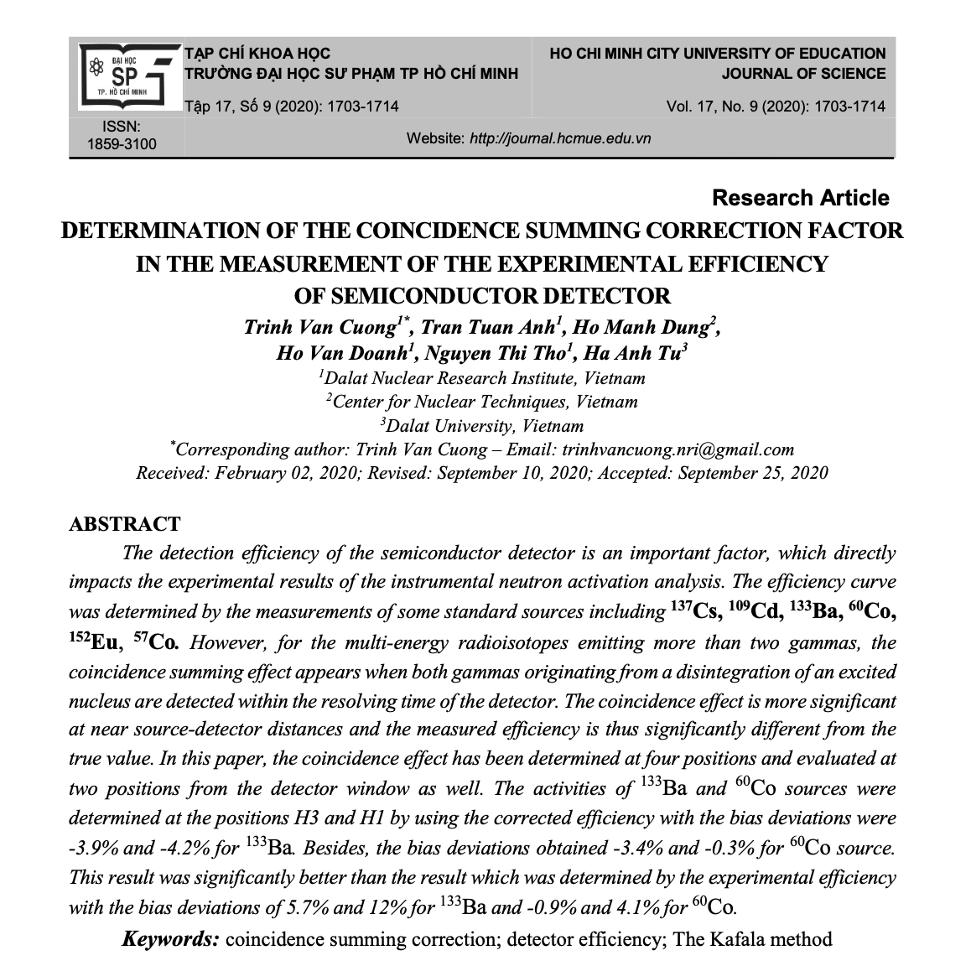

Slide 11

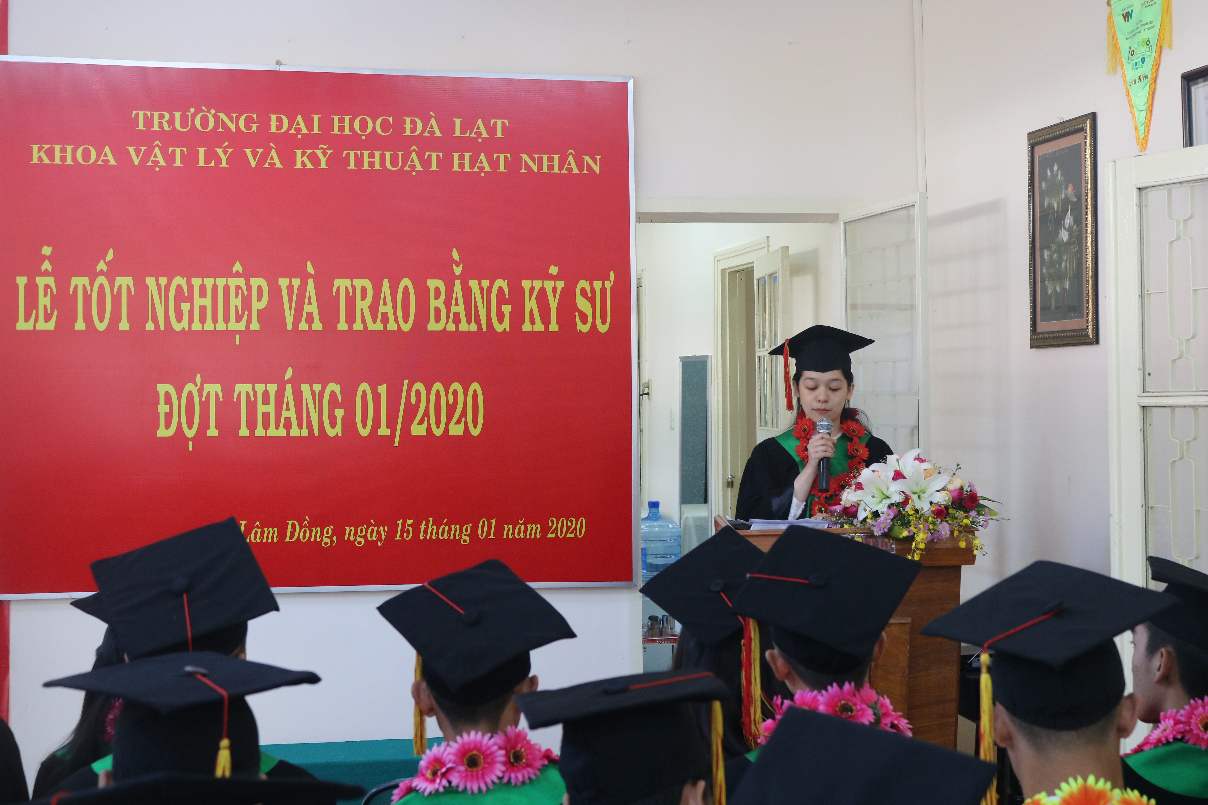
Finally

Slide 12
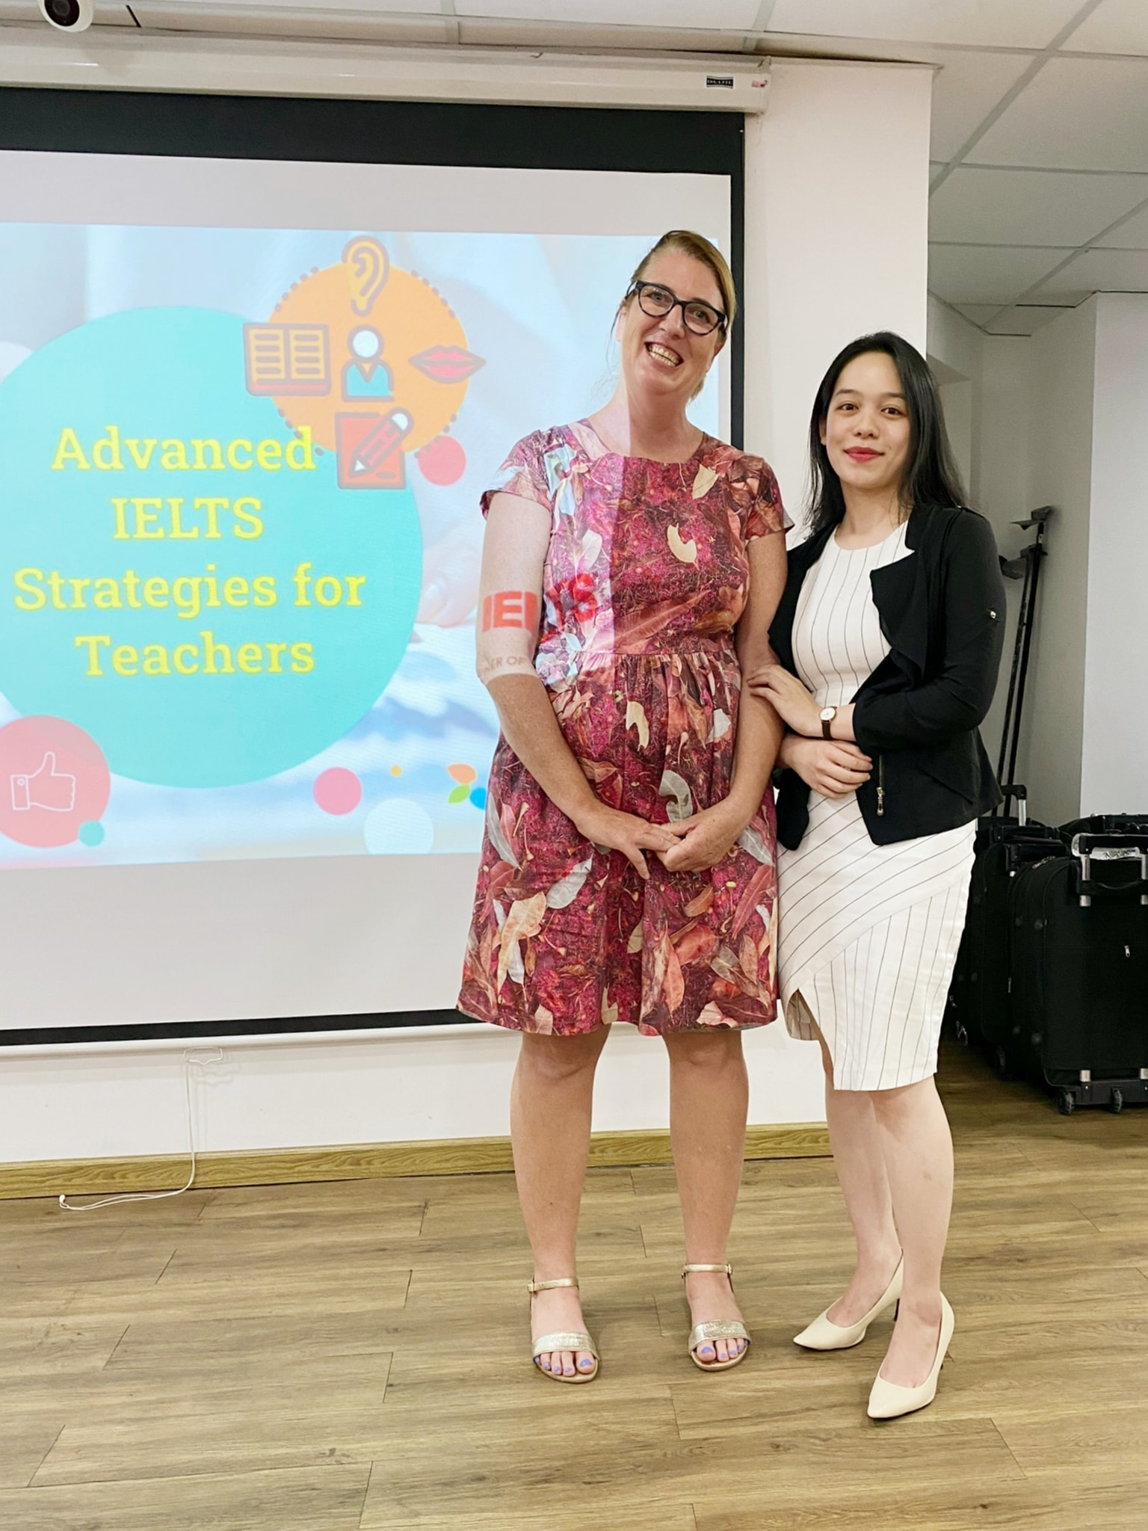
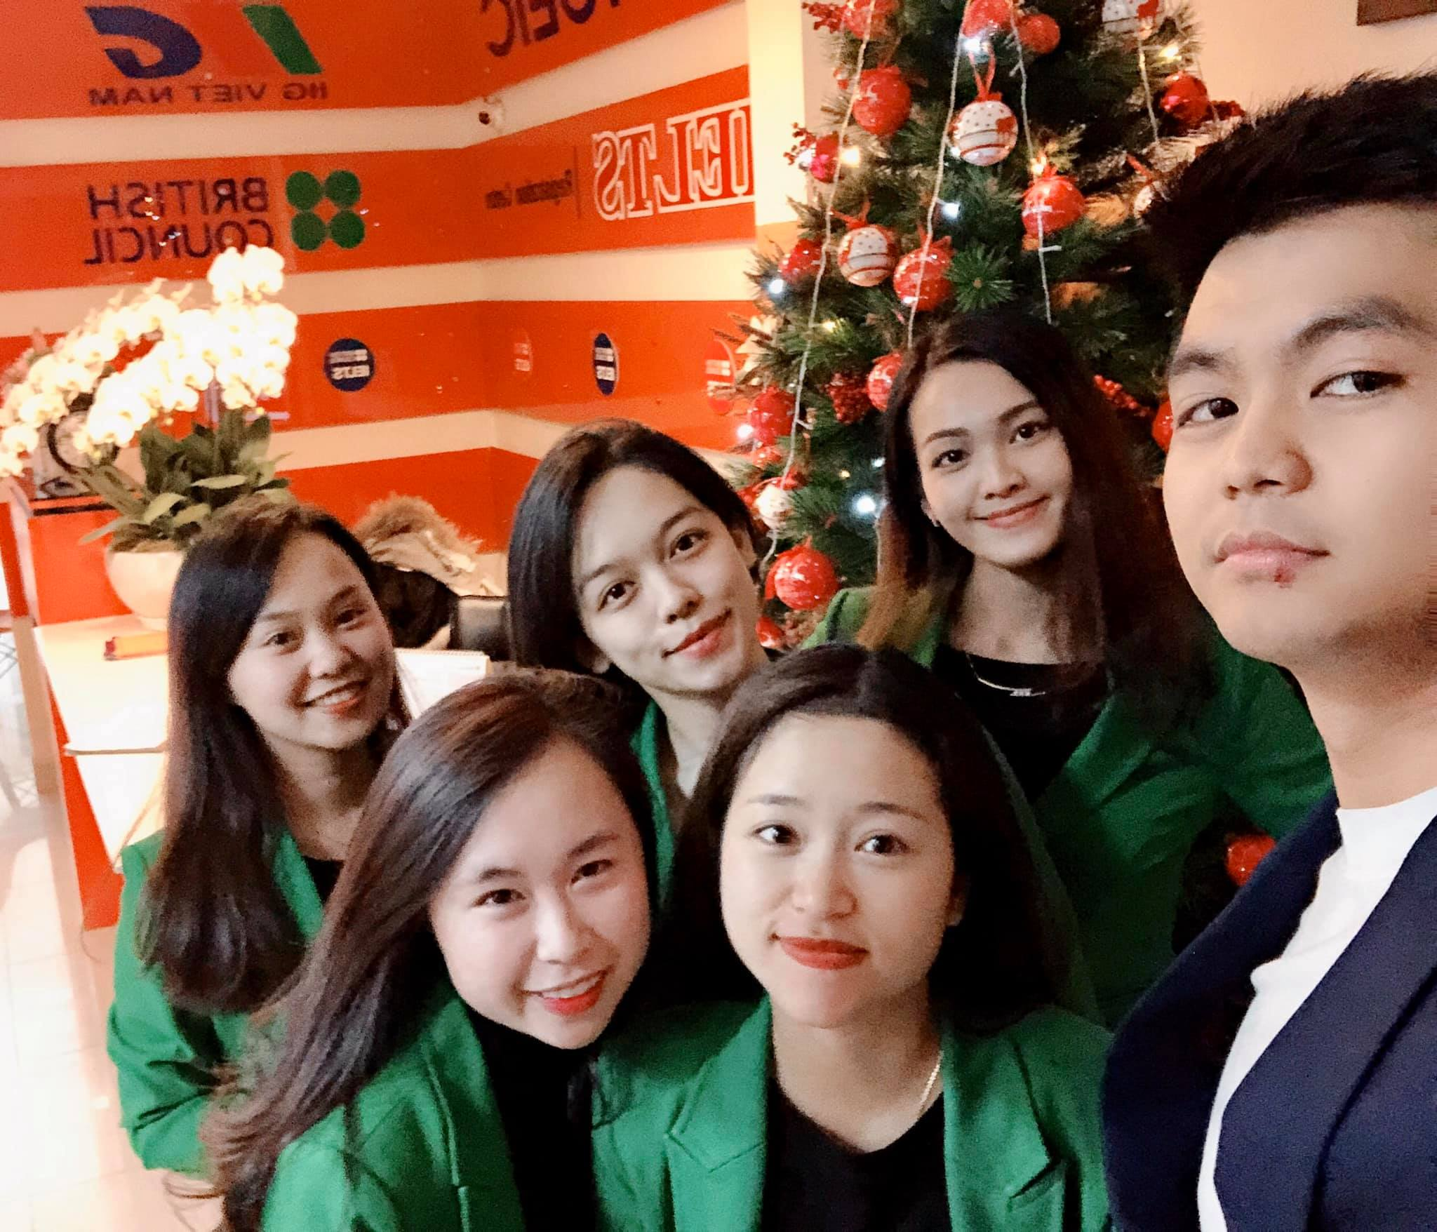
Being rejected from NRI...

Slide 13
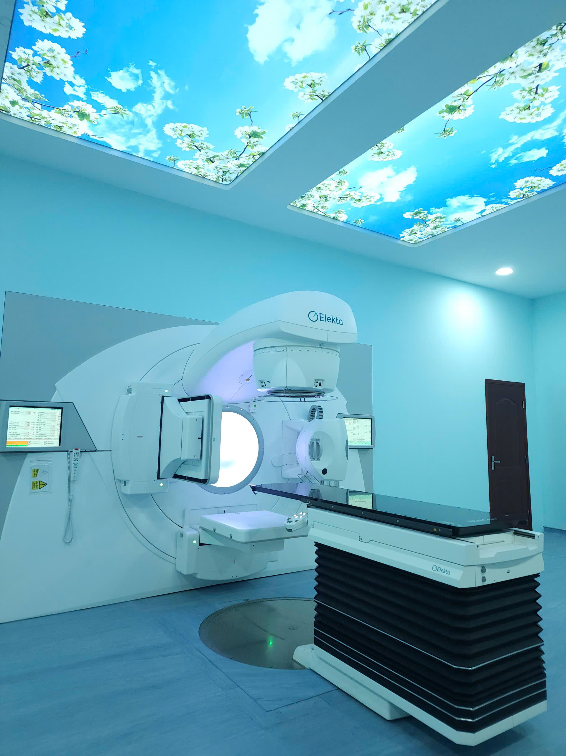
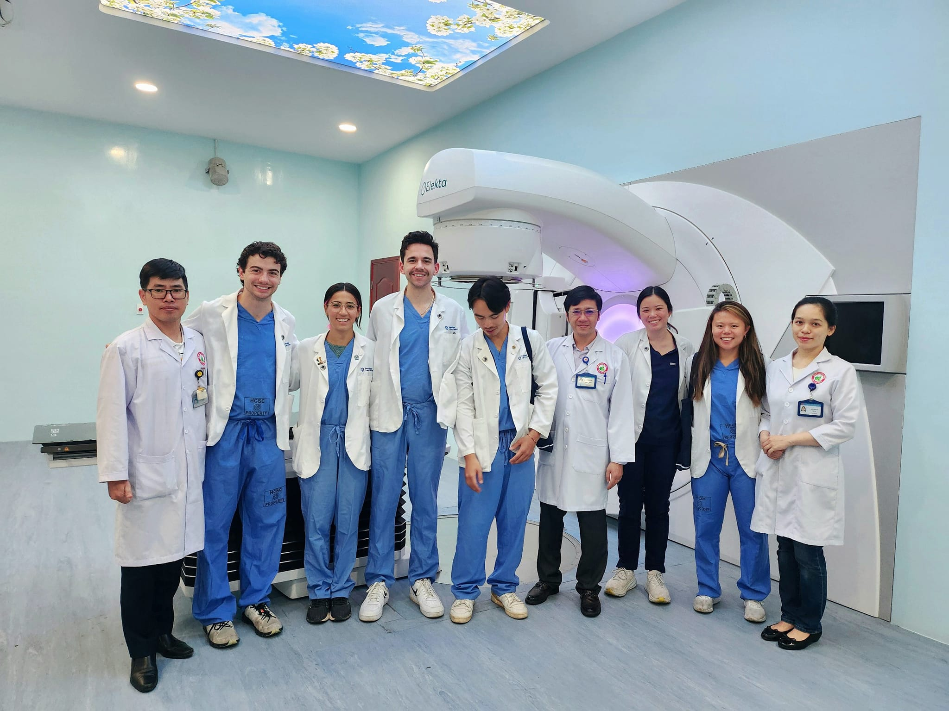
Until 2023

Slide 14
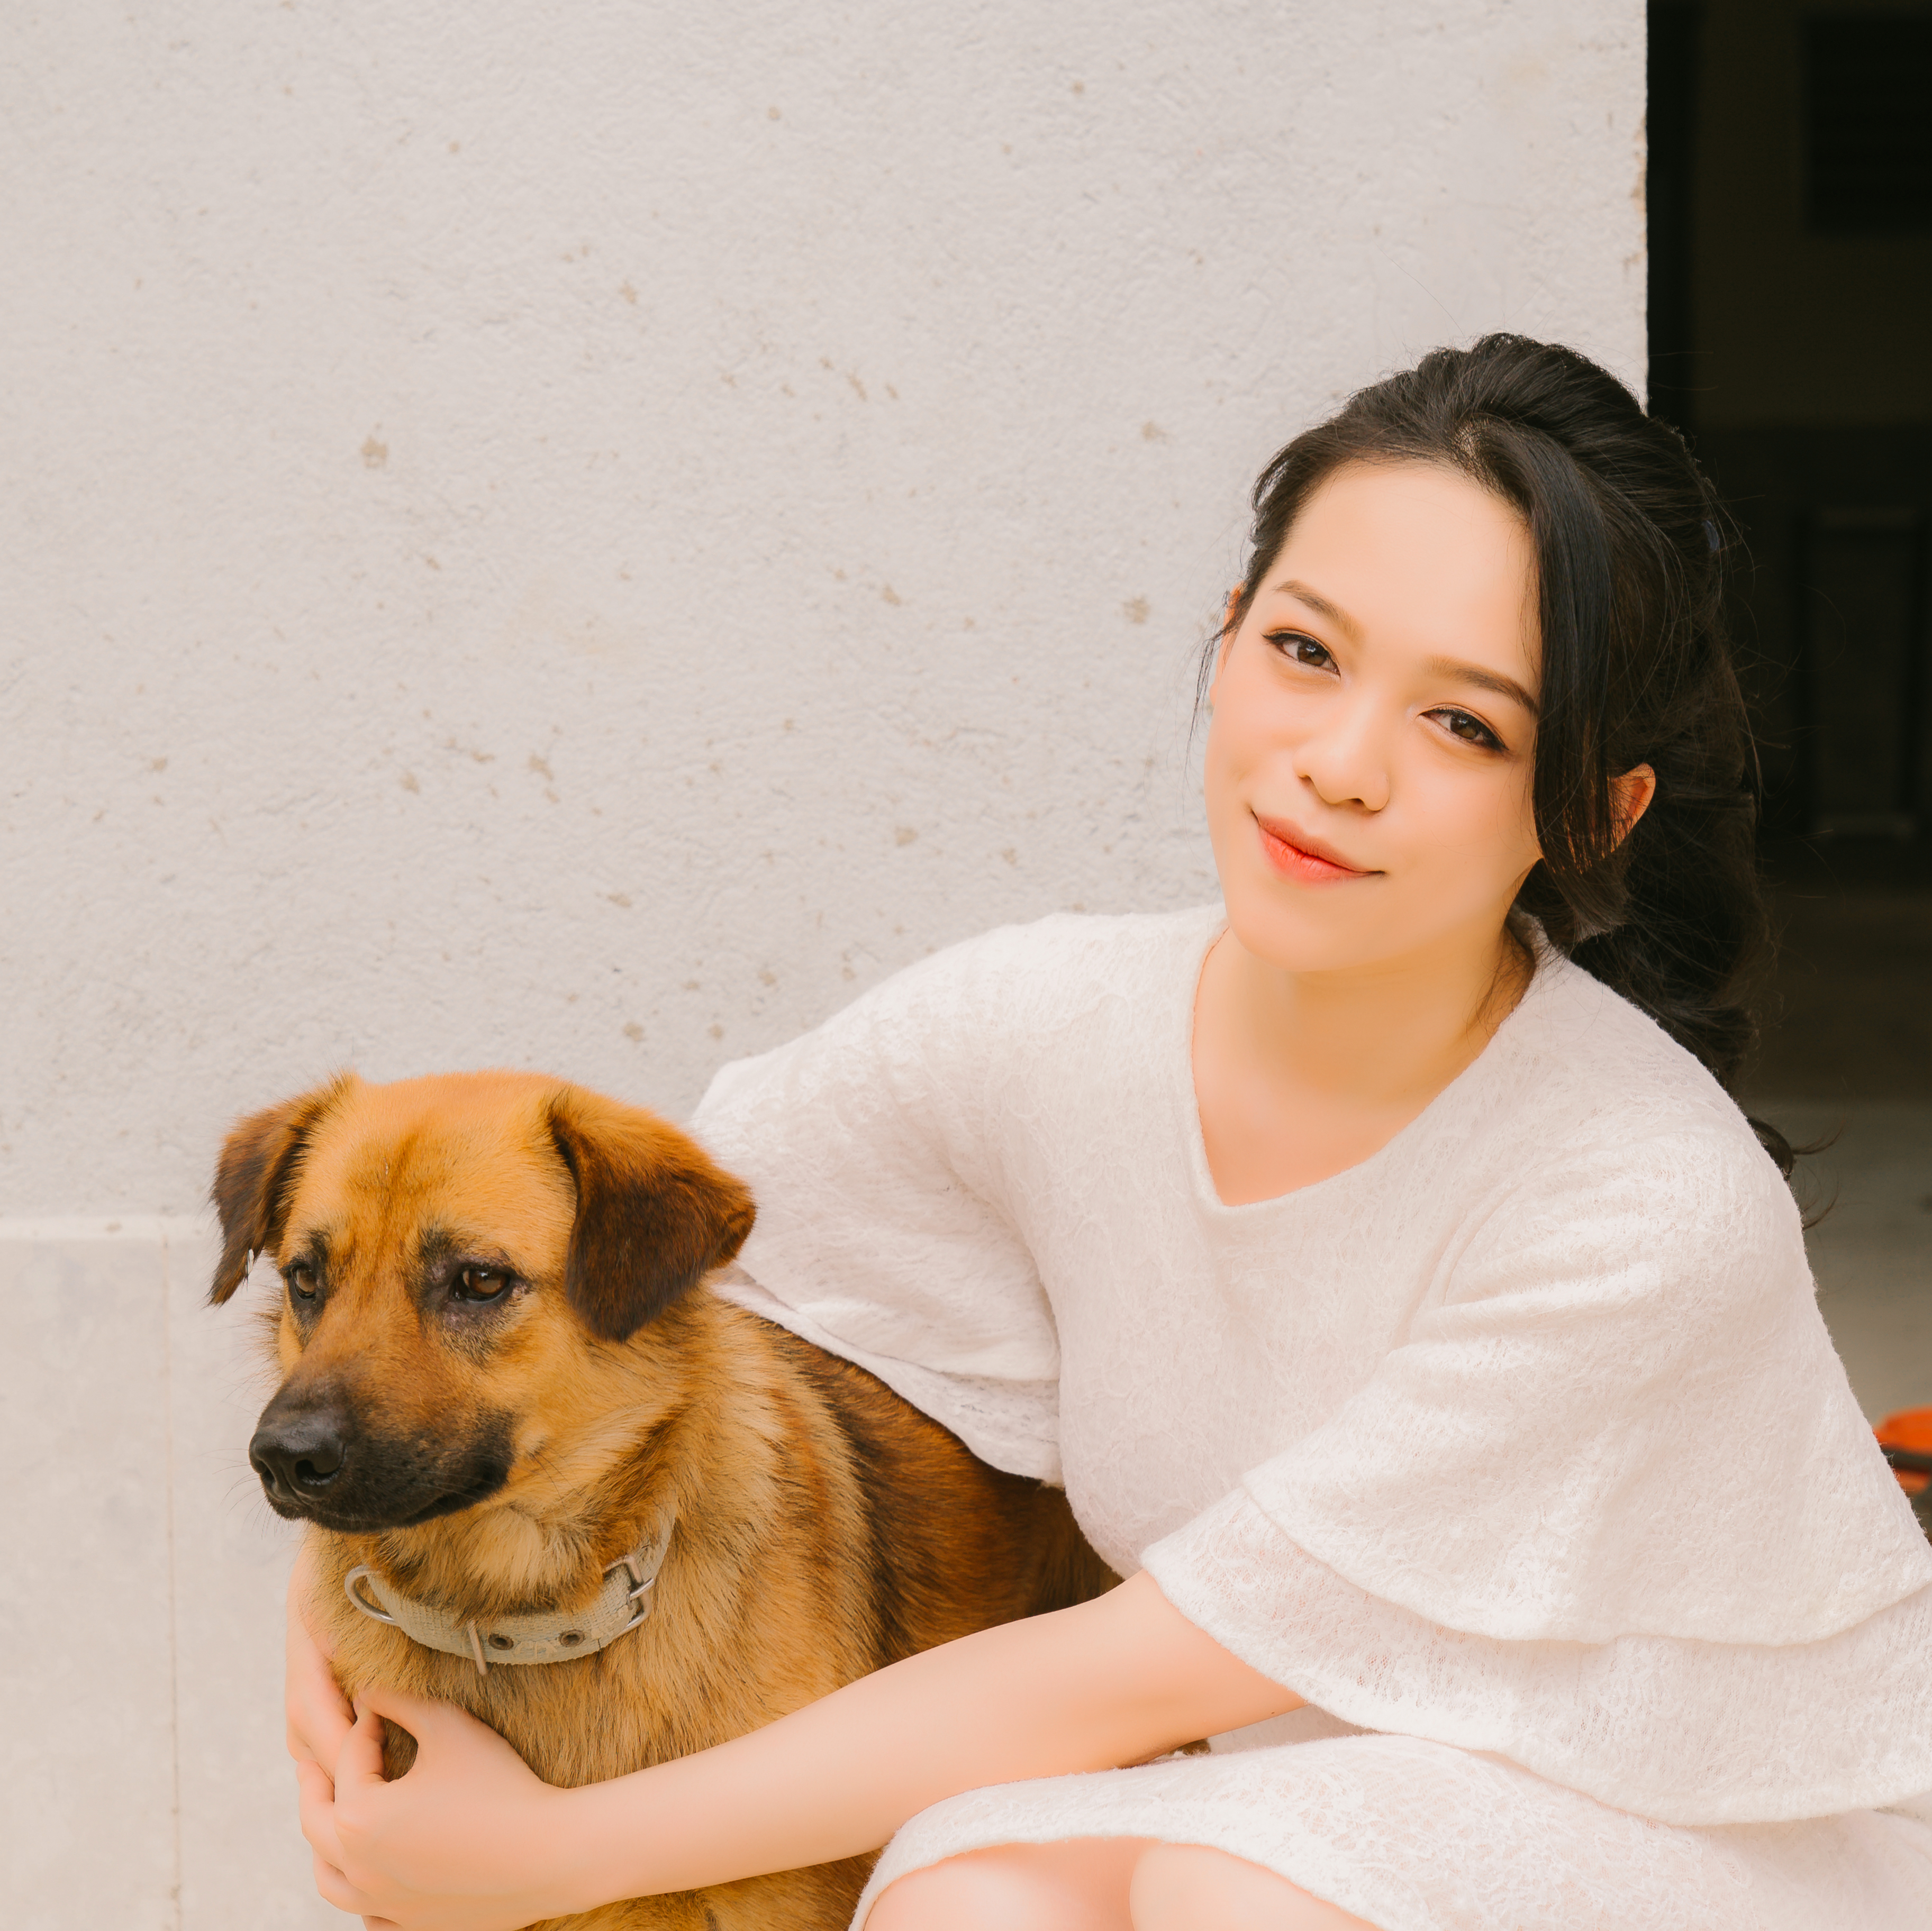
My upcoming plan
A research about CT dosimetry for applying to a PhD program.
Main Objectives:
Measure and evaluate patient radiation dose from X-ray, CT, and CBCT imaging
Build a quantitative patient dose database through experimental measurements and simulations
Propose shielding models and optimized imaging protocols to reduce patient dose while maintaining diagnostic quality
Develop standardized protocols for diagnostic radiology practices

Slide 15
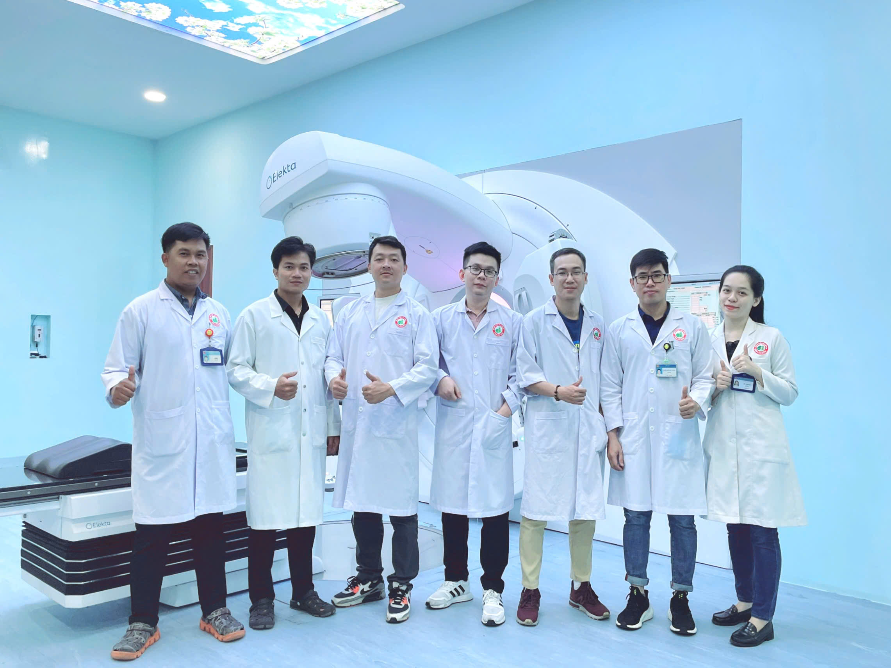
Don’t give up on your dream!

