Slide 1

Probing String-Modified Gravity in Neutron Stars
Tatsuya Daniel
Brown Theoretical Physics Center
Department of Physics, Brown University
PASCOS 2023
Collaborators:
Prof. Stephon Alexander, Brown University
Prof. Kent Yagi, University of Virginia

Slide 2
OUTLINE
Background
  Strong gravity regime
  Binary NS systems
  TOV equations
Scalar-tensor theories
Field Equations
Ongoing work
Summary

Slide 3
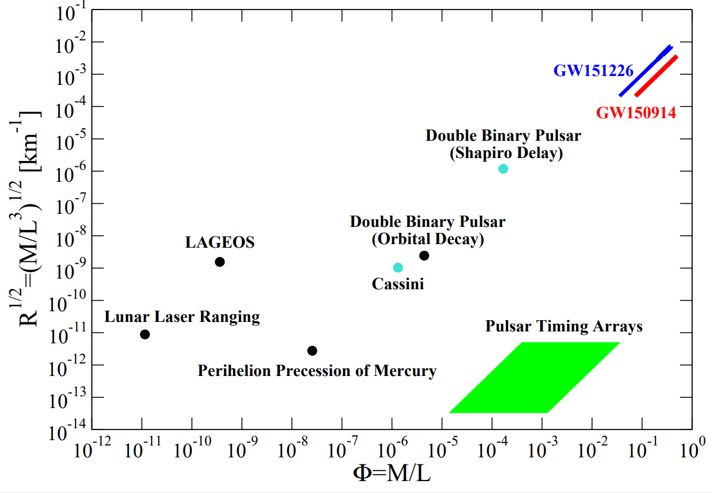
STRONG GRAVITY REGIME
Yagi, Yunes and Pretorius, 2016 PRD (ArXiv:1603.08955)

Slide 4
STRONG GRAVITY REGIME
Direct probe of
gravity
Yagi, Yunes and Pretorius, 2016 PRD (ArXiv:1603.08955)

Slide 5
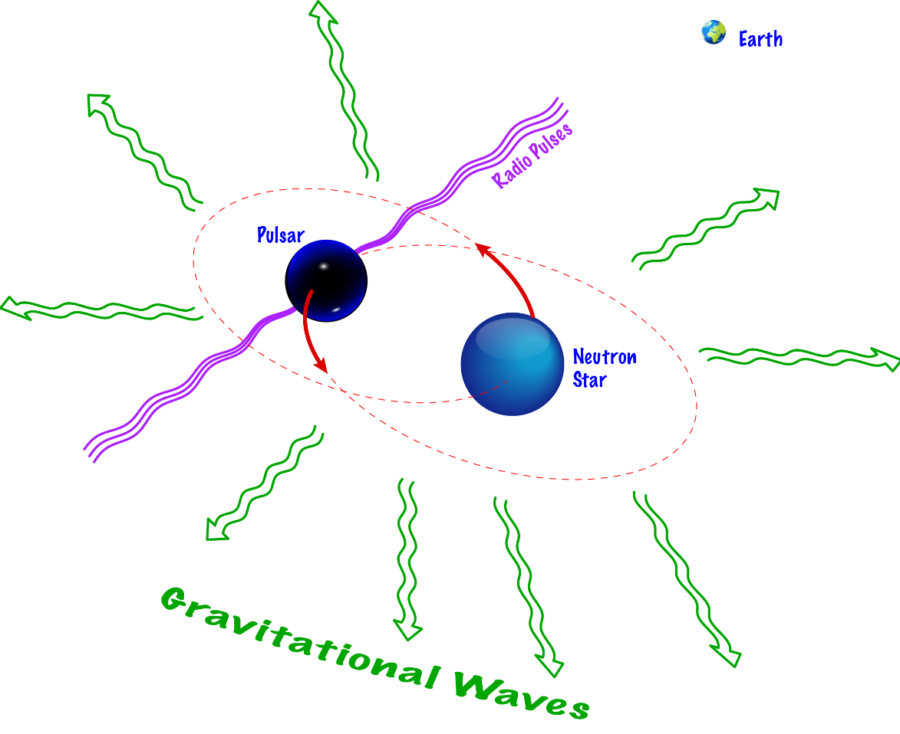
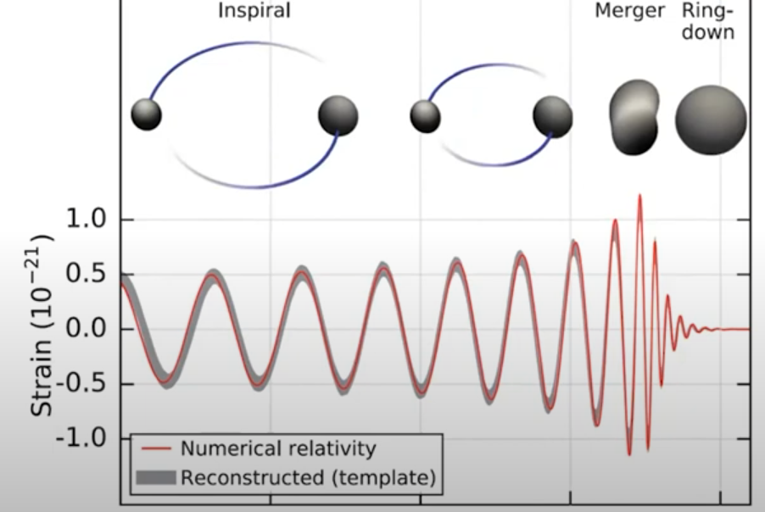
BINARY NS SYSTEMS
NS
Source:
NASA
NS
Source: Kent Yagi (U. Virginia)

Slide 6
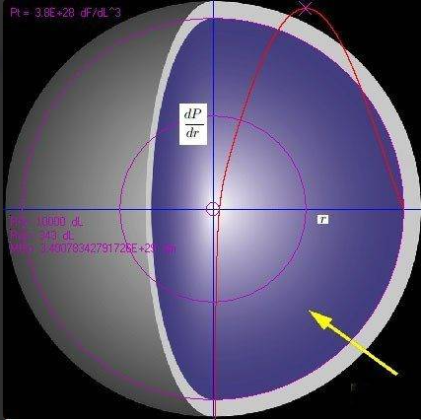
TOV EQUATIONS
Describes gravitational pressure of a spherically symmetric compact object in equilibrium
Source: Physics Forums

Slide 7
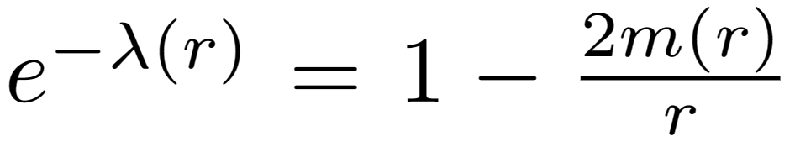
TOV EQUATIONS
Describes gravitational pressure of a spherically symmetric compact object in equilibrium
General form of NS metric:
where
Source: Physics Forums

Slide 8
TOV EQUATIONS
Describes gravitational pressure of a spherically symmetric compact object in equilibrium
General form of NS metric:
Will be modified if corrections to GR
  → Can be used to probe new physics (via GWs)
where
Source: Physics Forums

Slide 9
DCS + EDGB GRAVITY
New: Dynamical Chern-Simons gravity (dCS) and Einstein-dilaton-Gauss-Bonnet gravity (EdGB)

Slide 10
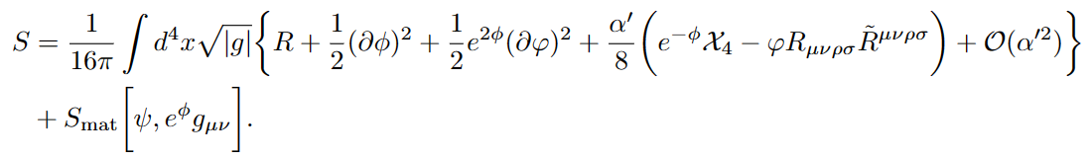
DCS + EDGB GRAVITY
New: Dynamical Chern-Simons gravity (dCS) and Einstein-dilaton-Gauss-Bonnet gravity (EdGB)
EdGB
dCS

Slide 11
DCS + EDGB GRAVITY
New: Dynamical Chern-Simons gravity (dCS) and Einstein-dilaton-Gauss-Bonnet gravity (EdGB)
Can we derive observational constraints?
EdGB
dCS

Slide 12
DCS + EDGB GRAVITY
New: Dynamical Chern-Simons gravity (dCS) and Einstein-dilaton-Gauss-Bonnet gravity (EdGB)
Can we derive observational constraints?
EdGB
dCS
Transform action from
Jordan to Einstein frame
Field and TOV equations
Solve TOV numerically
(current progress)
Observe modifications to mass-radius relation, universal relations

Slide 13
FIELD EQUATIONS

Slide 14
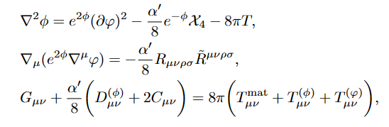
FIELD EQUATIONS

Slide 15
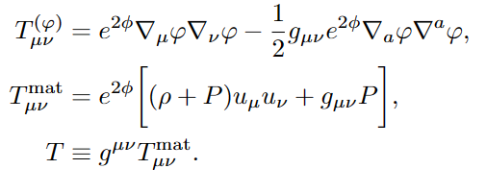
FIELD EQUATIONS
where

Slide 16
SOLVING TOV EQUATIONS: PROCEDURE

Slide 17
SOLVING TOV EQUATIONS: PROCEDURE
Impose initial conditions for mass, pressure and scalar field central values

Slide 18
SOLVING TOV EQUATIONS: PROCEDURE
Impose initial conditions for mass, pressure and scalar field central values
Choice of (α₀, β₀) and an EoS

Slide 19
SOLVING TOV EQUATIONS: PROCEDURE
Impose initial conditions for mass, pressure and scalar field central values
Choice of (α₀, β₀) and an EoS
Solve TOV equations numerically. Stellar radius given by P(R) = 0

Slide 20
SOLVING TOV EQUATIONS: PROCEDURE
Impose initial conditions for mass, pressure and scalar field central values
Choice of (α₀, β₀) and an EoS
Solve TOV equations numerically. Stellar radius given by P(R) = 0
Solve the equations in the exterior region with P = ρ = 0

Slide 21
SOLVING TOV EQUATIONS: PROCEDURE
Impose initial conditions for mass, pressure and scalar field central values
Choice of (α₀, β₀) and an EoS
Solve TOV equations numerically. Stellar radius given by P(R) = 0
Solve the equations in the exterior region with P = ρ = 0
Read off M, φ₀ by comparing the asymptotic behavior of the numerically-computed φ and m

Slide 22
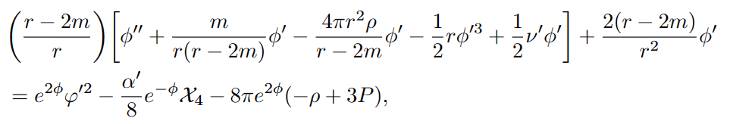
SOLVING TOV EQUATIONS: PROCEDURE
Impose initial conditions for mass, pressure and scalar field central values
Choice of (α₀, β₀) and an EoS
Solve TOV equations numerically. Stellar radius given by P(R) = 0
Solve the equations in the exterior region with P = ρ = 0
Read off M, φ₀ by comparing the asymptotic behavior of the numerically-computed φ and m

Slide 23
NEXT STEPS (ONGOING)

Slide 24
NEXT STEPS (ONGOING)
Solve TOV equations numerically by end of summer

Slide 25
NEXT STEPS (ONGOING)
Solve TOV equations numerically by end of summer
Plots of the mass-radius as well as universal relations

Slide 26
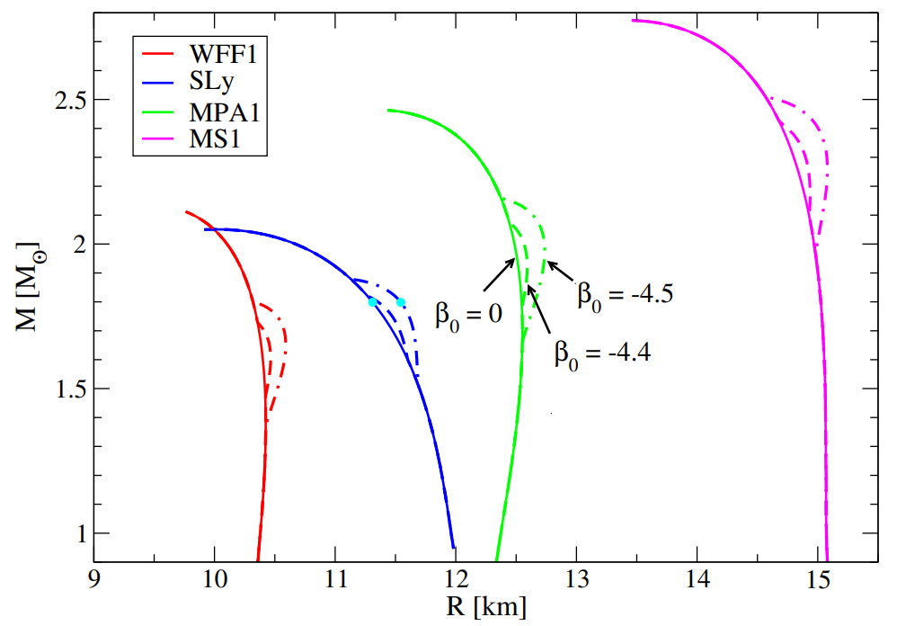
NEXT STEPS (ONGOING)
Solve TOV equations numerically by end of summer
Plots of the mass-radius as well as universal relations
Yagi and Stepniczka, 2021
(Phys. Rev. D 104, 044017)

Slide 27
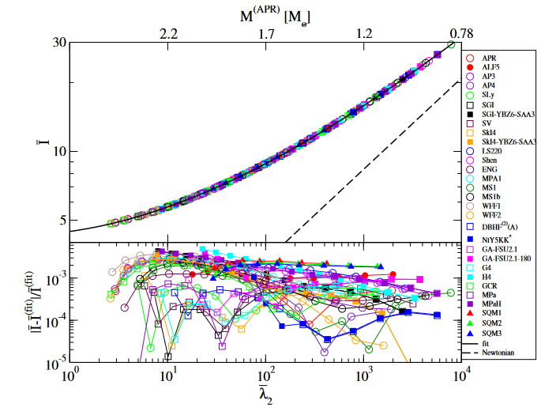
NEXT STEPS (ONGOING)
Solve TOV equations numerically by end of summer
Plots of the mass-radius as well as universal relations
Yagi and Stepniczka, 2021
(Phys. Rev. D 104, 044017)
Yagi and Yunes, 2017
(Physics Reports, Volume 681)

Slide 28
SUMMARY

Slide 29
SUMMARY
Scalar-tensor theories are modified theories of gravity

Slide 30
SUMMARY
Scalar-tensor theories are modified theories of gravity
Observational constraints placed on scalar-tensor theories from weak gravity tests, but not strong gravity

Slide 31
SUMMARY
Scalar-tensor theories are modified theories of gravity
Observational constraints placed on scalar-tensor theories from weak gravity tests, but not strong gravity
Considering two ST theories (Chern-Simons and Gauss-Bonnet), which are well-motivated from string theory, to probe strong gravity using binary NS systems

Slide 32
SUMMARY
Scalar-tensor theories are modified theories of gravity
Observational constraints placed on scalar-tensor theories from weak gravity tests, but not strong gravity
Considering two ST theories (Chern-Simons and Gauss-Bonnet), which are well-motivated from string theory, to probe strong gravity using binary NS systems
GW deviations from GR would be an interesting hint that GR needs modifications in strong gravity regime

Slide 33
BACKUP SLIDES

Slide 34
SCALAR-TENSOR THEORIES
Introduce scalar fields into action

Slide 35
SCALAR-TENSOR THEORIES
Introduce scalar fields into action
A benchmark theory (Damour and Esposito-Varèse, 1996 PRD):
  “
“Coupling
function”
Scalar field coupling
to metric

Slide 36
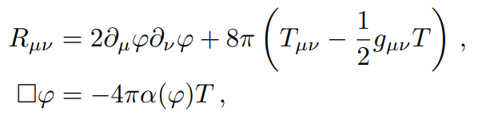
FIELD EQUATIONS OF ST THEORIES

Slide 37
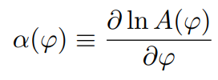
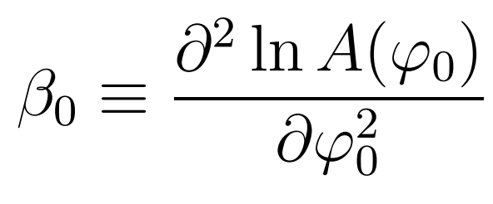
FIELD EQUATIONS OF ST THEORIES

Slide 38


FIELD EQUATIONS OF ST THEORIES
Damour and Esposito-Varèse (1996, PRD):

Slide 39
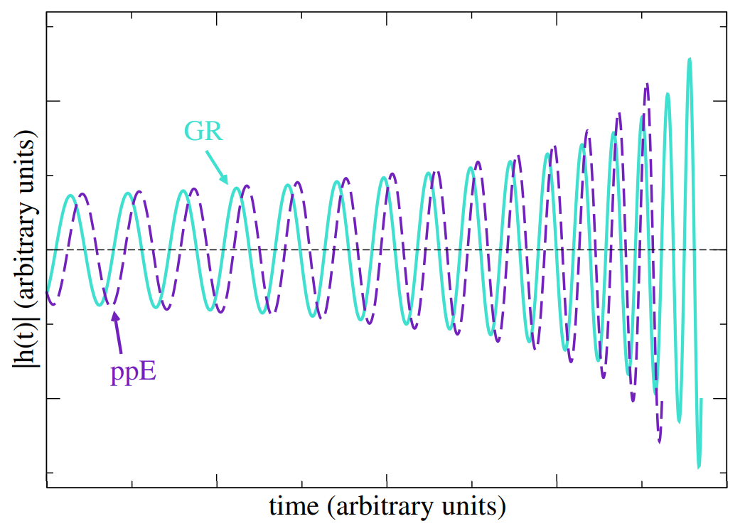
SPONTANEOUS SCALARIZATION
GR
When β is sufficiently negative, NSs can have nontrivial scalar field distribution profile
  Parametrized by (α₀, β₀)
NSs undergoing tachyonic instability
sGB
Carson, 2020 (ArXiv:2010.04745)

Slide 40
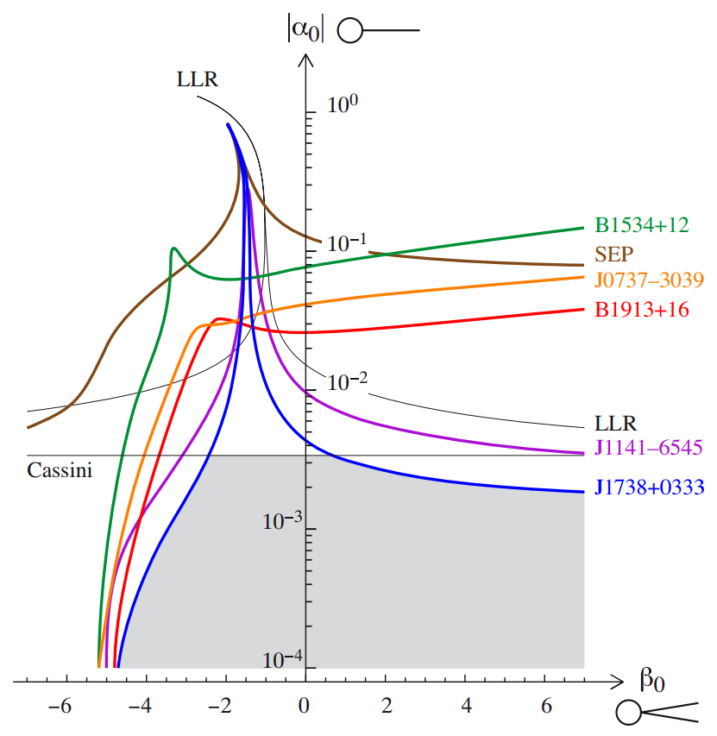
OBSERVABLE CONSTRAINTS ON ST THEORIES
Freire et al. 2012,
ArXiv:1205.1450

Slide 41
TOV EQUATIONS

Slide 42
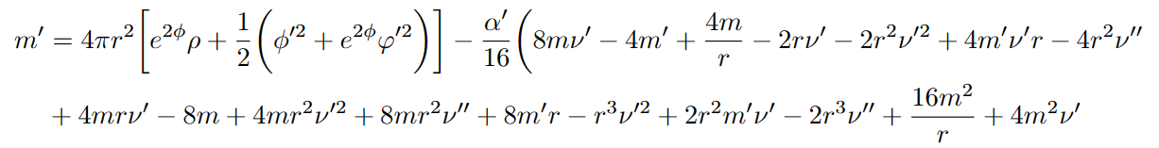

TOV EQUATIONS

Slide 43
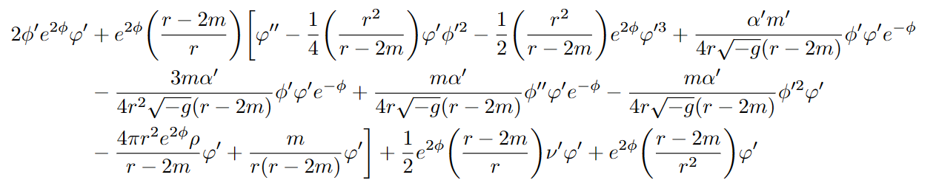

TOV EQUATIONS

Slide 44
TOV EQUATIONS

Slide 45
TOV EQUATIONS

Slide 46
TOV EQUATIONS

Slide 47
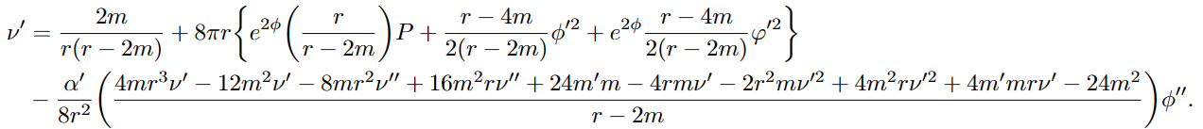
TOV EQUATIONS

Slide 48
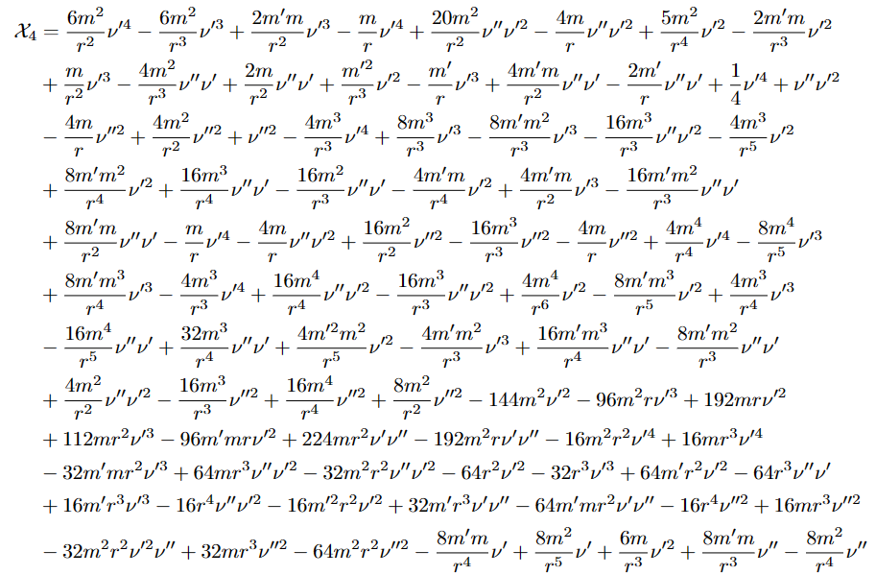
TOV EQUATIONS

