Slide 1




Results from FASER
Dave Casper
University of California, Irvine
(for the FASER collaboration)
Dark photon search CONF note on CERN Document Server
Collider neutrino direct detection paper (accepted by PRL)

Slide 2

FASER collaboration
84 members from 24 institutes in 10 countries
International laboratory covered by a cooperation agreement with CERN

Slide 3
Outline
Physics motivation and goals
The FASER detector
2022 operations and results

Slide 4

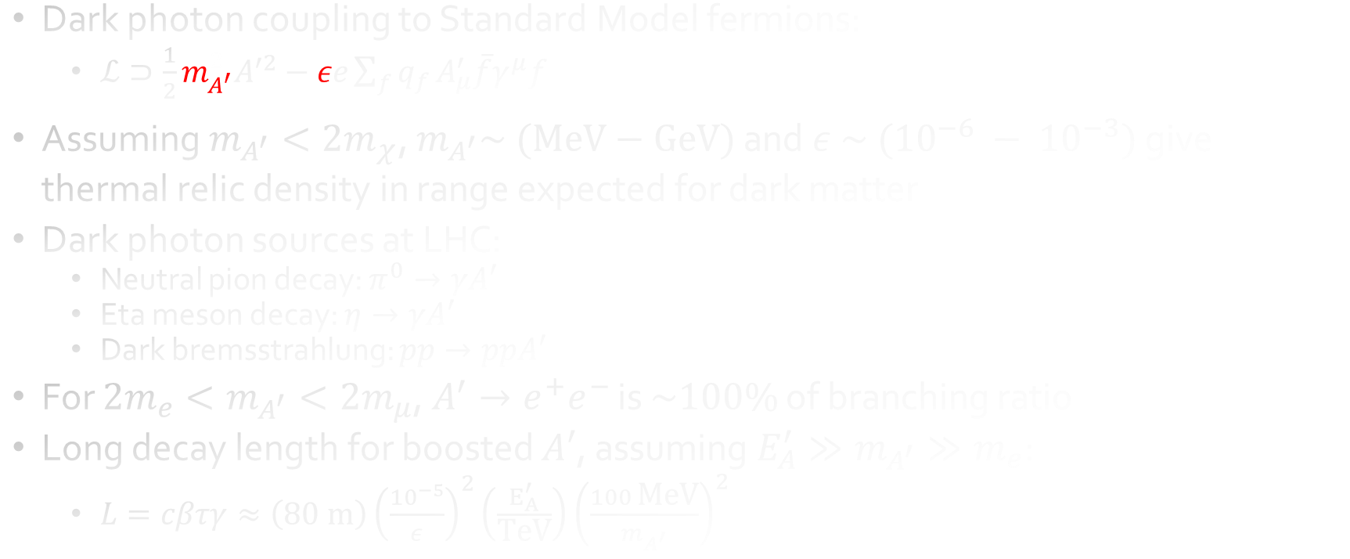
Motivation: search for long-lived $A′$
Dark photon coupling to Standard Model fermions:
  $ℒ⊃\frac{1}{2}m_{A^{′}}^{2}A^{′2}−εe\sum_{f}{q_{f}}A_{μ}^{′}\overline{f}γ^{μ}f$
Assuming $m_{A^{′}}<2m_{χ}$, $m_{A^{′}}\sim \text{ (}\text{MeV}−\text{GeV}\text{)}$ and $ε \sim ({10}^{−6} − {10}^{−3})$ give thermal relic density in range expected for dark matter
Dark photon sources at LHC:
  Neutral pion decay: $π^{0}→γA′$
  Eta meson decay: $η→γA′$
  Dark bremsstrahlung: $pp→ppA′$
For $2m_{e}<m_{A^{′}}<2m_{μ}$, $A^{′}→e^{+}e^{−}$ is $\sim 100\%$ of branching ratio
Long decay length for boosted $A′$, assuming $E_{A}^{′}≫m_{A^{′}}≫m_{e}$:
  $L=cβτγ≈\left(80 \text{m}\right){\left(\frac{{10}^{−5}}{ε}\right)}^{2}\left(\frac{E_{A}^{′}}{\text{TeV}}\right){\left(\frac{100 \text{MeV}}{m_{A^{′}}}\right)}^{2}$
Feng, Galon, Kling and Trojanowski, Phys. Rev. D 97 (2018) no. 3, 035001

Slide 5
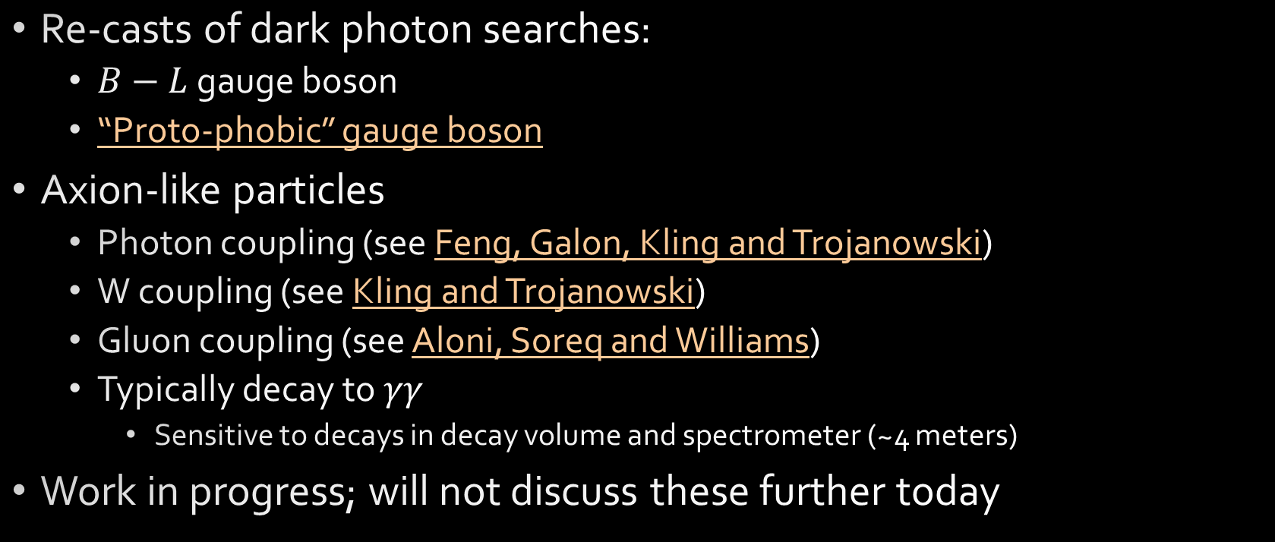
Motivation: ALP’s and other searches
Re-casts of dark photon searches:
  $B−L$ gauge boson
  “Proto-phobic” gauge boson
Axion-like particles
  Photon coupling (see Feng, Galon, Kling and Trojanowski)
  W coupling (see Kling and Trojanowski)
  Gluon coupling (see Aloni, Soreq and Williams)
  Typically decay to $γγ$
    Sensitive to decays in decay volume and spectrometer (~4 meters)
Work in progress; will not discuss these further today
FASER's Physics Reach for Long-Lived Particles: PRD 99 090511 (2019)

Slide 6
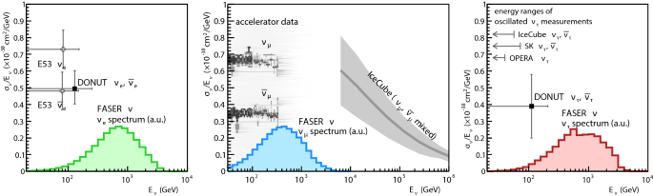



Motivation: collider neutrinos
Expect ~1300 $ν_{e}+{\overline{ν}}_{e}$
interactions in 150/fb
Expect ~20,000 $ν_{μ}+{\overline{ν}}_{μ}$
interactions in 150/fb
Expect ~20 $ν_{τ}+{\overline{ν}}_{τ}$
interactions in 150/fb
“Detecting and Studying High-Energy Collider Neutrinos with FASER at the LHC,” EPJC 80, 61 (2020)

Slide 7
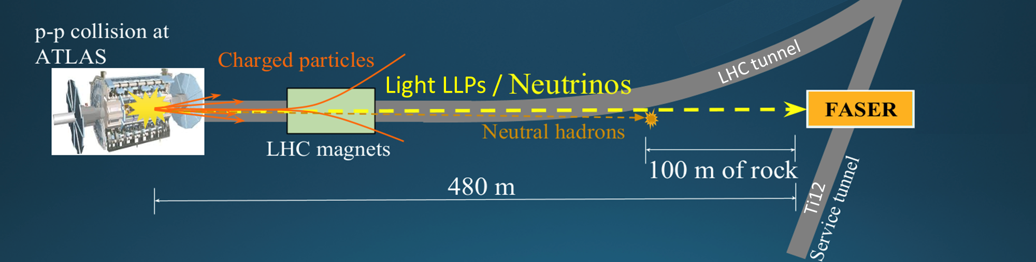
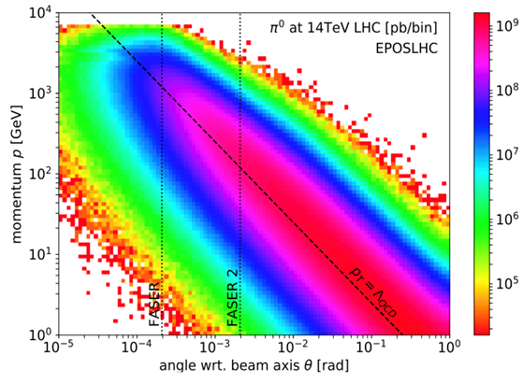
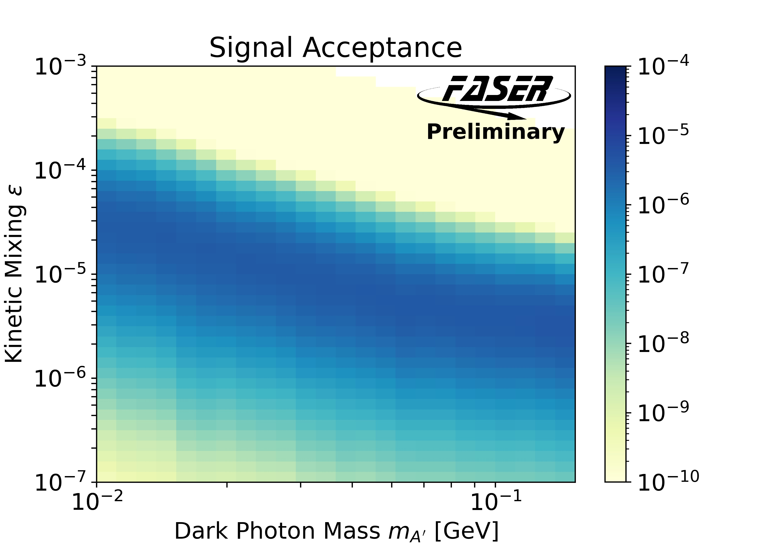
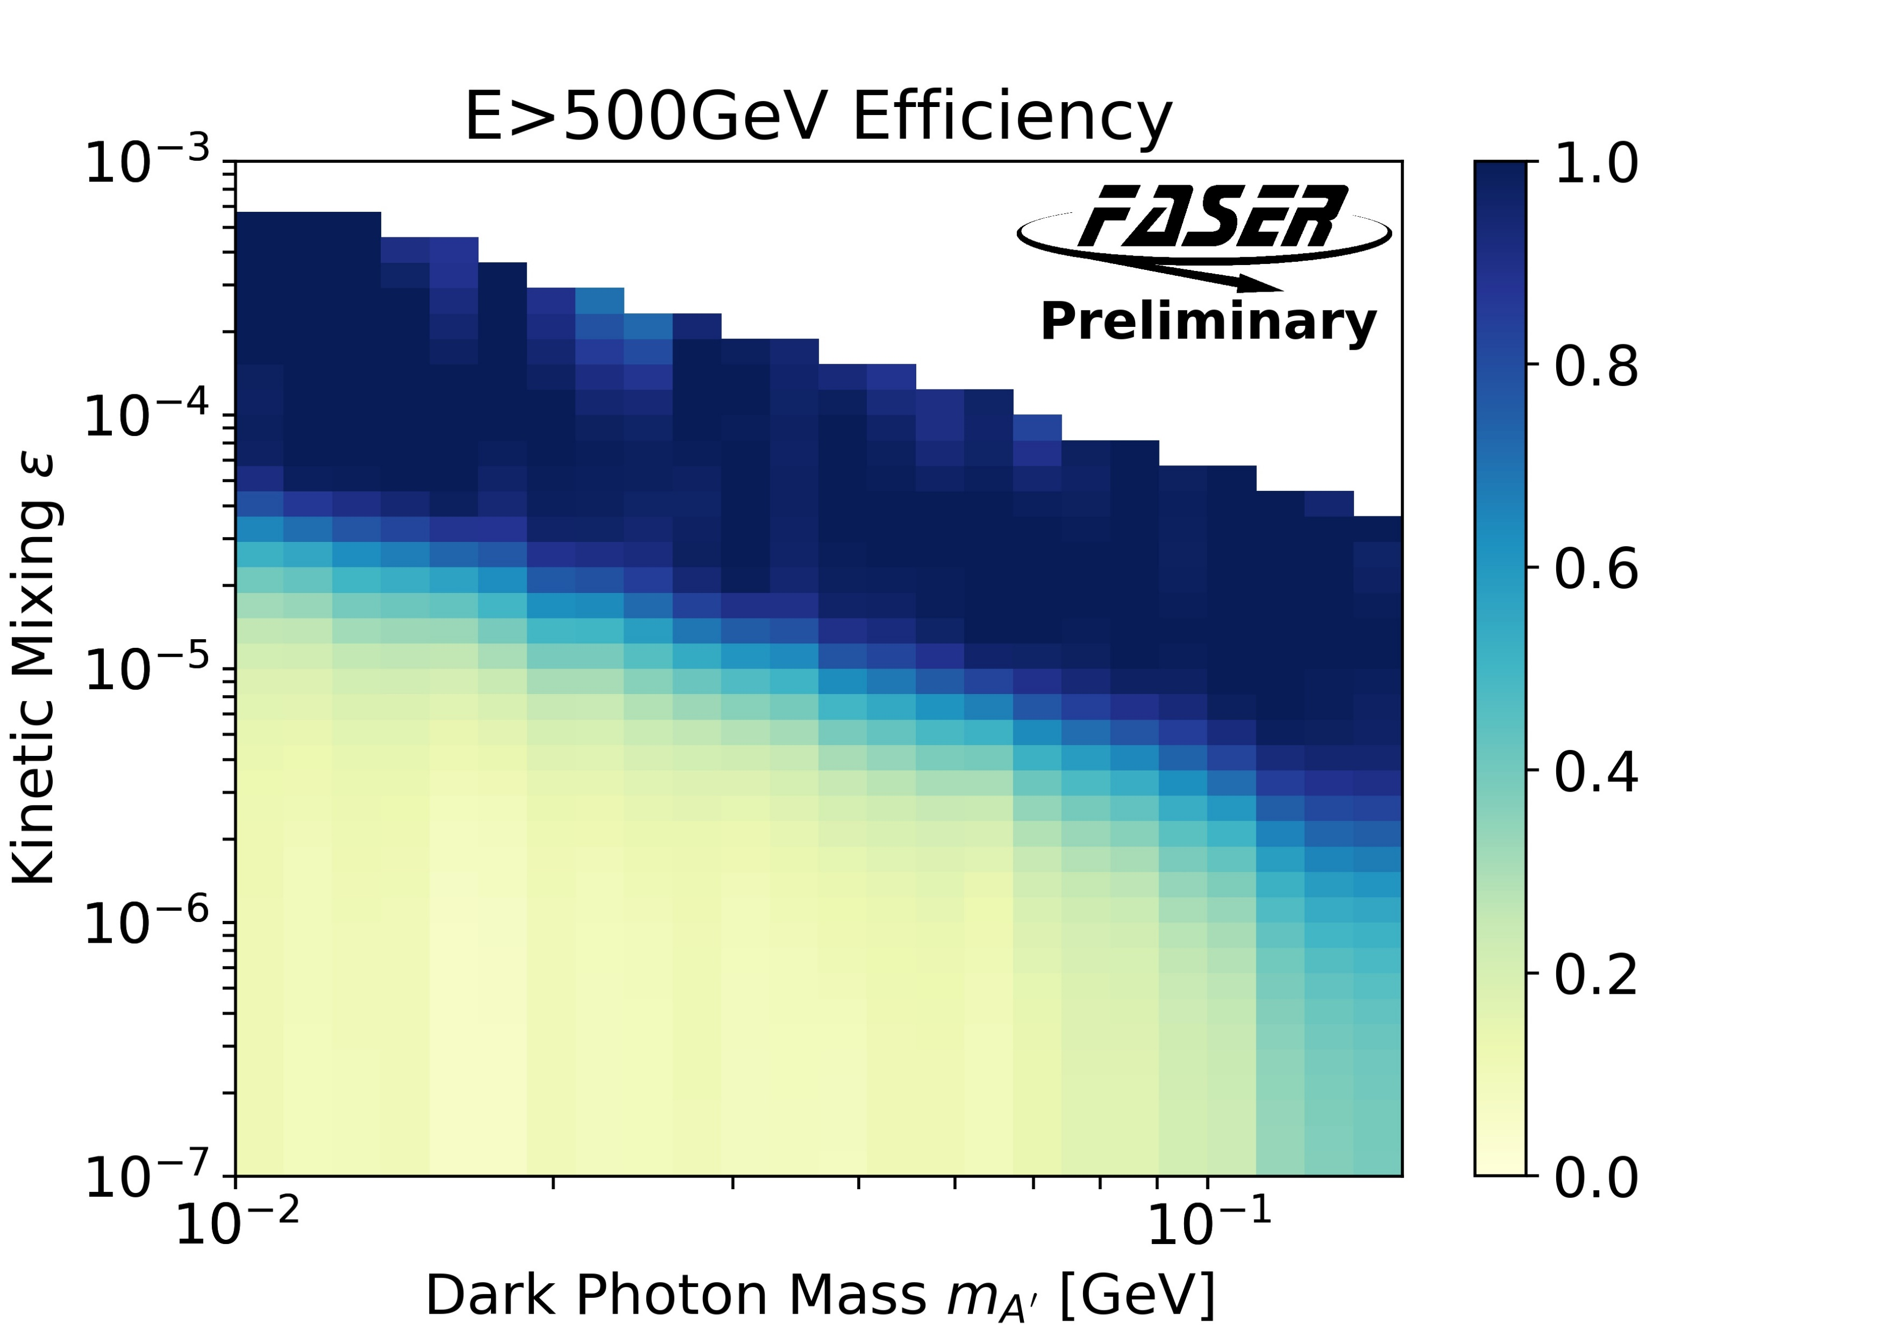
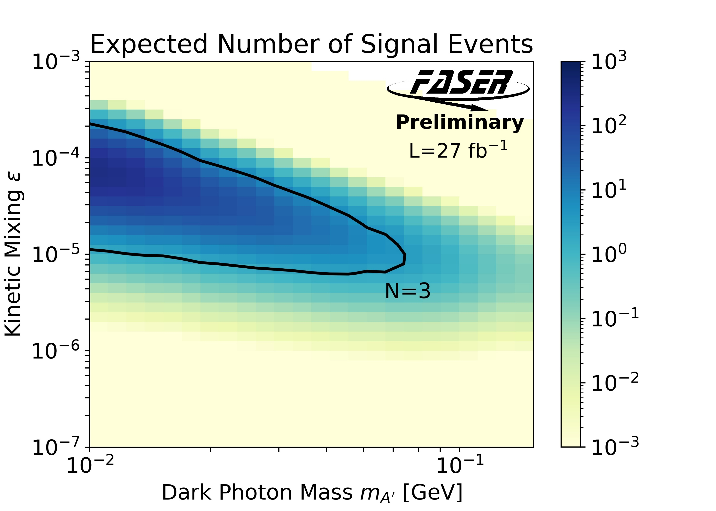




Looking forward in FASER
Detector subtends
$∼{10}^{−8}$ of solid
angle from ATLAS;
rely on collimation
from boost
$π^{0}$ production
$A′$ decay probability in
$1.5 \text{m}$ decay volume @$480 \text{m}$
Fraction of FASER $A′$ decays
with $E>500 \text{GeV}$
Signal expected assuming
50% selection efficiency
Kling & Trojanowski, FORESEE
Generator level studies

Slide 8
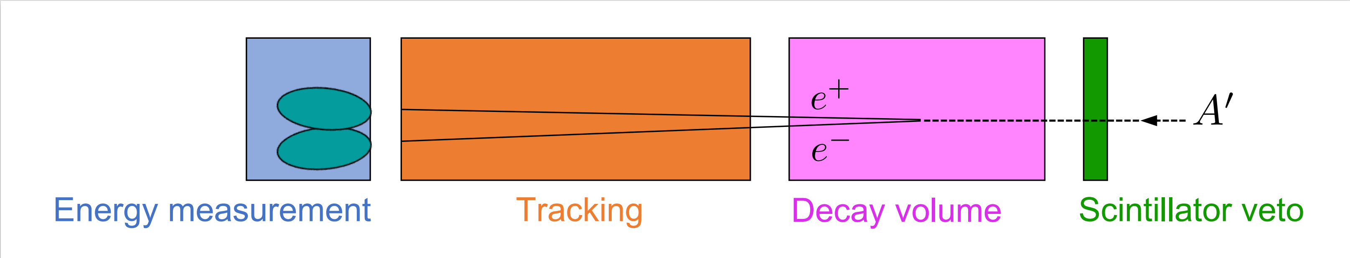
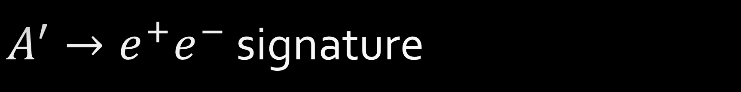
$A^{′}→e^{+}e^{−}$ signature
Veto entering charged particles
Reconstruct two energetic charged tracks
Confirm particle ID and energy with large shower in EM Calorimeter

Slide 9
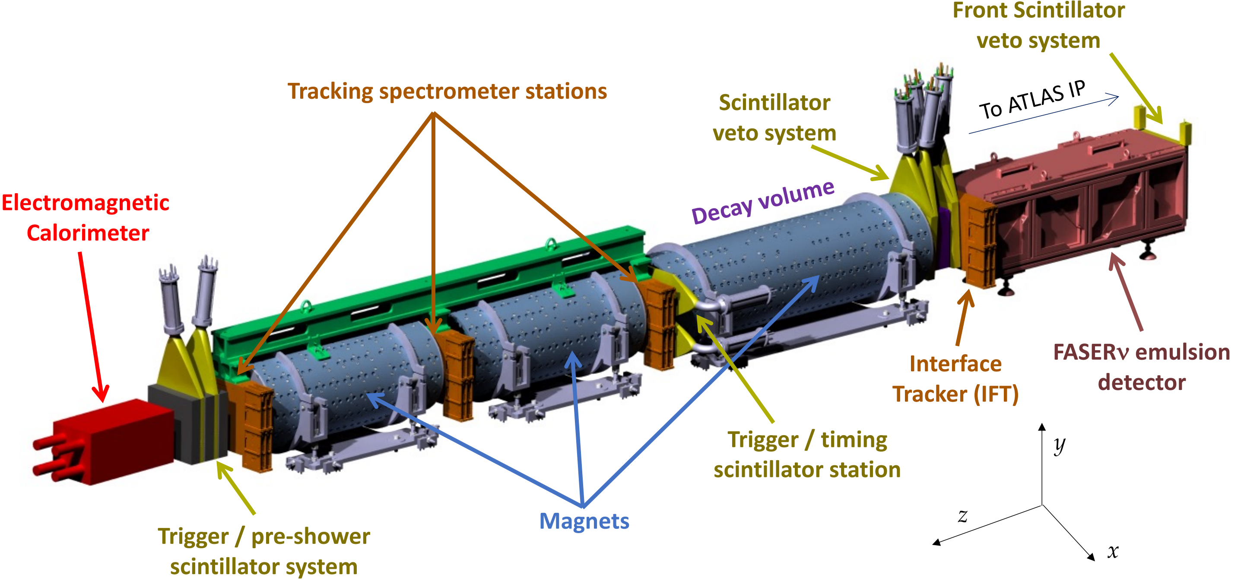



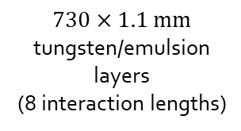



FASER Detector (arXiv:2207.11427)
Three stations of three layers
72 ATLAS SCT silicon strip modules
$2×20 \text{mm}$ thick
$30×35 {\text{mm}}^{2}$ area
$3×20 \text{mm}$ thick
$30×30 {\text{mm}}^{2}$ area
4 LHCb
Outer ECAL
modules
$$1.5 \text{m}$$
24 SCT modules
$$730×1.1 \text{mm}$$
tungsten/emulsion
layers
(8 interaction lengths)
$10 \text{mm}$ thick
dual PMT readout
($σ_{t}=400 \text{ps}$)
Tungsten/Graphite/Scintillator
stack
$0.57 \text{T}$ Halbach dipoles
$100 \text{mm}$ inner radius
4

Slide 10
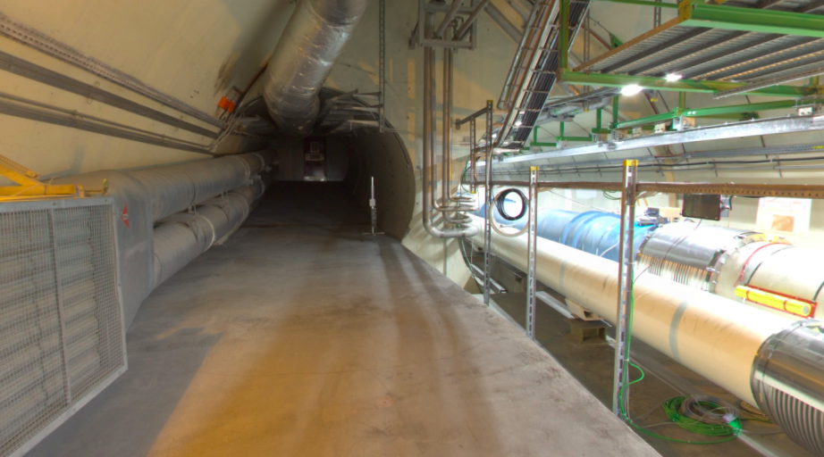
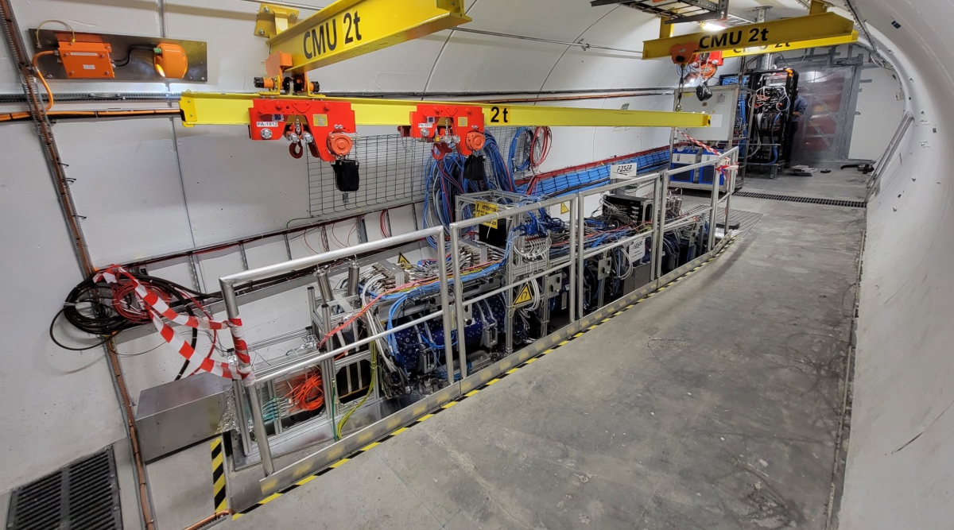
FASER Installation
To ATLAS
FASERnu
IFT
Veto
Decay volume
Tracking spectrometer
2017: Feng, et al. idea paper
2018-19: Proposal, funding and approval
2019-20: Construction and testing on surface
2020-21: Installation underground
2021-22: Commissioning with cosmics
2021: Test beam
2022: Collision data from LHC Run 3
Calorimeter
Preshower
In 2018…
Slide credit: C. Gwilliam

Slide 11
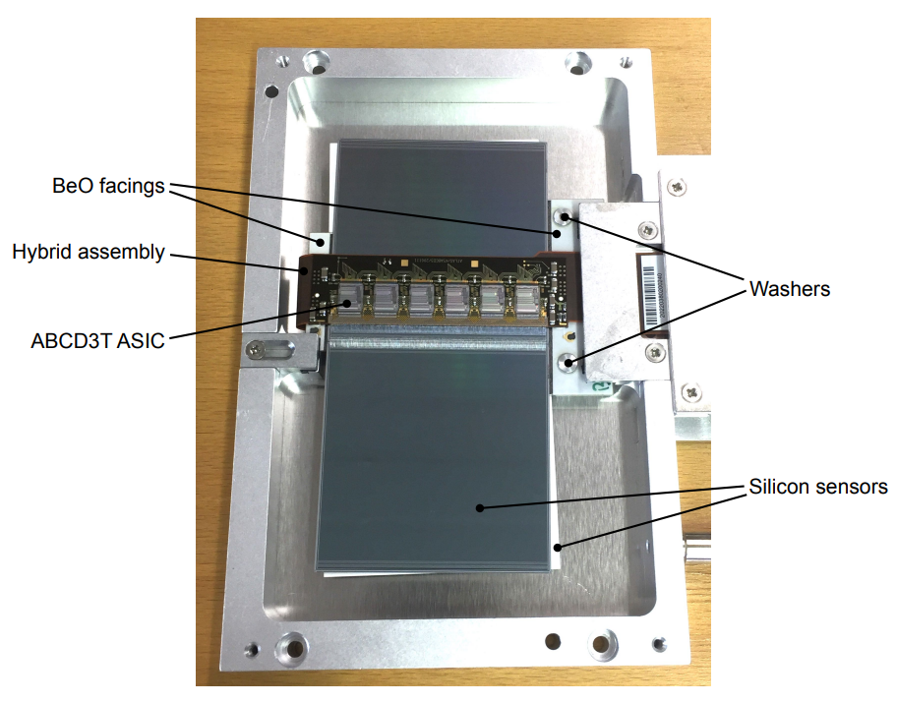
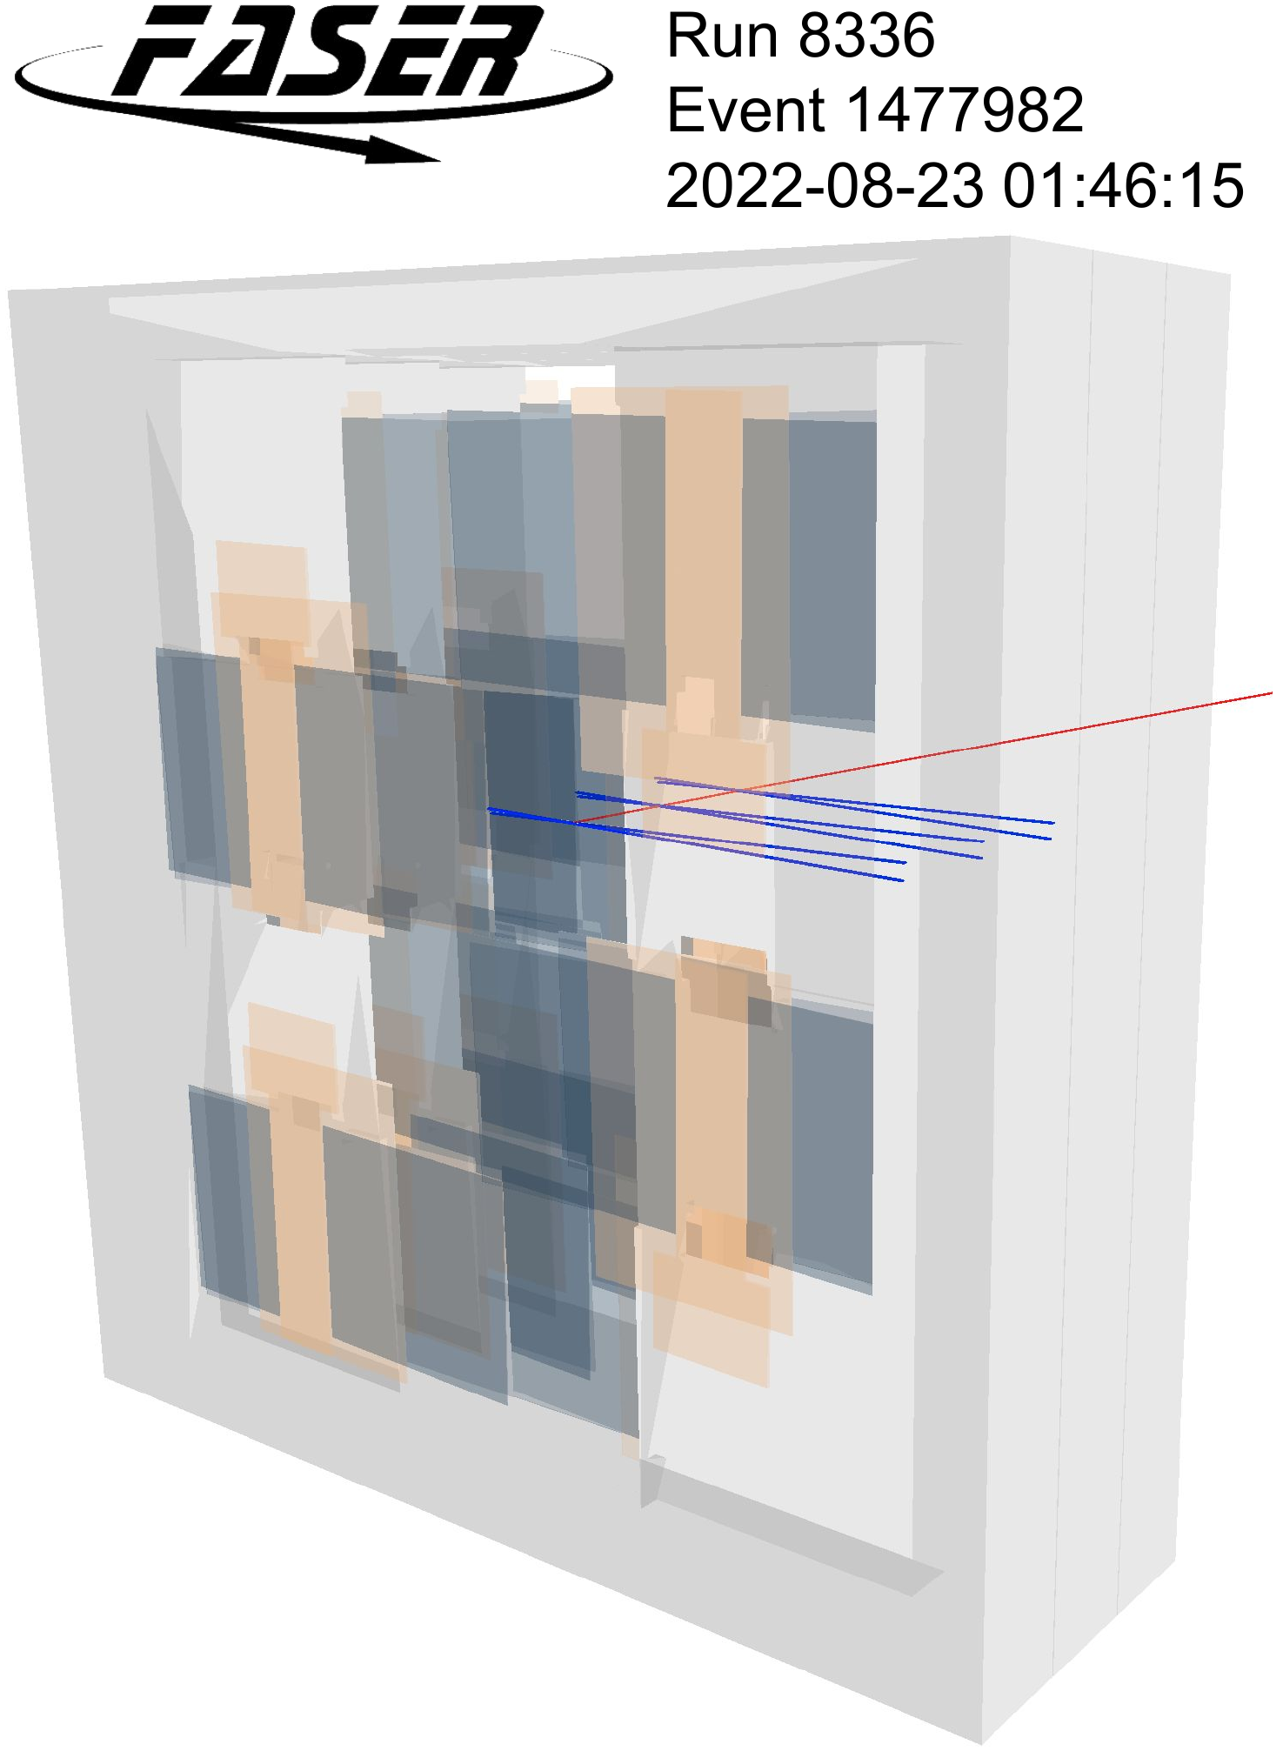
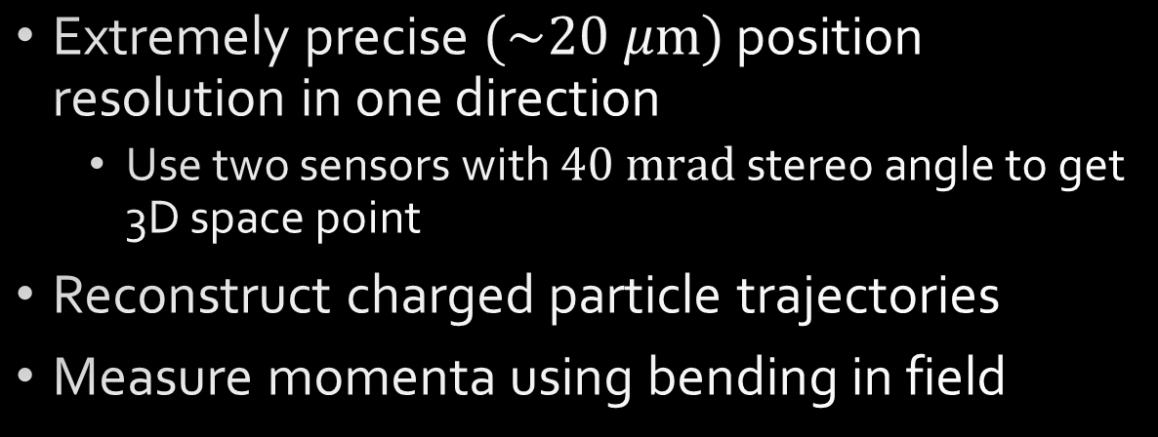
Tracker
Silicon microstrip detector modules (SCT) gifted by ATLAS
  1 plane = 8 modules
  (two-sided)
  1 station = 3 planes
  Full detector = 4 stations
Extremely precise $(\sim 20 μ\text{m})$ position resolution in one direction
  Use two sensors with $40 \text{mrad}$ stereo angle to get 3D space point
Reconstruct charged particle trajectories
Measure momenta using bending in field
“The tracking detector of the FASER experiment,” NIM 166825 (2022)

Slide 12
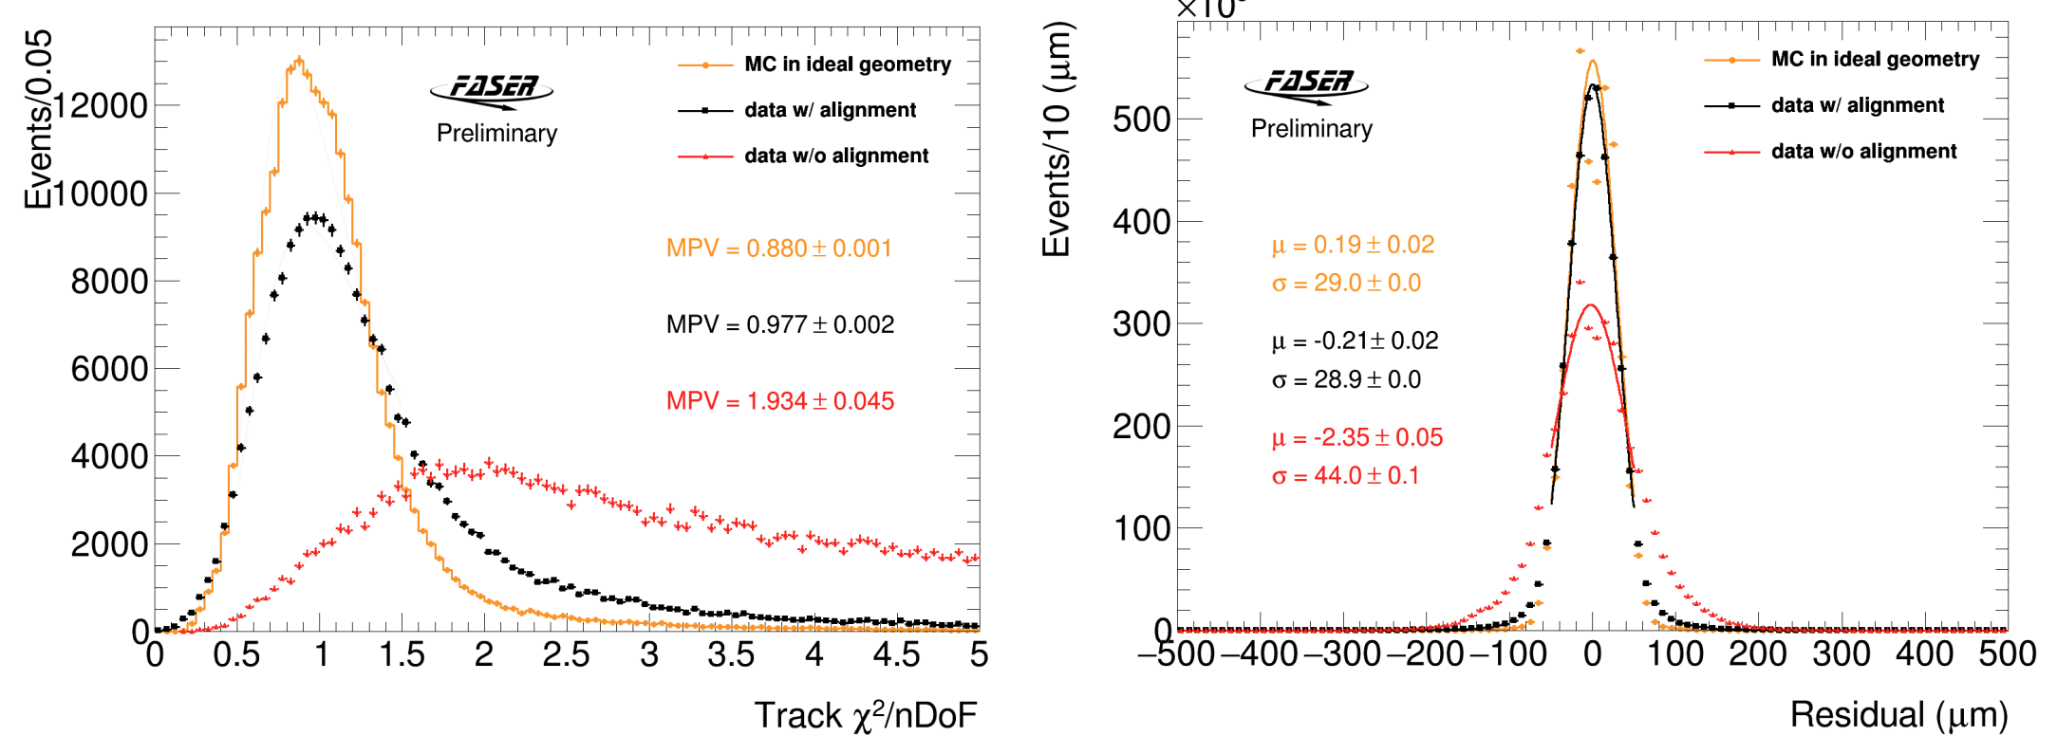
Tracker alignment
Preliminary alignment of three downstream tracker stations used in dark photon and neutrino searches

Slide 13
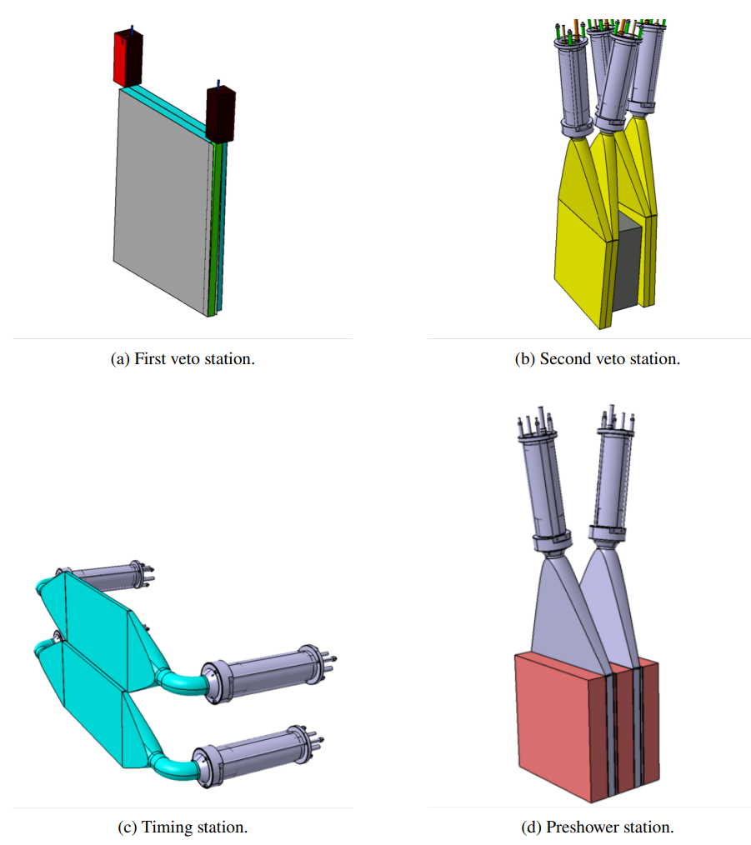
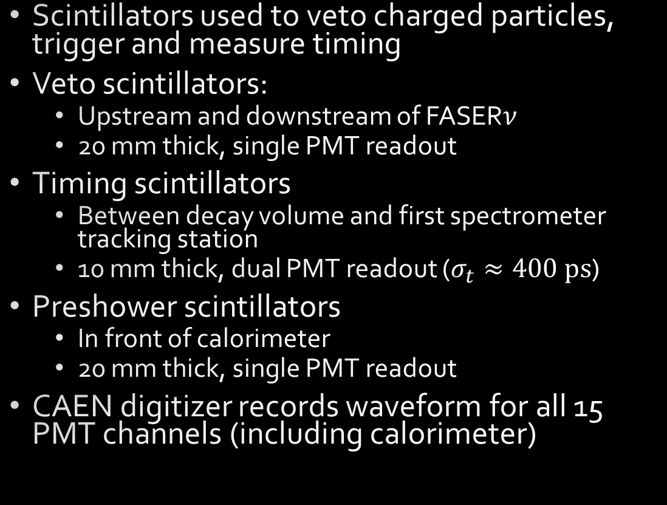
Scintillators
Scintillators used to veto charged particles, trigger and measure timing
Veto scintillators:
  Upstream and downstream of FASER$ν$
  20 mm thick, single PMT readout
Timing scintillators
  Between decay volume and first spectrometer tracking station
  10 mm thick, dual PMT readout ($σ_{t}≈400 \text{ps}$)
Preshower scintillators
  In front of calorimeter
  20 mm thick, single PMT readout
CAEN digitizer records waveform for all 15 PMT channels (including calorimeter)

Slide 14
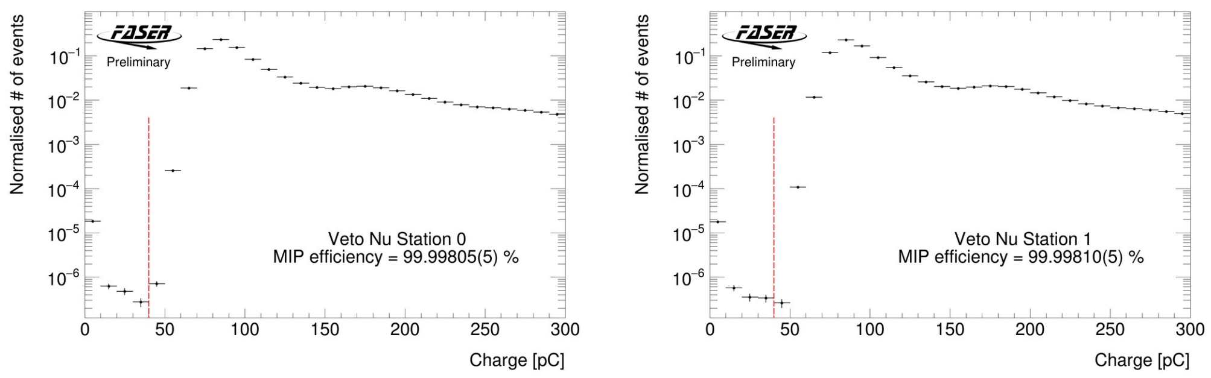
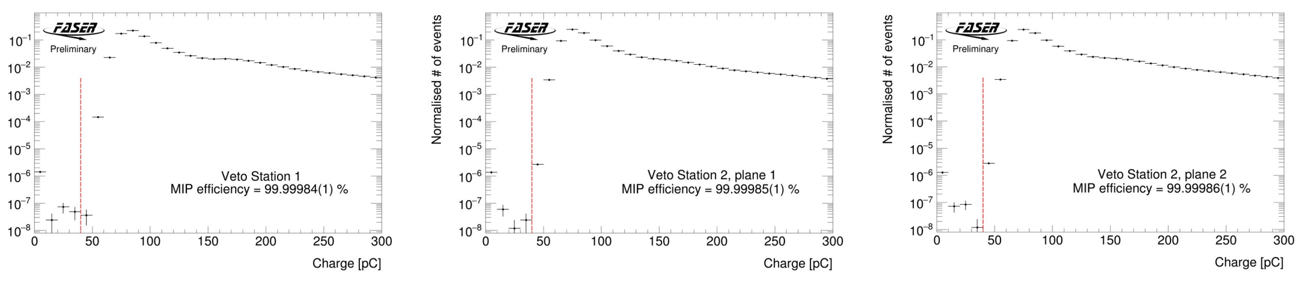
Scintillator performance
All veto scintillator inefficiencies measured to be $<2×{10}^{−5}$

Slide 15
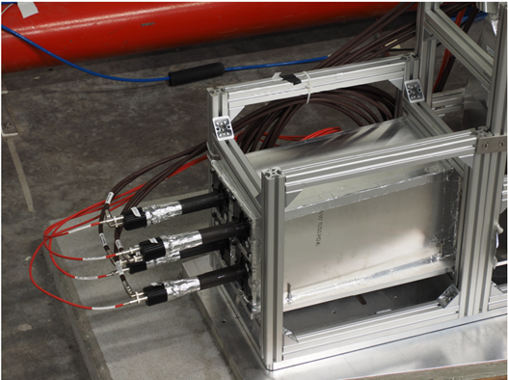
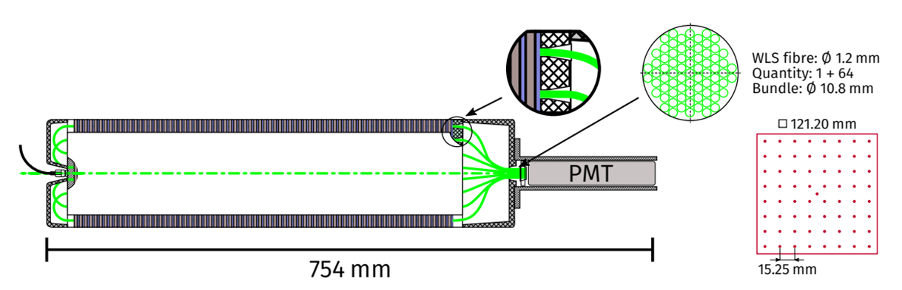
Calorimeter
4 LHCb outer ECAL modules loaned to us
  “Shashlik” design with fibers readout by PMT
  67 layers of scintillator alternating with 66 layers of tungsten
  Total depth: 25 radiation lengths

Slide 16
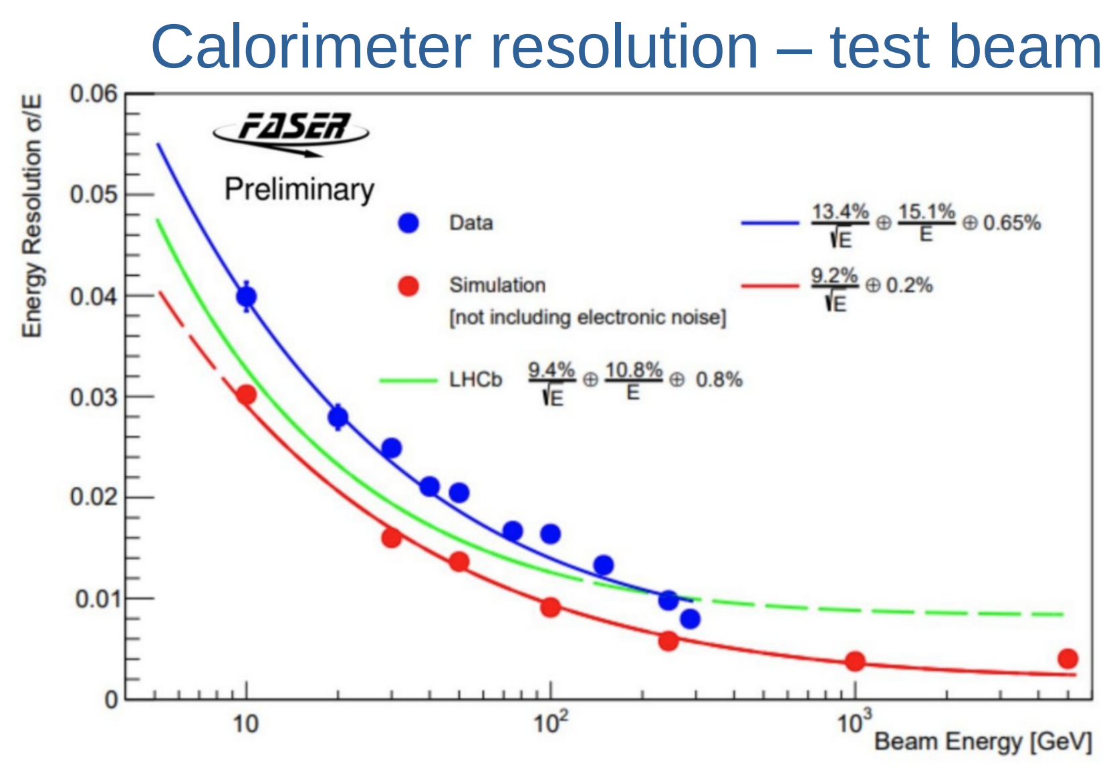
Calorimeter: energy resolution
Calorimeter response measured in dedicated 2021 test-beam campaign
  Results close to performance quoted by LHCb
Resolution ~1% or better at energies of interest in dark photon search
Test-beam paper in preparation!

Slide 17
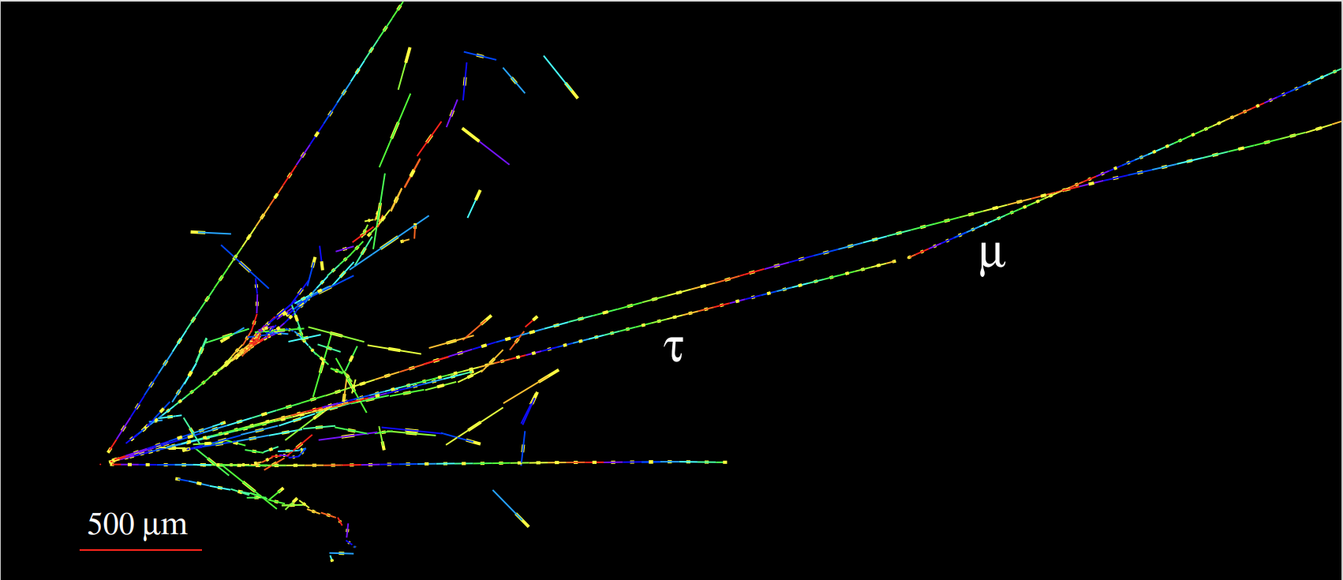


FASER$ν$
730 layers of 1.1 mm thick Tungsten plates interleaved with emulsion films
30 cm height, 25 cm width
Total mass 1.1 tons
Sub-micron spatial resolution
Replaced over course of each year’s run to limit track density
Development and scanning of films from 2022 underway
Simulated $ν_{τ}$ charged-current interaction,
and $τ→μ$ decay, in FASER$ν$
“Technical Proposal of FASERν neutrino detector,” arXiv:2001.03073

Slide 18
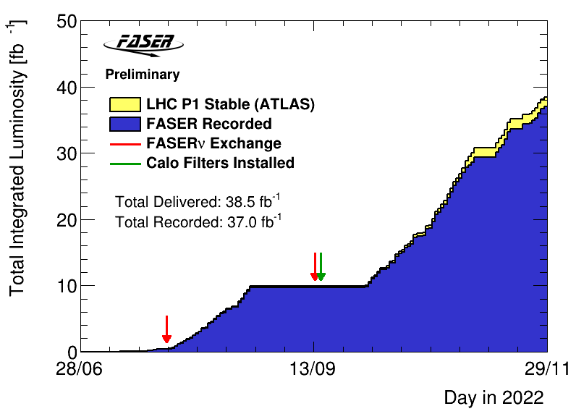
Operations and data set
Detector performed almost flawlessly in 2022
  Trigger rates up to 1.3 kHz
  DAQ deadtime: 1.3%
  Recorded 96.1% of delivered luminosity
  Over 350M single muon events
Calorimeter gain optimized for TeV energies after second emulsion exchange (green arrow)
  27.1/fb used for dark photon search

Slide 19

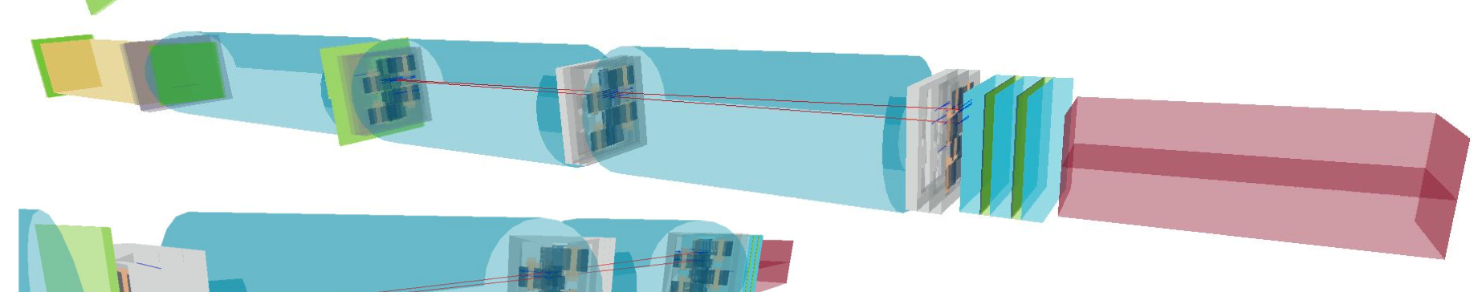
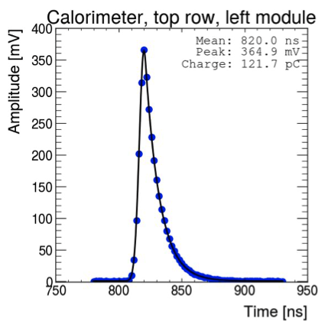

Simulated $A^{′}→e^{+}e^{−}$
Simulated A’ (m = 25 MeV, ε = 3e-5) signal with E(calo) = 645.2 GeV

Slide 20
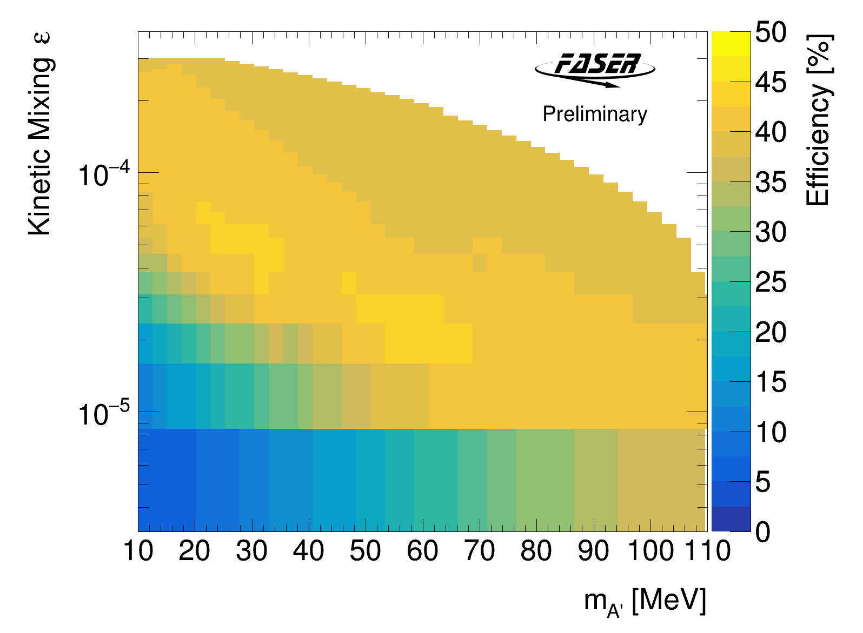
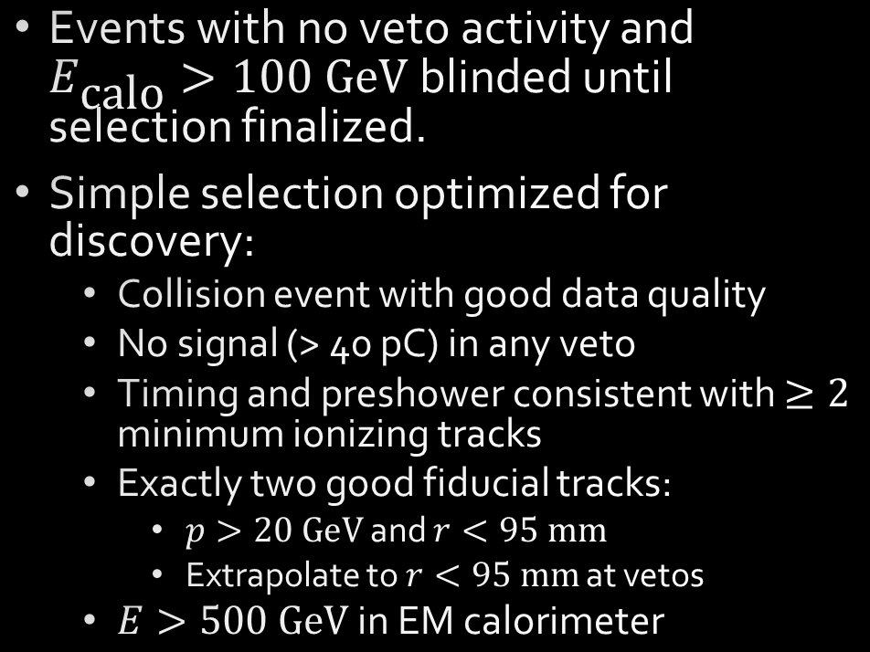
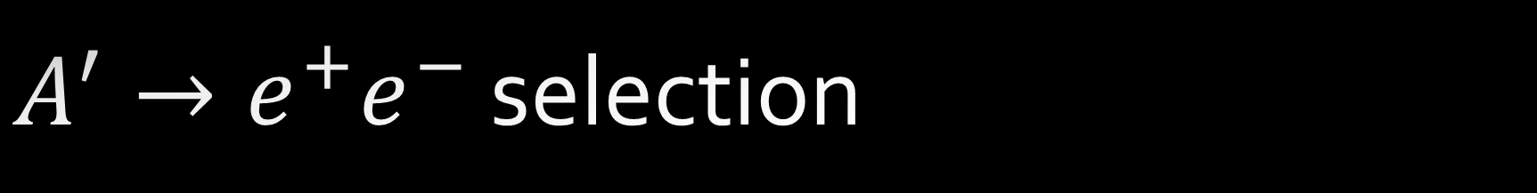
$A^{′}→e^{+}e^{−}$ selection
Events with no veto activity and $E_{\text{calo}}>100 \text{GeV}$ blinded until selection finalized.
Simple selection optimized for discovery:
  Collision event with good data quality
  No signal (> 40 pC) in any veto
  Timing and preshower consistent with $≥2$ minimum ionizing tracks
  Exactly two good fiducial tracks:
    $p>20 \text{GeV}$ and $r<95 \text{mm}$
    Extrapolate to $r<95 \text{mm}$ at vetos
  $E>500 \text{GeV}$ in EM calorimeter
Selection efficiency $∼40\%$ over region of sensitivity

Slide 21
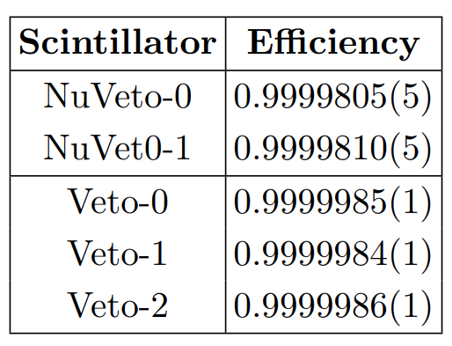
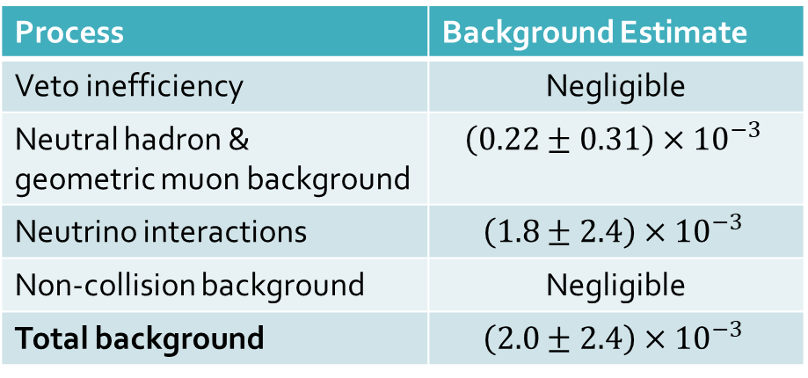
Dark photon backgrounds
Veto inefficiency
  Negligible
Muon-induced neutral hadrons
  Estimated from three-track sample, ignoring muon and removing photon conversions
Geometric muon background
  Negligible
Neutrino interactions in detector material
  Estimated from GENIE sample, corrected for material missing in simulation
  Small, but dominant background
Non-collision (cosmic or beam) background
  Negligible
Process | Background Estimate
Veto inefficiency | Negligible
Neutral hadron & geometric muon background | $$\left(0.22±0.31\right)×{10}^{−3}$$
Neutrino interactions | $$\left(1.8±2.4\right)×{10}^{−3}$$
Non-collision background | Negligible
Total background | $$\left(2.0±2.4\right)×{10}^{−3}$$
See https://cds.cern.ch/record/2853210/files/CERN-FASER-CONF-2023-001.pdf for more details and validation studies

Slide 22
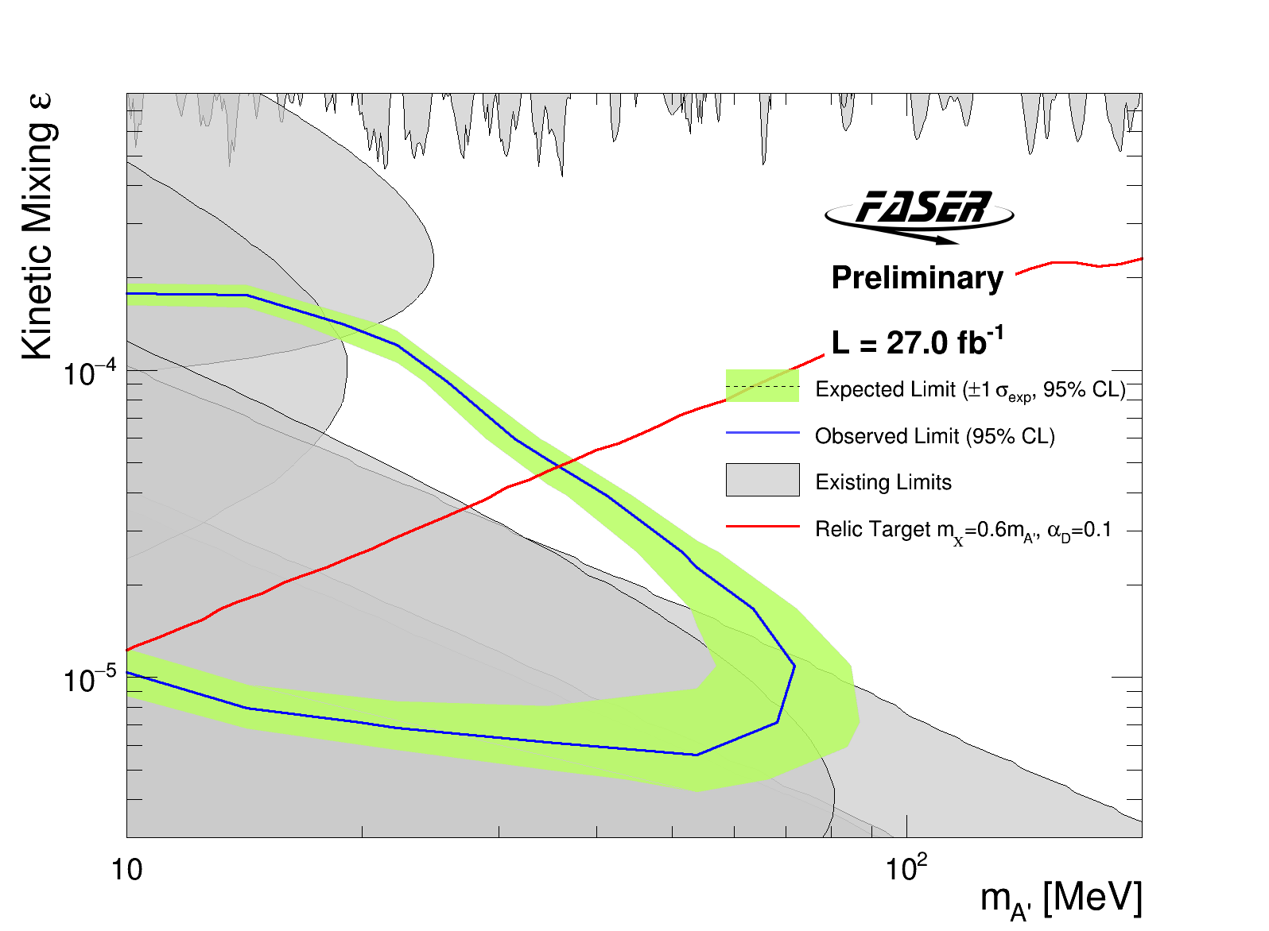
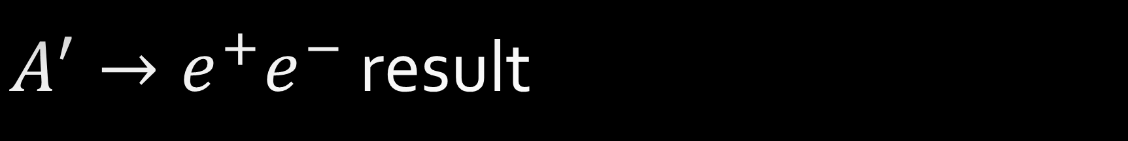
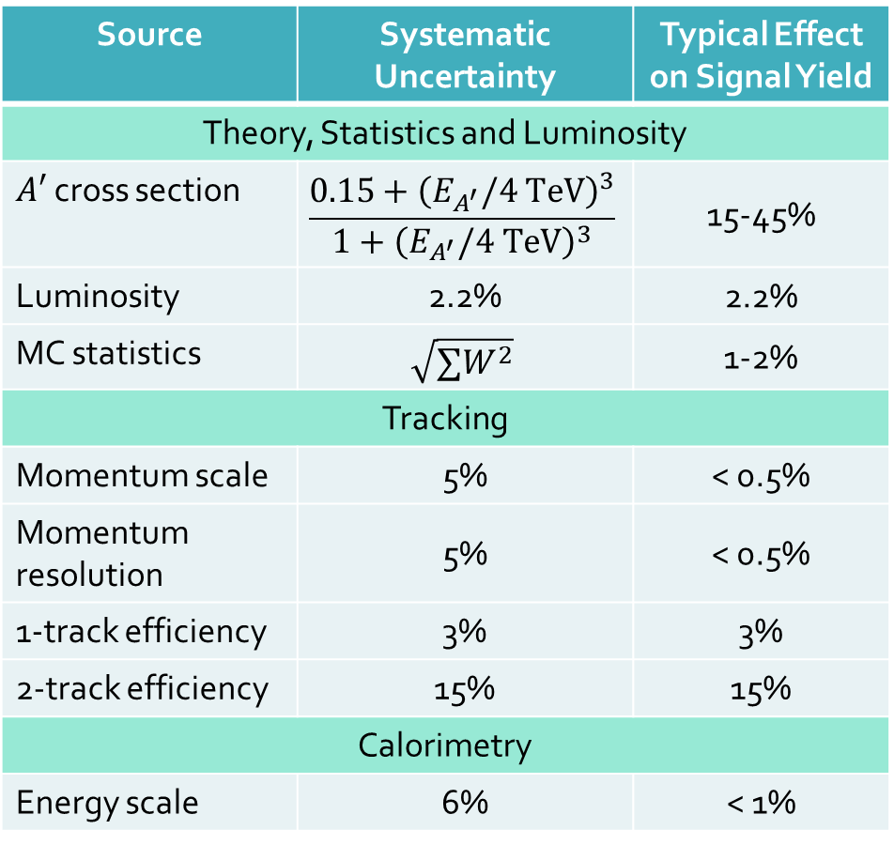
$A^{′}→e^{+}e^{−}$ result
95% CL excluded region based on 0 events passing selection
  0 events with even 1 fiducial track
Source | Systematic Uncertainty | Typical Effect on Signal Yield
Theory, Statistics and Luminosity
$A′$ cross section | $$\frac{0.15+{\left(E_{A^{′}}/4 \text{TeV}\right)}^{3}}{1+{\left(E_{A^{′}}/4 \text{TeV}\right)}^{3}}$$ | 15-45%
Luminosity | 2.2% | 2.2%
MC statistics | $$\sqrt{∑W^{2}}$$ | 1-2%
Tracking
Momentum scale | 5% | < 0.5%
Momentum resolution | 5% | < 0.5%
1-track efficiency | 3% | 3%
2-track efficiency | 15% | 15%
Calorimetry
Energy scale | 6% | < 1%

Slide 23
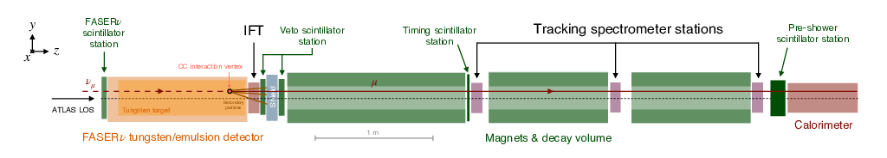

Collider neutrino search
Active electronic detector can find $ν_{μ}$ and ${\overline{ν}}_{μ}$ CC interaction signal above background:
  Long, high-momentum fiducial track
  No activity in forward veto station
  Blinded analysis (35.4/fb Run-3 luminosity used for neutrino search)

Slide 24

Expected backgrounds
Veto inefficiency
  Measured using singles rate in forward veto (only one of two layers fire)
  Negligible
Muon-induced neutral hadrons
  $n_{had}=0.11±0.06 \text{(}\text{stat}\text{)}$ estimated from simulation
  Conservative; ignores likely veto signal from parent muon
Geometric muons (leakage around veto)
  $n_{geo}=0.08±1.83 \text{(}\text{stat}\text{)}$ extrapolated from side-band
Please see https://arxiv.org/pdf/2303.14185.pdf for details

Slide 25
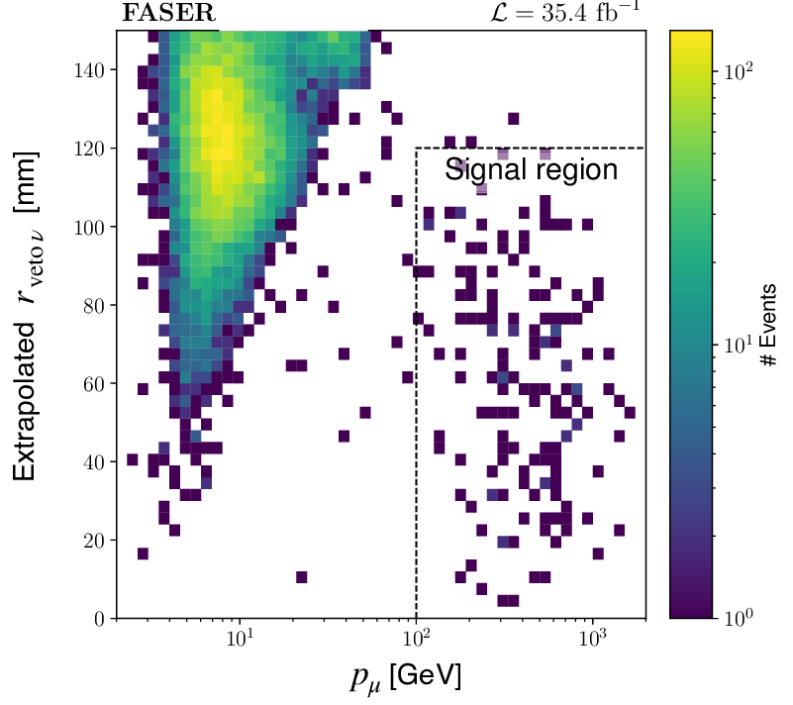

Collider neutrinos: results
${153}_{−13}^{+12}$ neutrino-like events observed over backgrounds
“No signal” hypothesis excluded at $16 σ$
No attempt to measure cross section, but luminosity-normalized prediction agrees well with data.

Slide 26
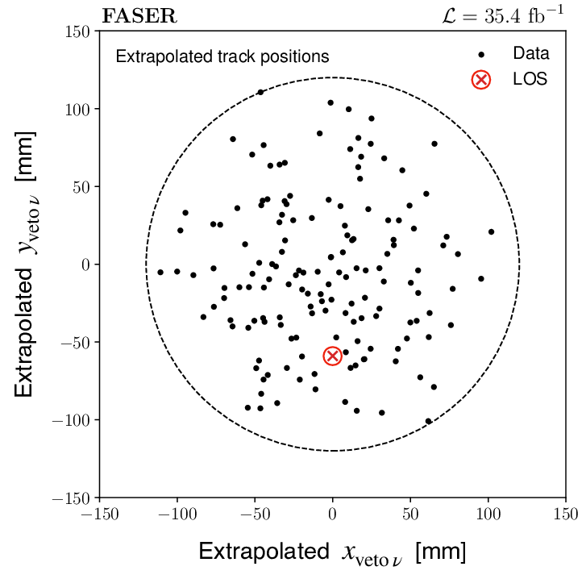
Collider neutrinos: extrapolation
Extrapolate candidate charged tracks to front veto position
  Uniform distribution not expected due to tighter cuts downstream
No evidence of entering contamination near edges

Slide 27
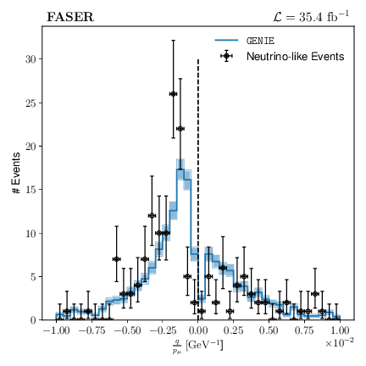


Collider neutrinos: $q/p$
Clear evidence of both $ν_{μ}$ and ${\overline{ν}}_{μ}$interactions with $E_{v}>300 \text{GeV}$
Luminosity-normalized prediction from GENIE and F. Kling fluxes

Slide 28
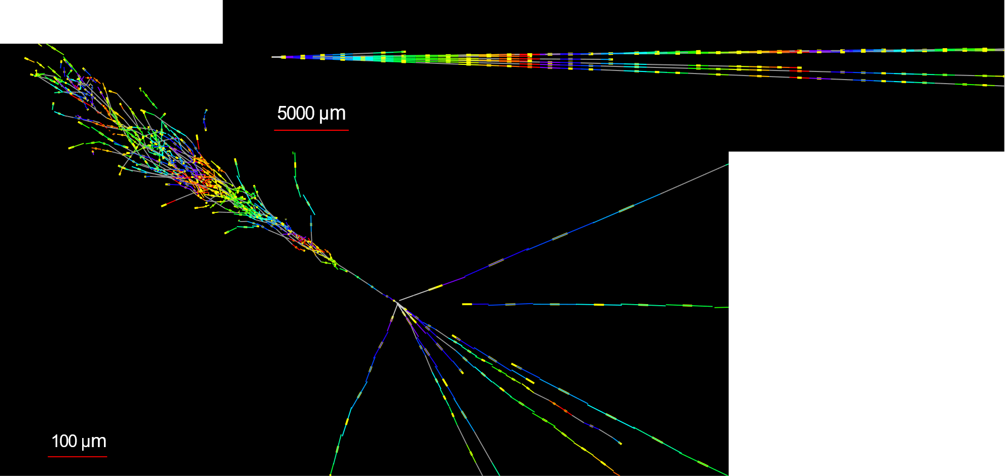


Teaser: $ν_{e}$ candidate in FASER$ν$
Side view
FASER$ν$ analysis in progress
This event very $ν_{e}$-like
  Single track for $2 X_{0}$
  Shower max at $7.8 X_{0}$
  $θ_{e}=11 \text{mrad}$ from beam
  $φ_{e}−φ_{\text{others}}=175°$
Beam view

Slide 29


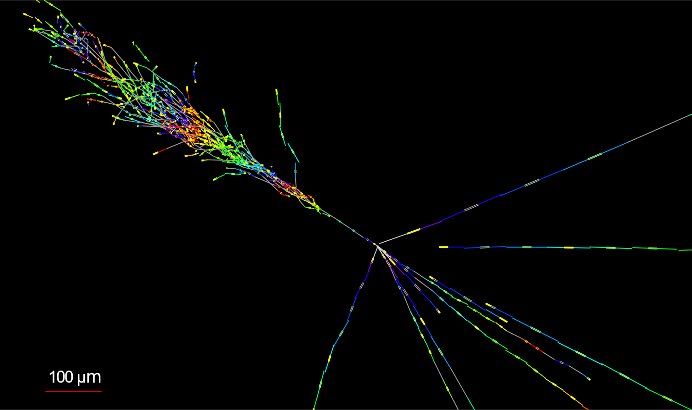
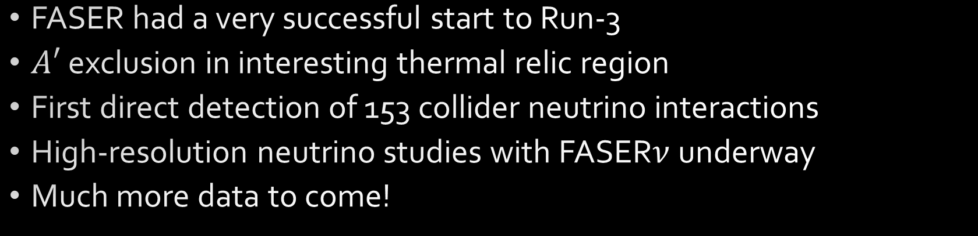
FASER Summary
FASER had a very successful start to Run-3
$A′$ exclusion in interesting thermal relic region
First direct detection of 153 collider neutrino interactions
High-resolution neutrino studies with FASER$ν$ underway
Much more data to come!

Slide 30



Acknowledgements
Financial support for FASER comes from:
We also thank:
  LHC for successful 2022 run
  ATLAS for accurate luminosity data
  ATLAS SCT for donated tracker modules
  ATLAS for Athena software framework
  LHCb for donated ECAL modules
  CERN FLUKA team for simulations
  CERN PBC and technical infrastructure teams for excellent support during design, construction and installation

Slide 31
FASER publications
The FASER Detector: arXiv:2207.11427
The FASER W-Si High Precision Preshower Technical Proposal: CERN Document Server
The tracking detector of the FASER experiment: NIM 166825 (2022)
The trigger and data acquisition system of the FASER experiment: JINST 16 P12028 (2021)
First neutrino interaction candidates at the LHC: PRD 104 L091101 (2021)
Technical Proposal of FASERν neutrino detector: arXiv:2001.03073
Detecting and Studying High-Energy Collider Neutrinos with FASER at the LHC: EPJC 80, 61 (2020)
Input to the European Strategy for Particle Physics Update: arXiv:1901.04468
FASER's Physics Reach for Long-Lived Particles: PRD 99 090511 (2019)
Letter of Intent: arXiv:1812.09139
Technical Proposal: arXiv:1811.10243

Slide 32
Backup
Supplemental material

Slide 33
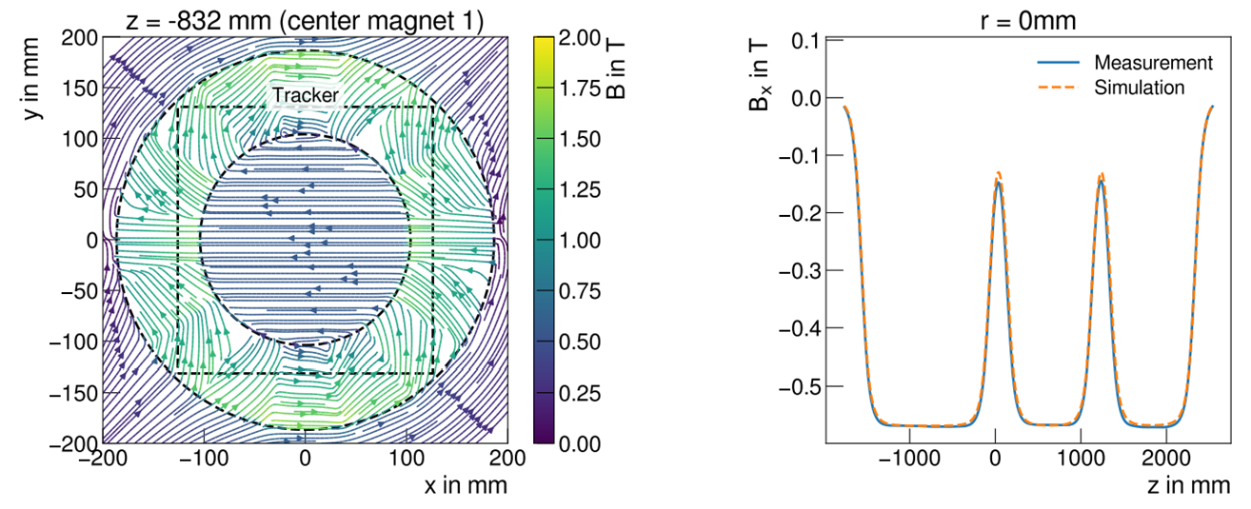

Magnets
Three permanent magnets with “Halbach” design produce very uniform dipole field of 0.57 T
The most expensive part of the experiment!
Jackson

Slide 34

Trigger and Data acquisition
Based on open-source DAQling framework
Automated, continuous data-taking
  No control room or dedicated shift-takers
Trigger rates up to 1.3 kHz
  Inputs from scintillators and calorimeter (CAEN digitizer)
DAQ deadtime in 2022 run: 1.3%
Event size: 21.5 kB, dominated by PMT waveform data
“The trigger and data acquisition system of the FASER experiment,” JINST 16 P12028 (2021)

Slide 35

Offline software
Adapted open-source Gaudi/Athena framework to FASER
  “Calypso”
  No time/person-power to build our own from scratch
Use native ATLAS/LHCb geometry descriptions for SCT/Calorimeter modules, respectively
ACTS track reconstruction in production before ATLAS…
FASER tracker frame, as constructed and rendered in
Calypso/Athena

Slide 36

A muon traversing FASER

Slide 37





$A^{′}→e^{+}e^{−}$ cut flow: calorimeter energy

Slide 38

FASER and NA-62 result from Moriond

Slide 39



Collider Neutrinos: Pilot search
Copious meson production makes the LHC an intense source of the world’s highest energy man-made neutrinos
  De Rujula and Ruckl (1984)
First search using 29 kg emulsion detector in 2018
  12.2/fb at 13 TeV CMS energy
  2.7 $σ$ excess of neutrino-like neutral vertices
FASER$ν$ emulsion detector will study in detail with Run-3 data
“First neutrino interaction candidates at the LHC,” PRD 104 L091101 (2021)

Slide 40

Forward Physics Facility for HL-LHC
FPF slide credits:
April 12 P5 report
by Jonathan Feng
FPF Website
FPF Whitepaper:
arXiv: 2203:05090

Slide 41

Forward Physics Facility for HL-LHC

Slide 42

FASER2 working design
Looking for
additional U.S.
groups interested
in FASER2!
6th Forward
Physics Facility
Meeting:
CERN, June 8-9

Slide 43



