Slide 1
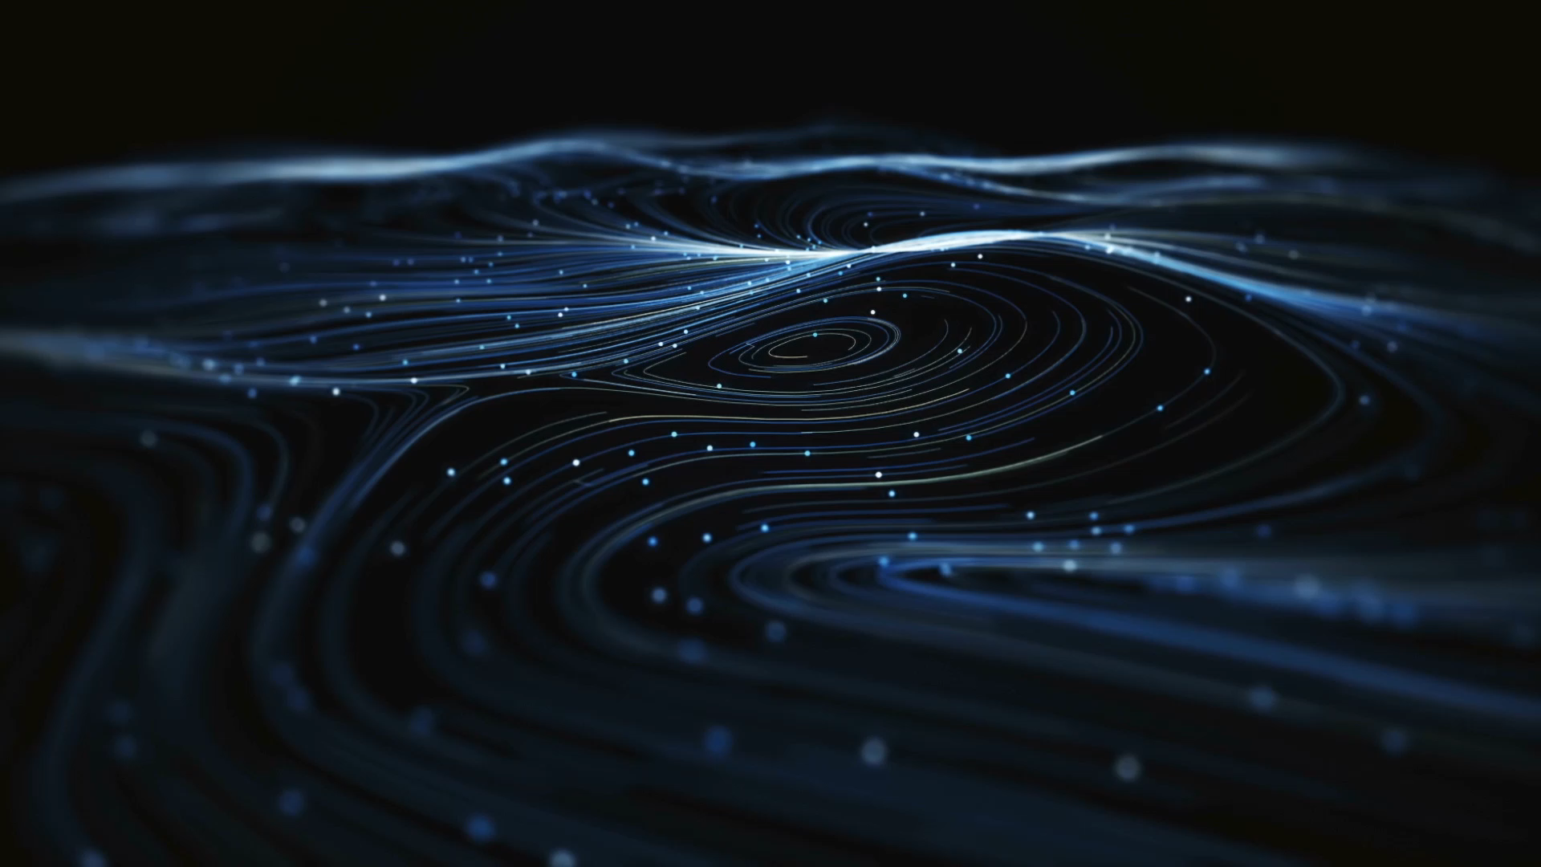
An SZ-Like Effect on Stochastic
Gravitational Wave Backgrounds
Particles, Strings, and Cosmology Conference
Marcell Howard
University of Pittsburgh
Co-authors: Morgane Konig, Tatsuya Daniel
arxiv: 2307.xxxxx

Slide 2


Co-authors

Slide 3
Outline
Background and motivation
Assumptions and derivation
Results
Conclusions

Slide 4
Stochastic Gravitational Wave Backgrounds
Gravitational wave signals from unresolvable sources
Astrophysical and Cosmological
Many different potential sources for both:
  Inflation, phase transitions, and many more

Slide 5
Why Primordial Gravitational Waves Are Interesting
Gravitons decouple early
Large optical depth
(Some) inflation models can be constrained by LISA

Slide 6
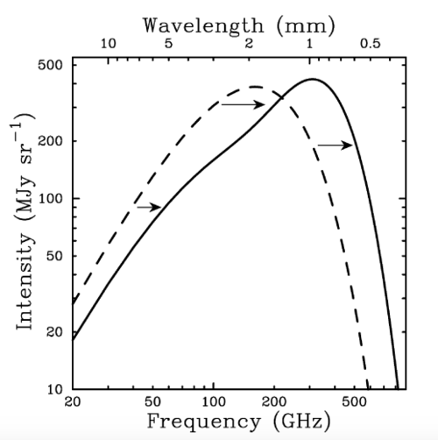
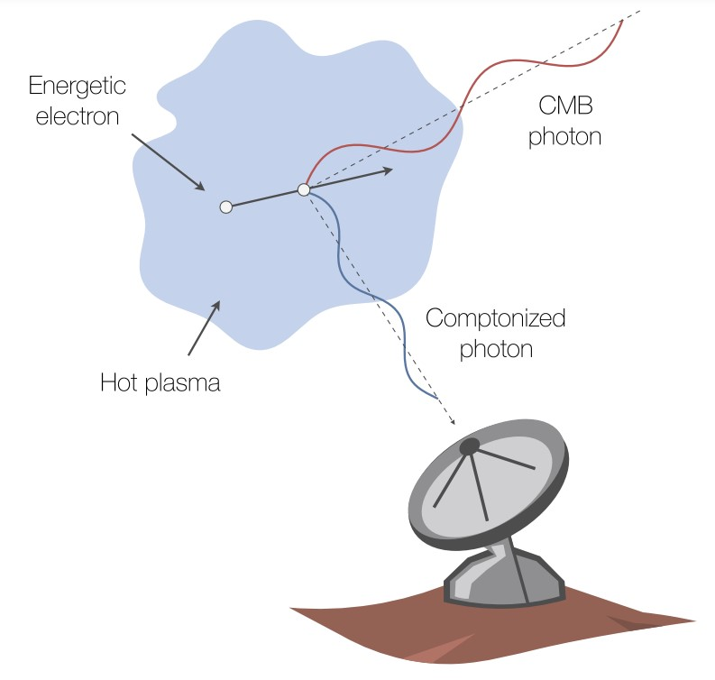
The Sunyaev-Zeldovich Effect
Carlstrom et al. 2002
Mroczkowski et al. 2019

Slide 7
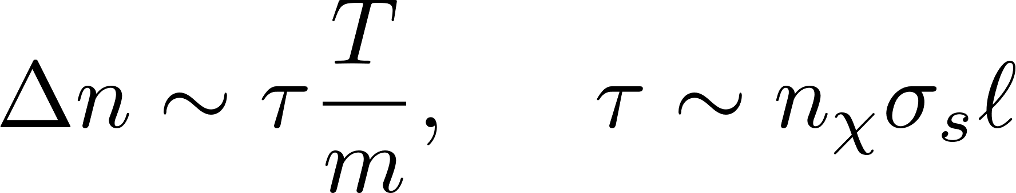
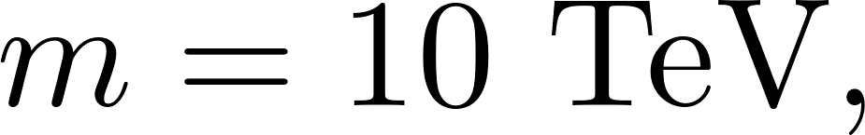
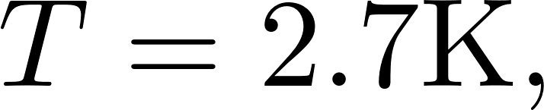
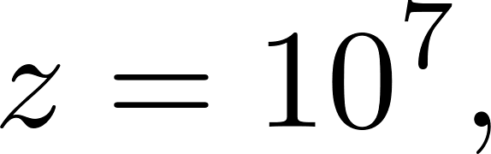
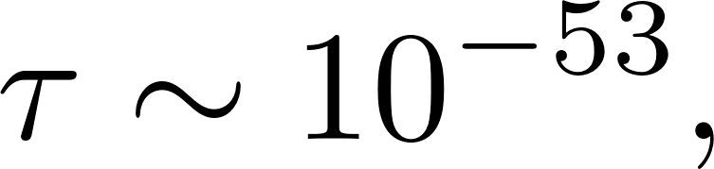
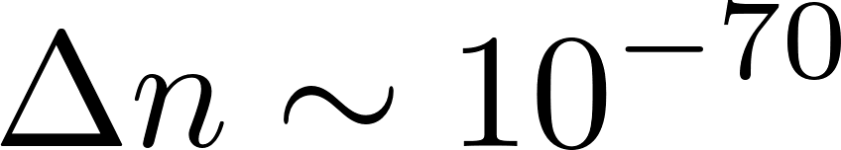
Order of Magnitude/Back of Envelope Estimate
Very tiny effect!
For
We are more interested in the formalism here

Slide 8
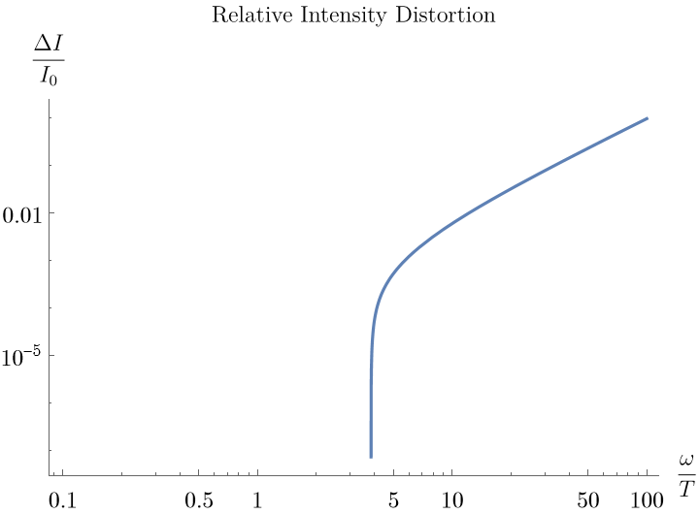
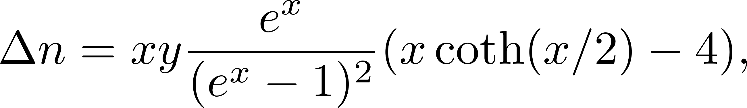
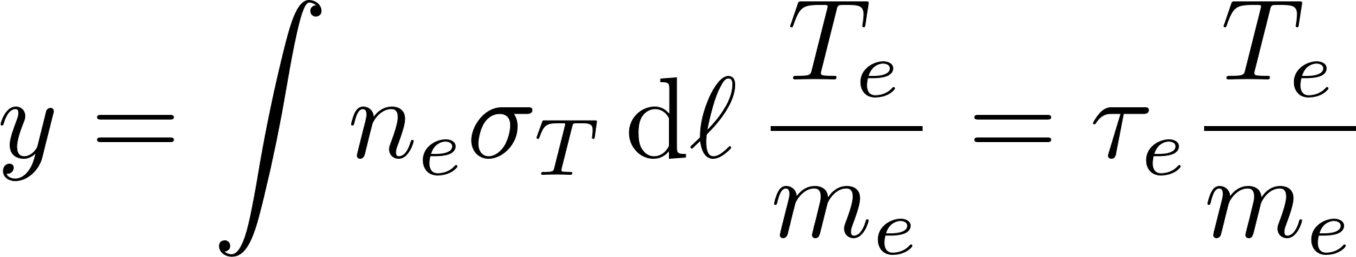
Kompaneets Equation

Slide 9

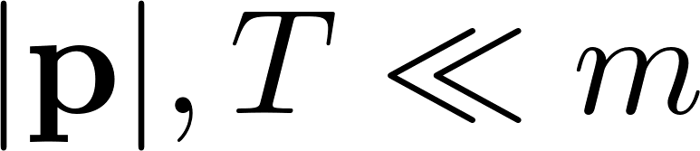
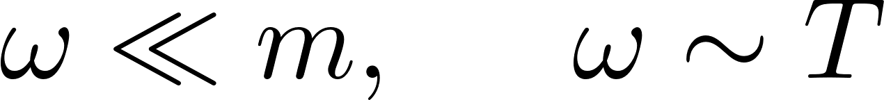
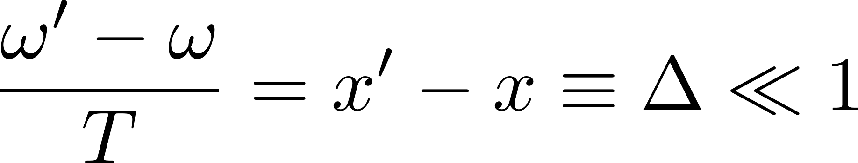
BSM Candidate and Graviton Assumptions
Minimal coupling to gravity
Thermal equilibrium at temperature,
Non-relativistic
Soft gravitons
Small energy shift

Slide 10
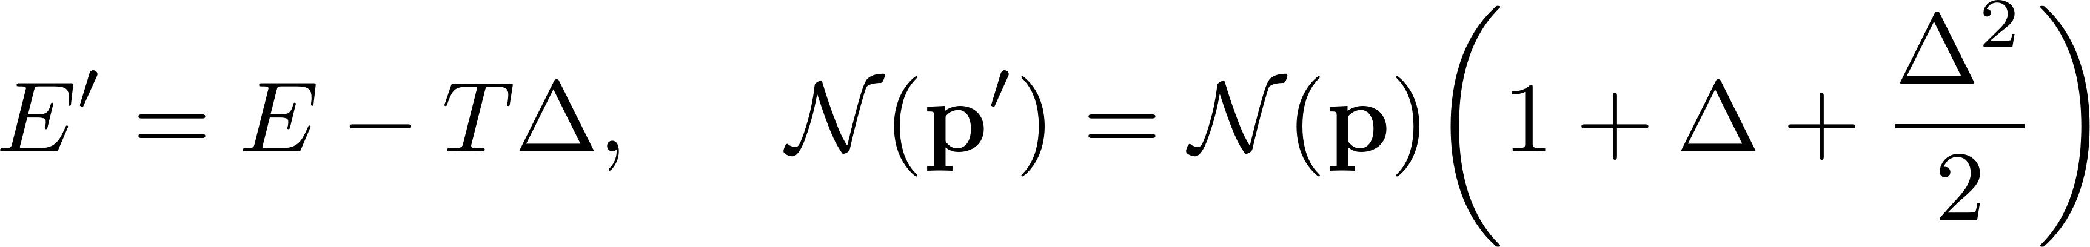
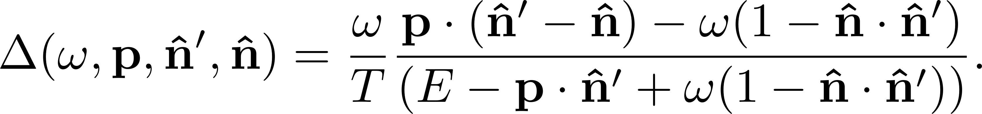
Boltzmann-Master Equation

Slide 11
Gravitational Kompaneets Equation

Slide 12
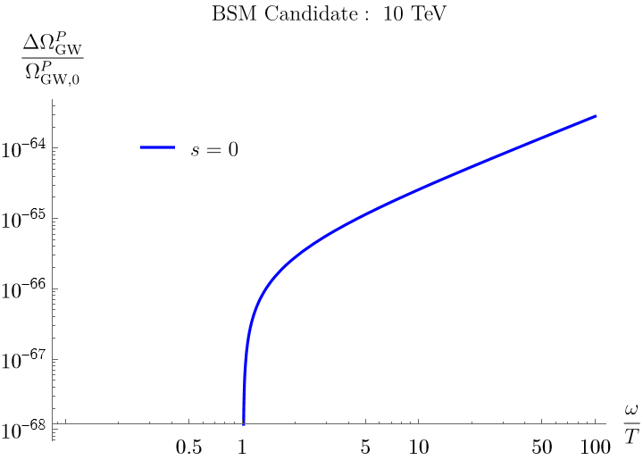
(Preliminary) Results

Slide 13
Future Work
BSM Thermal Equilibrium
  Add spin-1 (finished this morning!)
  Higher spin
Non-Thermal Candidates
  Primordial Black Holes

Slide 14
Summary and Conclusions
An analogous SZ signal is present in the cosmic gravitational wave background
Particles of various masses, spins can leave distinguishable imprints
SZ signal scales with mass but is redshift dependent

Slide 15

Thank You
Marcell Howard
mah455@pitt.edu

Slide 16
References
J.E. Carlstrom, G.P. Holder and E.D. Reese, Cosmology with the Sunyaev-Zel’dovich effect, Annual Review of Astronomy and Astrophysics 40 (2002) 643.
T Mrockowski et al., Astrophysics with the Spatially and Spectrally Resolved Sunyaev-Zeldovich Effects: A Millimetre/Submillimetre Probe of the Warm and Hot Universe, Space Science Reviews 215 (2018) 1.

Slide 17
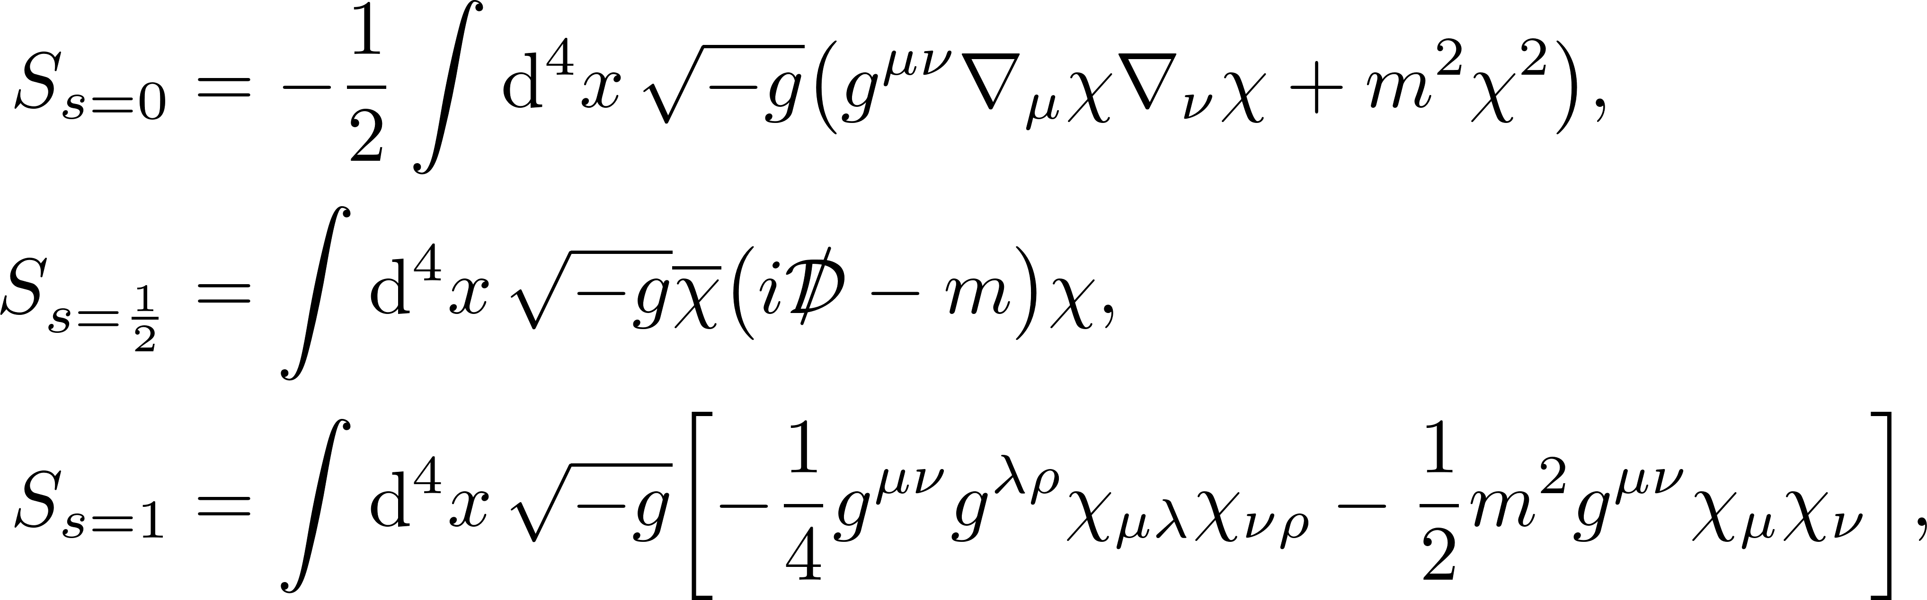
Backup Slide: Minimal Gravitational Couplings

Slide 18
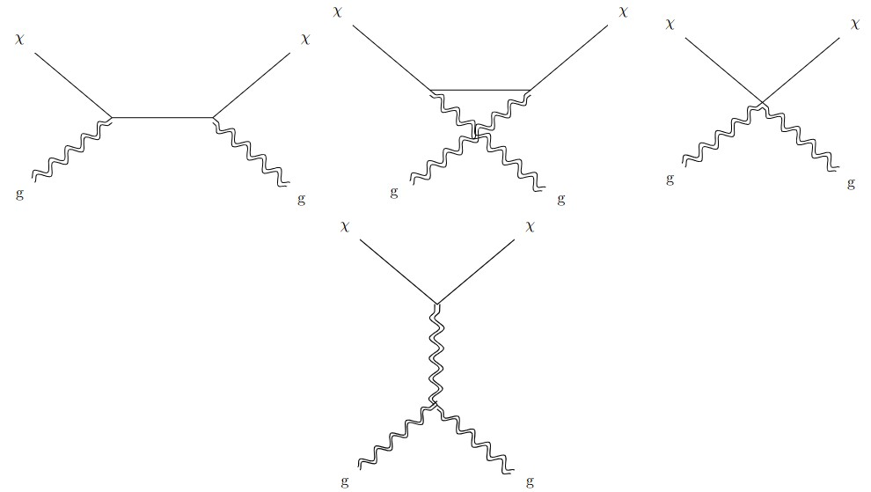
Feynman Diagrams

Slide 19
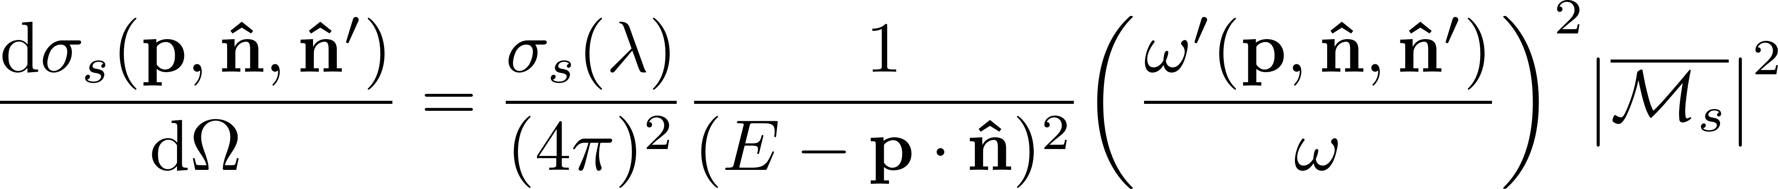
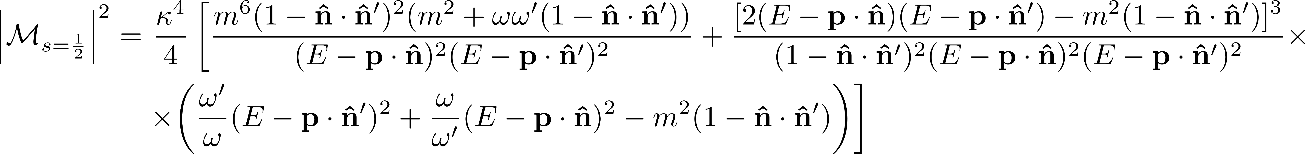
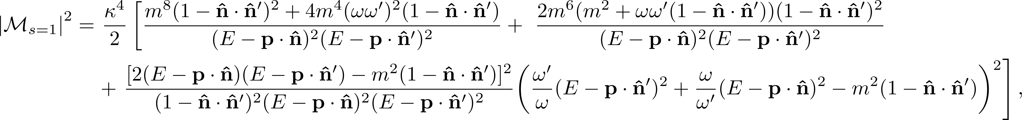
Backup Slide: Gravitational Compton Amplitude and Cross Section

Slide 20
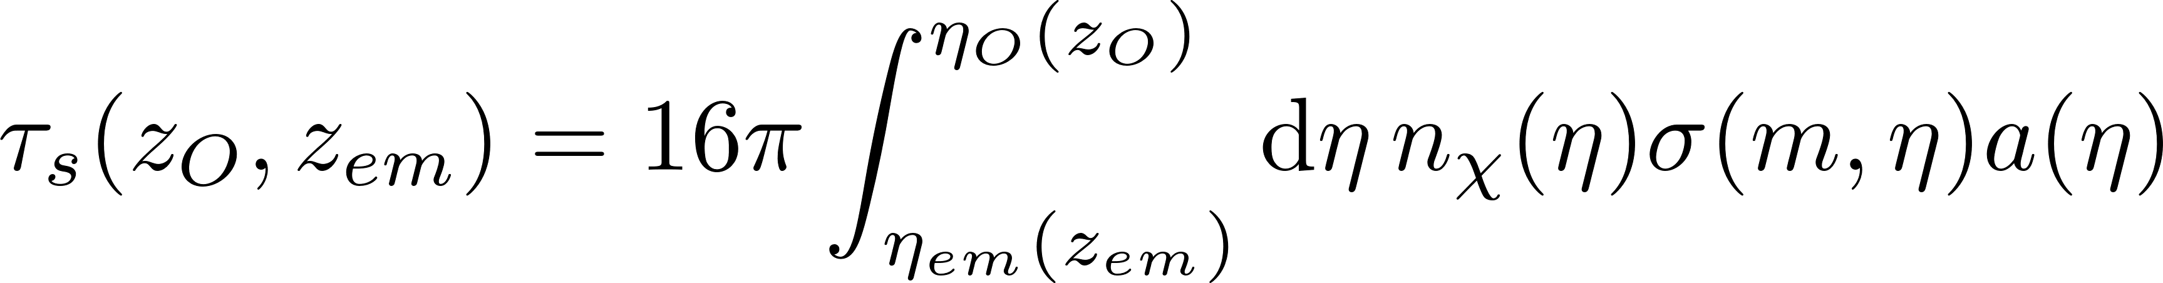
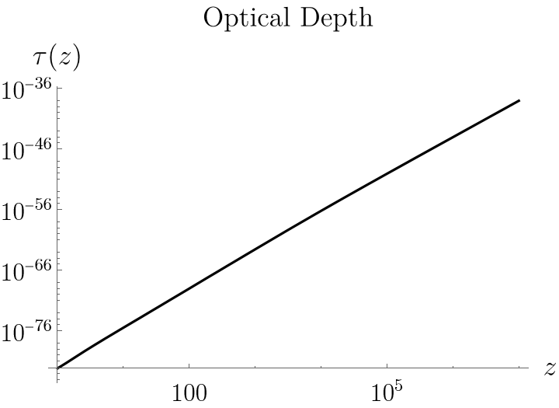
Backup Slide: Optical Depth

Slide 21
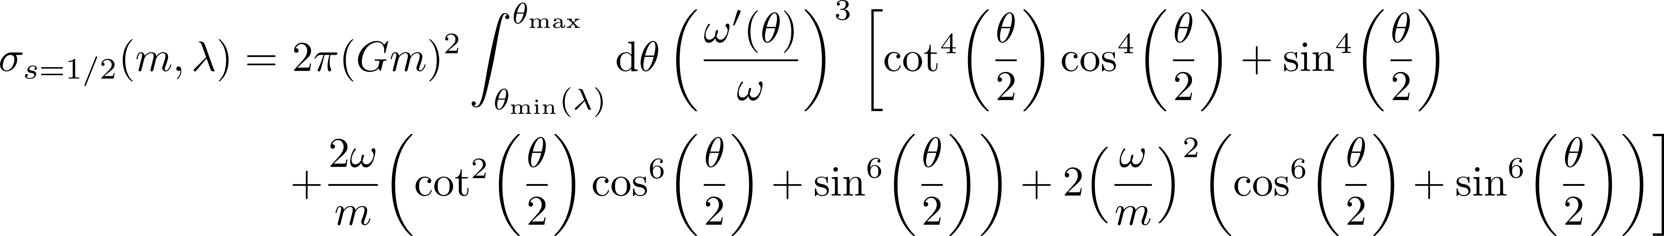
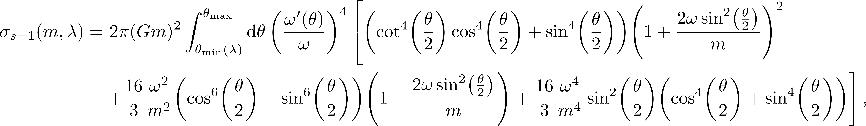
Backup Slide: Gravitational Compton Cross Section Cont.

Slide 22
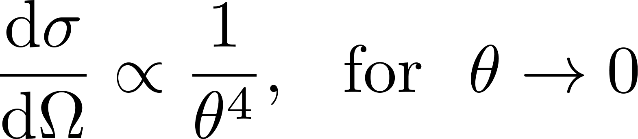
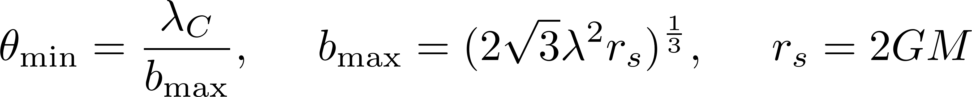
Infrared Divergence of Low Energy Coulomb Scattering
The cross section has an infrared divergence due to Coulomb scattering:
Introduce a cutoff at Geometric Optics limit:

