Slide 1

Electroweak Dumbbells and their dynamics
Teerthal Patel
PASCOS 2023
UC Irvine
Notes:
1

Slide 2

Background
EW Monopoles & Strings
G. ’t Hooft, Nucl. Phys. B 79, 276 (1974).
A. M. Polyakov, JETP Lett. 20, 194 (1974).
Monopoles in the SO(3) Higgs model
String solution in Abelian Higgs model
H. B. Nielsen and P. Olesen, Nucl. Phys. B 61, 45 (1973)
Y. Nambu, Nucl. Phys. B 130, 505 (1977).
Physical SU(2)xU(1) model
Background

Slide 3
Our work
Distribution of monopole-antimonopole pairs.
Static configurations of electroweak dumbbells
Ongoing
Dynamics of rotating electroweak dumbbells
Cosmological magnetogenesis from EWPT
T.P & T.V, JHEP, 2022(1), pp.1-14. (arXiv:210805357)
T.P & T.V, PRD 107.9 (2023): 093010 (arXiv:2303.04886)

Slide 4
Our work
Kibble
Mechanism
EWPT
Magnetogenesis
+
MHD
T.P & T.V, JHEP, 2022(1), pp.1-14.
arXiv:210805357
Static configuration of
Electroweak dumbbell
Dumbbell dynamics
T.P & T.V, PRD 107.9 (2023): 093010
arXiv:2303.04886

Slide 5
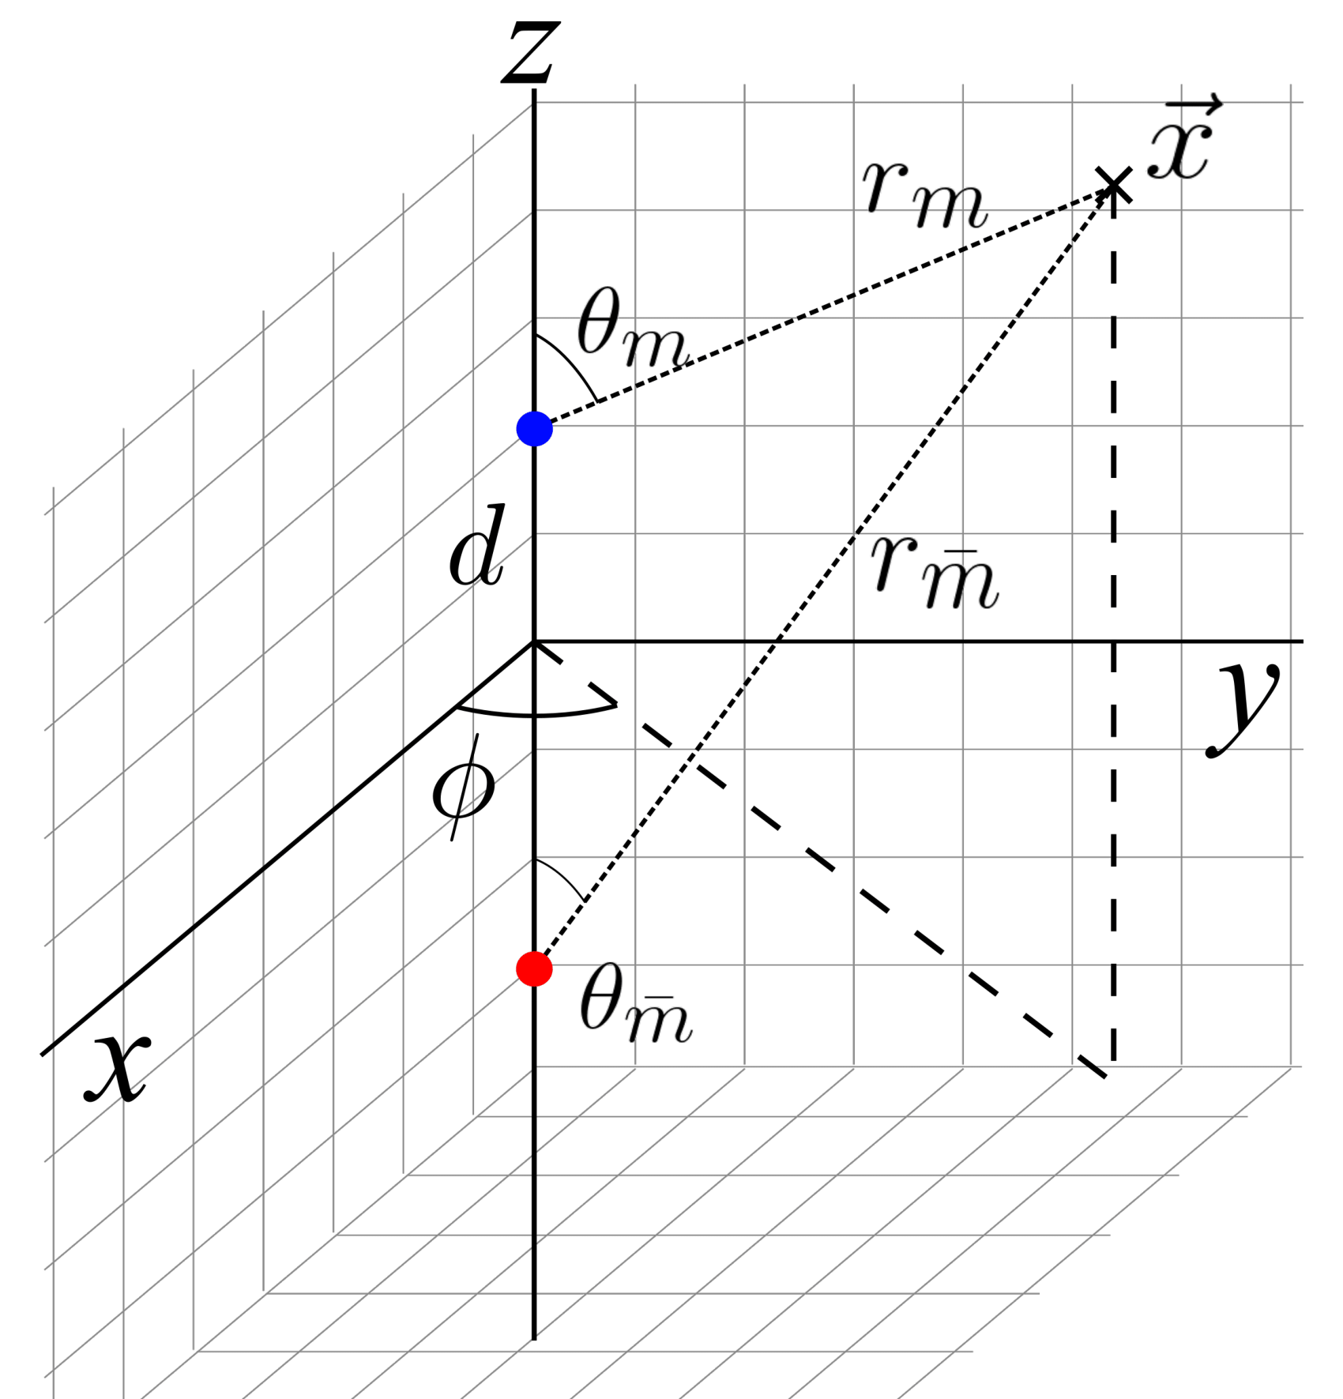
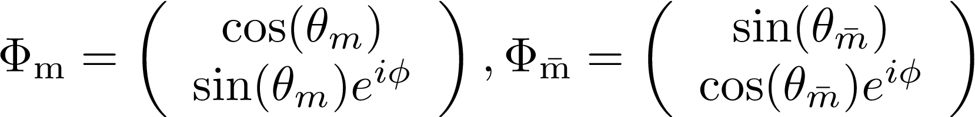

Static Configuration
Monopole
Antimonopole
Y. Nambu, Nucl. Phys. B 130, 505 (1977).
Monopole-Antimonopole Configuration
Novel Parameter: Twist
Vachaspati, T. and Field, G.B., 1994.
Electroweak string configurations with baryon number. Physical review letters, 73(3), p.373.
Static Configuration: Setup
5
Notes:
5

Slide 6
Static Configuration
The Higgs Configuration profile
: Monopole profile
: String profile
Bosonic EW Lagrangian
Fix Higgs configuration throughout
Use guess initial profiles
Use numerical relaxation
Static Configuration : Setup
6
Notes:
6

Slide 7
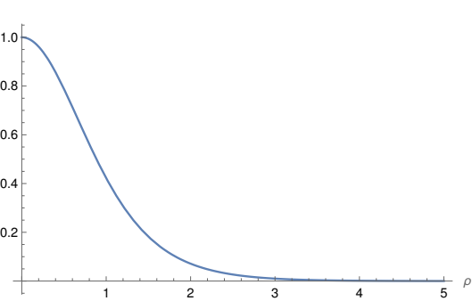

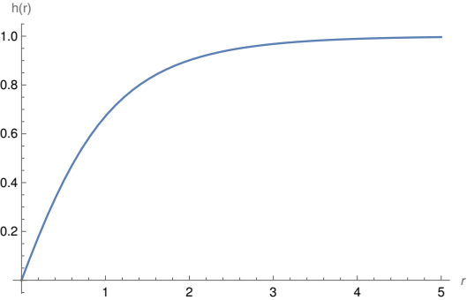

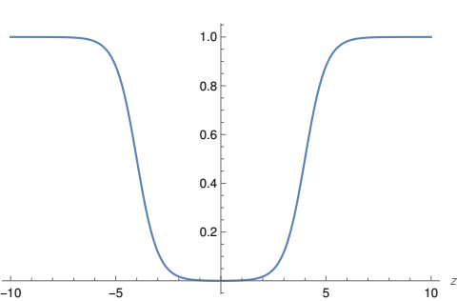

Initial Guess Profiles
String profile
Neilsen-Olesen infinite string profile
Cylindrical profile
‘t Hooft-Polyakov monopole radial profile
z-cutoff
Static Configuration : Initial Guess
7

Slide 8
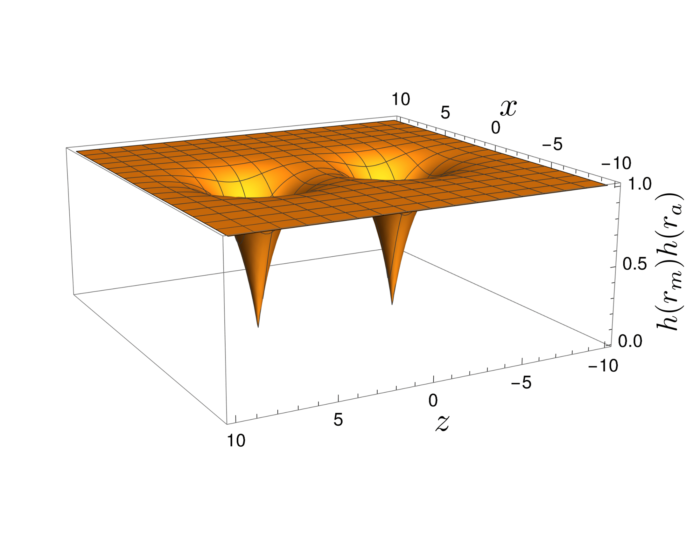
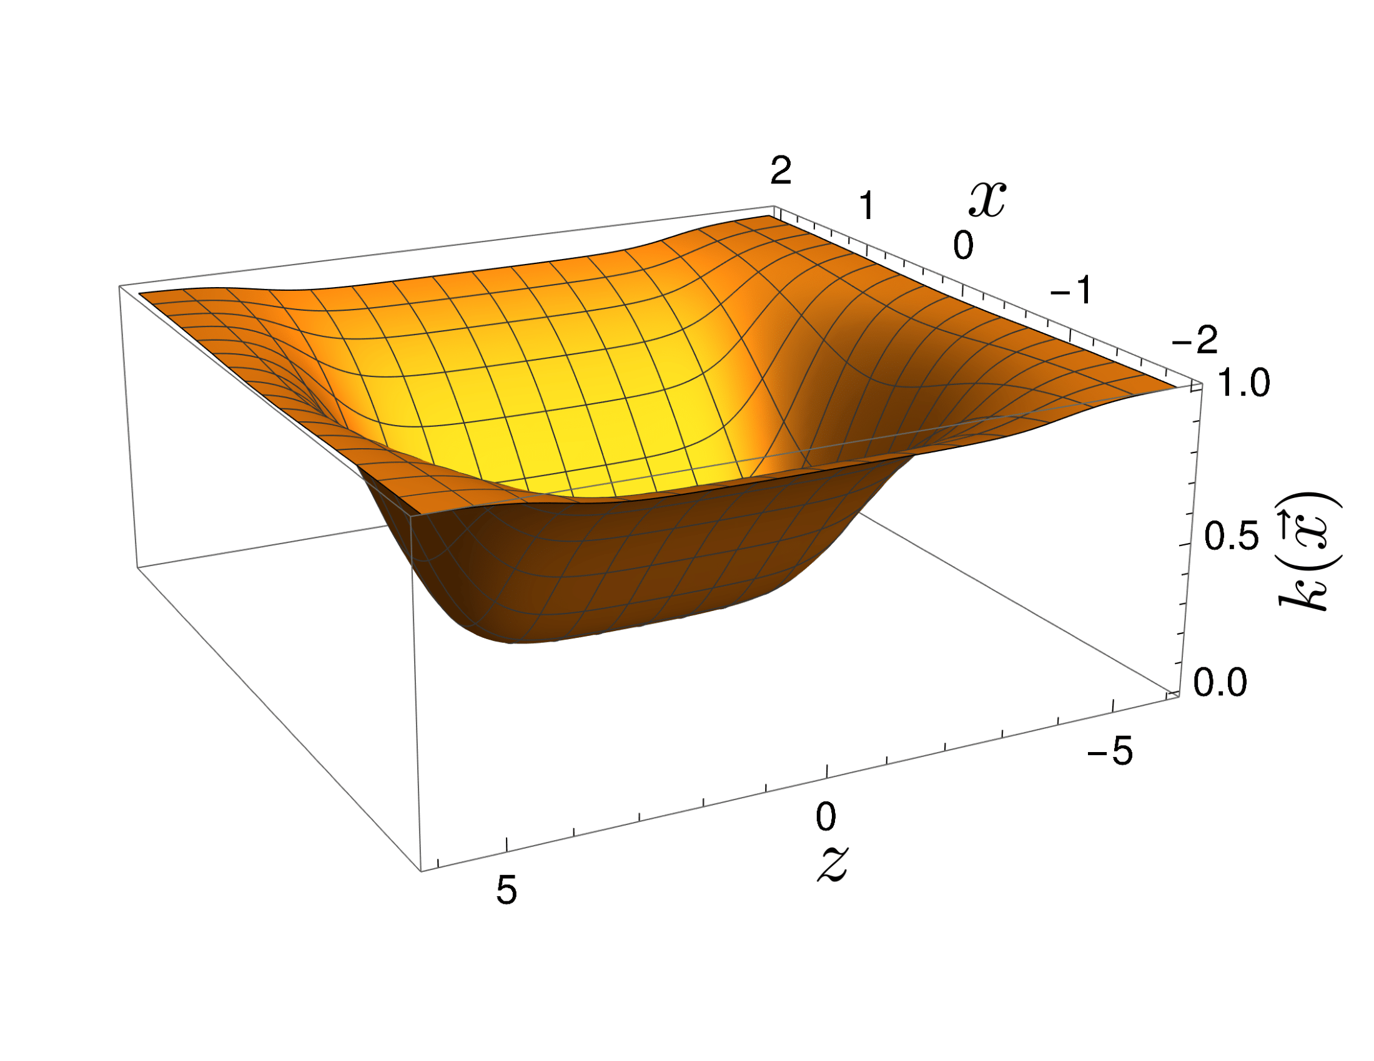

Initial Guess profile
String profile
Monopole-Antimonopole profile
Static Configuration : Initial Guess
8
Notes:
8

Slide 9
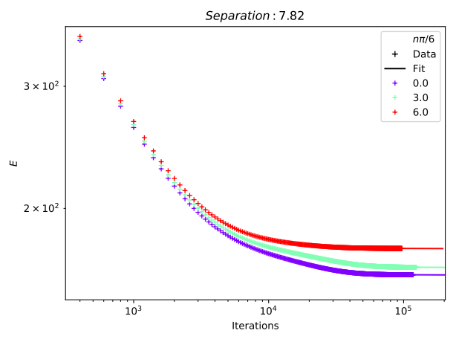
Numerical Relaxation
Numerical Relaxation
9

Slide 10

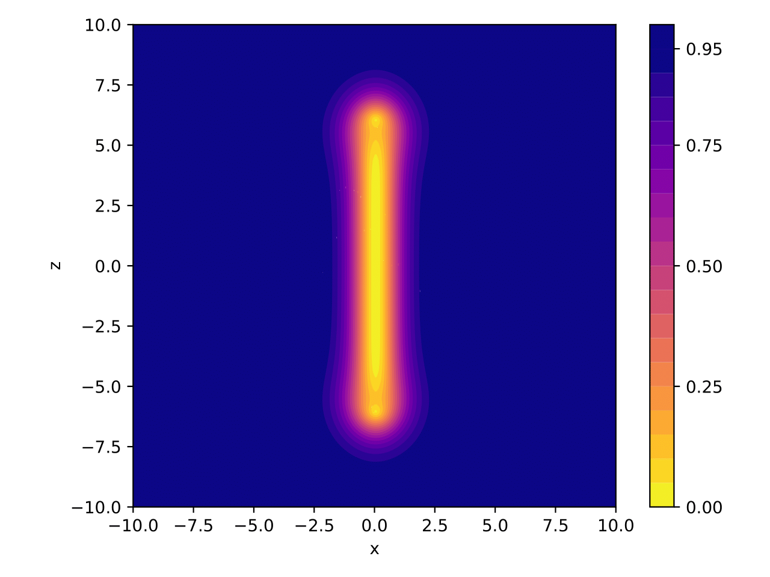
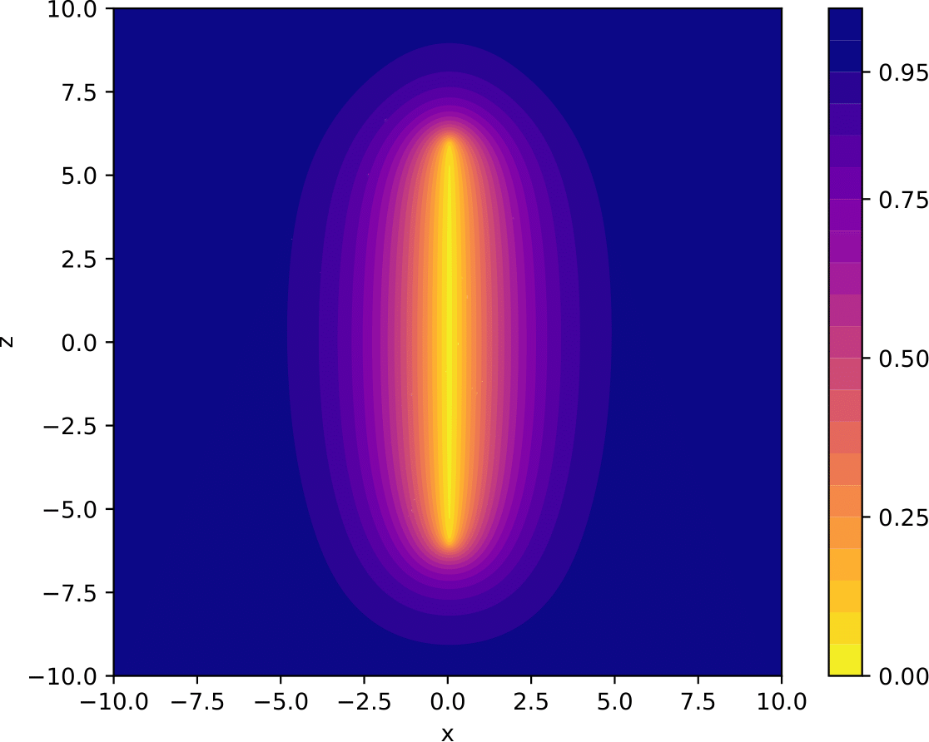
Results
Initial Guess
Relaxed
Numerical Relaxation : Results

Slide 11
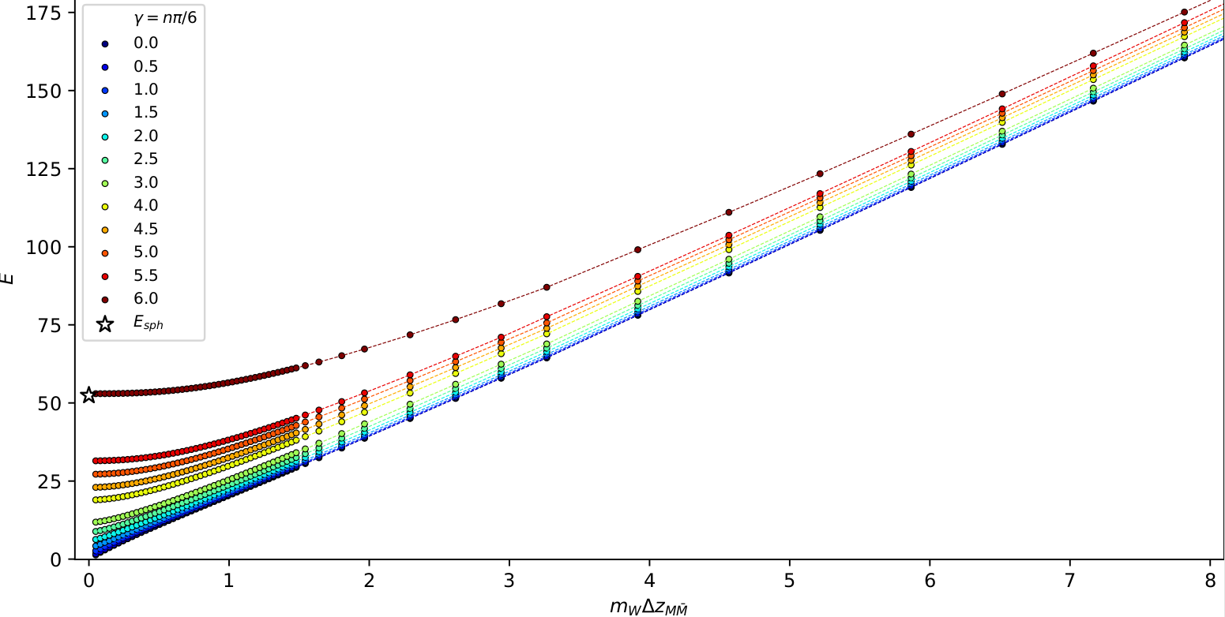
Results: Energy v separation
EW Sphaleron
Manton, N. S.
Physical Review D
28.8 (1983): 2019.
Results
11
Notes:
11

Slide 12



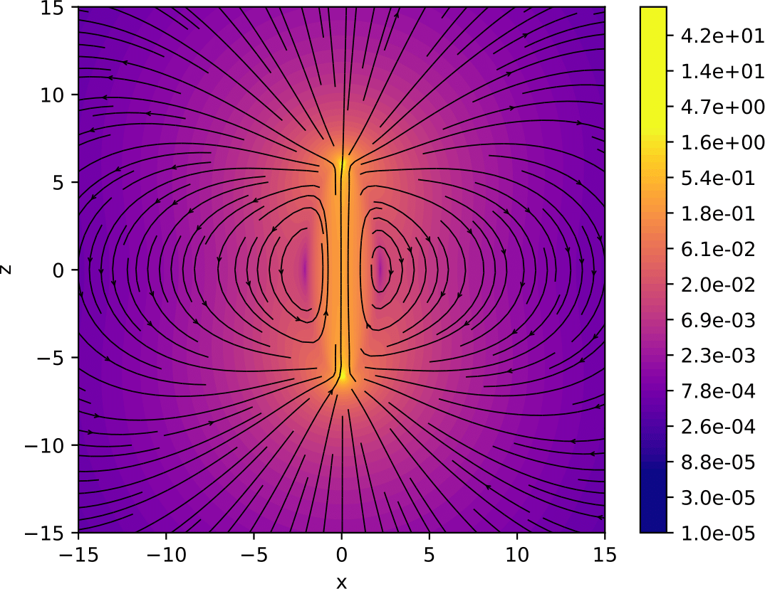
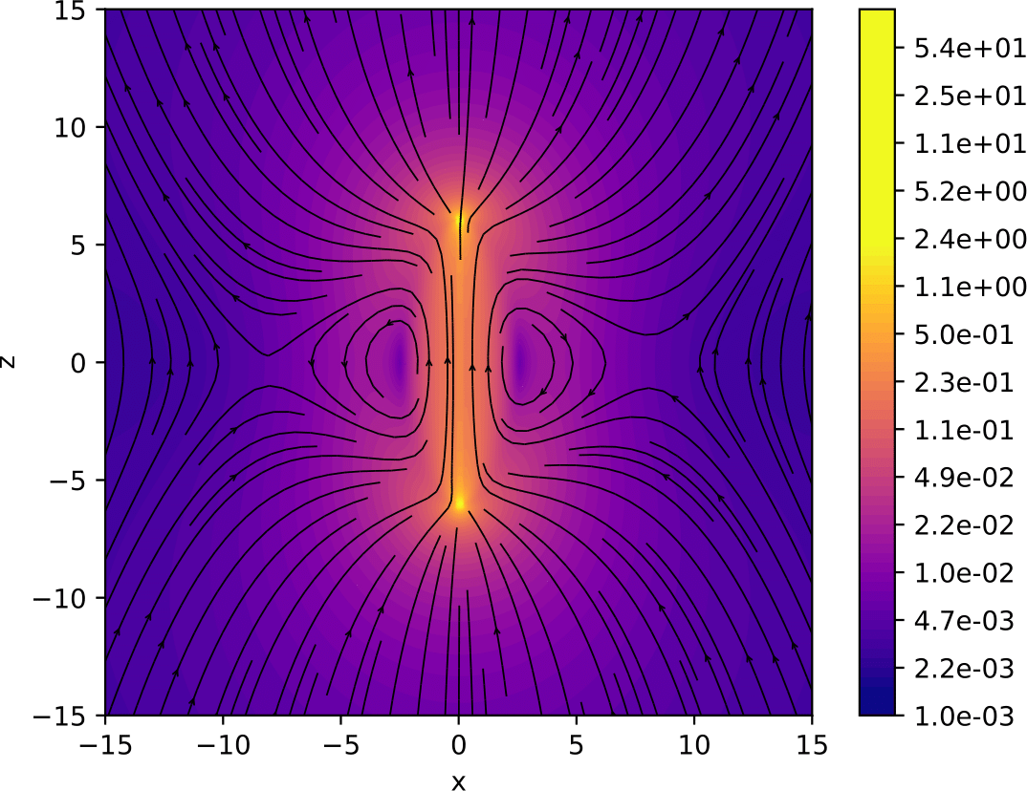
Results: Magnetic fields
Magnetic fields
12
Notes:
12

Slide 13
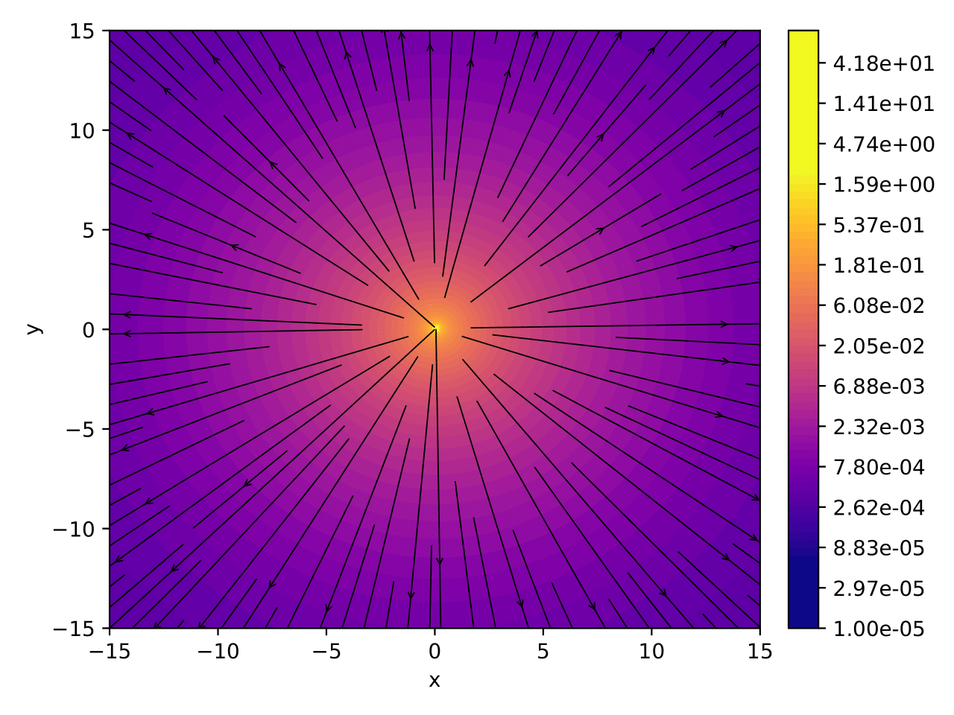
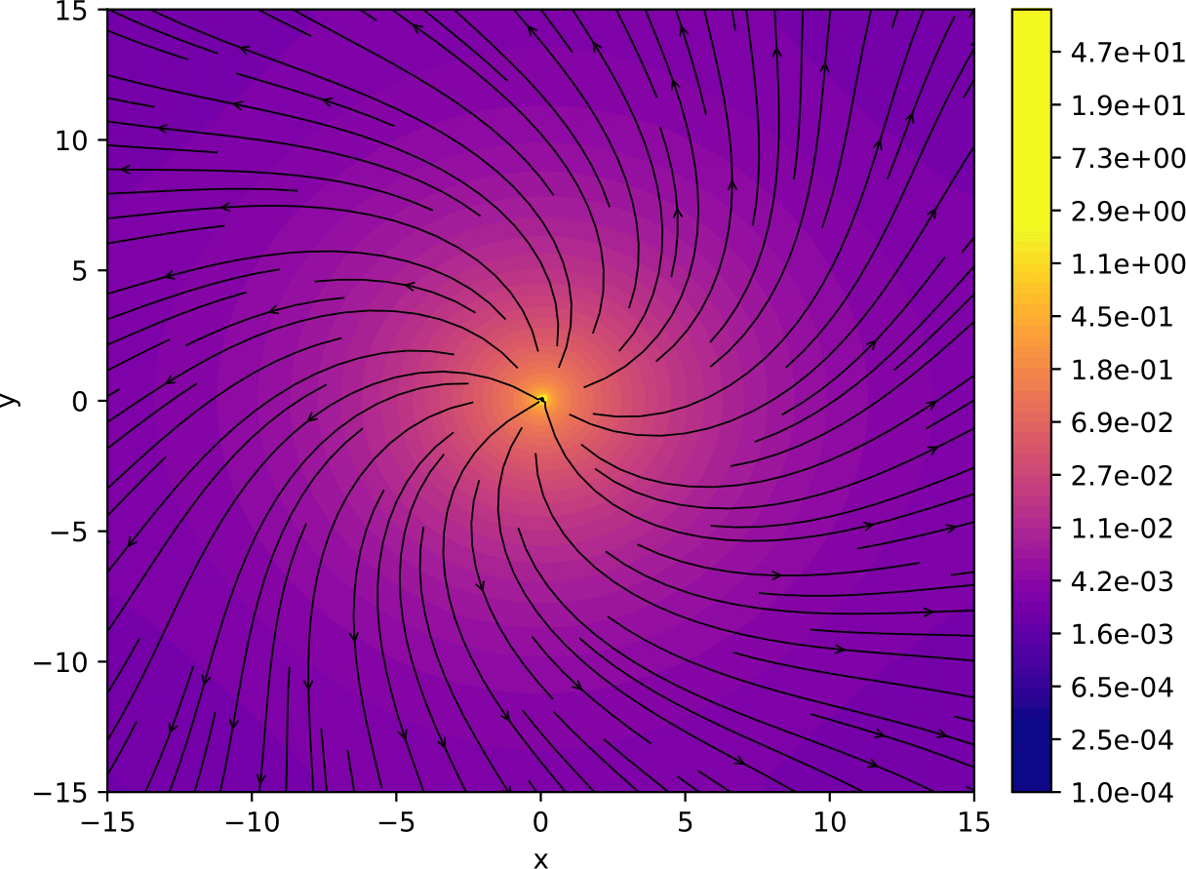
Results: Magnetic fields
Magnetic fields
13
Notes:
13

Slide 14
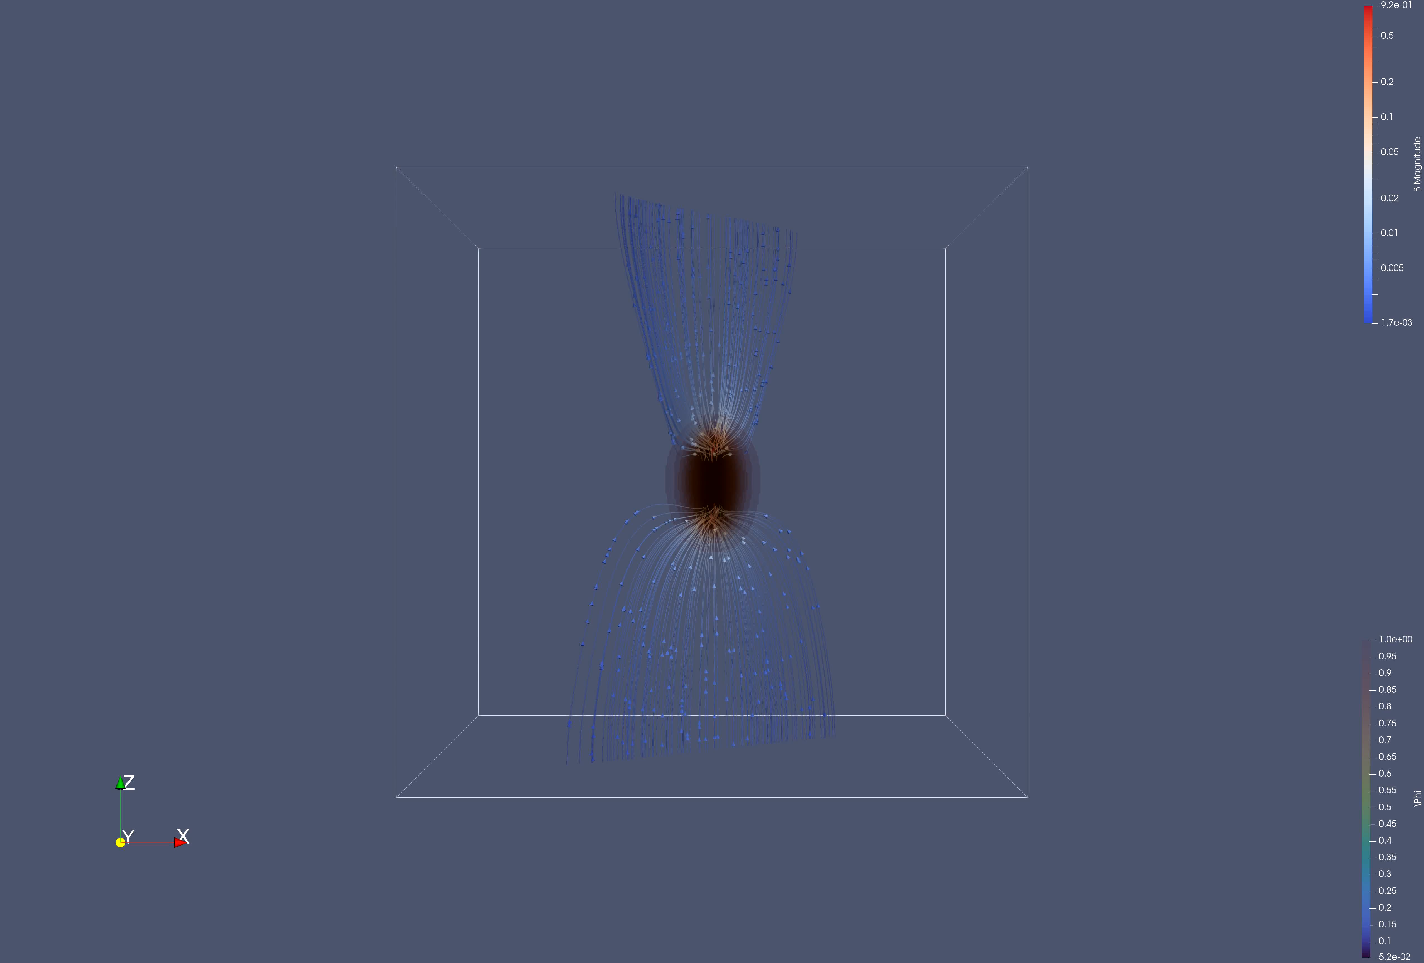
Results: Magnetic fields
Magnetic fields
14
Notes:
14

Slide 15
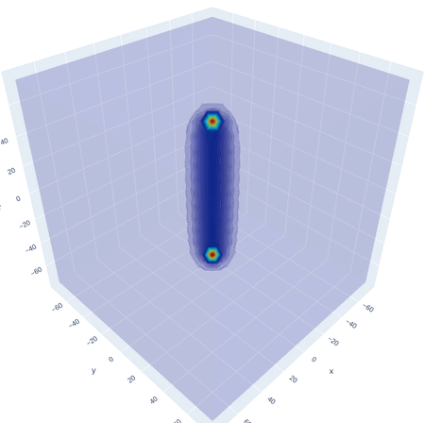
Ongoing(I) : Dumbbell Dynamics
Initial condition : Static field
configuration
Numerical evolution: Study dynamics
One major challenge is formulating relativistic initial conditions
Ongoing(I) : Rotating dumbbell dynamics
15
Notes:
15

Slide 16
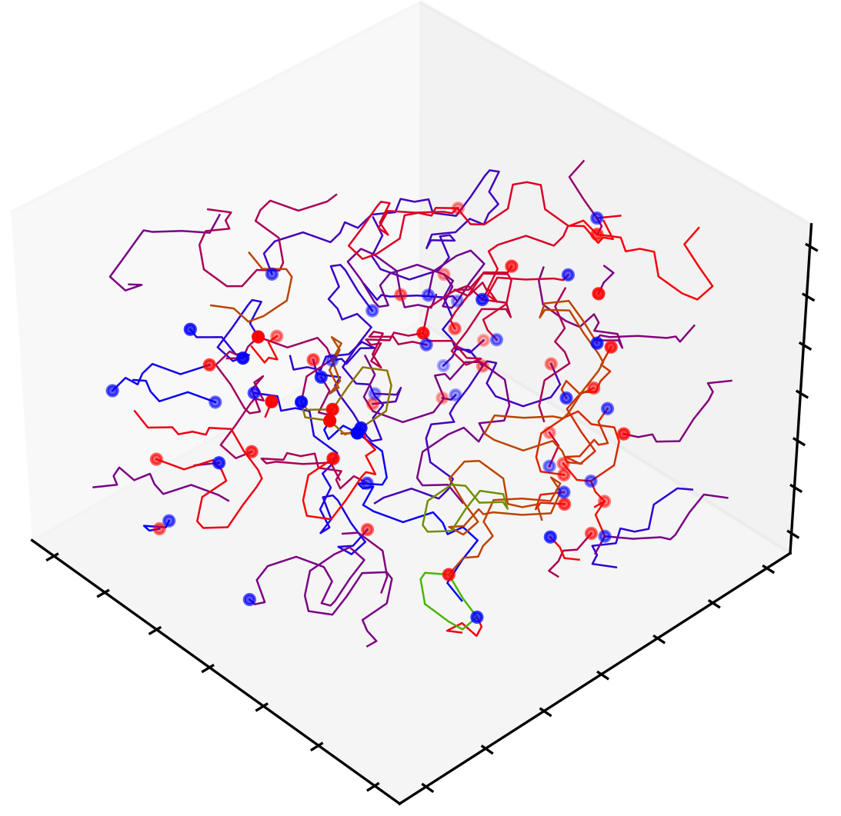
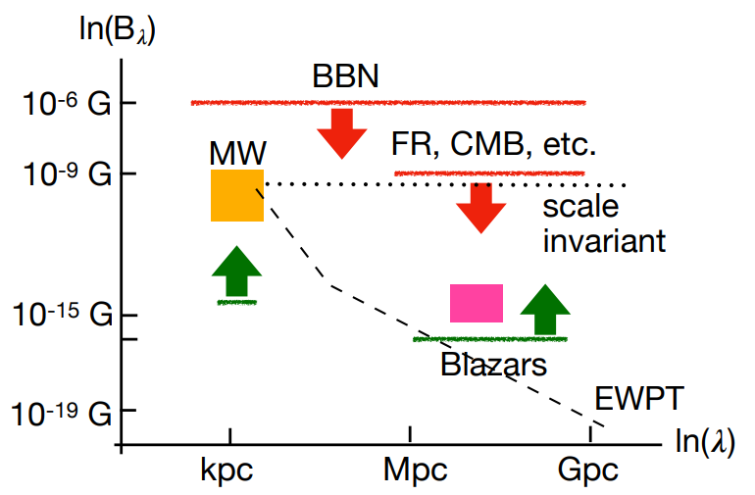
Ongoing(II) : Cosmological Magnetic Fields
Distribution of dumbbells
from EWPT
Bounds on cosmological magnetic fields
MHD evolution using PENCIL
Cosmological magnetic field spectrum in the present Universe
Vachaspati, Tanmay. "Progress on cosmological magnetic fields." Reports on progress in physics 84.7 (2021): 074901.
Teerthal Patel and Tanmay Vachaspati, JHEP 2022.1(2022):1-14 (arXiv:2108.05357)
PENCIL CODE : http://pencil-code.nordita.org/
Ongoing(II)
16
Notes:
16

Slide 17
Summary/Outlook
Resolved the static dumbbell configurations
Working on the dynamics and magnetogenesis
Possibilities to explore
Baryogenesis
Decay products of the annihilated dumbbell
17
Notes:
17

Slide 18
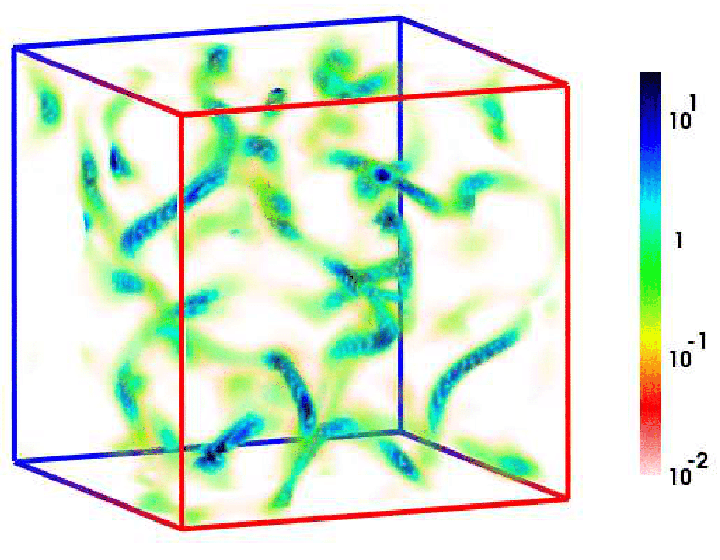
Ongoing: Cosmological Magnetic Fields
Distribution of dumbbells
from EWPT
Relic magnetic fields from EWPT simulations
Teerthal Patel and Tanmay Vachaspati, JHEP 2022.1(2022):1-14 (arXiv:2108.05357)
Diaz-Gil, Andres, et al, " Physical Review Letters 100.24 (2008): 241301.
6/26/2023
Ongoing : Cosmological magnetic fields
18
Notes:
18

Slide 19
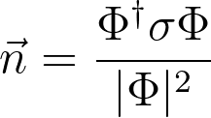
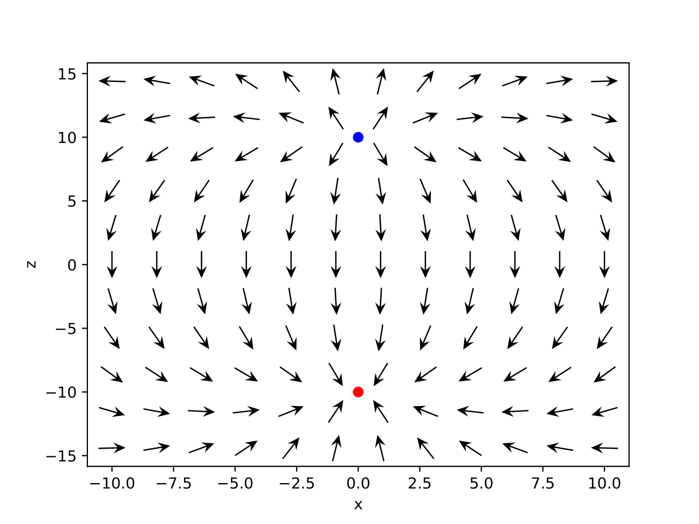
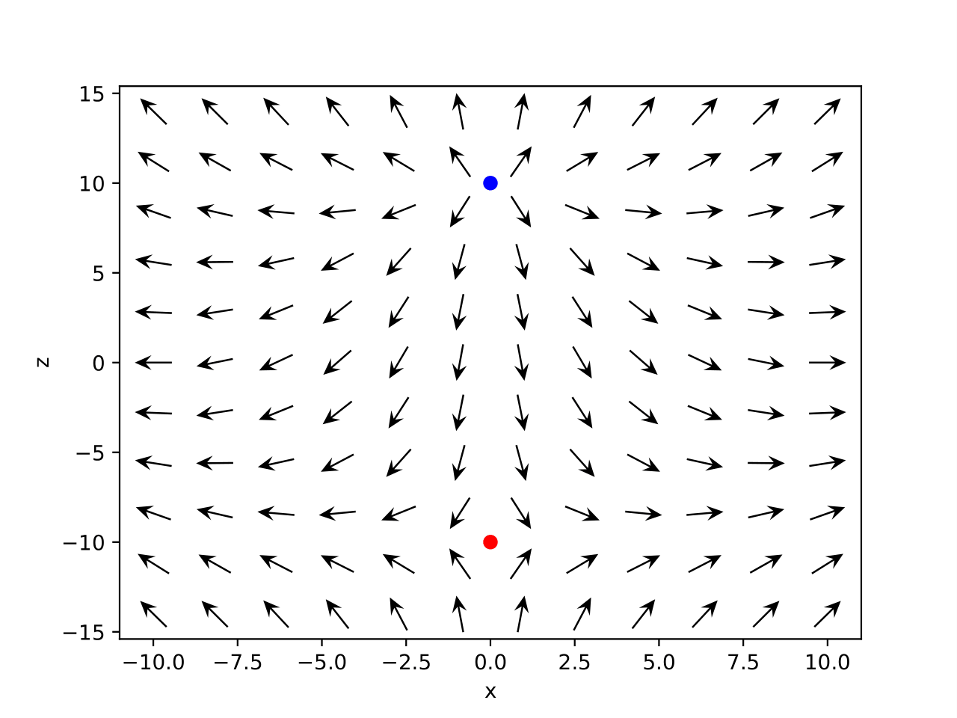
n plots
6/26/2023
19
Notes:
19

Slide 20
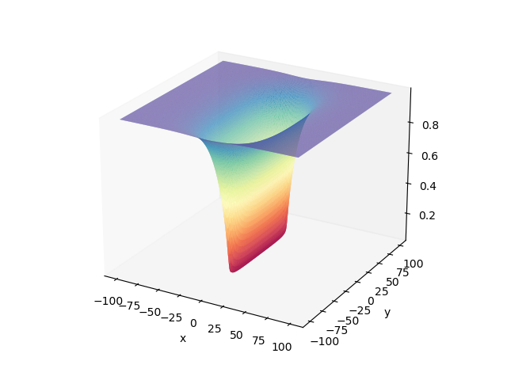
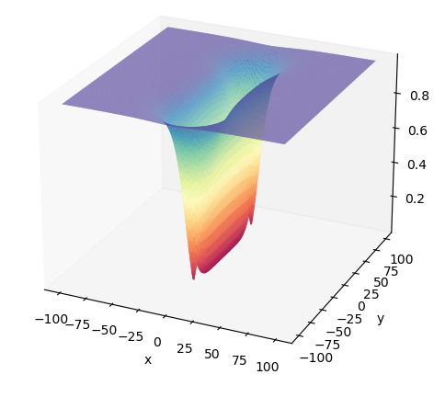
Numerical Relaxation
6/26/2023
Static Configurations of Electroweak Dumbbells
20
Notes:
20

