Slide 1
recent results of dark sector searches with the BaBar experiment
Brian Shuve
on behalf of the BaBar Collaboration
bshuve@g.hmc.edu
PASCOS – UC Irvine
June 28, 2023
TM and © Nelvana, all rights reserved

Slide 2
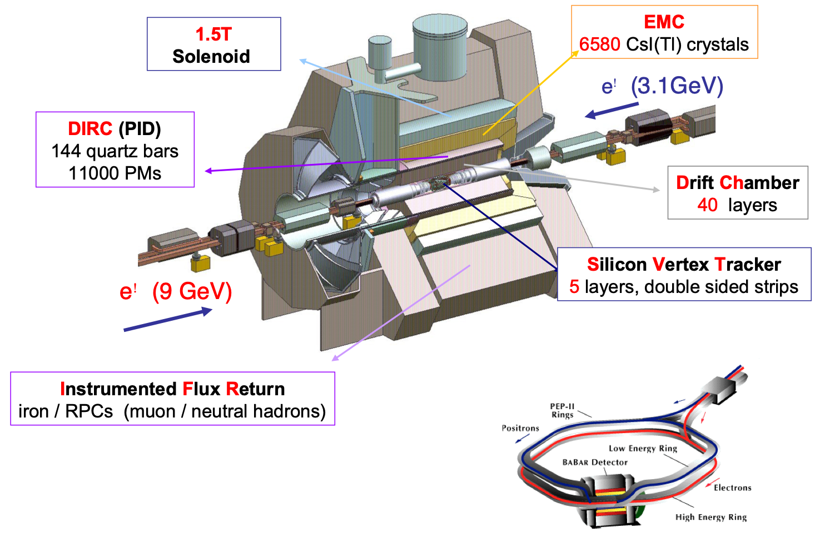


BaBar experiment
e⁺
432/fb on-
peak ( )
~500 million B meson pairs
e⁻
smaller samples
at
and off-peak
1999-2008
High luminosity, low backgrounds make BaBar an ideal experiment for discovering MeV-GeV scale hidden particles
2

Slide 3

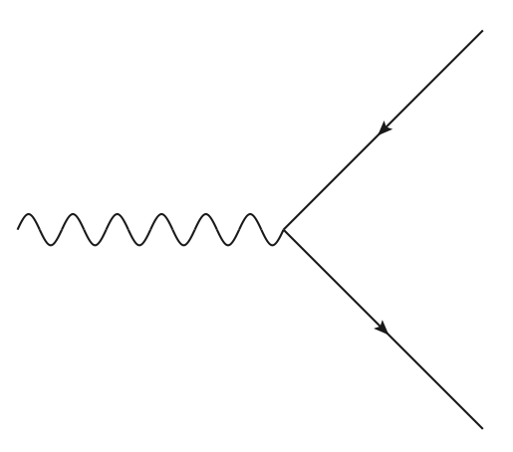





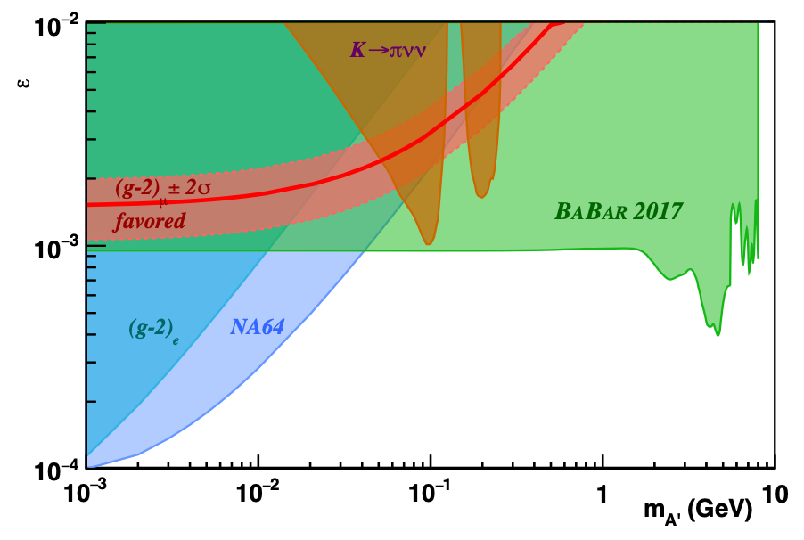
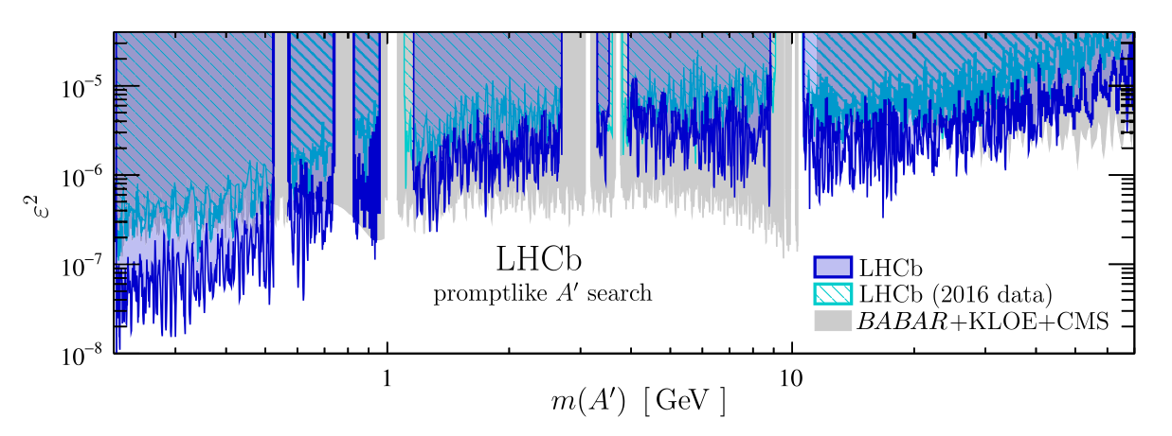
Hidden sector dm
For thermal dark matter masses below a few GeV, a low-mass mediator is needed for observed abundance
B. Lee, S. Weinberg, PRL 39, 165 (1977)
Many searches focus on minimal, predictive “portals”, such as a dark photon with kinetic mixing
visible decays:
invisible decays:
BaBar: PRL 113 (2014) 201801
LHCb: PRL 124 (2020) 041801
BaBar: PRL 119 (2017) 131804
However, a richer array of signatures is possible, necessitating new searches
3

Slide 4
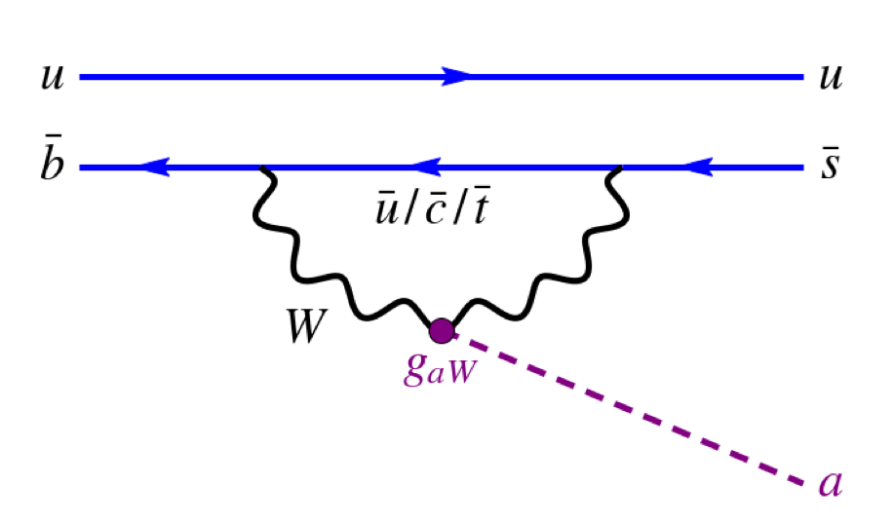
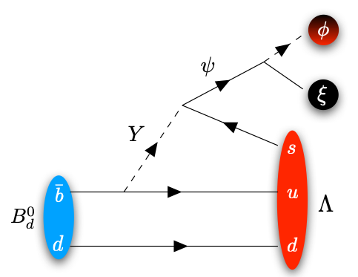

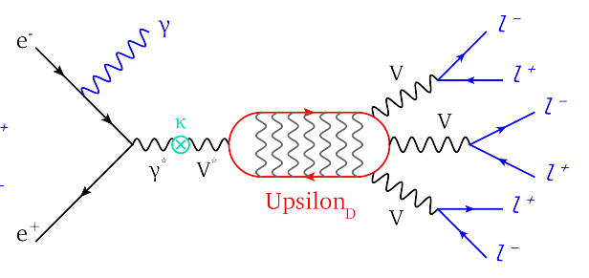
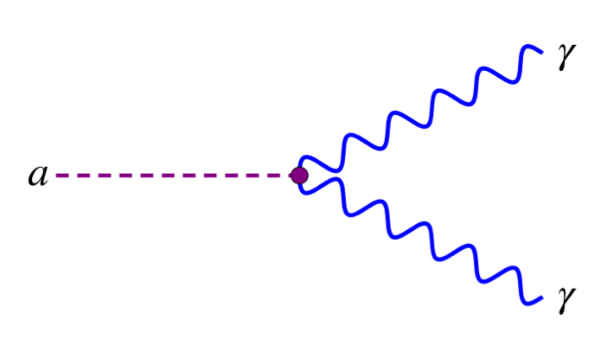

Searches presented today
Axion-like particles (ALPs)
DM bound states
B-Mesogenesis
B mesons decay to ALP via coupling to gauge bosons
dark photon + large coupling to DM
model of QCD-scale baryogenesis
search for DM bound states
B mesons decay to baryon + dark baryon
ϕD
BaBar, PRL 128, 131802 (2022), arXiv:2111.01800
BaBar, PRL 128, 021802 (2022), arXiv:2106.08529
BaBar, PRD 107, 092001 (2023) BaBar, arXiv:2306.08490 (submitted to PRL)
4

Slide 5
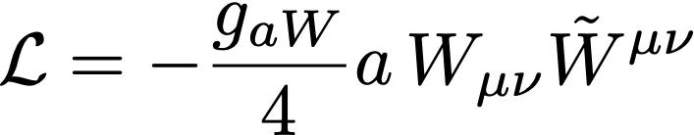






Axion-like particles
Axion-like particles (ALPs): pseudoscalars that couple to pairs of gauge bosons
Ubiquitous in BSM theories, ideal hidden sector mediators
If ALP couples to SU(2) gauge bosons, it can be produced in rare B meson decays:
E. Izaguirre, T. Lin, BS, PRL 118, 111802 (2017), arXiv:1611.09355
See also: Belle II search for ALP-fermion coupling, arXiv:2306.02830
5

Slide 6

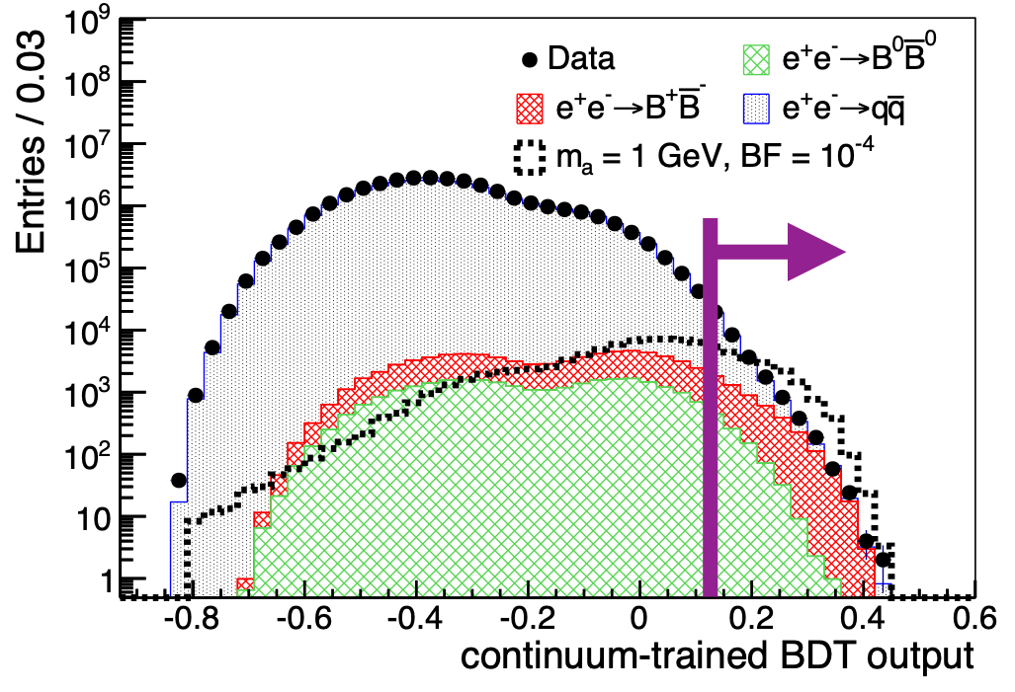
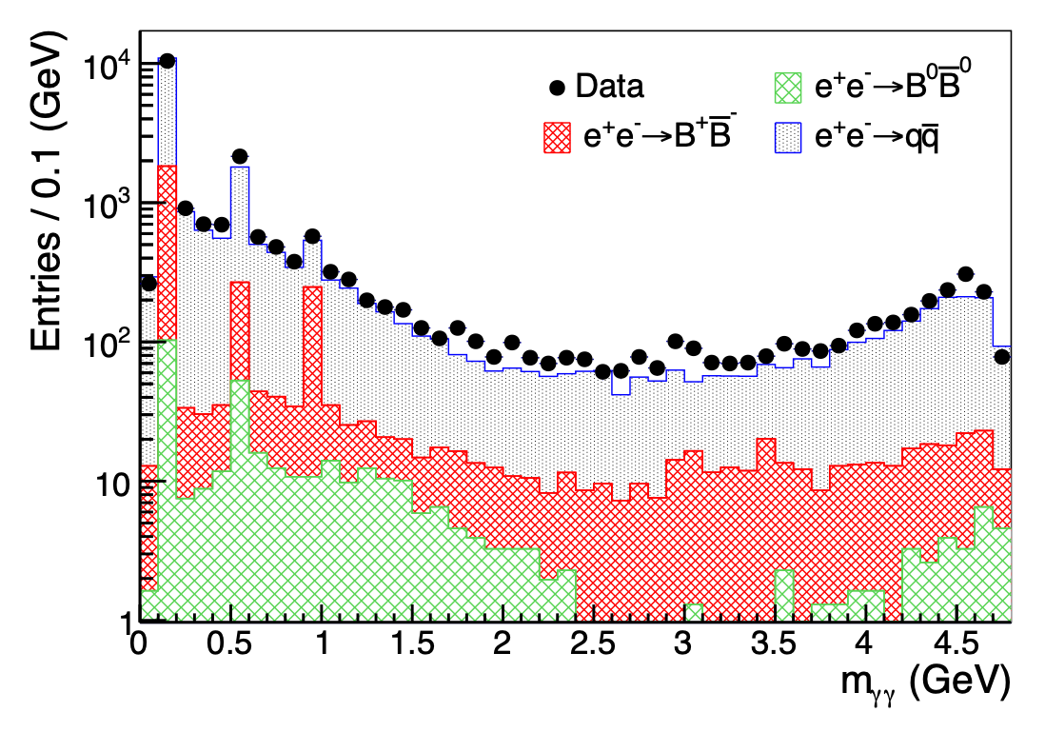




Axion-like particles
BaBar, PRL 128, 131802 (2022), arXiv:2111.01800
Reconstruct candidates, look for narrow peak in diphoton mass; assume prompt decays
Train separate boosted decision trees to reject dominant backgrounds
BaBar
BaBar
6

Slide 7

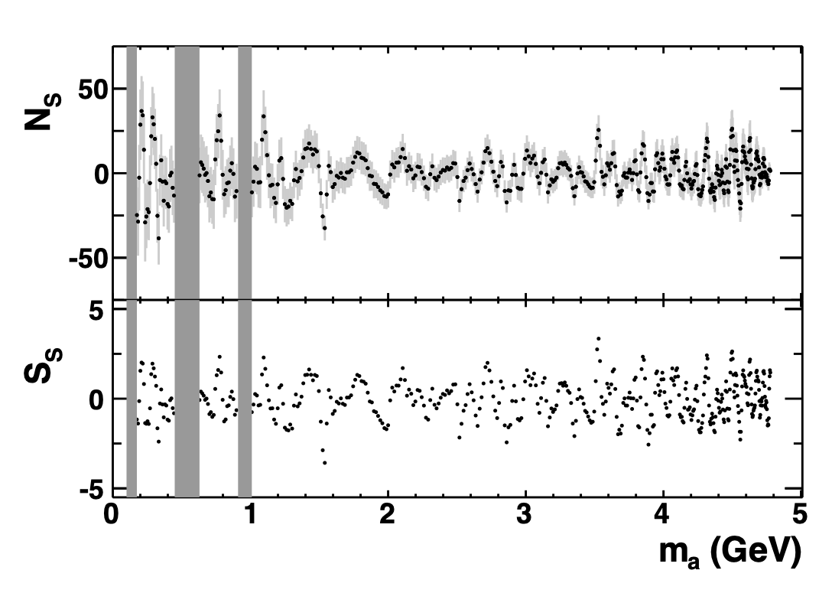
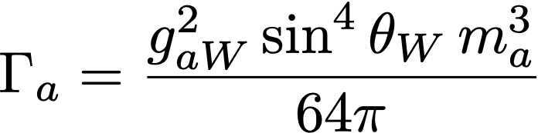
Axion-like particles
BaBar, PRL 128, 131802 (2022), arXiv:2111.01800
For each mass hypothesis, fit data in a window whose size is determined by ALP mass. We do not consider signals near
Background modeled as a smooth continuum plus a peaking component where relevant
We see no significant signal
number of signal events
We find that we are sensitive to ALPs with finite lifetime
BaBar
local signal significance

Slide 8
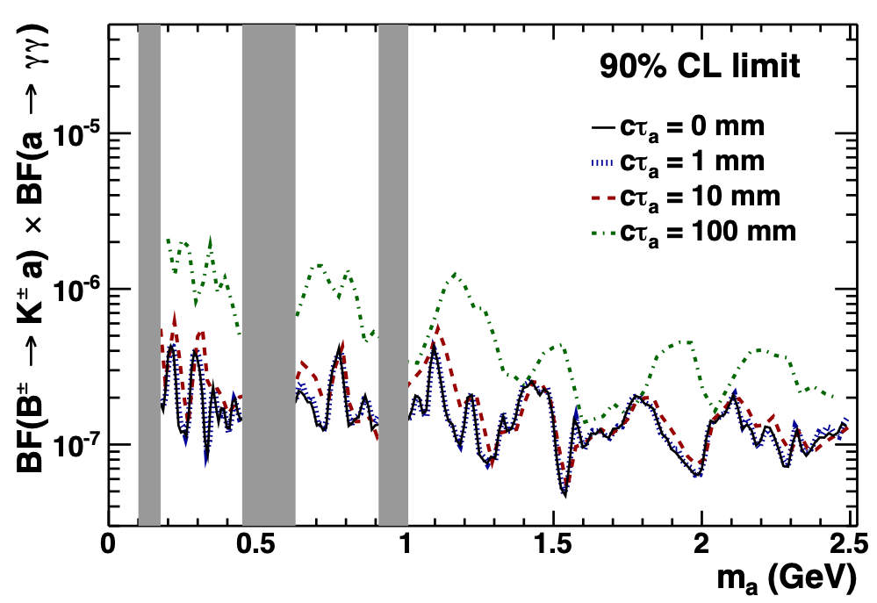
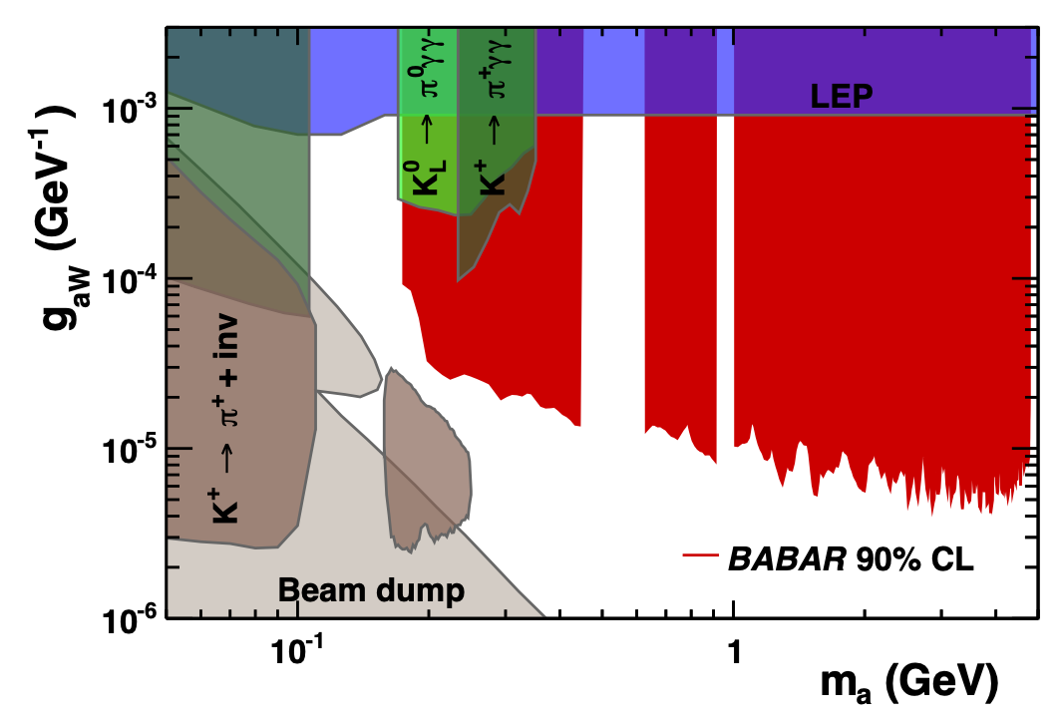
Axion-like particles
BaBar, PRL 128, 131802 (2022), arXiv:2111.01800
Re-do fits for long-lifetime signals and set 90% CL limits on the signal branching fraction as functions of ALP mass and lifetime
These are converted to limits on the coupling: improve on previous limits by up to two orders of magnitude!
BaBar
8

Slide 9


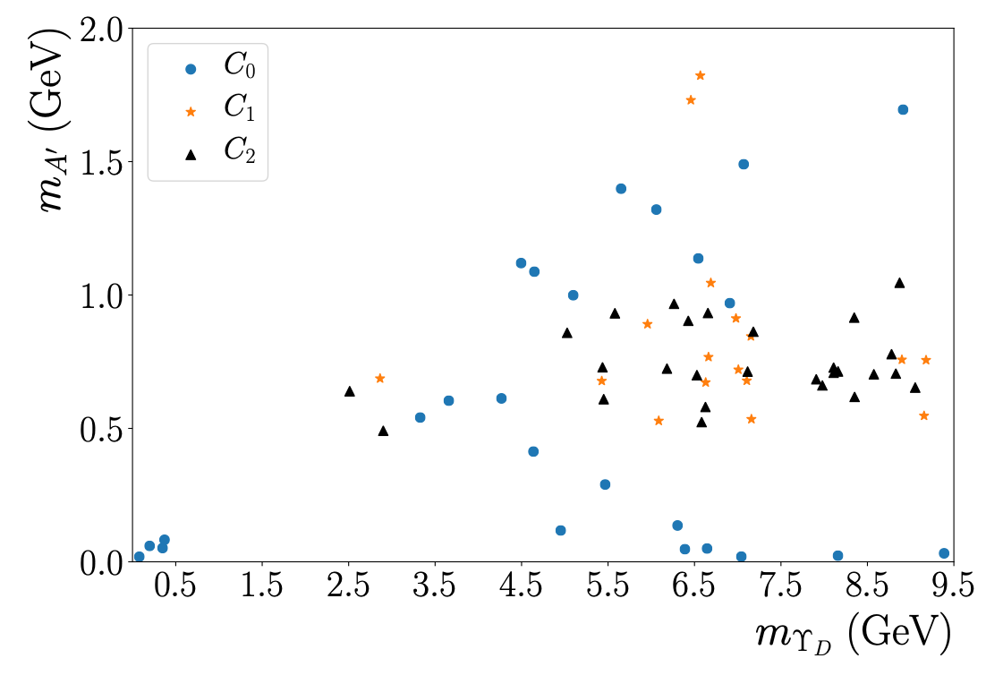
dm bound state: darkonium
Consider DM coupled to a dark photon: DM can form bound states (darkonia)!
H. An et al., PRL 116, 151801, arXiv:1510.05020
We search for the lightest vector darkonium,
We reconstruct dark photon decays into pairs of similar mass (min. 1 lepton pair)
Use multivariate analysis to separate signal from background
9

Slide 10

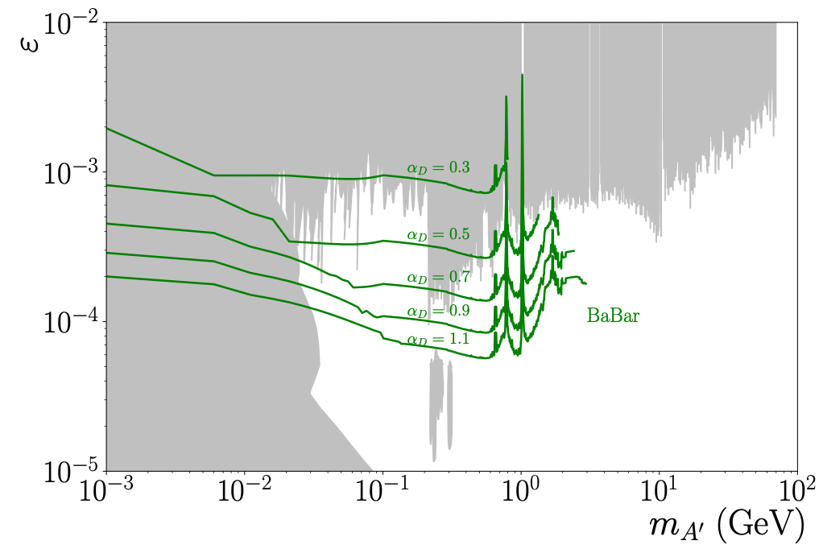

darkonium results
BaBar, PRL 128, 021802 (2022), arXiv:2106.08529
Repeat analysis for long-lived A’ decays, including information related to A’ decay position
In absence of significant signal, set 90% CL upper limit on kinetic mixing as function of DM coupling
BaBar
αD = 0.3
αD = 0.5
αD = 0.7
αD = 0.9
αD = 1.1
10

Slide 11

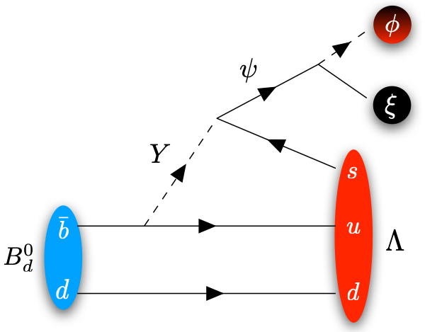

b-mesogenesis
Mechanism for baryogenesis & DM where regular + dark baryon asymmetries produced in CPV decays of B mesons
G. Elor, M. Escudero, A. Nelson, PRD 99, 035031 (2019); F. Elahi, G. Elor, R. McGehee, PRD 105, 055024 (2022)
Viable baryogenesis with low reheat temperatures,
ϕD
(dark baryon)
(SM baryon)
Signal depends on flavor structure; can also get e.g.,
11

Slide 12


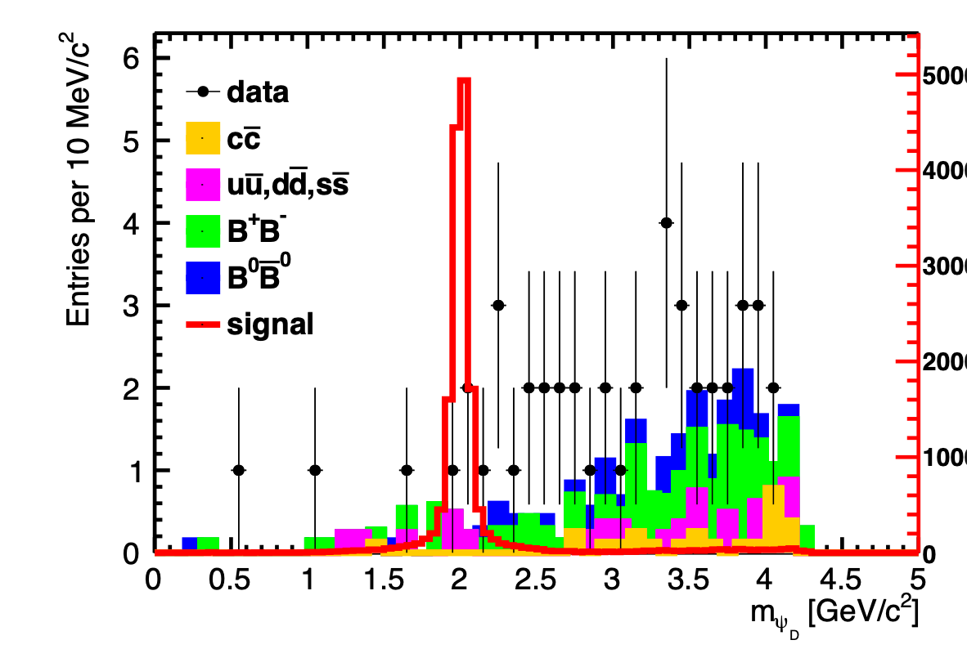
b-mesogenesis
BaBar, PRD 107, 092001 (2023) & arXiv:2306.08490 (submitted to PRL)
Fully reconstruct hadronic decay of “tag” B meson, search for single SM baryon ( or ) + missing mass from signal B decay
Use data to derive MC corrections due to missing decay modes
BaBar
12

Slide 13
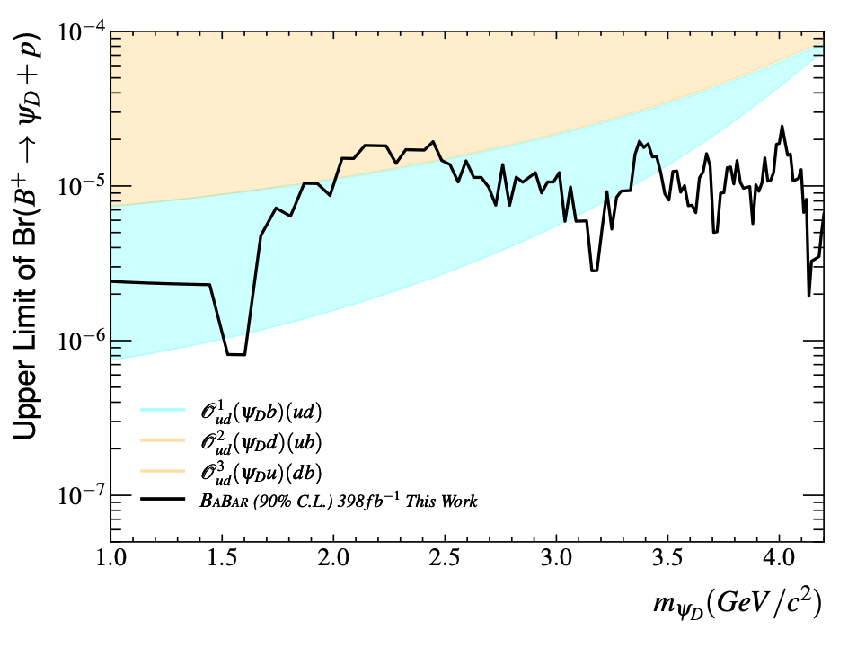
b-mesogenesis results
No significant signal is seen: set 90% CL limits on signal branching fraction
Shaded regions are branching fractions predicted from mesogenesis
BaBar
BaBar, arXiv:2306.08490, submitted to PRL
13

Slide 14
summary
B factories are among the best experiments to search for GeV-scale hidden sectors
Many years after it stopped running, BaBar continues to put out new and world-leading hidden-sector results
Presented three recent searches: axionlike particles, DM bound states, and non-thermal models of baryogenesis + DM
There are still models that are largely untested, and new searches at BaBar and Belle II can significantly improve sensitivity

Slide 15
BACKUP SLIDES

Slide 16


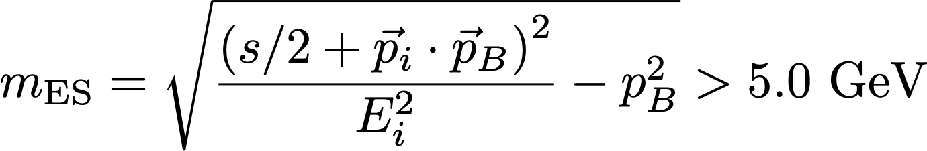



ALP selections
Preselection: Reconstruct candidates from candidate and two photons
Require
Perform kinematic fit requiring photon and kaon to originate from beamspot, constrain mass to and energy to beam energy
Train 2 Boosted Decision Trees: each is trained on MC for one of the two predominant backgrounds:

Slide 17




ALP selections
13 BDT training observables:
cosine of angle between
sphericity axes of candidate
and rest of event (ROE)
PID info for kaon candidate
2nd Legendre moment of ROE,
calculated relative to thrust
axis
helicity angle of most energetic
photon, and of kaon
energy of most energetic photon in candidate
invariant mass of ROE
multiplicity of neutral clusters
invariant mass of diphoton pair, with 1 photon in candidate and 1 photon in ROE, closest to each of

Slide 18






ALP signal extraction
Perform unbinned maximum likelihood fits for signal peak over smooth background
476 mass hypotheses, step size between adjacent mass hypotheses is given by the signal resolution,
is determined by fitting a double-sided Crystal Ball function to signal MC at various masses, interpolating for intermediate values
Resolution ranges from 8 MeV at to 14 MeV at
, decreasing back to 2 MeV at as a result of the kinematic fit
Signal MC resolution is validated by data/MC comparisons of
and , found to be consistent within 3%
Signal efficiency derived from MC, ranges from 2% at
to 33% at

Slide 19



ALP fit properties
Fits are performed over intervals of length depending on ALP mass, restricted to the range
Likelihood function includes contributions from signal, continuum background, peaking background
Signal PDF: modeled from signal MC and interpolated between simulated mass points
Continuum background PDF: second-order polynomial for , , first-order polynomial at higher masses
Peaking background PDF: each SM diphoton resonance is modeled as a sum of a signal template and a broader Gaussian distribution with parameters fixed to fits in MC — this component arises from continuum production of that is broadened because of kinematic fit

Slide 20
ALP SYSTEMATICS
Assess uncertainty on signal yield from fit by varying order of polynomial for continuum background (3rd-order for , constant at higher mass), varying shape of peaking background within uncertainties, and using next-nearest neighbor for interpolating signal shape
Dominates total uncertainty for some masses in vicinity of
Systematic uncertainty on signal yield from varying signal shape width within uncertainty is on average 3% of statistical uncertainty
6% systematic uncertainty on signal efficiency, derived from data/MC ratio in vicinity of
Other systematic effects negligible by comparison, including on limited signal MC statistics, luminosity

Slide 21

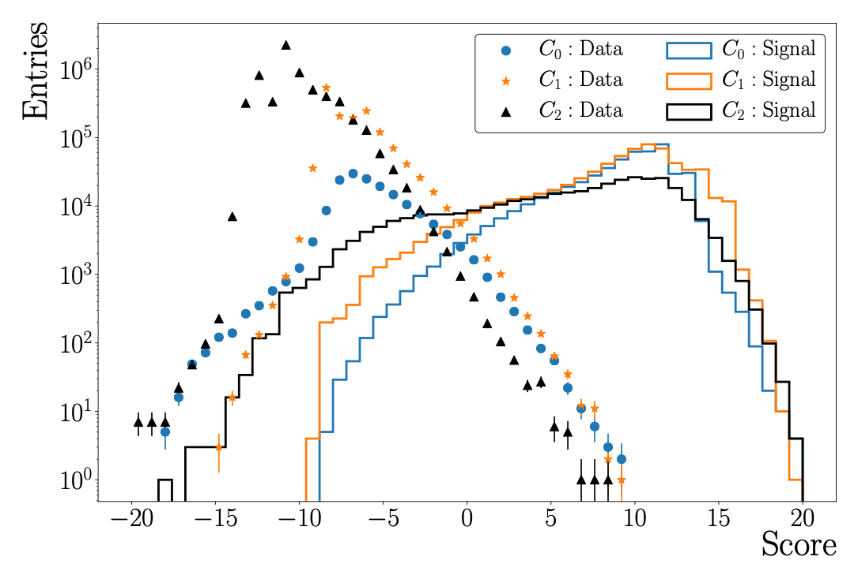
darkonium results
BaBar, PRL 128, 021802 (2022), arXiv:2106.08529
Consider windows around each mass in the plane of width 8x signal resolution; estimate background from adjacent windows
Cn sample corresponds to n pion pairs
BaBar
BaBar
MVA score
21

Slide 22
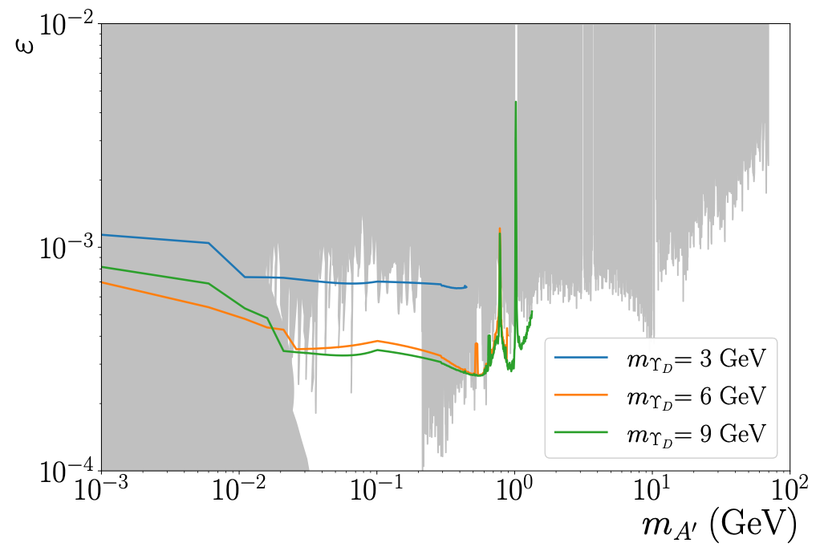

darkonium results
BaBar, PRL 128, 021802 (2022), arXiv:2106.08529
BaBar
22

Slide 23
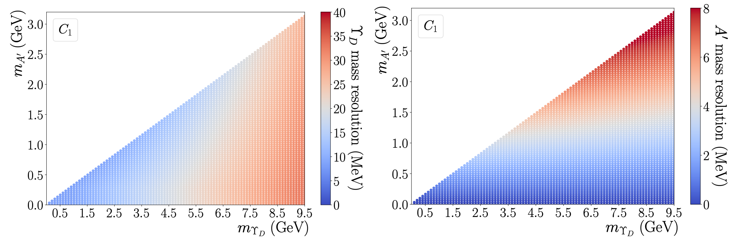
darkonium: resolution

Slide 24
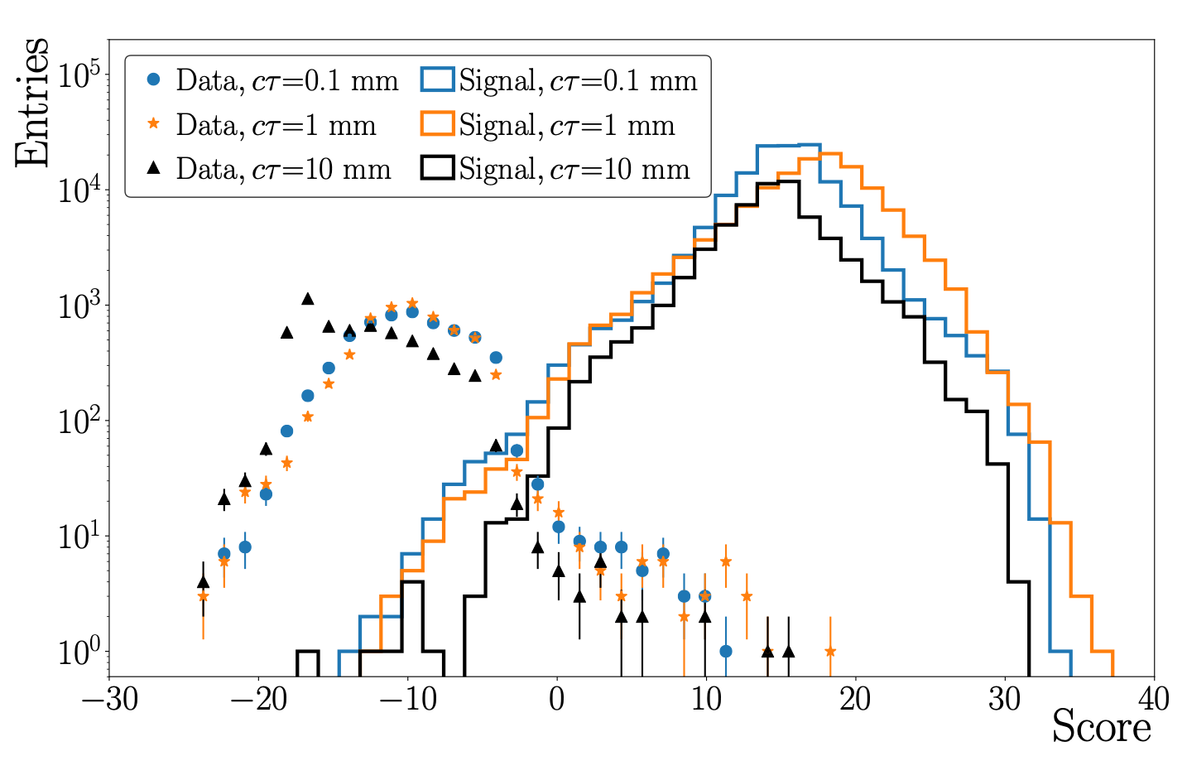
darkonium: long-lived a’

Slide 25
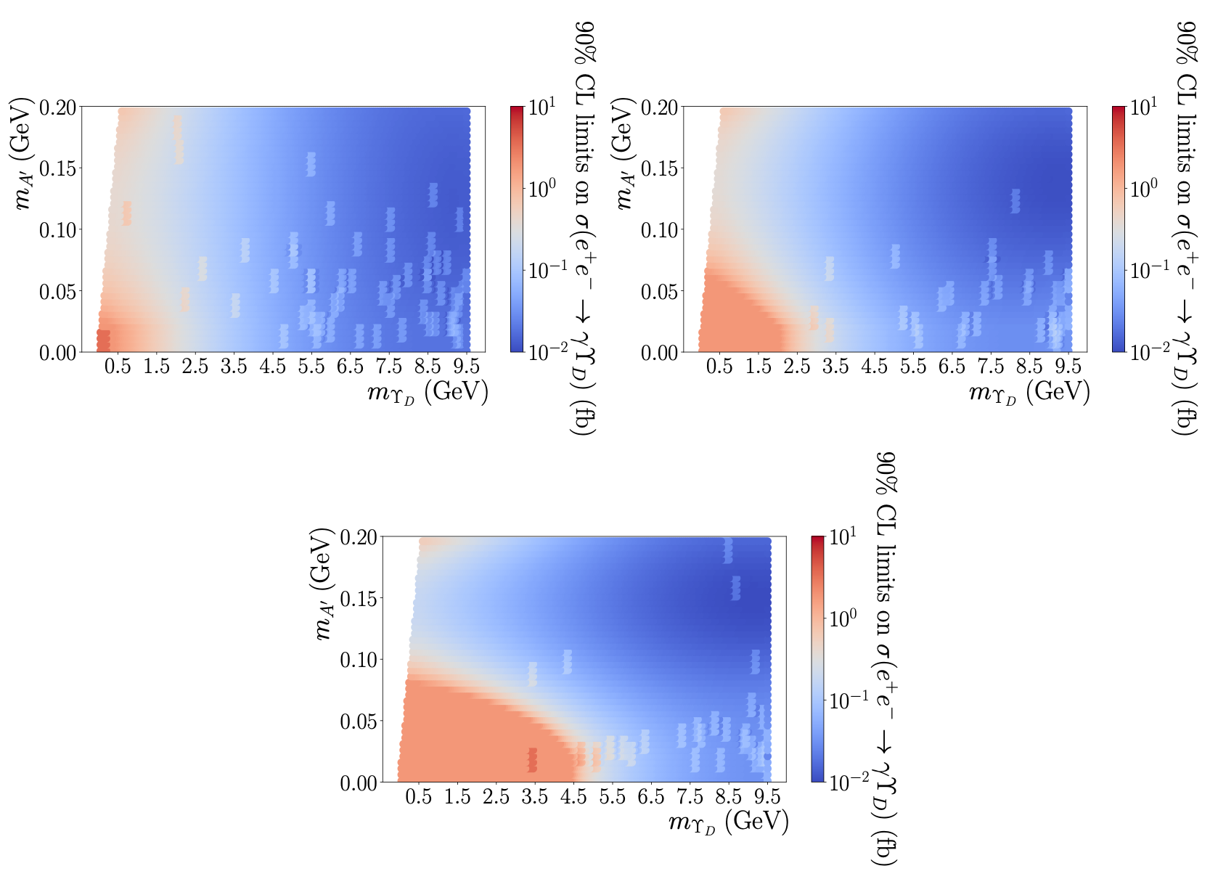
darkonium: long-lived a’

Slide 26

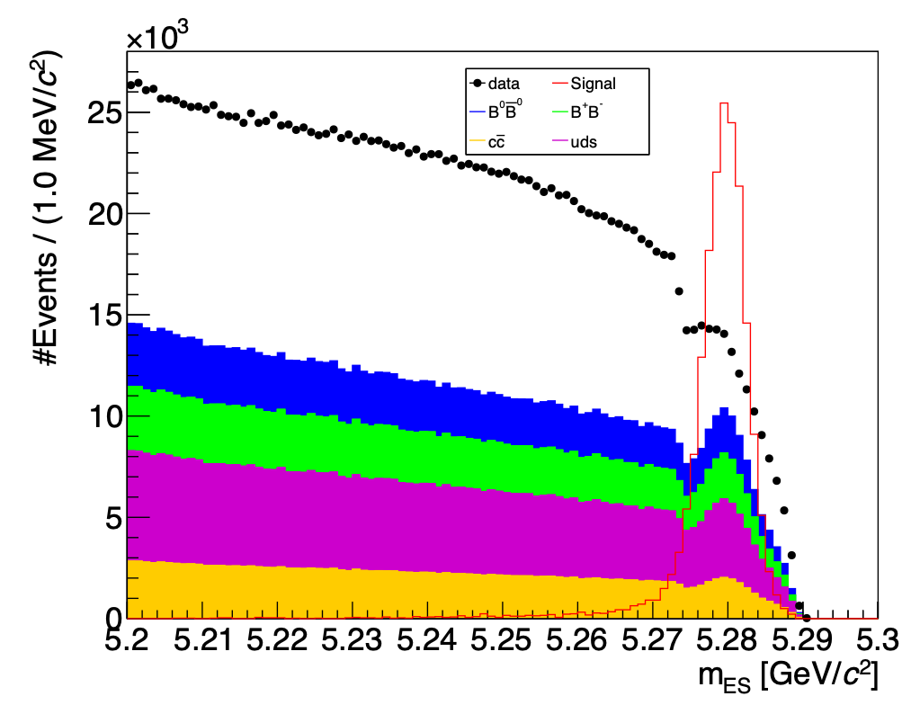
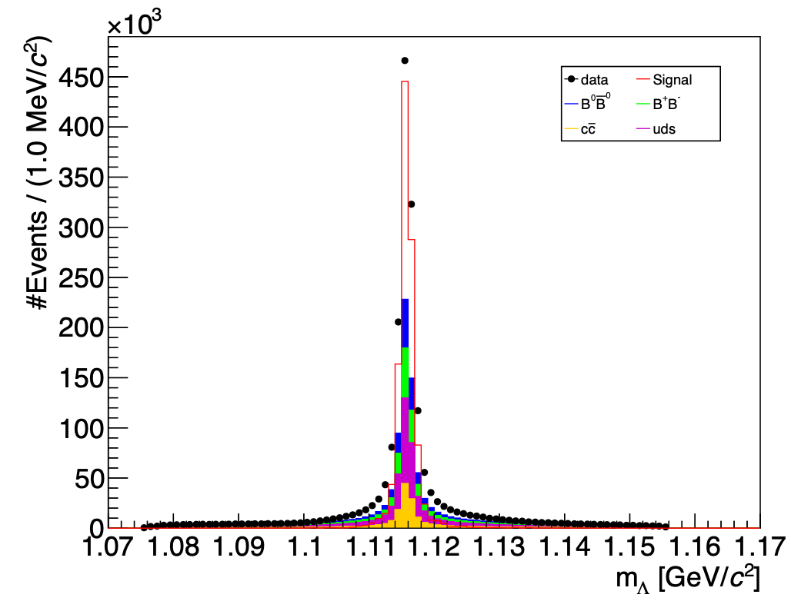
b-mesogenesis
BaBar, arXiv:2302.00208
Select events with:
26

Slide 27

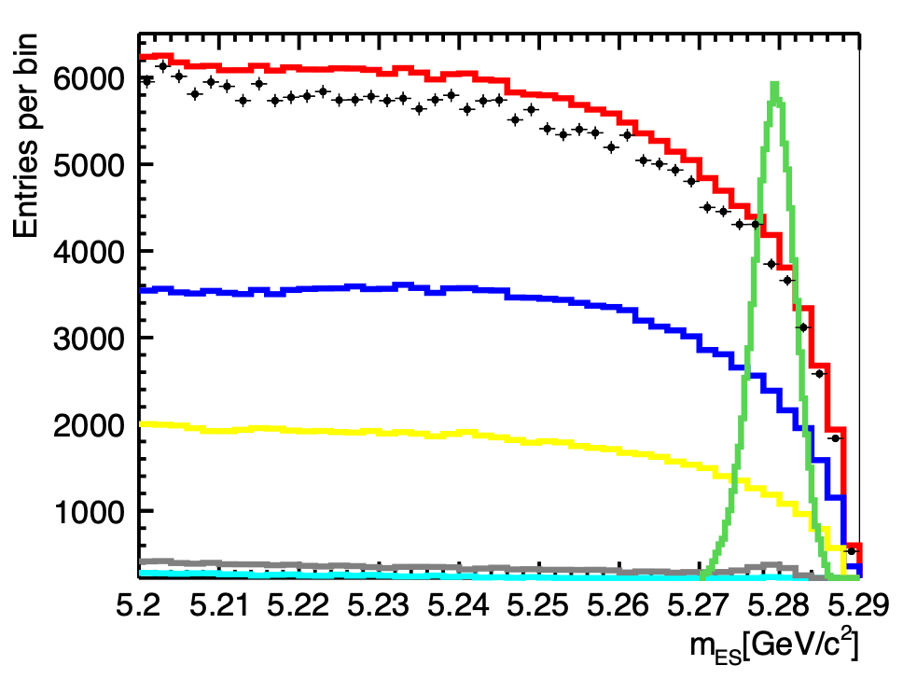
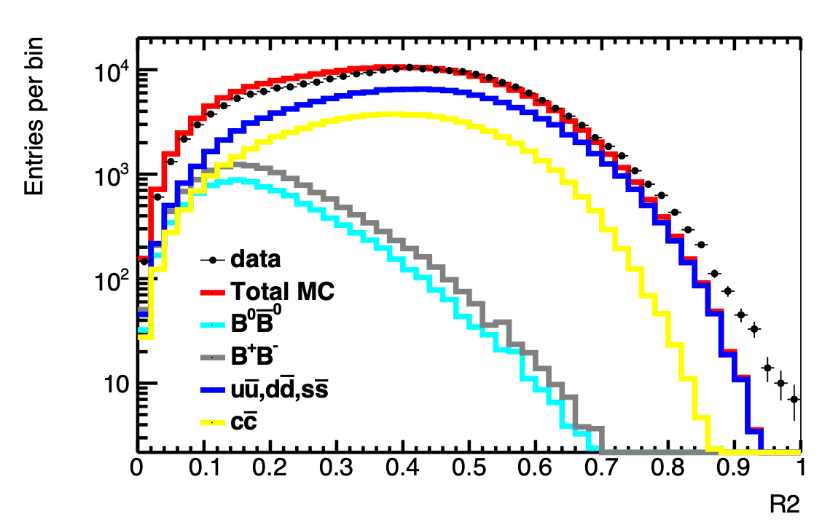
b-mesogenesis
BaBar, preliminary
Select events with:
BaBar
BaBar preliminary
27

Slide 28
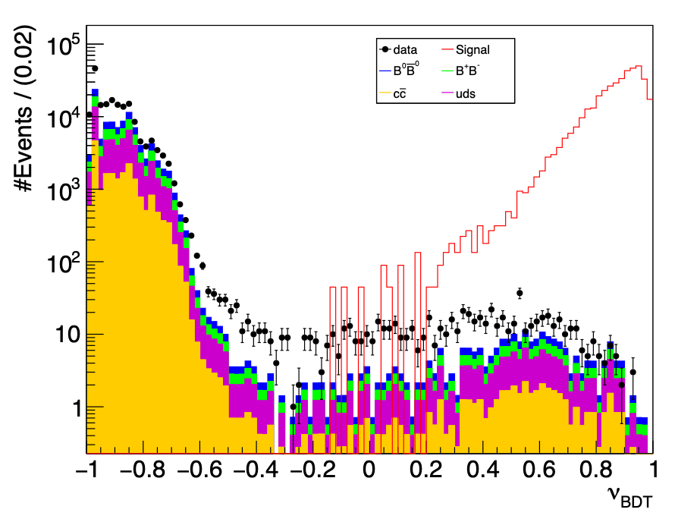
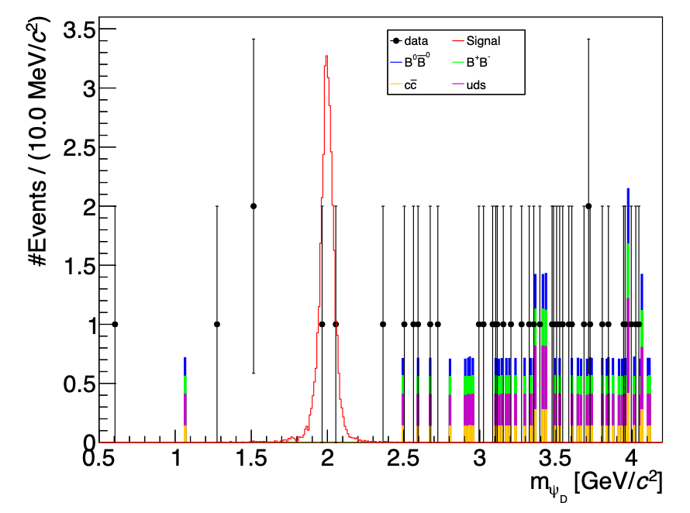
b-mesogenesis
BaBar, PRD 107, 092001 (2023) & arXiv:2306.08490 (submitted to PRL)
Fully reconstruct hadronic decay of “tag” B meson, search for single SM baryon ( or ) + missing mass from signal B decay
Train BDT using kinematic & purity observables that distinguish tagged B from continuum QCD events, as well as kinematic observables for signal B
Derive data/MC rescaling factors using side bands
BaBar
BaBar
signal
selection
normalized BDT score
28

Slide 29
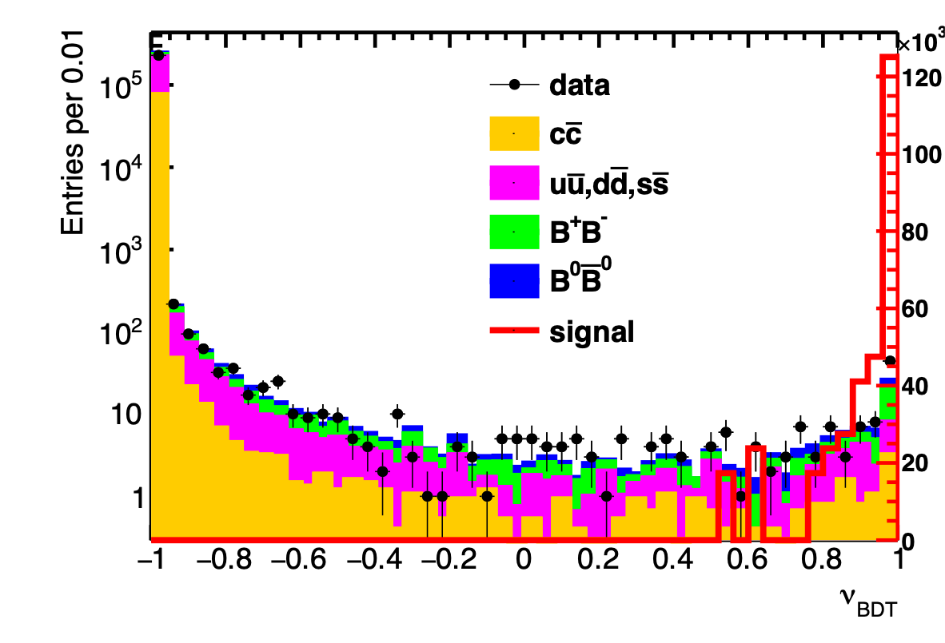
b-mesogenesis
BaBar, preliminary
BaBar
BaBar
signal
selection
29

Slide 30
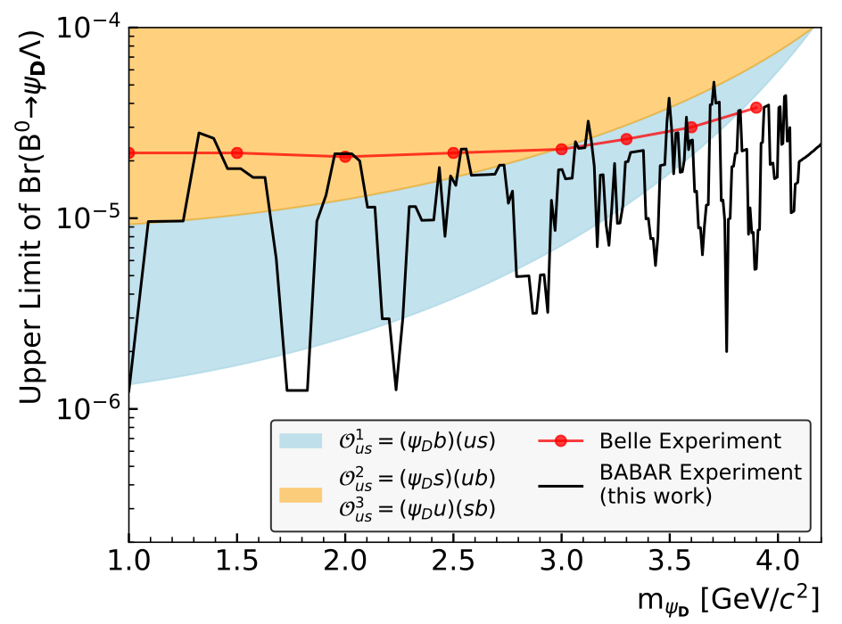
b-mesogenesis results
Scan over mass hypotheses: signal region size is 3x signal resolution, background is estimated from adjacent intervals
No significant signal is seen: set limits on signal branching fraction using profile likelihood method
Shaded regions are branching fractions predicted from mesogenesis
BaBar
BaBar
BaBar, arXiv:2306.08490, submitted to PRL
BaBar, PRD 107, 092001 (2023)
30

Slide 31
b-mesogenesis results
The same results can be re-interpreted to constrain R-parity-violating supersymmetry with low-mass neutralinos
C. Dib et al, JHEP 02 224 (2023)
31
BaBar, arXiv:2306.08490, submitted to PRL

