Slide 1
Introduction to EasyPET Exercise
Martin Grossmann :: Center for Proton Therapy :: Paul Scherrer Institute

Slide 2
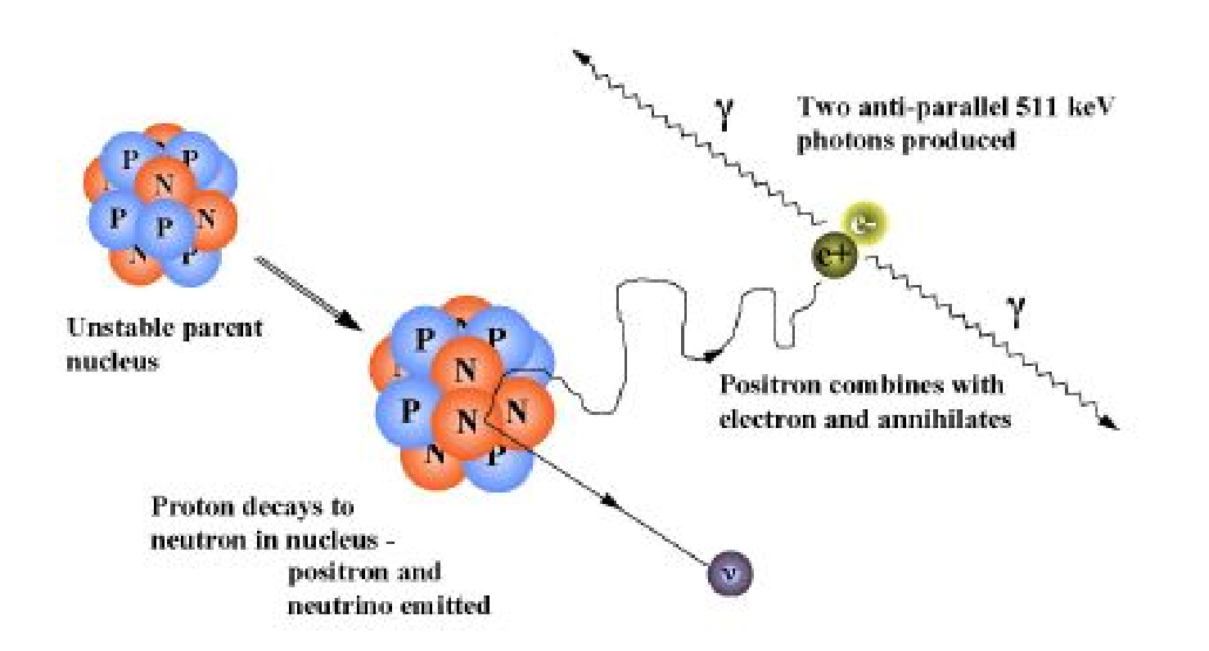
What is PET

Slide 3
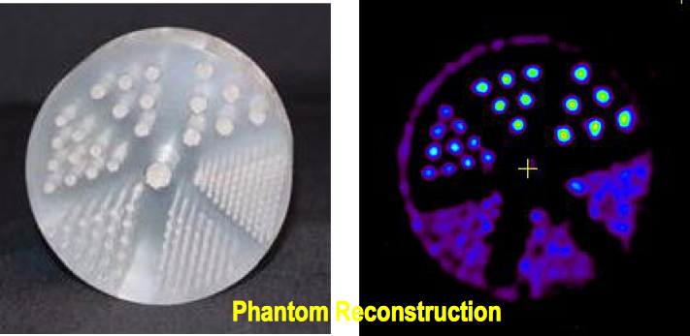
PET – Positron Emission Tomography
From Martin Purschke!
Ring of Photon
Detectors
Radionuclide decays, emitting β^{+.}
β⁺ annihilates with e– from tissue, forming back-to-back 511 keV photon pair.
511 keV photon pairs detected via time coincidence.
Positron lies on line defined by detector pair (known as a line of response or a LOR).
Back-to-back 511KeV photons are detected

Slide 4
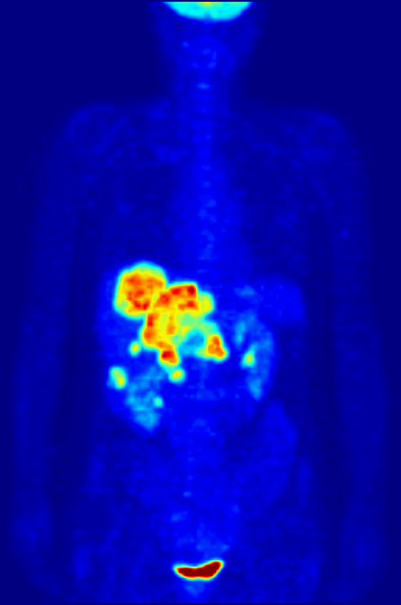
From Martin Purschke!
An Example - ¹⁸F
¹⁸F-FDG - Fludeoxyglucose is one of the commonly used radiotracers
It is a sugar, so it accumulates where the body burns a lot of energy (“uptake”)
Unusual “hot spots” can point to cancer
Whole-body PET scan using 18F-FDG to show liver metastases of a colorectal tumor

Slide 5
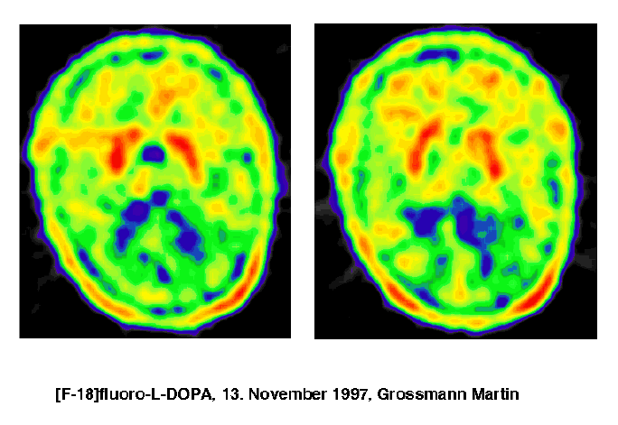
PET image of the brain
Dopamine = chemical messenger in our body
Parkinson’s disease: dopamine production in the central brain not properly working
PET image using dopamine with F¹⁸ isotope

Slide 6
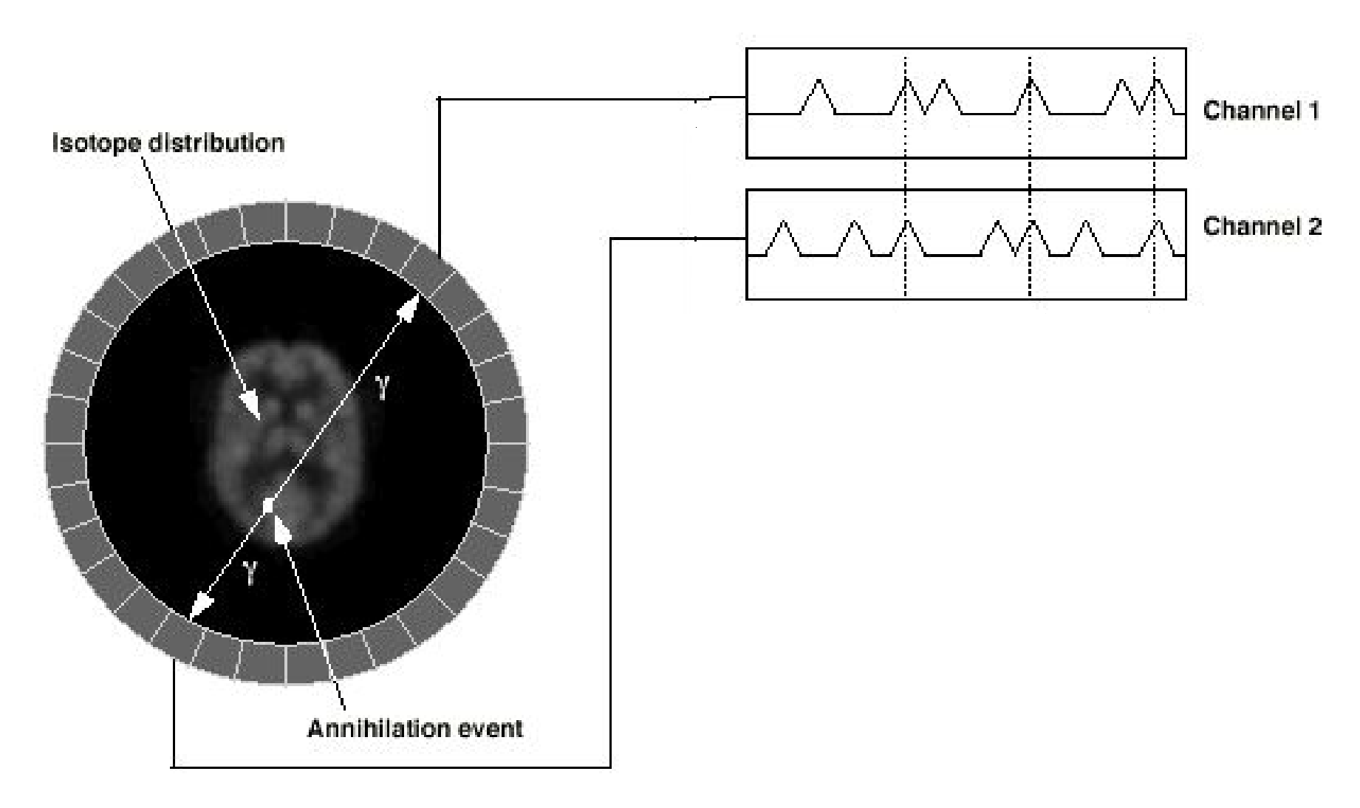
Coincidence detection

Slide 7
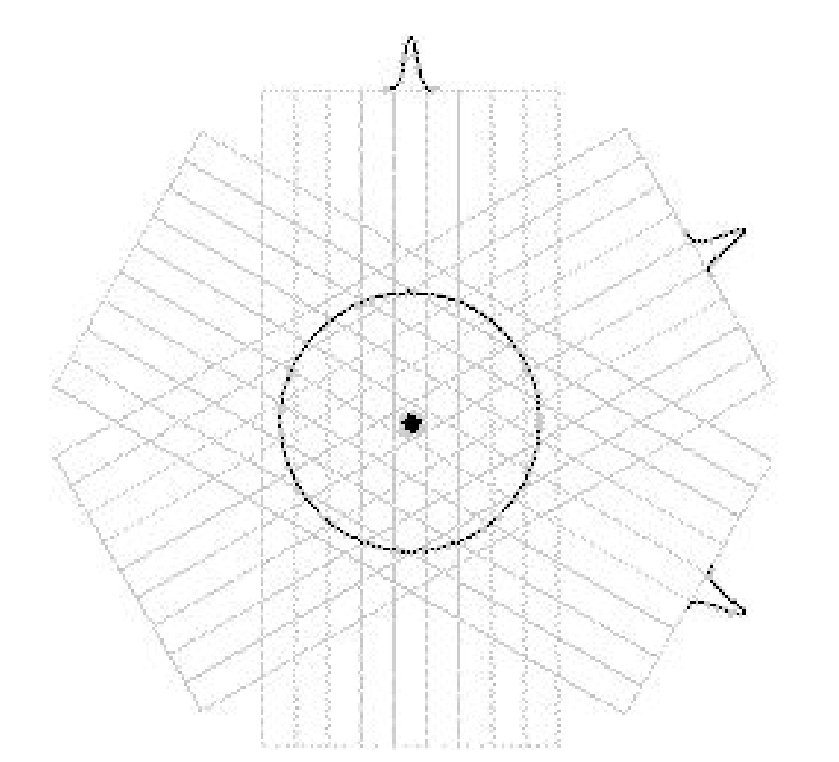
2D PET image
LOR (lines of response) arranged into sets of 1-dimensional parallel projections

Slide 8

2D PET image
Back-Projection allows to reconstruct original source distribution

Slide 9
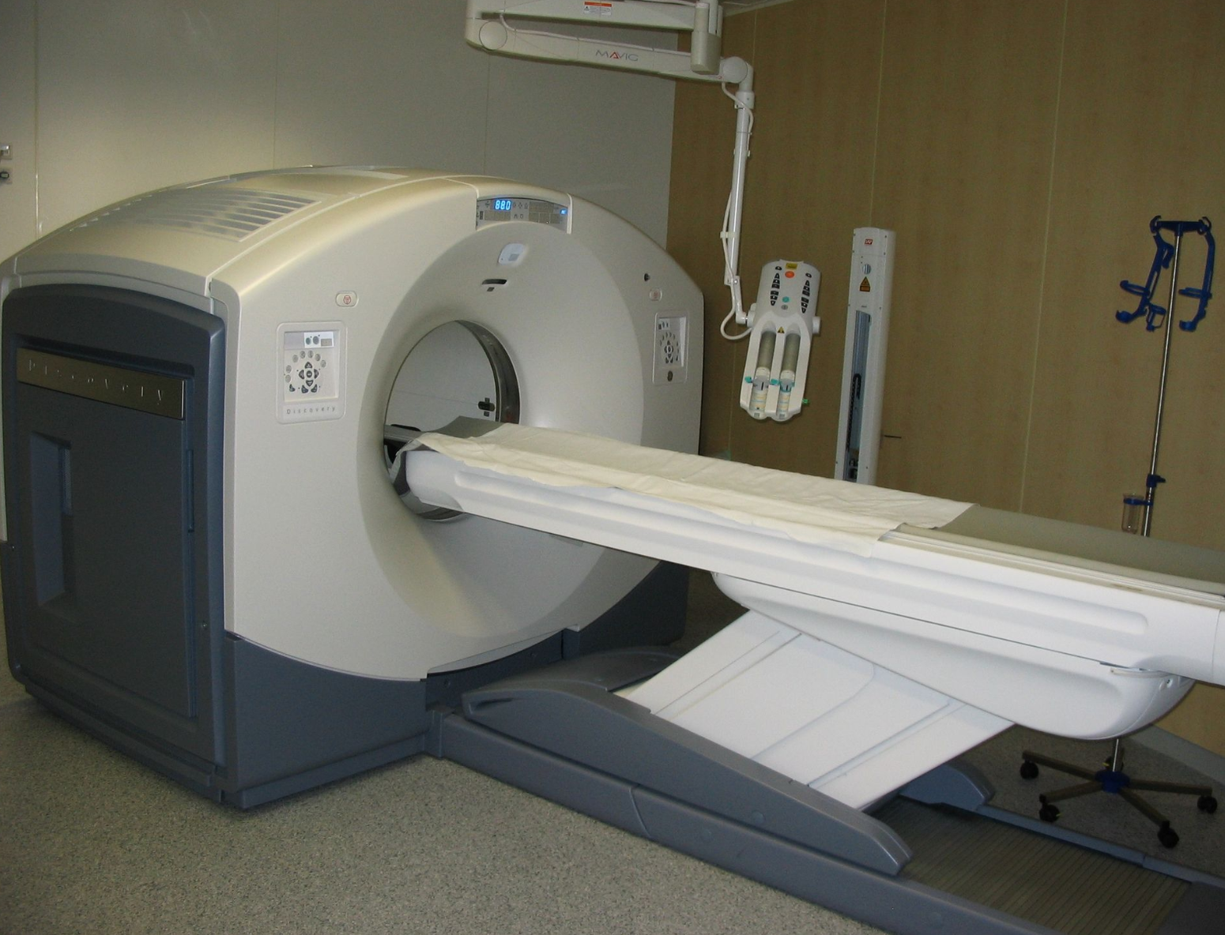
Commercial PET scanner

Slide 10
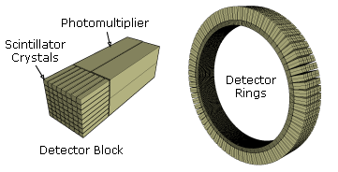
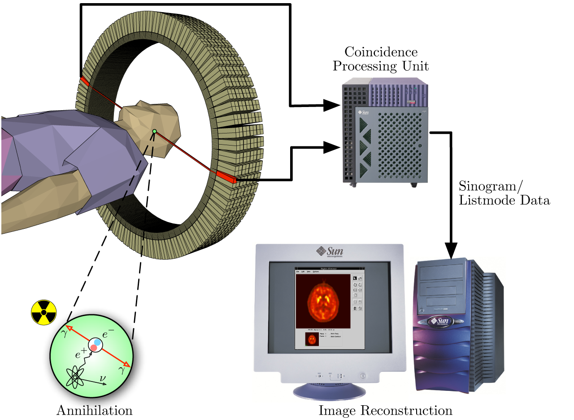
Commercial PET scanner

Slide 11
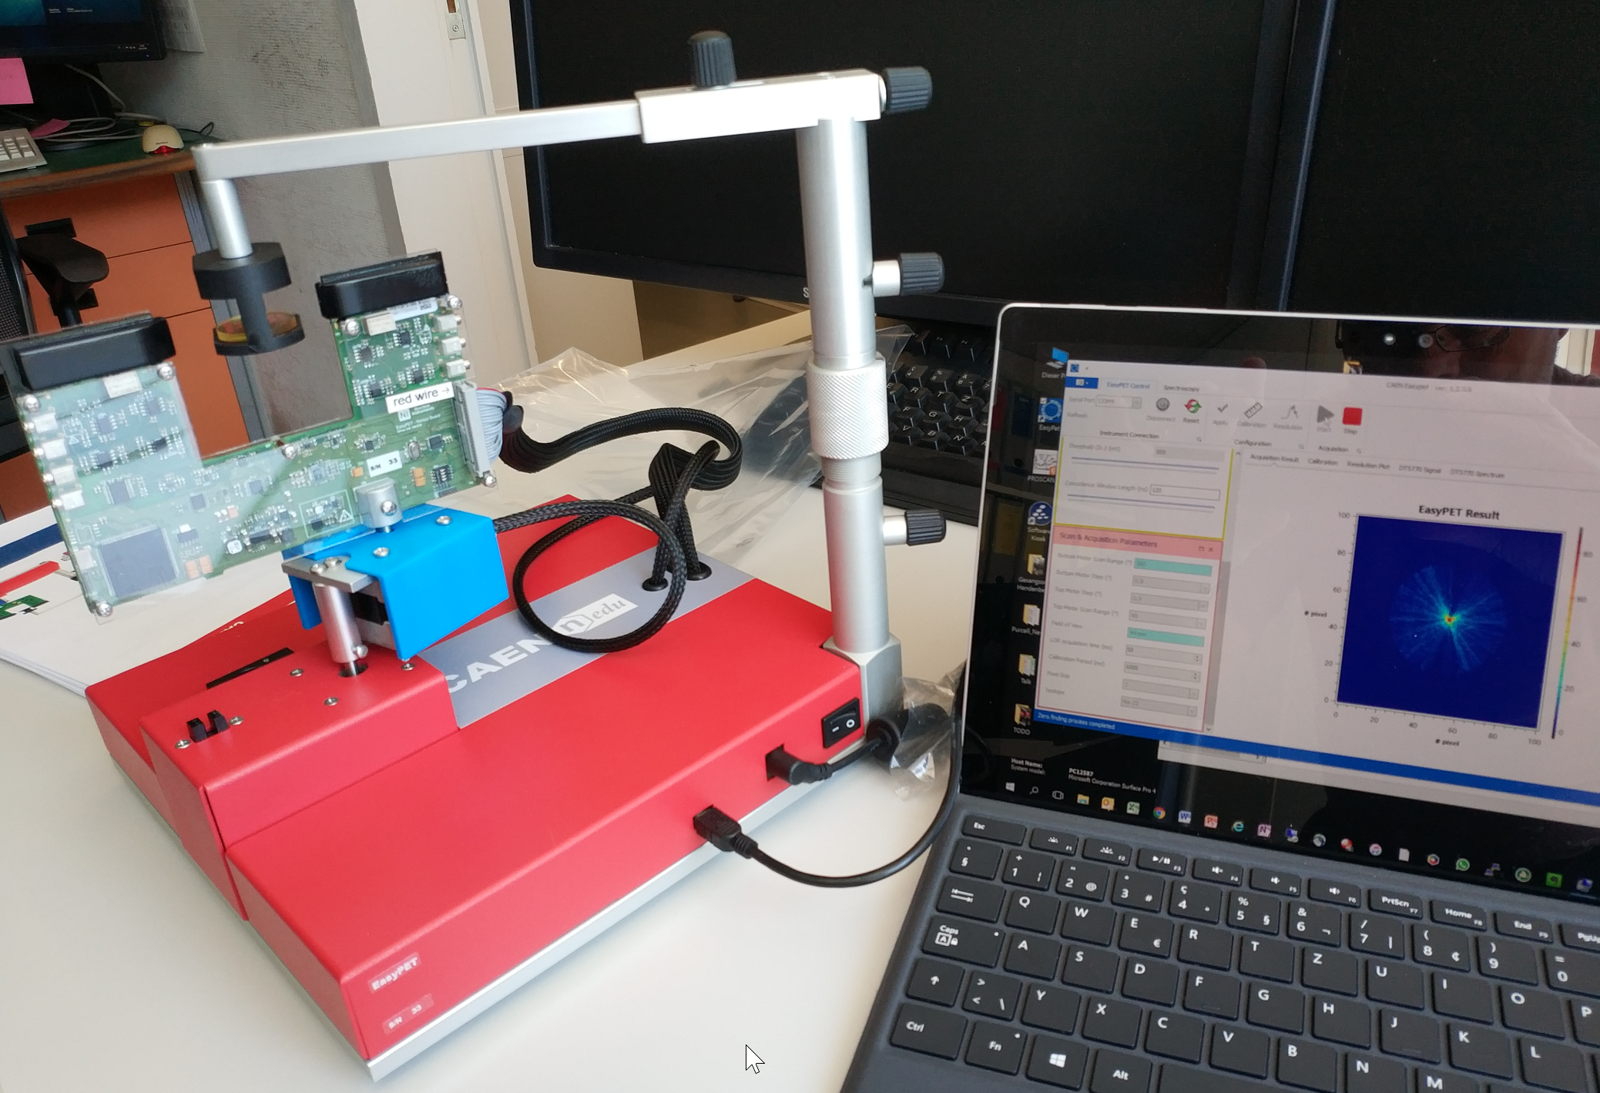
EasyPET
2 detectors moving around the target

Slide 12

LySO Crystals
Lutetium-yttrium oxyorthosilicate
Lu2(1-x)Y2xSiO5
Scintillator crystal

Slide 13
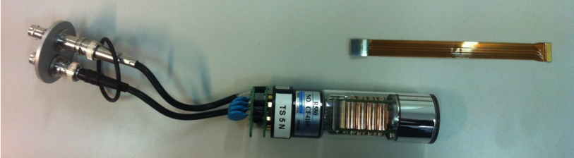
Silicon Photo Multiplier - SiPM
Solid state photon detectors
High gain, low voltage («bias»)
Very compact
Compatible with magnetic resonance imaging MRI

Slide 14
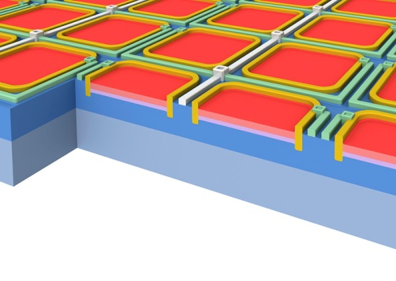
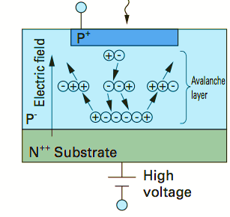
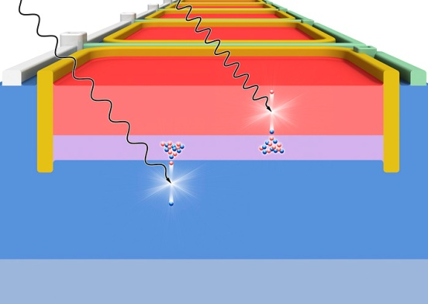

Silicon Photo Multiplier - SiPM
SiPM is a High density (up to 104/mm2 ) matrix of diodes with a common output, working in Geiger-Müller regime
Common bias is applied to all cells (few % over breakdown voltage)
Each cell has its own quenching resistor (from 100kΩto several MΩ)
When a cell is fired an avalanche starts with a multiplicative factor of about 10⁵-10⁶
The output is a fast signal (trise~ ns; tfall ~ 50 ns) sum of signals produced by individual cells
SiPM works as an analog photon detector

Slide 15
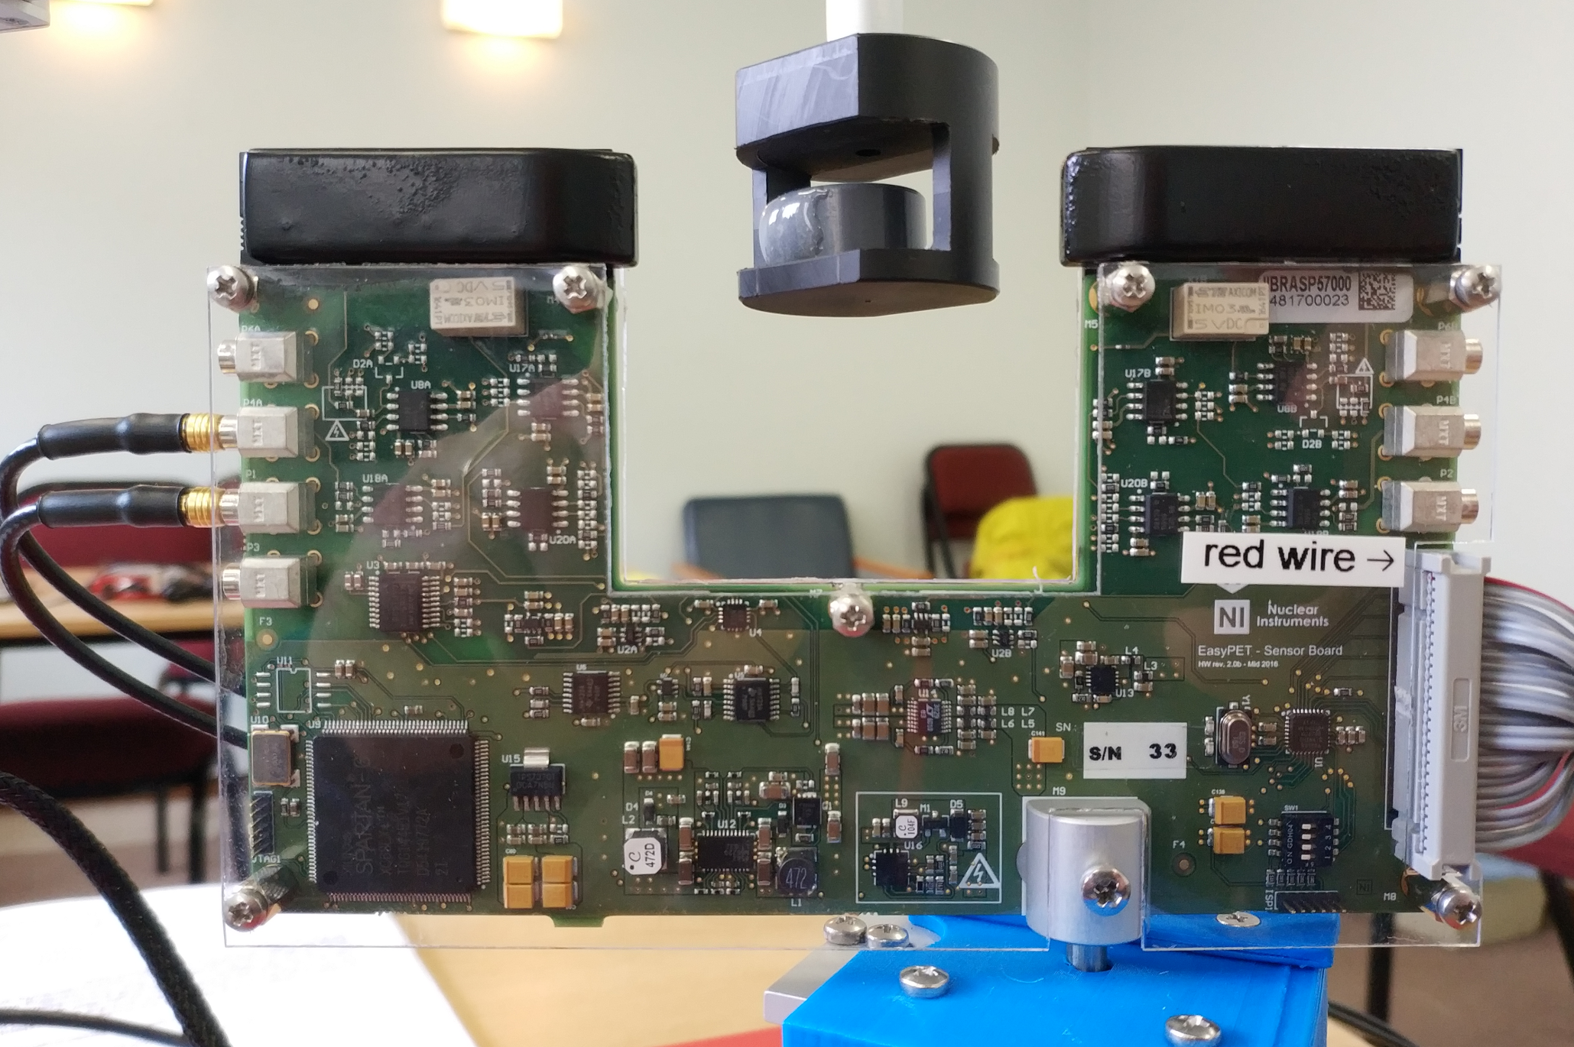
EasyPET PCB
Channel 1
Channel 2
Analog output
Comparator signal
Coincidence signal

Slide 16
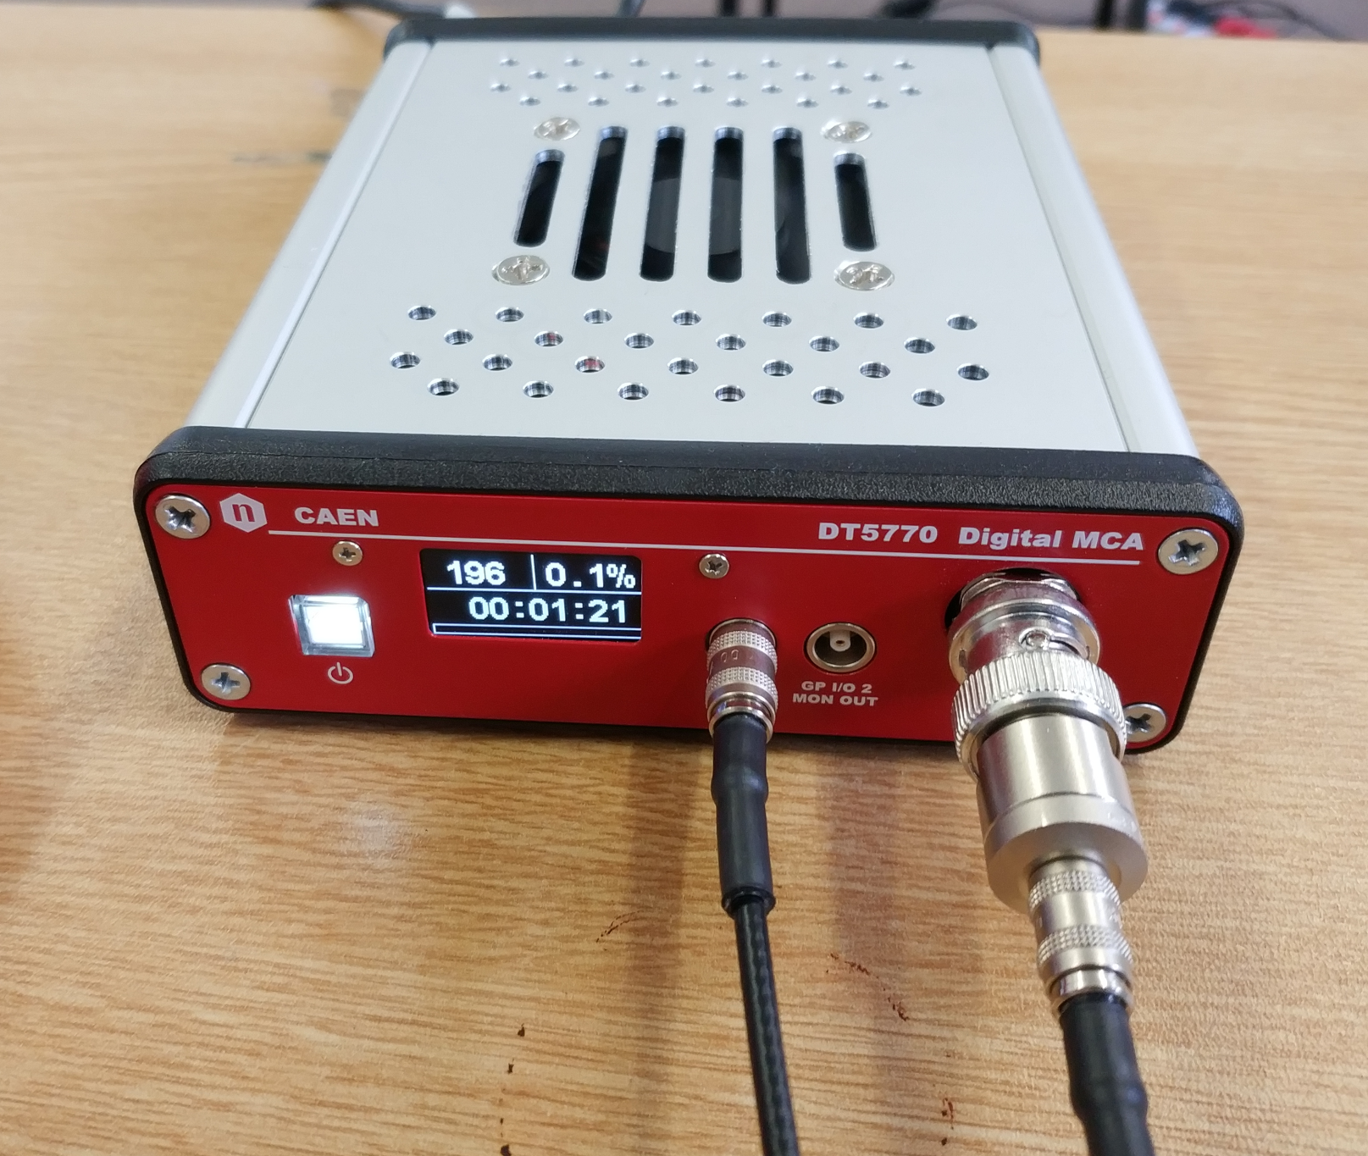
DT5770 Multi Channel Analyzer (MCA)
Analyze pulses
Accept signal and trigger input
Readout with PC

Slide 17
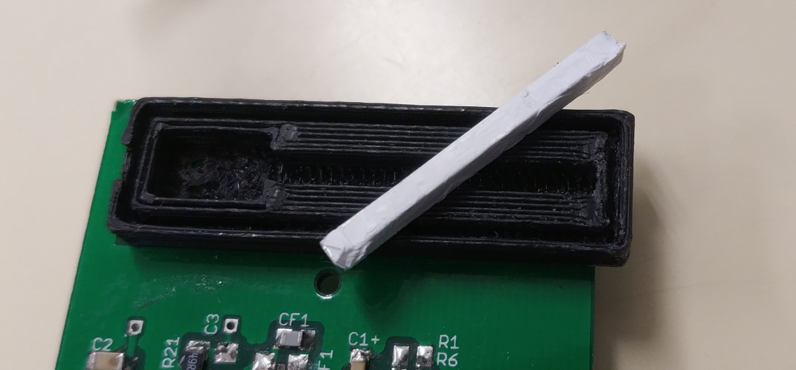
Source Alignment

Slide 18
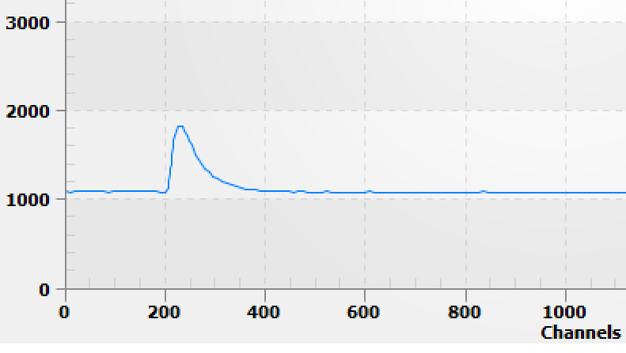
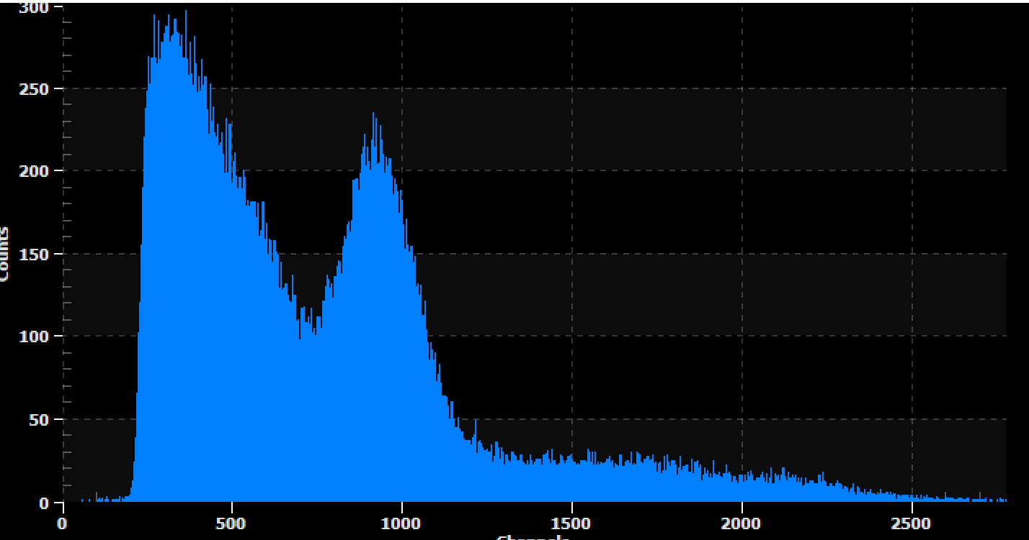
Multi Channel Analyzer (MCA)
Look at individual pulses
Acquire spectrum

Slide 19
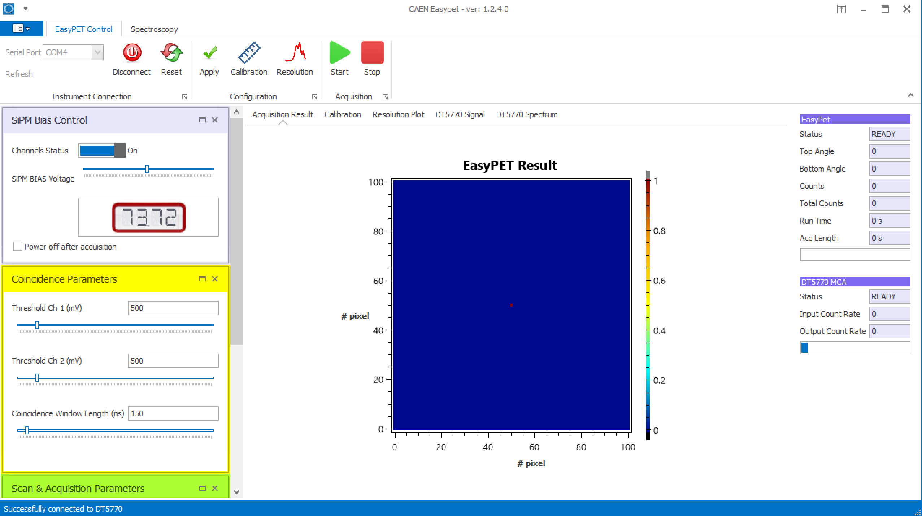
EasyPET GUI

Slide 20

Handling radioactive sources

Slide 21
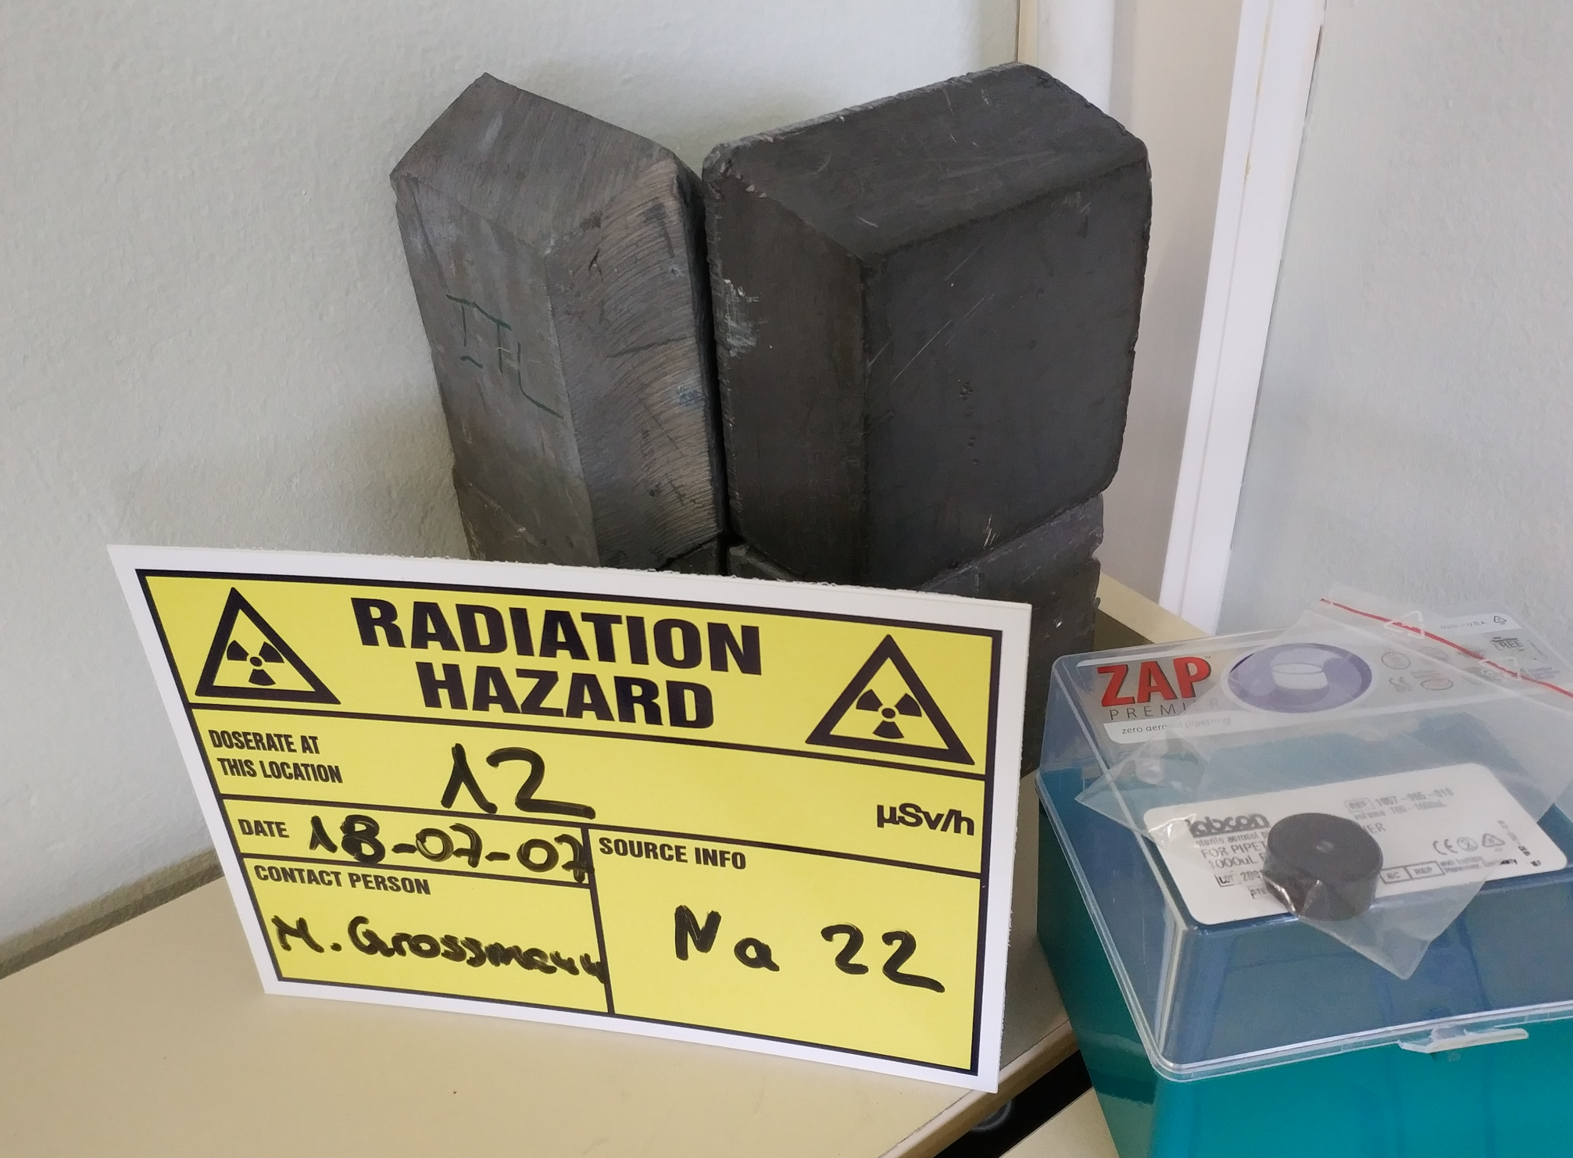
Handling radioactive sources

Slide 22
PET image

Slide 23


