Slide 1
NPSS Training School
Image reconstruction part 2: regularisation
Kris Thielemans
University College London, UK

Slide 2
Contents
Regularisation in general
Maximum A Posteriori/
Penalised Maximum Likelihood
Optimisation algorithms for MAP/PML

Slide 3
Iterative reconstruction in clinical practice
Early stopping
(at fixed number of iterations, which is dependent on the scanner, tracer, target organ and local practice)
Apply some post-filtering

Slide 4
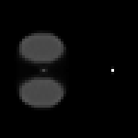

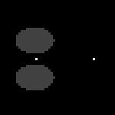
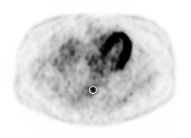
Problem with early-stopping: quantification
20 iterations
100 iterations
True image
True values only obtained after large number of iterations.
(Low contrast features appear late)
Courtesy Johan Nuyts, KU Leuven, Belgium
iteration
J Nucl Med, 2005; 46:469P (abs)
Convergence rate for 20 lesions
Notes:
The top row shows that a “lesion” in the middle of two large objects is only recovered after 100 iterations (i.e. it looks too smooth at 20 iterations), while the right “lesion” is already visible after 20 iterations. This is because it has less surrounding activity, and therefore it is intuitively easier to reconstruct. (This can be made mathematically precise by looking at the measured data and how MLEM works).
The bottom row illustrates the same for a simulation of a realistic patient. The right hand side plots different curves, one for each lesion. The horizontal axis is the number of iterations. You can see that initially, the values were all underestimated, and they get to 100% at the end. However, if we would stop at 50 iterations, each lesion would have a different quantitative “recovery”, and this will depend on its size, its location, surrounding activity, attenuation, etc. (i.e. it is not easy to predict how much you will underestimate the values).
Note that for “cold” objects (i.e. lower activity than the surrounding regions), usually MLEM initially overestimates the true activity (as it takes several image updates before the cold region can be distinguished from the warmer surroundings).

Slide 5
Maximum Likelihood
Problems of Maximum Likelihood:
  ML estimate looks ‘noisy/spiky’ in low statistics
  instability: sensitive to errors in system model
  Needs lots of iterations for convergence of quantitative measures
  ML solution is ill-conditioned
Needs regularisation

Slide 6
Regularisation types
Early stopping
  Problematic: when to stop is object/region dependent
Post-filtering
  Slow because you first need to iterate a long time
Inter-iteration filtering
Sieves
Use of penalty/a priori information (MAP)
  aka Bayesian methods
  Introduces ‘penalty’ term (encodes type of images you expect/like)

Slide 7

Fundamental trade-off with iterative algorithms
Contrast
Resolution
Quantification
Noise-reduction
Visual appeal
Notes:
In image reconstruction, we always have to balance these 2 “qualities”. For instance, we have seen that with increased iteration number, MLEM images get very noisy, but small objects have higher contrast.
Similarly, noise-reduction by filtering will decrease contrast.
This trade-off means that there is no “optimal image”. You will have to decided what balance you prefer, which will depend on what you are going to use the image for. In other words, the “optimal image” is task-dependent.

Slide 8
Maximum a Posteriori (MAP)
Remember Maximum Likelihood:
  Maximise log Prob(image | data)
It makes more sense to maximise Prob(image | data)
How?
Rewrite using Bayes’ rule:
  log Prob(image | data) =
  log Prob(data | image) +
  log Prob(image) + cst
Encodes what kind of images you expect/like

Slide 9
MAP vs fitting
MAP:
  Maximise
  log Prob(data | image)
  + log Prob(image)
Fitting with regularization
Minimise
distance(data, forw_proj(image)+background)
+ penalty(image)
Notes:
These slides illustrates 2 different ways to look at the iterative reconstruction, with exactly the same outcome.
On the top, we want to find the image that is most likely for some measured data, and (via Bayes’ rule), this corresponds to maximising the sum of the log-likelihood (which is higher if the data is close to the estimated data) and the log-prior (which is higher if the image is more likely to correspond to a patient).
Fitting takes the opposite (but equivalent) point of view: it minimises the sum of a “distance” between the data and the estimated data and a penalty (which is lower if the image more desirable).
Clearly, these are identical if
log Prob(data | image) = - distance(data, forw_proj(image)+background)
log Prob(image) = -penalty(image)
Note that the sum of the 2 terms is often called the “objective function”: we are trying to find the image that optimises (i.e. maximise for MAP, minimise for fitting) this function.

Slide 10
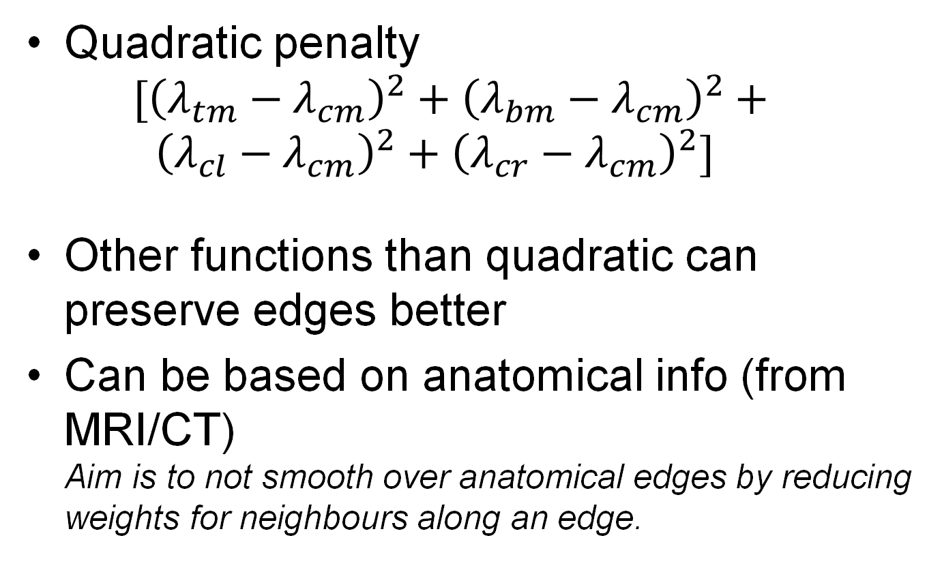
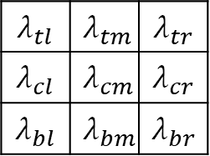
Examples of penalties
$$λ_{tl}$$ | $$λ_{tm}$$ | $$λ_{tr}$$
$$λ_{cl}$$ | $$λ_{cm}$$ | $$λ_{cr}$$
$$λ_{bl}$$ | $$λ_{bm}$$ | $$λ_{br}$$
Quadratic penalty
  $$[{\left(λ_{tm}−λ_{cm}\right)}^{2}+{\left(λ_{bm}−λ_{cm}\right)}^{2}+$$
  $${\left(λ_{cl}−λ_{cm}\right)}^{2}+{\left(λ_{cr}−λ_{cm}\right)}^{2}]$$
Other functions than quadratic can preserve edges better
Can be based on anatomical info (from MRI/CT)
Aim is to not smooth over anatomical edges by reducing weights for neighbours along an edge.
Notes:
The quadratic penalty is higher when neighbouring voxel values differ more. OSEM images become “grainy” with higher iteration number (sometimes called “they have salt and paper noise”). Adding this penalty makes sure that this will not happen and images are smoother. Of course, if there are true edges/discontinuities in the image (e.g. at the boundaries of an organ/lesion/brain structure/etc) the quadratic penalty will penalise this as well.
Edge-preserving penalties generally will gradually reduce the amount of penalisation for higher values of the difference between 2 neighbours. Therefore, you are telling the reconstruction algorithm that if there’s a large difference, it likely corresponds to a true edge.
(There is a complicated relation between MAP and post-filtering, which is out-of-scope).

Slide 11
MAP advantages over MLEM
Results are no longer dependent on iteration number
(needs enough iterations, but too many doesn’t hurt)
Results are easier to predict
  Results independent of initial image and of exact algorithm that was used
  Can be analysed theoretically
Iterative problem is easier to solve
  Algorithm can be designed to need less iterations for MAP than MLEM
Notes:
You can run a MAP algorithm for many iterations, because the penalty prevents noise-increase. After sufficient iterations, the image will not change anymore (“the algorithm has converged”). This means that as long as you set the number of iterations high enough, you don’t need to worry that you’ve stopped too early to see a lesion (while still at low noise). You can therefore achieve more reliable quantification.

Slide 12
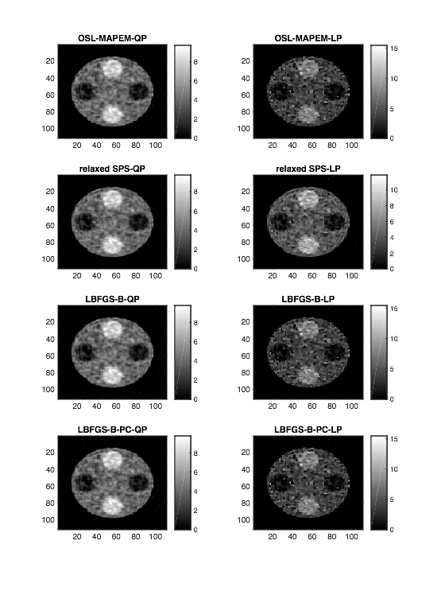
MAP Advantage: Converged Images
1000 iterations
1000 iterations
61 iterations
42 iterations
Different algorithms all converge to the same image (for the same prior)
Notes:
Researchers have designed many different algorithms to find the MAP solution. Here we show that for a given MAP problem (and measured data), all these algorithms give the same image, as long as you run them “long enough”, and that that image still looks “reasonable”. Therefore, it’s easier to study MAP results as you don’t need to worry about the algorithm (but only about the data and the prior).
However, different algorithms do achieve “convergence” (i.e. find the MAP solution) at different “speeds”. For fast algorithms, it will mean that we get quantitative numbers faster than what would be achievable with MLEM.

Slide 13
MAP disadvantages ?
More choice
  Which penalty are we going to use?
  What parameters are we going to use? (how large is the penalty?)
Effect of the penalty is more complicated than you would hope
  The balance between the “fitting” term and the penalty depends on the whole object, not just the local edges.
Notes:
The last point surprised many researchers and is not so easy to grasp. You can maybe get a feeling for it by considering the objective function again
O(image) = distance(data, forw_proj(image)+background)+ penalty(image)
Now consider a patient scanned on 2 days. Let’s suppose the radioactivity distributes everywhere the same on both days, aside from in one region (e.g. the liver) and see what happens elsewhere (e.g. the pancreas). For the type of penalty that we considered (which depends on difference between neighbours only), the penalty term hardly changes in the pancreas (as by assumption the underlying image is the same there), but the forward projection will depend on the values in the liver as well. Therefore, the balance between the 2 terms (log-likelihood and penalty) will be different.
To investigate how this affects the image, we would need to compute mathematically how the 2 terms change and therefore how the final “optimum” images will differ. This can be done using 2nd order derivatives (at least if the changes are small enough). If you’re up for it, the seminal paper on this topic is https://web.eecs.umich.edu/~fessler/papers/files/jour/96/web/fessler-96-srp.pdf. Compensating for this effect is still somewhat of a research topic.

Slide 14
MAP Algorithms
Any algorithm that does (constrained) optimisation
Often adjusted/tweaked specific for the PET problem
Types:
  (preconditioned) gradient ascent
  Surrogate-based
  Proximal-based (out-of-scope)
Need for further modifications for subset algorithms (out-of-scope)

Slide 15
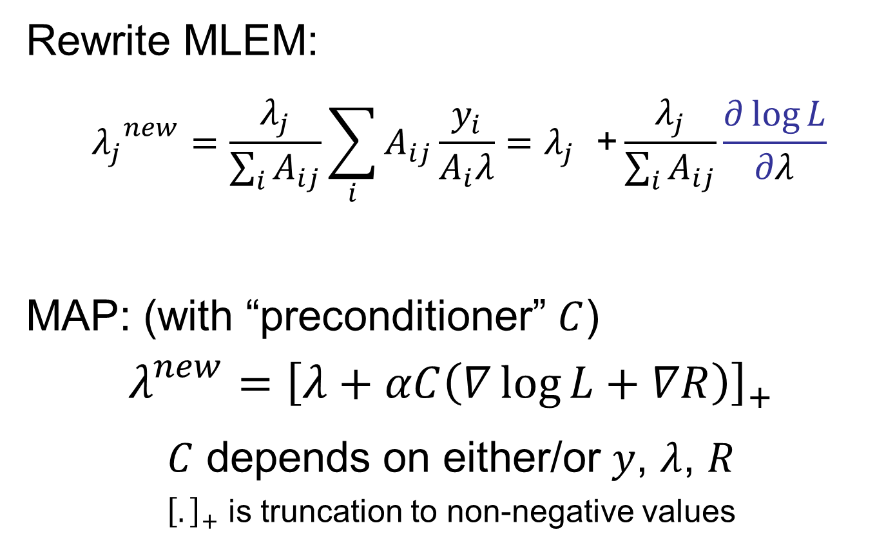
Gradient-ascent type of algorithms
Rewrite MLEM:
$${λ_{j}}_{}^{new}=\frac{λ_{j}}{\sum_{i}{A_{ij}}}\sum_{i}{A_{ij}\frac{y_{i}}{A_{i}λ}}=λ_{j}\text{ +}\frac{λ_{j}}{\sum_{i}{A_{ij}}}\frac{∂\log{L}}{∂λ}$$
MAP: (with “preconditioner” $C$)
$$λ_{}^{new}={\left[λ+αC\left(∇\log{L+∇R}\right)\right]}_{+}$$
$C$ depends on either/or $y$, $λ$, $R$
${\left[.\right]}_{+}$ is truncation to non-negative values

Slide 16
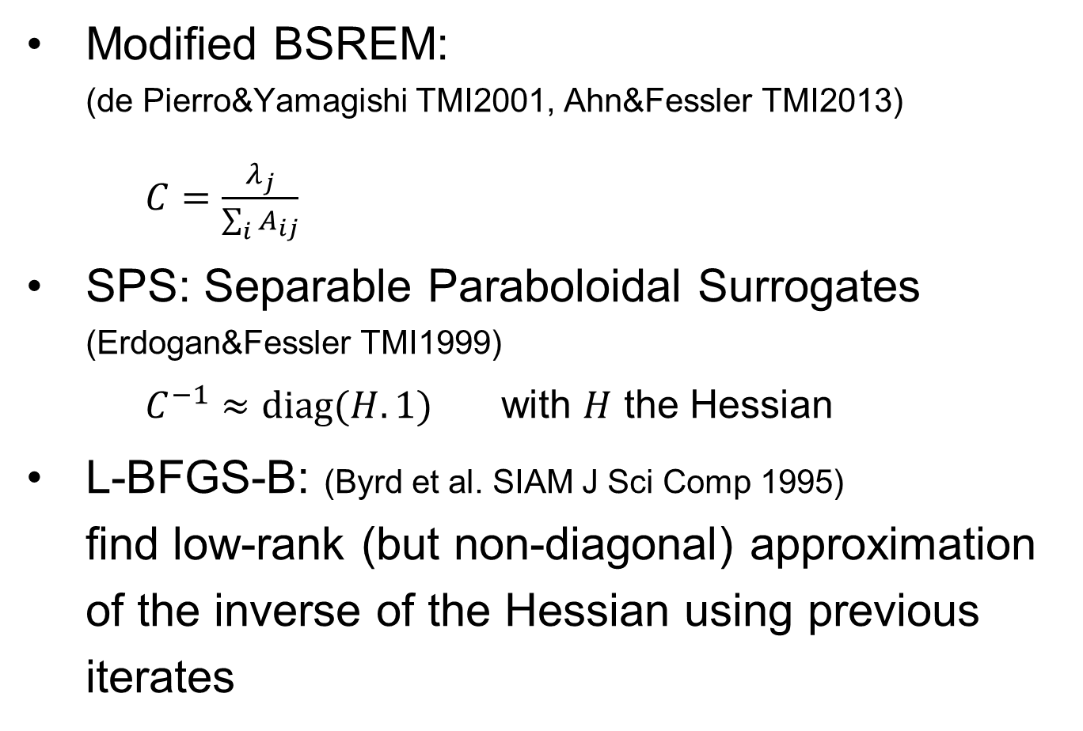
Preconditioning examples
Modified BSREM:
(de Pierro&Yamagishi TMI2001, Ahn&Fessler TMI2013)
  $C=\frac{λ_{j}}{\sum_{i}{A_{ij}}}$
SPS: Separable Paraboloidal Surrogates (Erdogan&Fessler TMI1999)
  $C^{−1}≈\text{diag}(H.1)$ with $H$ the Hessian
L-BFGS-B: (Byrd et al. SIAM J Sci Comp 1995)
find low-rank (but non-diagonal) approximation of the inverse of the Hessian using previous iterates

Slide 17

Surrogates
At each iteration, find a “simple” function to optimise that will bring us closer to the optimum.
Illustration for minimisation of non-convex function
$$Φ^{n}\left(λ^{n};λ^{n}\right)=Ψ\left(λ^{n}\right) \\ Φ^{n}\left(λ;λ^{n}\right)≥Ψ(λ)$$
for$λ$ in feasible region
Can be useful for constrained problems using 2 strategies:
Surrogate that is easier to minimise with constraints
Surrogate that allows unconstrained optimisation

Slide 18
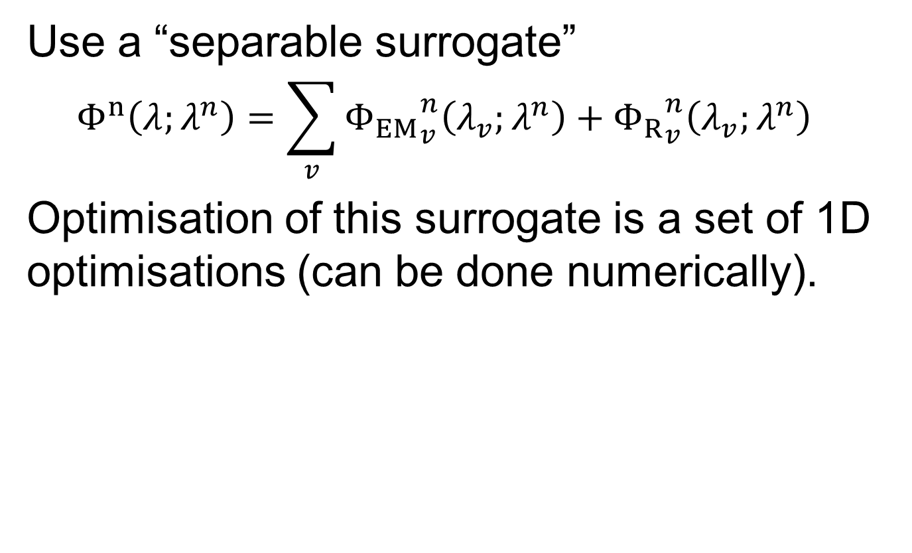
de Pierro MAP-EM surrogate
Use a “separable surrogate”
  $$Φ^{n}\left(λ;λ^{n}\right)=\sum_{v}{{Φ_{EM}}_{v}^{n}\left(λ_{v};λ^{n}\right)+{Φ_{R}}_{v}^{n}\left(λ_{v};λ^{n}\right)}$$
Optimisation of this surrogate is a set of 1D optimisations (can be done numerically).

Slide 19
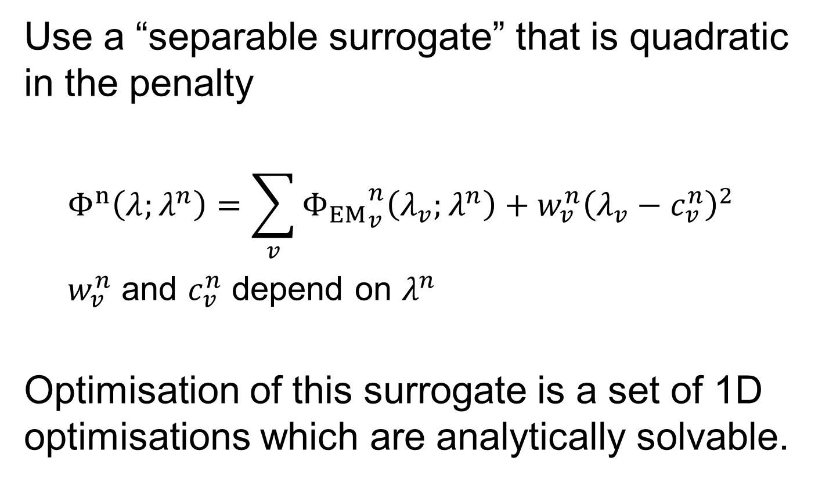
Wang&Qi MAP-EM surrogate
Use a “separable surrogate” that is quadratic in the penalty
  $$Φ^{n}\left(λ;λ^{n}\right)=\sum_{v}{{Φ_{EM}}_{v}^{n}\left(λ_{v};λ^{n}\right)+{w_{v}^{n}\left(λ_{v}−c_{v}^{n}\right)}^{2}}$$
  $w_{v}^{n}$ and $c_{v}^{n}$ depend on $λ^{n}$
Optimisation of this surrogate is a set of 1D optimisations which are analytically solvable.

Slide 20
SIRF-Exercises
Continue your previous work
PET/MAPEM: implement the MAP-EM algorithm
Advanced: check the Synergistic notebooks

