Slide 1
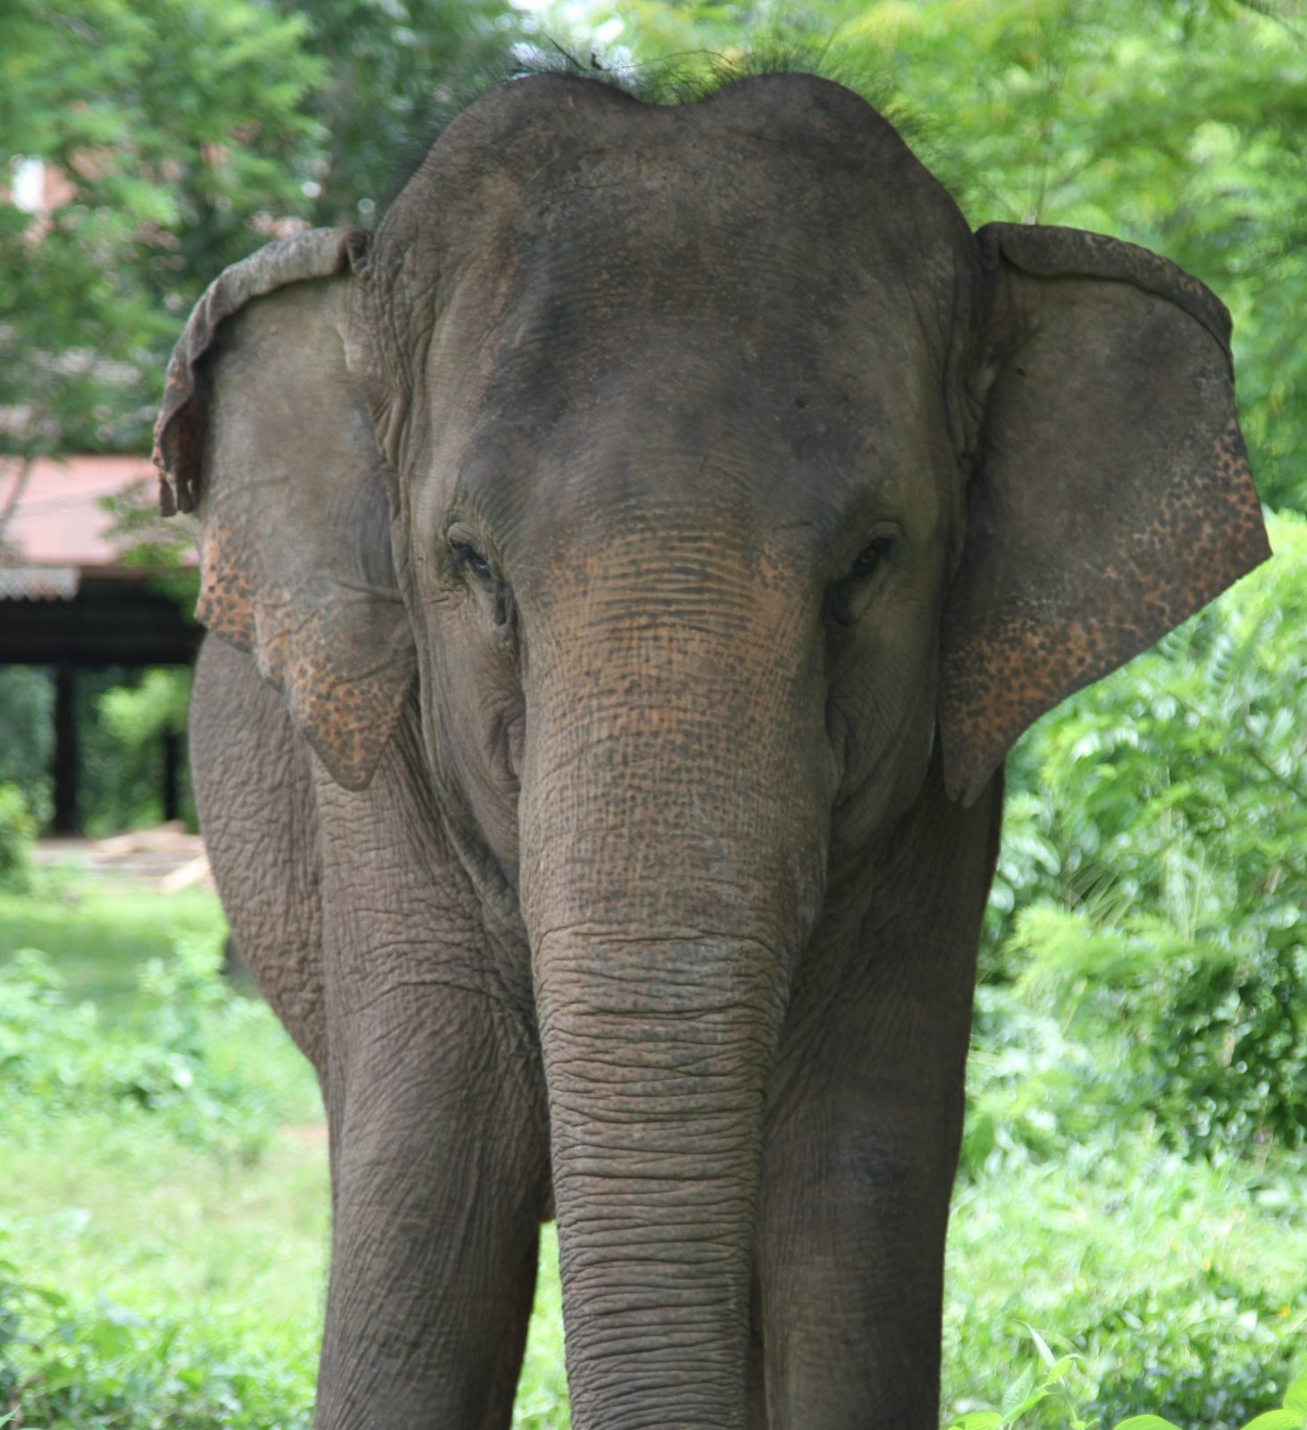
Reminder

Slide 2
Image reconstruction
Data are (in first approximation) proportional to “line integrals” (also known as “projections”).
We can store these in “sinograms”, which are a way to order all possible Lines of Response (by angle and distance from origin)
Image reconstruction attempts to “invert” the measurement, i.e. find the image that is consistent with the measured data.

Slide 3
FBP
Based on an analytic inversion formula of the X-ray transform
Back-projection in itself gives very smooth images. A specific sharpening filter (called the ramp filter) needs to be applied to recover the true image.

Slide 4
FBP issues
Need to discretise analytic formulas
  After all, only discrete detectors available
Analytic methods ignore
  Noise (has to be handled by filtering)
  Finite detector size
  Limited angles

Slide 5
Maximum Likelihood/
Iterative algorithms
Inverse problem
  forward model (can) incorporate what we know about the acquition process
  ML maximises the log-likelihood, which takes noise into account
  Different algorithms exist, but in PET, MLEM and OSEM are most popular

Slide 6
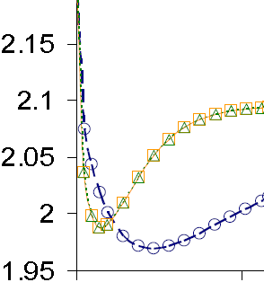
OSEM acceleration
Region Of Interest value
6 subsets vs
18 subsets:
~ 3 times faster
CPU time
Initial acceleration roughly equal to number of subsets.
Equivalently
Initial convergence rate only determined by number of image updates
Notes:
Initially we are far away from the true solution. Using only a subset of the data therefore results in a good step in the right direction, but with much less computational effort. As long as the subset of data is not too small, this update image is (almost) identical to the one we would obtain using all the data.

Slide 7
SIRF and CIL description
Project background
Software overview
Example results

Slide 8
Synergistic Image Reconstruction Framework
Aims
  powerful enough to handle real data,
  simple enough to be used for training and fast prototyping
  robust enough to be incorporated into real-word pipelines
Open source
  Apache 2.0 license
  Actual distribution is GPL due to use of FFTW

Slide 9
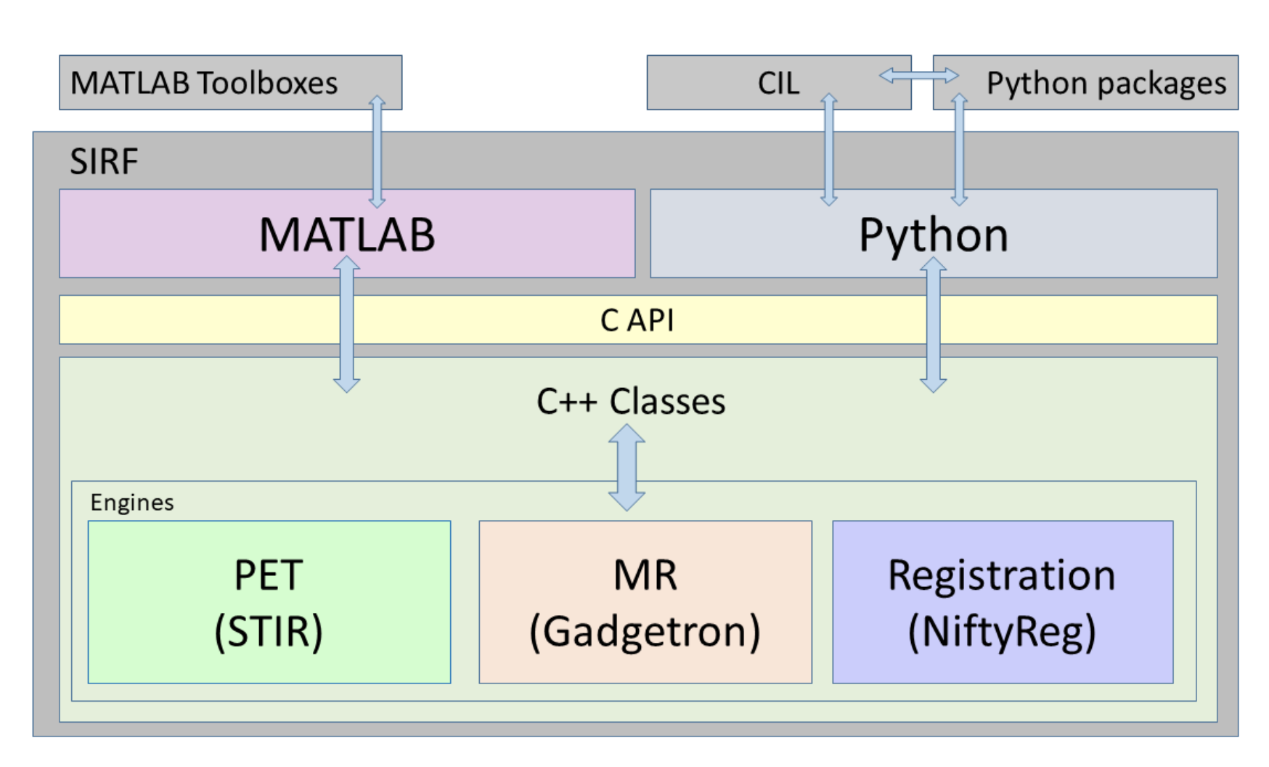

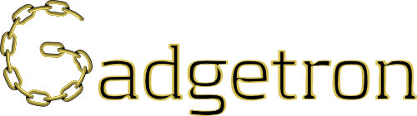
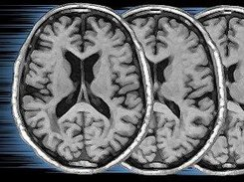
SIRF Software Architecture
PET & SPECT
NiftyReg

Slide 10
Example SIRF reconstructions
(epilepsy study, PET-FDG)
T1-weighted MR
Uniform-weighted quadratic MAP
Bowsher-weighted quadratic MAP
OSEM

Slide 11
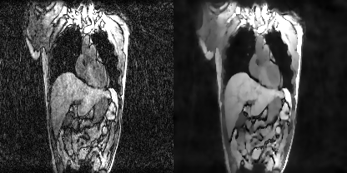
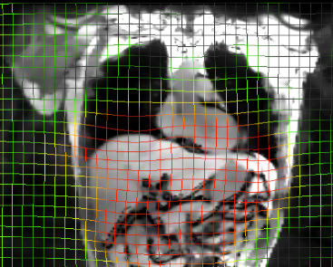
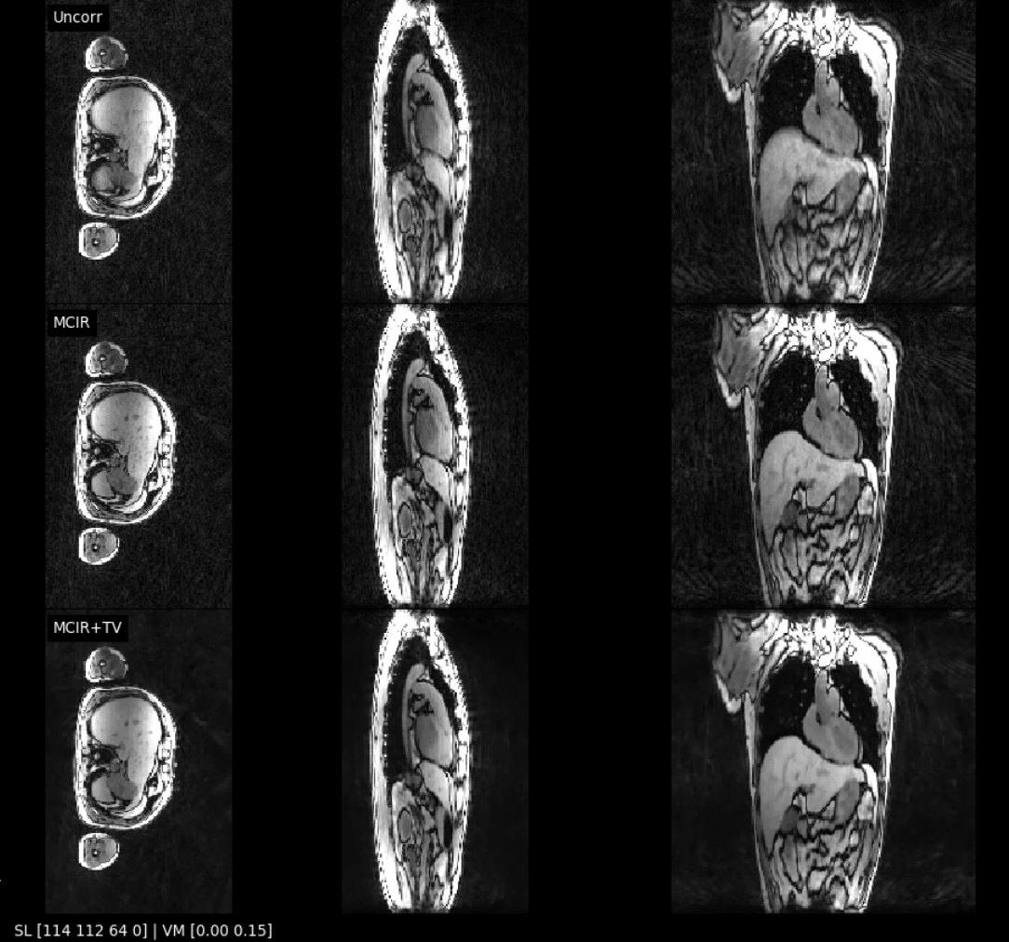
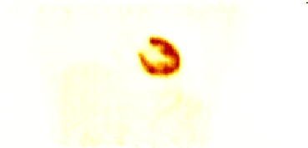
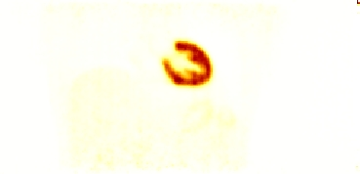
Siemens mMR: respiratory gated PET/MR
Motion compensation to reduce artefacts and noise
Workflow:
  Gated MR recon (FISTA+TV)
  Image registration
  MCIR of gated MR with GTV
  MCIR of gated PET
  (OSSPS)
No TV
With TV
No MC
With MC
MCIR =
Motion Compensated Image Reconstruction

Slide 12
Software for Tomographic Image Reconstruction
http://stir.sourceforge.net
https://github.com/UCL/STIR
Main publication:
Thielemans, Tsoumpas, et al (2012) STIR: Software for Tomographic Image Reconstruction Release 2,
Physics in Medicine and Biology, 57(4):867-83.
Kris Thielemans
University College London
Algorithms And Software Consulting Ltd
Charalampos Tsoumpas
Rijksuniversiteit Groningen
Nikos Efthimiou
Massachusetts General Hospital

Slide 13
STIR 1-slide overview
Development started in 1997, open source from 2000, Apache 2.0 since STIR 4.1.0.
Covers PET and SPECT
Aims to provide start-to-end quantitative image reconstruction
Capabilities
  Estimation of parts of the acquisition model
  Image reconstruction
  Motion-compensated reconstruction
  Parametric imaging (for dynamic data)

Slide 14
Current PET scanner support (since 4.1)
Siemens mMR and older Siemens scanners
PET raw data · SyneRBI/SIRF Wiki (github.com)
GE Signa PET/MR and any GE PET/CT that uses RDF 9
(SIRF supported is preliminary)
Warning: Time-of-Flight branch of STIR mostly works except for data-algebra

Slide 15
Data storage
Histogrammed
  counts detected in a certain time frame
  often called “sinograms” or “projections”
    4D: TOF, (2D) sinogram, view, radial
    sinogram-index runs over “axial positions”
    and “ring-differences” (aka segments)
List mode data
  A list of all coincidences
  Currently no listmode reconstruction in SIRF
  but coming soon!
Attenuation image
“Normalisation” (or “calibration”) files
AcquisitionData
ListmodeToSinograms
ListmodeData

Slide 16
Some sirf.STIR pecularities
To do simulations, you need to start from “template” AcquisitionData
  Read one from file
  Construct one based on a particular scanner (together with some extra parameters)
Note that the sinogram-data in this “template” will not be used for the simulation.
(it does not need to exist -> read failures)

Slide 17
sirf.STIR image dimensions restrictions for a particular PET scanner:
  axial spacing and number of slices is fixed
  “in-plane” spacing and number of pixels is arbitrary
Exercises are set-up such that images and acquisition data are compatible.
You can create an ImageData from an AcquisitionData, which is guaranteed to work.

Slide 18
STIR writes a lot of diagnostic output by default
In current exercises, most data has not been brought up-to-date yet, so warnings about radio-nuclide, timings etc. These can be safely ignored.
You can redirect it to files (as illustrated in most notebooks)
msg_red = pet.MessageRedirector('info.txt', 'warnings.txt', 'errors.txt’)
You can reduce verbosity
sirf.STIR.set_verbosity(0)

Slide 19
How to get/install the software?
STFC Cloud: https://training.jupyter.stfc.ac.uk/
Your own installation:
  Virtual Machine
  Docker
  (self-built)
More detail on the HackMD site

Slide 20
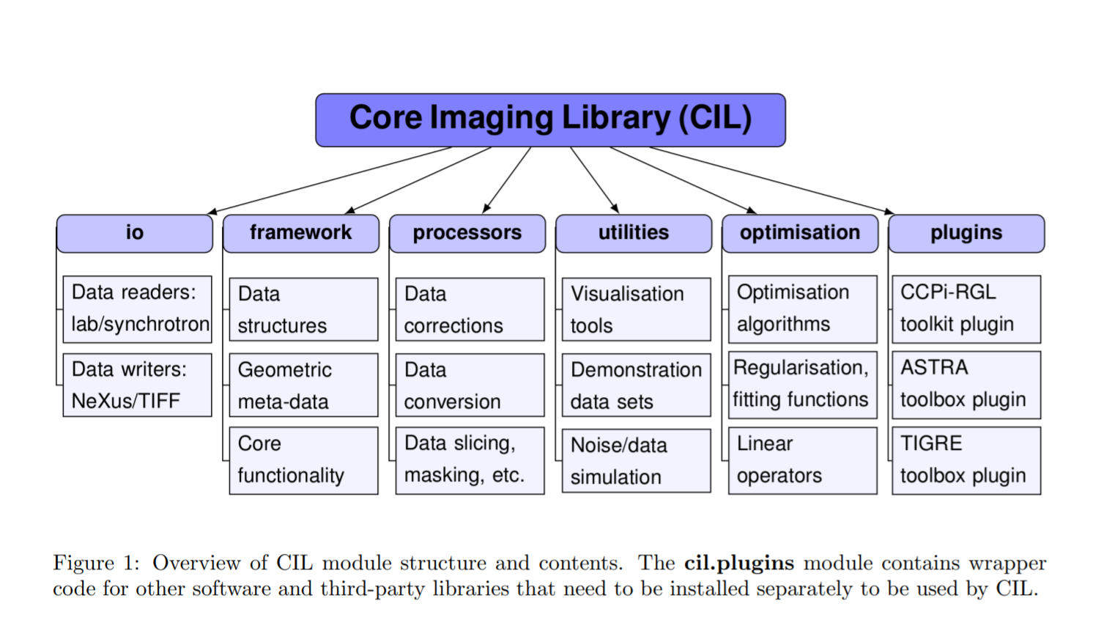
CIL https://github.com/TomographicImaging/CIL
Open Source Python framework for tomographic imaging with emphasis on challenging datasets where conventional filtered back-projection fail.
Apache 2.0 license
CIL aims to combine the best of the two worlds of:
Tomography
Optimisation software
Notes:
We envision that in particular two types of researchers might find CIL useful:
• Applied mathematicians and computational scientists can use existing mathematical building blocks and the modular design of CIL to rapidly implement and experiment with new reconstruction algorithms and compare them against existing state-of-the-art methods. They can easily run controlled simulation studies with test phantoms and within the same framework transition into demonstrations on real CT data.
• CT experimentalists will be able to load and pre-process their standard or non-standard data sets and reconstruct them using a range of different state-of-the-art reconstruction algorithms. In this way they can experiment with, and assess the efficacy of, different methods for compensating for poor data quality or handle novel imaging modalities in relation to whatever specific imaging task they are interested in
Particular emphasis is on enabling a variety of regularised reconstruction methods within a “plug and play” structure in which different data fidelities, regularisers, constraints and algorithms can be easily selected and combined

Slide 21
SIRF-Exercises
Now
First look at the Introductory/ notebooks.
PET/display_and_projection repeats some of that material but goes in a bit more detail on PETAcquisitionData.
PET/image_creation_and_simulation shows how to create some images with geometric shapes, and explains attenuation modelling etc.
PET/OSEM_reconstruction shows how to run a sirf.STIR class for OSEM reconstruction.
PET/reconstruct_measured_data (optional) goes into detail on how to reconstruct data from the Siemens mMR.
After coffee (?)
PET/ML_reconstruction illustrates Maximum Likelihood Estimation via OSEM and gradient ascent.
PET/DIY_OSEM (optional): write MLEM and OSEM yourself using SIRF functionality (optional).

Slide 22
Relevant links
IEEE NPSS School on Advanced Topics in PET/CT and PET/MR - Thailand 2023 - Extra information – HackMD
https://github.com/SyneRBI/SIRF-Exercises/blob/master/DocForParticipants.md
https://github.com/SyneRBI/SIRF-Exercises/blob/master/notebooks/Introductory/README.md
https://github.com/SyneRBI/SIRF-SuperBuild/blob/master/VirtualBox/documentation/README.md

