Slide 1
NPSS Training School
Image reconstruction
Kris Thielemans
University College London, UK

Slide 2
Aims and Structure

Slide 3
Aims
For you to gain
understanding of image reconstruction
  Concepts
  Most common algorithms
  Some ideas of the future
hands-on experience using SIRF
  Use and evaluate existing algorithms
  Allow you to implement your own, or combine existing ones

Slide 4
Additional aims
Join/grow a community of researchers improving image quality and willing to share experience and software
  sharing between modalities as well as fields (medical and material science)
  international
Accelerate research and translation into practice

Slide 5
Schedule
Today
Lecture: basics of PET image reconstruction
Tomorrow
Demonstration of tools
Hands-on: Simulation and “simple” reconstruction
Coffee
Lectures and Hands-on: MAP and multi-modal data
Lunch

Slide 6
What are the data?
First approximation: projections
For each detected event, the emission occurred on a Line Of Response (LOR)
The mean number of detected events will therefore be proportional to the accumulated activity on that LOR
Hence, the (mean of the) data are (proportional to) line-integrals through the activity image.
Notes:
This slide is a simplification. We will talk much more about this in future lectures.

Slide 7
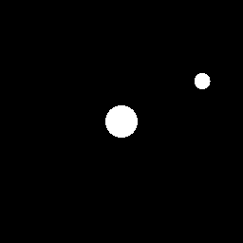

Projection data (sinogram)
Line integrals through the object (X-ray transform)
Image
Projections
3
3
2
1.
2.5
1.2
1
2
y
φ
0
1.5
-1
1
-2
0.
0.5
0.
-3
0
-3
-2
-1
0
1
2
3
-3
-2
-1
0
1
2
3
x
s
y
φ
s
x
Notes:
This slide explains the traditional way to represent the data as a “sinogram”. It uses a simple simulation as example.
On the left is the “image” or the radioactivity distribution. Black says there is no radioactivity, white that there is (with a certain activity, here given as “1”). So, there are 2 circular objects here.
The lines are used to denote the lines for which we are taking the projections.
The right shows a “sinogram”, which is a way to display the projections. Each dot in the sinogram corresponds to a line in the left image. The intensity of the pixels in the sinogram uses a “grey scale”, here going from black (0) to white. A black pixel in the sinogram means that there was no activity along that line. A bright pixel means that there was a lot of activity. (Side note: in this simulation, the maximum in the sinogram happened to be 1.2. This is due to the specifics of the choice of units, duration etc. You can safely ignore this.)
The bottom image shows the coordinates used in the sinogram.

Slide 8
Contents
Analytic Algorithms
Iterative Algorithms
Noise characteristics in image reconstruction

Slide 9
Analytic methods (FBP et al)
Are based on mathematical inversion of the complete set of ‘line integrals’ (X-ray transform)
Common to CT, SPECT, PET, even some MRI sequences.
Measured data have to be precorrected (i.e. attenuation, scatter etc.) to get as close as possible to line integrals before they can be handed to FBP.

Slide 10
1st attempt at Reconstruction: backprojection
detector
(projection)
back
projection
object
reconstruction
Acquisition: we only know direction of detected photons
Reconstruction: photon could have originated anywhere along the back-projected line; assign counts along line with equal probability, proportional to detected counts (back projection)
Notes:
Reconstruction is based on knowledge of the geometry of detection. We know that a photon detected at a point on the detector should have travelled in a straight line normal to the detector, even if we don’t know the exact location of the emission.
The simplest method of reconstruction is back projection in which the ray is traced back over the complete reconstruction matrix. We update the reconstruction matrix on computer by assigning a constant number proportional to the number of counts on the projection to every pixel along the ray path.
This process is completed for all projection points completing ray paths which correspond to all detected photons.

Slide 11


Back projection illustrated
Image
Projections
3
3
2
1.
2.5
1.2
1
2
y
φ
0
1.5
-1
1
-2
0.
0.5
0.
-3
0
-3
-2
-1
0
1
2
3
-3
-2
-1
0
1
2
3
x
s
$$φ=0$$
$$φ=0.5$$

Slide 12
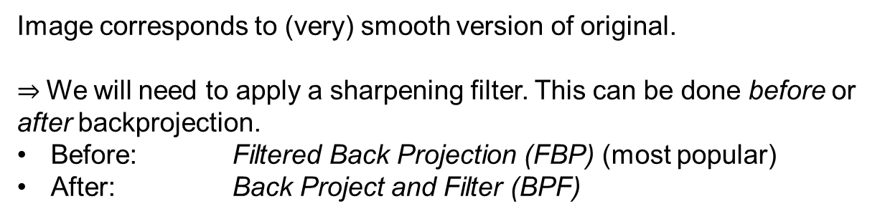
Back projection
(sum of all angles)
Image corresponds to (very) smooth version of original.
$⇒$We will need to apply a sharpening filter. This can be done before or after backprojection.
Before: Filtered Back Projection (FBP) (most popular)
After: Back Project and Filter (BPF)

Slide 13
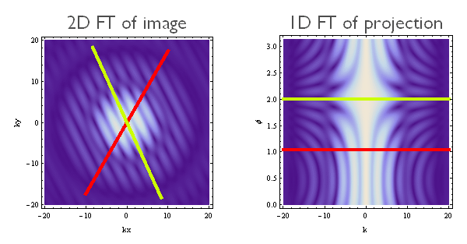








Central Slice Theorem
(basis for proof of FBP)
$$F\left(k_{x}, k_{y}\right)$$
$$P_{φ}(k)$$
$$k_{y}$$
$$φ$$
$$k_{y}$$
$$k_{x}$$
$$k$$
Sketch of proof
$$F\left(k_{x}, k_{y}\right)=∫dx e^{−ik_{x}x}∫dy e^{−ik_{y}y}f(x,y)$$
$$F\left(k_{x}, 0\right)=∫dx e^{−ik_{x}x}\left[∫dy f(x,y) \right]$$
$$F\left(k, 0\right)=∫ds e^{−iks} p_{φ=0}\left(s\right) \\ =P_{φ=0}(k)$$
Projection along vertical line
Notes:
Notation:
f(x,y) is the image
$p_{φ}(s)$ is the projection of the image along a line with angle $φ$, and distance from the origin $s$
Capitals are used for data after Fourier transform
The formulas on the slide show that $F(k_{x},0)$, i.e. the data on a horizontal line through the origin ($k_{x}=0, k_{y}=0$) in the 2D Fourier transform of the image, is equal to the 1D Fourier transform of the projection $p_{φ=0}(s)$of the image, i.e. the line integrals at $φ=0$ at different distance $s$ of the line from the origin. Note that $p_{φ=0}(s)$ is represented as one line of the sinogram.
This proof can be extended to other angles, for instance by rotating the coordinate system. This is a technical detail however (out-of-scope for this course). You would find that the line goes through the centre of the 2D FT of the image (hence “central” in the name of the theorem). You can see this visually represented with the lines of different colors.

Slide 14
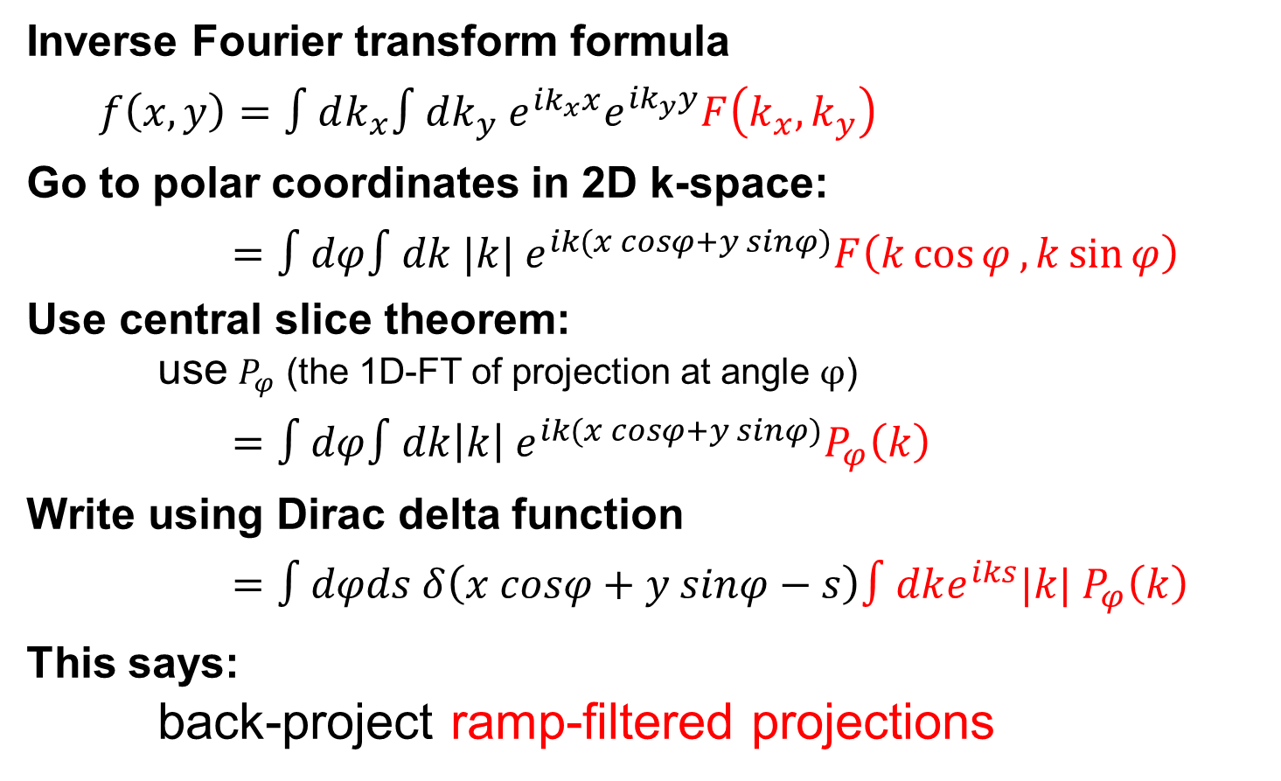
Sketch of proof of FBP
Inverse Fourier transform formula
$f\left(x,y\right)=∫dk_{x}∫dk_{y} {e^{ik_{x}x}e}^{ik_{y}y}F\left(k_{x}, k_{y}\right)$
Go to polar coordinates in 2D k-space:
$=∫dφ∫dk |k| e^{ik(x cosφ+y sinφ)}F\left(k\cos{φ}, k\sin{φ}\right)$
Use central slice theorem:
use $P_{φ}$ (the 1D-FT of projection at angle $φ$)
$=∫dφ∫dk{\left|k\right| e}^{ik(x cosφ+y sinφ)}P_{φ}\left(k\right)$
Write using Dirac delta function
$=∫dφds δ\left(x cosφ+y sinφ−s\right)∫dke^{iks}|k| P_{φ}\left(k\right)$
This says:
back-project ramp-filtered projections
Notes:
Depending on the definition of the Fourier Transform, we need some 1/(2pi) factors here, but they are just are global factors.
The red part of the last formula is the 1D inverse Fourier Transform (FT) of $|k| P_{φ}\left(k\right)$. Remember that convolution (in space) with a spatially-invariant filter corresponds to multiplication in frequency space (with the FT of the kernel). So, this formula says that the 1D projection (at a particular $φ$) is convolved with a filter whose FT is $|k|$. This is the definition of the ramp filter.
The integral with the Dirac delta is the back projection of the “red” function. You can (try to) understand this by seeing that at a particular image-point $x,y$, for every angle $φ$, all values are accumulated for which $x cosφ+y sinφ−s=0$, but this is the same as saying that the point $x,y$ is on the line $φ,s$
Clearly, the ramp-filter $|k|$ enhances high frequencies (it is zero at zero frequencies and linearly increases). This is often a problem is the noise in the data is high-frequency. So, the ramp-filter enhances noise. In practice it is therefore often combined with a low-pass filter to reduce the noise (but of course, this will also reduce resolution). So more later on filtering.
There is a subtlety in this derivation. Usually, polar coordinates are defined in the range $0≤ φ<2π$ and $k≥0$. In that case, the absolute value of $k$ is not necessary in the derivation above. However, in CT/PET image reconstruction it is customary to use the range $0≤ φ<π$ and $−∞<k<+∞$, hence the absolute value. Note that this choice means that standard 1D Fourier Transforms can be used in projection space (using the range $0≤ φ<π$ and $−∞<s<+∞).$

Slide 15
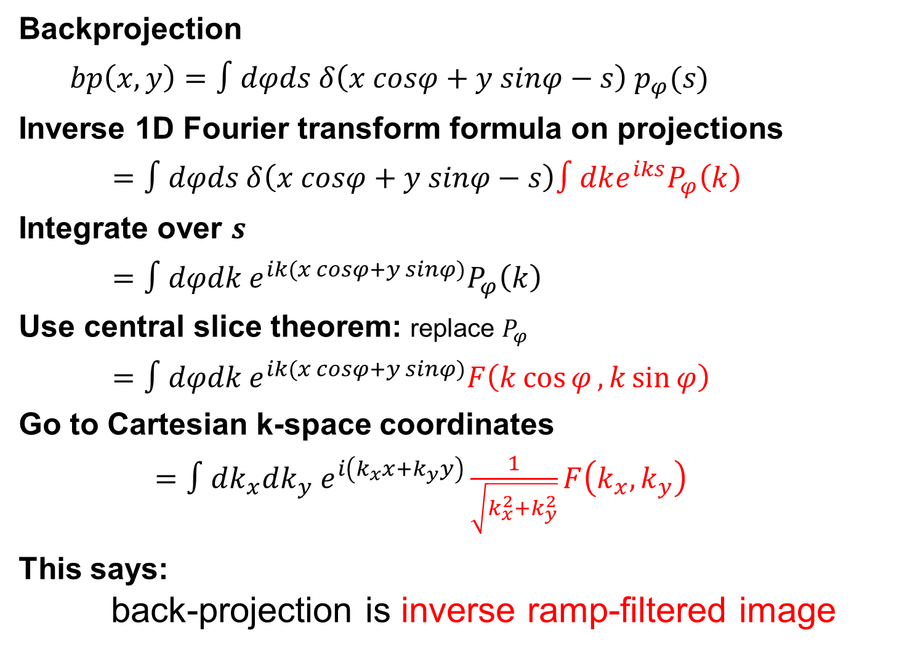
Sketch of proof of BPF
Backprojection
$bp\left(x,y\right)=∫dφds δ\left(x cosφ+y sinφ−s\right){ p}_{φ}(s)$
Inverse 1D Fourier transform formula on projections
$=∫dφds δ\left(x cosφ+y sinφ−s\right)∫dke^{iks}P_{φ}\left(k\right)$
Integrate over $s$
$=∫dφdk{ e}^{ik(x cosφ+y sinφ)}P_{φ}\left(k\right)$
Use central slice theorem: replace $P_{φ}$
$=∫dφdk e^{ik(x cosφ+y sinφ)}F\left(k\cos{φ}, k\sin{φ}\right)$
Go to Cartesian k-space coordinates
$=∫dk_{x}dk_{y} e^{i\left(k_{x}x+k_{y}y\right)}\frac{1}{\sqrt{k_{x}^{2}+k_{y}^{2}}}F\left(k_{x}, k_{y}\right)$
This says:
back-projection is inverse ramp-filtered image
Notes:
Again, depending on the definition of the Fourier Transform, we need some 1/(2pi) factors here, but they are just are global factors.
The red part of the last formula is the multiplication of $1/|k|$ and the 2D Fourier Transform (FT) of the image. This corresponds to a convolution of the backprojected image with a smoothing filter.. So, this formula says that the true image can be obtained by convolving the backprojected image with the corresponding sharpening filter (often called a 2D ramp-filter).

Slide 16
Contents
Analytic Algorithms
Iterative Algorithms
Noise characteristics in image reconstruction

Slide 17
What are the data?
Projections
(basis for derivation of FBP)
Add Attenuation, scatter,
randoms (PET)
Detection efficiencies
(e.g. defective detector block)
Gaps between blocks (PET)
Noise!
Notes:
We will be talking about attenuation, scatter and randoms later.
“Gaps” between detector blocks occur for some PET scanners, e.g. small ring radius and large detector blocks.

Slide 18
Iterative image reconstruction
Basic idea:
We can model the acquisition process:
“given an image, this is what I will measure”
estimated_data =
forward_project(image)+background
Try to find an image such that we fit the measured data:
measured_data ~ estimated_data
This fit has to be done iteratively.
Notes:
In PET/SPECT/CT we often talk about “forward projecting” for modelling the acquisition process. This is because it is related to “line integrals” as we’ve seen. There’s more going on (such as attenuation and scatter etc), see later!
(Note that terminology is a bit unclear. Sometimes people say “forward projection” for the term without the background, sometimes it includes the background. Sorry. That’s life.)

Slide 19
Components of
“iterative reconstruction”
Forward model
Goodness-of-fit function
Iterative scheme to improve the fit (i.e. increase the goodness-of-fit)
Notes:
Image reconstruction is a specific type of what is called an “Inverse Problem”: you know the forward model and you have measured the (noisy) output, now you need to “invert” the forward model. (I put “invert” in quotes, as we don’t actually compute the inverse operator (it might not even exist!), but instead do the fit for the specific measured data that we have).
The iterative loop is an example of a general way to solve such inverse problems.
This is in contrast to FBP, where we do compute the inverse operator (as in the “perfect” case of all projections and no noise, it actually exists).

Slide 20
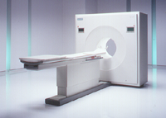
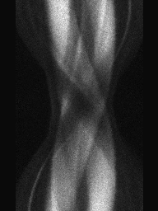
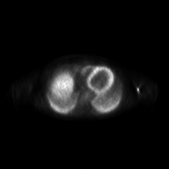
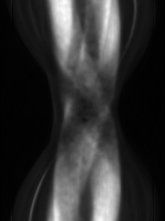
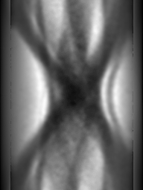
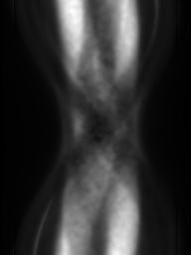
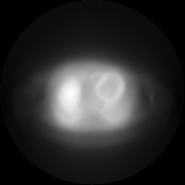
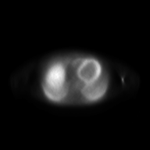
Example of one particular iterative algorithm
(MLEM, see later)
measured data
patient
BP
measured
estimated
patient
original
projections
update
(x ratio)
estimated data
FP
current image
current
estimate
estimated
projections
Notes:
This slide provides an animation. It shows the gradual improvement of the image and the estimated data, which fits the measured data a bit better every iteration.
The process starts of with an initial estimate of the image (here just a blank image), it then estimates what would be measured (forward_project + background), then we compare it to the measure data (here by using a ratio (see later why)), and then uses the discrepancies to compute an improvement to the image, and so on

Slide 21
Contents
Analytic Algorithms
Iterative Algorithms
  Forward Model
  Goodness-of-fit: Maximum Likelihood
  Example algorithms
Noise characteristics in image reconstruction

Slide 22
forward model
Modelling the system
(“system matrix”)
What is the probability that a photon emitted from location X will be detected at detector pair Y
(if there is no background)?
Can include
  detector geometry, detection efficiency, collimators, …
  attenuation
  scatter
Estimated data is obtained by summing over all locations of (counts at X * detection probability)
Y₁
μ
X
Y₂
Notes:
Note: “Y” is then not strictly a “detector location” but a detector pair
The overall equation is
estimated_data =
forward_project(image)+background
This is a model for the (mean) of the measured data.
Ignoring the background term, in PET and SPECT, the forward_projection is (in very good approximation) linear, i.e. if you have 2 sources, then we have
forward_project(source1 + source2) = forward_project(source1) + forward_project(source2)
We can therefore (conceptually!) consider the patient as a sum of voxels, and compute the forward projection by doing every voxel on its own, and then adding up all the sinograms.
Obviously, the data produced by forward projection of a source is going to be proportional to its activity (or equivalently to the mean number of radioactive decays in the source)
The “system matrix” is a mathematical way to do this. The math isn’t very important for general understanding, but it is a concept that is often used in image reconstruction.
For a single element of the sinogram $y_{b}$ (with $b$ an index over all possible Lines of Response (LORs)), I can compute the forward projection using a sum over all voxels which have activity $λ_{v}$ as
$$y_{b}=\sum_{b}{P_{bv}}λ_{v}$$
with $P_{bv}$ an element of the system matrix $A$. Clearly, elements in P are going to be proportional to detection probabilities.
Ignoring the math, the important thing to remember is that we have a way to model the acquisition process. Lots of effects can be modelled, and can be included in the “system matrix”.
Side note :
For X-ray CT, the acquisition model is slightly different, as it is based on the Lambert-Beer law. It would therefore look something like
$$y_{b}\sim exp(−\sum_{v}{A_{bv}}μ_{v})$$
with $μ_{v}$ the attenuation in the voxel $v$. In addition, you’d have to take some sensitivity factors into account etc. This is out of scope (at least, of my part of the module).
In practice, most often in CT people will take the logarithm of the data to “remove” the exponential. Then we’re back to a linear model ☺

Slide 23
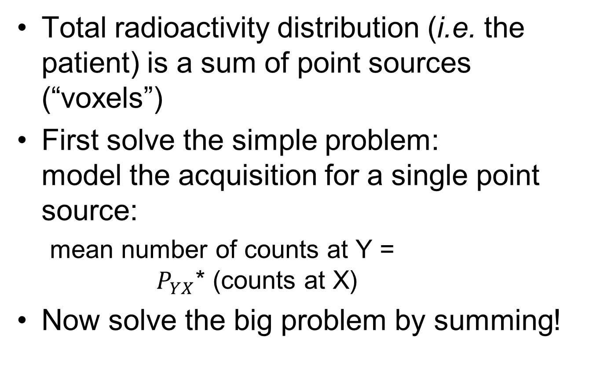
Different way to say the same
Total radioactivity distribution (i.e. the patient) is a sum of point sources (“voxels”)
First solve the simple problem:
model the acquisition for a single point source:
  mean number of counts at Y =
  $P_{YX}$* (counts at X)
Now solve the big problem by summing!

Slide 24
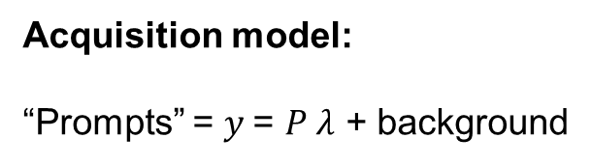
Types of PET coincidences
True (unscattered)
Scattered
Accidental
or “random”
Measured data:
“Prompts” = Trues + Scatters + Randoms
P =T +S +R
Acquisition model:
“Prompts” = $y$= $P λ$ + background
Notes:
Accidental coincidences occur when 2 photons are detected (within the coincidence timing window) that originate from different annihilations.

Slide 25
Contents
Analytic Algorithms
Iterative Algorithms
  Forward Model
  Goodness-of-fit: Maximum Likelihood
  Example algorithms
Noise characteristics in image reconstruction

Slide 26
What is a good fit?
“goodness-of-fit” needs to take noise into account

Slide 27
Statistical Estimation
Main idea
  Prob(Image | Data)
  Probability that the distribution of the tracer corresponds to a certain image, given the current measured data
  Find the most probable image
  Maximum a Posteriori (MAP)
How ? (use Bayes’ Theorem)
Prob(Image | Data)=
Prob(Data | Image)*Prob(Image)/Prob(Data)
Maximum Likelihood (ML): No a priori info on image
Prob(Image)=constant
Contains all info:
1) forward model & noise model 2) a priori info on images
Notes:
All information of the imaging system is encoded in Prob(Data | Image), i.e. the probability of measuring some data given a certain image (i.e. object in the scanner).
(The notation Prob(A | B) is standard for saying the “probability of A given B”)
Prob(Image) is “prior” information, i.e. prior the scan. This encodes the probability that the image corresponds to the actual tracer distribution. This is a tricky concept. We will encounter it again later (MAP slides), but in many cases, it is easier to say that you have no information at all. This then leads to Maximum Likelihood.
Prob(Data) is possibly even harder to get your head round. It is the probability of measuring any data at all. Maybe easier is to look at it as a normalization constant (all probabilities need to integrate to 1, so you can use it to normalise Prob(Data | Image)*Prob(Image). However, for MAP and ML, all this doesn’t matter: we are interested in finding the image that maximises Prob(Image | Data), and as Prob(Data) doesn’t depend on the image, we can happily ignore it!

Slide 28
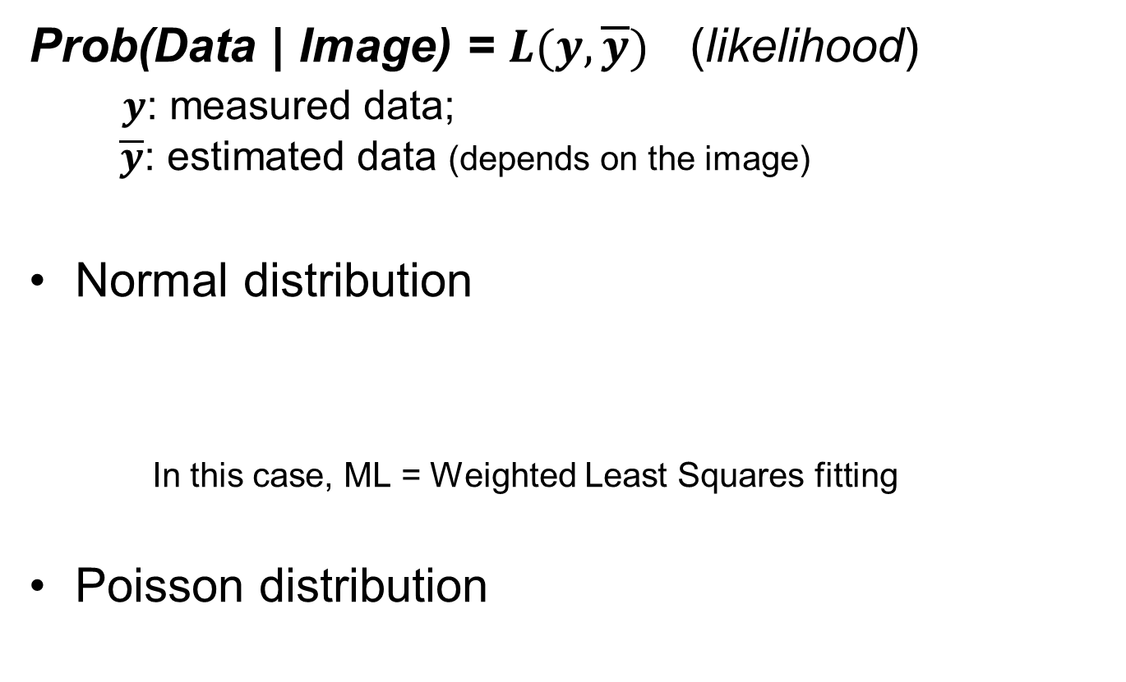

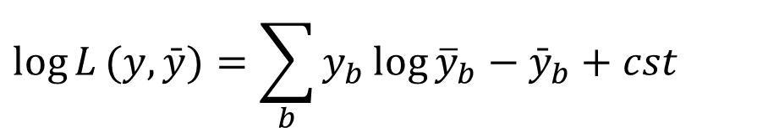
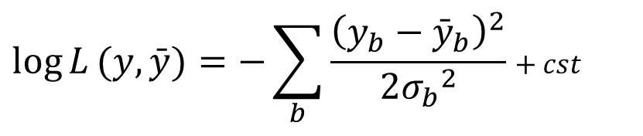
Maximum Likelihood (ML) Examples
Prob(Data | Image) = $L(y, \overline{y})$ (likelihood)
$y$: measured data;
$\overline{y}$: estimated data (depends on the image)
Normal distribution
In this case, ML = Weighted Least Squares fitting
Poisson distribution
$$\log{L}(y,\bar{y})=−\sum_{b}{\frac{{\left(y_{b}−{\bar{y}}_{b}\right)}^{2}}{2{σ_{b}}^{2}}}+cst$$
$cst$:
terms that do not depend on the image
$$\log{L}(y,\bar{y})=\sum_{b}{y_{b}\log{{\overline{y}}_{b}}−{\bar{y}}_{b}+cst}$$
Notes:
The probability of measuring the data given an image is called the “likelihood”. It contains 2 ingredients: the forward model for the mean of the estimated data; and the noise model (i.e. the probability of a measurement given the mean data). The likelihood therefore tells you how likely some measured data are if you know the image (and the forward model).
$\overline{y}$ is our model for the mean of the data (given by the forward projection of the image).
Using a proper noise model will give a better estimate of the image (i.e. lower variance).
2 examples of noise models are given.
the “normal” distribution (sometimes called “Gaussian distribution”), i.e. $\frac{1}{2π}exp\left(−{{\left(y−μ\right)}^{2}}/{2σ^{2}}\right)$. You can see that maximising L then corresponds to the familiar Least Squares fit (here weighted with variances, for instance to take different attenuation into account).
The Poisson distribution (see formula on earlier slide). This latter is normally used for emission tomography as it provides a better noise model for counting statistics.
Formulas are given in terms of the logarithm of the likelihood for convenience. Maximising L is equivalent to maximising log L. The cst term denotes a “constant” (i.e. anything that is independent of the image itself, and so irrelevant when determining the maximum of L).

Slide 29
Contents
Analytic Algorithms
Iterative Algorithms
  Forward Model
  Goodness-of-fit: Maximum Likelihood
  Example algorithms
Noise characteristics in image reconstruction

Slide 30
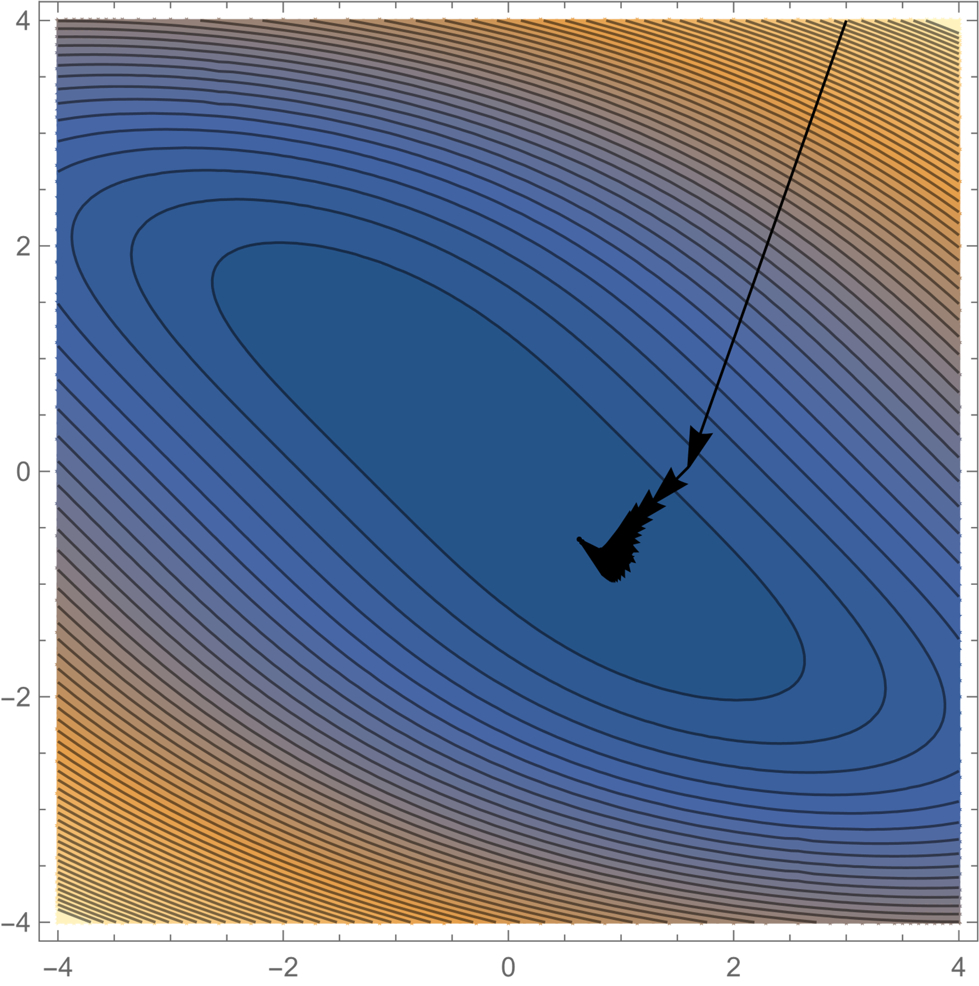




Gradient ascent
Generic algorithm to maximise $Ψ(x)$
$x_{next}=x+α ∇Ψ\left(x\right)$
$$small α$$
$$larger α$$
Not so easy to choose the step size $α$
Notes:
The above contour plots are generated for an “objective” function $Ψ\left(x,y,\right)=−\left(x^{2}+2xy+y^{2}+\frac{y^{4}}{10}\right)$.
Each arrow indicates a step (from $x$ to $x_{next}$). I’ve then done this 30 times (i.e. 30 iterations)
I’ve generated these plots using the follow code in Mathematica. (No explanation provided!):
f[x_,y_]:=-(x^2 +2 x y+y^2+ y^4/10)
cp=ContourPlot[-f[x,y],{x,-4,4},{y,-4,4},Contours->50]
grad[f_,{x_,y_}]:=Apply[Function[{i,j},Derivative[i,j][f][x,y]],{{1,0},{0,1}},{1}]
pts=Block[{step=.1,pt={3,4},iters=30},NestList[Function[pt,nxt=pt+step*grad[f,pt]],pt,iters]];
Show[{cp,Graphics[Map[Arrow, Transpose[{Drop[pts,-1],Drop[pts,1]}]]]}]
pts=Block[{step=.2,pt={3,4},iters=30},NestList[Function[pt,nxt=pt+step*grad[f,pt]],pt,iters]];
Show[{cp,Graphics[Map[Arrow, Transpose[{Drop[pts,-1],Drop[pts,1]}]]]}]

Slide 31
MLEM: Maximum Likelihood via Expectation Maximisation
A “standard” iterative algorithm for Maximum Likelihood (ML) estimation (for Poisson data)
It converges to the ML solution.
It involves forward and back projection, and compares measured and estimated data by division.
Notes:
MLEM is a commonly used example of an iterative reconstruction algorithm. It is an iterative procedure for estimating the Maximum Likelihood (ML) for the Poisson distribution (EM stands for “Expectation Maximisation” which is a general method for maximising a probability). MLEM is sometimes called EMML.
Explaining the EM procedure is out-of-scope.
The actual form of the iterative process used by MLEM is on the next slide.
It can be shown that, when iterated until convergence (i.e. iterate an infinite number of times), the MLEM algorithm will provide the ‘most likely’ activity distribution which matches the measured projection data. Furthermore, the likelihood is improved at every iteration.
The algorithm compares by division (and not subtraction) because of the form of the Poisson distribution.

Slide 32
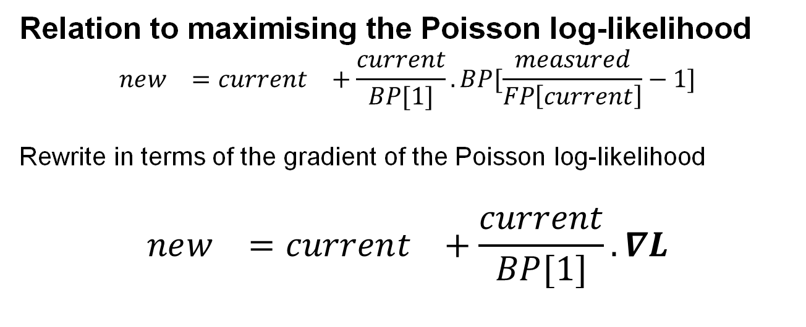
MLEM reconstruction
Relation to maximising the Poisson log-likelihood
$$new_{}=current_{}+\frac{current}{BP[1]}. BP[\frac{measured}{FP\left[current\right]}−1]$$
Rewrite in terms of the gradient of the Poisson log-likelihood
$$new_{}=current_{}+\frac{current}{BP[1]}.∇L$$
Notes:
current_estimate etc stands for the current estimated image. The MLEM formula describes how to generate a (more likely) new estimate. Divisions and multiplications in this formula are “element-wise”, e.g. take the measured sinogram and divide it by the estimated data element by element.
The algorithm needs to be started with a strictly positive image. As the measured data are positive numbers (as they are counts), you can see that the new estimate is positive. This is by design: we want to find “activity” which is a positive quantity.
FP[current_estimate] denotes the “forward projection” of the current estimate (including the background term).
BP[1] is the backprojection of a sinogram that has all values equal to 1. You can see that the division with BP[1] is necessary to let the algorithm converge if measured_data = FP[current_estimate].
Mathematically, FP is a linear transformation (multiplication with the system matrix, add the background). BP performs multiplication with the transpose of the system matrix. (This isn’t obvious of course, but can be derived using gradients etc, see notes of previous slide).
It can be seen that this algorithm is related to maximising the Poisson log-likelihood by rewriting it slightly as
$$new_{}=current_{}+\frac{current}{BP[1]}. BP[\frac{measured}{FP\left[current\right]}−1]$$
This can be written in terms of the gradient of the Poisson log-likelihood (derivation is below)
$$new_{}=current_{}+\frac{current}{BP[1]}.∇L$$
MLEM is therefore a “gradient-ascent” type algorithm. At convergence, the gradient is zero, which means we are at a maximum. (Strictly speaking, the gradient can be negative wherever the image is zero. This is due to the non-negativity constraints, i.e. we require to be the image values to be >= 0)
Mathematical side note:
Remember that the logarithm of the Poisson distribution is
$$\log{L}(y,\bar{y})=\sum_{b}{y_{b}{\bar{\log{y}}}_{b}−{\bar{y}}_{b}+cst}$$
for measured data $y$ with (estimated) mean $\overline{y}$. To find the ML solution, we can compute the gradient w.r.t. the image $λ$, after plugging in the system model (i.e. the equation of $\overline{y}$ in terms of the image $λ$). In somewhat rough notation
$$\frac{∂}{∂λ}\log{L}\left(y,\bar{y}\right)=\frac{∂}{∂\overline{y}}\log{L}(y,\bar{y})\frac{∂\overline{y}}{∂λ}=\sum_{b}{\left(\frac{y_{b}}{{\overline{y}}_{b}}−1\right)\frac{∂{\overline{y}}_{b}}{∂λ}}$$
So you can see that it will make sense to divide the measured data $y_{b}$ with the estimated data ${\overline{y}}_{b}$, and you want that quotient to be as close to 1 as possible.
You can now plug-in the system model and derive a gradient ascent algorithm yourself!
Side note 1: To compute $\frac{∂{\overline{y}}_{b}}{∂λ}$, we can use that ${\overline{y}}_{b}=\sum_{v}{p_{bv}λ_{v}+r_{b}}$ with $p$ the system matrix, and $r$ a background term (e.g. for scatter etc., see later). We see therefore that $\frac{∂{\overline{y}}_{b}}{∂λ_{v}}=p_{bv}$, i.e. the elements of the system matrix $P$. We can put this together and find that the gradient in voxel $v$ is
$$\frac{∂}{∂λ_{v}}\log{L}\left(y,\bar{y}\right)=\sum_{b}{p_{bv}\left(\frac{y_{b}}{{\overline{y}}_{b}}−1\right)}$$
Note that the sum over the $b$(i.e. the “bins” in the sinogram) can be seen as a type of “backprojection” of the sinogram $\left(\frac{y_{b}}{{\overline{y}}_{b}}−1\right)$. (Think about what would happen if all probabilities would be zero, except for 1 LOR). Yet another way to look at this is that this backprojection corresponds to multiplication of the sinogram with the transpose of the system matrix. In vector notation
$$\frac{∂}{∂λ}\log{L}\left(y,\bar{y}\right)=P^{T}\left(\frac{y_{b}}{{\overline{y}}_{b}}−1\right)$$
Side note 2: usually, we are interested in images that are non-negative (i.e. we don’t want negative “activity”). That gives some extra complications, but MLEM takes care of that. See also notes for the next slide on MLEM.
Side note 3: rewriting the gradient as $\sum_{b}{p_{bv}\left(\frac{y_{b}−{\overline{y}}_{b}}{{\overline{y}}_{b}}\right)}$, you can possibly see that it looks very similar to what you would get from a weighted least squares problem: $\sum_{b}{p_{bv}\left(\frac{y_{b}−{\overline{y}}_{b}}{σ_{b}^{2}}\right)}$.
Side note 4: if you write gradient ascent for the weighted least squares algorithm, you will get a variation of the SIRT algorithm, see e.g. The SIRT Algorithm | TomRoelandts.com where the system matrix is written as $A$

Slide 33


MLEM Evolution over initial iterations
Start with uniform image
Display images in terms of iteration number (1 - 50)
no noise
with noise
Notes:
This slide shows a movie of the reconstructed images over iterations (you need the pptx to see it).
The evolution shows that the reconstructed images gradually gets sharper over iterations. It starts very smoothly (as the initial image is uniform) but with each iteration, the image gets closer to the “true” image.

Slide 34
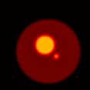
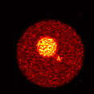
MLEM Evolution over later iterations
Display images in terms of
log(iteration_number)
(because EMML convergence slows down)
no noise
with noise
Notes:
This slide shows a movie of the reconstructed images over iterations (you need the pptx to see it).
At later iterations, the behaviour is different without and with noise.
Without noise, the image stabilises (“converges”). In this case, the final image is still somewhat smooth. That is because in this simulation, some resolution effects were not modelled during the reconstruction (see also a later lecture).
With noisy data, the image looks more and more noisy. You can see that the “underlying” image is the same, but noise dominates.
See also notes on next slide.

Slide 35
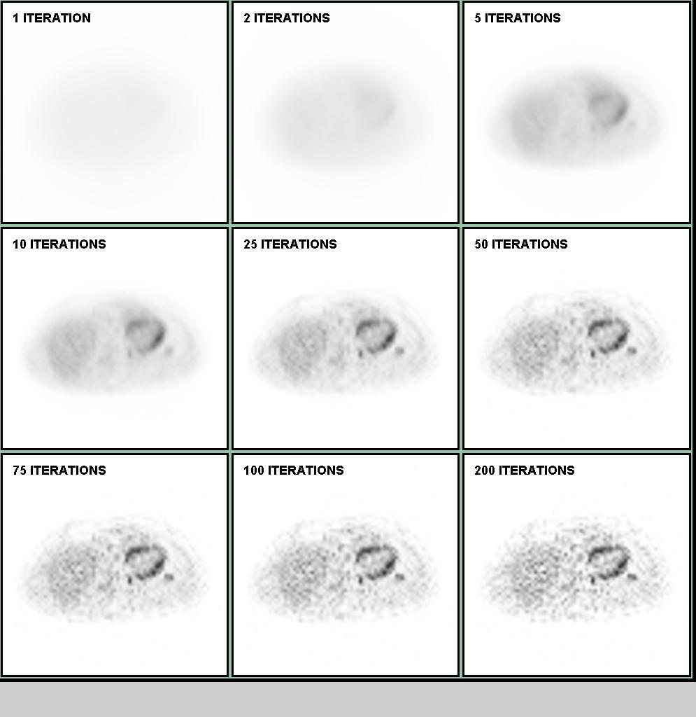
MLEM evolution over iterations
comparison with measurement
1 2 5
comparison with true object
10 15 20
50 100 150
Notes:
The results of iterating with the MLEM algorithm is shown. You can see that early iterations are very smooth however very quickly you get a good result. The result continues (in terms of likelihood, top-right plot) to improve and gets sharper with increasing iteration number. However, clearly the noise gets worse. This is also illustrated in the bottom-right graph showing the mean square error (MSE) comparing the result with the true object. The MSE initially improves but then noise gets worse so that the overall MSE is worse at high iteration number.
This is a general problem with ML image reconstruction. The data is noisy, and there is sufficient “freedom” in the model such that a noisy image actually fits the data better than a “reasonable” image. You therefore must control the noise by either stopping early or by applying some additional filtering or by using prior info on the image (MAP).

Slide 36
Problems with MLEM
Lots of iterations needed to get close to the Maximum Likelihood solution
(the algorithm slows down)
Too many iterations leads to undesirable images
Not enough iterations leads to blurring
(and other difficulties)
Each update needs a lot of computation
(forward projection, back projection, some algebra)

Slide 37
Acceleration: Ordered Subsets
ML-EM: each update involves BP and FP for all projection angles
OSEM: each update only uses a subset of projection angles
ML-EM
4 iterations
OS-EM
1 iteration
Update 1
Update 2
Update 3
Update 4
Much less computation per image update
Notes:
This slide illustrates the idea of subsets. The arrows indicate the directions of the projections, for instance corresponding to 8 different detector positions in SPECT.
Each ML-EM iterations will perform all forward projections/ratios/back projections, so for all 8 angles. In contrast, OSEM (in this example) uses only 2 angles. We normally choose the angles as “different” as possible (here there are only 2, so we will take them orthogonal), such that they give as much complementary information about the image. At every update, a different subset of all the angles is chosen in a certain order. (You can find some papers on which order is best, and which subsets to take. This is not important for our purposes though).
As each OSEM update uses less projections, it will take less computation time than an MLEM update. However, if there are enough angles in each subset, they might give “enough” information about the image to give a useful update. This is born out experimentally as well, see next slides.

Slide 38
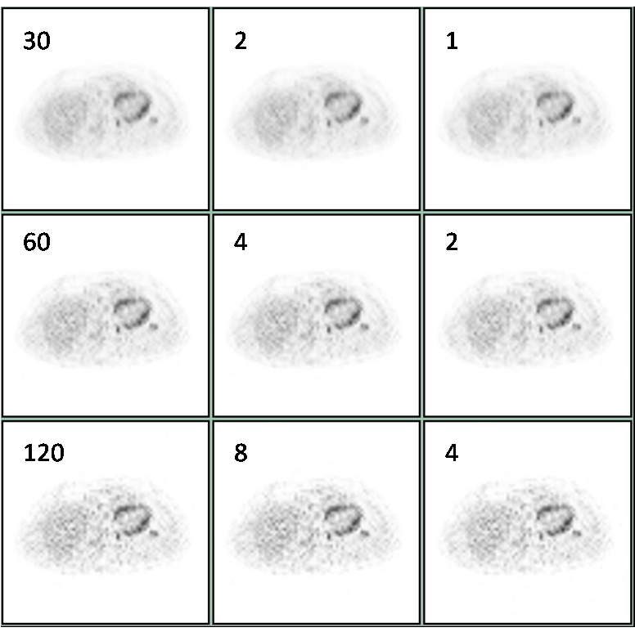
Acceleration ~ no. of subsets
OSEM
15 subsets
OSEM
30 subsets
EM
No. of updates
30
60
120
Numbers “inside” indicate number of (full) iterations (each using all the data)
Notes:
If there is enough data in each subset, then the image obtained after N updates is almost equal to the image obtained by N MLEM updates.
However, as the computation time for an OSEM update is much smaller than for an MLEM update (it is smaller with a factor equal to the number of subsets), using subsets dramatically reduces the cost of using an iterative algorithm.
Put another way, in a (full) OSEM iteration, there are num_subsets updates, so each OSEM iteration is roughly equivalent to num_subsets MLEM iterations.
The figure illustrates this. Each row uses the same number of image updates, but compared to the left column (MLEM), the total computation time is 15 times smaller for the middle column, and 30 times for the right column.
However, this speed-up is true initially, but starts to break down after a larger number of iterations, and more so when using a large number of subsets. Also, for very noisy data, an OSEM update is noisier than an MLEM update (as OSEM uses less data). So, after a large enough number of updates, images reconstructed with OSEM will be (somewhat) noisier than an MLEM image.

Slide 39
OSEM: why does it work?
Image
space
Illustration à la J .Fessler
Note that OSEM does not converge to the ML solution
(worse for noisier data)
but it is never used at high iteration number anyway.
Notes:
This is a schematic diagram where the blue box is the space of all possible images. The initial image is somewhere on the “top right”, while the Maximum Likelihood (ML) solution is the yellow “star”. The black crosses are the ML solutions when using each subset of the data (i.e. each subset will have a slightly different ML solution).
The arrows indicate an update. There are 3 arrows corresponding to the 3 subsets. They point “towards” the ML solution of the subset. As long as we are “far” away from the ML solutions, it doesn’t matter which subset we use, or indeed if we used all data (MLEM). However, once we start to get “close”, then each update will be somewhat different, and actually no longer point towards the true ML solution.
This proves an intuitive explanation for the observation that initially (i.e. when still far away), each OSEM update is equivalent to an MLEM update, but after a while, OSEM does slightly worse than MLEM.
However, we have seen a little earlier that the image is too noisy if you iterate too long anyway, so in practice, OSEM is used for a few iterations only.

Slide 40
Contents
Analytic Algorithms
Iterative Algorithms
  Forward Model
  Goodness-of-fit: Maximum Likelihood
  Example algorithms
Noise characteristics in image reconstruction

Slide 41
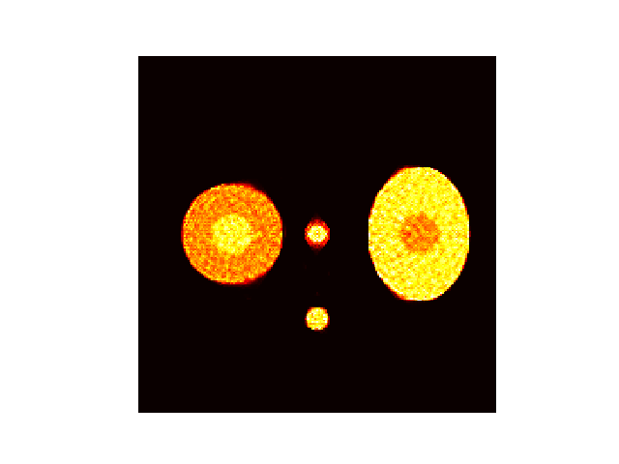
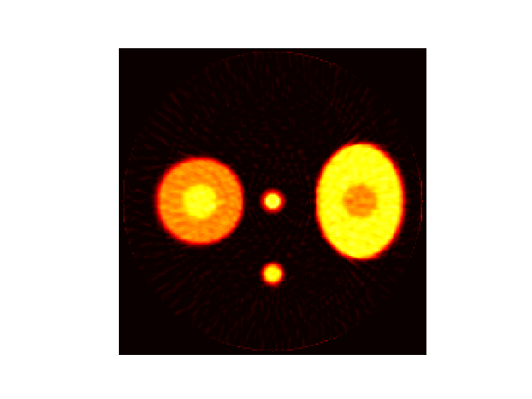
OSEM vs. FBP for increasing degree of noise
Start with very low noise (i.e. high counts) and increase noise (MLEM stopped after 200 iterations)
OSEM
FBP
Notes:
This slide shows a movie with reconstructed images from increasingly noisy data. The movie is only when putting Powerpoint in presentation mode.
I’ve used OSEM here (8 subsets, 200 “sub-iterations”, i.e. 200 image updates), but results would be very similar for MLEM.

Slide 42

Fundamental trade-off
Contrast
Resolution
Quantification
Noise-reduction
Visual appeal
Notes:
In image reconstruction, we always have to balance these 2 “qualities”. For instance, we have seen that with increased iteration number, MLEM images get very noisy, but small objects have higher contrast.
Similarly, noise-reduction by filtering will decrease contrast.
This trade-off means that there is no “optimal image”. You will have to decided what balance you prefer, which will depend on what you are going to use the image for. In other words, the “optimal image” is task-dependent.

Slide 43
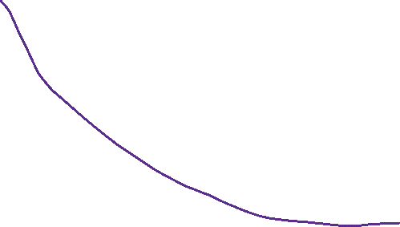
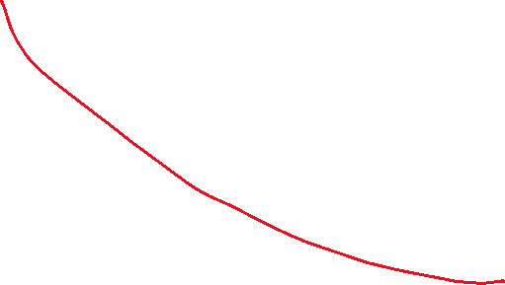
How to evaluate?
Trade-off curves
contrast
noise
Allows comparing different algorithms (lower curves are better)
Does not allow determining optimal parameter
Notes:
This slide discusses how to compare 2 different algorithms, each with 1 parameter (e.g. filter FWHM, iteration number).

Slide 44
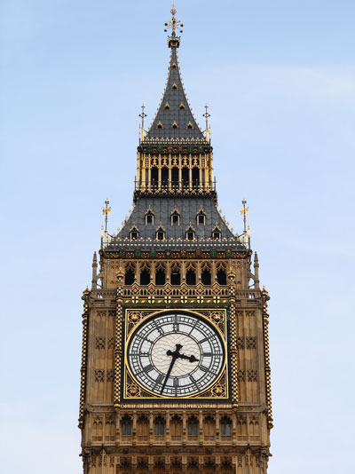
Why streaks/spikes?
Very low count illustration
  3 counts!
ML
FBP
Notes:
This slide illustrates that if we’d have only counts in 3 Lines-Of-Response (LORs), FBP would give 3 streaks as reconstructed image (with some negative values next to the streaks due to the ramp filter), while MLEM would find the “most likely image”, which here are 3 point sources at the intersection of the lines.
Note of course that you cannot reconstruct an image from only 3 LORs. The slide just gives an intuitive explanation why noise in FBP looks like streaks, while it looks like “salt-and-pepper” noise in MLEM.

Slide 45
Pixel-wise stddev images for FBP/MLEM
  Compute standard deviation of each pixel value (over repeated measurements), and display this as an image
ML
FBP
Notes:
This slide intents to show the different noise characteristics of different reconstruction algorithms. The data here was computed by doing repeated simulations, each with a different noise realisation. That gave many different reconstructed images. I then computed the stddev for each pixel (over the different noise realisations).
If the stddev in a pixel is very low, it will have a value which is almost the same in every noise realisation (which is good!).
You can see that the FBP “spreads out” the noise over the whole image, while MLEM almost (but not quite) gives the original Poisson noise distribution (i.e. high stddev (but low CV) in high count regions).

Slide 46
Resolution recovery
Data is identical
Model changes
  A matrix includes blurring
Algorithm changes needed?
  No, mathematical model is the same, so same algorithms can be used
Numerical Conditioning changes?
  Yes: worse conditioned, so worse convergence rate

Slide 47
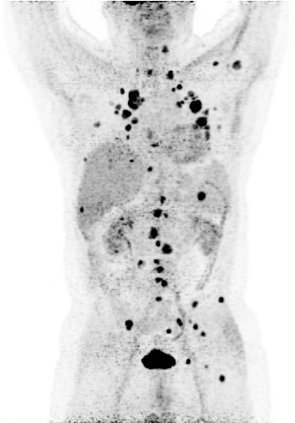
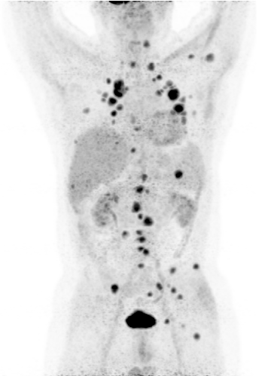
Improved resolution and noise?
No PSF
post-filtered
No PSF
With PSF
E. Rapisarda, V. Bettinardi, K. Thielemans et al, PMB 2010,
IOP Copyright, not for redistribution

Slide 48


No noise
With noise
No PSF model
Early iterations
With PSF model

Slide 49


No noise
With noise
No PSF model
Late iterations (logarithmic)
With PSF model

Slide 50
Go to Mentimeter

Slide 51
Summary
Choices need to be made that determine trade-off between resolution/contrast and noise.
Iterative algorithms allow incorporation of
  Accurate system model
  Noise model
 | Analytic | Iterative
Speed | 😀 | 😢
Predictable performance | 😀 | 😢
Flexibility | 😢 | 😀
SNR/detectability | 😢 | 😀

Slide 52



