Slide 1
Refresher: Physics of Hybrid Imaging
IEEE NPSS School of Advanced Topics in PET/CT and PET/MR
Youngho Seo, PhD
UCSF Physics Research Laboratory – University of California, San Francisco and Berkeley, and Lawrence Berkeley National Laboratory

Slide 2
Combined SPECT/CT and PET/CT/MRI Developments
The first multimodality prototypes developed in the mid 1990s: (a) a SPECT/CT scanner at UCSF, (b) a PET/CT scanner evaluated clinically at the University of Pittsburgh and (c) an MR/PET scanner for small animals at UC, Davis.
Townsend DW. Phys Med Biol. 2008;53:R1-R39

Slide 3
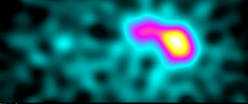
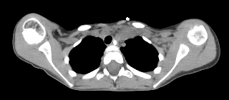


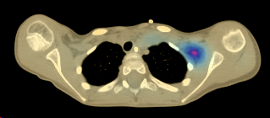

Dual-Modality Imaging – Example of SPECT/CT
Functional-anatomical correlation
  Rigid transformation of SPECT into CT
CT-based attenuation correction and scatter correction
  Generate attenuation map from CT, not a source-based transmission scan.
  With CT-derived attenuation map and EM (estimation maximization) algorithm, attenuation correction is ‘standard’ with current SPECT/CT and PET/CT scanners.
CT
SPECT (FBP)
CT + SPECT
MLEM (AC, Geometric Blur Corrected)

Slide 4
SPECT/CT (or SPECT-CT)
CT/SPECT (or CT-SPECT)
PET/CT (or PET-CT)
CT/PET (or CT-PET)
SPECT/MR(I)
MR(I)/SPECT
PET/MR(I)
MR(I)/PET
Hybrid Imaging
Dual-modality
Combined dual-modality
…

Slide 5
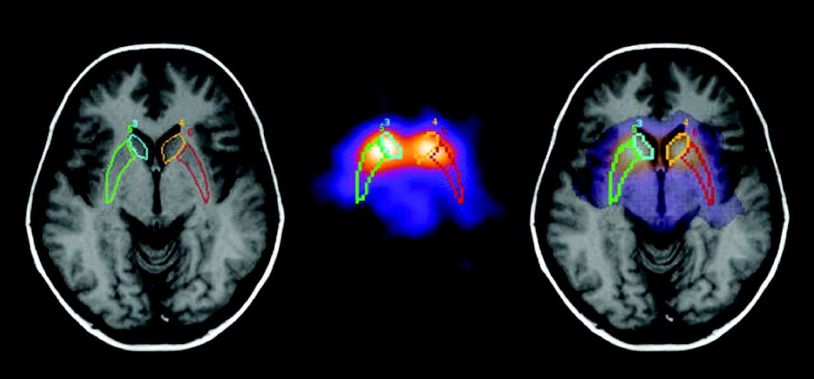
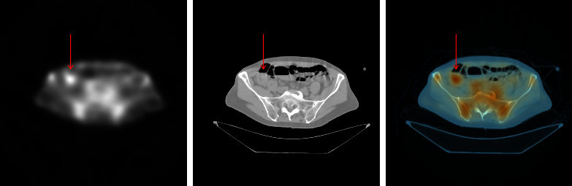
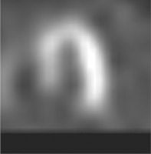
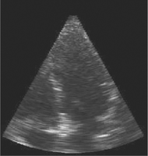
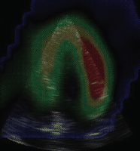
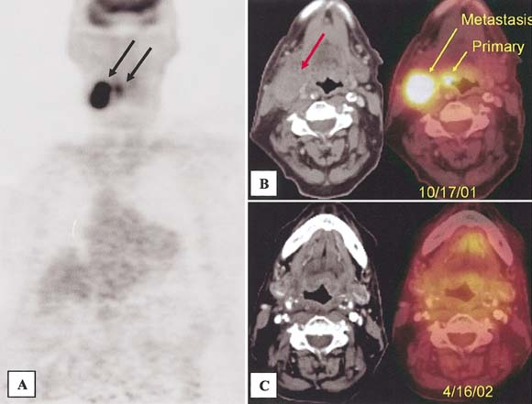
Software and Hardware Fusion
SPECT/MRI in basal ganglia with
123I-b-carbomethoxyiodophenyl tropane
(Slomka, et al., J Nucl Med 45:36S, 2004)
SPECT/CT with ¹¹¹In-ProstaScint®
(Wong, et al., PhD thesis, UCSF, 2002)
Pre/postsurgical PET/CT of head-neck squamous cell carcinoma
(Towsend et al., Semin Nucl Med 33:193)
Real-time ultrasound/gated SPECT
(Shekar et al., Radiographics 23:1673, 2003)
Software-based image registration is complementary, not competitive with dual-modality imaging
Notes:
SPECT Ultrasound an MRI SPECT images from Shekar et al., Radiographics 23:1673, 2003
Since the beginning of nuclear medicine, users have recognized that radionuclide imaging lacks anatomical information and offers relatively poor spatial resolution. For this reason, there always has bee a strong interest in combining SPECT and PET images with anatomical information from different modalities. One way to do this is to acquire the anatomical and functional information on different systems in separate procedures, and then combine the resulting images in software. This offers the flexibility of allowing the combination of images that don’t exist in a combined system. It can work well in a localized region or where body parts can be constrained so that they don’t move excessively, for example in the head and brain.

Slide 6
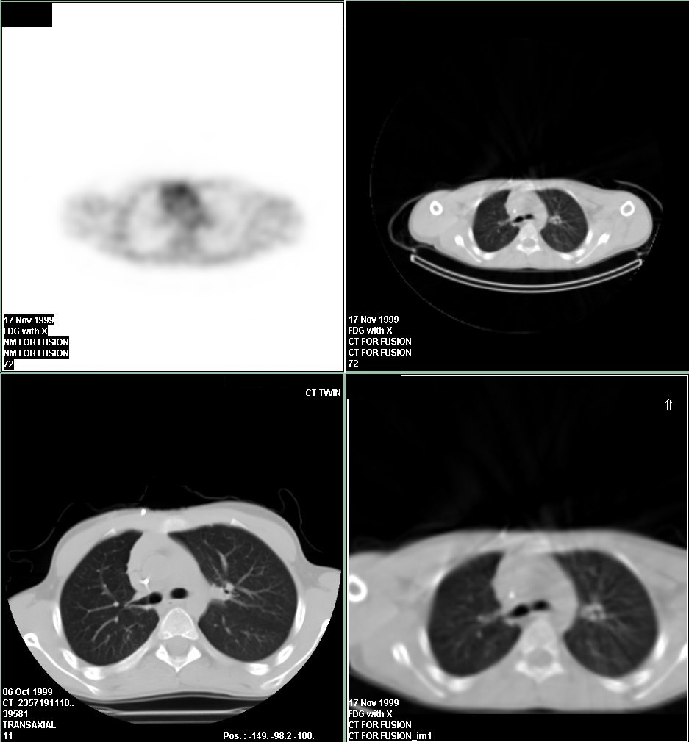
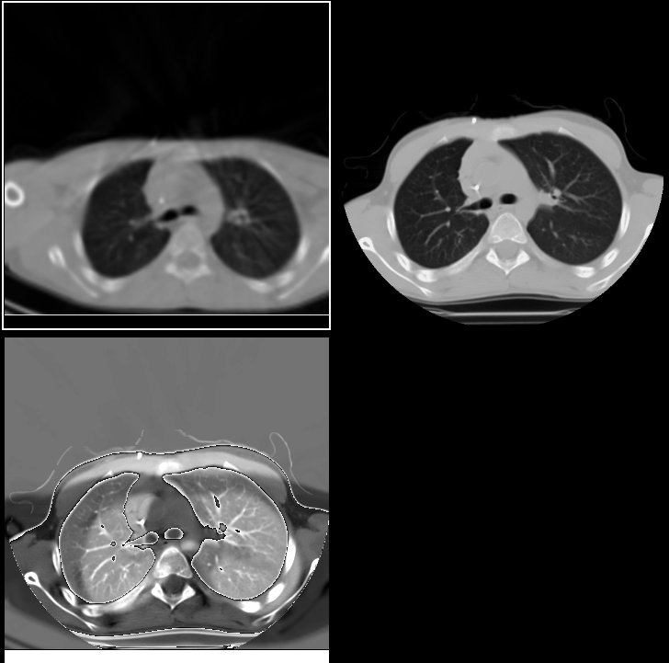
Voluntary and Involuntary Patient Motion
Inhalation /Expiration CT Subtraction
SPECT/CT
CT only
SPECT/CT images acquired with shallow breathing
Images courtesy: GE Medical Systems

Slide 7
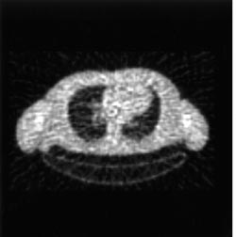
SPECT and Transmission Imaging
SPECT
Detector
Patient
Bailey, “Transmission Scanning in Emission Tomography”, Eur J Nucl Med, 25:774-787, 1998.
Scanning Radioactive Line Source

Slide 8
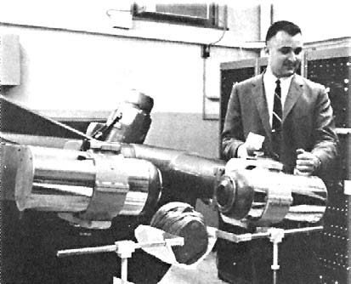

Emission-Transmission Imaging Conceived at Beginning of Radionuclide Imaging
Mark II
Univ of Pennsylvania
David Kuhl, MD
On May 14, 1965, Kuhl, Hale, and Eaton obtained the first transverse axial transmission CT scan of a patient’s thorax using a Mark II scanner. The CT scan was accomplished by replacing the detector underneath the patient with a small radioactive source (Am-241) such that the movement of the source underneath the patient followed the movement of the detector above. Kuhl DE, Hale J, Eaton WL. Transmission scanning: a useful adjunct to conventional emission scanning for accurately keying isotope deposition to radiographic anatomy. Radiology 1966:87:278-284.

Slide 9
Transmission-Emission Computer Tomograph (1987)
X-Ray Source
Semiconductor Detector
Strip Scintillator
Image
Memory Buffer
DM Mirshanov, Tashkent Branch, All-Union Research Surgery Center, USSR Academy of Medical Science. “Transmission-Emission Computer Tomograph”, USSR Patent 621.386:616-073 20.01.87-SU-181935, Jan 20, 1987.
Display

Slide 10
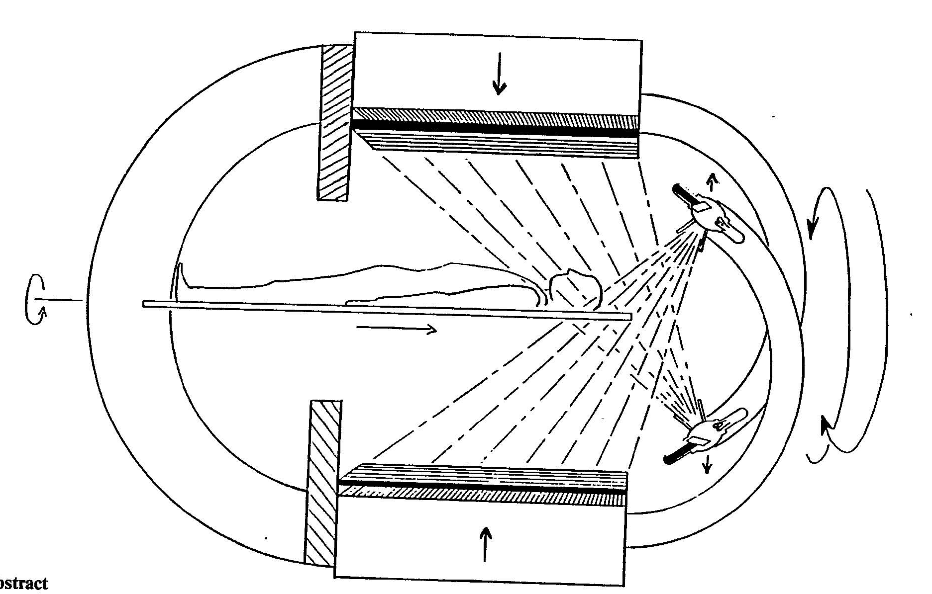
“Transmission/Emission Registered Imaging (TERI) Computed Tomography Scanners”
International Patent Application PCT/US90/03722
Abstract: “Acquisition of CT trans-mission data and emission data is achieved with the same scanner. Because the transmission and emission data sets are spatially registered, the map of attenuation coefficients described by the recon-structed transmission images can be used for generating a mathe-matically correct matrix for correc-tion of sequentially or simultaneous-ly acquired SPECT imaging data. The imaging devices can be gam-ma camera.”
Filing Date: 2 July 1990
Applicant and Inventor: Charles H. Kaplan, Chicago IL

Slide 11
SPIE Vol 1231 Medical Imaging IV Image Formation (1990)
Description of a Simultaneous Emission-Transmission CT System
Bruce H. Hasegawa, Eric L. Gingold, Susan M. Reilly,
Soo-Chin Liew, and Christopher Cann
Department of Radiology and Bioengineering Graduate Group
University of California, San Francisco (Box 0628)
San Francisco, CA 94143
1. ABSTRACT
We are designing an instrument which will perform correlated emission-transmission image acquisition, but which departs from previous systems by incorporating a low-power x-ray tube and generator, rather than a radionuclide source, for the transmission image. The system uses an array of high-purity germanium (HPGe) detectors and detector electronics with energy discrimination circuitry to separate x-rays (at 100 or 120 kVp) from higher energy gamma rays from the ^{99m}Tc or ¹²³I radiopharmaceutical injected into the patient. The data acquisition electronics have time constants matching the charge collection time (50 ns) of the HPGe detectors to maximize count-rate capabilities (up to 1 million cps per detector element), while maintaining adequate energy resolution (approximately 10% FWHM). Each detector channel has two energy windows for simultaneous transmission-transmission

Slide 12
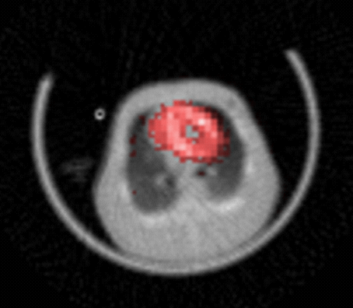
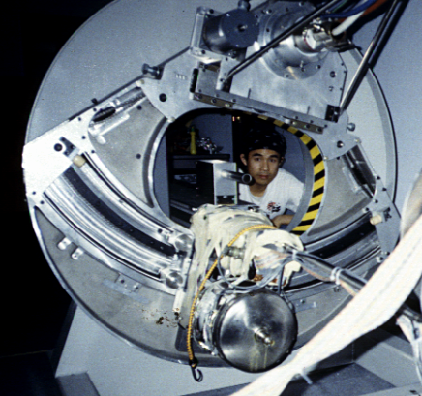
Simultaneous SPECT/CT (1990)
Simultaneous Emission (SPECT) – Transmission (x-ray CT) System
  Shortcomings: High x-ray flux compared to gamma emission, unnecessary motion artifacts for x-ray tomographic acquisition, etc.
X-ray tube
X-ray
Radionuclide source (e.g., ^{99m}Tc)
collimator
Detector (e.g., HPGe)
Energy Discrimination
X-ray data
Radionuclide data
LN₂ cryostat

Slide 13
Transmission Imaging (Radionuclide vs. X-Ray Source)
Siemens Somatom
125 kV, 2.5 mm Al + 0.4 mm Cu, 24º W target
3.5×10⁶ photons/mAs/mm² @ 0.75 m
R Birch, M Marshall, GM Ardran: Catalogue of Spectral Data for Diagnostic X-rays, Scientific Report Series No. 30 (The Hospital Physicists' Association, London, 1979).
1 mA x-ray tube produces
1.97×10⁶ photons/sec/mm² at 1 m
CT scanners operate at 600 mA
1.18×10⁹ photons/sec/mm² at 1 m
1 Ci = 3.7×10¹⁰ disintegrations/sec
Assume 3.7×10¹⁰ photons/sec
1 Ci source produces
2.94×10³ photons/sec/mm² at 1 m
1 mA tube equivalent to 669 Ci
600 mA tube equivalent to 401,190 Ci
X-ray source offers faster scans, higher statistics, better spatial resolution, and can be turned off and thrown away

Slide 14
Is Simultaneous SPECT CT Feasible With a Single Detector?
Maybe
1 mA x-ray source produces 2 million photons/sec/mm² at 1 m
Radionuclide image < 1 photons/sec/mm²
Really fast camera count-rate necessary
Possible damage to photomultiplier tubes
Can discriminate x-ray from γ-ray photons with energy-resolving x-ray detectors
Filing Date: 2 July 1990
Applicant and Inventor: Charles H. Kaplan, Chicago IL

Slide 15
Sequential Dual-Modality SPECT/CT
X-ray tube produces photon fluence equivalent to several thousand Curies of radioactivity
X-ray scatter ~ 0.1% primary
X-ray scatter to radionuclide detector can be equivalent of hundreds to thousands of Curies of radioactivity
X-ray tube
Camera
Camera
Separating radionuclide detectors from x-ray beam reduces scatter cross-talk
X-ray detector

Slide 16
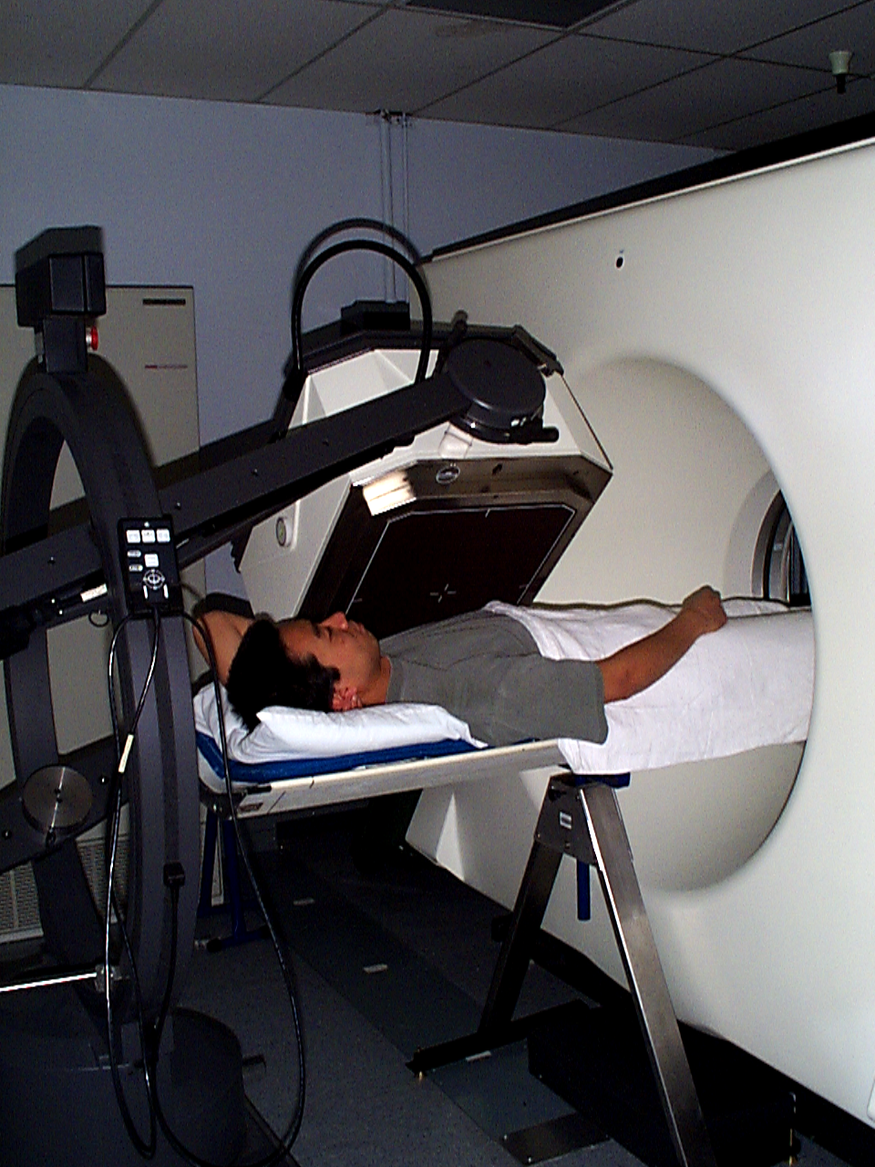
UCSF SPECT/CT System (1995)
SPECT
CT
X-Ray CT
Radionuclide
Emission
Computer
Correlated Image
Equipment courtesy of GE Medical Systems

Slide 17
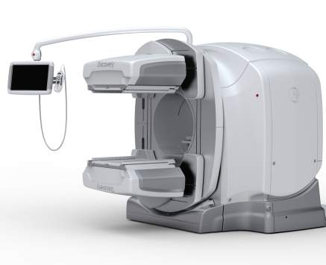
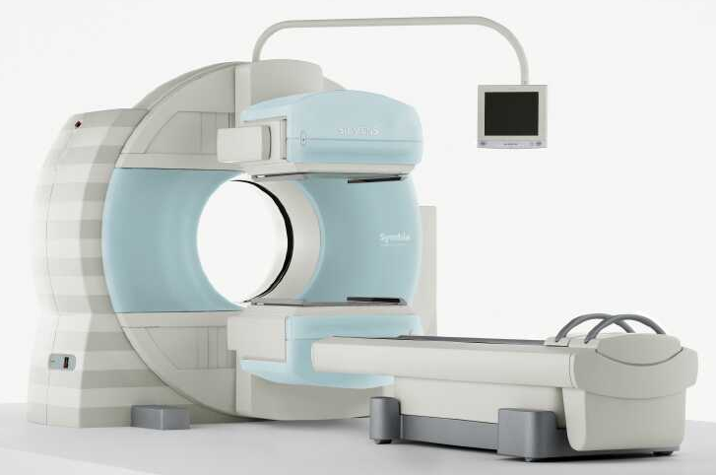
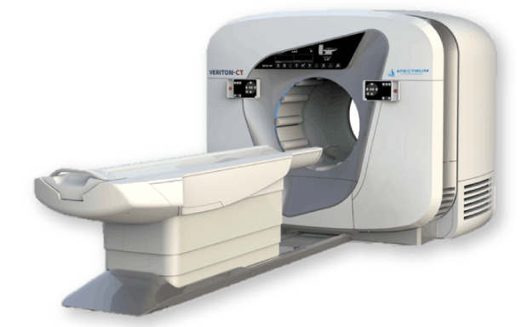
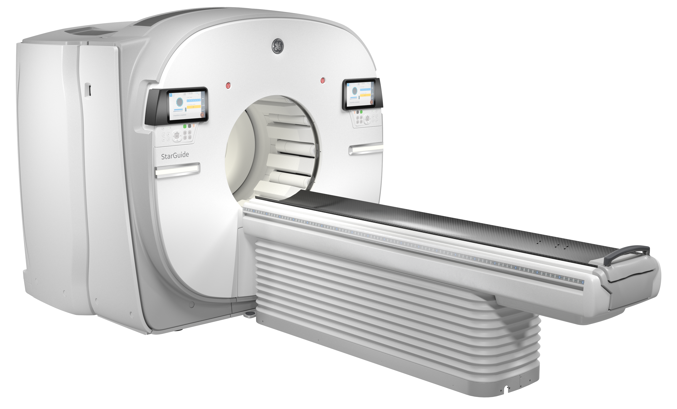
Modern Commercial SPECT/CT Systems
GE Discovery NM/CT 670
Siemens Symbia
Spectrum Dynamics Veriton-CT
GE StarGuide

Slide 18

SPECT-CT Movie
Movie courtesy of GE Healthcare
Disclaimer: Claims embedded in this movie are the views of GE Healthcare.

Slide 19
Correction of Radionuclide Data using CT
Attenuation Coefficients
Object Geometry
Correct Radionuclide Data for Physical Perturbations
CT Image
Scatter Coefficients
Improve Image Quality and Quantitative Accuracy of Radionuclide Data

Slide 20
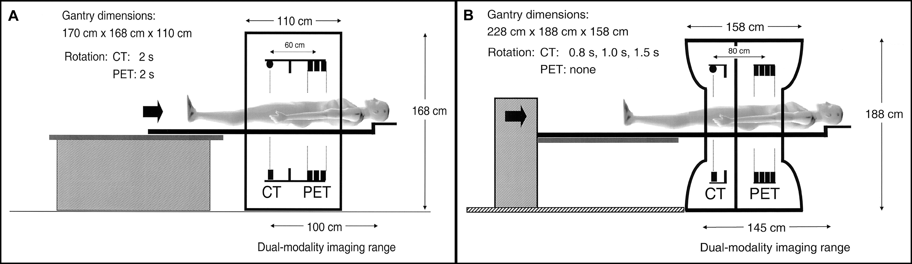
CT-based Attenuation Correction
X-ray CT offers rapid attenuation map generation capability.
Townsend DW, et al. J Nucl Med. 2004;45:4S-14S.
bed 1
bed 2
bed n
Transmission-Emission
transmission
emission
transmission
emission
transmission
emission
bed 1, 2, …
bed n
CT Transmission-Emission
CT
emission
emission
emission

Slide 21
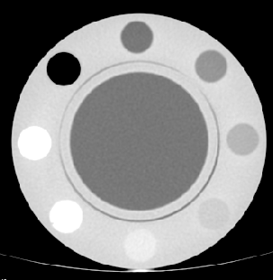
CT-Based Attenuation Coefficients Derivation
0.20
sample chamber
Water
60% ETOH
400 mg/cc
0.15
300 mg/cc
-1
200 mg/cc
acrylic
100 mg/cc
CT Image of Calibration Phantom
50 mg/cc
water
Linear Attenuation
0.9% Saline
0.10
Coefficients (cm )
0.05
Air
Calibration Procedure
Scan calibration phantom with K₂HPO₄ on x-ray CT scanner
Reconstruct x-ray CT data
Define VOI’s to get CT numbers (HU’s)
Calculate expected μ(E_{E})
0.00
-1000
-800
-600
-400
-200
0
200
400
600
Hounsfield Units
Piecewise linear fit

Slide 22



Attenuation Correction Algorithm
Transmission
Projection
Emission
Projection
Filtered
Backprojection
Iterative Reconstruction
Transmission
Tomogram
Attenuation map must be calibrated for energy of radionuclide photons!
Energy
Calibration
Attenuation
Corrected
SPECT/PET
Image
Attenuation
Map

Slide 23


¹³¹I-MIBG Uptake in Neuroblastoma
CT
SPECT
CONVENTIONAL
SPECT/CT

Slide 24
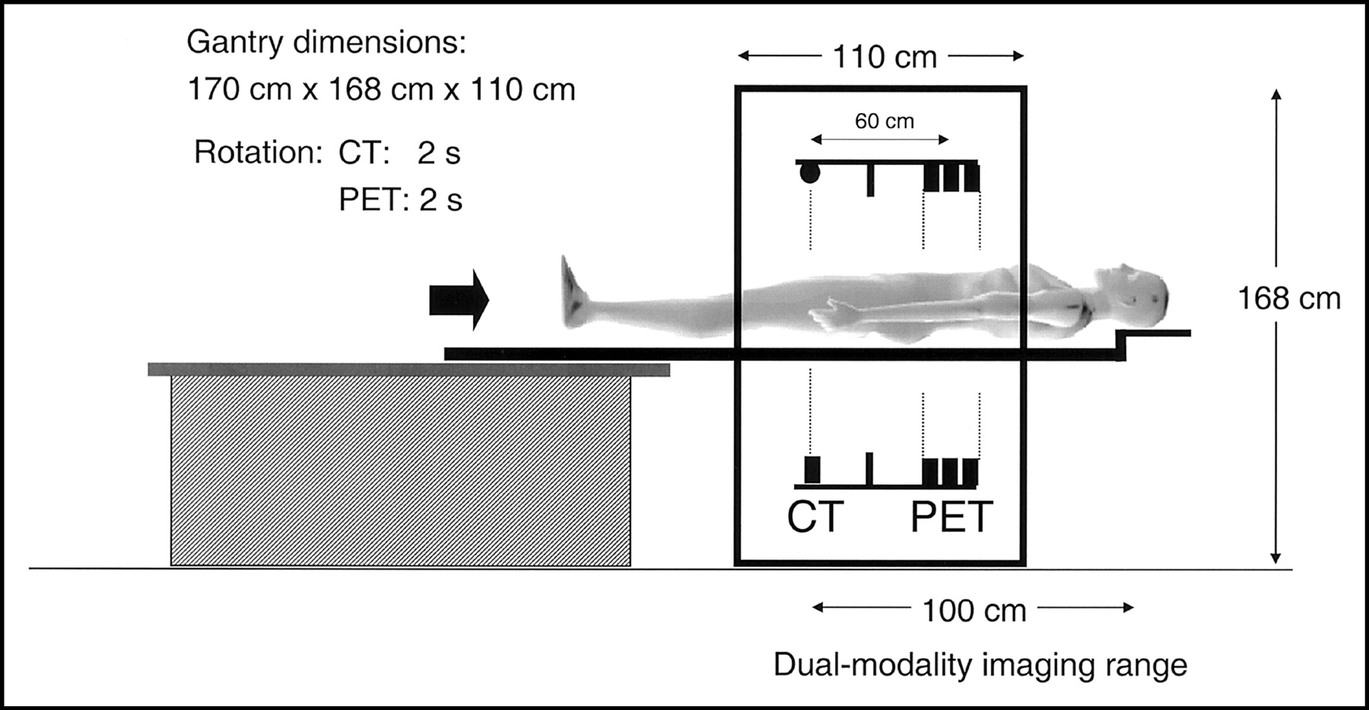
Combined PET/CT (1998)
University of Pittsburgh Medical Center (UPMC) in collaboration with CTI (Knoxville, TN) developed:
  Combined CT (Siemens Somatom AR.SP) and PET (ECAT ART, CPS Innovations) – Partial ring PET needed rotation.
Townsend DW, et al. J Nucl Med. 2004;45:4S-14S.

Slide 25
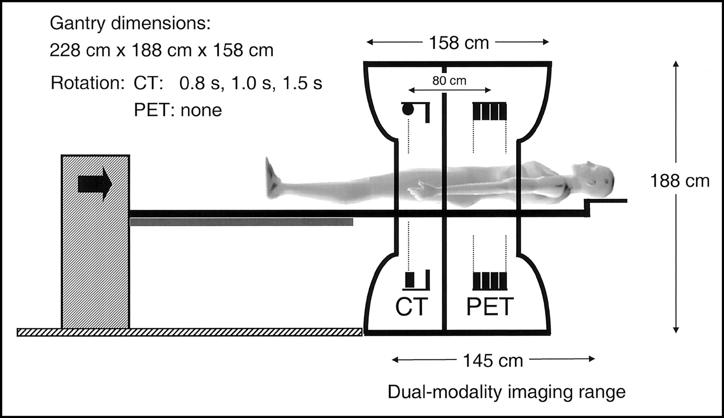
Commercial PET/CT Development
CPS Innovations (Knoxville, TN) introduced the commercial version of PET/CT.
Townsend DW, et al. J Nucl Med. 2004;45:4S-14S.

Slide 26
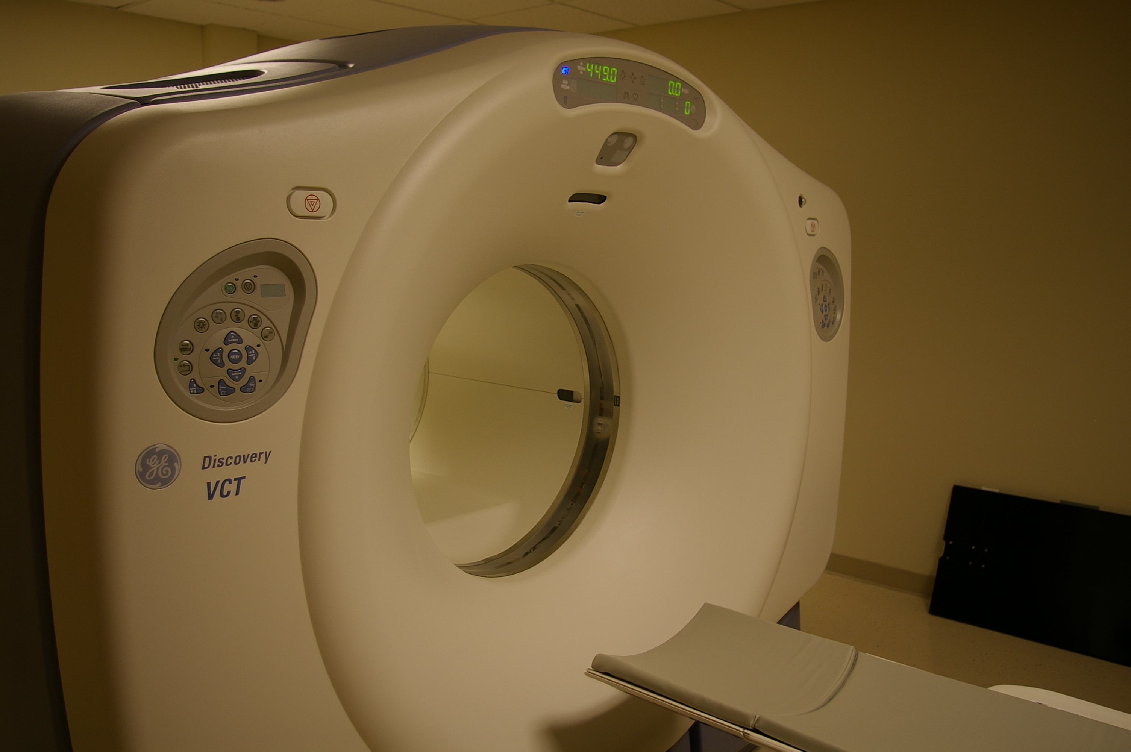
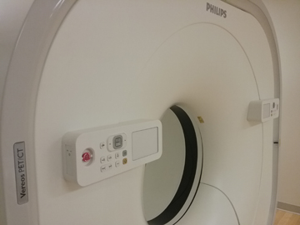
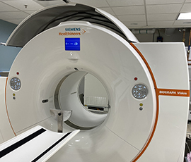
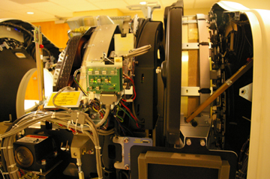
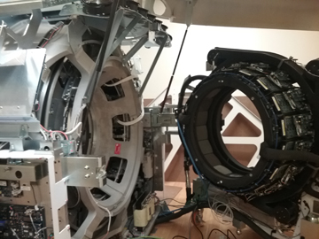
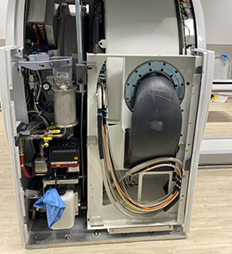
Modern Commercial PET/CT Systems

Slide 27
Combined PET/MR and SPECT/MR
Using MRI as anatomical reference for PET
Nonionizing radiation.
Excellent soft tissue contrast by MRI.
A means of imaging functional(PET)-functional(e.g., MRS, fMRI)-anatomical data (e.g., T1w, T2w MRI) as one-stop shopping or even simultaneous imaging possible (almost).
  MR-compatible microPET insert
  Human PET head insert
  Whole-body PET/MR as a single gantry or two separate systems with a patient bed that shuttles between the two scanners
Challenges include:
  Accurate attenuation map generation and correction.
  Synergy – Motion correction for PET data using MR data.
Same principles are applied to SPECT/MR (still at a preclinical stage).

Slide 28
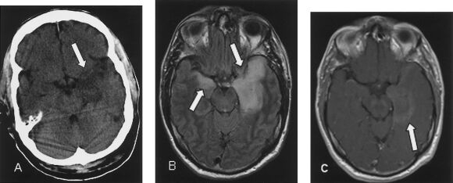
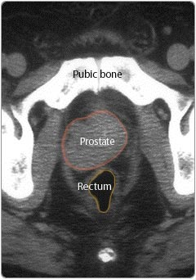
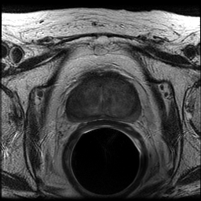
Soft Tissue Contrast of CT and MRI
CT
MRI
Ahmed M, et al. Semin Vasc Surg. 2004;17:181-205 (top images) ,
The Prostate Centre (www.prostatecentre.ca) (bottom left) &
Image courtesy of J. Kurhanewicz (UCSF) (bottom right)

Slide 29
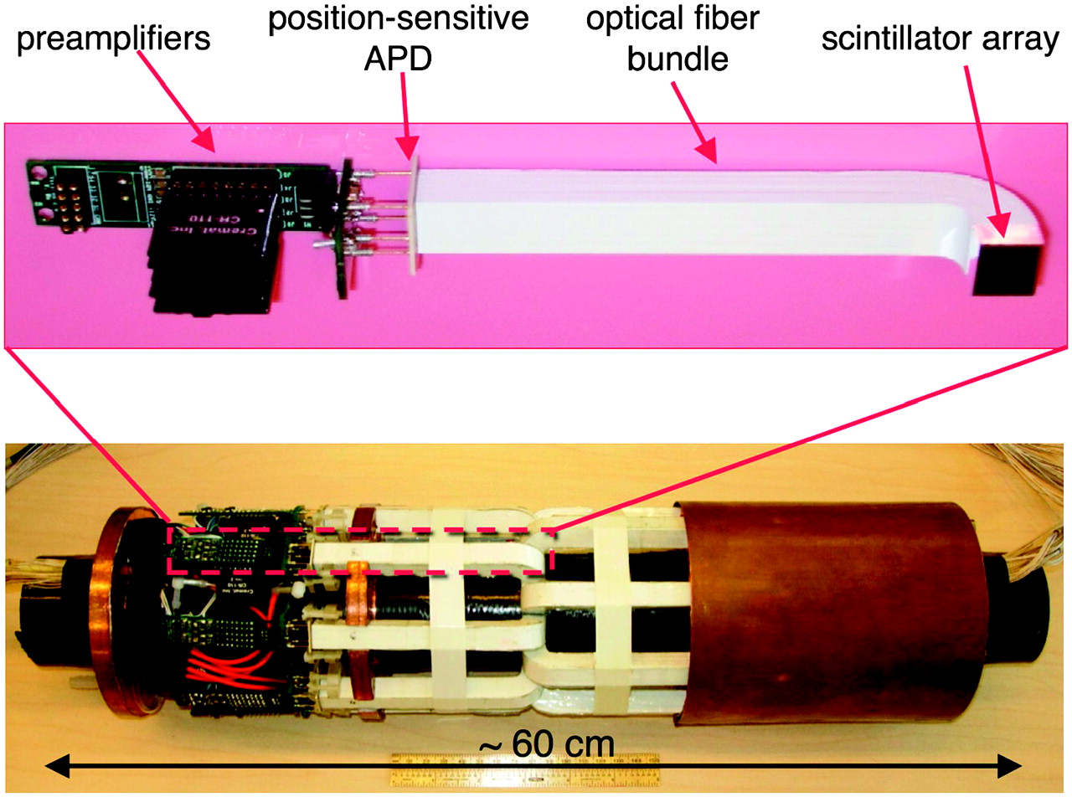
MR-Compatible microPET Insert
One such example is from the group at University of California, Davis. They developed:
  MR-compatible (for both PET and MRI) small animal PET insert that provides simultaneous PET/MRI capability in a high-field small animal MRI scanner.
Cherry SR. J Nucl Med. 2006;47:1735-1745.

Slide 30
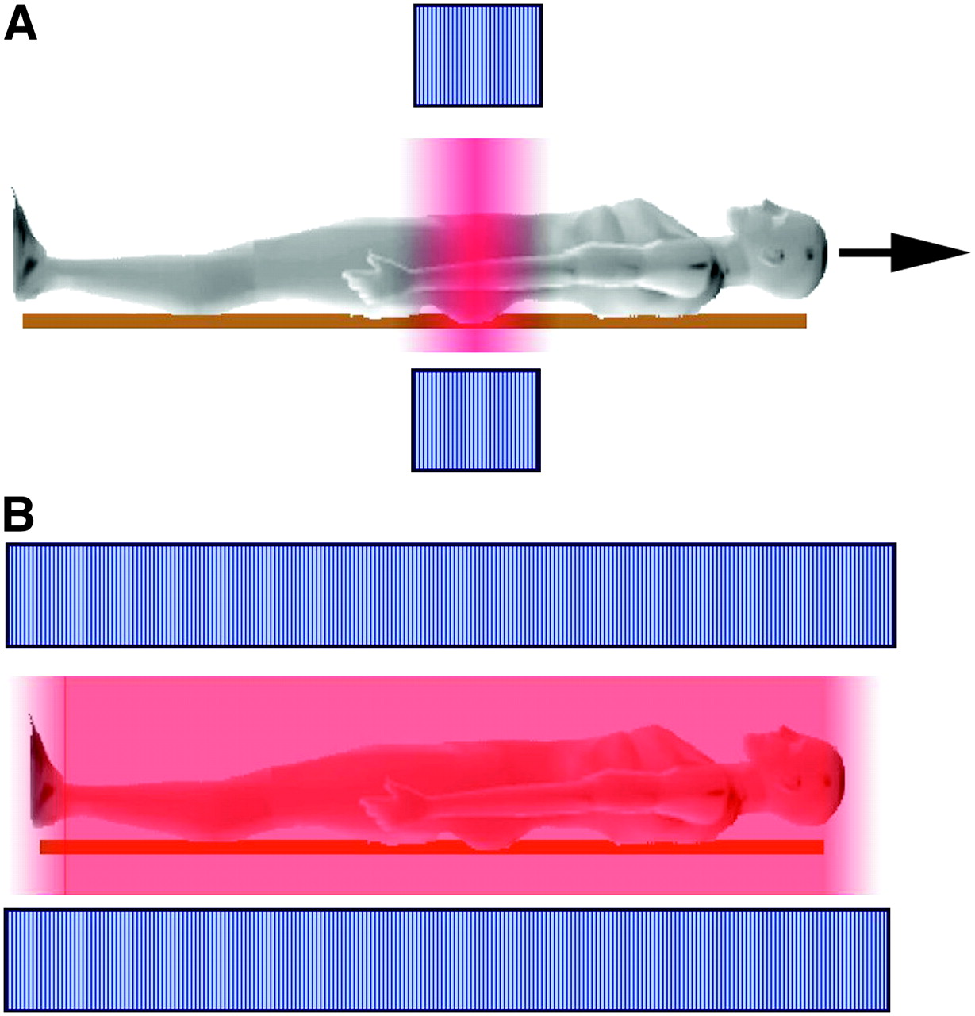
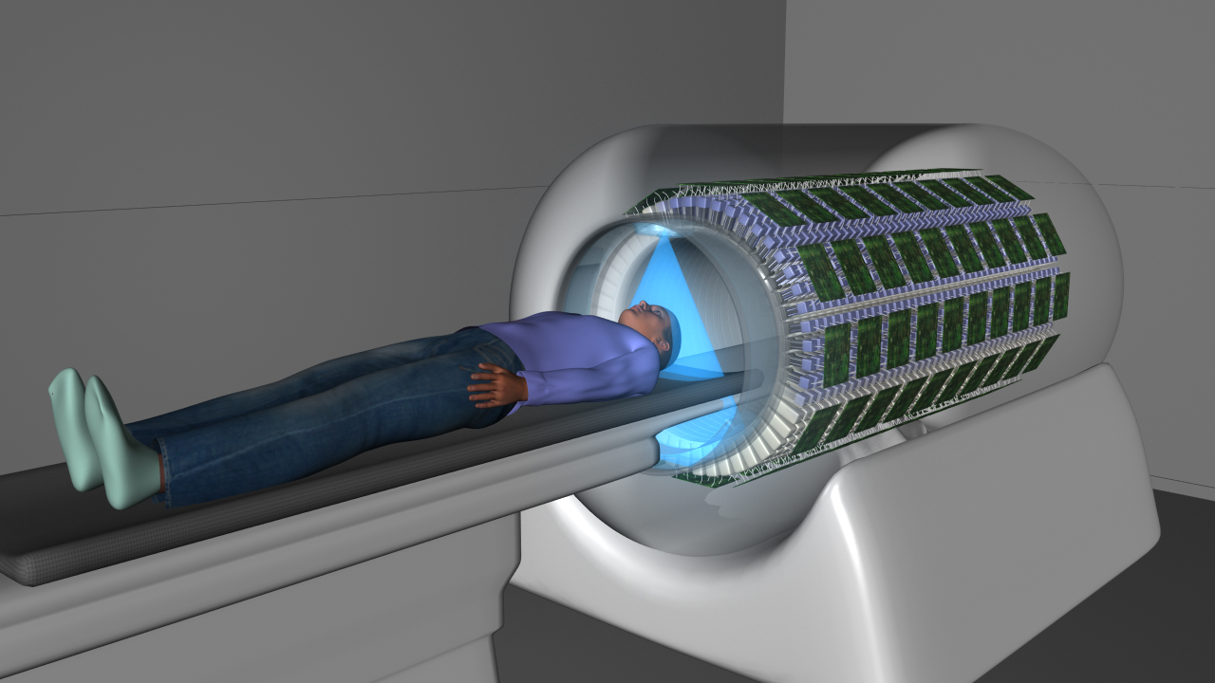
Total-Body PET/MRI
Ideas to realize total-body PET/MRI include
  Limited axial field of view PET and MRI combination
  Full cylinder of PET and MRI combined
Total-Body (Full Cylinder) PET
By UC Davis and United Imaging Healthcare
Cherry SR. J Nucl Med. 2006;47:1735-1745.

Slide 31
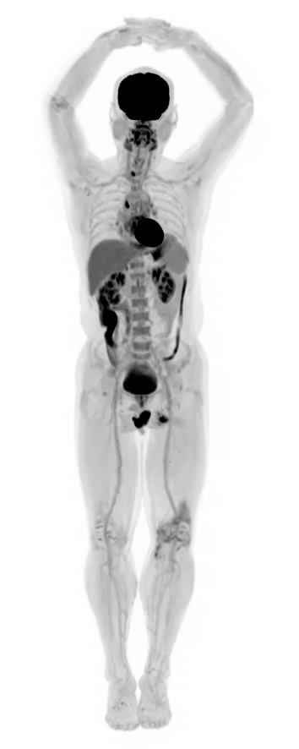

Total-Body PET/CT
uEXPLORER
Ring diameter: 78.6 cm; Transaxial FOV: 68.6 cm; Axial FOV: 194.8 cm
# of crystals: 564,480; # crystal blocks: 13,440; # of SiPMs: 53,760
80 detector row CT

Slide 32
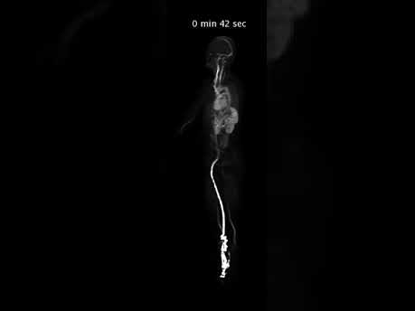
Notes:
https://www.youtube.com/watch?time_continue=6&v=JaszDkmgfMY

Slide 33
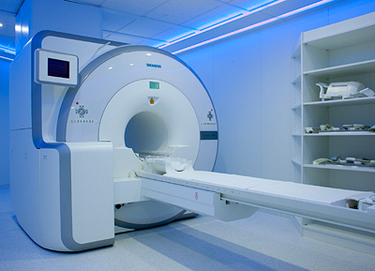
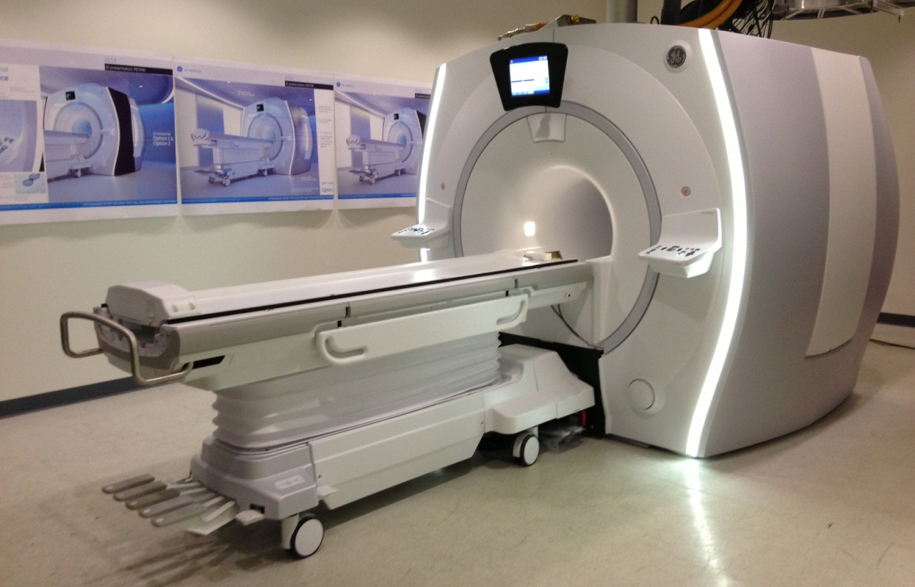
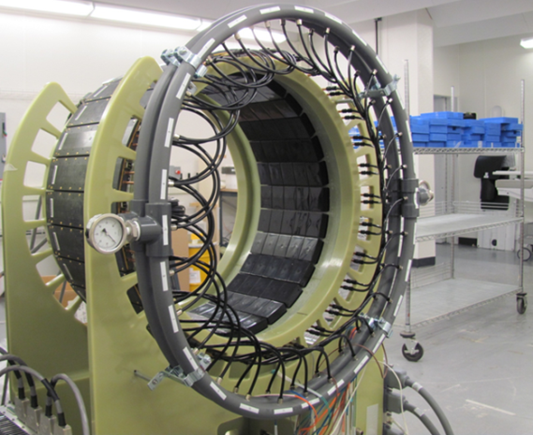
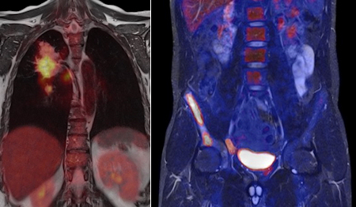

Integrated PET/MRI Systems
PET Insert
PET Insert
These images(top left, top right, and bottom right) are property of Siemens Healthcare. Scrapped from press releases.
GE Confidential and Proprietary
Technology in development that represents ongoing research and development efforts. These technologies are not products and may never become products. Not for sale. Not cleared or approved by the FDA for commercial availability.
Pichler BJ. J Nucl Med. 2010;51:333-336.

Slide 34
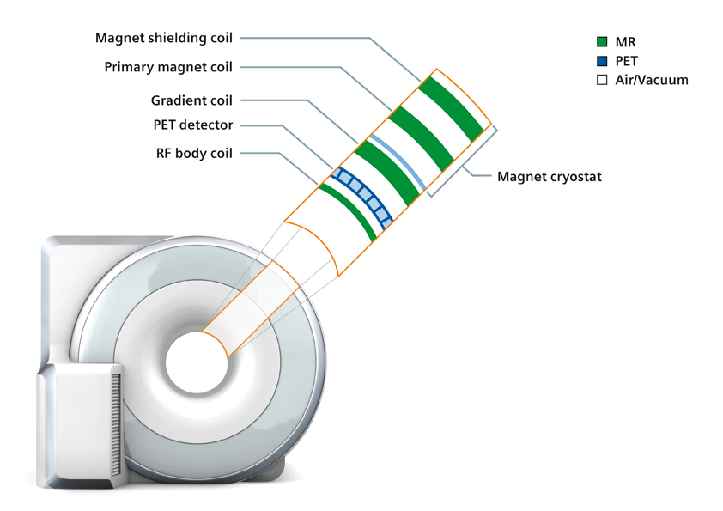
two is now one.
The first whole-body MR-friendly PET architecture

Slide 35
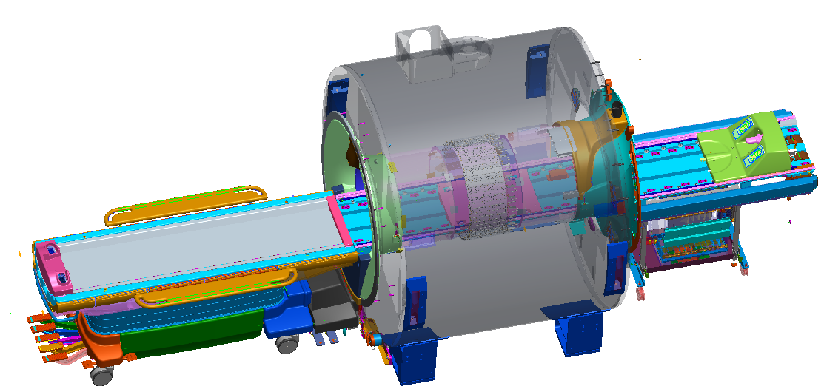
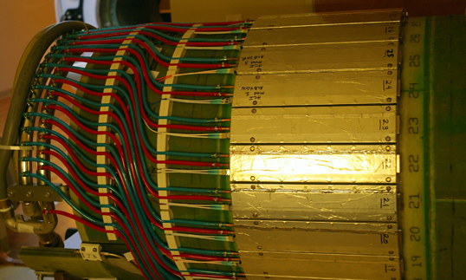
GE Time-of-Flight PET/MR
** Other Magnet enclosures
are not shown for clarity
Magnet
PET Ring
Stationary
CMA coil
PET Tube
Rear end bell **
Front end bell**
LPCA
Rear bridge
Front bridge
PET/MR Cradle
250mm
PET detector
Rear pedestal
1600mm
1720mm
PET/MR Mobile table
2379mm

Slide 36
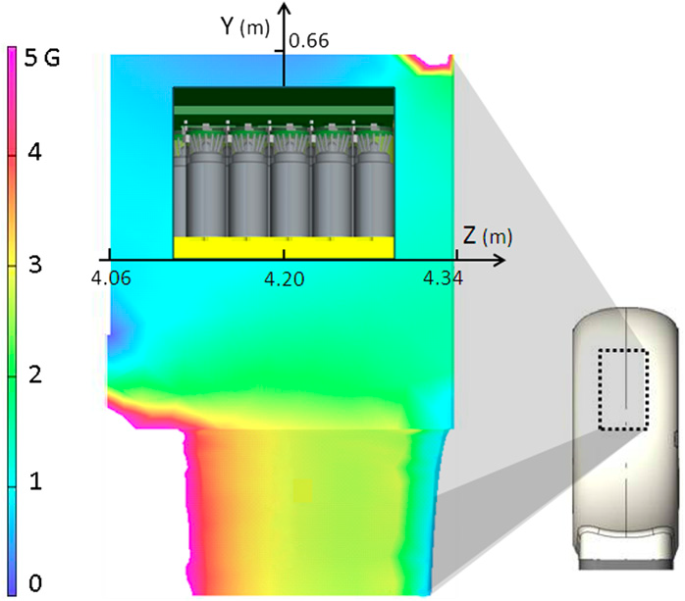
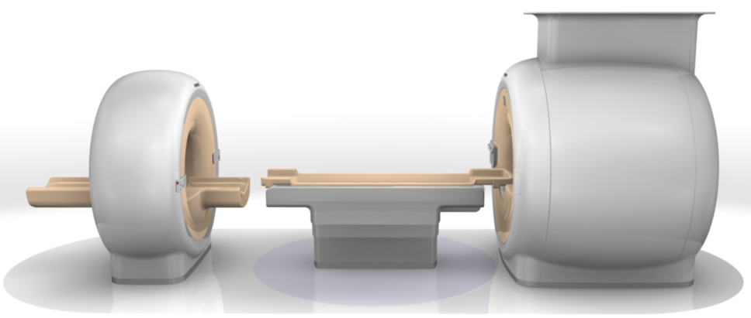
Two Systems Sharing One Patient Bed
This PET/MRI system from a commercial vendor put together separate PET and MRI systems with one patient bed that goes in both scanners without having to move the patient.
Zaidi H, et al. Phys Med Biol. 2011;56:3091-3106
This image is property of Philips Healthcare. Scrapped from a press release.

Slide 37
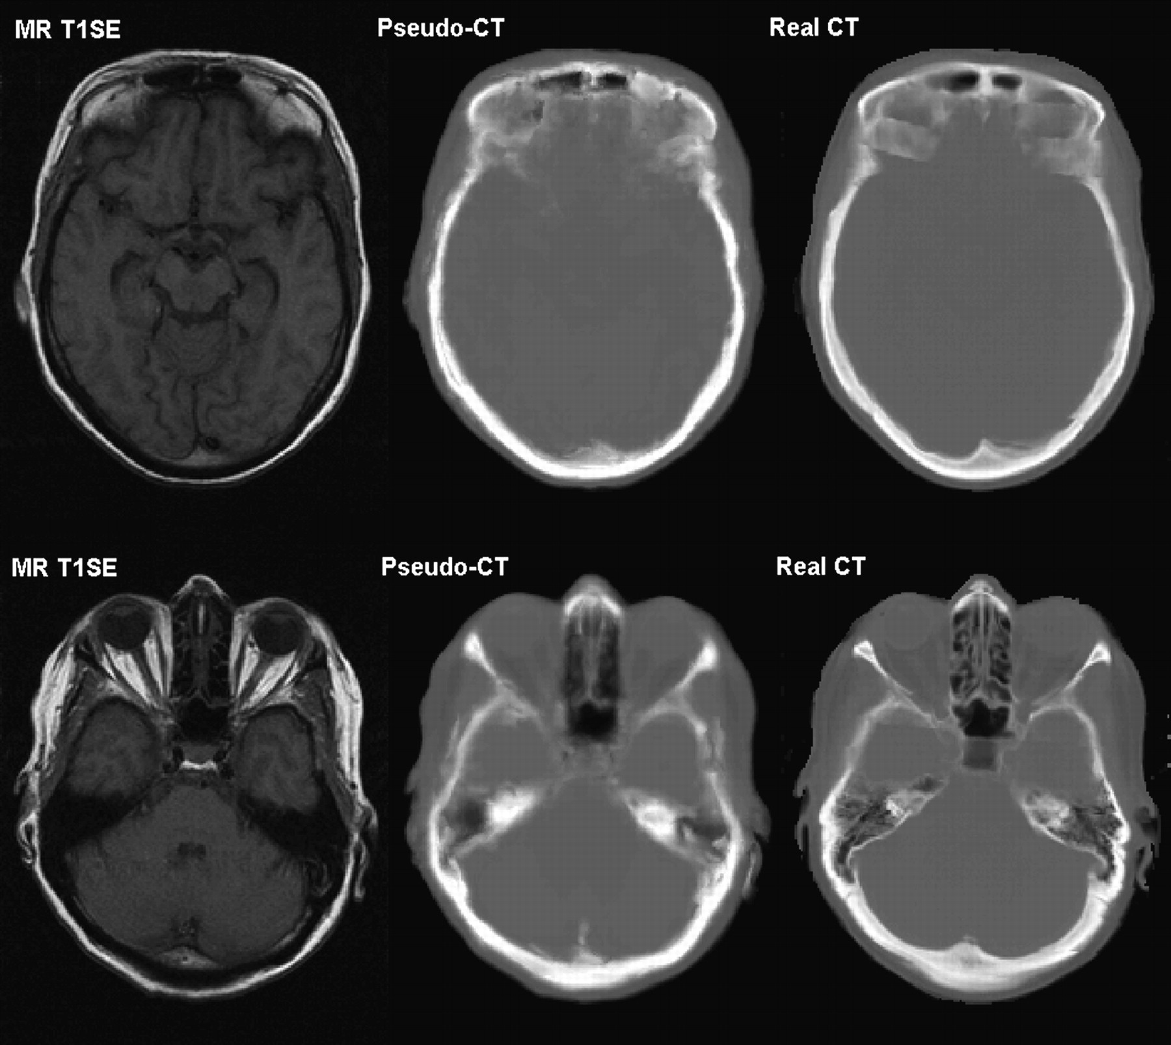
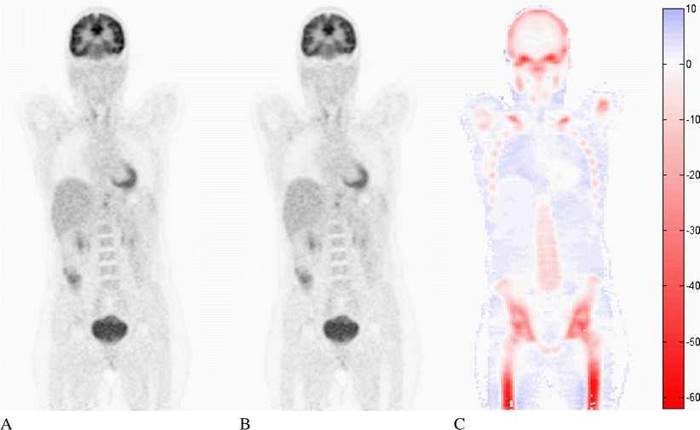
Attenuation Correction of PET using MRI
MRI does not provide linear attenuation coefficient map that is easy to derive from x-ray CT images.
  Use of an MR image for attenuation map generation is works-in-progress.
  Segmentation and atlas matching method, and CT-like pulse sequence that delineates bones are under investigation.
Hofmann M, et al. Eur J Nucl Med Mol Imaging. 2008;36:93-104
Hofmann M, et al. J Nucl Med. 2008;49:1875-1883.

Slide 38




CT-like MRI (UTE/ZTE) & Motion Correction of PET using MRI
Ultrashort or zero echo time (UTE/ZTE) MR pulse sequence provides intense signal from bone, which can create CT-like MR images. Then, potentially, UTE/ZTE MR image can be better utilized for PET attenuation correction.
CTAC (reference)
Zero TE
ZTAC
Wiesinger et al., ZTE Bone Imaging, ISMRM 2014
Navigator echo technique from MRI could provide real-time motion-tracking data (including respiratory-induced internal motions).
Simultaneous PET/MRI thus can utilize the periodic MRI navigator signal to correct for motion-induced projection data inconsistency of PET.
Yang J, et al. SNMMI. 2016

Slide 39
Deep Learning Approach Example for Direct AC and SC
Conventional method:
  Pseudo CT generation
  μ-map transformation
  Scatter simulation
  Separately corrected in sinogram space
Deep Joint Correction:
  Accelerated one-step
  Not using CT or MRI
Yang J, et al. Phys Med Biol. 2019;64:0750019
Notes:
However, this approach can correct attenuation and scatter simultaneously in image space, without using CT or MR images.

Slide 40


Positron Range in a Magnetic Field
Cherry SR. J Nucl Med. 2006;47:1735-1745
Radionuclide | Half-life | Max. β⁺ energy
¹¹C | 20.4 min | 0.96 MeV
¹³N | 9.97 min | 1.19 MeV
¹⁵O | 123 sec | 1.73 MeV
¹⁸F | 109.8 min | 0.634 MeV
⁶⁸Ga | 67.8 min | 1.90, 0.821 MeV
⁸²Rb | 76 sec | 2.60, 3.38 MeV
⁸⁹Zr | 78.4 hr | 0.902 MeV
¹²⁴I | 4.18 days | 1.54, 2.14 MeV
Levin CS, Hoffman EJ. Phys Med Biol. 1999;44:781-799
Then, what happens if these positron emissions occur in a strong magnetic field?

Slide 41



Positron Range in a Magnetic Field
Huang S-Y, et al. IEEE Nuc Sci Symp Conf Rec. 2014
Left: The simulated positron trajectories of a ⁶⁸Ga point source in water is shown with a uniform magnetic field at (a) 0 T, (b) 3 T, and (c) 7 T. The magnetic field was applied in the direction going into the paper plane
Right: The simulated positron PSF of ⁶⁸Ga in water with a 3 T uniform magnetic field

Slide 42

Positron Range in a Magnetic Field
Radionuclide | Half-life | Max. β⁺ energy
¹⁸F | 109.8 min | 0.634 MeV
⁶⁸Ga | 67.8 min | 1.90, 0.821 MeV
Huang S-Y, et al. IEEE Nuc Sci Symp Conf Rec. 2014
The system spatial resolution in full-width at half maximum (FWHM) is compared between the PET/CT (orange) and PET/MRI (blue) measured with the (a) ¹⁸F and (b) ⁶⁸Ga line source phantoms imaged in water.

Slide 43


SPECT/MR
Although SPECT/CT was developed prior to PET/CT, development of combining SPECT with MRI is slowly progressing. It is the same principle. MR-compatible SPECT (still in the preclinical stage) is being evaluated.
  Replace photomultiplier tubes with solid-state detectors (CdZnTe or CdTe) or APD-based technologies.
  Nonmagnetic collimators (casting of collimators using tungsten powder composite)
  Rotation can be avoided by building a ring detector system for SPECT.
Xu J, et al. Proc of SPIE. 2010;7622:76220V
Lee KS, et al. Phys Med Biol. 2011;56:685-702.

