Slide 1
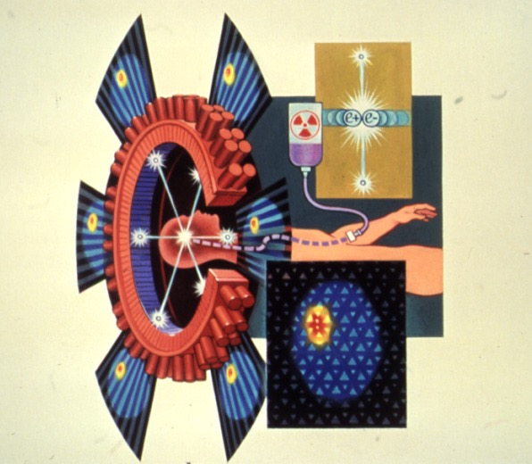
Basics of PET Physics
Margaret E. Daube-Witherspoon, PhD
daubewit@pennmedicine.upenn.edu
January 27, 2023

Slide 2
Topics of review
Basic nuclear physics as applied to positron emission tomography
Sources of radiotracers for PET
Detection of annihilation photons from positron decay
What is measured with PET
Corrections for physical effects in PET imaging
Limits on PET scanner performance
Time-of-flight PET
Total-body PET imaging considerations & applications
Scanner harmonization

Slide 3
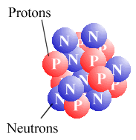
Physical signal
Nuclear physics
Stable isotopes
(⁹⁸Tc – 43 protons, 55 neutrons)
¹⁹F – 9 protons, 10 neutrons
¹²C – 6 protons, 6 neutrons
¹⁴N – 7 protons, 7 neutrons
¹⁶O – 8 protons, 8 neutrons
Unstable isotopes
(^{99m}Tc – 43 protons, 56 neutrons)
¹⁸F – 9 protons, 9 neutrons
¹¹C – 6 protons, 5 neutrons
¹³N – 7 protons, 6 neutrons
¹⁵O – 8 protons, 7 neutrons

Slide 4
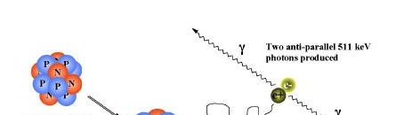
Physical signal
Gamma decay
^{99m}Tc (6.02 h)
0.1426
γ₁
0.1405
γ₃
γ₂
0.0
⁹⁹Tc (2.13**10⁵ y)
Nucleus decays to lower energy state by emitting gamma ray
^{99m}Tc t_{1/2} = 6 hours, 140 keV
²⁰¹Tl t_{1/2} = 3 days, ~70 keV
¹¹¹In t_{1/2} = 2.8 days, 171/245 keV
¹²³I t_{1/2} = 13 hours, 159 keV

Slide 5
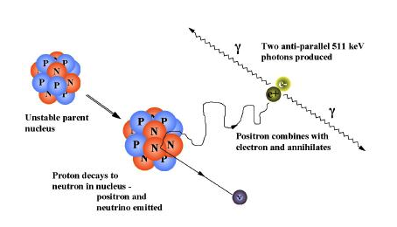
Physical signal
Positron decay
vi) Two 511 keV photons
produced by e+ e-
annihilation
~180˚
i) Unstable parent nucleus
iii) Positron travels
short distance in tissue
(Neutrino escapes)
ii) Proton decays to neutron
Emits positron (e⁺) and neutrino
¹¹C t_{1/2} = 20 minutes
¹³N t_{1/2} = 10 minutes
¹⁵O t_{1/2} = 2 minutes
¹⁸F t_{1/2} = 110 minutes

Slide 6
Signal source
Sources of positron-emitters
Generators
  Useful when radionuclide half-life is short and a radioactive “parent” is available
  ⁶⁸Ga from ⁶⁸Ge
  ⁸²Rb from ⁸²Sr
  Parent radionuclides shipped to hospitals
Cyclotrons
  Necessary when radionuclide half-life is short but NO radioactive parent is available
  ¹⁸F, ¹¹C, ¹³N, ¹⁵O
  Shorter radionuclides produced on-site
  ¹⁸F shipped world-wide

Slide 7
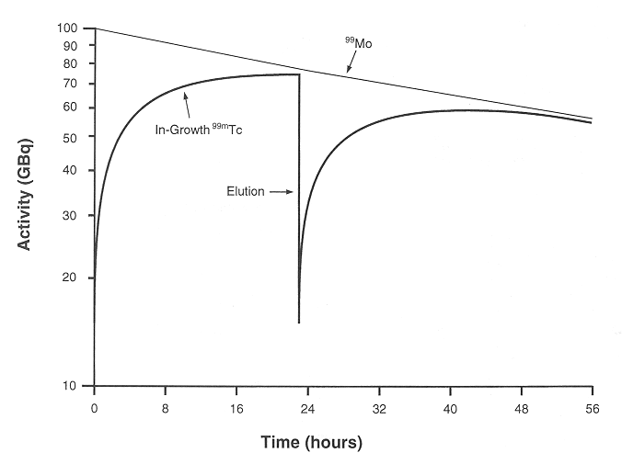
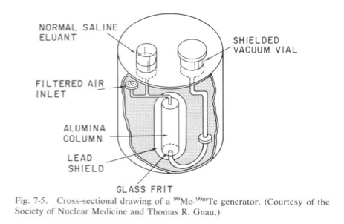
Signal source
Generators:
Parent-daughter relationships
Parent
Daughter
dN_{p}
dt
= − λ_{p}N_{p}
dN_{d}
dt
= λ_{p}N_{p} - λ_{d}N_{d}
{
{
Produced
Decaying
Molybdenum generator
⁹⁹Mo ^{99m}Tc
t_{1/2} = 66 h t_{1/2} = 6 h
Transient equilibrium
Parent sticks to ion exchange column
Daughter is removed (“eluted”) from the column using chemical differences between parent and daughter

Slide 8
Signal source
Generators for PET
Parent
Daughter
dN_{p}
dt
= − λ_{p}N_{p}
dN_{d}
dt
= λ_{p}N_{p} - λ_{d}N_{d}
{
{
Produced
Decaying
Gallium generator
⁶⁸Ge ⁶⁸Ga
t_{1/2} = 288 d t_{1/2} = 68 min
Generators must be replaced
Physical decay of parent (less activity available)
Physical decay of column (parent “breakthrough”)
Used to label agents for prostate imaging
Rubidium generator
⁸²Sr ⁸²Rb
t_{1/2} = 25 d t_{1/2} = 75 s
Used in myocardial perfusion imaging

Slide 9
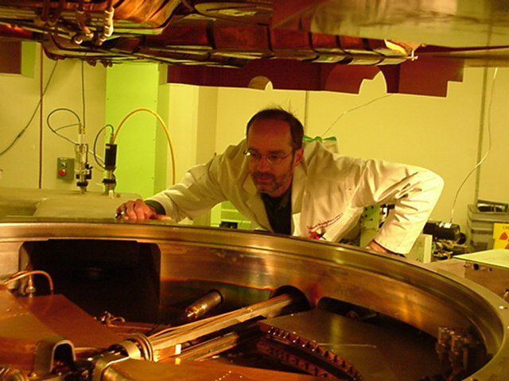
Signal source
Cyclotron:
isotope production for most
positron emitters
Exponential growth of ‘daughter’
p (22 MeV) + ¹⁸O n + ¹⁸F
t_{1/2} ~ 2 h

Slide 10
Signal source
Cyclotron production
Target material
  Robust to irradiation
  Easily handled form (i.e., solid, gas)
Radiochemical separation of radionuclide from target material
Radiochemical production of desired radiotracer
  Adding the radionuclide to a physiologically interesting molecule
  ¹⁸F in [¹⁸F]-fluorodeoxyglucose

Slide 11
Signal source
¹⁸F-Fluorodeoxyglucose (FDG)
CH₂OH
Ido et al. 1978
O
H
H
Glucose is key source of energy for many cells, especially tumors
Glucose
Blood → tissue → cell
Phosphorylation →…→ glycogen
H
OH
OH
OH
H
H
^{OH}

Slide 12
Signal source
¹⁸F-Fluorodeoxyglucose (FDG)
CH₂OH
Ido et al. 1978
O
H
H
Glucose
Blood → tissue → cell
Phosphorylation →…→ glycogen
H
OH
OH
OH
H
Deoxyglucose
Blood → tissue
Phosphorylation & then trapped in cell
H
^{H}

Slide 13
Signal source
¹⁸F-Fluorodeoxyglucose (FDG)
CH₂OH
Ido et al. 1978
O
H
H
Glucose
Blood → tissue → cell
Phosphorylation → glycogen
H
OH
OH
OH
H
Fluorodeoxyglucose
Blood → tissue
Phosphorylation & then trapped in cell
Information which cells are using glucose & how much
H
¹⁸F
Patient injected activity: 10 mCi (370 MBq) = 3.7 x 10⁸ decays/s
Tracer kinetics: 6 pico-mole ~ 1 nano-gram

Slide 14
Some PET Radiotracers and Applications

Slide 15
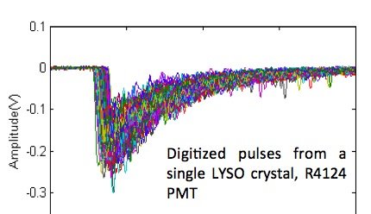

Scintillation Detector
Signal source
Scintillator
Absorbs some or all 511-keV energy & converts to light photons
Scintillator | NaI(Tl) | BGO | LSO/LYSO
τ (ns) | 230 | 300 | 40
Photons/MeV | 41,000 | 7000 | 26,000
1/μ (cm) | 2.9 | 1.1 | 1.2
% effic. 2.5-cm | 58% | 91% | ~ 80%
Fast decay (τ) -> high count-rate performance good timing resolution
High light output (photons/Mev) -> good energy resolution good spatial resolution (Anger-logic)
High stopping power (μ) ->
good efficiency

Slide 16
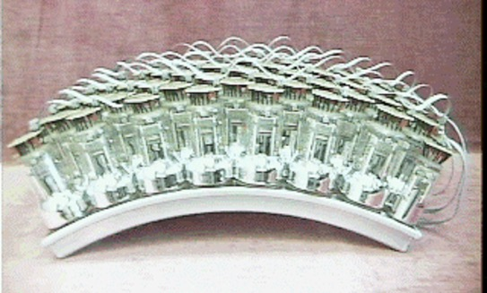
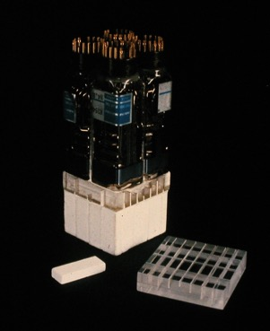
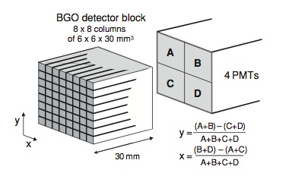
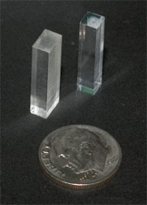
Photo-sensor
Signal source
Photomultiplier
Tube (PMT)
Position-sensitive (Anger) detector
converts energy of light photons to electrons (signal)
Block detector
(Anger-logic)
PMTs generally larger than small crystals
Requires Anger logic to distinguish crystal of interaction

Slide 17
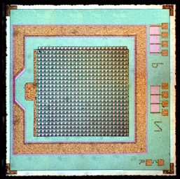
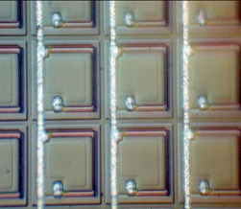
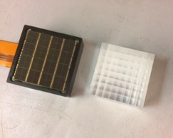
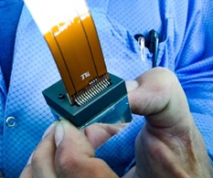
Newer Photo-sensor: Si-PMs
Signal source
Avalanche photodiode (APD)
Small APDs operating in Geiger mode with hundreds of micro cells per mm²:
  Small, compact design
  Available in arrays
  Very high quantum efficiency
  Fast timing characteristics
  High gain, no need for amplification
  Can operate inside MR
  Potential for low encoding (e.g., 1-to-1)
Micro-cell
30 μm
1 mm
Common readout line
Lab. SiPM, Dept. of Experimental and Theoretical Physics, Moscow Engineering Physics Institute
2D flood
  3.86 x 3.86 x 19 mm³ LYSO
  PDPC digital SiPM
  64-channel array
Notes:
Solid-state photo-sensors introduced in mid-2000’s and used initially for small animal PET scanners
SiPMs have become a real game changer for clinical PET systems in only the last few years
More expensive than conventional PMTs, but the favorable properties make it very desirable for PET, both PET-MR and PET-CT

Slide 18
Signal detection
Coincidence Detection
c = 3 x 10⁸ m/sec
coincident photons
2τ ~ 4-5 ns

Slide 19


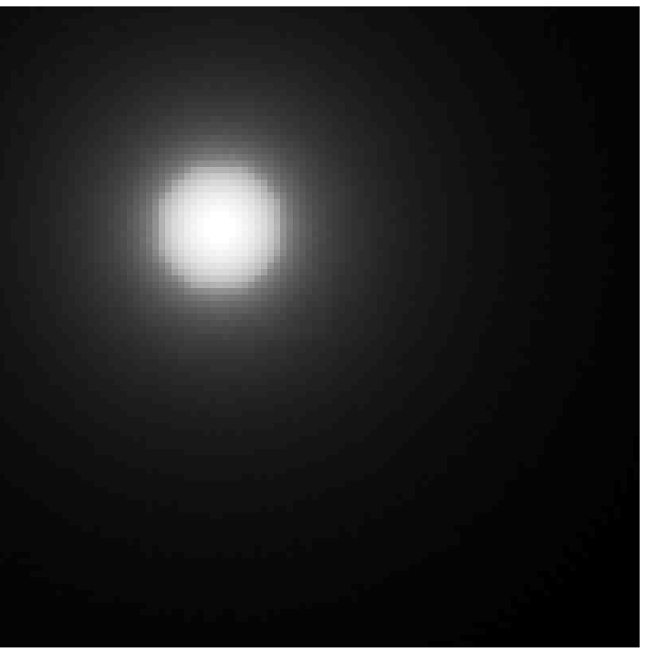
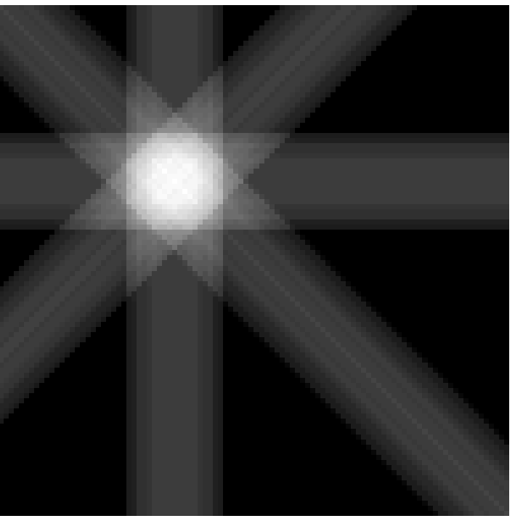

Using coincidence information to create an image
180 views
2 views
4 views
8 views

Slide 20
Signal detection
What is Measured with PET
b
True coincidence
a
Coincidence?
  Y = N(T)
Record event
What is measured
Normalization
Trues

Slide 21
Signal detection
What is Measured with PET
b
True coincidence
a
Coincidence?
  Y = N(A_{b}x T)
Record event
What is measured
Normalization
Attenuation
Trues

Slide 22
Signal detection
What is Measured with PET
b
True coincidence
a
Scattered coincidence
Coincidence?
  Y = N(A_{b}x T + S)
Record event
What is measured
Normalization
Attenuation
Trues
Scatter

Slide 23
Signal detection
What is Measured with PET
b
Random coincidence
(~2τ . singles²)
True coincidence
a
Scattered coincidence
Coincidence?
  Y = N(A_{b}x T + S + R)
Record event
What is measured
Normalization
Attenuation
Trues
Scatter
Randoms

Slide 24
Signal interaction
Interactions of gamma rays with tissue
atom
Photo-electric
Complete absorption of photon by inner-shell atomic electron
hν_{o}
e⁻
energy = hν_{o}
Compton
Scattering of photon by outer-shell electron leads to loss of energy and change of direction
e⁻
e⁻
hν′

Slide 25
Signal interaction
Attenuation and scatter
Narrow beam absorption is exponential with linear attenuation coefficient μ
μ decreases as photon energy increases
Attenuation decreases detector rates
Broad beam scatter increases detector rates
d
I = I₀ e^{-μd}

Slide 26
Relative effect of attenuation
SPECT camera
PET
patient
patient
d
d₁
d₂
SPECT: Lower energy photons compared to PET (larger μ), but some photons only travel short distances.
PET: Higher energy photons so μ is smaller, but pair of photons must traverse entire body width.
Suppose d=15 cm at torso center:
Suppose d₁=d₂=15 cm:
μ(140keV) = 0.15/cm
μ(511keV) = 0.096/cm
I/I₀ = e^{-μd} = 0.20
I/I₀= e^{-μd1} e^{-μd2} = e^{-μ(d1+d2)} = 0.06

Slide 27
Attenuation correction is more accurate in PET than SPECT
SPECT camera
PET
patient
patient
d?
d₁
d₂
In SPECT, we do not know d; therefore, only approximate correction is possible
In PET, the total path length D=d₁+d₂ can be measured and allows an accurate correction
I/I₀ = e^{-μd?}
I/I₀ = e ^{-μd1} e^{-μd2} = e^{-μD}

Slide 28
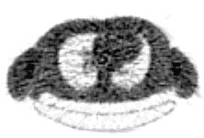
Transmission Scan
d1
d2
¹³⁷Cs point source (662 keV, t_{1/2} = 30 yr)
⁶⁸Ge line source (511 keV, t_{1/2} = 288 d)
D
Emission
I / I₀ = e^{-μd1 .} e^{-μd2}
= e^{-μD}
Transmission
I / I₀ = e^{-μD} → AC = e^{μD}

Slide 29
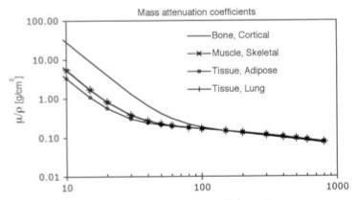
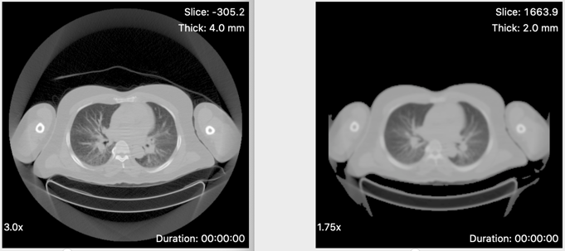
X-ray CT has replaced gamma-ray transmission sources for attenuation measurements
X-ray CT scan - source of X-rays with energies from ~30 to 120 keV. We assume an ‘effective’ energy of ~ 75 keV
spectra
X-ray source
positron source
γ-ray source
Intensity
I₀(E)
0
E (keV)
30
120
511
662
(Recall that the PET emission data is attenuated at 511 keV)
CT -> PET Transmission image: scaled and hybrid segmentation
511 keV

Slide 30
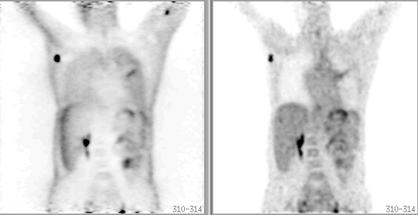
Impact of Attenuation Correction
No AC
AC
Without attenuation correction:
Skin artifact
Artificially high lung uptake
Lower apparent uptake in the center

Slide 31

Randoms Correction — Delayed window technique
Signal A
time
A
Delayed Signal A
Coincidence
Window, 2τ
B
Signal B
Randoms = (2τ) x singles**2
True coincidence
Random coincidence

Slide 32
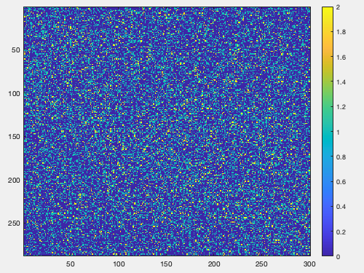
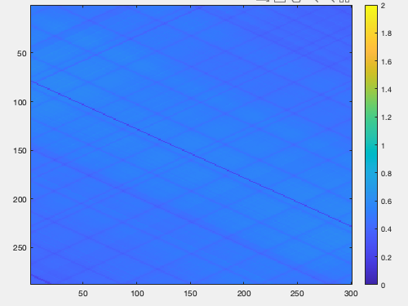
Randoms Correction — Calculation from singles rates
Randoms = (2τ) x singles**2
Maps of randoms:
Measured randoms depends on the rate of measuring coincident events → noisy correction
Coincidence fraction (# coincidences / # singles) is a few %
Calculation of randoms from singles depends on the rate of measured single events → less noisy correction
Noise in corrections can propagate into image
Measured
Calculated

Slide 33
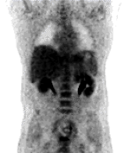
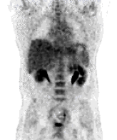
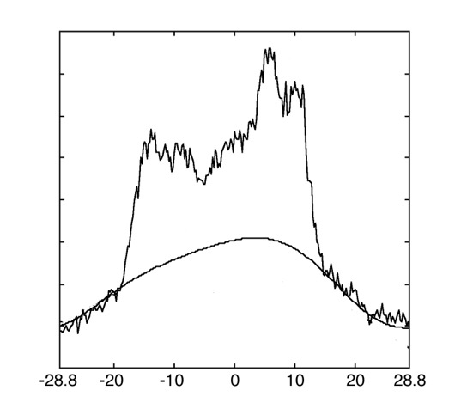
Scatter Correction
A
B
before
after
Single Scatter Simulation:
Calculate the contribution to each LOR for an arbitrary scatter point using the Klein-Nishina equation for single Compton scatter with known attenuation distribution + guess of activity distribution

Slide 34
3D: higher sensitivity…increased scatter
true
scatter
random
2D septa allowed mechanical rejection of scatter, randoms
True events
Energy rejection important for 3D
threshold with good energy resolution -> fewer scatter events measured
Scatter events
threshold with poor energy resolution -> more scatter events measured

Slide 35
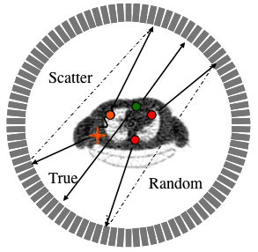
Scanner Deadtime
NEC = T/(1+S/T+R/T)
Ideal Trues
(no deadtimes)
NEMA NU2-2001
20-cm phantom
Philips Allegro
Univ. of Pennsylvania

Slide 36
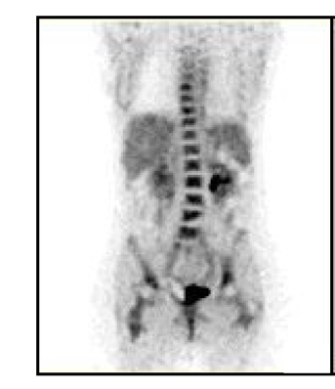
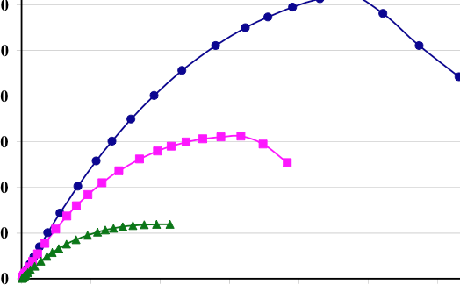
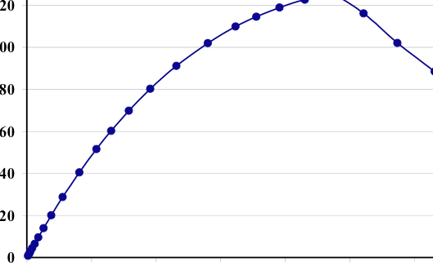
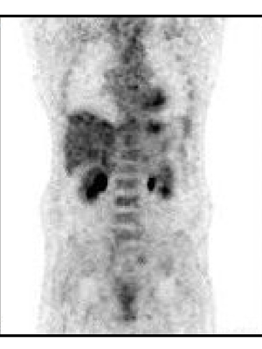
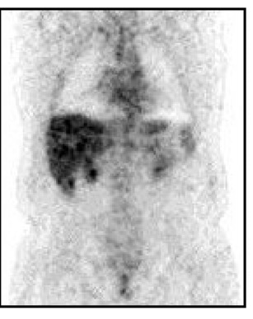
Image quality (SNR) depends on patient size
NEC ~ (Signal / Noise)²
diam.
Clinical imaging range
20 cm
Signal/noise ratio
27 cm
35 cm
Activity
Notes:
These data are from Allegro, but I would make argument general - heavy patients have lower image quality, and it is not practical to make up the difference in ’good’ counts (~6x) by imaging longer, or by injecting more activity.

Slide 37
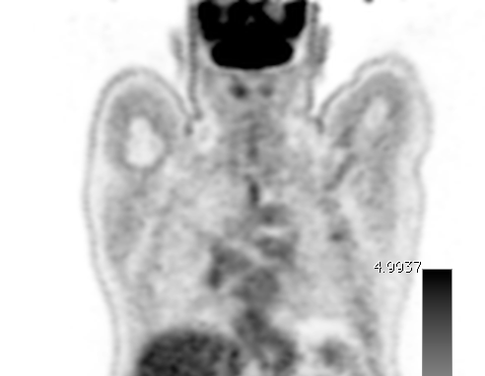
PET Scan Quantification
Standardized Uptake Value (SUV)
What is it?
  SUV = (Activity Concentration in region) / (Activity Concentration in whole volume)
Why use SUV?
  Repeat scans with different injected activities
  Repeat scans on scanners with different sensitivities
  Clinical trials – conformity of results among sites
Conc = Dose/Weight
A_{LESION} = 7.8 kBq/mL

Slide 38
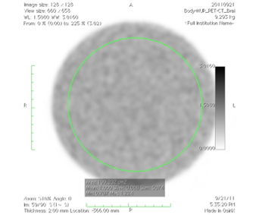
PET Scan Quantification
Standardized Uptake Value (SUV)
What is it?
  SUV = (Activity Concentration in region) / (Activity Concentration in whole volume)
Calibrated from uniform phantom study
Conc = Dose/Weight
A_{LESION} = 7.8 kBq/mL
SUV_{LESION} = 1.8

Slide 39
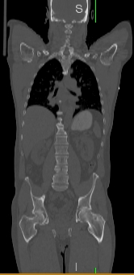
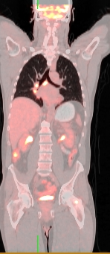
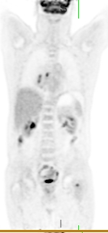
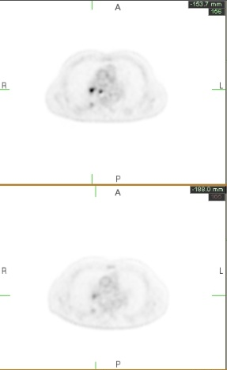
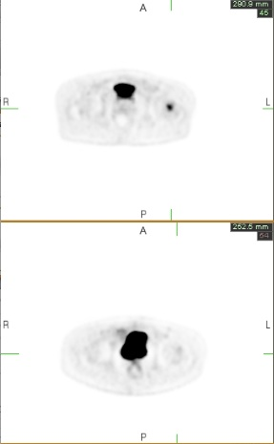
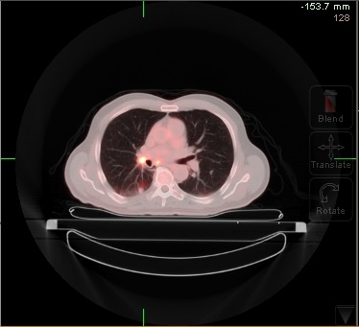
FDG PET/CT - staging lung cancer
Lung
Pelvis
August 9
October 10
What is the quantitative change in lesion uptake?

Slide 40
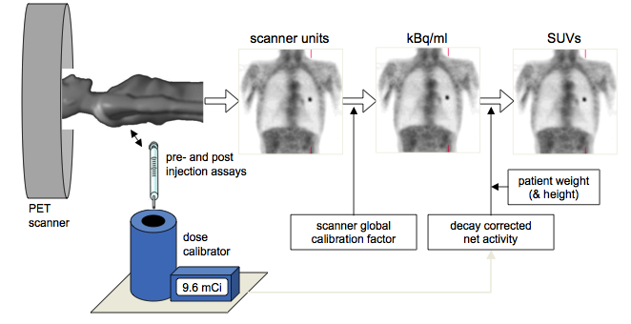
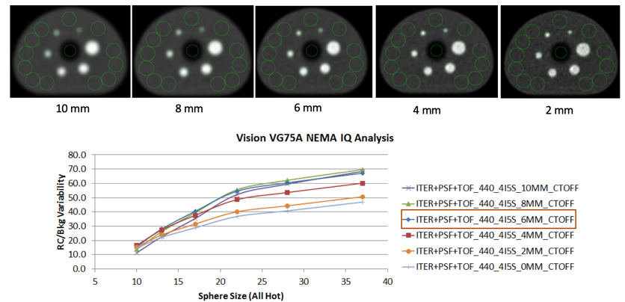
Chain of data quantitation
Accuracy depends on many factors: dose assay, instrument calibration, reconstruction
SUV depends on lesion size and image reconstruction approach, e.g. filter and #iterations
Courtesy, Siemens

Slide 41
Limits on PET scanner performance
Limitations of scanner
  Spatial resolution
  Sensitivity (geometric scanner design, detector efficiency)
  Count rate performance (non-linear behavior as increase activity)
  Inaccurate corrections for physical effects
Limitations by patient
  Motion
  Tracer uptake

Slide 42
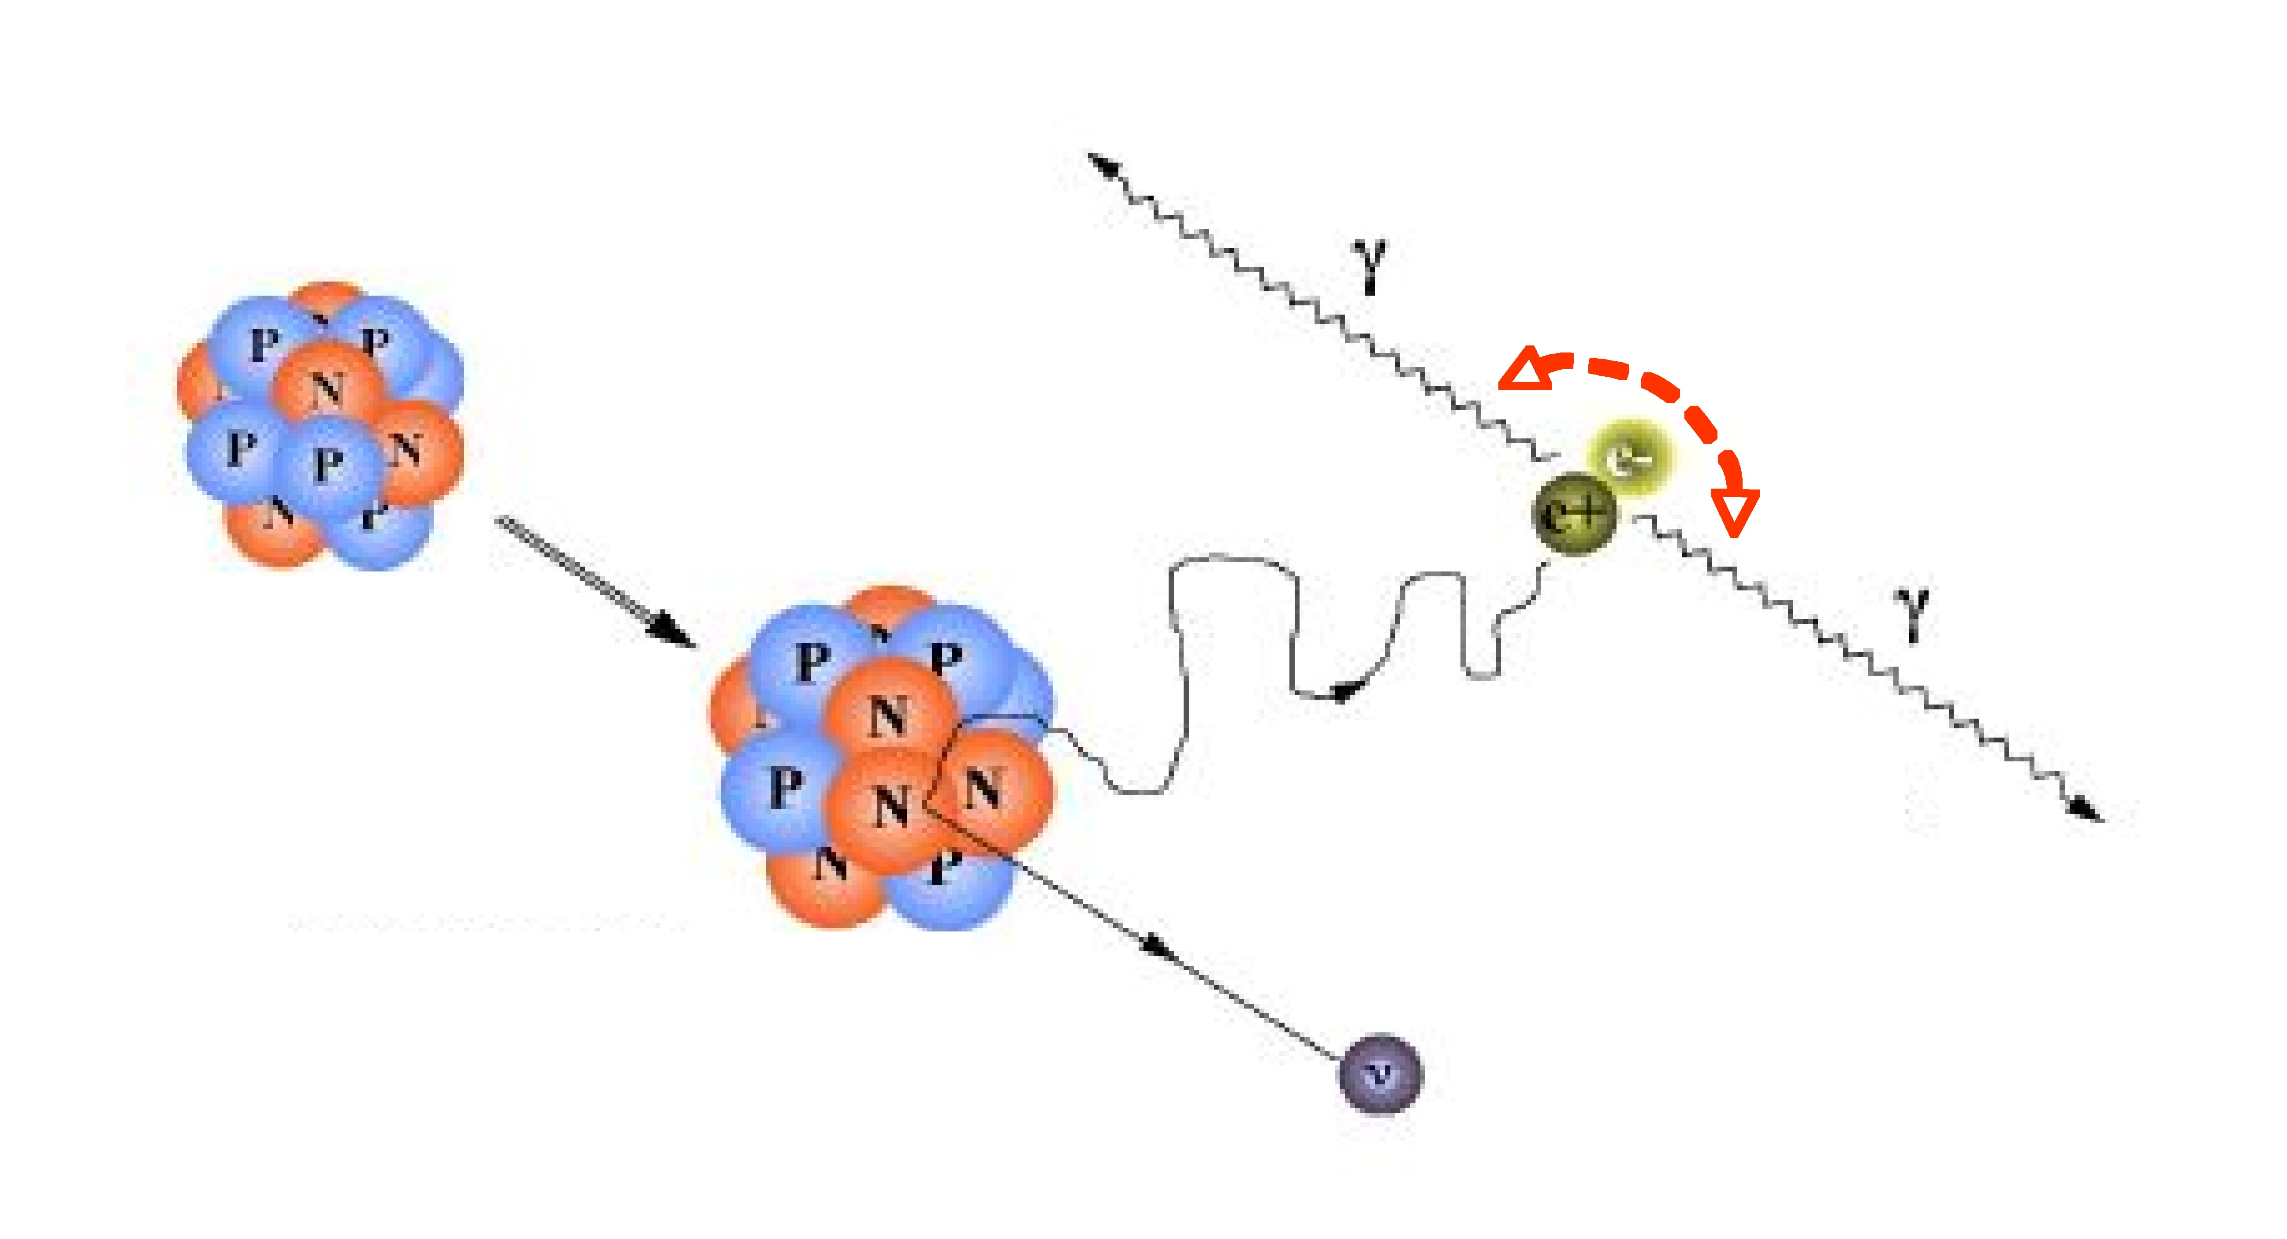
Limits on spatial resolution
Photon non-collinearity:
  FWHM_{NC}=0.0022 X scanner diameter
  (2mm for a 90-cm diameter)
Positron range, R:
 | ¹⁸F | ¹¹C | ⁸²Rb
R_{max} (mm) | 2.6 | 3.8 | 16.5
FWHM_{p} (mm) | 0.22 | 0.28 | 2.6
R
Detector resolution (FWHM_{d} )
  Crystal size
~180˚

Slide 43
Impact of spatial resolution limitations
Spatial resolution blurring impacts
Quantitative accuracy (blurring of uptake between structures)
Detection of small tumors / structures
Depends on location in scanner FOV
Partial volume effect (PVE)
Measured activity < true activity
Recovery coefficient = A_{meas} / A_{true}
SUV_{mean} – average uptake in volume of interest (VOI) over structure
SUV_{max} – maximum uptake in structure of interest (1 voxel)
SUV_{peak} – average uptake in small VOI within structure

Slide 44
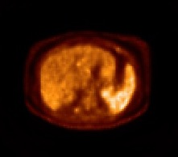
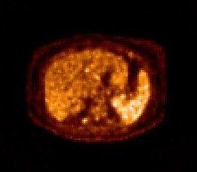
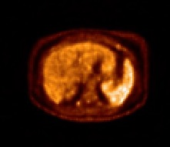
Time-of-flight (TOF) PET
Image reconstruction from projections
y(s,ϕ)
back-projection
Δt = t₁-t₂
ϕ
t₁
t₂
Δx = c . Δt/2
500 ps → ~7.5 cm
220 ps → ~3.3 cm
10 ps → 1.5 mm
x(u,v)
TOF kernel
TOF information reduces coupling of signals, thus improves SNR
non-TOF
TOF
Low noise
High noise
Low noise
Low contrast
High contrast
High contrast
Notes:
One of the key concepts originally introduced in the late 1970’s and refined in the last several years is TOF. In brief - the precise measurement of the time difference between detectors allows the reconstruction to achieve higher SNR, approximately a factor of 2x for current instruments.
We see here the benefit – without TOF we can achieve high contrast – better quantitative accuracy – with a larger number of iterations which also leads to higher noise. With TOF the faster local convergence allows us to achieve both high contrast and low noise – this is often interpreted as an effective gain in sensitivity.

Slide 45
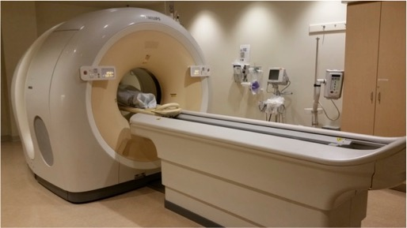
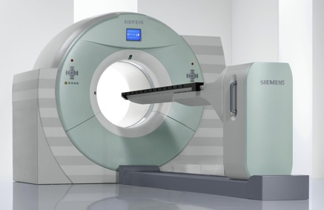
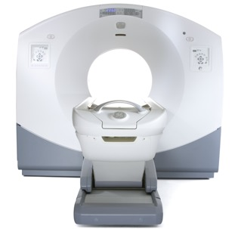


Philips Ingenuity TF
TOF PET/CT scanners from all vendors
PMT-based PET/CT: 2006 -> Timing resolution 500-600 ps
Siemens mCT
GE Discovery 690, 710
SiPM-based PET/CT: 2017 -> Timing resolution 200-400 ps
Philips Vereos
Siemens Vision
GE Discovery MI

Slide 46



What is TB (Total-Body) PET?
Commercial PET-CT: Axial FOV 15-30 cm
TB-PET: Higher sensitivity per volume
  Total sensitivity gain (>20x for 1-m axial FOV)
  Per-organ sensitivity ~3x
Simultaneous imaging of large volume
  Kinetic modeling of multi-organ system
Notes:
Gain in total-body sensitivity is very high, > 20x for 1-m scanner
Gain per organ (point) is more modest, about 3x

Slide 47







Long axial FOV scanners
uEXPLORER (United Imaging)
uEXPLORER PET Detectors: 10:1 encoding, crystals:SiPMs
LYSO Detector Module
Block with integrated light-guide
Block flood map
2940 crystals
2.76 mm
18 mm
5x14 blocks
7x6 crystals/block
6 mm
194 cm AFOV
TOF = 509 ps, 3-mm spatial resolution
Courtesy, Hongdi Li, UIH America
PennPET Explorer
PennPET Detectors: 1:1 encoding, crystals:SiPMs
2D flood
  3.86 x 3.86 x 19 mm³ LYSO
  PDPC digital SiPM
TOF = 250 ps, 4-mm spatial resolution
64 - 142 cm AFOV
Notes:
Leading into the next talk – what do we need for long AFOV scanners where cost will be an issue
Both uEXPLORER and PennPET Explorer have chosen to use LYSO but in very different detector configurations. UI has better spatial resolution, PennPET has better TOF.

Slide 48


Long axial FOV scanners
Siemens Biograph Vision Quadra
GE Omni Legend
106 cm AFOV
32-64 cm (→ 128 cm) AFOV
Quadra Detectors: 25:1 encoding, crystals:SiPMs
BGO detectors with deep learning to obtain TOF information
TOF = 230 ps, 3.5-mm spatial resolution
Prenosil, et al., J Nucl Med, 2021
Notes:
Leading into the next talk – what do we need for long AFOV scanners where cost will be an issue
Both uEXPLORER and PennPET Explorer have chosen to use LYSO but in very different detector configurations. UI has better spatial resolution, PennPET has better TOF.

Slide 49
How do we measure benefit of new scanner performance or image reconstruction approach?
Must define task:
Lesion contrast (SUV) - accuracy of quantitation
Detectability - numerical and human observers
Variability of lesion uptake - as a function of location, environment, statistics

Slide 50
Tracer uptake measurements depend on…
Tracer: e.g., FDG biology and time of uptake
Physics: β⁺ range, β⁺ fraction
Patient variables: motion (breathing) habitus (BMI)
SNR: scan time instrument performance - sensitivity, spatial resolution, TOF
Quantification: dose and instrument calibration data correction methods reconstruction algorithm

Slide 51






Physical phantoms to assess performance of image quality
NEMA Image Quality
SNMMI CTN

Slide 52


Standardizing Performance with NEMA IQ Phantom
8.5 mm
44 mm
Default parameters
Harmonized parameters
5 scanners at 3 sites
Notes:
To better understand what we are trying to do, I’ll first show the data we are collecting.
The data collected for this project was collected with the NEMA IQ phantom, shown above. It holds six spheres at a time, which are selected from the 13 spheres sizes offered, ranging from 8.5mm to 44mm in diameter.
3. Data is collected for these experiments with hot spheres in a warm background, with two possible contrast ratios: 9.7:1 or 4.85:1

Slide 53

Quantifying Performance with NEMA IQ Phantom
  Resolution (PSF) model can be included to compensate for parallax errors
CRC: Mean VOI
CRC: Max voxel
Notes:
To better understand what we are trying to do, I’ll first show the data we are collecting.
The data collected for this project was collected with the NEMA IQ phantom, shown above. It holds six spheres at a time, which are selected from the 13 spheres sizes offered, ranging from 8.5mm to 44mm in diameter.
3. Data is collected for these experiments with hot spheres in a warm background, with two possible contrast ratios: 9.7:1 or 4.85:1

Slide 54
Summary
Basic nuclear physics as applied to positron emission tomography
Sources of radiotracers for PET
Detection of annihilation photons from positron decay
What is measured with PET
Corrections for physical effects in PET imaging
Limits on PET scanner performance
Time-of-flight PET
Total-body PET imaging considerations & applications
Scanner harmonization

Slide 55
What determines the direction of measured events in PET?
  Septa
  Collimator
  Coincidence line between 2 photons detected within timing window
  Choice of scintillator
Notes:
Remember, we assume two photons are related if they arrive at detector within a small timing interval.

Slide 56
Which two factors primarily determine the spatial resolution achieved in a clinical PET scanner during ¹⁸F-FDG imaging?
  Positron range
  Detector spatial resolution
  Photon non-collinearity
  Detector timing resolution

Slide 57

This PET image:
Has not been corrected for attenuation.
Has been over-corrected for attenuation.
Has been corrected for attenuation using a Ge-68 transmission source rather than a CT scanner.
Shows pathologic uptake of the PET tracer in the skin.
Has not been properly normalized.
Notes:
Other tell-tale sign of NAC = hot lungs.

