Slide 1
«Good morning, good afternoon and good evening!»
22nd Virtual Real Time Conference –
Feedback
AdCom November 2020
Stefan Ritt, Martin Grossmann

Slide 2


Real Time Conference 2020
Planned for April 2020 in Vietnam
  Typically 200 participants
Decision February 2020:
go for fully virtual conference

Slide 3
Conference Concept
3 hours daily for 10 days
  2 hours plenary session with oral presentations
  20 min break
  40 min poster session
Additional program on some days
  2 short courses
  WIE event
  Zoom coffee breaks / feedback discussion
  Student paper awards
  → Full program with same #contributions as in person

Slide 4



Conference Concept
Rotating schedule for timezones
Day 1-4
Day 5-7
Day 8-10

Slide 5
Technology
Zoom Webinar & Slido (plenary)
Individual Zoom rooms
  Posters, Membership desk, Industrial Exhibit
  Social events (coffee breaks)
Streaming via IEEE.tv
  Only some talks (free)
Slack messaging system
Indico website
File exchange Indico or Dropbox (large files)
Padlet pinboard (Job offers!)

Slide 6
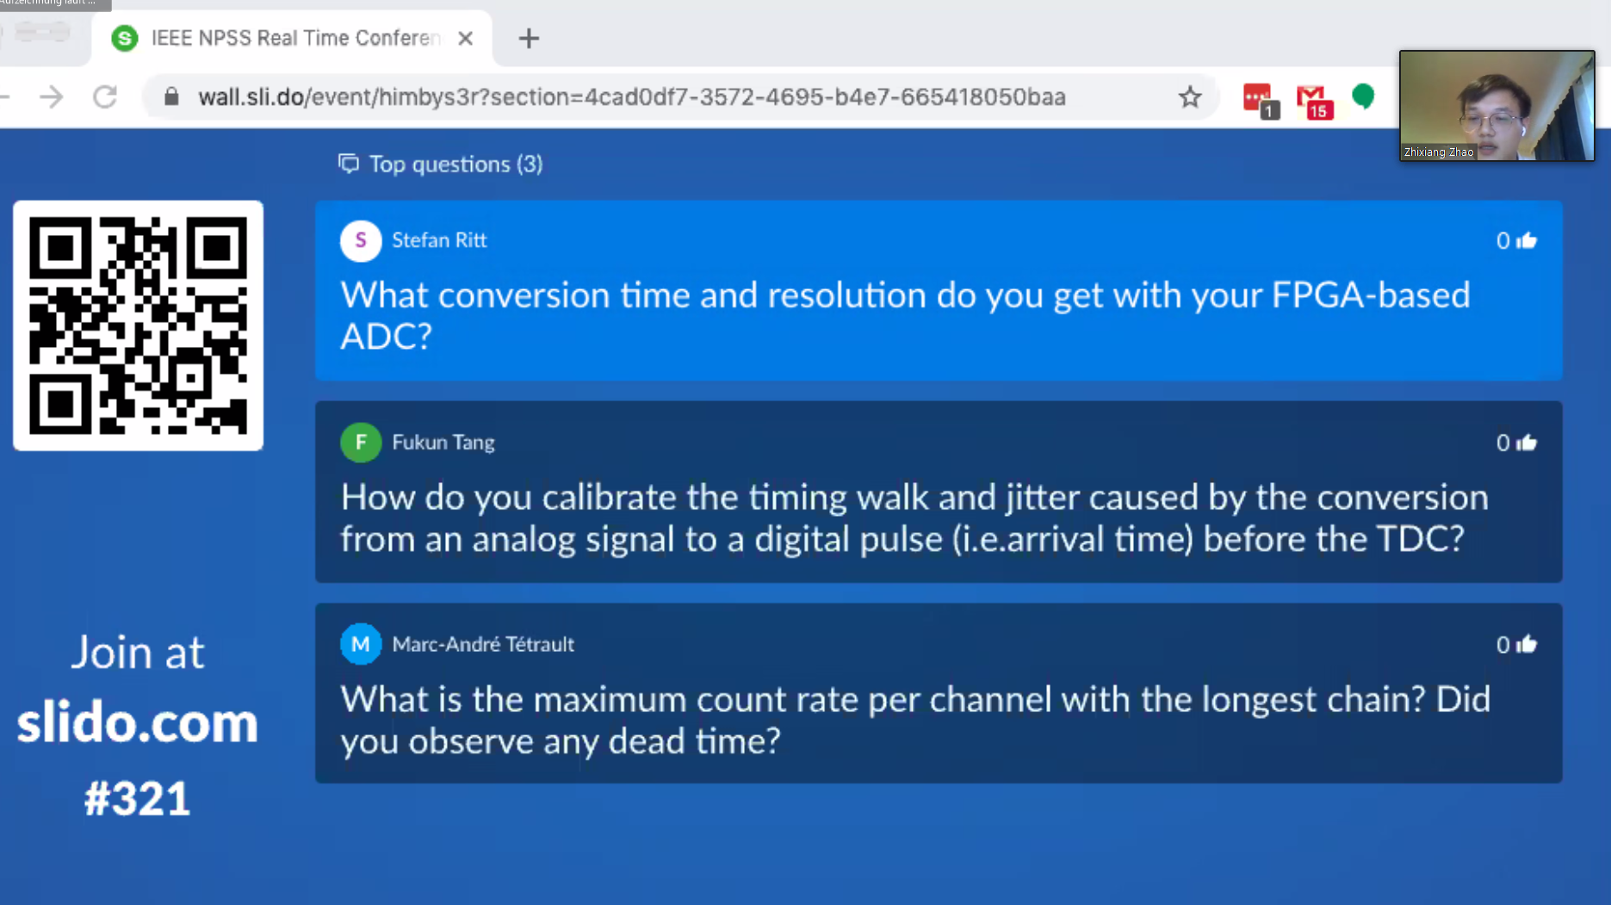
Slido

Slide 7
Videos
Record all plenary talks & make available to registered participants
Mini-Orals
  presenter uploads 1 min video
  Concatenate videos and show in 30 min plenary session
Prerecorded oral presentations (as fallback)
  Only 1 speaker did not wish to present live

Slide 8
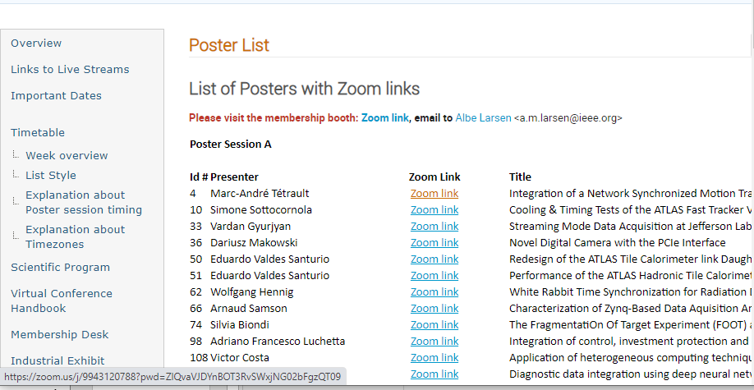
Poster rooms
Collect all Poster links on website

Slide 9



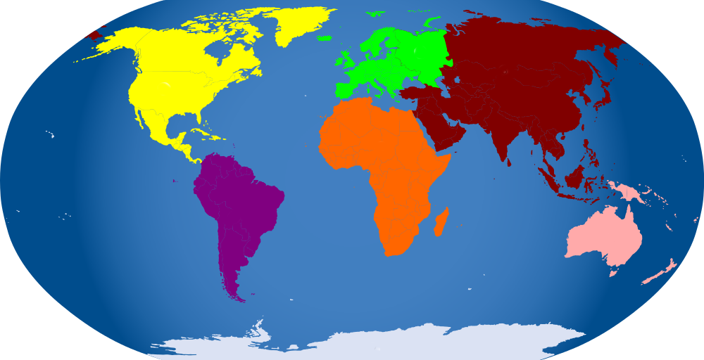
Streaming
Zoom can stream to Facebook and Youtube
We used WOWZA and IEEE.tv

Slide 10
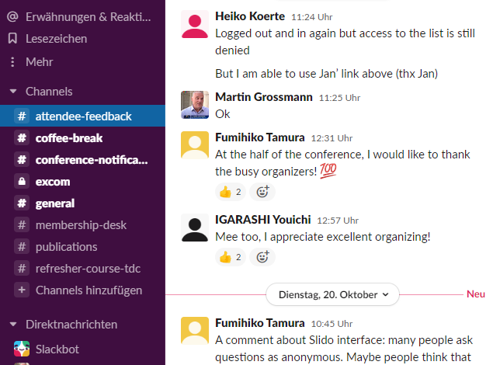
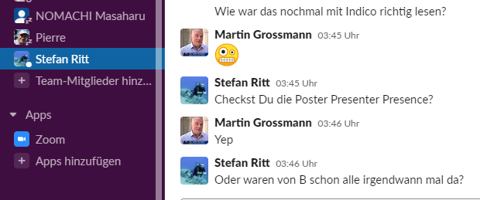
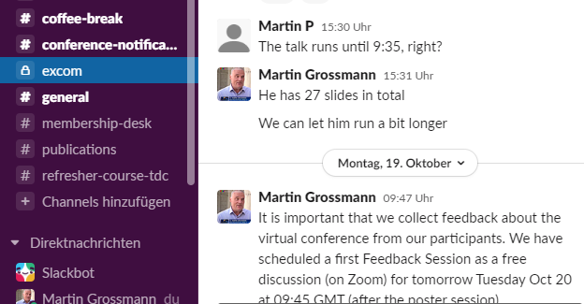
Slack
Direct communication channel
Various groups

Slide 11
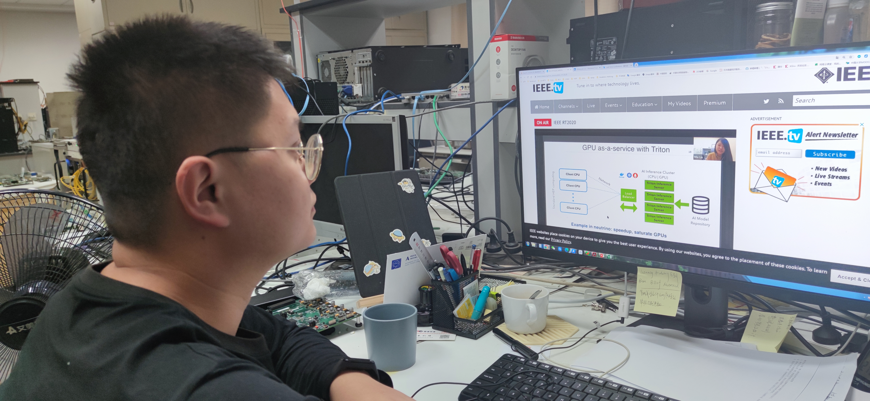


Technology across borders
Zoom stopped commercial activity in China
  Buy Zoom licenses for Chinese poster presenters
  New (2021): must use International Zoom Client
    Version for download in China does not work
Streaming via youtube and Facebook blocked
  Solution via IEEE.tv
Alternative for Dropbox
Pay registration fee by Alipay

Slide 12
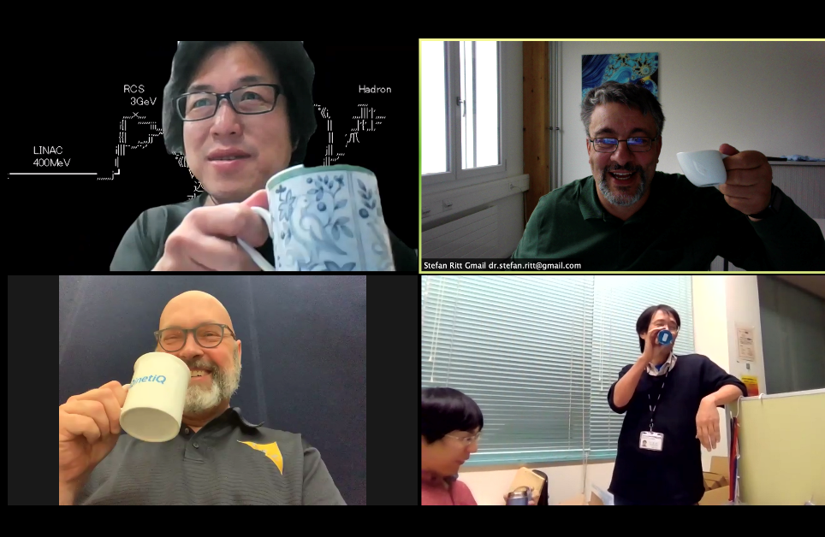
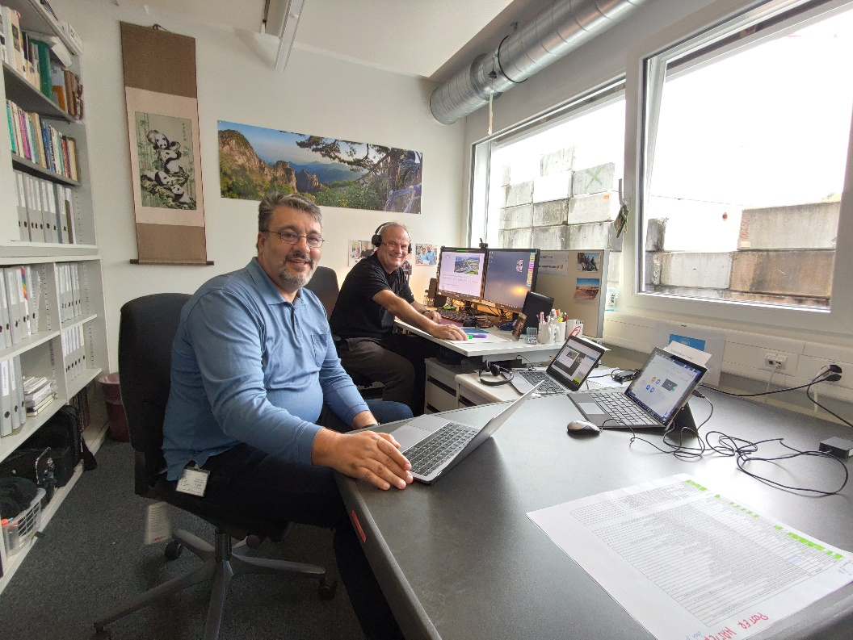
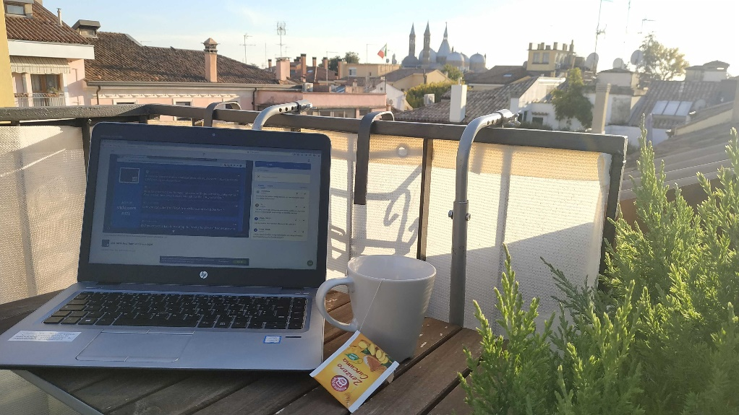
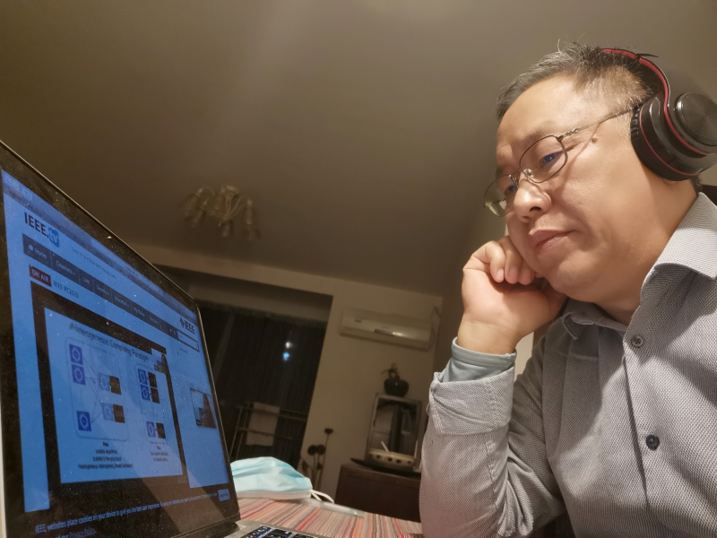
Experience?
It worked!

Slide 13
Experience
Technology super smooth and reliable
Audio and Video very good
  Problems were local → recommend testing well before session
Q&A via slido very smooth
  No problems passing microphone around
  However, less discussion possible
Poster / Industrial Exhibit
  Can show more than just poster

Slide 14
Participation
Total 212

Slide 15
Plenary Session Attendance
very late evening
afternoon
morning
night
Americas
Europe
Asia/Pacific

Slide 16
Experience: Poster rooms
Each poster repeated 3 times
Day 1-4
Day 5-7
Poster A1/B1/C1
Poster A2/B2/C2
Day 8-10
Poster A3/B3/C3

Slide 17

Experience: Poster rooms
Poster repetition
  Empty rooms → better assing 1 fixed session
Setup of Zoom rooms
  Access limitations (passcodes, waiting rooms, …)
    Better set up centrally
Caution: License issue
  One account max two simultaneous meetings
  Need to contact Sales for «concurrent license»
    We improvised by setting up 40 mail addresses

Slide 18
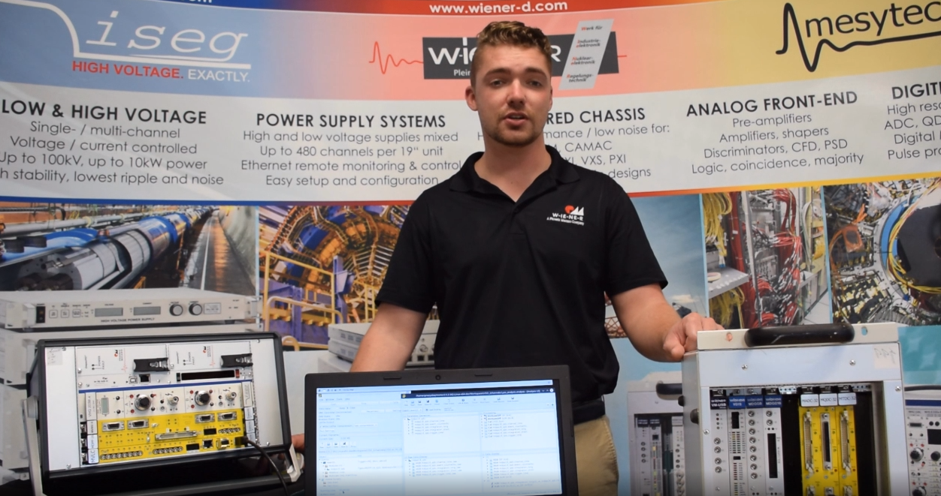
Industrial Exhibit
5 vendors
  Fee: USD 300, plus 5 min «pitch» in plenary USD 100
  It is possible to attract vendors
  Not many visits by participants
    Same for IEEE Membership booth, sadly…

Slide 19
Support
Need competent people in the background reacting fast!
  For Real Time: 2 persons, busy 100%

Slide 20
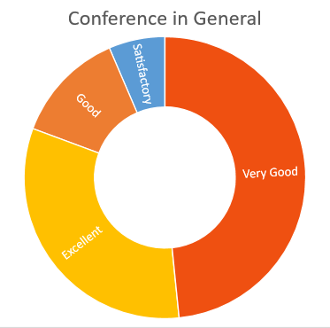
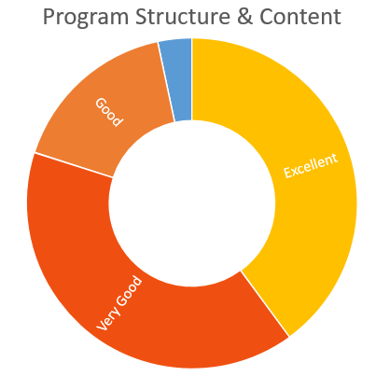
Participant survey

Slide 21
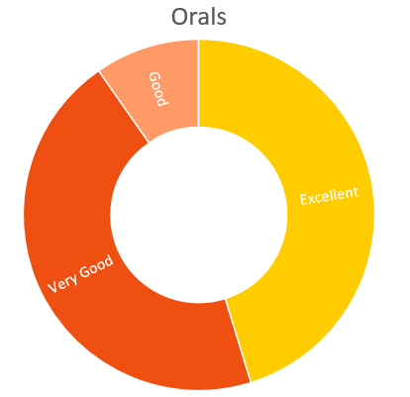
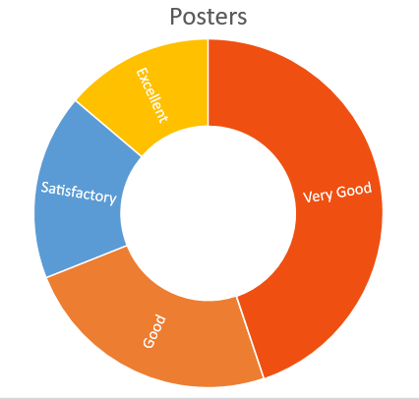
Participant survey

Slide 22
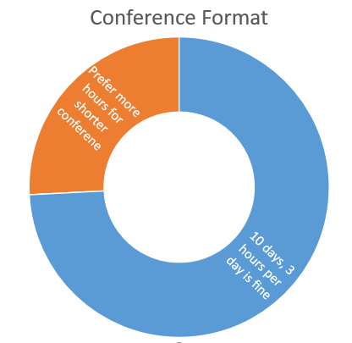
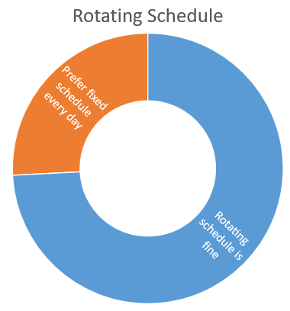
Participant survey

Slide 23
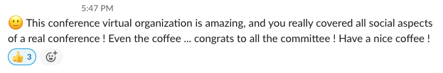

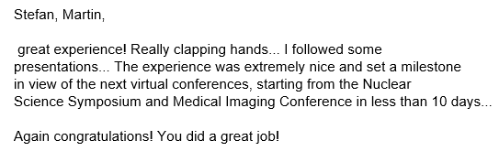
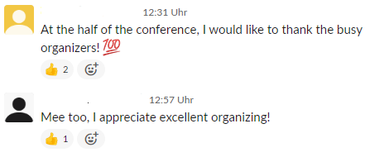
More participant feedback

Slide 24
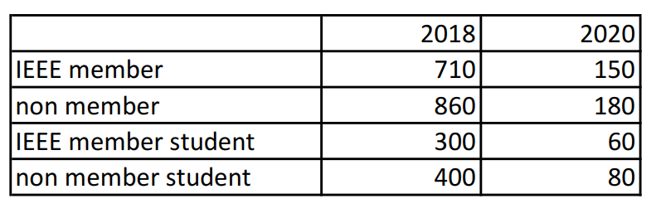
Finances
Registration fee model
  USD
  Virtual fees 20% of in person fees
  Significantly cheaper, but not free!

Slide 25
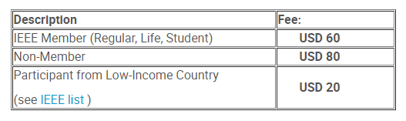
Finances
Category «General Attendee»
  Full access to conference
  No presentation, no publication

Slide 26
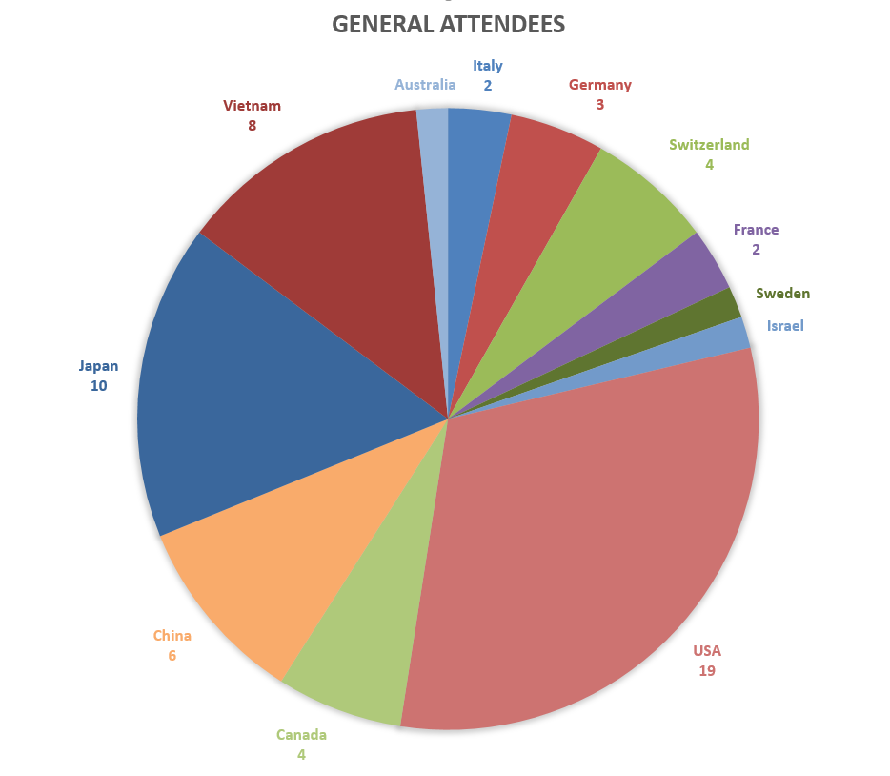
General Attendees

Slide 27
Financial Result
Financial report submitted 17.12.2020
  Still awaiting result of audit
Final balance USD 21’627
  2018: USD 23’223

Slide 28
Conclusion
Virtual Conference is possible
Attracts more participants than in person event
Expanding the community
Technology smooth and stable
Overall experience very positive
Financial return sustainable
Learn from experience

Slide 29
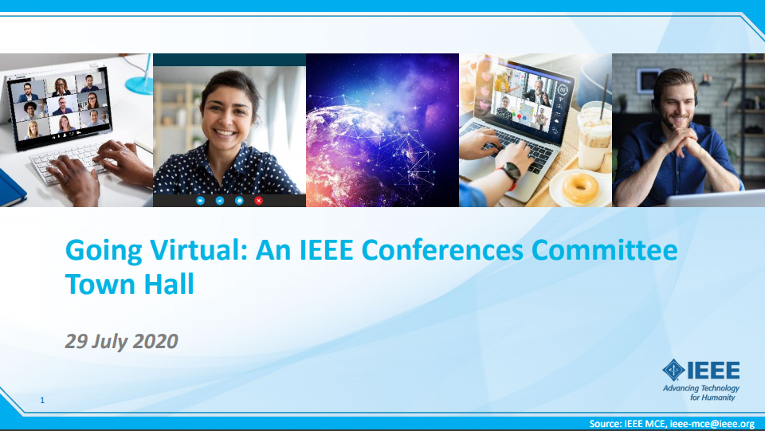
https://ieeemce.org/wp-content/uploads/going-virtual-town-hall-07-29-20.pdf

