Slide 1
Dynamic Modeling of Pulsed Alternators using LTSpice
Cesar Negri, Saeed Daneshvardehnavi
Michael Giesselmann^{ξ}
Center for Pulsed Power & Power Electronics
Texas Tech University
Department of Electrical & Computer Engineering
Lubbock, Texas, USA
^{ξ} email: Michael.Giesselmann@ttu.edu

Slide 2
Abstract
We are reporting on the formulation and performance of dynamic models for Pulsed Alternators for LTspice. The models are modular and hierarchical and cover both the electrical and mechanical aspects of the electric machine including the mechanical torque, speed and inertia. The models also include the effects of the damper cage and the excitation winding to accurately represent the sub-transient and transient behavior. The models can be also used to represent synchronous generators in steady state operation. LTspice is a powerful, widely available software package that can be used to model Pulsed Power circuits. We are presenting the detailed models as well as results of the simulations.

Slide 3
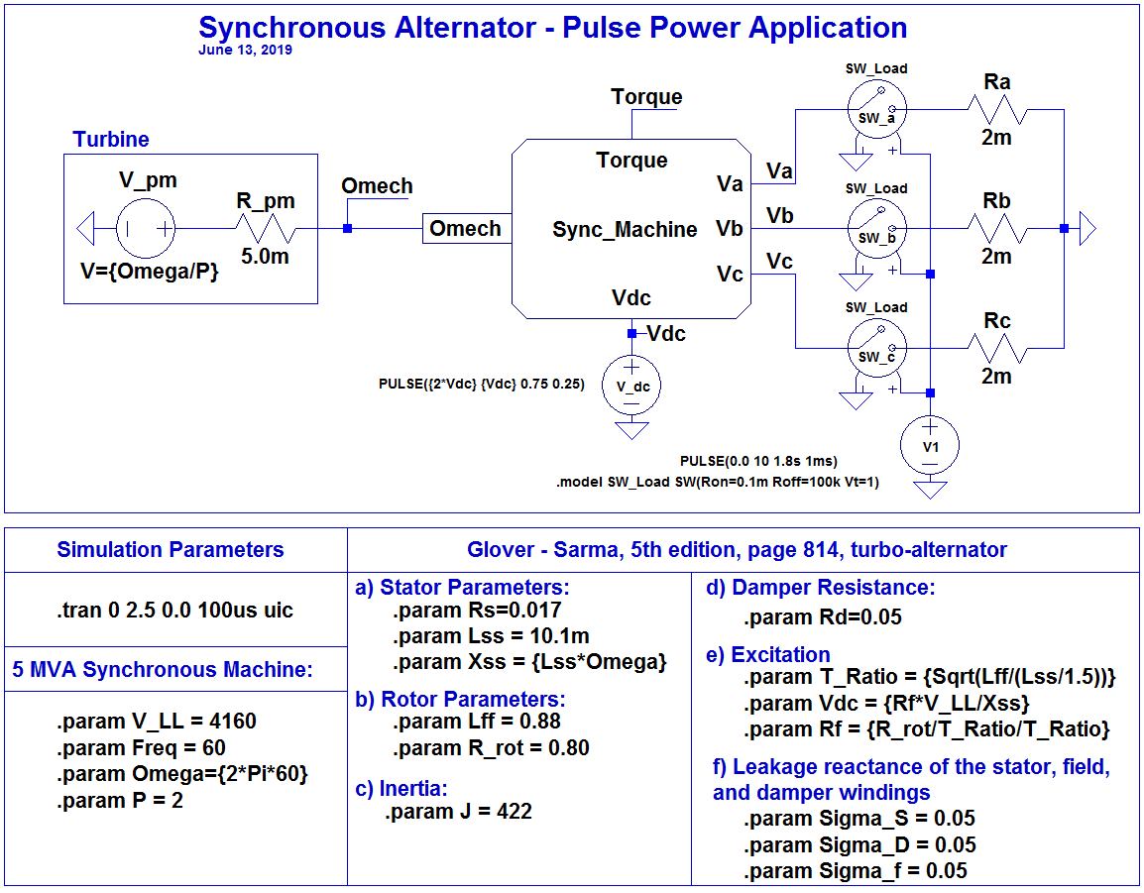
Model

Slide 4
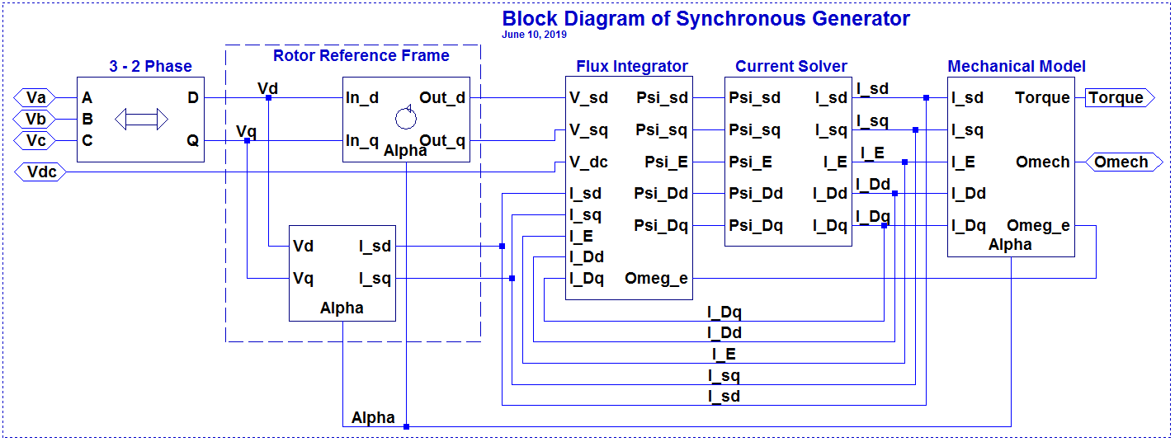
Block - Synchronous Generator

Slide 5
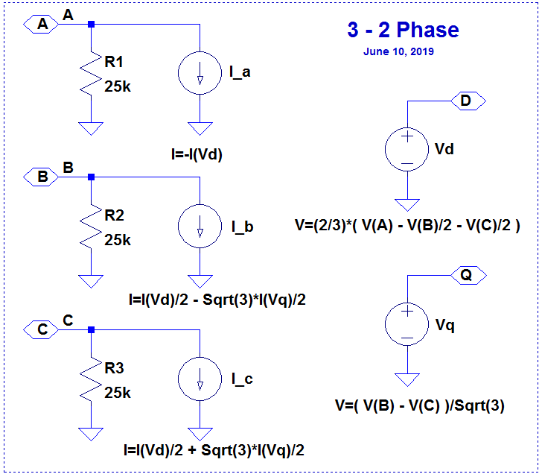
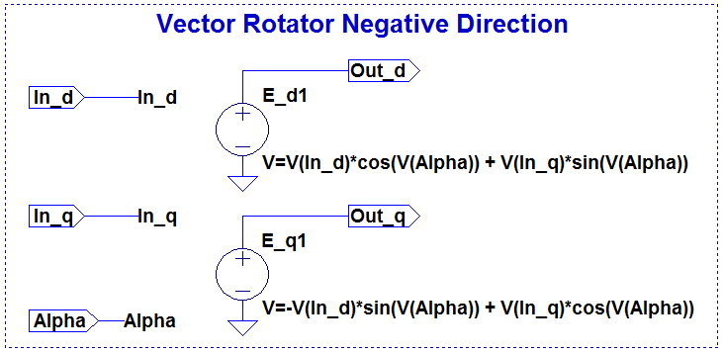
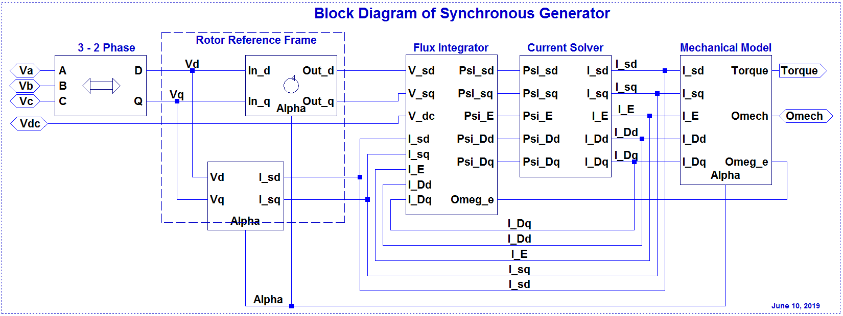
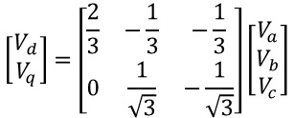
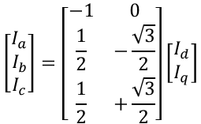

Block – 3-2 Phase and Negative Rotation
$$\left[\begin{matrix}I_{a} \\ I_{b} \\ I_{c}\end{matrix}\right]=\left[\begin{matrix}−1 & 0 \\ \frac{1}{2} & −\frac{\sqrt{3}}{2} \\ \frac{1}{2} & +\frac{\sqrt{3}}{2}\end{matrix}\right]\left[\begin{matrix}I_{d} \\ I_{q}\end{matrix}\right]$$
$$\left[\begin{matrix}V_{d} \\ V_{q}\end{matrix}\right]=\left[\begin{matrix}\frac{2}{3} & −\frac{1}{3} & −\frac{1}{3} \\ 0 & \frac{1}{\sqrt{3}} & −\frac{1}{\sqrt{3}}\end{matrix}\right]\left[\begin{matrix}V_{a} \\ V_{b} \\ V_{c}\end{matrix}\right]$$
$${\left[\begin{matrix}V_{d} \\ V_{q}\end{matrix}\right]}_{rotor}=\left[\begin{matrix}\cos\left(Alpha\right) & \sin\left(Alpha\right) \\ −sin\left(Alpha\right) & \cos\left(Alpha\right)\end{matrix}\right]{\left[\begin{matrix}V_{d} \\ V_{q}\end{matrix}\right]}_{stator}$$
Park Transformation
Inverse Clarke Transformation
Clarke Transformation

Slide 6
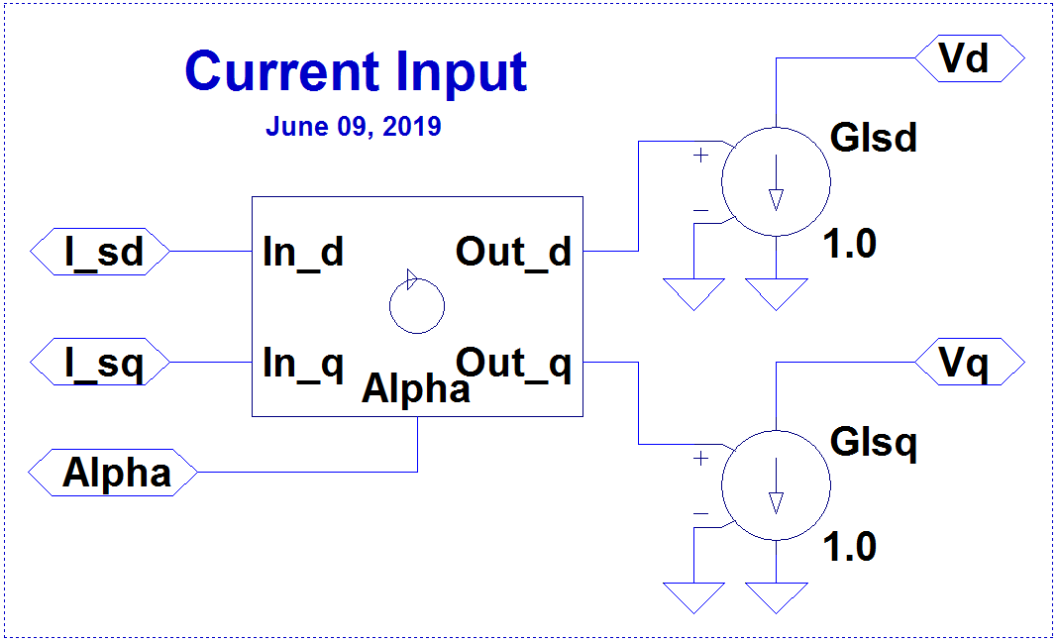
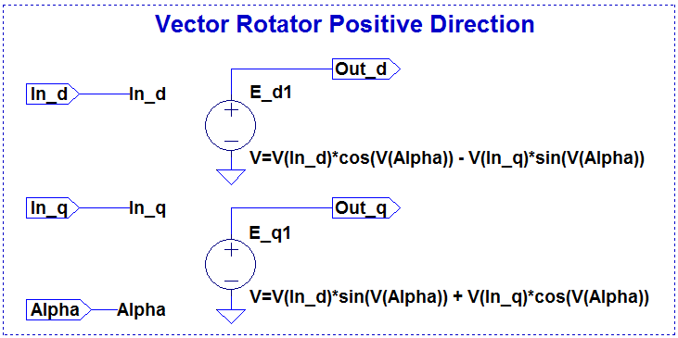

Block – Current Input and Positive Rotation
$${\left[\begin{matrix}I_{d} \\ I_{q}\end{matrix}\right]}_{stator}=\left[\begin{matrix}\cos\left(Alpha\right) & −\sin\left(Alpha\right) \\ \sin\left(Alpha\right) & \cos\left(Alpha\right)\end{matrix}\right]{\left[\begin{matrix}I_{d} \\ I_{q}\end{matrix}\right]}_{rotor}$$
Inverse Park Transformation

Slide 7
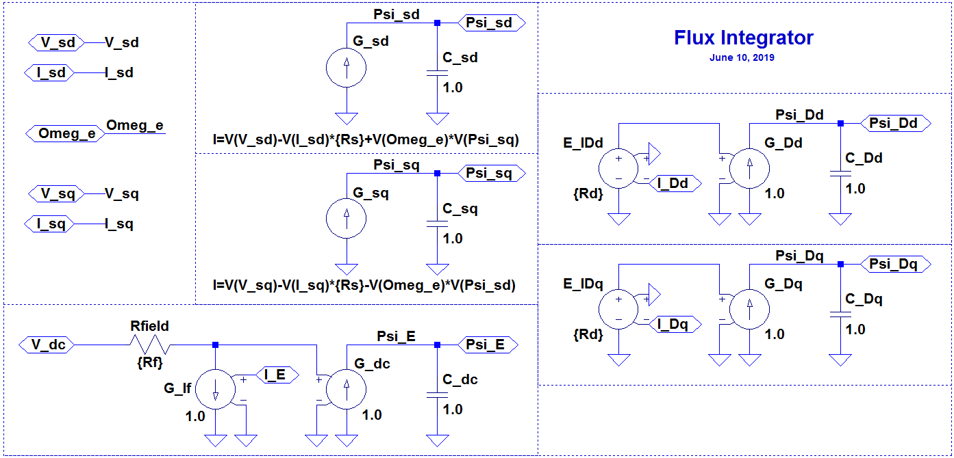
Block – Flux Integrator

Slide 8
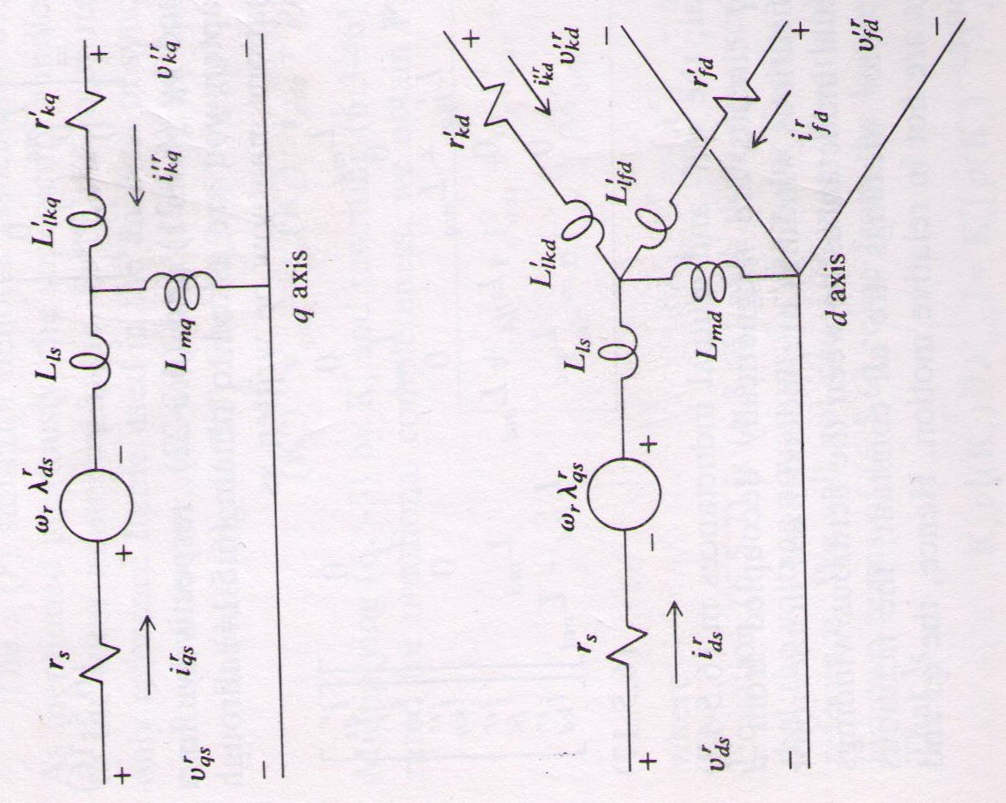
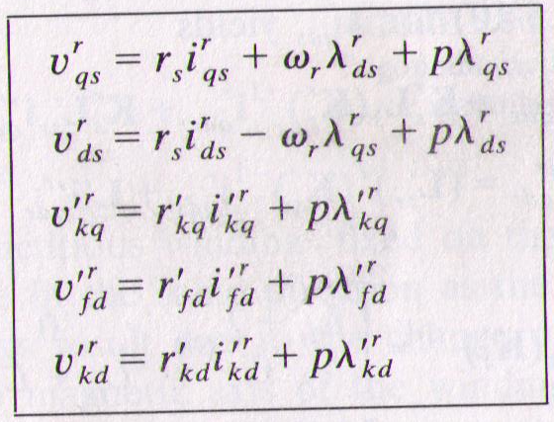
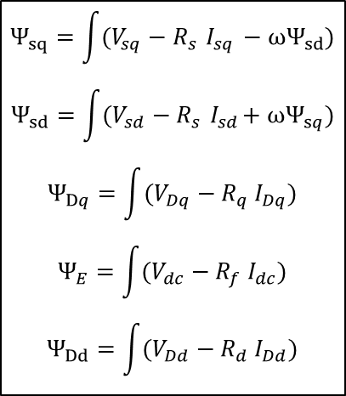
Block – Flux Integrator
$$Ψ_{sq}=\int{(V_{sq}−R_{s}{ I}_{sq} −ωΨ_{sd})}$$
$$Ψ_{sd}=\int{(V_{sd}−R_{s}{ I}_{sd}+ωΨ_{sq})}$$
$$Ψ_{Dq}=\int{(V_{Dq}−R_{q}{ I}_{Dq})}$$
$$Ψ_{E}=\int{(V_{dc}−R_{f}{ I}_{dc})}$$
$$Ψ_{Dd}=\int{(V_{Dd}−R_{d}{ I}_{Dd})}$$
Source: Krause, Paul C., Electromechanical Motion Devices, McGraw-Hill College (1989).

Slide 9
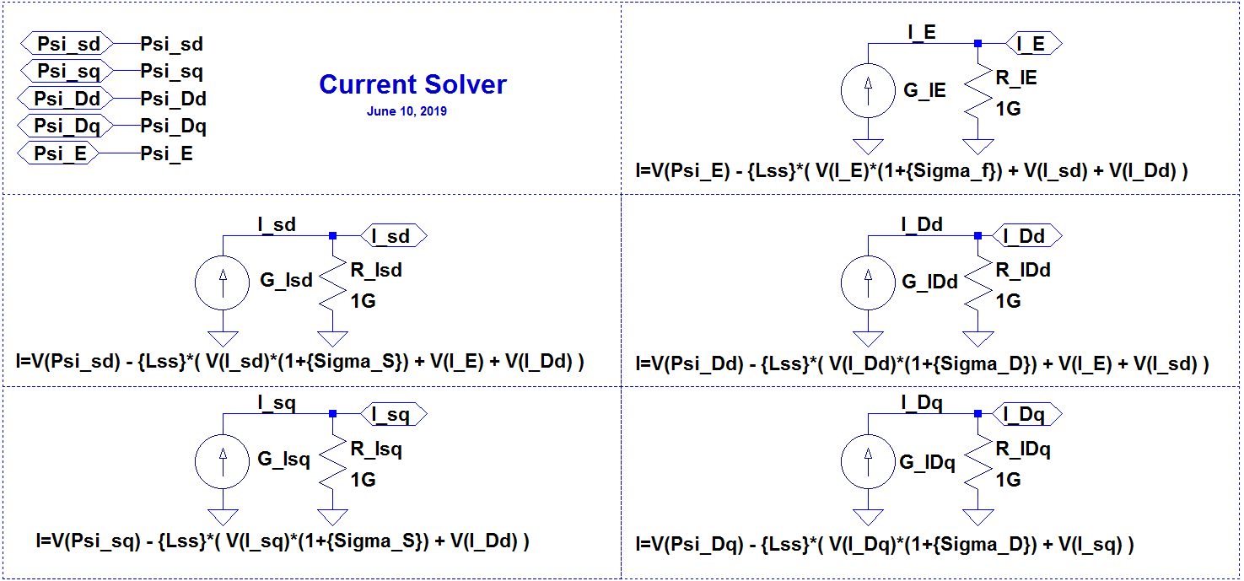
Block – Current Solver

Slide 10
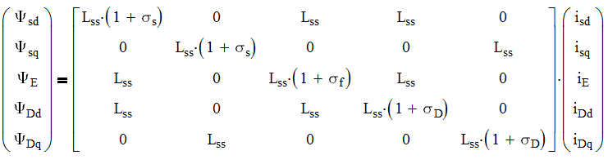
Block – Current Solver
Source: Krause, Paul C., Electromechanical Motion Devices, McGraw-Hill College (1989).

Slide 11
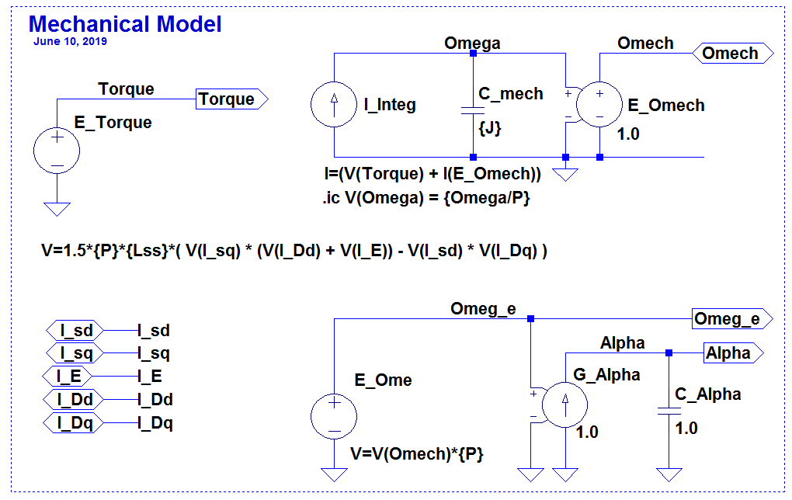
Block – Mechanical Model
Torque equation for non-salient pole machine:

Slide 12
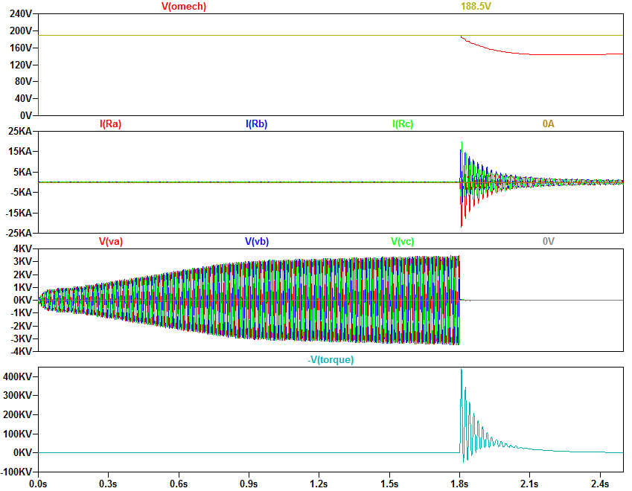
Simulation Results
1V = 1rad/s
1V = 1Nm

Slide 13
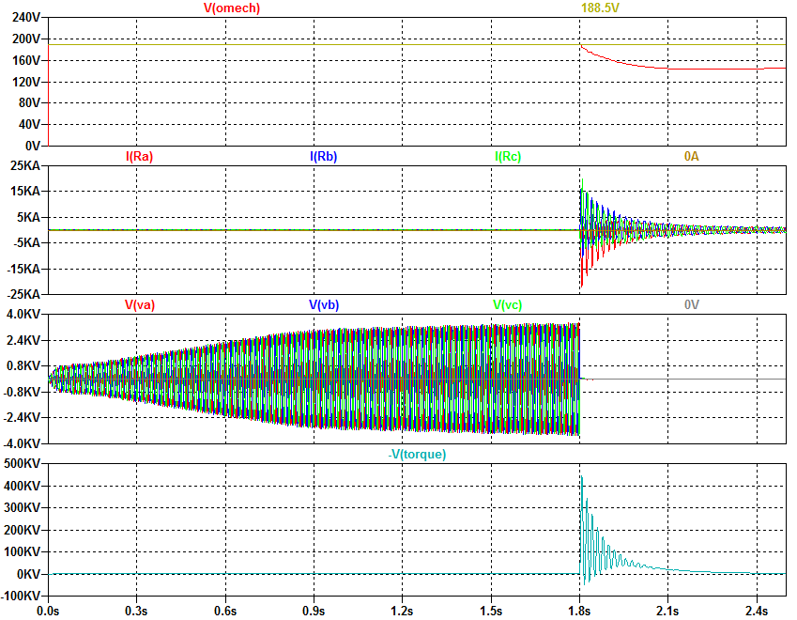
Simulation Results
1V = 1rad/s
1V = 1Nm

Slide 14
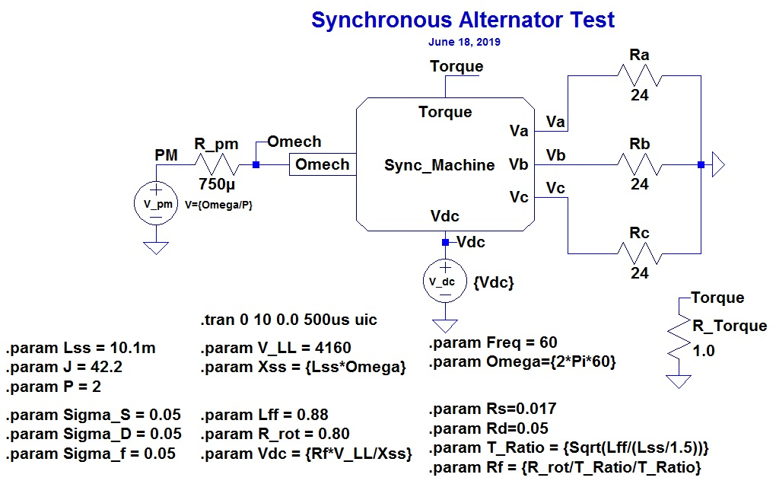
Steady State Test

Slide 15
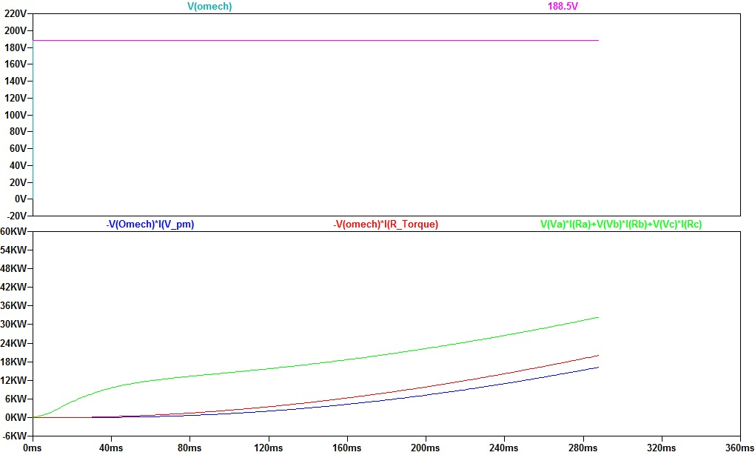
Simulation Results Startup
1V = 1rad/s

Slide 16
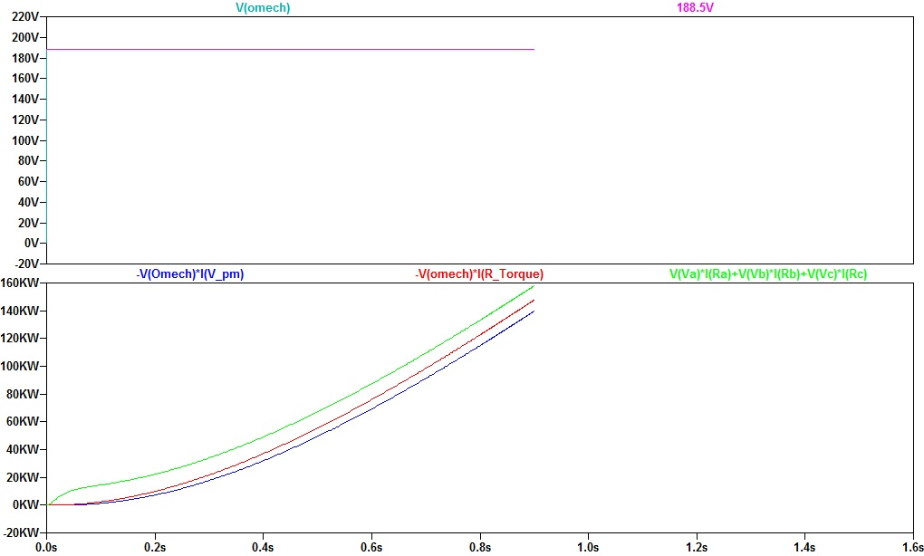
Simulation Results, Intermediate Time
1V = 1rad/s

Slide 17
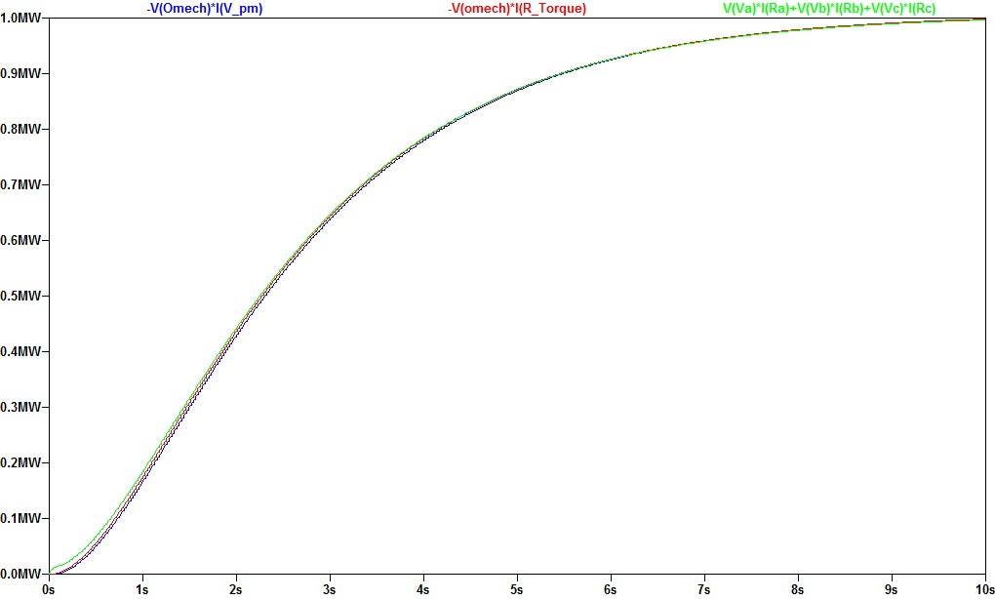
Simulation Results, 10 sec

Slide 18
Conclusion
This paper demonstrates that LTSpice for Windows is a very powerful simulation tool for pulsed power circuits. The software has a user friendly and simple interface that also support custom symbols and hierarchical structures.
This paper demonstrates the exact analytical treatment of the transient behavior of a 3-phase synchronous machine considering the rotor reference frame
Fundamental design equations for synchronous machines are presented

Slide 19
References
[1] Krause, Paul C. and Wasynczuk, O., Electromechanical Motion Devices, McGraw-Hill College, 1989.
[2] Matsch, Morgan, Electromagnetic and Electromechanical Machines, John Wiley & Sons, 1986.
[3] Glover, Sarma, Power System Analysis and Design, 2’nd edition, PWS Publishing Co., 1994.
[4] Chapman, Electric Machinery Fundamentals, 2’nd Edition, McGraw-Hill, 199 1.
[5] Justus, Dvnamisches Verhalten Elektrischer Maschinen, Vieweg, Wiesbaden, Germany, 1991.

Slide 20


