Slide 1
Statistics and Propagation Modeling of Atmospheric Lightning
William Brooks, David Barnett, John Mankowski, James Dickens, Andreas Neuber
---------------------------------------------------------------------------------------------------------------------------------
Center for Pulse Power and Power Electronics (P³E)
Department of Electrical and Computer Engineering
Texas Tech University
Box 43102, Lubbock, TX 79409-3102, USA
W. A. Harrison, David Hattz
--------------------------------------------
Mission Engineering Development Group
CNS Pantex, FM2373 and HWY 60
Amarillo, TX 79120
2019 IEEE Pulsed Power and Plasma Science Conference
June 23rd–28th, Orlando, Florida

Slide 2
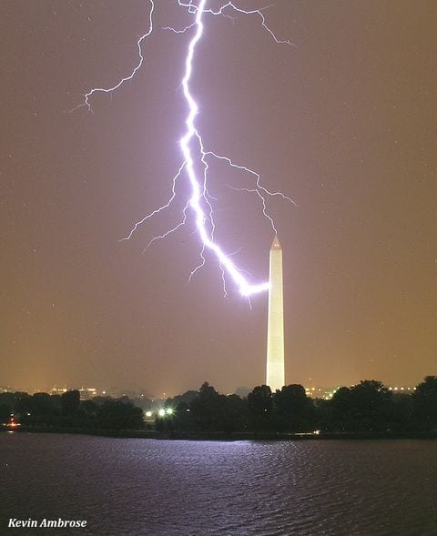
Motivation
Lightning Protection is Imperfect
  Buildings are at risk of being struck
Investigation of these risks
  Characterize risks
  Establish bounds on potentially problematic lightning
Related Work
  Investigate protection and mitigation of problematic lightning
Kevin Ambrose (Weatherbook.com)

Slide 3
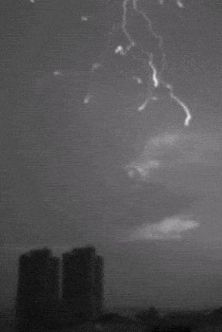
Propagation Models
First Principles
  Piolet Streamer
    Meek ‘59
  Bipolar Piolet with Space Leader
    Rakotonandrasana et al. ‘08
Stochastic Models
  Random Walk Model
    Hutzler and Hutzler-Barre ’78
  Electrostatic Components
    Niemeyer in ‘87
  Charge Modelling and Branching
    Shi et al. 2014
1. Saba, M. M. F., A. R. Paiva, C. Schumann, M. A. S. Ferro, K. P. Naccarato, J. C. O. Silva, F. V. C. Siqueira, and D. M. Custódio (2017), Lightning attachment process to common buildings, Geophys. Res. Lett., 44, 4368–4375, doi: 10.1002/2017GL072796.

Slide 4
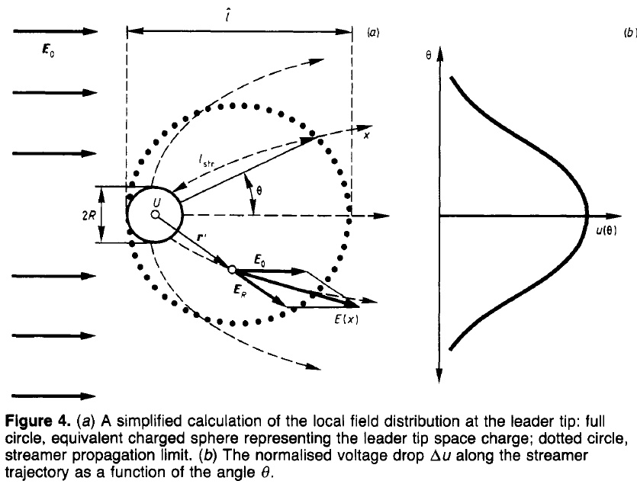
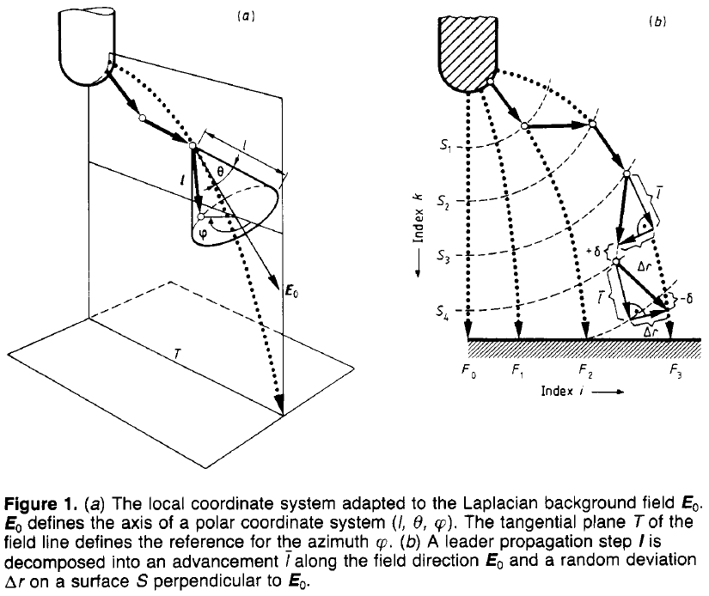
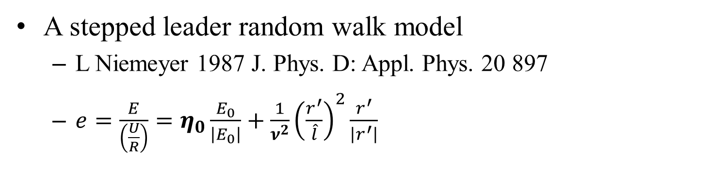
Gas Diffusion Models
A stepped leader random walk model
  L Niemeyer 1987 J. Phys. D: Appl. Phys. 20 897
  $e=\frac{E}{\left(\frac{U}{R}\right)}=η_{0}\frac{E_{0}}{\left|E_{0}\right|}+\frac{1}{ν^{2}}{\left(\frac{r^{′}}{\hat{l}}\right)}^{2}\frac{r^{′}}{\left|r^{′}\right|}$

Slide 5
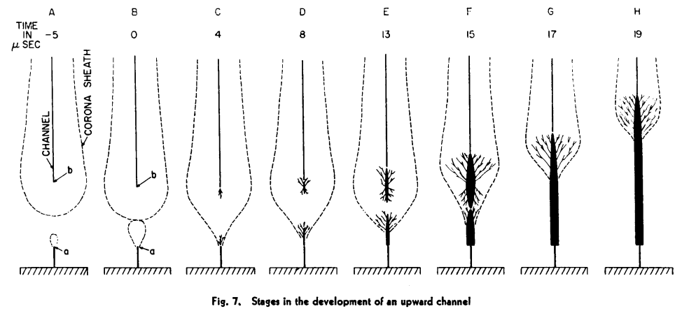
Attachment
Intensified electric field at lighting rod is induced
This gives rise to an upward leader
When the two are intercepted the stroke begins
The Lightning Stroke- II by C. F. Wagner and A. R. Hileman.

Slide 6
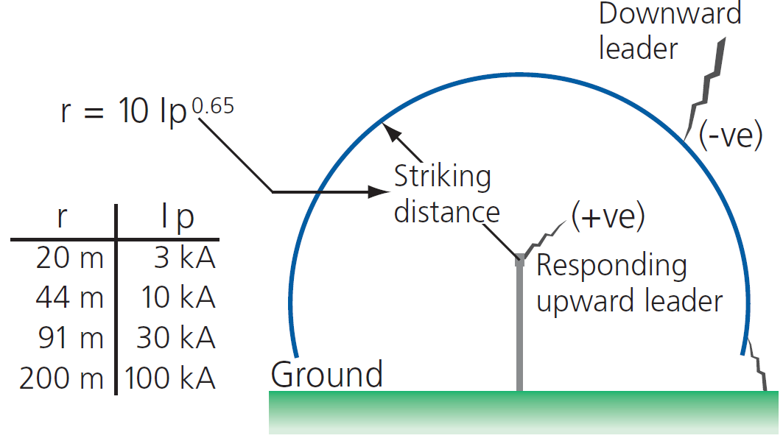
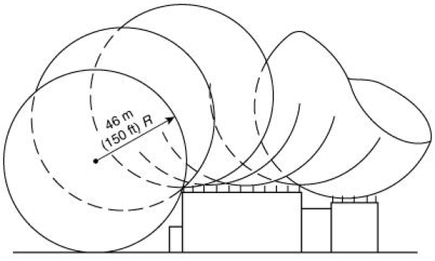
Rolling Sphere Model
Pentair, Lightning Protection Consultant Handbook, Pentair, Ed. Pentair Engineered Electrical and Fastening Solutions, 2009.
Standard for the Installation of Lightning Protection Systems, NFPA Std., 2011.

Slide 7
Resulting Stochastic Model
Monte Carlo Random Walk
  Propagation starts to fixed height ~200 m
  (Uniform) Random starting position (X,Y)
  Generate Series of Radom 3D Steps
    Uniform Polar Angle (X,Y Plane)
    Gaussian Angle from Z
  Propagate until within striking distance
  Strike to nearest object
  (Record Even & Repeat)

Slide 8
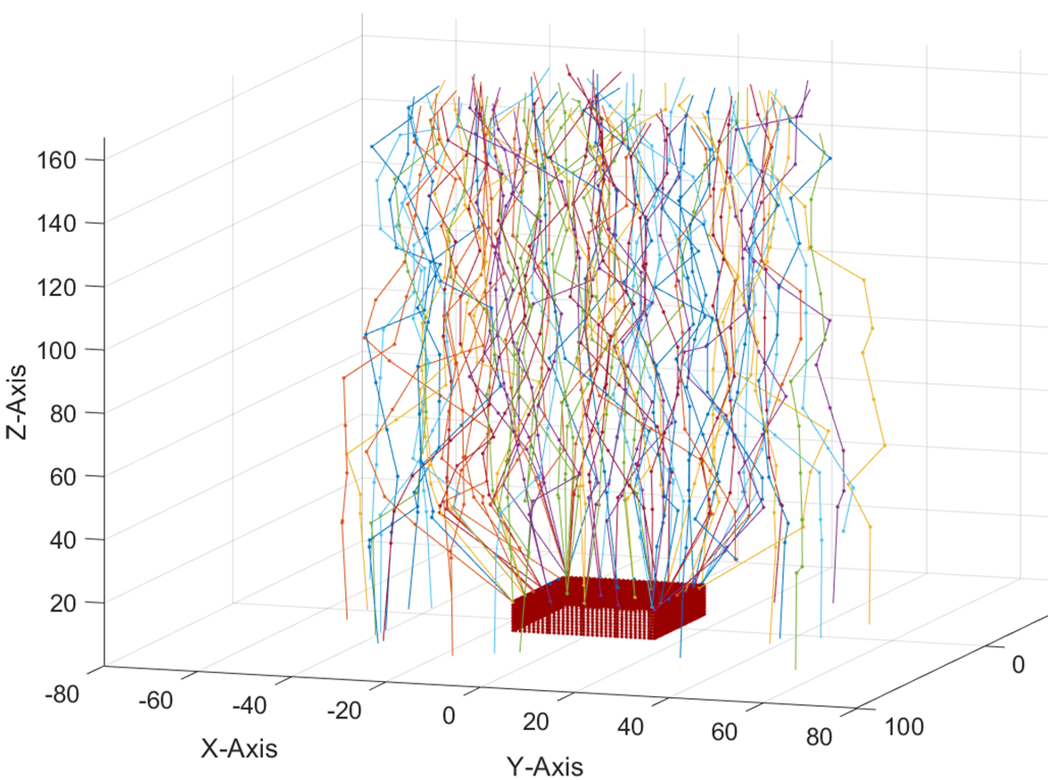
Model Capabilities
Monte Carlo methods of arriving at empirical probability of lightning protection failures.
  Tolerant of cm-sized features in 100’m contexts.
Inherently Parallelizable:
  100 000 runs in minutes on circa-2015 consumer desktop computers.
Support for arbitrary CAD geometries
  Geometry is specified by external stereolithography (STL) files.

Slide 9
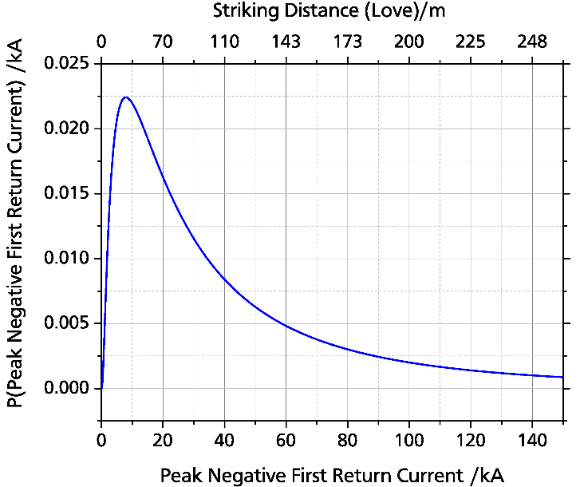
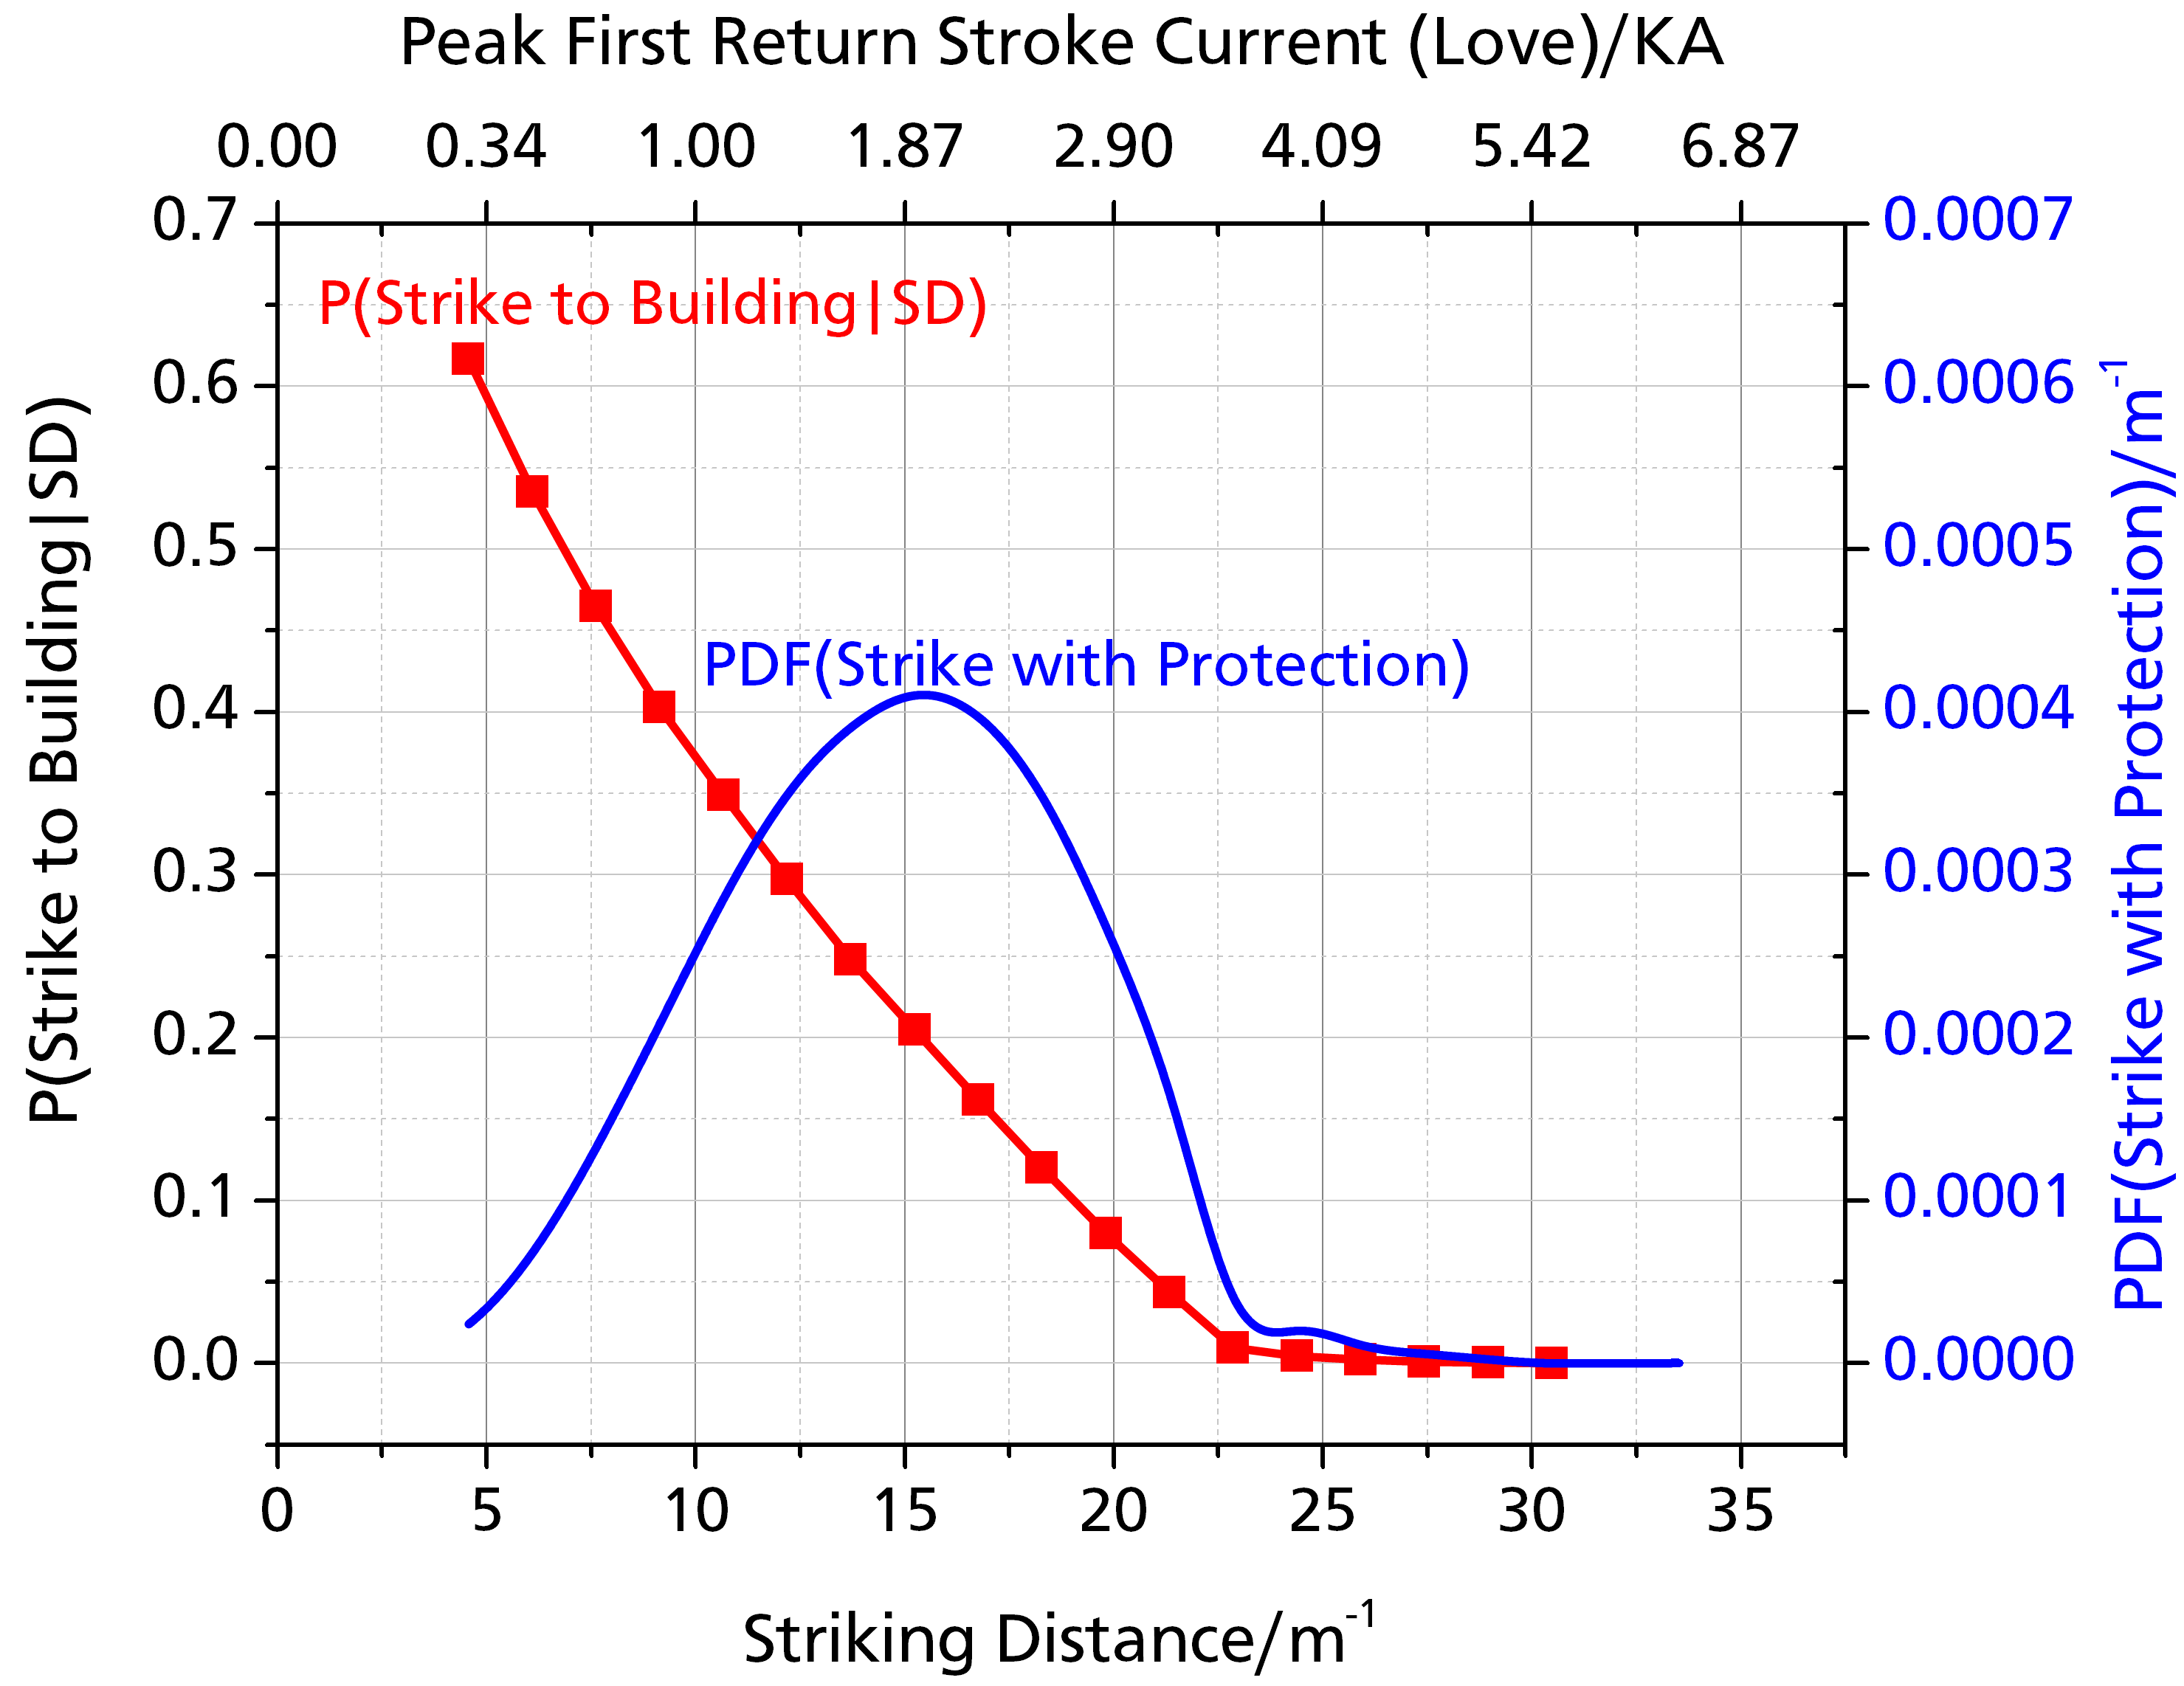
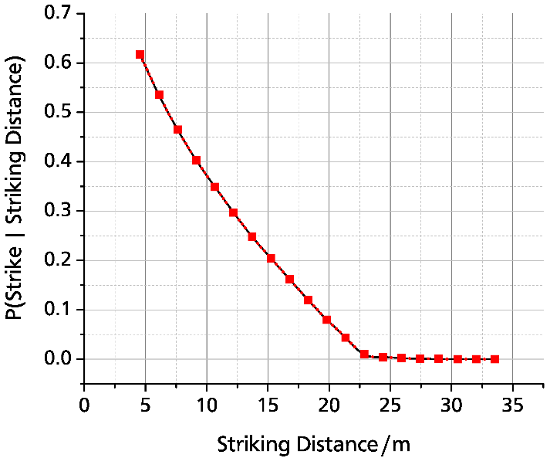

Arriving at Total Probabilities
$${PDF}_{total}(SD)=P\left(S | SD\right)⋅PDF\left(SD\right)$$
Brooks et al. Investigation of Lighting Attachment Risks to Small Structures Associated with Electrogeometric Model (EGM) [unpublished manuscript]. Lubbock: Texas Tech University; 2019

Slide 10
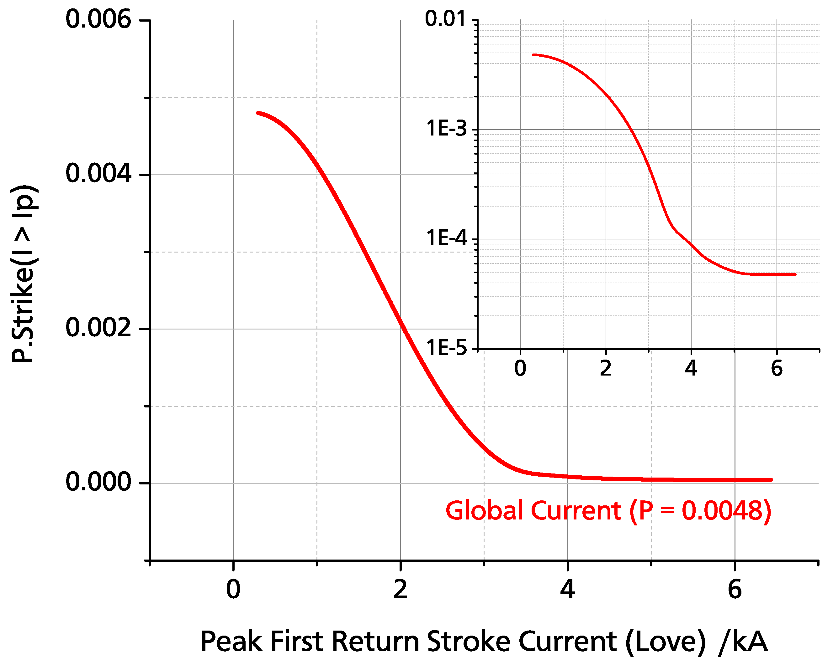
Consequences of Probability Distribution
Brooks et al. Investigation of Lighting Attachment Risks to Small Structures Associated with Electrogeometric Model (EGM) [unpublished manuscript]. Lubbock: Texas Tech University; 2019

Slide 11
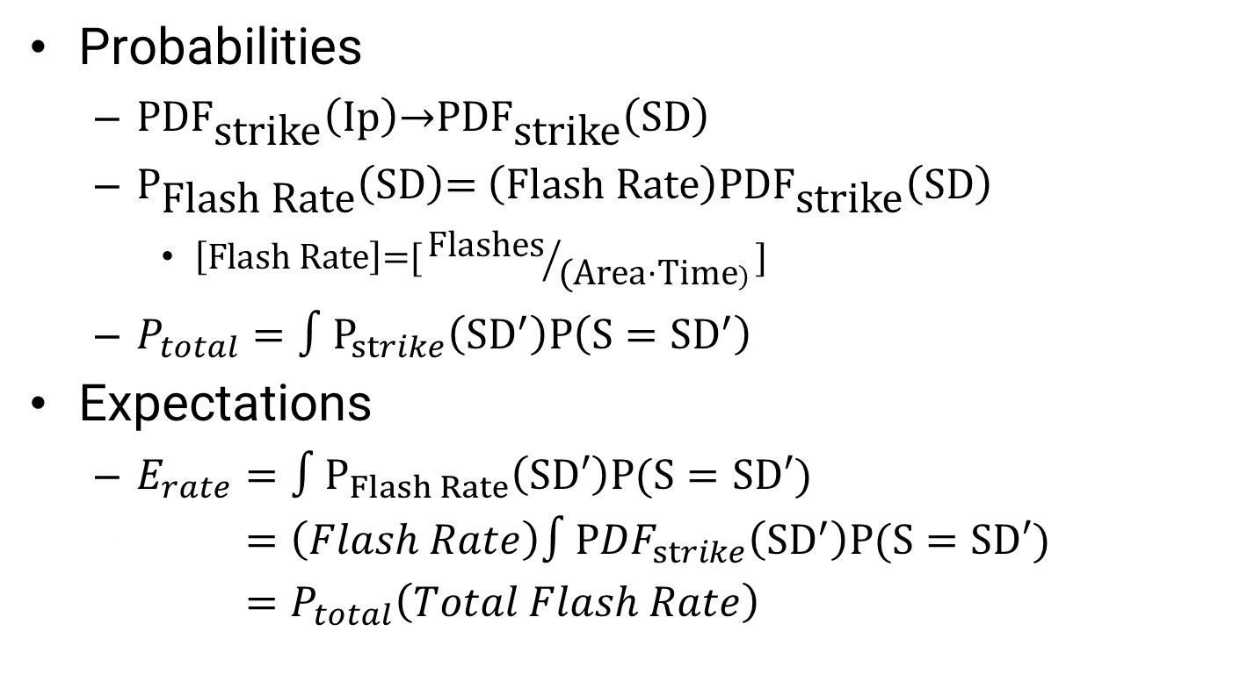
Expectation (E)
Probabilities
  ${\text{PDF}}_{\text{strike}}\left(\text{Ip}\right)\text{→}{\text{PDF}}_{\text{strike}}\left(\text{SD}\right)$
  ${\text{P}}_{\text{Flash} \text{Rate}}\left(\text{SD}\right)\text{= }\left(\text{Flash} \text{Rate}\right){\text{PDF}}_{\text{strike}}\left(\text{SD}\right)$
    $\left[\text{Flash} \text{Rate}\right]\text{=[}{\text{Flashes}}/{\text{(}\text{Area}\text{⋅}\text{Time})}\text{]}$
  $P_{total}=∫P_{strike}\left({SD}^{′}\right)P\left(S={SD}^{′}\right)$
Expectations
  $E_{rate}=∫P_{Flash Rate}\left(SD′\right)P(S=SD′)$
  $E_{rate}=\left(Flash Rate\right)∫{PDF}_{strike}\left({SD}^{′}\right)P(S=SD′)$
  $E_{rate}=P_{total}\left(Total Flash Rate\right)$

Slide 12
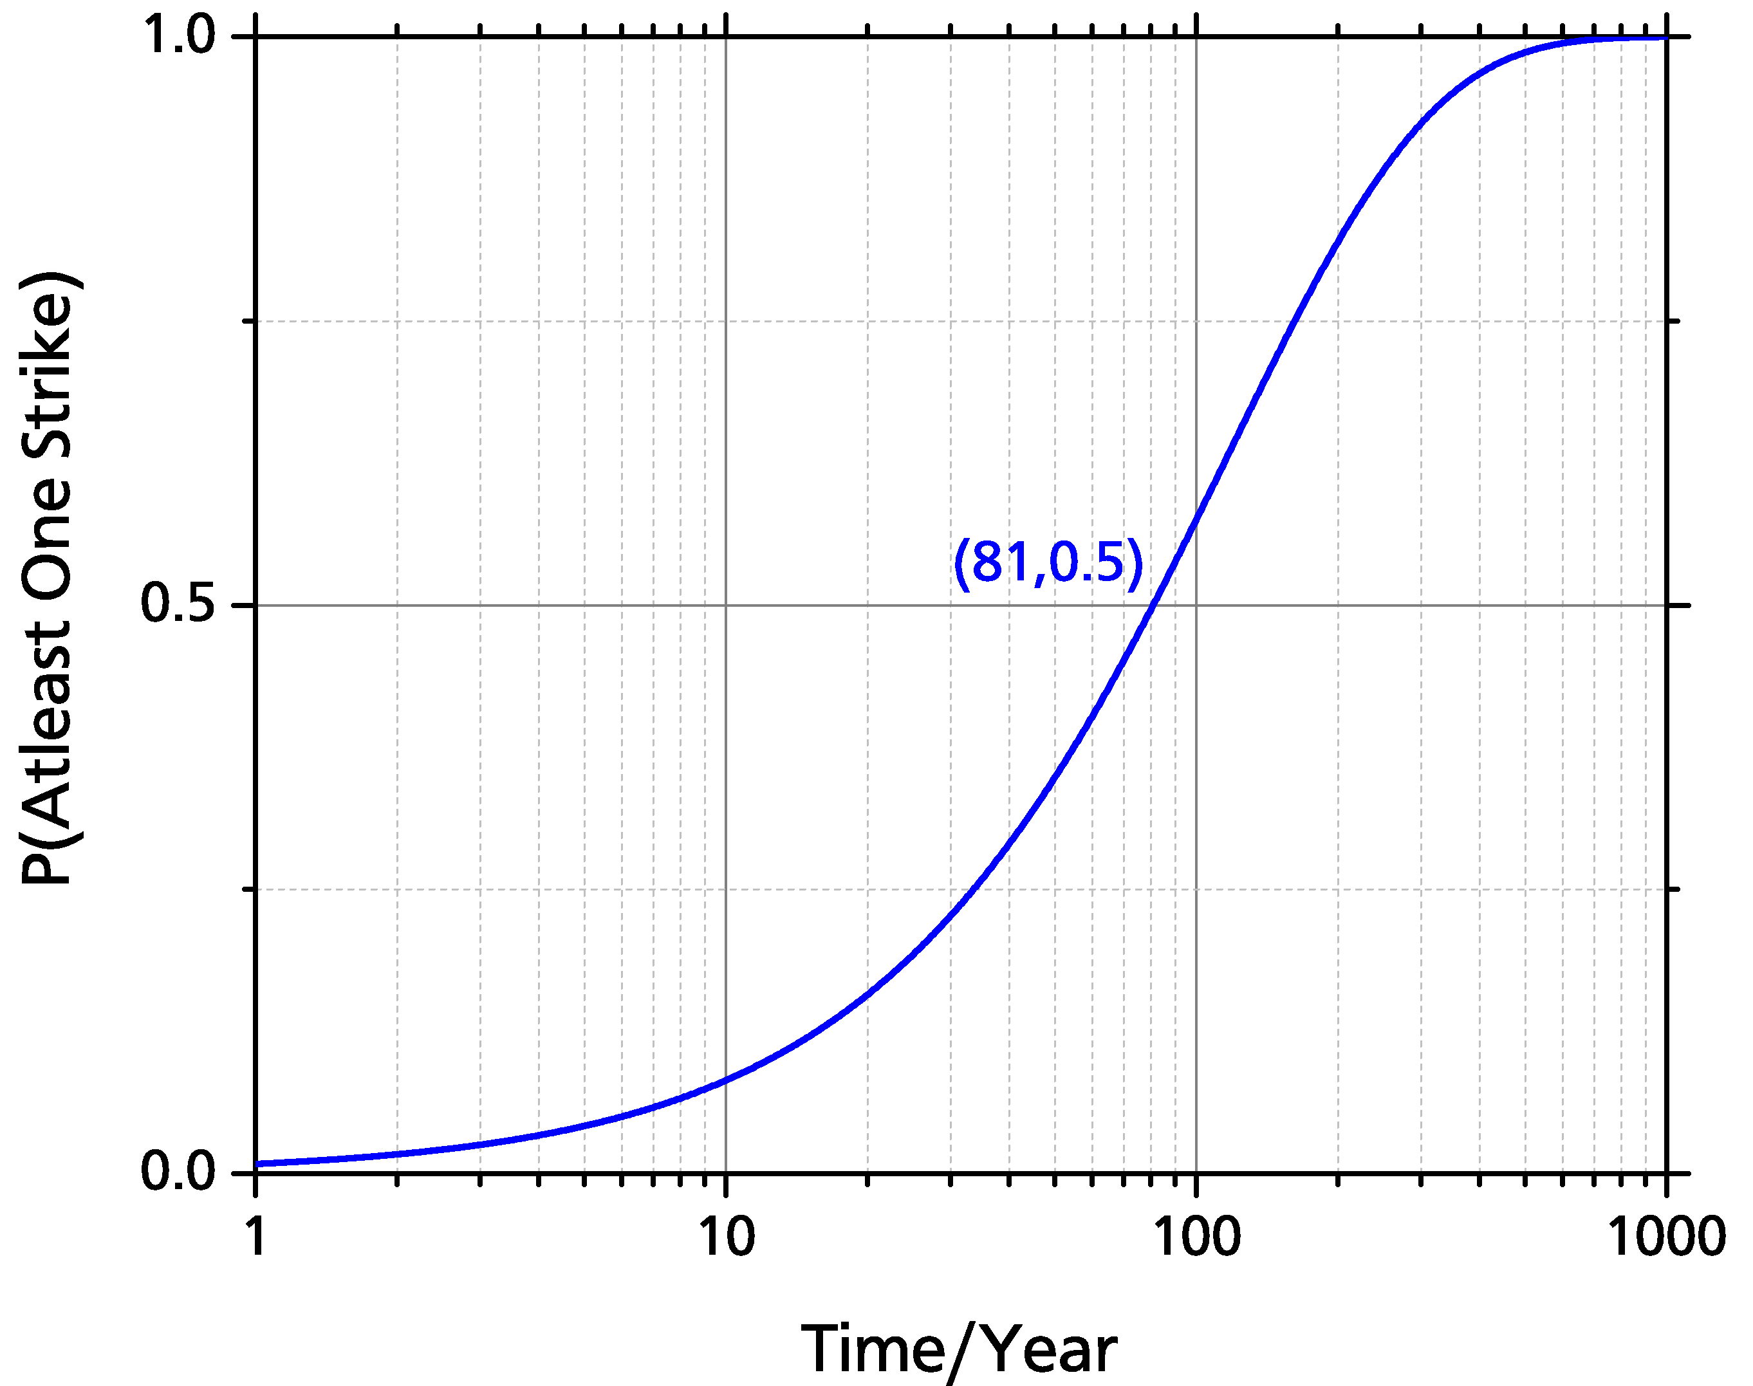
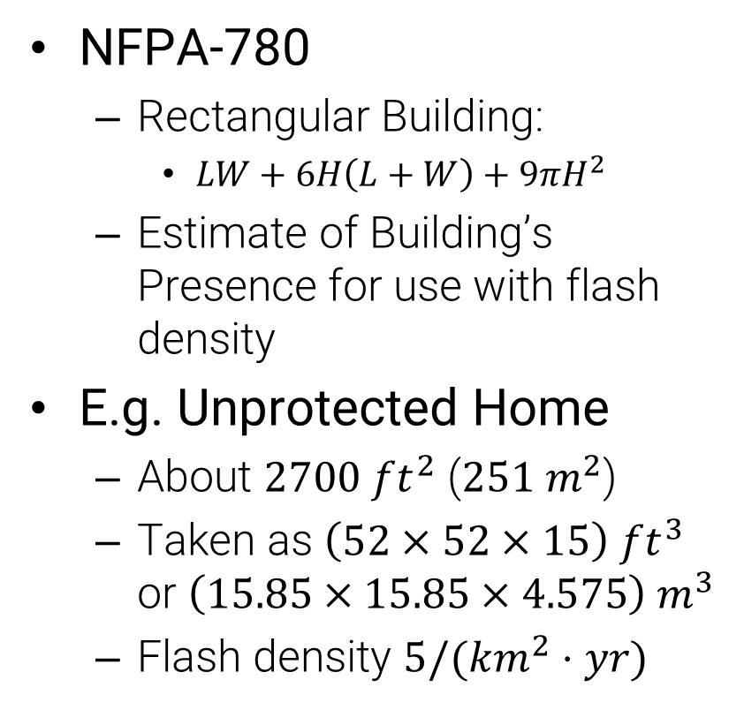
Collection Area
NFPA-780
  Rectangular Building:
    $LW+6H\left(L+W\right)+9πH^{2}$
  Estimate of Building’s Presence for use with flash density
E.g. Unprotected Home
  About $2700 ft^{2}$ ($251 m^{2}$)
  Taken as $\left(52×52×15\right) ft^{3}$ or $\left(15.85×15.85×4.575\right){ m}^{3}$
  Flash density $5/(km^{2}⋅yr)$
Notes:
For further comparison, a human (taken to be a (1m x 1m x 2m) box has a 50% change after ~1004 yrs.

Slide 13
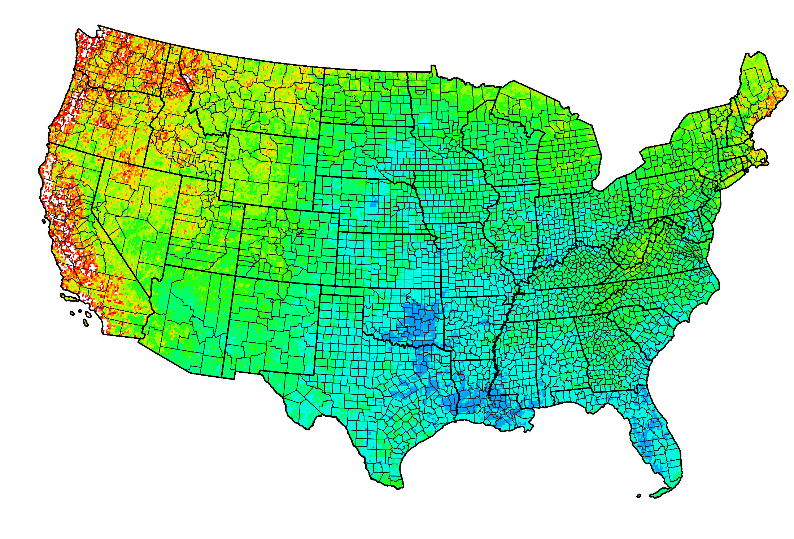
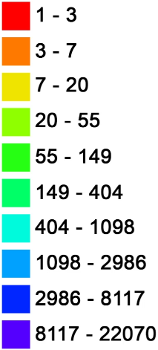
NLDN Stroke Density
Count of Vaisala NLDN lightning strikes within 0.1 degree grid cells within the United States. Political boundaries based on 2017 United States Census Bureau TIGER data.
Notes:
Vaisala data hosted: ftp://ftp.ncdc.noaa.gov/pub/data/swdi/database-csv/v2/
TIGER/Line Shapefile: https://www.census.gov/geographies/mapping-files/time-series/geo/tiger-line-file.2017.html
Composited/Rendered using https://www.qgis.org/en/site/

Slide 14
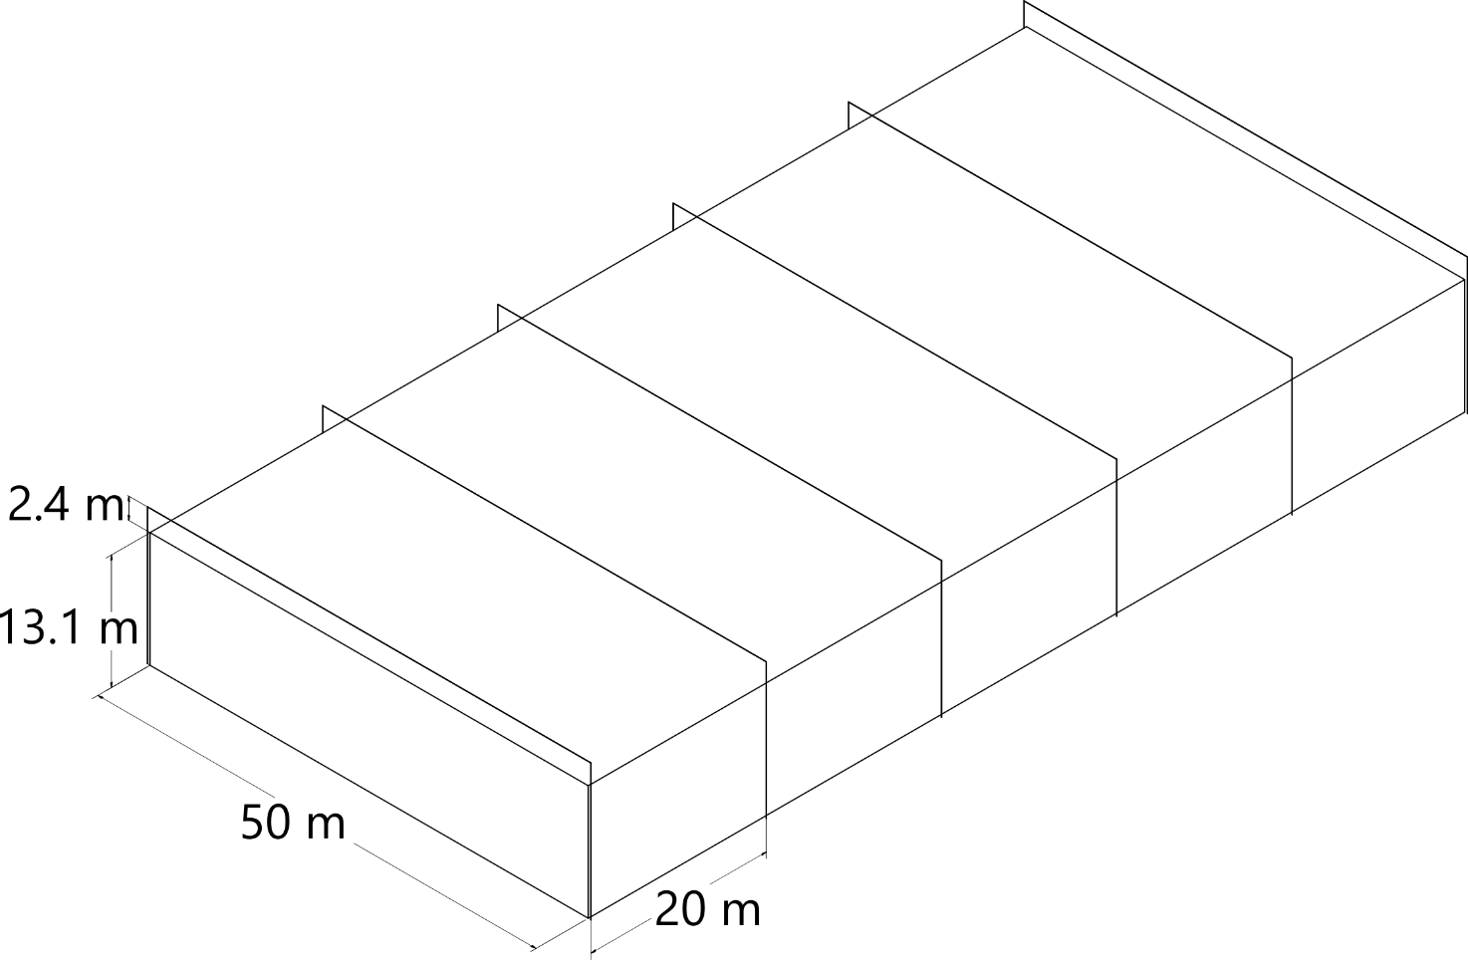
Reference Geometry
Parametric Sweep
  Building Height
  Footprint Area
  Inset Protection
  Aspect Ratio
1. Brooks et al. Investigation of Lighting Attachment Risks to Small Structures Associated with Electrogeometric Model (EGM) [unpublished manuscript]. Lubbock: Texas Tech University; 2019

Slide 15
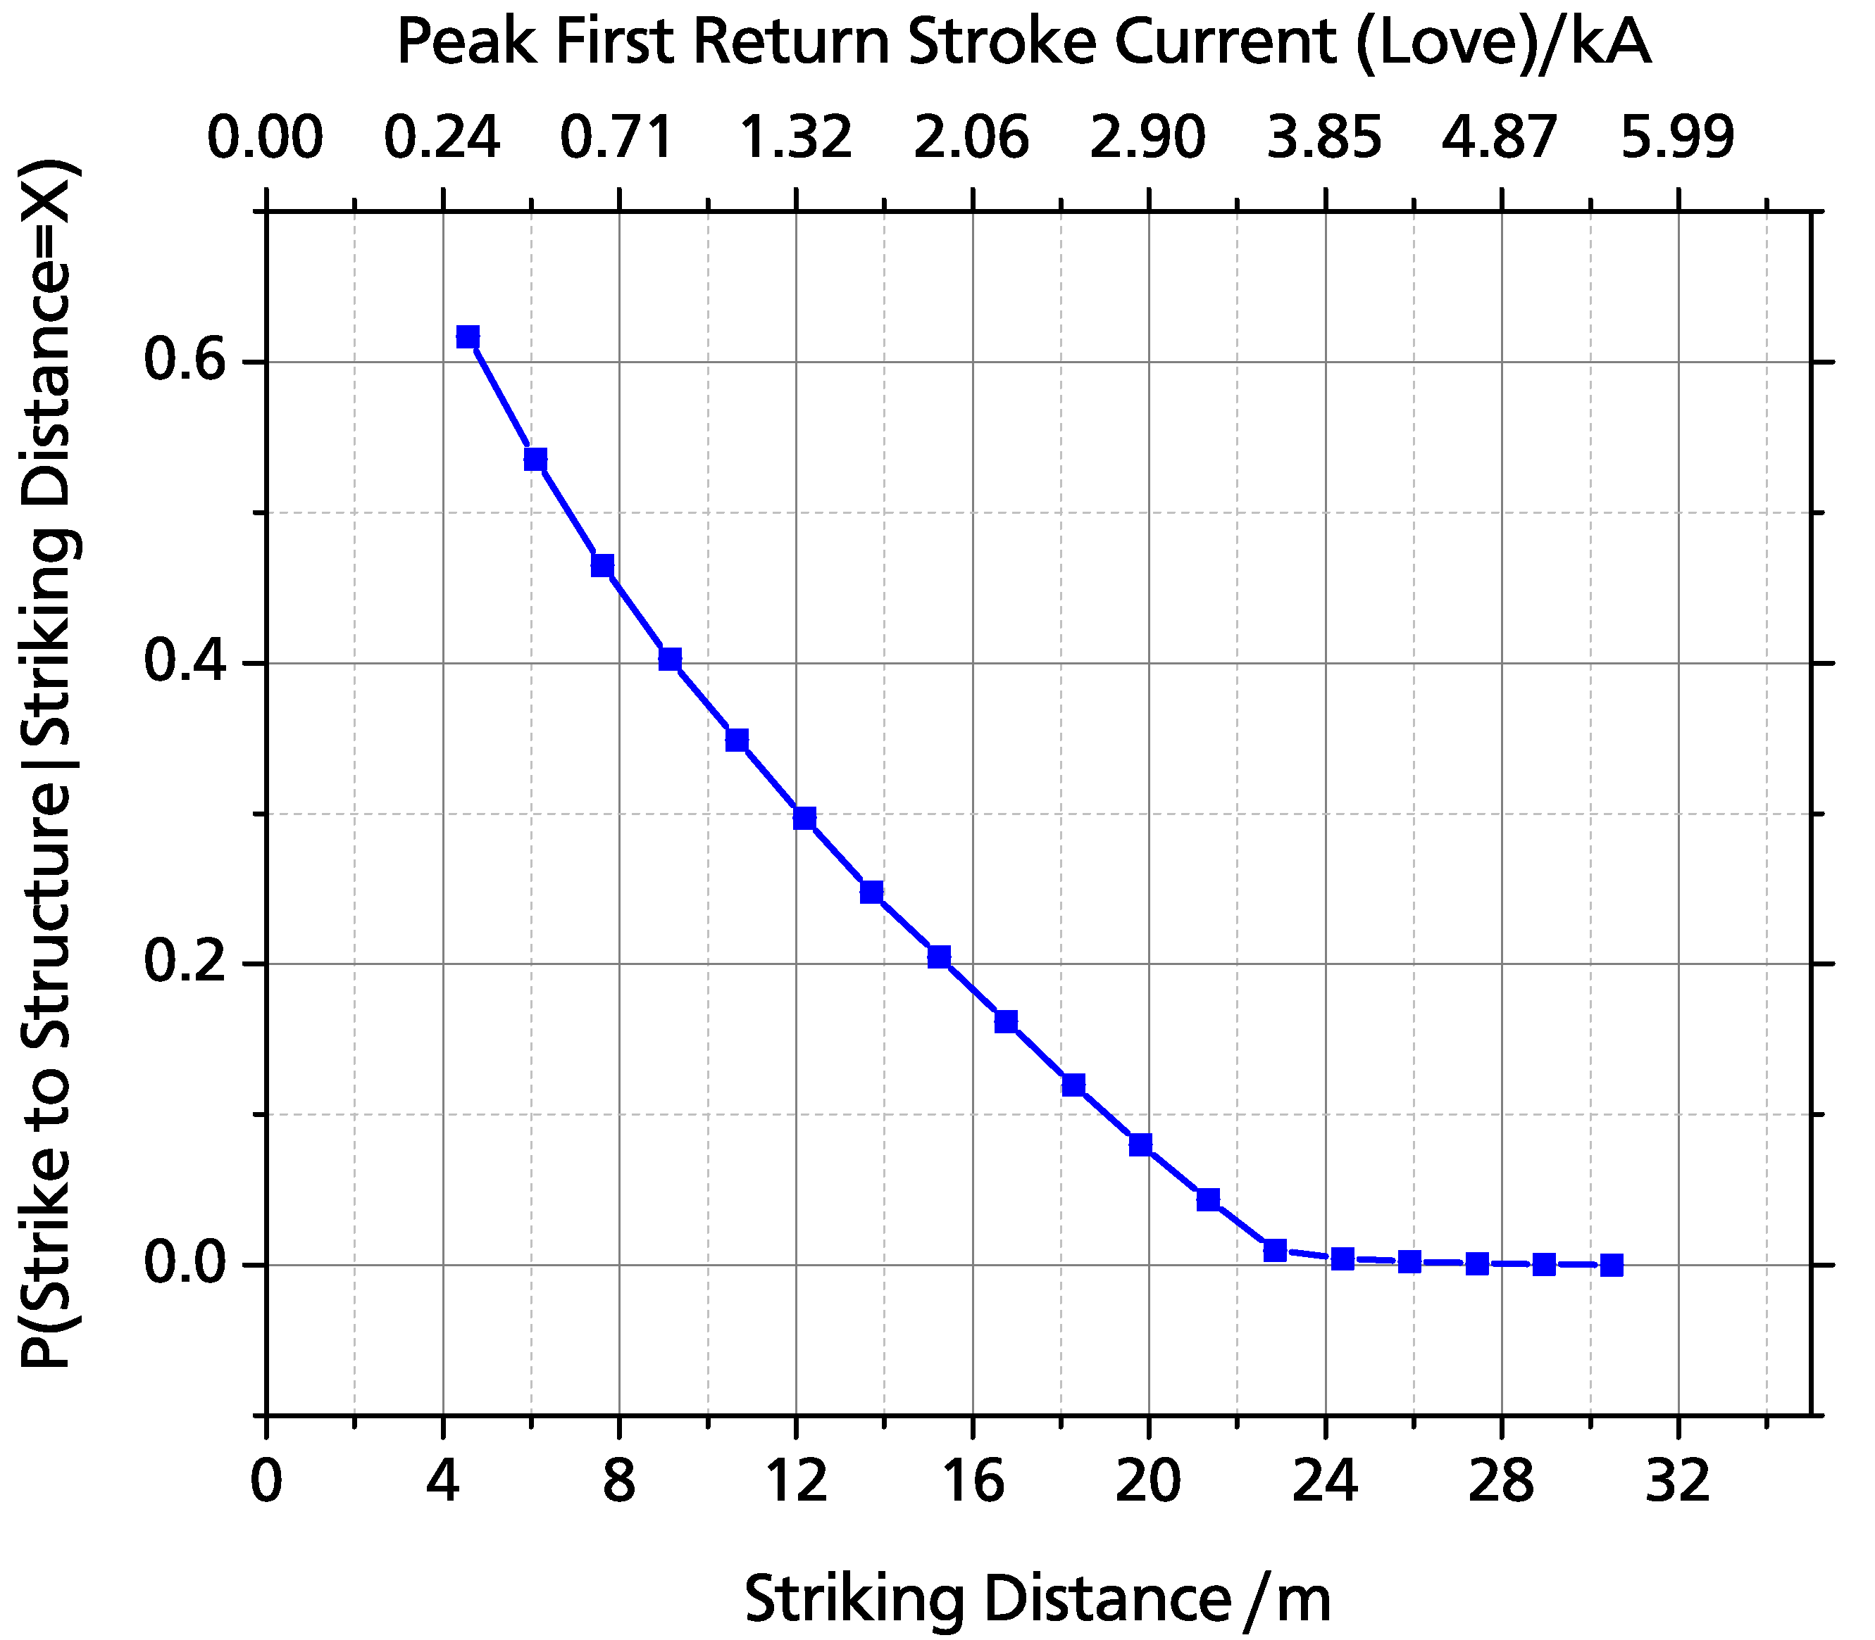
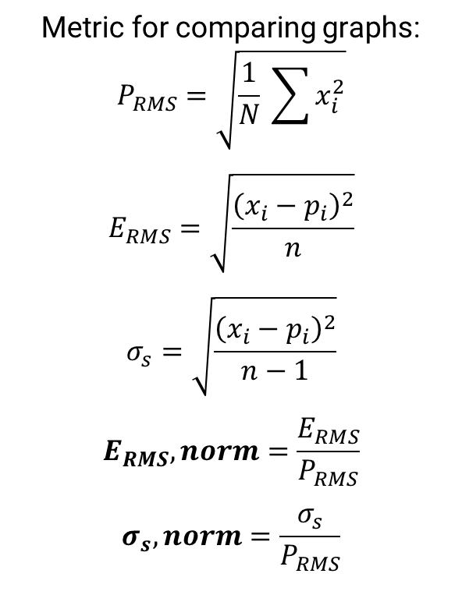
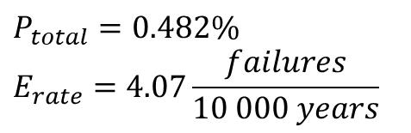
Reference Case & Error Calculation
Metric for comparing graphs:
$$P_{RMS}=\sqrt{\frac{1}{N} \sum{x_{i}^{2}}}$$
$$E_{RMS}=\sqrt{\frac{{\left(x_{i}−p_{i}\right)}^{2}}{n}}$$
$$σ_{s}=\sqrt{\frac{{\left(x_{i}−p_{i}\right)}^{2}}{n−1}}$$
$$E_{RMS},norm=\frac{E_{RMS}}{P_{RMS}}$$
$$σ_{s},norm=\frac{σ_{s}}{P_{RMS}}$$
$$P_{total}=0.482\%$$
$$E_{rate}=4.07\frac{failures}{10 000 years}$$
Brooks et al. Investigation of Lighting Attachment Risks to Small Structures Associated with Electrogeometric Model (EGM) [unpublished manuscript]. Lubbock: Texas Tech University; 2019

Slide 16
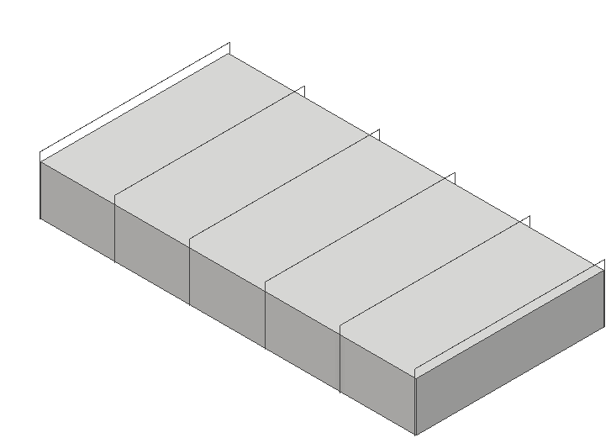
Building Height
Height was Varied as X [m]
Catenary Wire Height Varied as X + 2.4
20 m
Reference
(100 x 50) m
Building Height: 13.1 m
Catenary Height: 15.5 m

Slide 17
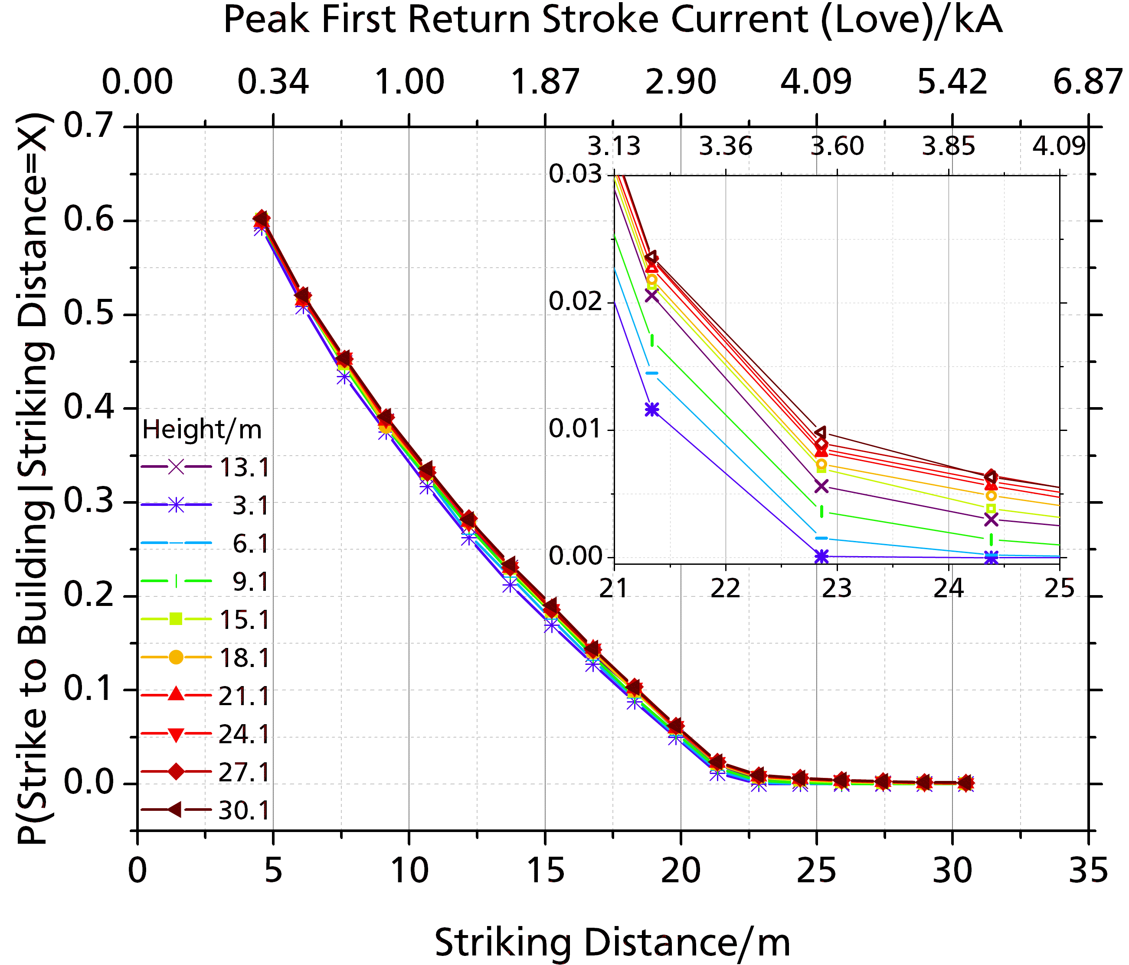
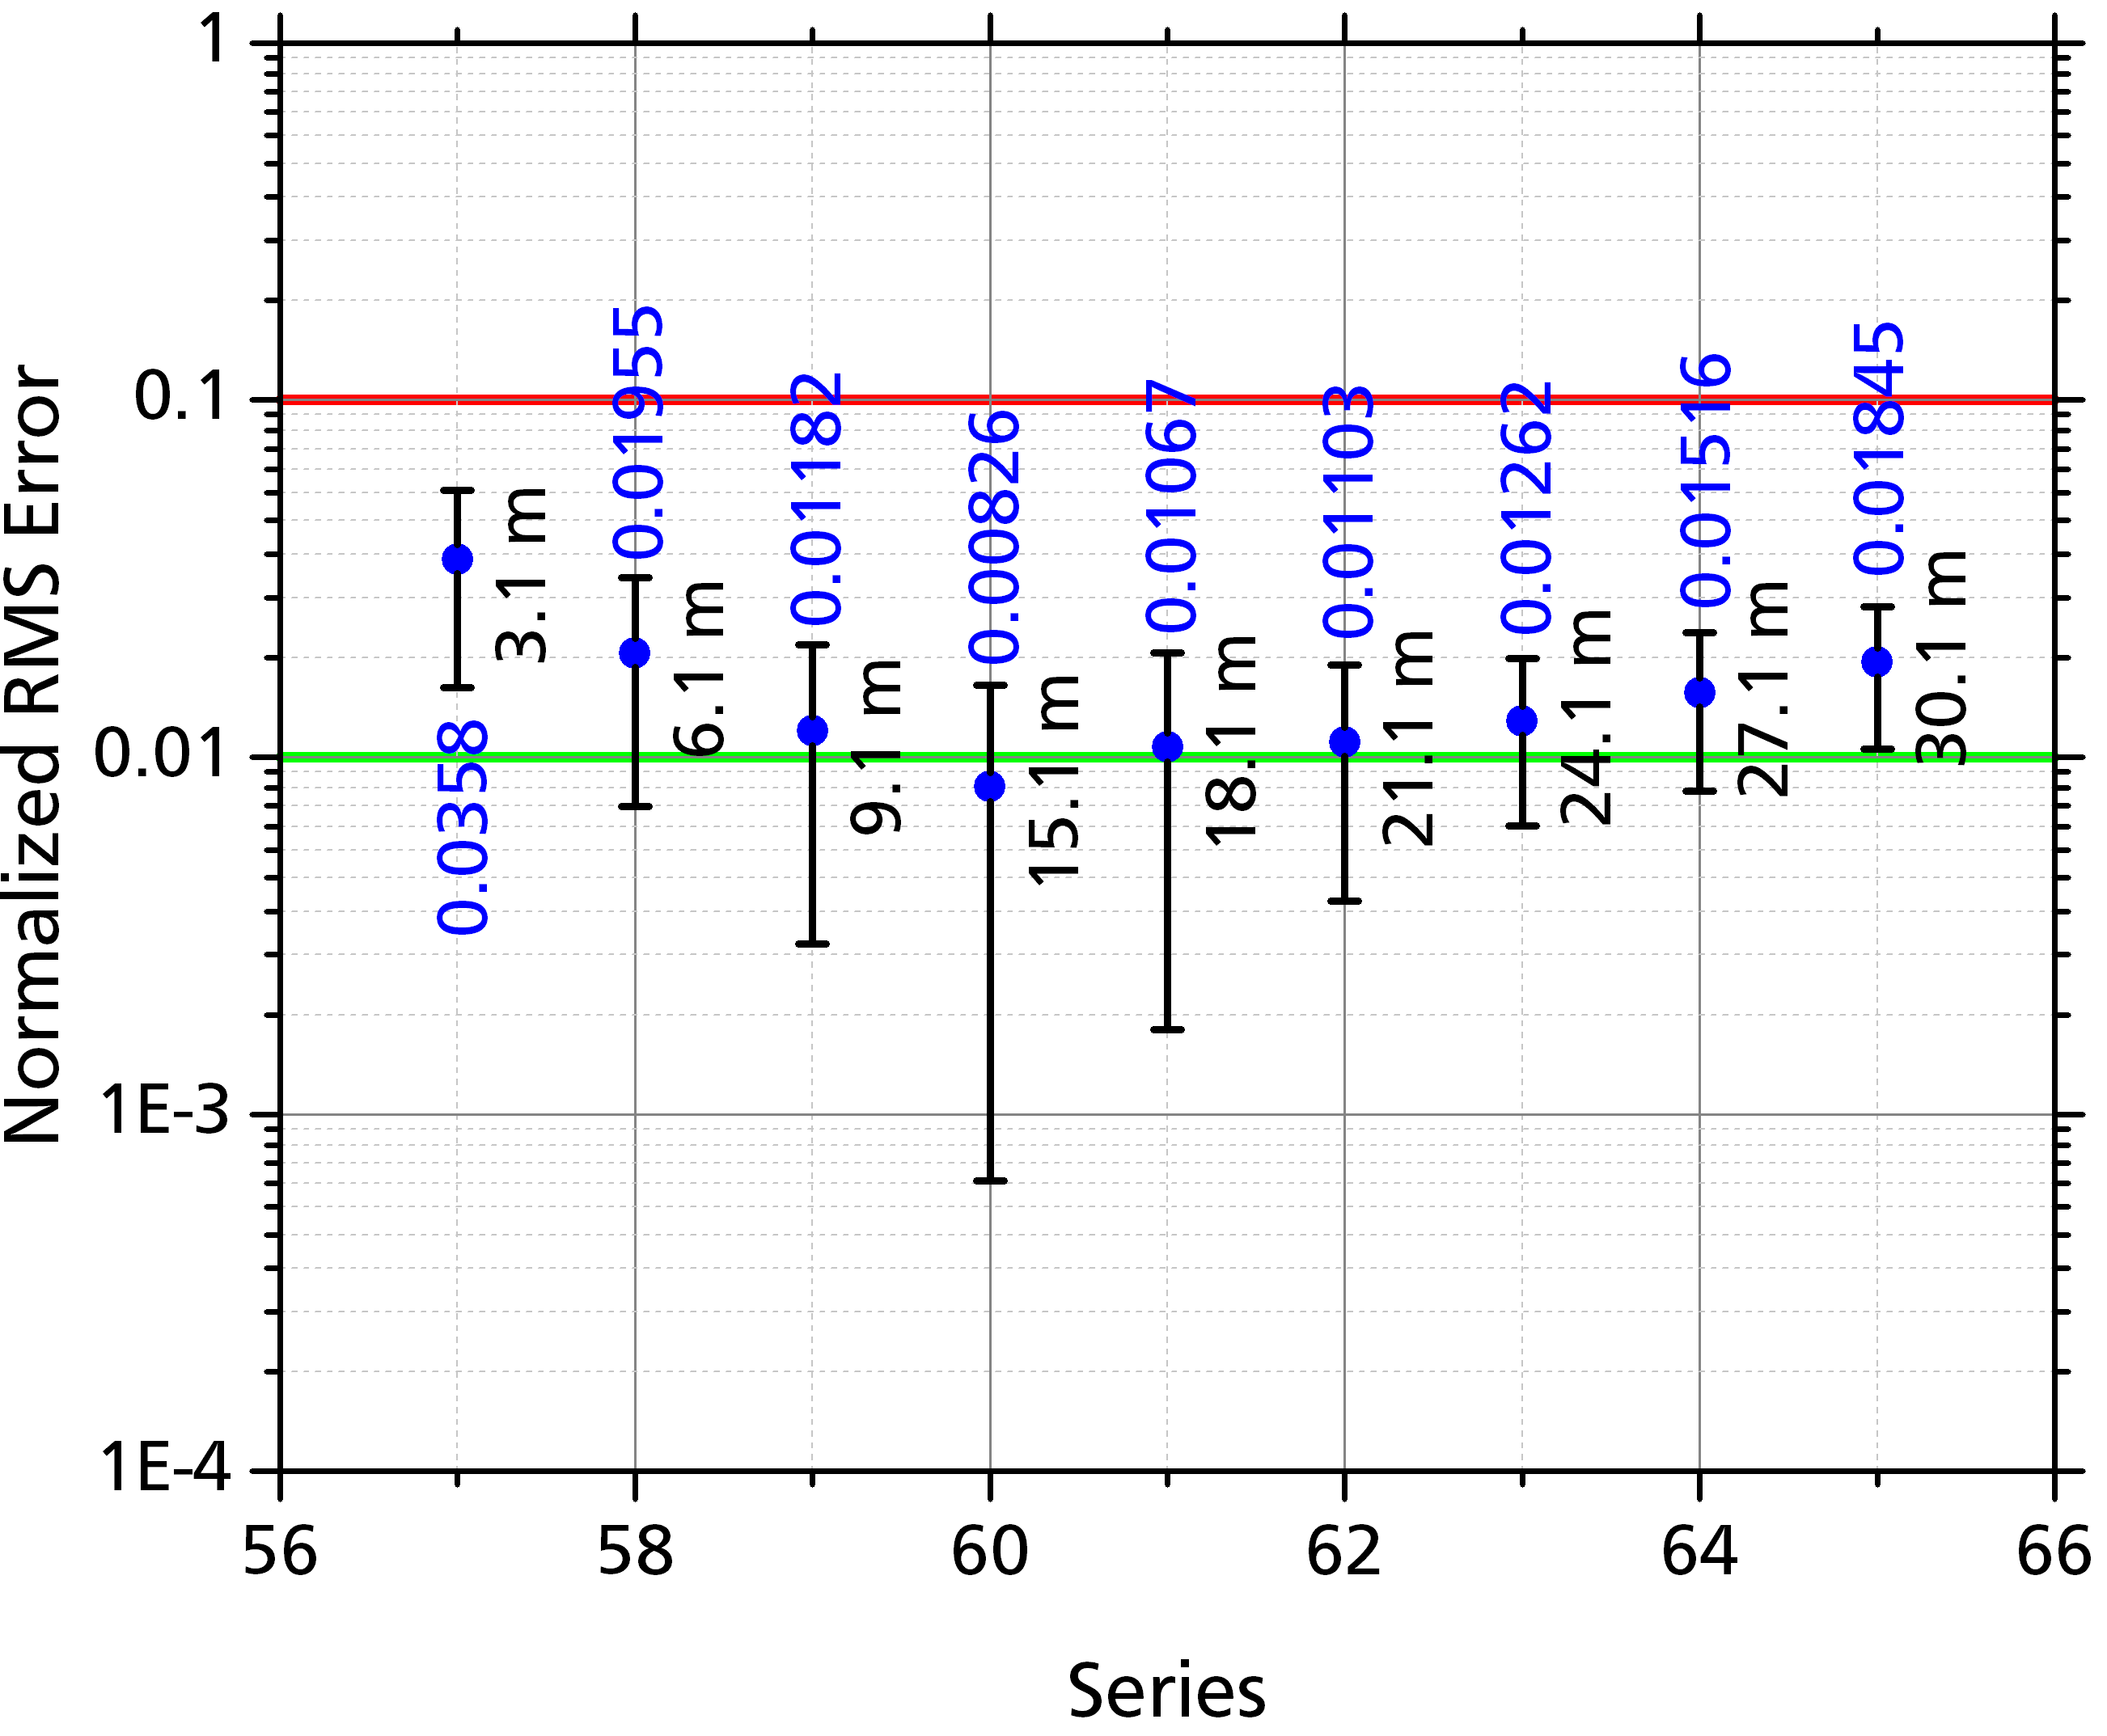
Variation of Building Height
Short buildings show weak dependence on height:
Taller buildings are at increased risk of being struck.
For less the buildings measured effect is very slight.

Slide 18
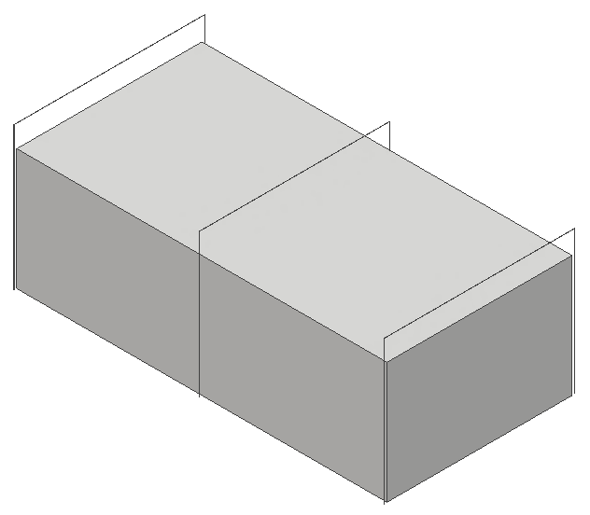
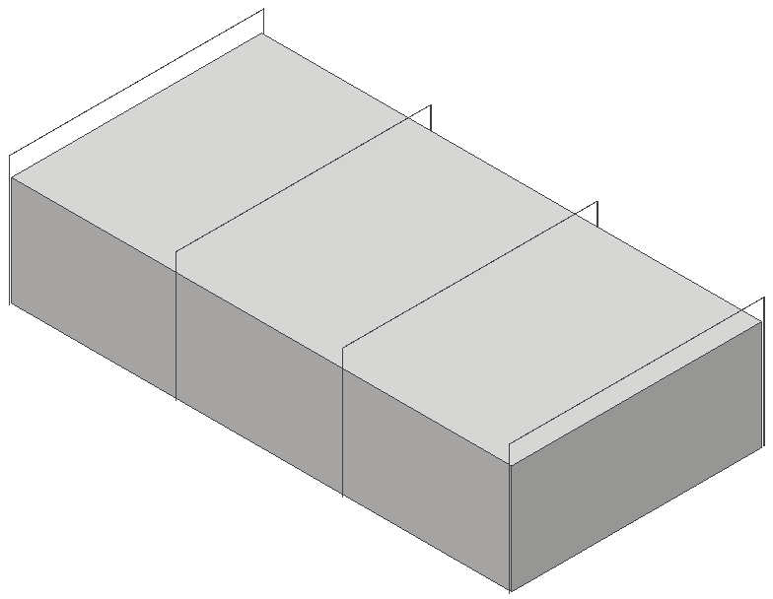
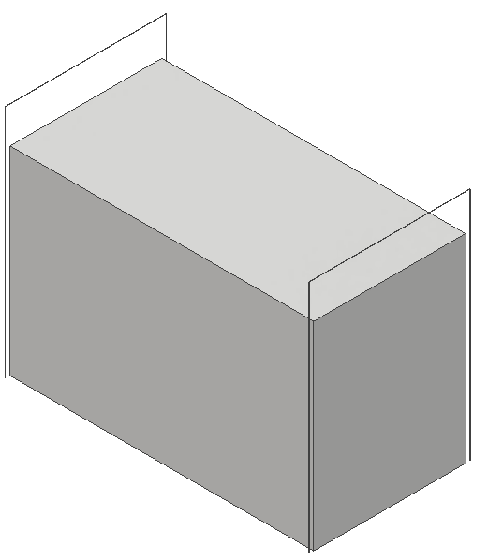
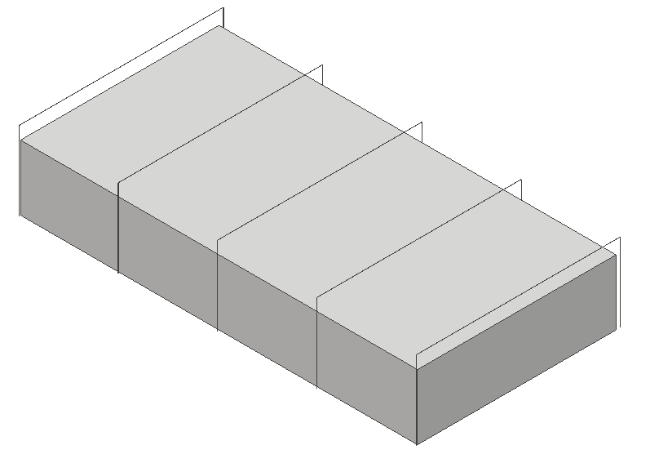
Footprint Area
(20 x 10) m
(40 x 20) m
(60 x 30) m
20 m
(80 x 40) m
(100 x 50) m
Reference
Building Height: 13.1 m
Catenary Height: 15.5 m

Slide 19
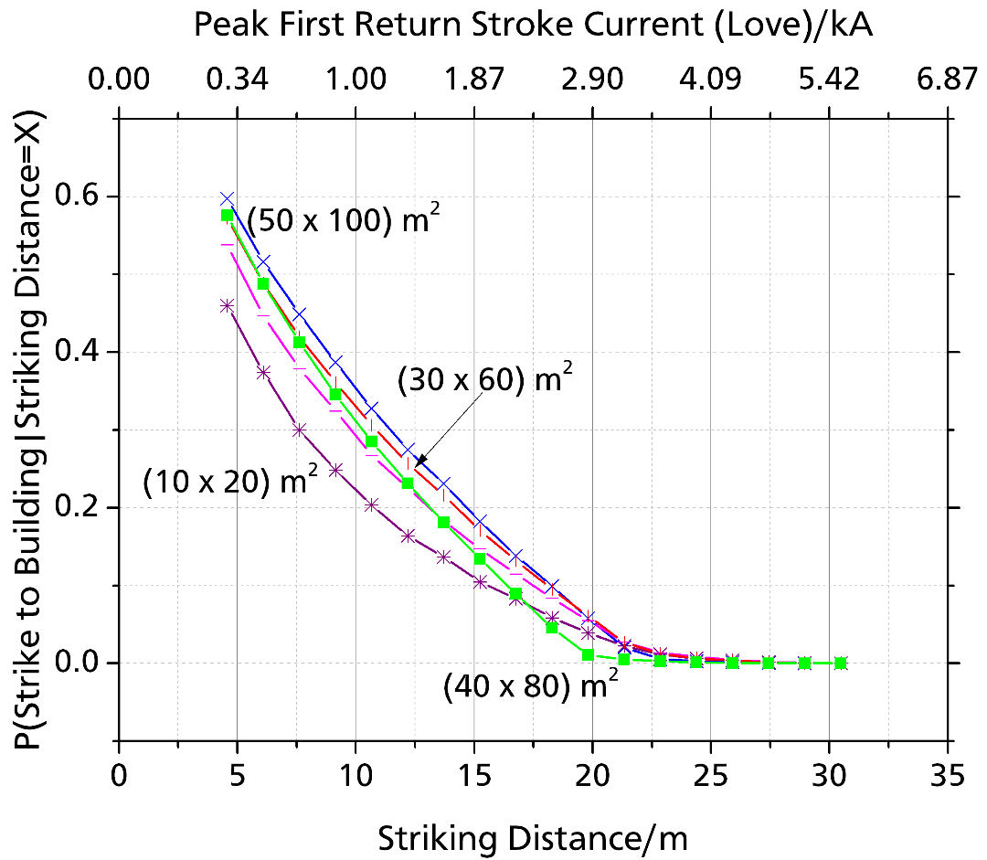
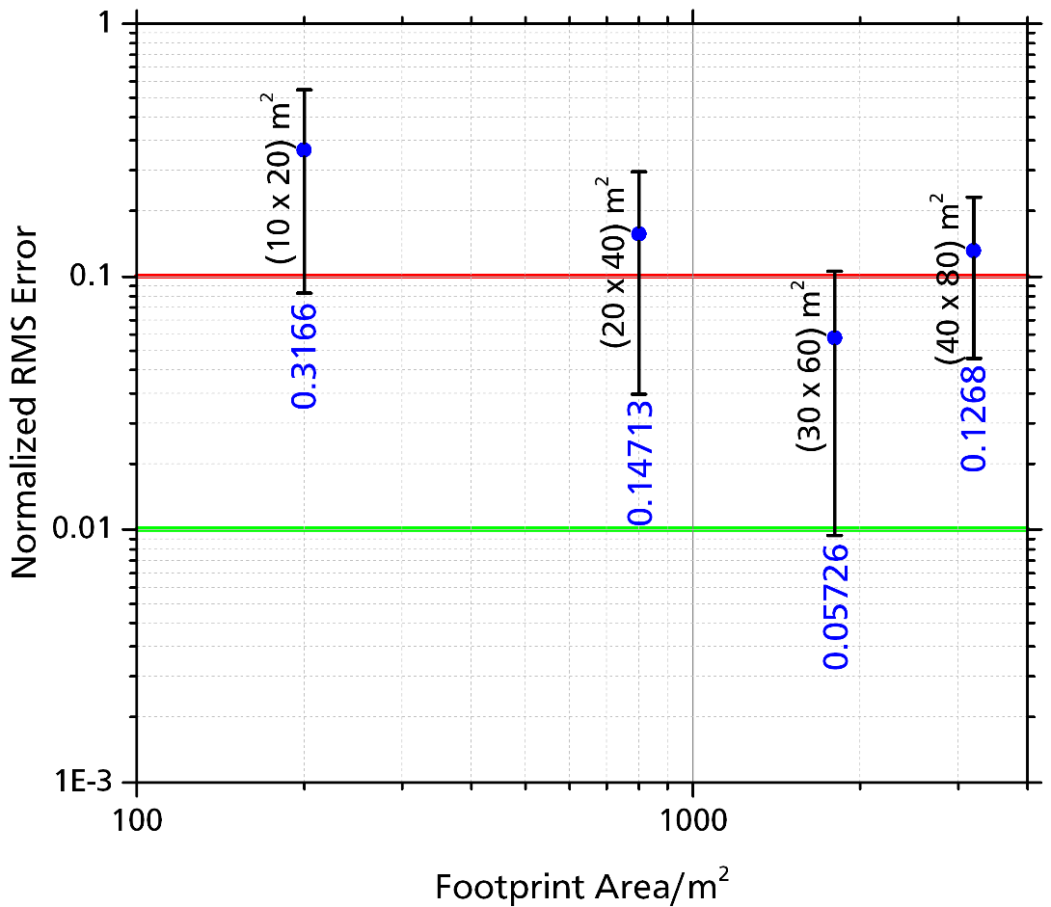
Variation of Footprint Area
Risk generally increased with increasing footprint area.
Larger buildings are at increased risk of being struck.
The effect is much more pronounced for small structures.

Slide 20
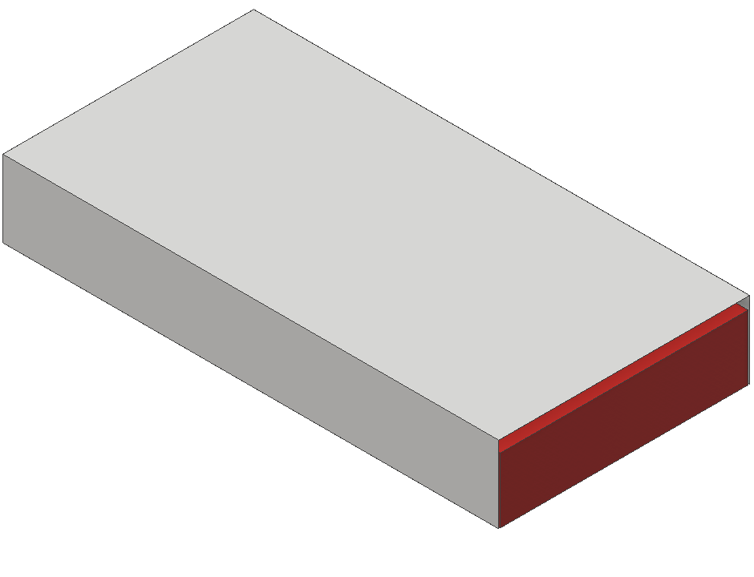
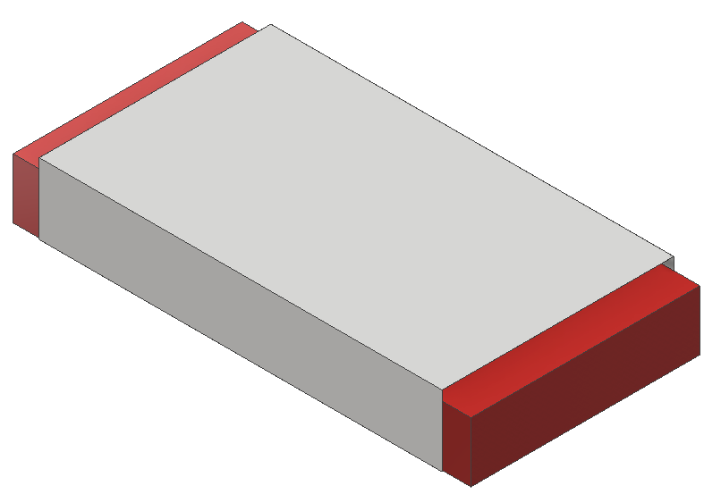
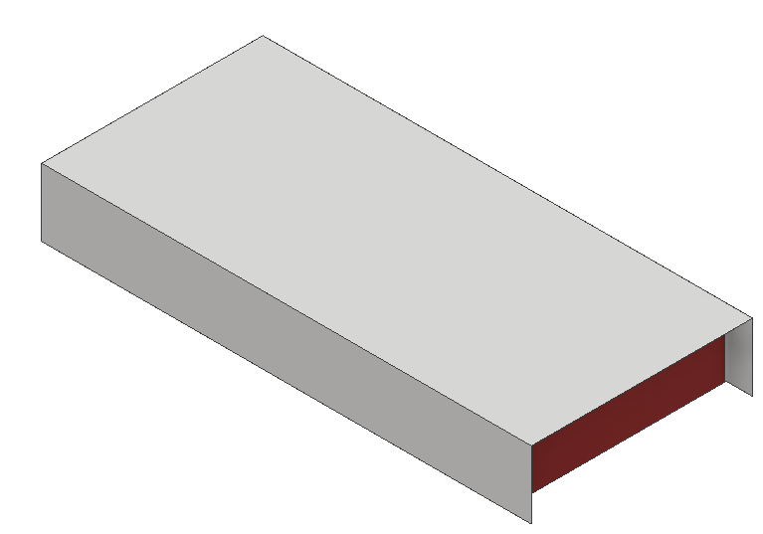
Building Inset Protection
0 Inset
(Flush)
(+) Inset [m]
(Interior)
(-) Inset
(Past)
Building idealized to capture only edge effects.

Slide 21
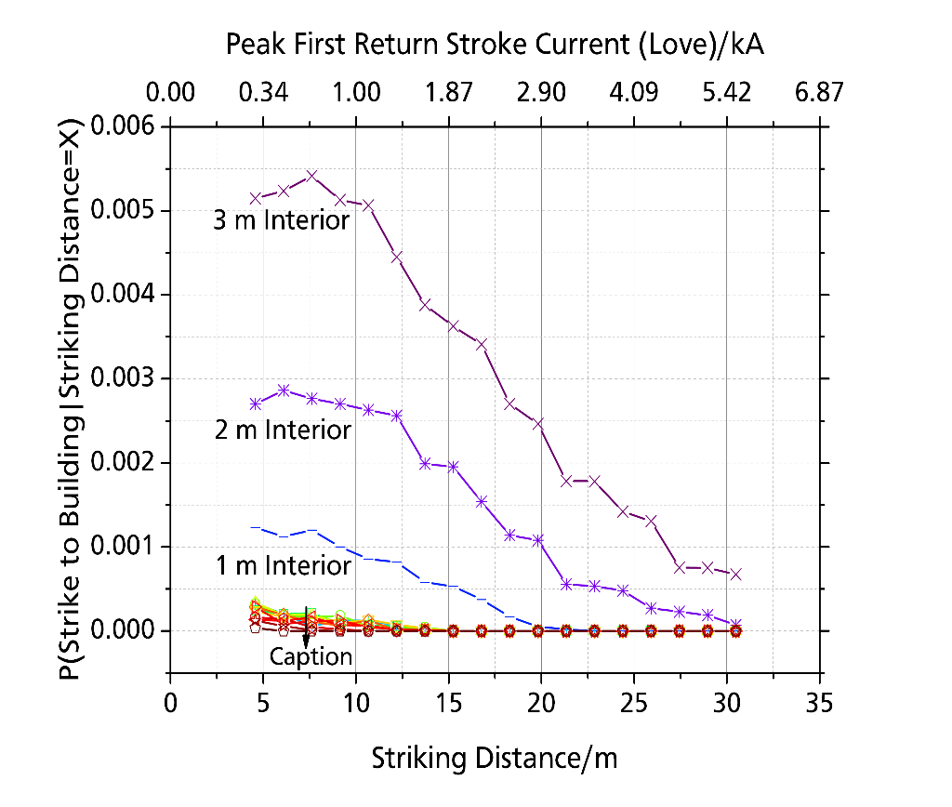
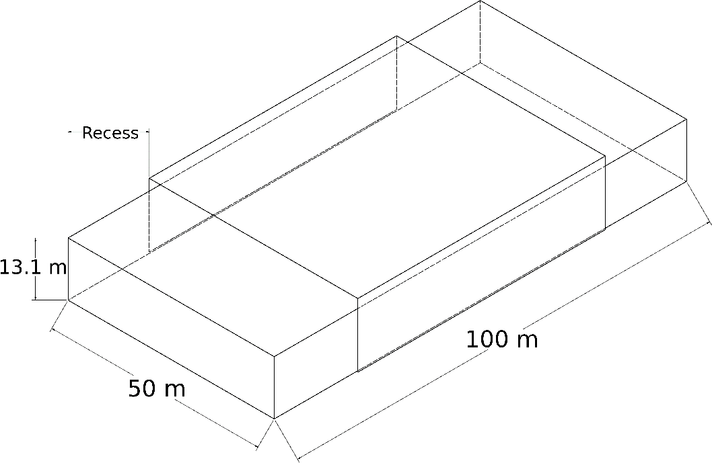
Variation of Inset Protection
Unprotected protrusions are at significant risk.
P is much smaller than previous values as protection is idealized.
Inset protection of 0.15 m or less incurs limited additional risk.
2. Brooks et al. Investigation of Lighting Attachment Risks to Small Structures Associated with Electrogeometric Model (EGM) [unpublished manuscript]. Lubbock: Texas Tech University; 2019

Slide 22
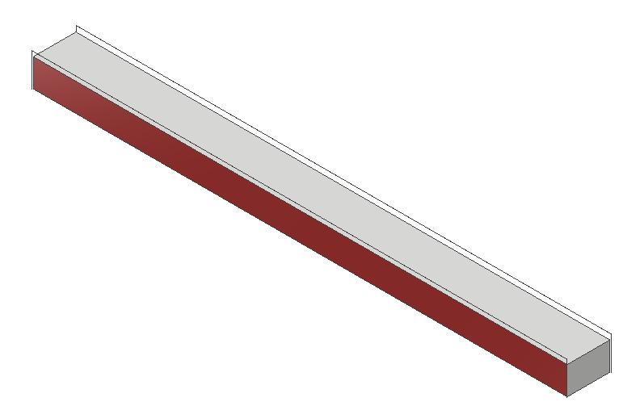
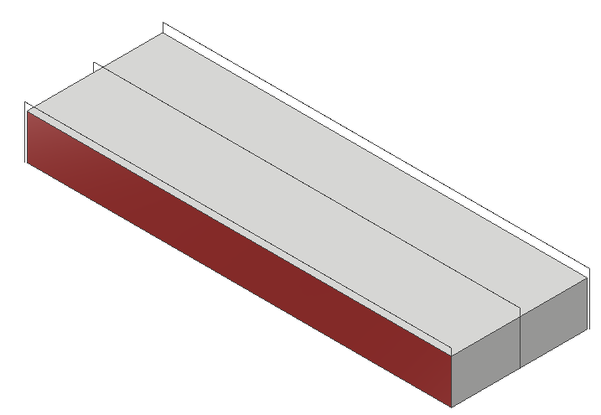
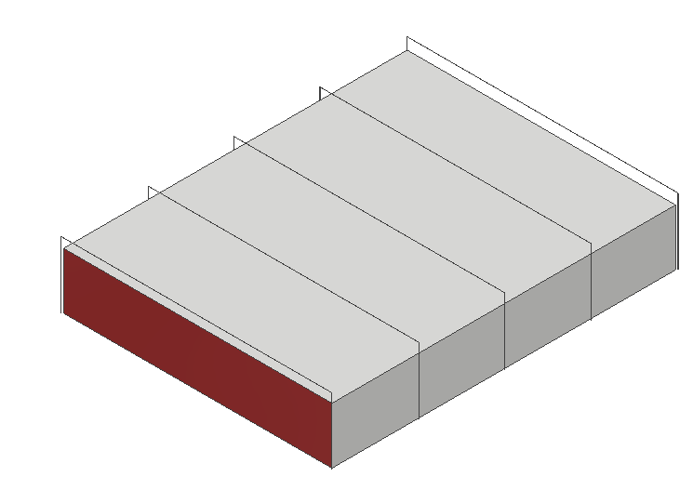
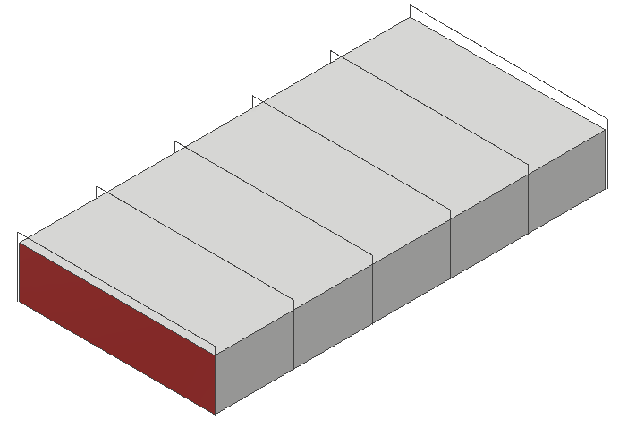
Building Aspect Ratio
( 40 x 125 ) m
( 20 x 250 ) m
Width
(Second Dimension)
( 80 x 62.5 ) m
( 200 x 25 ) m
Length
(First Dimension)
Building Volume held constant in effort to avoid collection volume effects, if any.
Aspect taken as: Length / Width

Slide 23
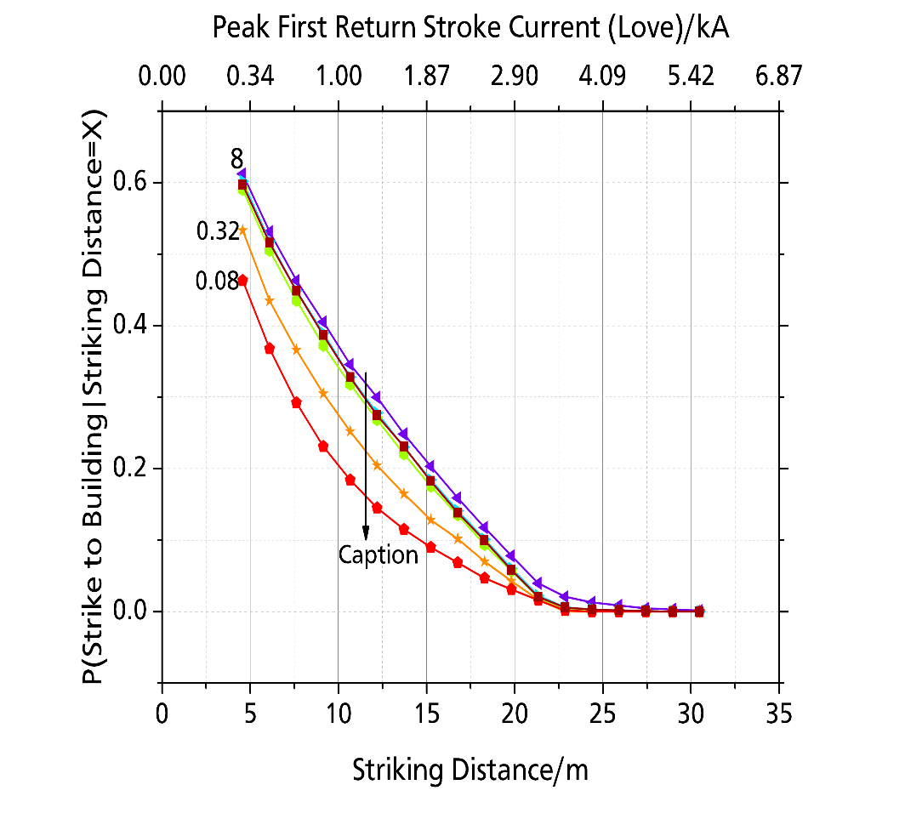
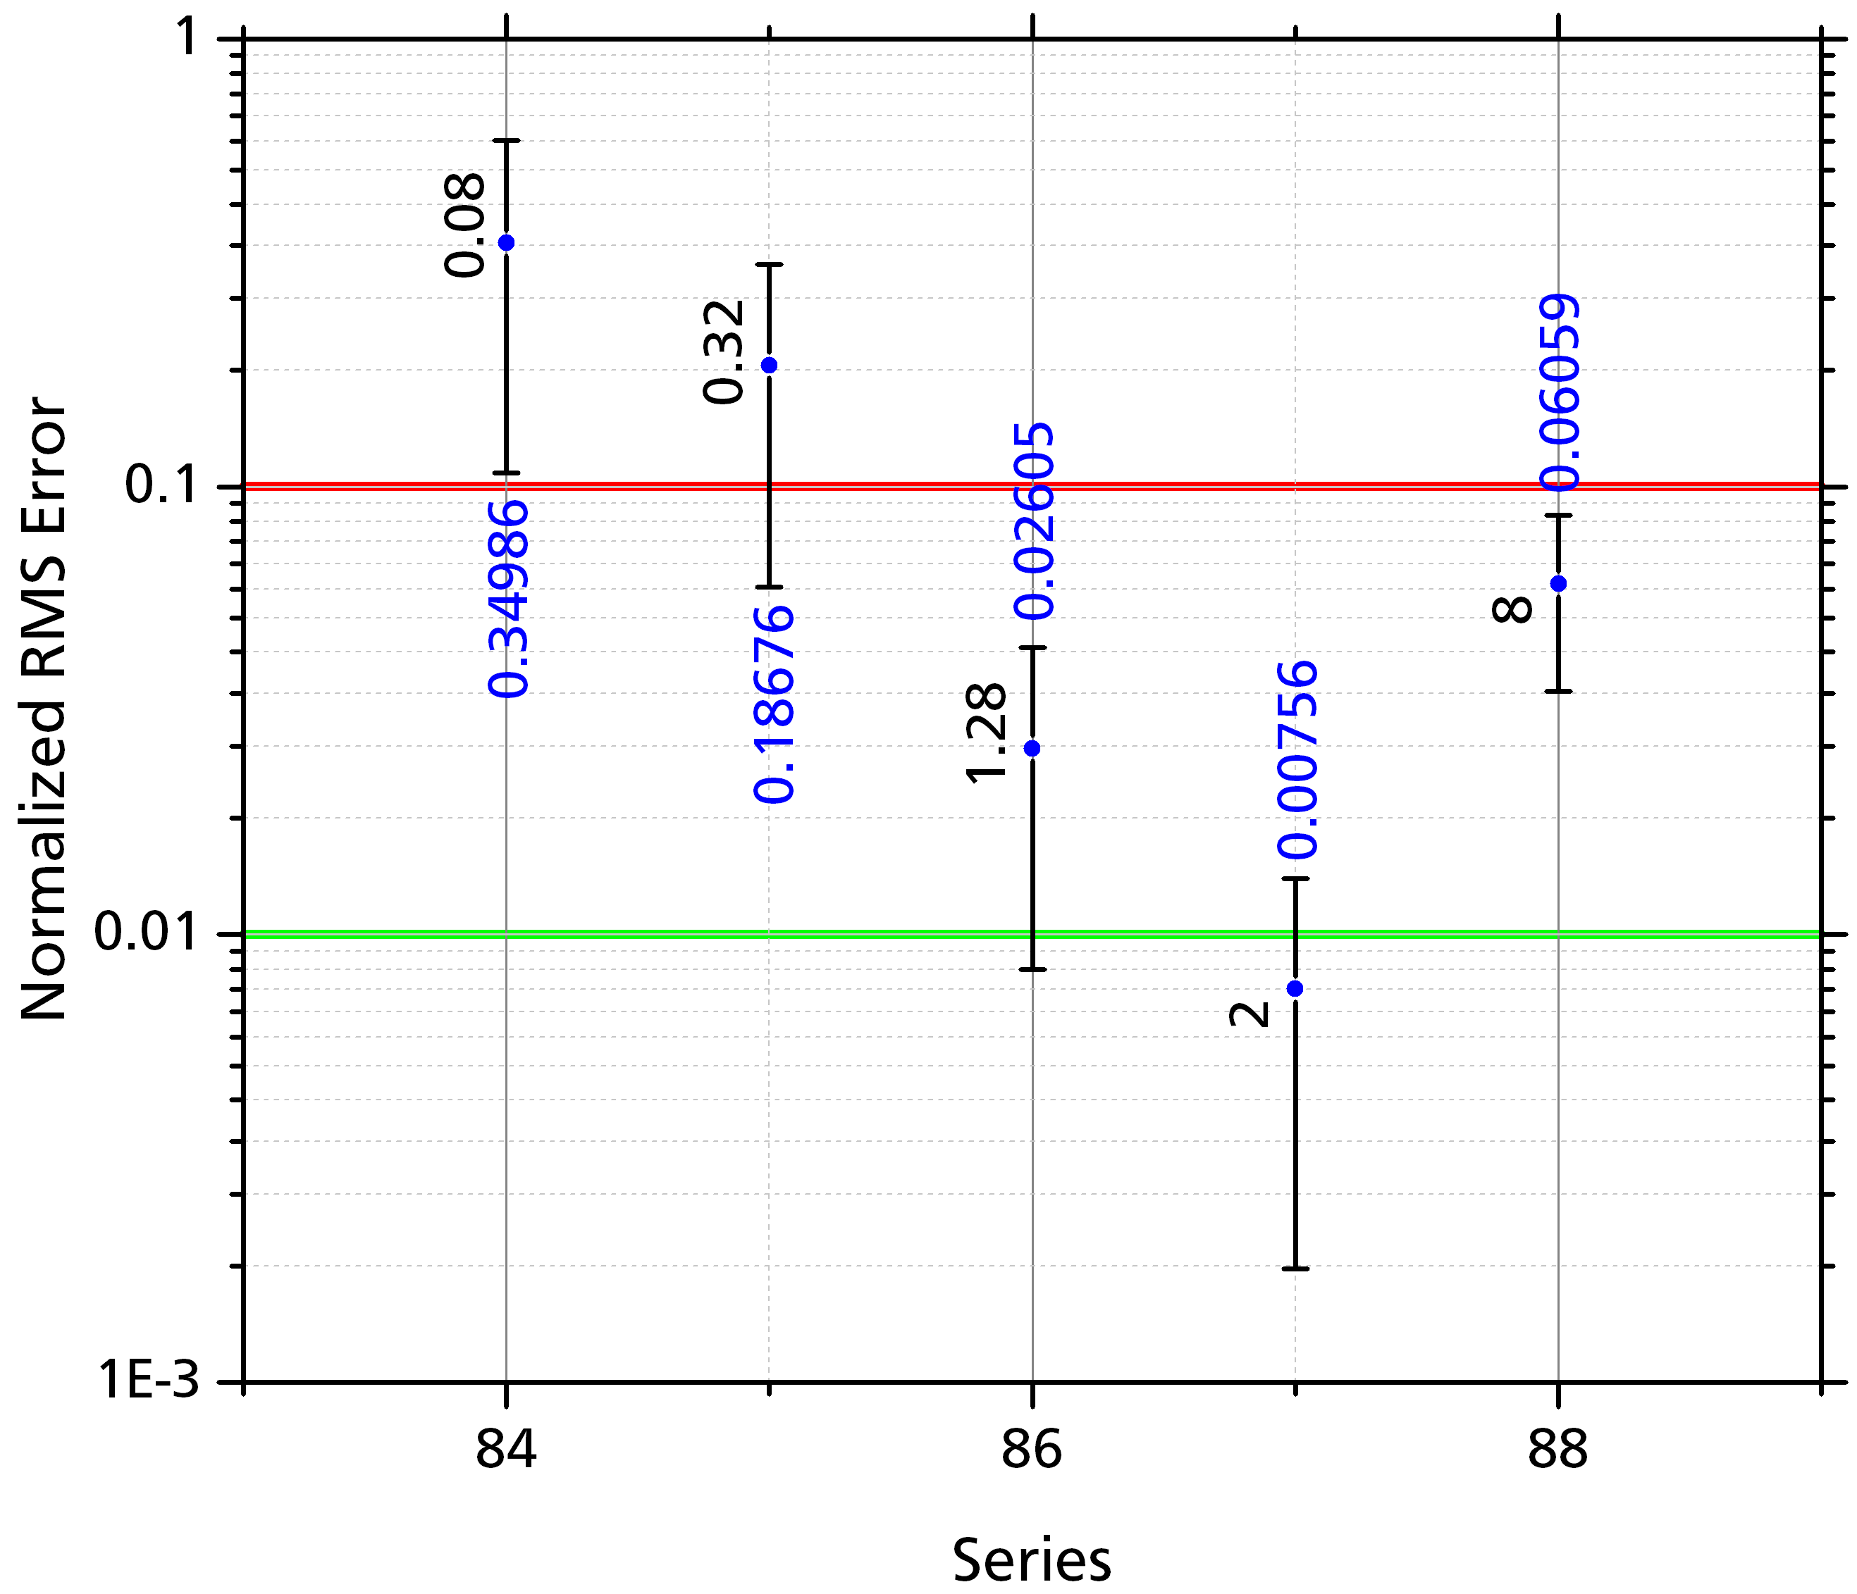
Variation of Aspect Ratio
Extreme aspect ratio buildings were much better protected.
This is believed to be a consequence of competition with ground.
The reference has an aspect of 0.5 and shows good agreement with the aspect 2 case.
2. Brooks et al. Investigation of Lighting Attachment Risks to Small Structures Associated with Electrogeometric Model (EGM) [unpublished manuscript]. Lubbock: Texas Tech University; 2019

Slide 24
Conclusions
A stochastic model of stepped leader propagation in downward negative lightning with inclusion of final jump process was developed.
  Large volumes of simulated lightning strikes to complex geometries can be evaluated quickly.
Large structures were found to produce worst case error.
  The simulated structure was found to be vulnerable to less than 0.5 % of lighting strikes.
  Rates were found to be weakly sensitive to height.
  Aspect ratio was found to have pronounced impact.
  Protection inset was found to be substantial.

