Slide 1

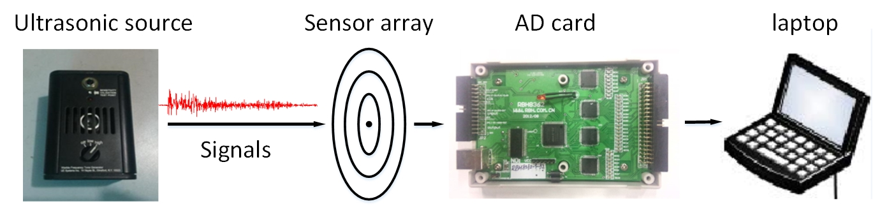
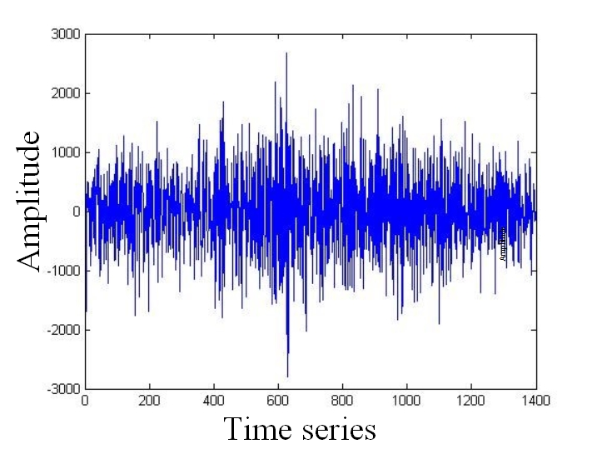
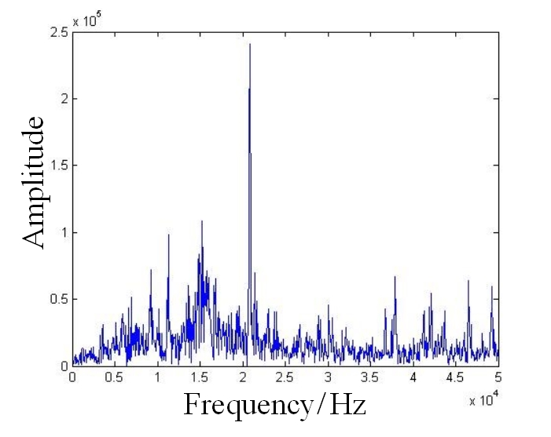
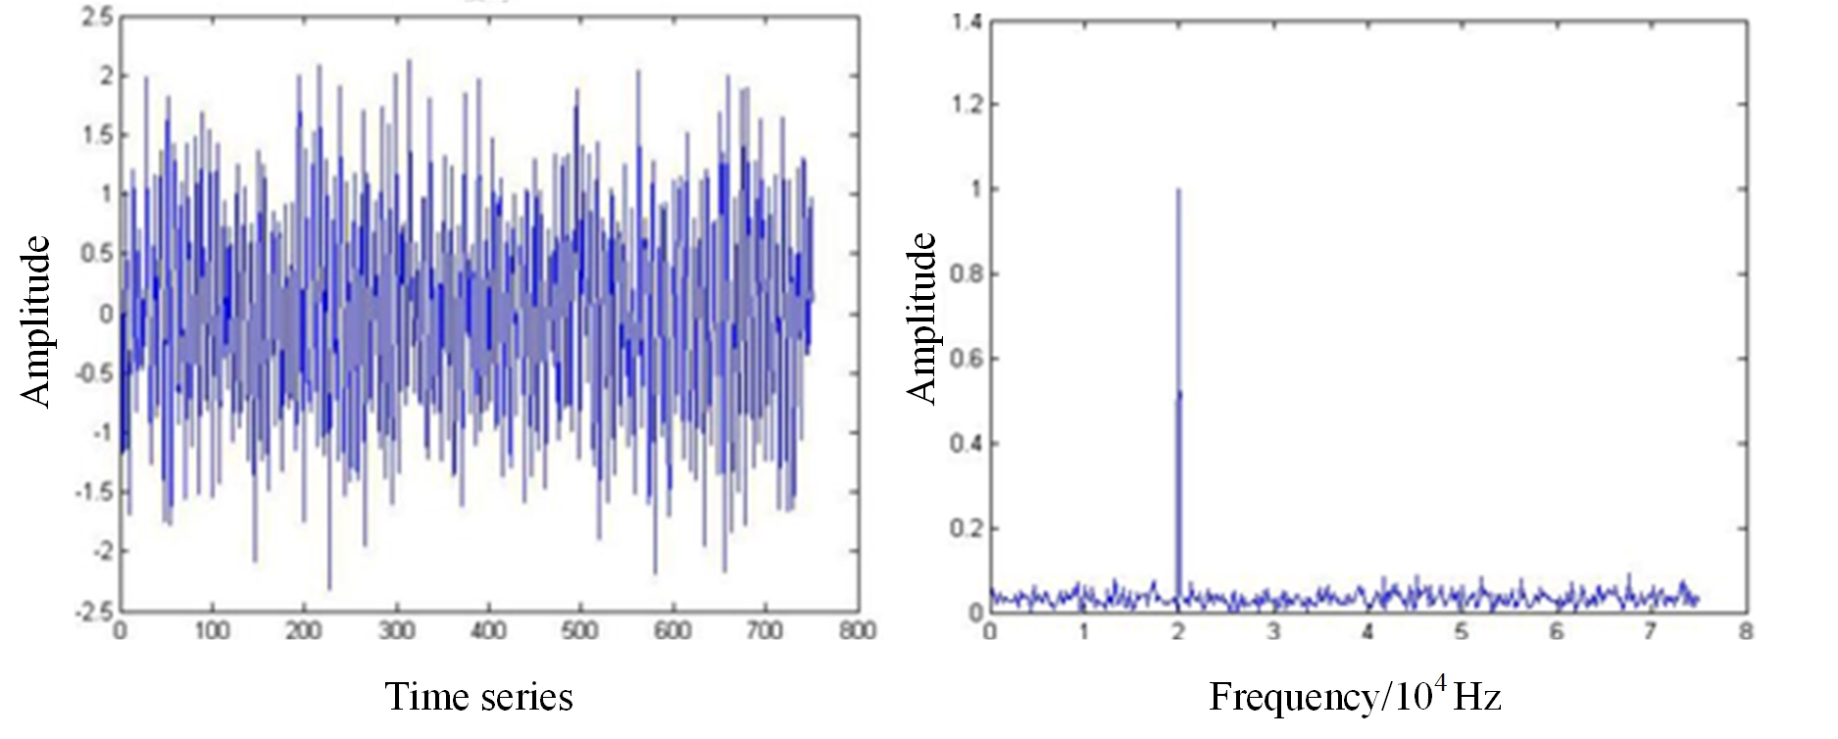
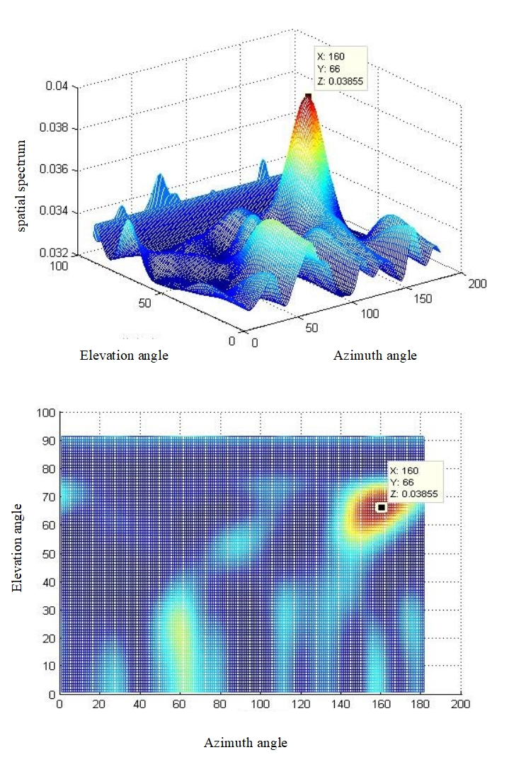
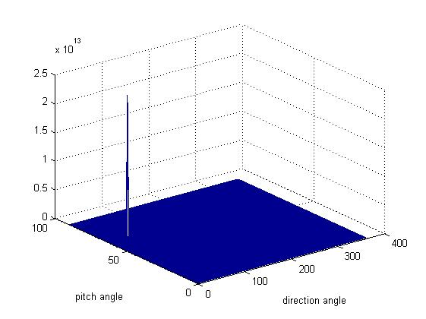
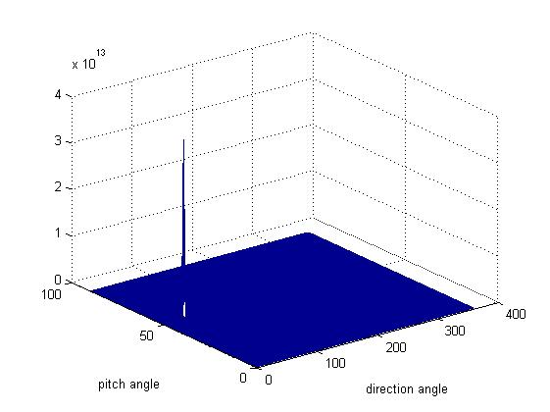
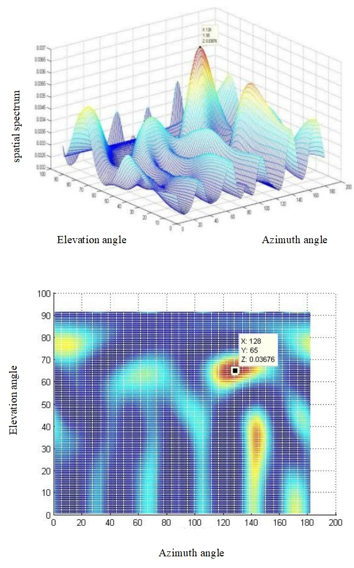
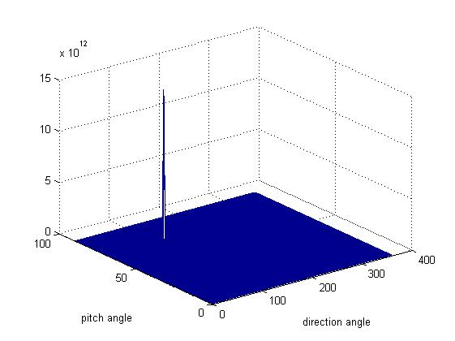
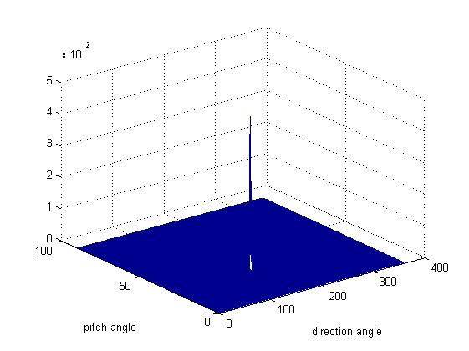
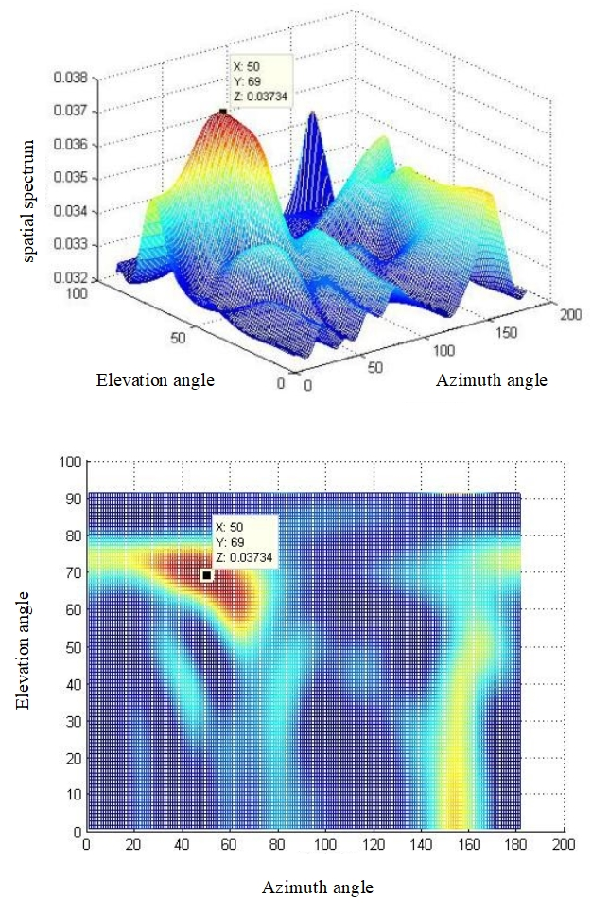
Ultrasonic Localization Research for Corona Discharge Based on Double Helix Array
Bin Wang, Ming Dong, Jiacheng Xie, Ao Ma
State Key Laboratory of electrical insulation for power equipment
Xi’an Jiaotong University, Xi’an, China
Partial discharge especially corona discharge is the main reason for the outdoor insulation deterioration. It’s necessary and valuable to locate the corona occurred outside the electrical equipment timely and accurately. Ultrasonic location method is an effective way in corona discharge detection. In this paper, a corona discharge location method based on double helix ultrasonic sensor array is proposed. Firstly, the location array and the MUSIC algorithm is introduced. Secondly, MATLAB simulation is performed to simulate a corona source which emits ultrasonic narrowband single with space noise, and this paper calculated the location results of the source using MUSIC algorithm, which is of great accuracy. Finally, laboratory experiment is also performed in the paper, and this paper successfully located the signal emitted from a transducer which emits 21kHz ultrasonic pulse signals. Based on the simulation and experiment, the result shows that the error of ultrasonic location based on double helix array is less than 2% in MATLAB simulation and 10% in experiment, which means this array can successfully locate the corona source, and thus has potential for engineering application.
Keywords—corona discharge; ultrasonic location; MUSIC algorithm; double helix array; MATLAB simulation
Experimental Platform in Laboratory
Experiment Details
Abstract
Simulation Details
signal received by the sensor
Results
signal received by the simulation probe
(a) Location spatial spectrum with source coordinate (168°,67°).
Results
(a) Location spatial spectrum with source coordinate (44°,63°).
(b) Location spatial spectrum with source coordinate (40°,52°).
(b) Location spatial spectrum with source coordinate (135°,59°).
Conclusions
Based on the simulation and experiment, the result shows that the error of ultrasonic location based on double helix array is less than 2% in MATLAB simulation and 10% in experiment. With great acoustic performance, this array thus has potential for engineering application.
(c) Location spatial spectrum with source coordinate (119°,70°).
(d) Location spatial spectrum with source coordinate (154°,30°).
(c) Location spatial spectrum with source coordinate (57°,64°).

