Slide 1

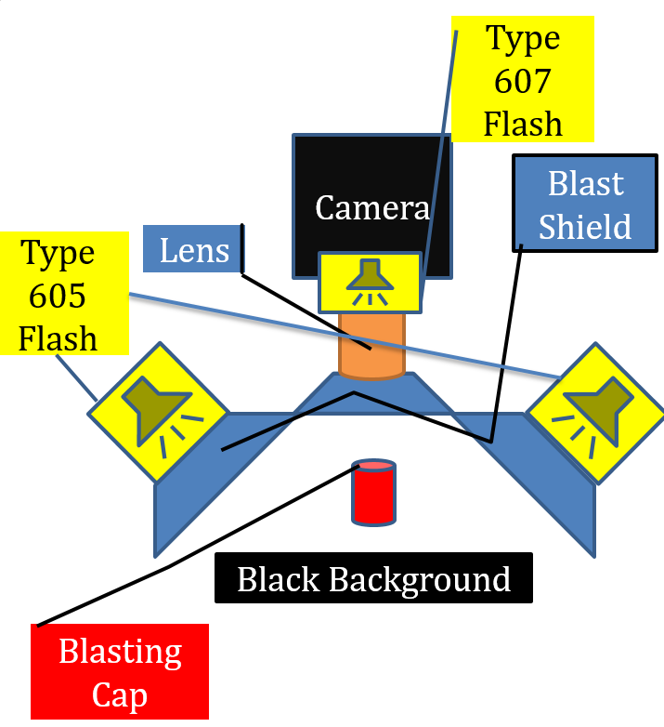
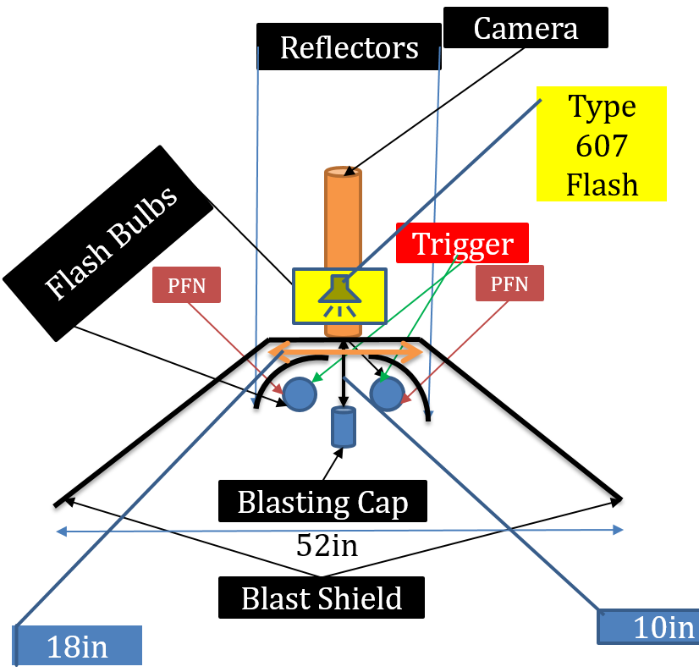
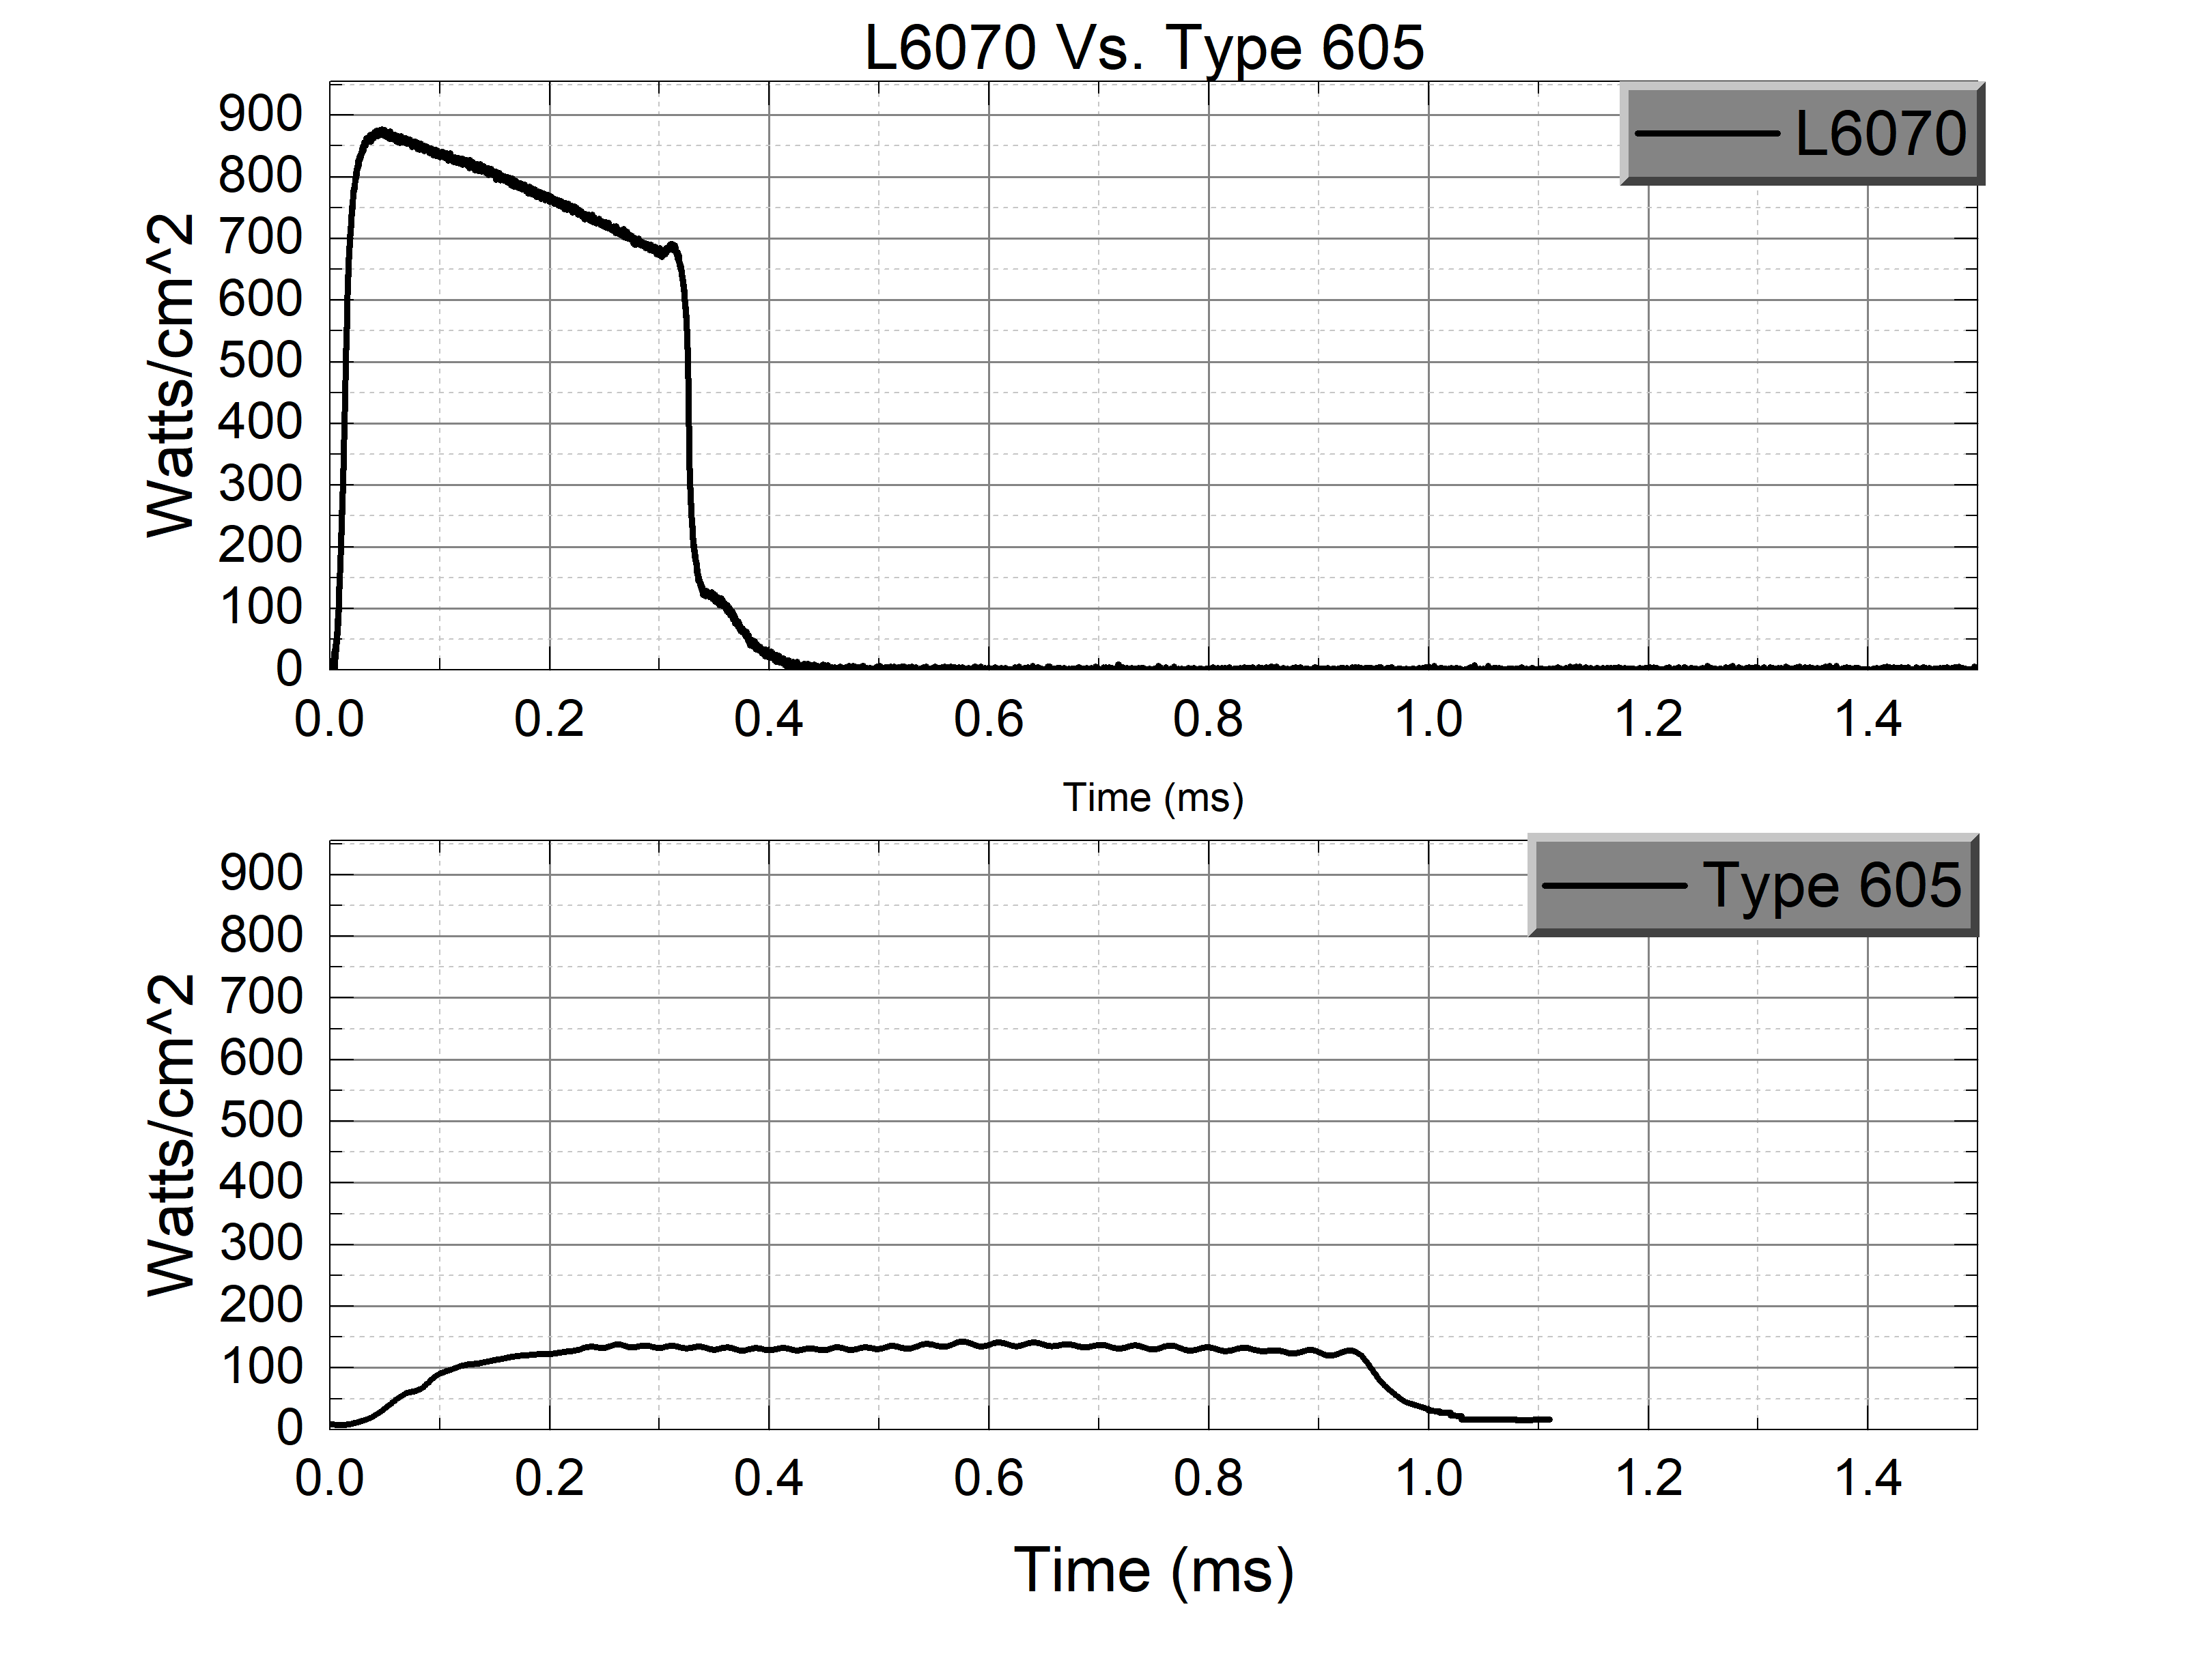
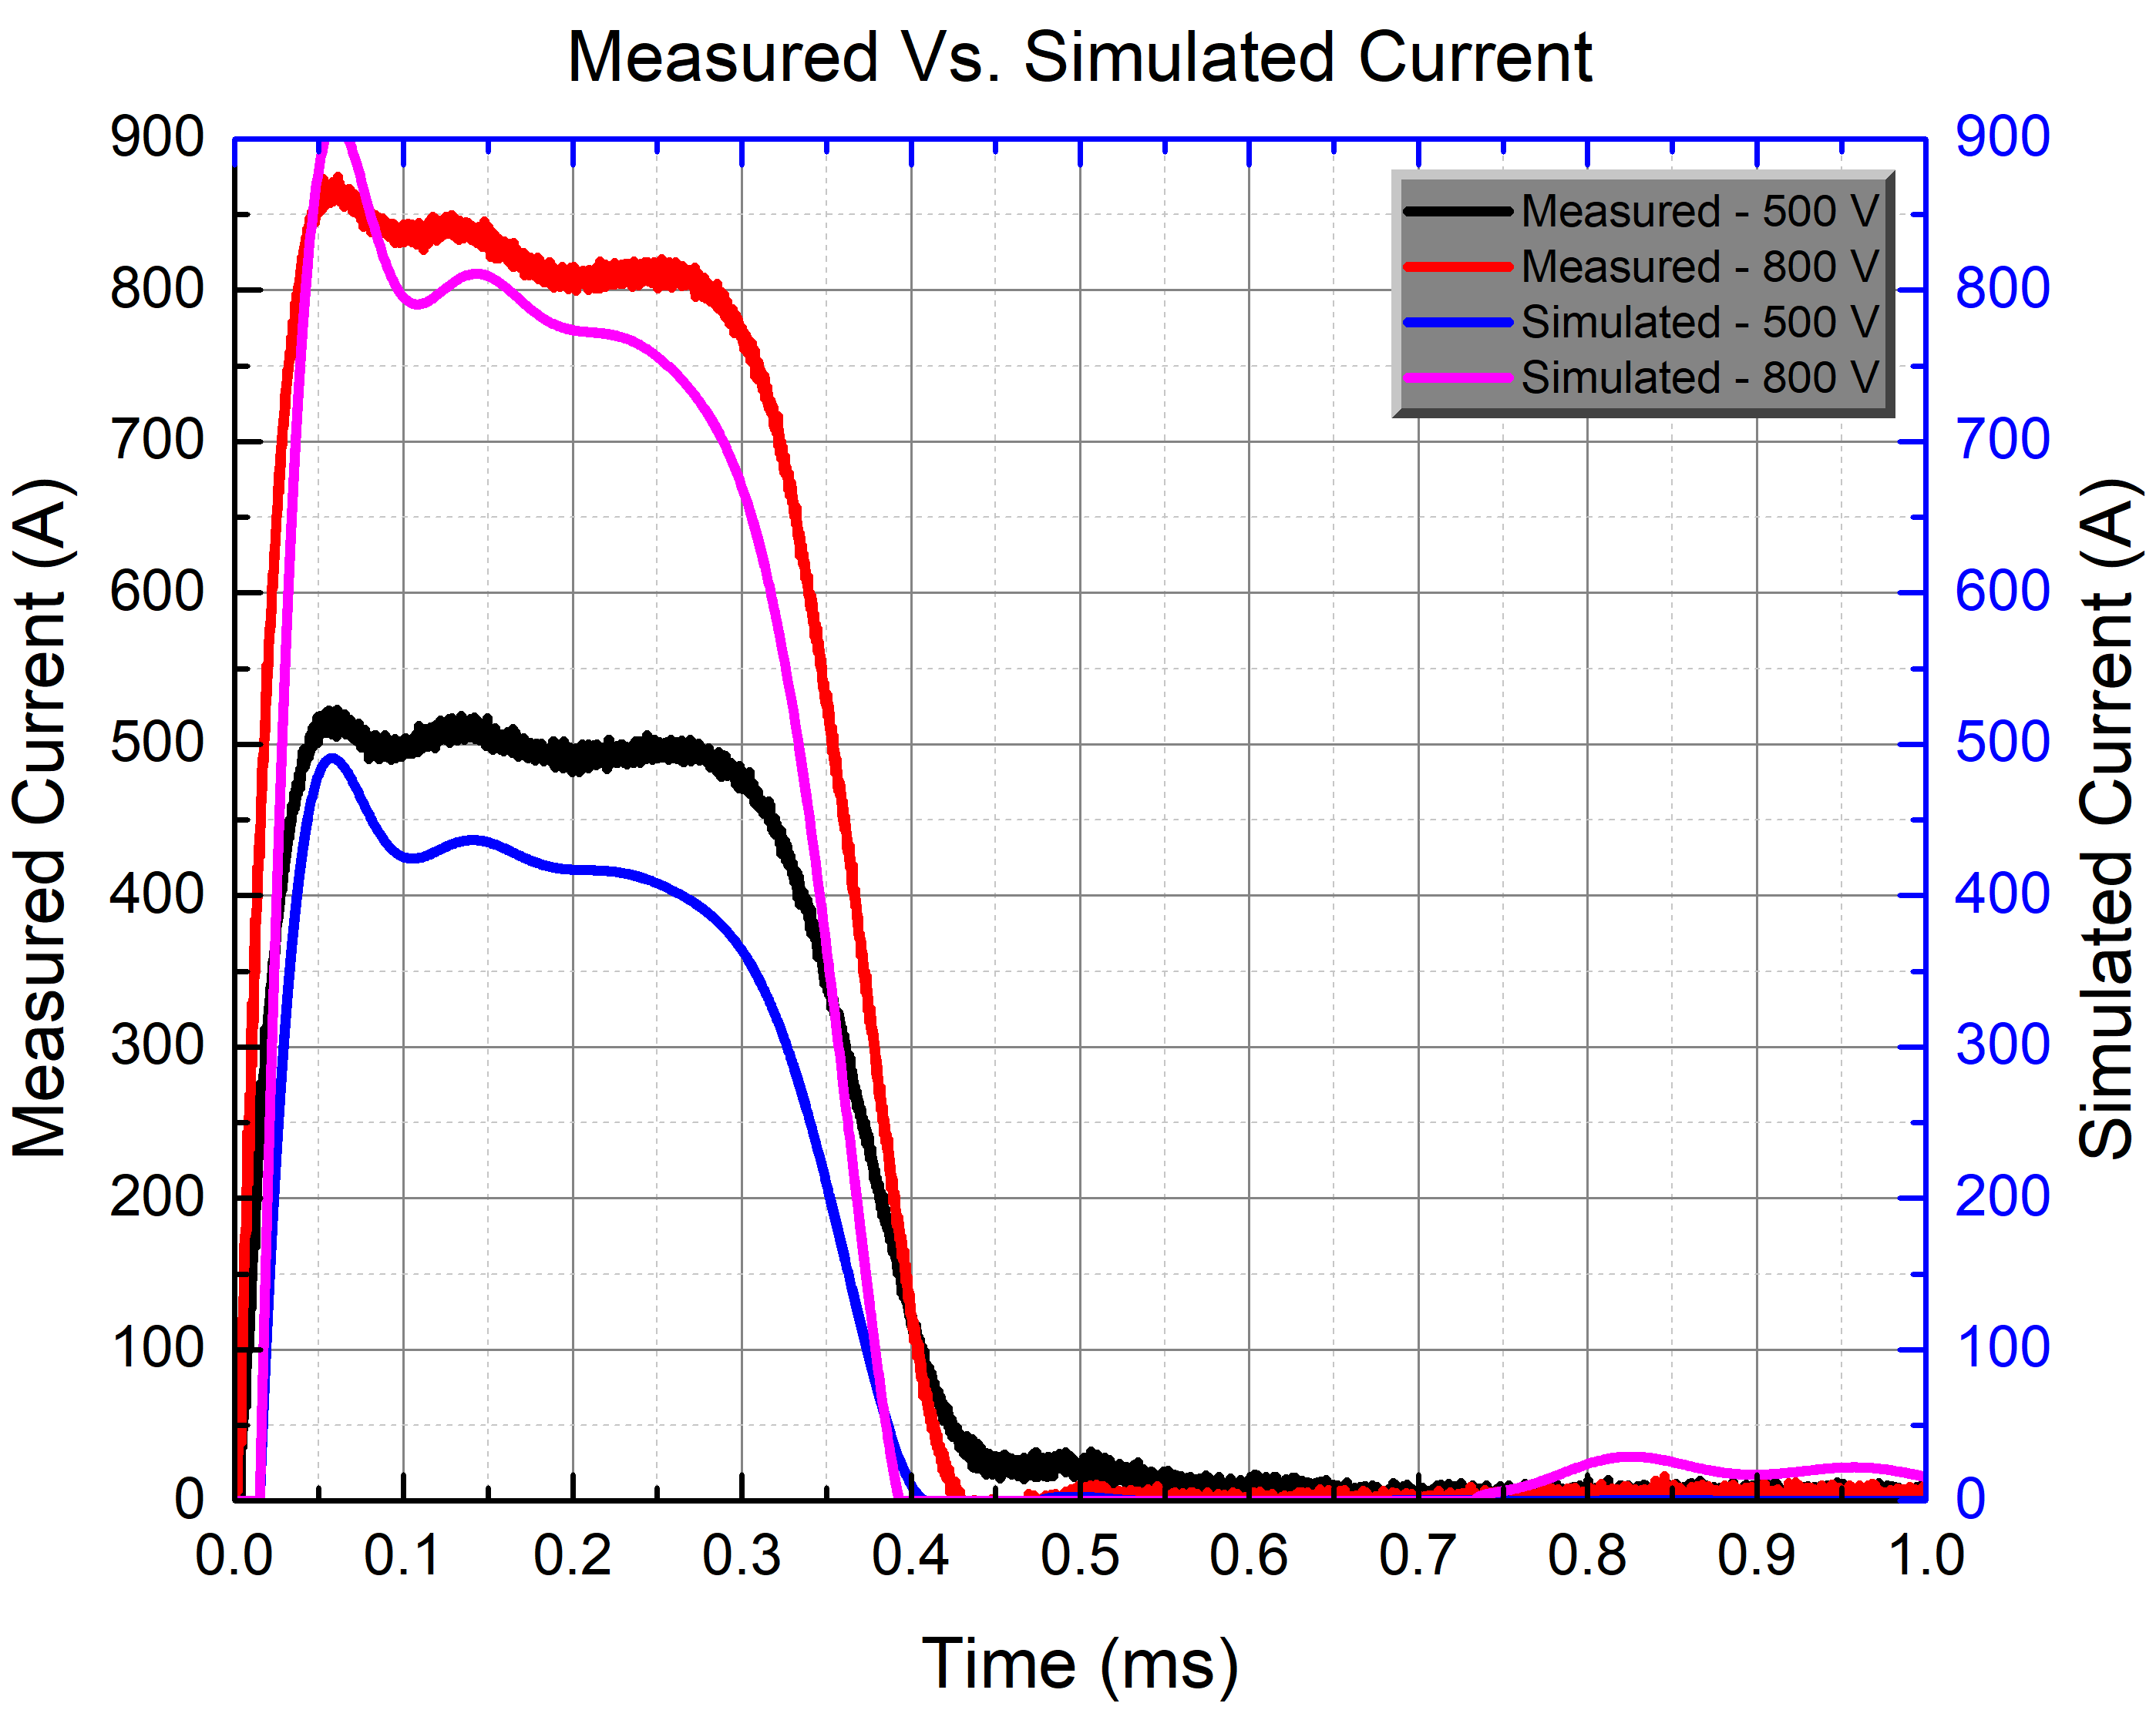
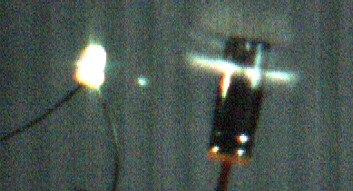
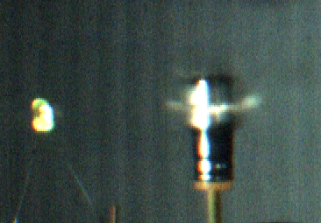
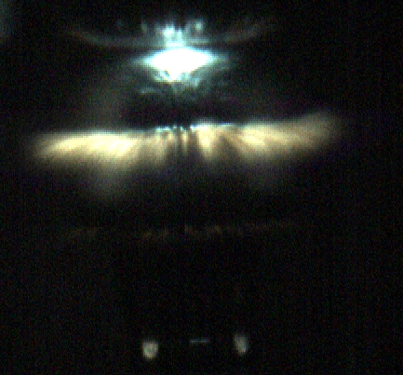

HIGH-SPEED IMAGING OF EXPLODING DETONATORS
H. J. Gaus III, D. H. Barnett, A. A. Neuber, J. J. Mankowski
Center for Pulsed Power and Power Electronics (CP³E), Texas Tech University
Abstract
Experiment Layout
This poster describes a high-speed imaging setup for capturing exploding detonators with short exposure time cameras. With three, commercially available, high intensity, pulsed xenon light sources (> 10⁷ candela intensity) satisfactory image quality was achieved for a minimum exposure time. Beyond that the combined flash lamp output was too dim at desired shorter exposure times. As such, an alternative lamp system was pursued that would provide the higher required light intensity output.
Two types of lamp arrays were designed and tested. A large lamp array comprised of a few high energy flash lamps and small lamp array comprised of many low-energy flash lamps. The large lamp array is intended for multiple shot use and is placed behind a protective sheet of polycarbonate far from the detonator. The small lamp array with low cost flash lamps is intended for one time use and will be placed much closer to the detonator. As such, these small lamps were driven beyond the manufacturer’s specified energy limit to maximize the light intensity output. Multiple six stage, Rayleigh line PFNs were constructed to deliver the lamp energy. The PFN is modeled using LTSpice to verify circuit operation. Experimental measurements on the voltage and current were collected and compared to simulated results. A photodiode is used to measure relative light intensity from the different light sources. Finally, images are shown of the exploding detonator at various frame rates.
Originally an industrial flash setup was used shown below on the left. After initial testing was preformed it was concluded insufficient light intensity was delivered to target. The custom flash arrangement show below in the right block diagram was then used. This new arrangement allows for more light to be placed on target making it more visible. The images shown below show why more light is needed on target. The type 607 & 605 are industrial flash units with the type 607 putting x10 more light on target than the 605
Objectives
Capture images on the micro-second time scale
Deliver maximum light onto target in relatively small time stamp
Design and model a PFN to verify circuit operation
Build circuit and to test design
Incorporate circuit into experiment setup and test design
Photodiode Results of Custom Light Vs. Type 605 Industrial Lighting
Reasoning Behind Switch from Type 605 to Custom Bulbs Setup
L6070
Relatively cheap
Can be placed close to target
Delivers x5 light intensity per bulb
Able to use several at same time
Used with custom reflectors
Type 605
Industrial Flash setup
Expensive to replace
Must be kept behind shield
Very weak delivery at distance
Non-customizable
Simulation
PFN was modeled in LTSpice. A current dependent resistor was used to simulate the behavior of the flash bulb. The resistance of the bulb is Where $R=\frac{K_{0}}{\sqrt{I}}$ $K_{0}=k_{0}∗\frac{l}{d}$ and ($k_{0}$ = gas constant of xenon)(l = arc length)(d=bore diameter)(I is the current across the bulb(1). The following images show the output and schematic.
320k FPS 720k FPS 1.62M FPS
References
1. Optimal Design of Pulse Forming Networks and Flashlamps for Thermal flash Processes. (2004). In: 12th IEEE international Conference on Advanced Thermal Processing of Semiconductors. Portland, OR: IEEE, p.80.
IEEE International Power Modulator and High Voltage Conference 2018, June 3rd – June 7th 2018, Jackson, Wyoming, US

