Slide 1

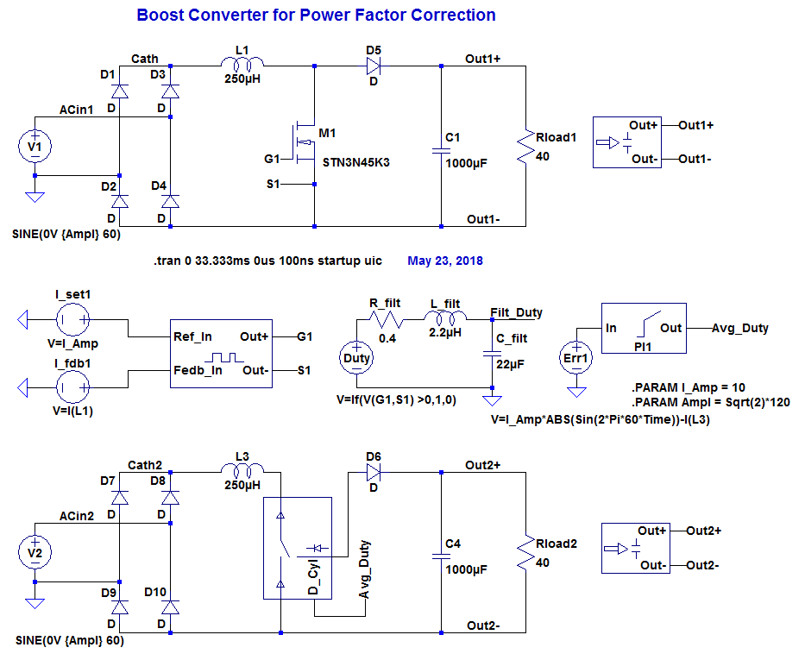
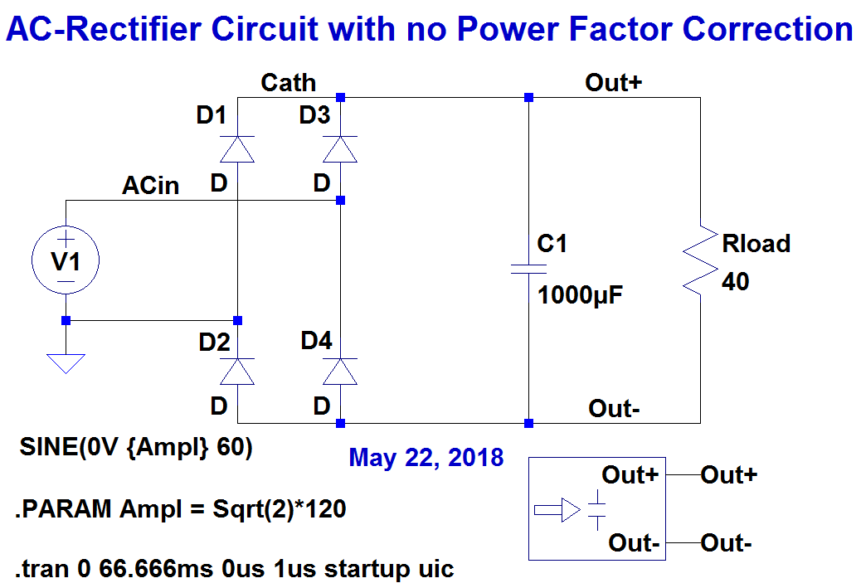
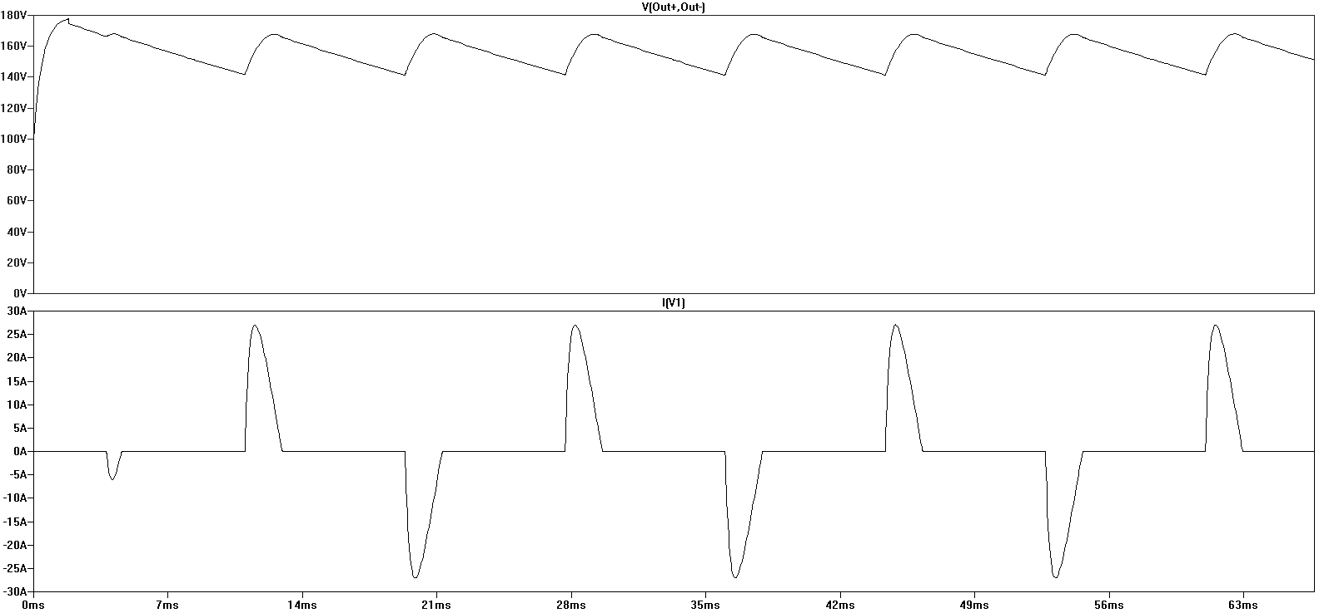
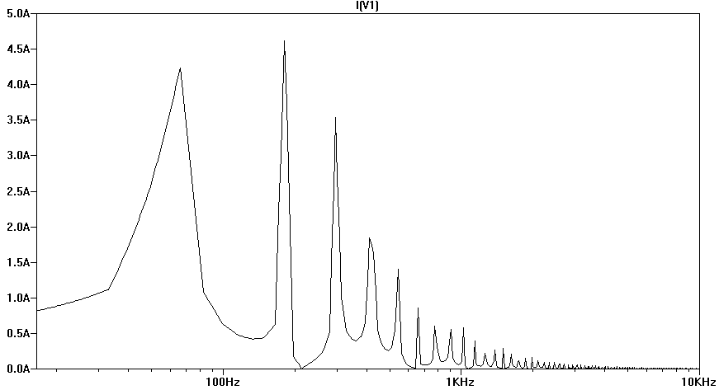
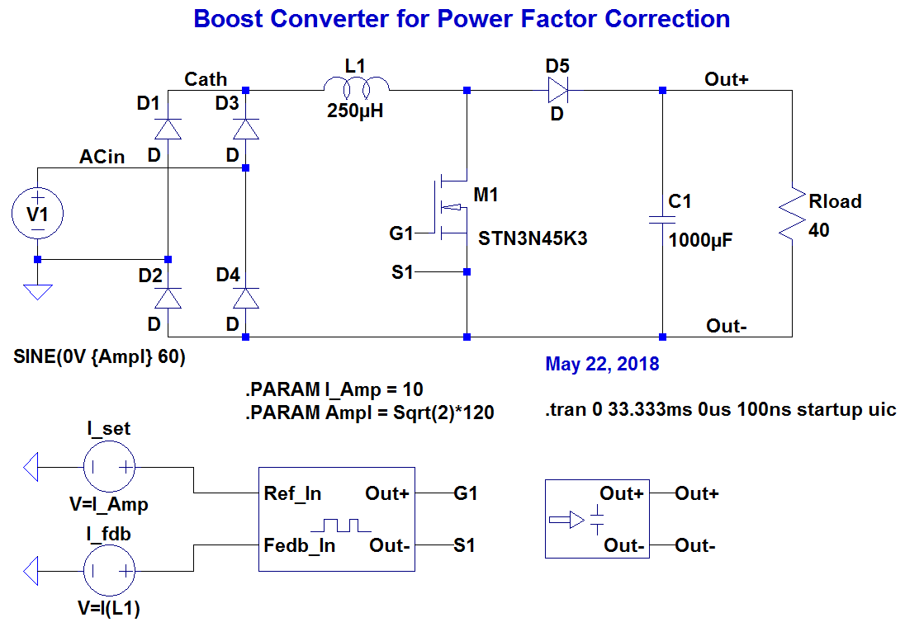
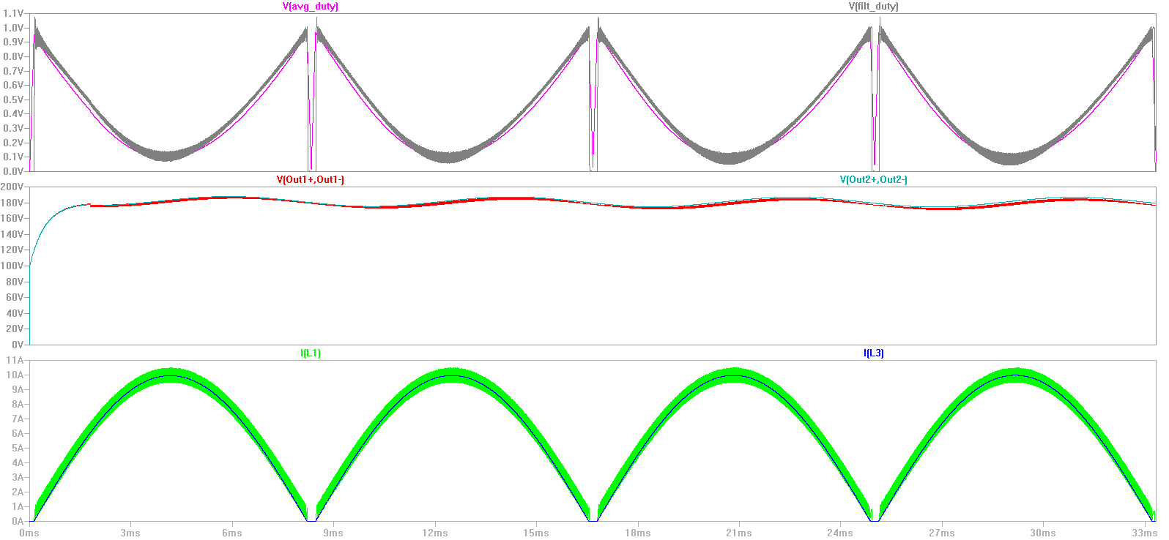
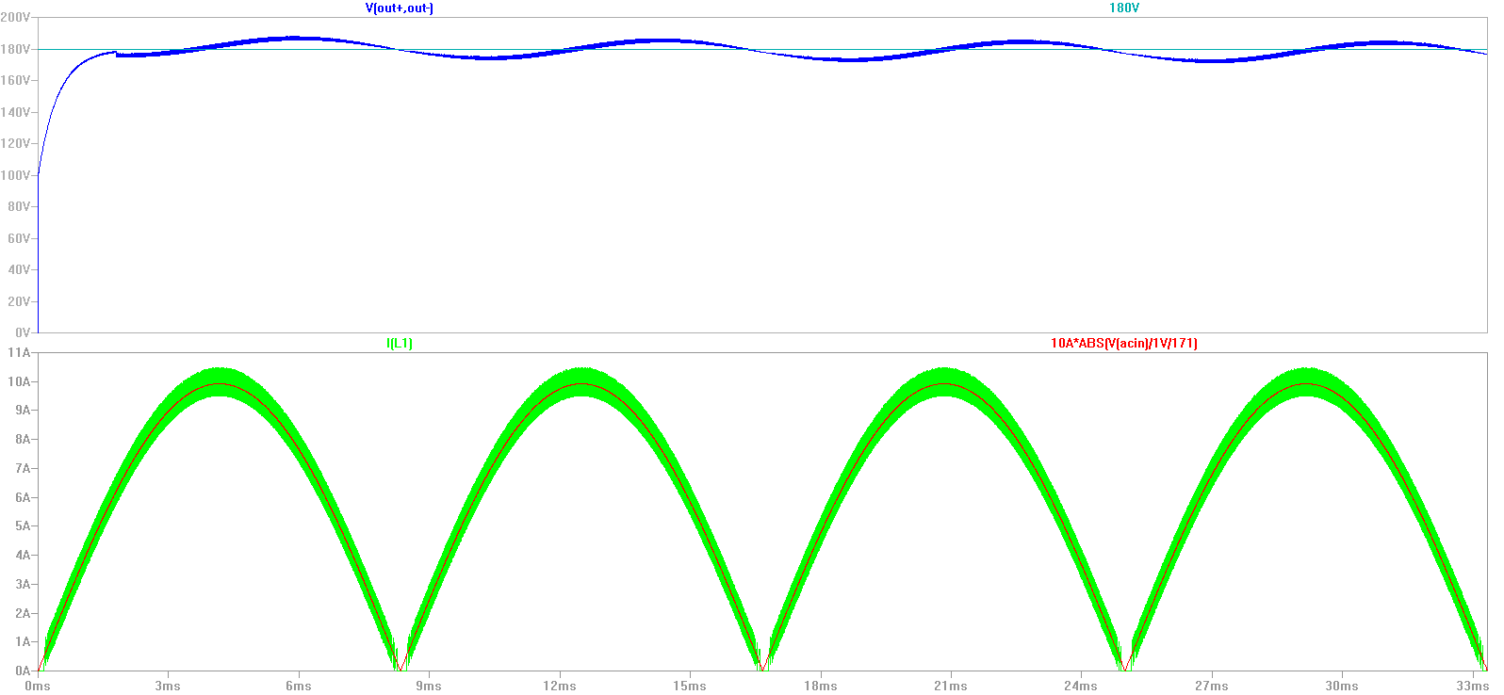
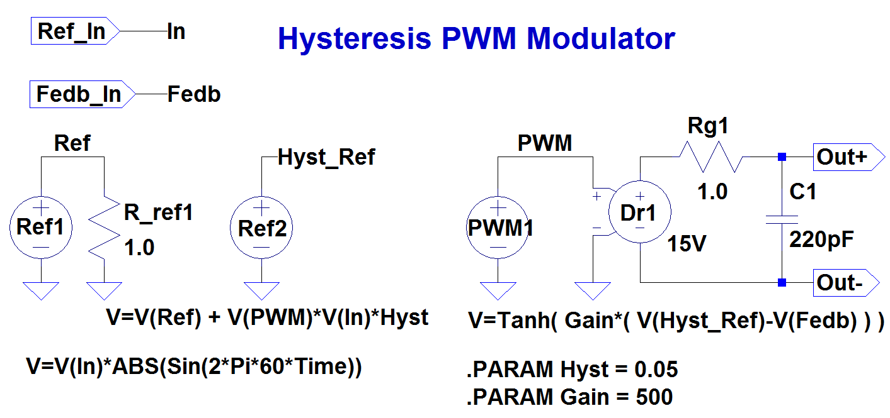
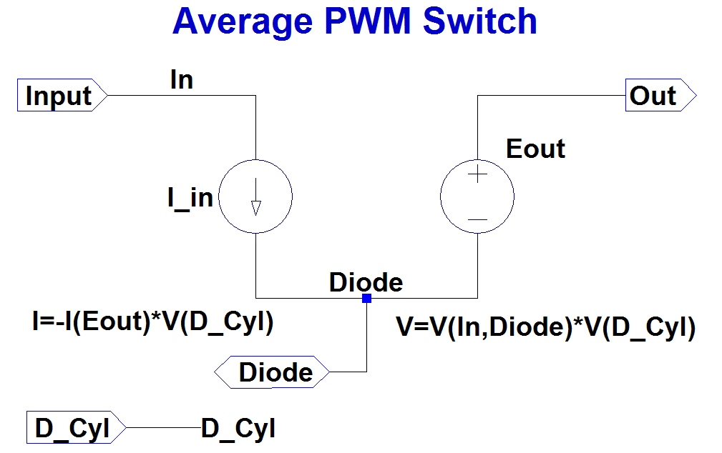
Modeling Power Factor Correction Circuits with LTspice
Michael G. Giesselmann and Vishwajit Roy
Pulsed Power Laboratory, Department of Electrical & Computer Engineering, Texas Tech University
Lubbock, Texas 79409 USA
Abstract
Circuit Simulation Models & Results
LTspice is a powerful simulation language that is specifically optimized for modeling Switch Mode Power conversion. It is not limited to small numbers of nodes and freely available [1]. We are presenting several examples of simulations for popular electronic power factor correction circuits that improve the input power factor of AC Power Supplies by active wave-shaping of the AC input current and the associated avoidance of harmonics. The simulations are performed using a cycle-by cycle switching approach as well as using a time averaged PWM model. A fast inner current loop is controlling the shape of the input current such that it matches the sinusoidal shape of the AC input voltage. A time averaged PWM model is useful for fast simulations covering many cycles to design and study secondary feedback control that regulates the output voltage of the converter.
Keywords—Boost converter; Power Factor Correction; Time Averaged models; Feedback control; LTspice
Conclusions
In this paper we have shown simulations of Boost converters used to draw a nearly sinusoidal input current from a AC source and thus avoiding harmonics. This will result in a power factor which is close to unity. We compared a conventional model that uses a cycle-by-cycle switching approach with a model using a time-averaged switch. We found that the results of both models agree very closely. Since there are no high frequency switching transitions that need to be followed, the model with the time-averaged switch can run orders of magnitude faster in a stand-alone simulation.
Center for Pulsed Power and Power Electronics
Texas Tech University
Lubbock, TX, USA
Texas Tech University
2016

