Slide 1

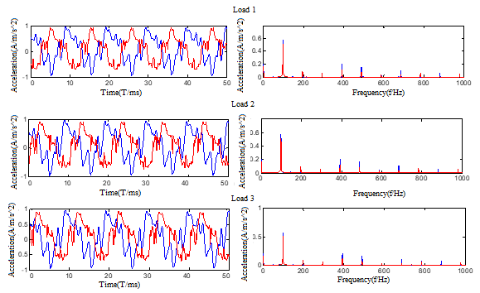
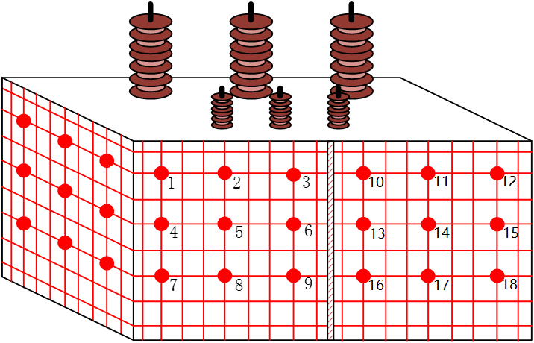
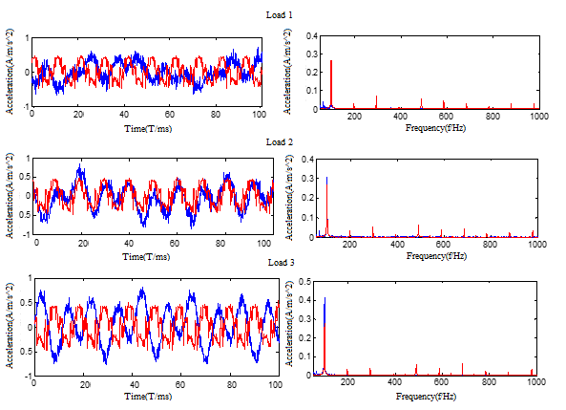

A Transformer Vibration Signal Separation Method based on BP Neural Network
  Chunhui Gu, Yu Qin, Zhiyuan Pan, Yilin Wang, Yuhang Shi, Yong Wang, Hang Zhang
  Electric Power Test & Research Institute Guangzhou Power Supply Co., Ltd., Guangzhou, China
  State Key Laboratory of Electrical Insulation and Power Equipment, Xi'an Jiaotong University, Xi’an, China
I. INTRODUCTION
The vibration signal analysis method generally analyzes the mixed signals on the surface of transformer oil tank, and the signals contain a lot of vibration information of the core and winding. The vibration of the transformer produced from the vibration sources such as winding, core and air cooling device, and then interact with each other, the final mixed signals pass through fasteners, transformer oil and other transfer media to the tank surface. If the vibration signal on the surface of the tank is analyzed directly, the mechanical state of the winding and core can’t be evaluated effectively. Therefore, it is of great significance to study the separation of vibration signals on the surface of the transformer oil tank for the transformer state monitoring technology based on the vibration signal analysis method. In this paper, the vibration signal separation technology of transformer oil tank surface based on BP neural network is proposed, which is based on the vibration characteristics of the winding and core, and its effectiveness is verified.
Ⅱ. EXPERIMENTAL METHOD AND SYSTEM
Ⅲ. TRANSFORMER VIBRATION SIGNAL SEPARATION TECHNOLOGY
BASED ON BP NEURAL NETWORK
BP Neural Network
BP neural network is a multi-layer neural network with three or more layers. As shown in Fig. 1, there are no connections between the upper and lower neurons and all the neurons in the left and right layers are all connected. The BP neural network is applicable to the case where the output signal has no feedback effect on the input signal, and is suitable for separating the vibration signals of the winding and the core.
Experimental System
According to the mechanism of transformer vibration, the no-load test and steady state short-circuit test of transformer are carried out respectively. In the no load test, the winding only has a very small excitation current, so the transformer vibration in the test can be considered as generated only by the core. In the steady state short-circuit test, when the current is large enough, it can be considered that all the measured vibration signals come from the vibration of the winding.
The mixed signals measured on the tank surface of the transformer are used as the input layer, the vibration signal of the core and the vibration signal of the winding are used as the output layer, and the two BP neural networks are constructed at the same measuring point, and the trained network is used to separate the mixed signal. And winding vibration and core vibration are obtained. The test transformer used in this paper is a three-phase test transformer, and the layout of measuring points is shown in Fig. 2. The parameters of the transformer are SY-50/10, 50KVA and 10kV/400V.
The vibration signals under 400V no-load condition, which all are considered to come from the core, are used as the output layer. The mixed vibration signals under different load conditions are used as the input layer. The core neural network is built. And then, the vibration signals under 80A steady short circuit condition, which all are considered to come from the winding, are used as the output layer. The mixed vibration signals under different load conditions are used as the input layer. The winding neural network is built.
In order to test the separation effect of neural network, keep the condition of 400V, and different load test are carried out. The measured mixed vibration signals are used as the new input layer, and the vibration signals of the core and the winding are calculated by the learned neural network. The vibration signals of the core and the winding are compared with the corresponding operating conditions.
Taking the No. 1 measuring point as an example, this paper illustrates the separation effect of winding and core vibration signals based on BP neural network., as shown in Fig. 3. The blue curve is the core source signal based on the no-load test, and the red curve is the core signal separated from the BP neural network. From the time domain diagram, it can be seen that the core signals based on the no-load test is similar to the separated signals, but there is a certain phase difference. It can be seen from the frequency domain diagram that the vibration amplitude of the source signals and the separated signals at the base frequency 100Hz and the main frequency 200Hz are almost exactly the same. The effect is ideal.
Using the learned winding neural network to separate the mixed signals under different loads, as shown in Fig. 4. The blue curve is the source signal of the winding under different load conditions, and the red curve is the separated winding signal based on the BP neural network. There is a certain phase difference between the winding source signal and the winding signal separated by the neural network. In the frequency domain diagram, the vibration amplitude of the source signals and the separated signals is almost exactly the same, and the separation effect is generally ideal.
Fig. 1. BP neural network
Fig. 3. The core neural network separation result
Fig. 2. Layout of measuring points
on three-phase test transformer
Fig. 4. The winding neural network separation result
Ⅳ. CONCLUSIONS
The BP neural network is suitable for the output signal without feedback on the input signal, and is suitable for the separation of the vibration signal of the transformer winding and core.
In the no-load test, the vibration of the transformer can be considered to be produced only by the core, and be used as the output layer of the core neural network. In the steady short-circuit test, the transformer vibration can be considered to be produced only by the winding, and be used as the output layer of the winding neural network.
The waveform similarity coefficient is introduced to evaluate the separation effect, and the coefficient is nearly 1. The separation effect of BP neural network is good.
Author email: 229893157@qq.com
2018 IEEE International Power Modulator and High Voltage Conference, Jackson Lake Lodge, WY -June 3rd -7th, 2018

