Slide 1



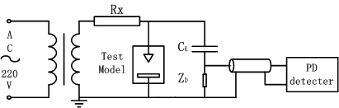
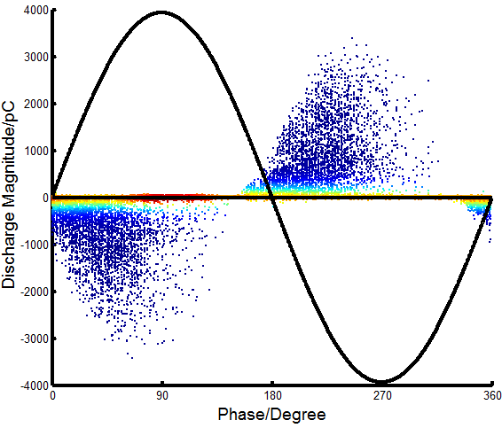
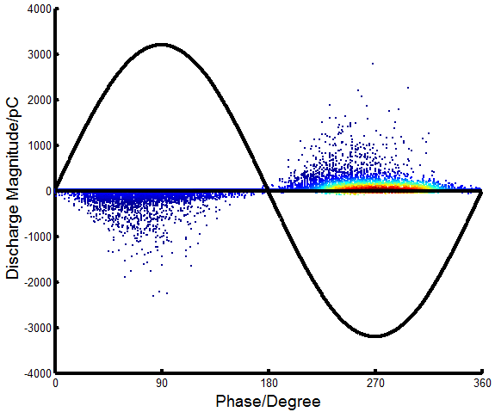
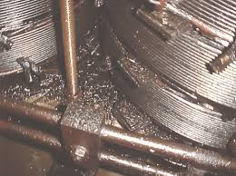
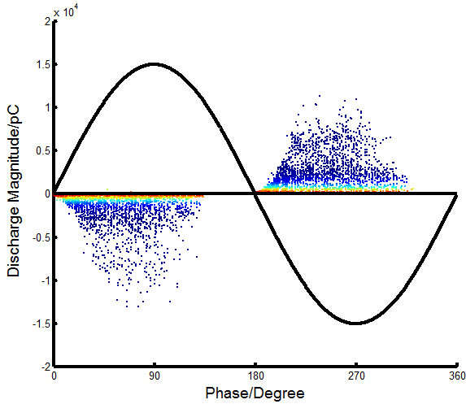
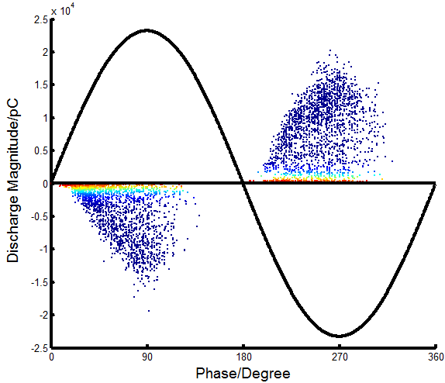
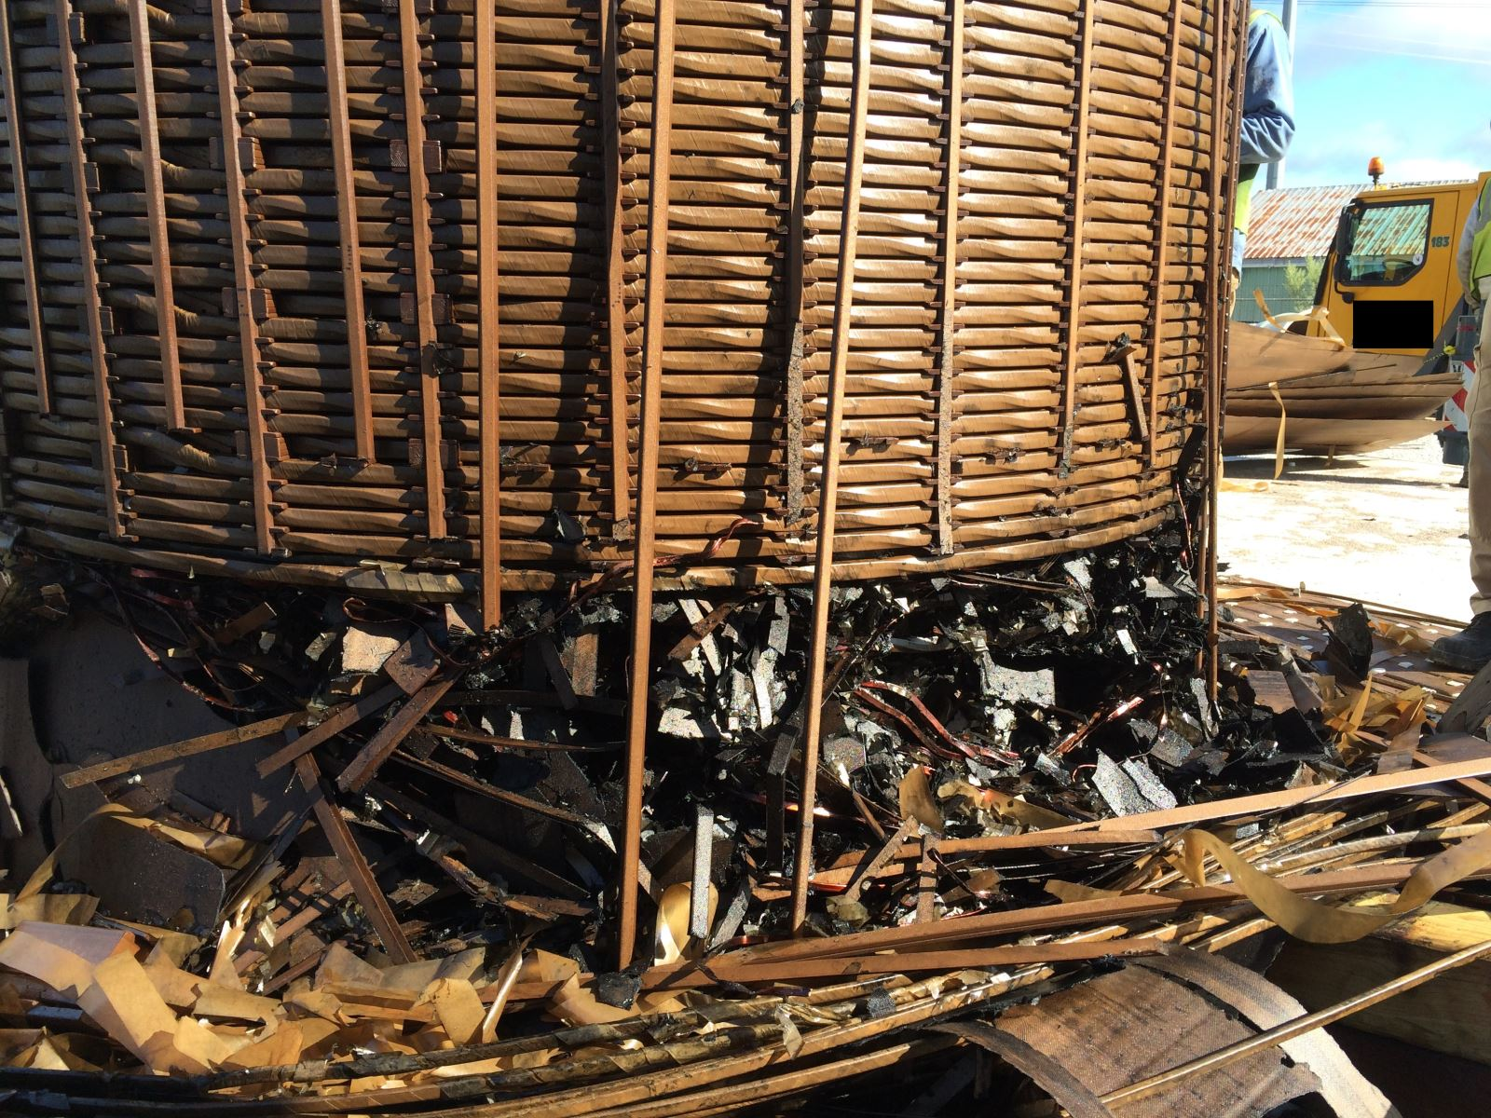
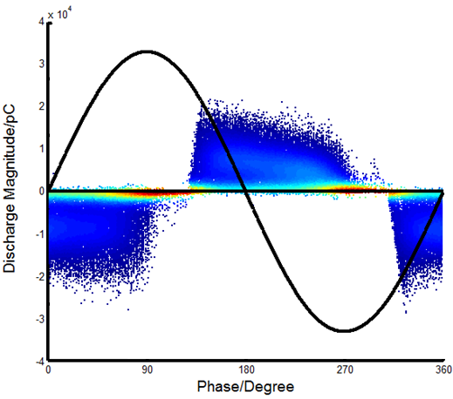
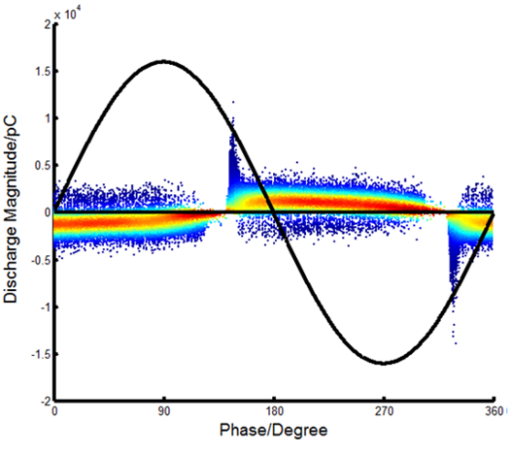
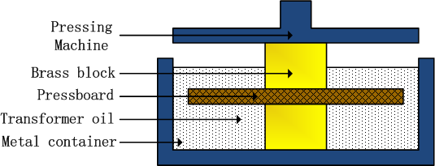
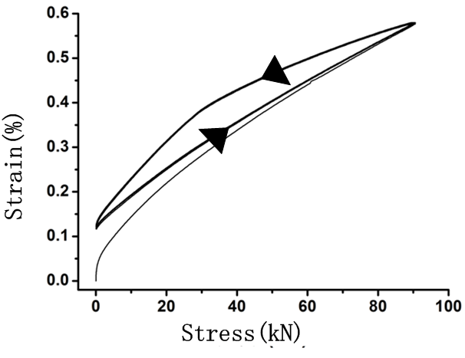
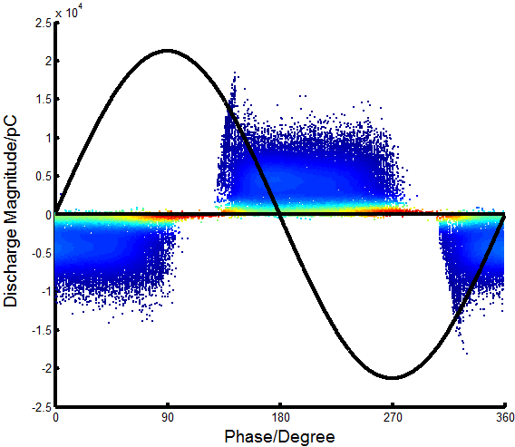
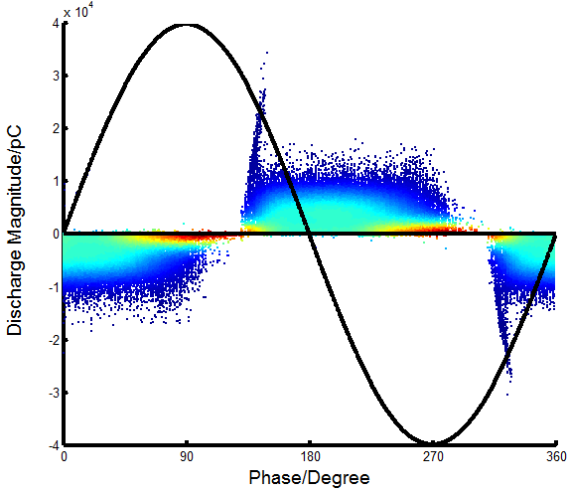
Research on Influence of Mechanical Stress on Insulation Characteristics of Oil-immersed Pressboard
Yanjie Cui, Xining Li, Lingyu Zhu, Shengchang Ji , Fan Zhang
State Key Laboratory of Electrical Insulation and Power Equipment, Xi'an Jiaotong University
E-mail: xjtuhvcyj@gmail.com
Abstract
PRPD PATTERNS
Oil-immersed pressboard are used in transformer to separate high voltage winding and low voltage winding, as well as providing structural support. Thus during normal operation of a transformer, oil-immersed pressboard will be subjected to the action of mechanical stress and constantly aging. Moreover, when the transformer suffers a sudden short-circuit, huge axial force will act on the pressboard near winding ends, affecting insulation properties of the pressboard, leading to failure of the transformer. Therefore, it is necessary to study the evolution of insulation properties of oil-impregnated paperboard under different mechanical stress. In this paper, normal mechanical stress experiments on oil-immersed pressboard were performed, and partial discharge tests of insulation pressboard after pressed were carried out in order to obtain its partial discharge inception voltage, breakdown voltage and partial discharge characteristics. Material testing machine is used to apply mechanical stress between 0 and 100 MPa to the pressboard and the strain curve is recorded as well. Insulation characteristics of pressed oil-immersed pressboard were obtained by performing both short-term and long-term partial discharge tests under point-plane electrodes. Experimental results indicates that mechanical stress on pressboard will reduce its insulation ability. As the applied mechanical stress increases, the breakdown voltage and withstand voltage time of pressboard will continue to decrease. Partial discharge inception voltage stays substantially when the mechanical stress is relatively low, but decreases rapidly when the mechanical stress is higher than 20MPa. When the mechanical stress is higher, the maximum discharge magnitude and average discharge magnitude will be higher, but the distribution phase of discharges has little to do with the mechanical stress..
New paperboard has a high discharge magnitude. PRPD has a symmetrical trapezoidal shape and the discharge magnitude reaches peak value of 25nC around the zero-crossing point. As mechanical stress is increased to 20MPa, the performance of the insulation board has been improved, and the maximum discharge capacity reduced to about 10nC. PRPD can be clearly divided into two areas, namely the peak area near the zero crossing and the original trapezoidal areas. The peak area near the zero-crossing point is narrow, and the maximum discharge generally present here. When the applied stress is raised to 60MPa, discharge magnitude rises to about 20nC. PRPD pattern shows a characteristic of typical air gap discharge. A certain amount of voids appear inside the paperboard. Maximum discharge occurs at the peak area near the zero crossing point, which is higher than 8nC in the trapezoidal area of the origin discharge. The maximum discharge reached 35nC when the applied stress is 100MPa, which is much higher than that of new pressboard, indicating that the internal damage of the pressboard is obvious at this time.
Partial discharge experiments were conducted under plate-plate electrode and needle-plate electrode. Constant-voltage method and the step-up voltage increasing method are used respectively. Since pressboard may absorb moisture during the mechanical aging process, both oil and pressboard are placed in a vacuum drying oven and dried at 80° C. for 24 hours to remove moisture before the partial discharge test.
PDIV AND dURATION
INTRODUCTION
(a)Plate-plate
(b)Plate-plate
(c)Needle-plate
During normal operation, oil immersed pressboard is affected by temperature, electric field, and mechanical force. Under the action of these stresses, the insulation material continuously deteriorates, and the properties of the material are constantly declining. When the insulation capability of material is lower than normal operating stress, defects may occur inside transformer, which may cause breakdown and leading to failure of the equipment. Therefore, it is necessary to study the aging process of insulation properties of oil-paper under the effects of thermal, electrical, and mechanical stress. In this paper, mechanical aging experiments of oil-paper insulation materials was carried out, and partial discharge tests on mechanically aged pressboard was conducted in order to obtain degradation rules of its insulation properties.
Long-term voltage test was performed on the pressed oil-immersed pressboard under plate electrodes. Size parameters of plate electrodes were manufactured according to IEC 156. When the mechanical stress is less than 30MPa, partial discharge inception field strength of pressboard actually increases, which indicates that the mechanical stress is mainly to make the paperboard denser and improve its internal fiber tightness. Partial discharge inception field strength of the board is significantly decreased when mechanical stress is greater than 60MPa, indicating that fibers inside the pressboard are pulled and. Some fibers are fractured, forming voids and a lot of debris, leading to a significant reduction in the PDIV. Duration time of paperboards with different degrees of extrusion under long-term voltage is also different. When mechanical stress is less than 20MPa, the duration time will be prolonged with the increase of the mechanical stress, and it can reach up to 6500s at 20MPa. When the mechanical stress is higher than 20MPa, the duration time decreases rapidly with the increase of the mechanical stress, and the duration time of the pressboard subjected to 100MPa mechanical stress is only about 200s.
PDIV of mechanical stressed pressboard under needle-plate electrode is shown in Figure 7. When the applied stress is less than 20 MPa, PDIV is maintained approximately at 19 kV. However, PDIV rapidly when applied stress is higher than 20 MPa, reaching a minimum of 9 kV at 100MPa, which is only half of the new board.
(a) 0MPa
(b) 20MPa
PRPD patterns
(c) 60MPa
(d) 100MPa
PRPD pattern of pressed pressboard under needle-plate electrode is shown in Figure 8. PRPD plots appear as triangles under different mechanical forces, and maximum discharge magnitude is near peak value of applied voltage. As the applied stress increases, discharge decreases first and then rises, reaching a minimum of 2.5nC at 20MPa. When the applied pressure is 100MPa, the maximum discharge capacity can reach 20nC, which is much higher than 3.5nC of new pressboard, indicating that damage in the interior of pressboard is also greater. As the mechanical stress rises, the discharge near the zero-crossing point gradually decreases, and the triangle as a whole shows a tendency of shifting to the right, which indicates that the air gap discharge characteristics are continuously decreasing. Due to the increased porosity inside the paperboard, it is difficult to store a large amount of gas under the needle-plane electrode, and therefore the air gap discharge composition will continue to decrease as the applied stress increases.
EXPERIMENTAL PLATFORM AND METHOD
CONCLUSION
(a) 0MPa
(b) 20MPa
The effect of mechanical stress on oil immersed pressboard varies greatly according to different applied stresses. When the applied stress is less than 20MPa, the mechanical stress will increase the density of fibers in the pressboard, forming a tighter pressboard in which voids will be reduced. Therefore the insulation performance will be improved, including increasing the PDIV, decreasing the discharge magnitude, and increasing the long-term voltage duration time. However, when the applied stress is higher than 20MPa, the external stress causes the fibers inside the insulating pressboard to be pressed against each other and a part of the fibers are broken. After the application of stress is removed, these fibers can no longer be restored to their original state, thereby forming new air gaps and broken fibers, weakening the dielectric strength, result in reduced PDIV, increased discharge magnitude, and shortened long-term voltage duration time. Therefore, stress higher than 20MPa should be avoided in transformer, and attention should be paid to the air gap discharge as a symbolic parameter for the effect of mechanical stress on oil immersed pressboard.
Mechanical stress is applied by a universal testing machine with a maximum mechanical pressure of 95 kN. Insulating pressboard is generally subjected to a pressing force between the windings, a brass block having a size of 3×3×1.5 cm is adopted. Brass bock is located on the middle of pressboard when applying mechanical stress. Stress-strain curve shows that pressboard is deformed when stress is applied.
(c) 60MPa
(d) 100MPa

