Slide 1

Load Capacitance Effects on the Energy Mechanism and Severity of Series dc Arcs
Eric Bauer, Bailey Hall, Matt Foster, Will Perdikakis, Jin Wang, Daniel Schweickart*, Dennis Grosjean**
The Ohio State University
Air Force Research Lab (AFRL-RQQE)*
Innovative Scientific Solutions, Inc.**
June 6th, 2018

Slide 2
Outline
► Review of Transient Series Arc Characteristics
► Arc Energy Balance & Critical Energy Threshold
► Two-Stage Energy Accumulation Mechanism

Slide 3
Hardware Test Setup
Review of Transient Series Arc Characteristics

Slide 4


Research Motivation
  How can we design the load & source impedances to prevent sustained series arcs in dc networks?
  Timescale challenge:
    Prevention: micro seconds
    Detection & Isolation: milli seconds

Slide 5
Minimum Arc Voltage
[3]
  Electrons must transition from solid medium to ionized gas
  Transitions result in voltage drops at cathode & anode—dependent on electrode materials, gas composition, current magnitude
  Minimum arc voltage (V_{column} = 0) is sum of anode & cathode drops: V_{min}

Slide 6
LC Effects on V_{min}
  Consider an abstracted dc load on a µs time scale
  Meeting V_{min} depends on inductor & capacitor voltages
  Electrode separation causes inductive voltage boost → meets V_{min} → arc occurs
  Inductive boost duration depends on stored energy magnitude, E_{L}
  After E_{L} = 0, load capacitor voltage must drop by V_{min} for arc to occur
    If drop occurs too slow compared to gap motion, arc is unlikely [4]

Slide 7
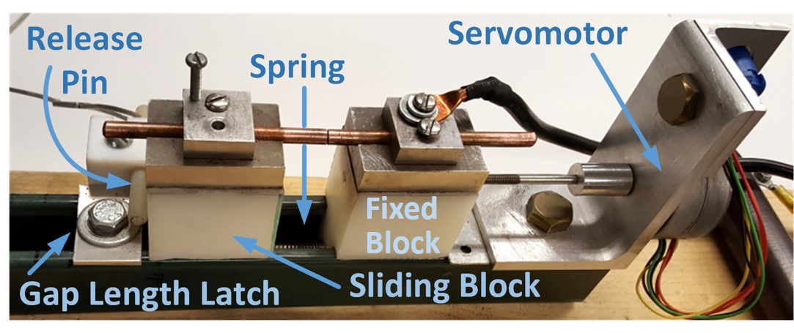
Experimental Setup [4]
  Circuit setup with variable resistor bank & Aeronvironment ABC-600 dc source
  Used spring electrode separation mechanism identical to [5]
  Recorded I_{line} , V_{gap} , V_{load} at 10 MS/s with Tektronix DPO4045B
    11-bit resolution
    100 ms record length for transient
[5]

Slide 8
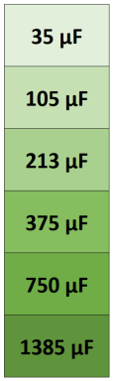
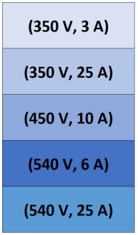
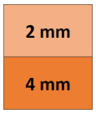

Test Conditions [4]
  Room temperature & pressure
  Round copper electrodes, 6 mm diameter
  Fixed line inductance
(V_{bus}, I_{load})
pairs
C_{load}
Terminal
Gap Length
X
X
X
= 900 tests

Slide 9
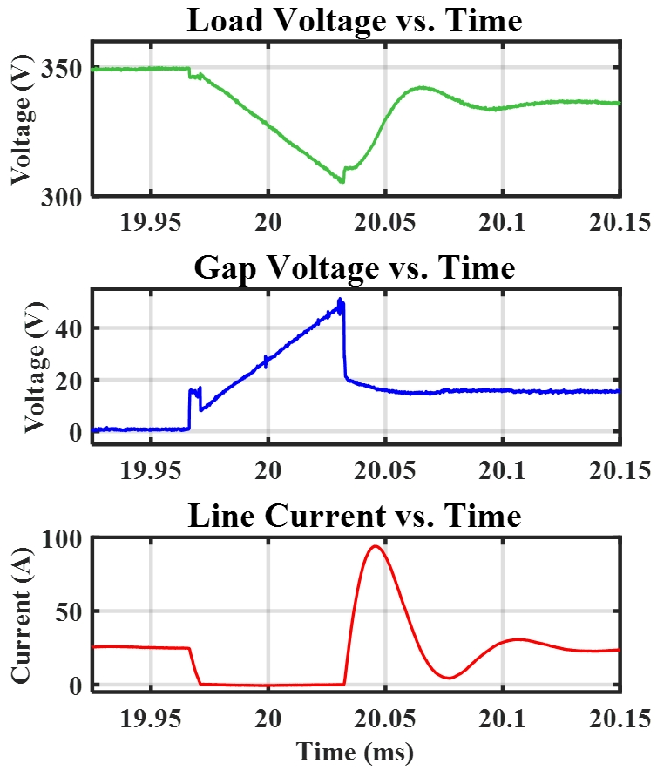
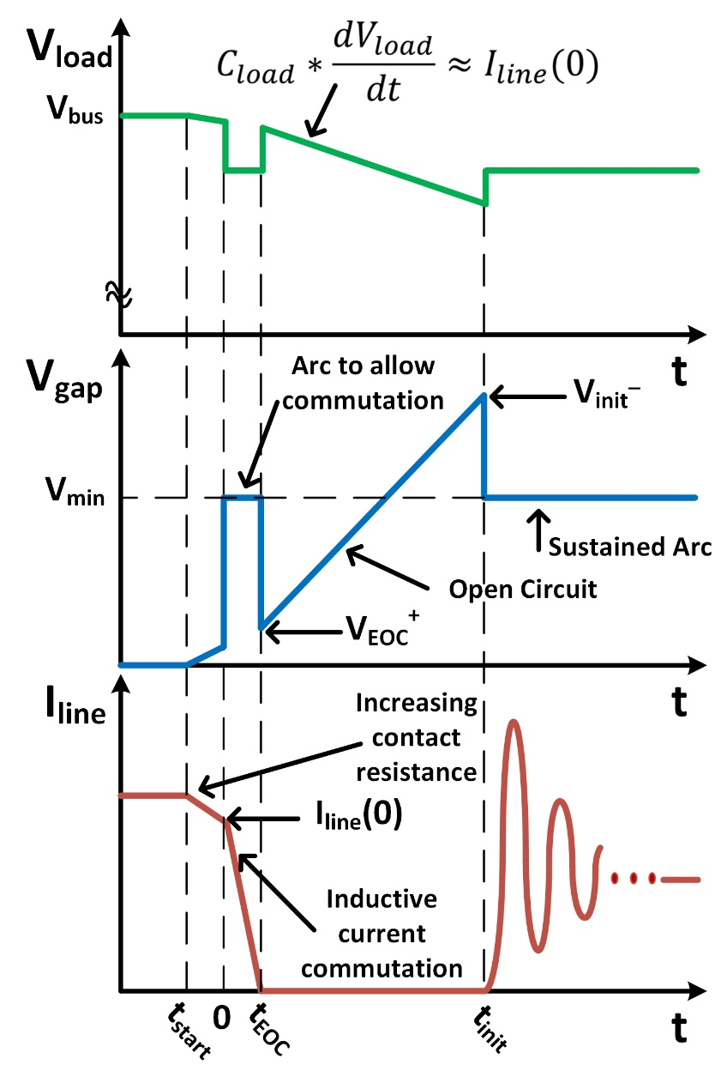
Generic Arc Transient Waveforms [4]
350 V, 25 A, 2 mm, and 35 μF

Slide 10
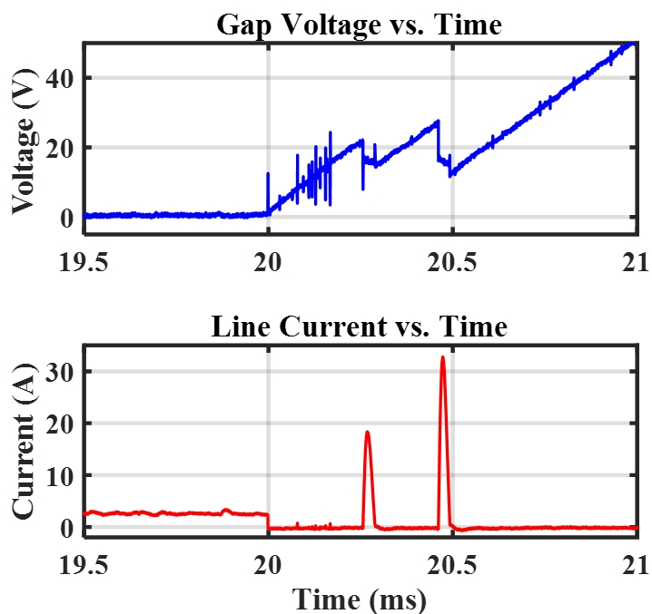
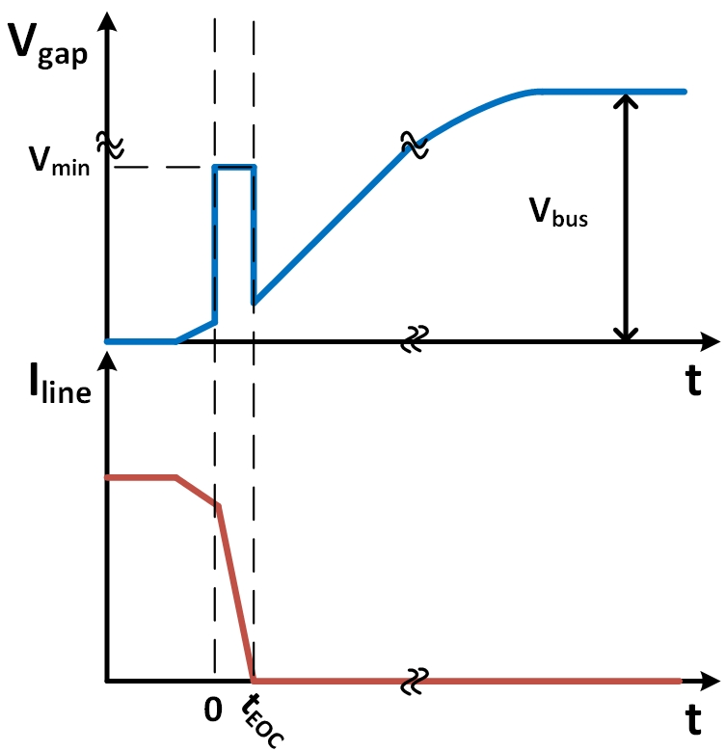
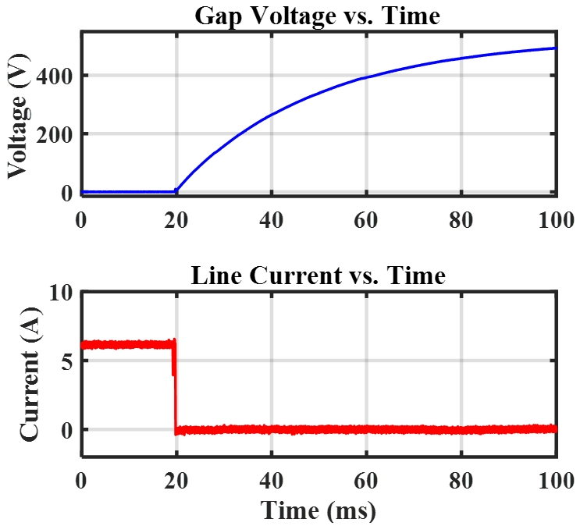
Severity: Open Circuit (575/900)
[4]
  Definition: commutation arc occurs, but re-ignition does not occur in any manner lasting more than 300 µs
540 V, 6 A, 2 mm, and 375 μF
350 V, 3 A, 2 mm, and 35 μF

Slide 11
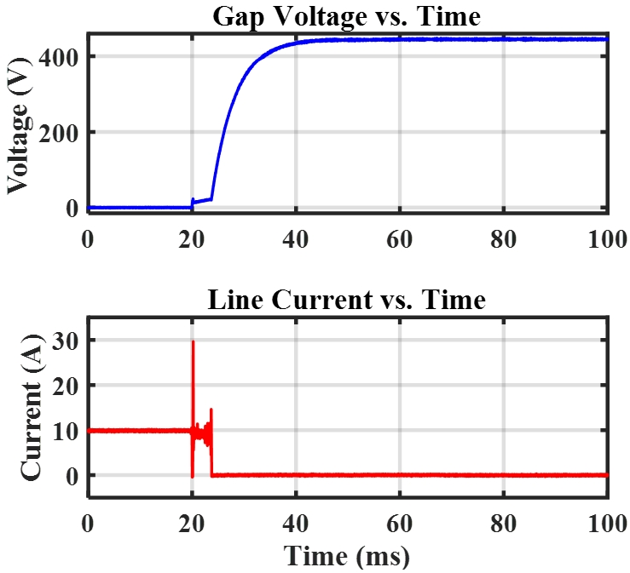
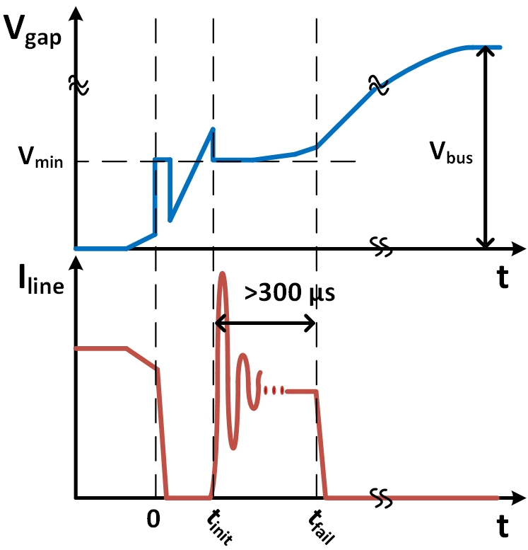
Severity: Failed to Sustain Arc (111/900)
[4]
  Definition: successful re-ignition occurs but fails to sustain after at least 300 µs and goes to open circuit
450 V, 10 A, 2 mm, and 105 μF

Slide 12
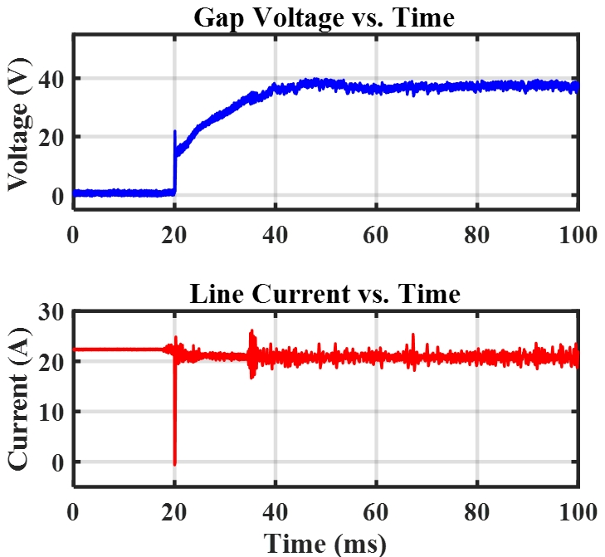
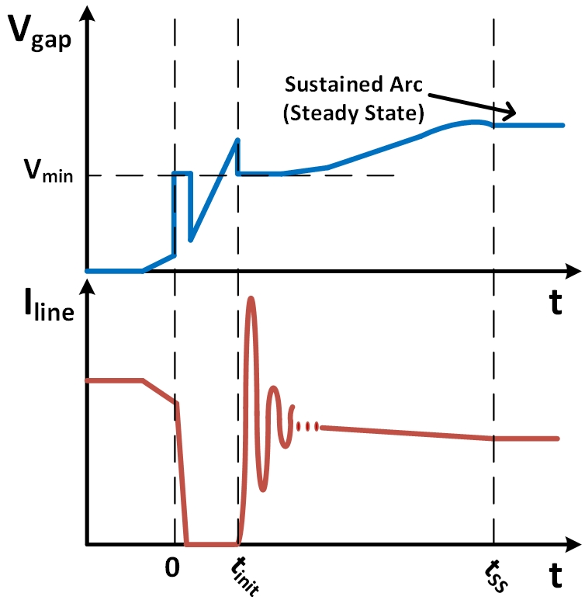
Severity: Sustained Arc (214/900)
[4]
  Definition: successful re-ignition occurs and the arc continues into steady state until power is removed
540 V, 25 A, 2 mm, and 213 μF

Slide 13
Hardware Test Setup
Arc Energy Balance & Critical Energy Threshold

Slide 14
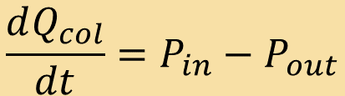
Arc Energy Balance
  Thermal ionization requires high enough column temperature
    Temperature measures the thermal energy of the column, Q_{col}
  Dynamics of column energy given by:
    P_{in} = Ohmic input power
    P_{out} = cooling power of arc
  Saha’s Equation steeply relates temperature to degree of ionization → conductance [3]
  A critical Q_{col}* threshold exists for conductive channel → arc ignition [7,8]
    Input energy increases conductance
    Gap length decreases conductance via longer path & more cooling surface area
    Using input energy accumulation, threshold estimate E* can be observed
$$\frac{dQ_{col}}{dt}=P_{in}−P_{out}$$
[6]

Slide 15
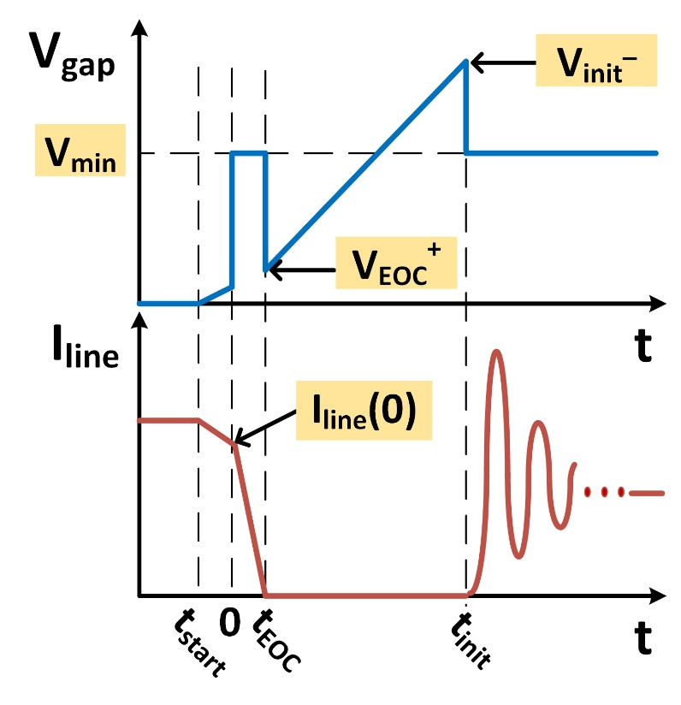
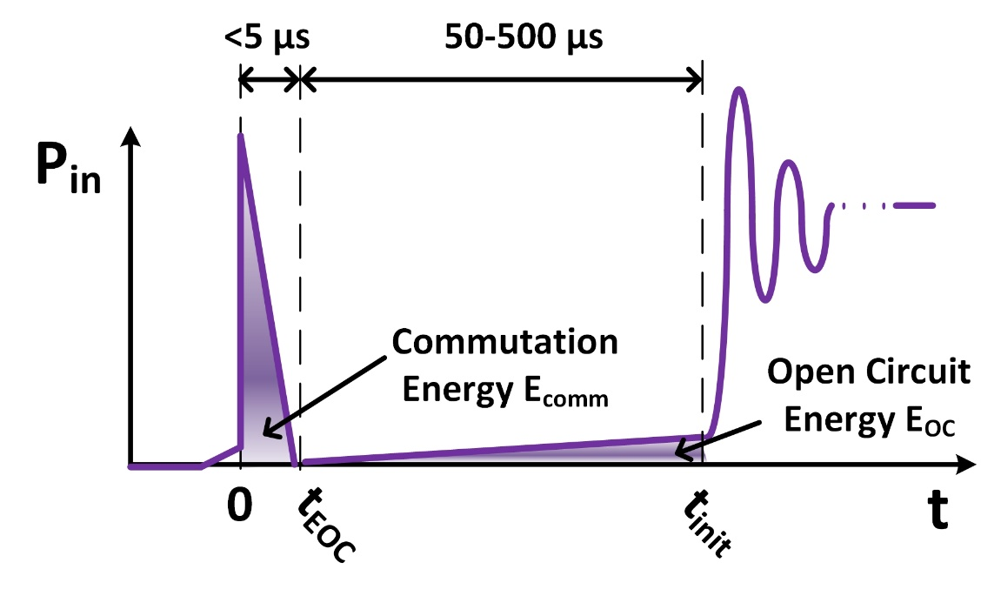
Energy Accumulation in Arc Transient
  Energy accumulation occurs in two stages of generic transient:
    Commutation Energy: stored inductive energy
    Open Circuit Energy: Ohmic losses due to residual arc conductance
  Dynamic arc conductance lags arc current due to thermal inertia [9-11]
    Residual conductance can be non-zero at t_{EOC}

Slide 16
Hardware Test Setup
Two-Stage Energy Accumulation Mechanism

Slide 17
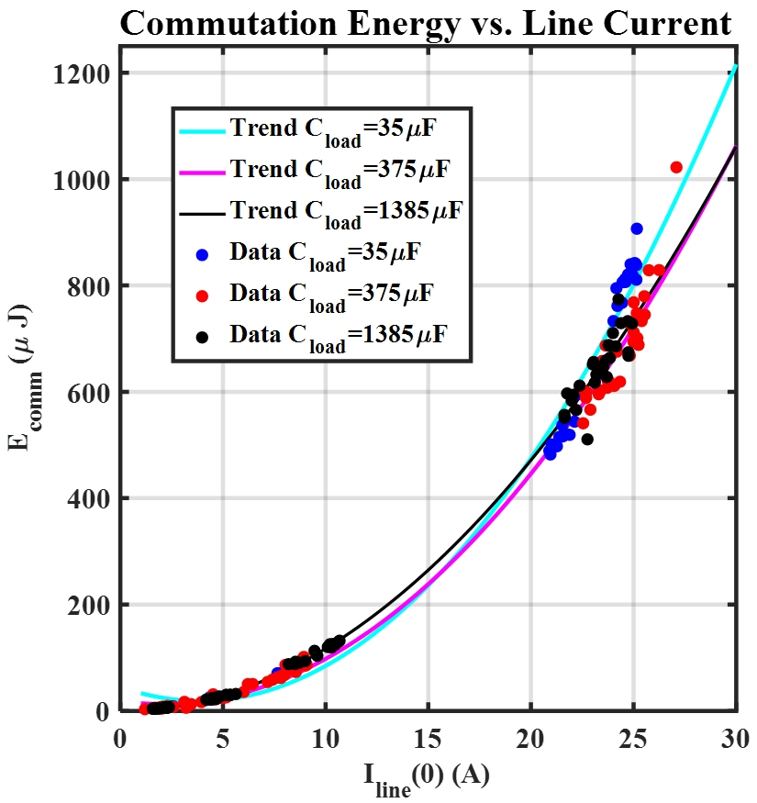
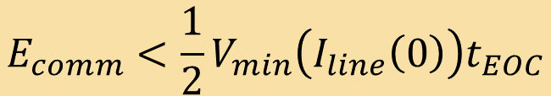
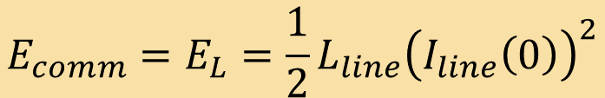
Commutation Energy
  Energy stored in the inductor at t = 0
$$E_{comm}=E_{L}=\frac{1}{2}L_{line}{\left(I_{line}\left(0\right)\right)}^{2}$$
$$E_{comm}<\frac{1}{2}V_{min}\left(I_{line}\left(0\right)\right)t_{EOC}$$
225/450 tests at 2 mm
L_{line} = 2.85 µH

Slide 18
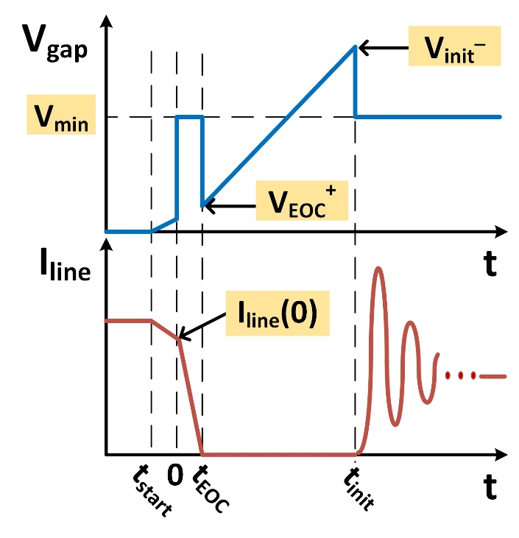
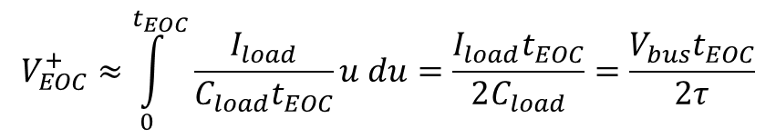
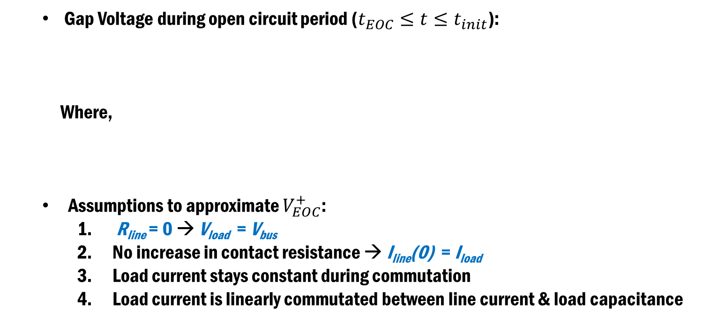



Arc Waveforms Revisited
  Gap Voltage during open circuit period ($t_{EOC}≤t≤t_{init}$):
  Where,
  Assumptions to approximate $V_{EOC}^{+}$:
    R_{line} = 0 → V_{load} = V_{bus}
    No increase in contact resistance → I_{line}(0) = I_{load}
    Load current stays constant during commutation
    Load current is linearly commutated between line current & load capacitance
$$v_{gap}\left(t\right)=V_{bus}\left(1−βe^{\frac{−(t−t_{EOC})}{τ}}\right)$$
$β=1−\frac{V_{EOC}^{+}}{V_{bus}}$, $τ=R_{load}C_{load}$
$$V_{EOC}^{+}≈\int_{0}^{t_{EOC}}{\frac{I_{load}}{{C_{load}t}_{EOC}}u du}=\frac{I_{load}t_{EOC}}{2C_{load}}=\frac{V_{bus}t_{EOC}}{2τ}$$
$$β≈1−\frac{t_{EOC}}{2τ}$$

Slide 19



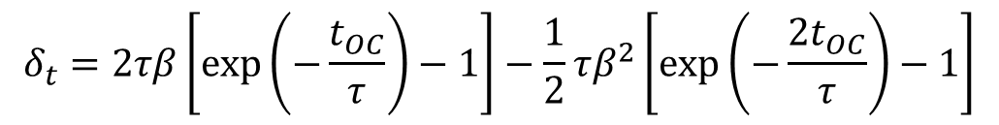
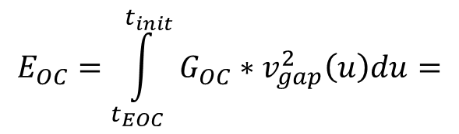
Open Circuit Energy
  At the start of open circuit, there is residual conductance from E_{comm}
  Assume that arc conductance stays constant in open circuit, G_{OC}
  Let ${t_{OC}≜ t}_{init}−t_{EOC}$, then approximation of energy follows:
$$E_{OC}=\int_{t_{EOC}}^{t_{init}}{G_{OC}∗v_{gap}^{2}\left(u\right)du}=$$
$$G_{OC}V_{bus}^{2}(t_{OC}+δ_{t})$$
Effective open circuit time
$$G_{OC}V_{bus}^{2}(t_{OC}+δ_{t})$$
Average power
Where,
$$δ_{t}=2τβ\left[\exp\left(−\frac{t_{OC}}{τ}\right)−1\right]−\frac{1}{2}τβ^{2}\left[\exp\left(−\frac{{2t}_{OC}}{τ}\right)−1\right]$$

Slide 20

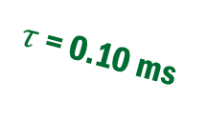
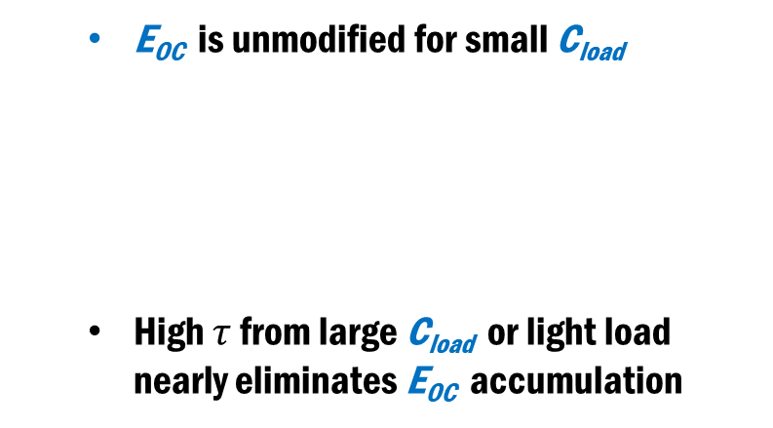






Effect of $τ$ on Open Circuit Energy
  E_{OC} is unmodified for small C_{load}
  High $τ$ from large C_{load} or light load nearly eliminates E_{OC} accumulation
$τ$ = 0.01 ms
$${\lim_{τ→0}{δ}}_{t}=0$$
$τ$ = 0.05 ms
$τ$ = 0.10 ms
$${\lim_{τ→∞}{δ}}_{t}≈−t_{OC}$$
$τ$ = 1 ms
$τ$ = 10 ms

Slide 21
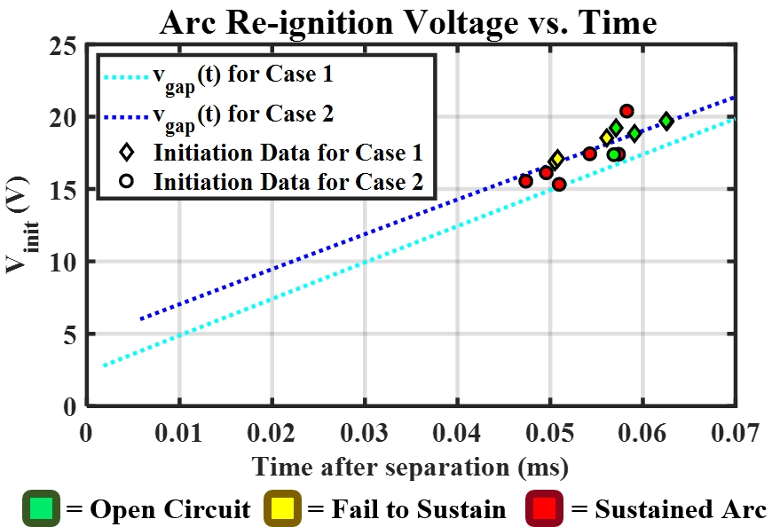
Case Comparison of Energy Accumulation
  Case 1: 450 V, 10 A, 35 µF, 2 mm
  Case 2: 350 V, 25 A, 105 µF, 2 mm

Slide 22
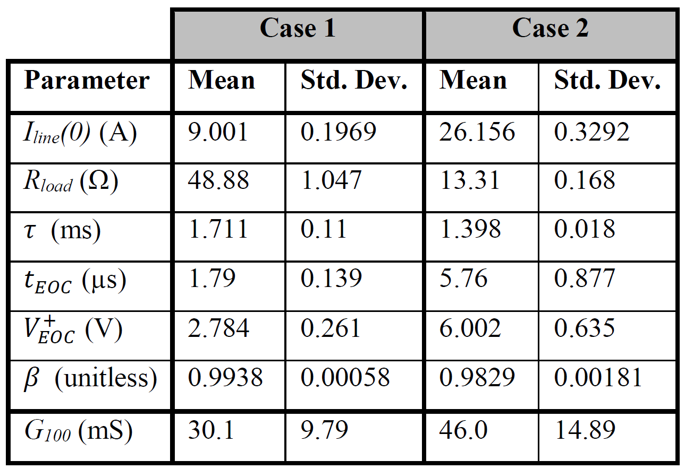
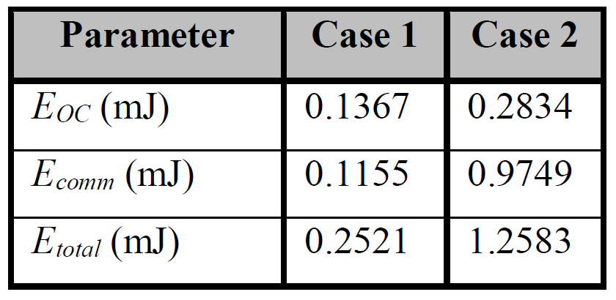
Energy Accumulation Calculations
  Case 1: 450 V, 10 A, 35 µF, 2 mm
  Case 2: 350 V, 25 A, 105 µF, 2 mm
  Estimate G_{OC} using 100 ns before current zero, G₁₀₀ [11]

Slide 23
Conclusions
  Proposed analytical mechanism of energy accumulation needed for arc re-ignition
    Effect of all circuit parameters—V_{bus}, I_{load}, C_{load}, L_{line}—explained
  Experimental results validate description of each mechanism stage
  Provides analytical methods for designing loads to improve series arc prevention
  Analysis applies to Constant Power Loads with millisecond bandwidths
    Load can be modeled as RC load during transient

Slide 24
References (1/2)
[1] P. Kisliuk, “Arcing at Electrical Contacts on Closure. Part V. The Cathode Mechanism of Extremely Short Arcs,” J. Appl. Phys., vol. 25, no. 7, pp. 897–900, 1954.
[2] J. Sekikawa and T. Kubono, “Voltage-current characteristics of breaking arc at constant opening speed in the air,” IEEE Trans. Components Packag. Technol., vol. 27, no. 1, pp. 167–171, 2004.
[3] L. Vanfretti, “Circuit Breakers – The Switching Arc and Arc Modeling,” 2007.
[4] E. Bauer, et al, “Experimental Observations of the Transient Characteristics of Series dc Arcs with Capacitive Loads,” 2018 IEEE International Power Modulator and High Voltage Conference (IPMHVC), Jackson, WY, 2018, In Press
[5] E. Bauer, et al, “Steady state characterization of arcing in 540 v dc distribution systems,” SAE, Fort Worth, TX, USA, Tech. Paper 2017-01-2035, Sept. 2017.
[6] M. Walter and C. Franck, “Improved method for direct black-box arc parameter determination and model validation,” IEEE Trans. Power Deliv., vol. 29, no. 2, pp. 580–588, 2014.
[7] M. Binnendijk, W. F. H. Merck, R. P. P. Smeets, K. Watanabe and E. Kaneko, "High-current interruption in vacuum circuit breakers," in IEEE Transactions on Dielectrics and Electrical Insulation, vol. 4, no. 6, pp. 836-840, Dec 1997.

Slide 25
References (2/2)
[8] R. P. P. Smeets, E. P. A. van Lanen, M. Popov and L. van der Sluis, "In search for performance indicators of short-circuit current interruption in vacuum," 2008 23rd International Symposium on Discharges and Electrical Insulation in Vacuum, Bucharest, 2008, pp. 79-82.
[9] Tomas Roininen et al. (2013). Live Tank Circuit Breakers Application Guide. ABB AB High Voltage Products. Ludvika, Sweeden.
[10] R. Oshiro and E. Kaneko, "Investigation about influence on breakdown voltage by arc condition before quenching," 2015 3rd International Conference on Electric Power Equipment – Switching Technology (ICEPE-ST), Busan, 2015, pp. 532-537.
[11] H. Urai, Y. Ooshita, M. Koizumi, N. Yaginuma and M. Tsukushi, "Estimation of interruption performance in high-voltage circuit breakers with a modified method for arc parameter evaluation," 2011 1st International Conference on Electric Power Equipment - Switching Technology, Xi'an, 2011, pp. 559-565.

Slide 26
Thank You!
Questions?
For further information, please contact:
Eric Bauer: bauer.432@osu.edu
Dr. Jin Wang: wang.1248@osu.edu

