Slide 1
2018 IEEE IPMHV Conference, Jackson Hole, WY June 6, 2018
Modeling of Inverters for Fuel Cells for Grid-Tied and Islanding mode with smooth transitions
M. Giesselmann*, S. Bayne*, D. Reale**, F. Cingoz**, N. Shamin*, and M. Kelley
*Texas Tech Univ. Ctr. for Pulsed Power & Power Electronics
**DOOSAN Inc., South Windsor, CT
2018 IEEE IPMHV Conference, 6 Jun 2018, Oral Session 10, 11:15

Slide 2
Abstract
We are reporting on models for a group of inverters that can feed real and reactive power into a utility grid in Grid-Tied mode and capable of smooth transition to islanded mode. In grid tied mode, the inverters are operating in D-Q mode and inject controllable amounts of real and reactive power into the grid. In islanded mode the inverters are grid forming and share power using droop control. We are presenting MatLAB-Simulink models and results of the simulations including the transitions.
Keywords—Fuel Cells; Grid-Tie inverters; PQ-control; Droop-control

Slide 3
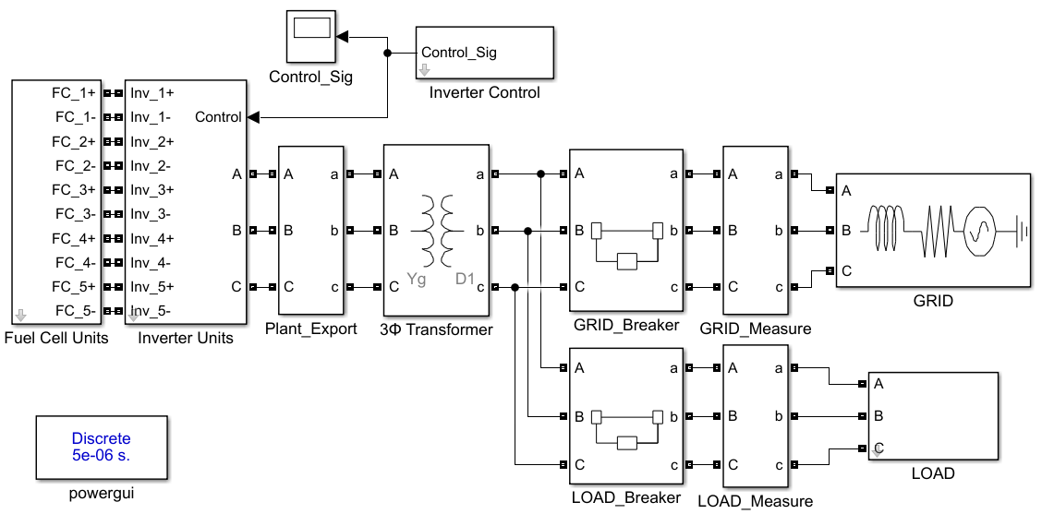
Overall Model
A total of five fuel cell units and five inverter units are connected behind a single transformer.
Simulated X/R of the grid source is 7.
Equivalent load bus is 1.625 MW / 0.25 Mvar
A switching IGBT / Diode inverter topology is selected
3-Phase transformer is 480 V / 13.8 kV (Yg-D)

Slide 4
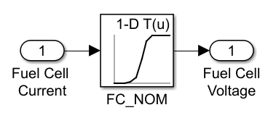
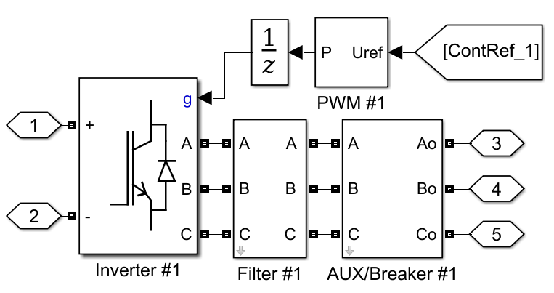
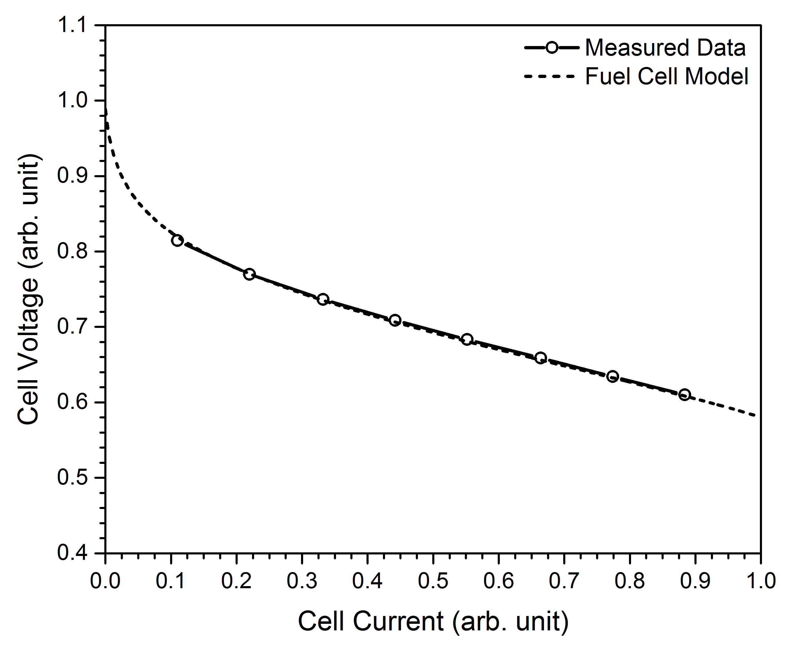
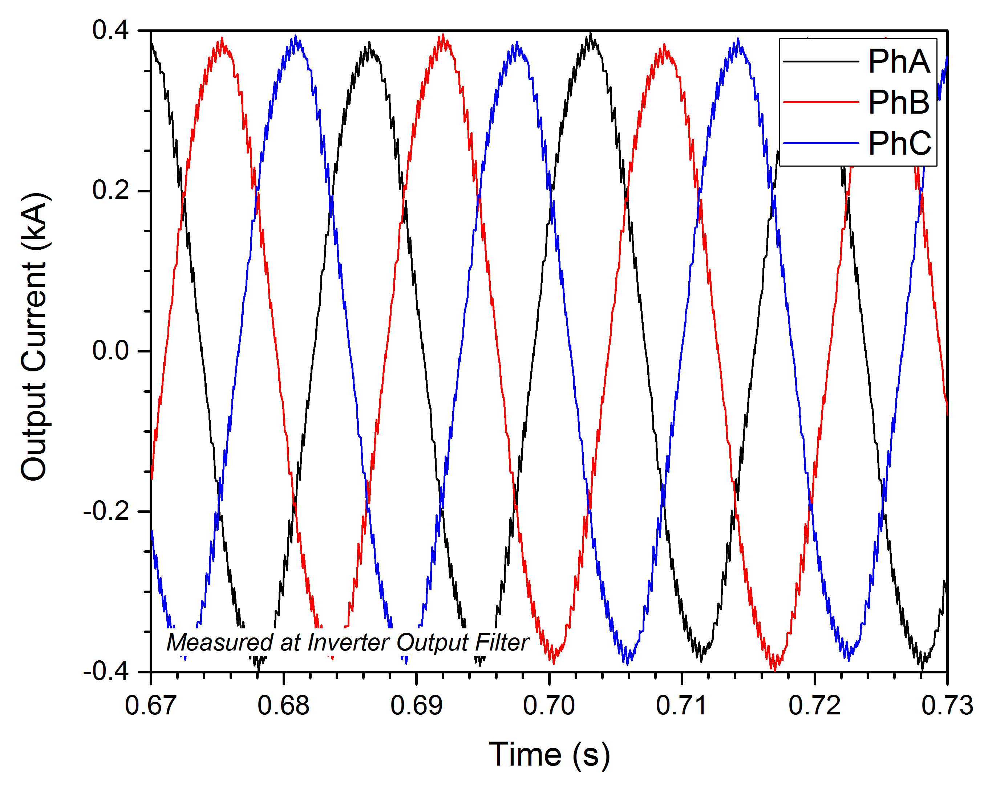
Subsystem Overview
Cell current utilized as an input to a voltage lookup table.

Slide 5
Mode of Operation
D-Q mode
  Grid-tied operation
  Rotating reference frame
  Load distribution easily achieved via real and reactive power setpoints
V-f Droop mode
  Islanded operation
  Power sharing achieved via inverter droop characteristics
    Real output power droops frequency
    Reactive output power droops voltage

Slide 6
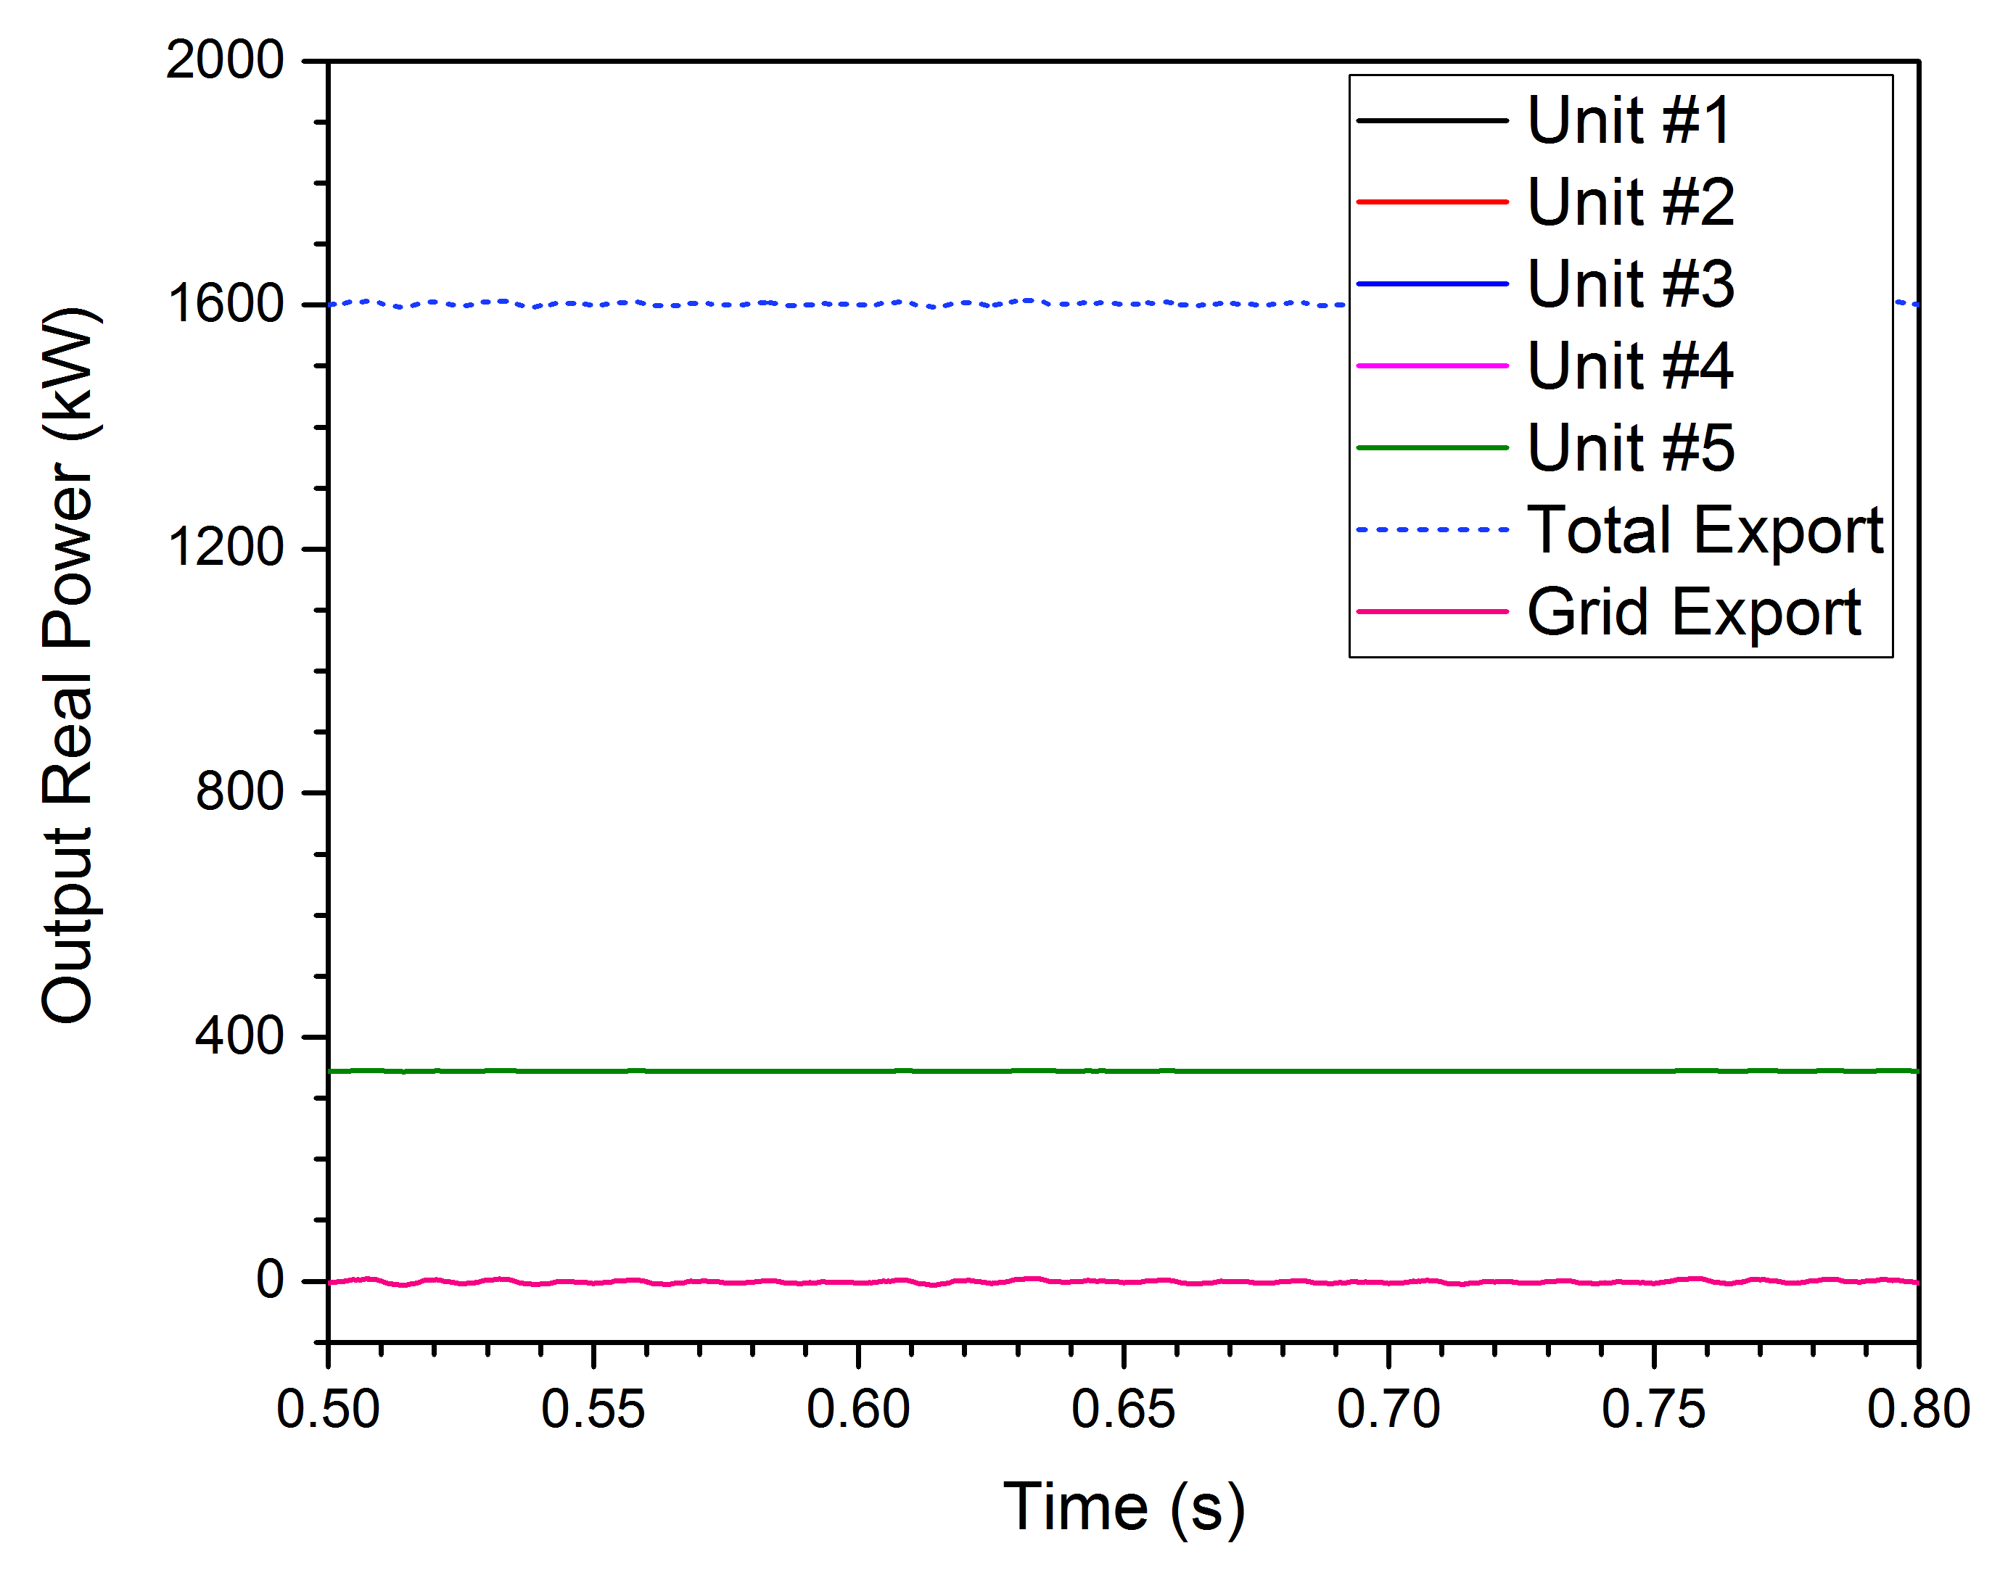
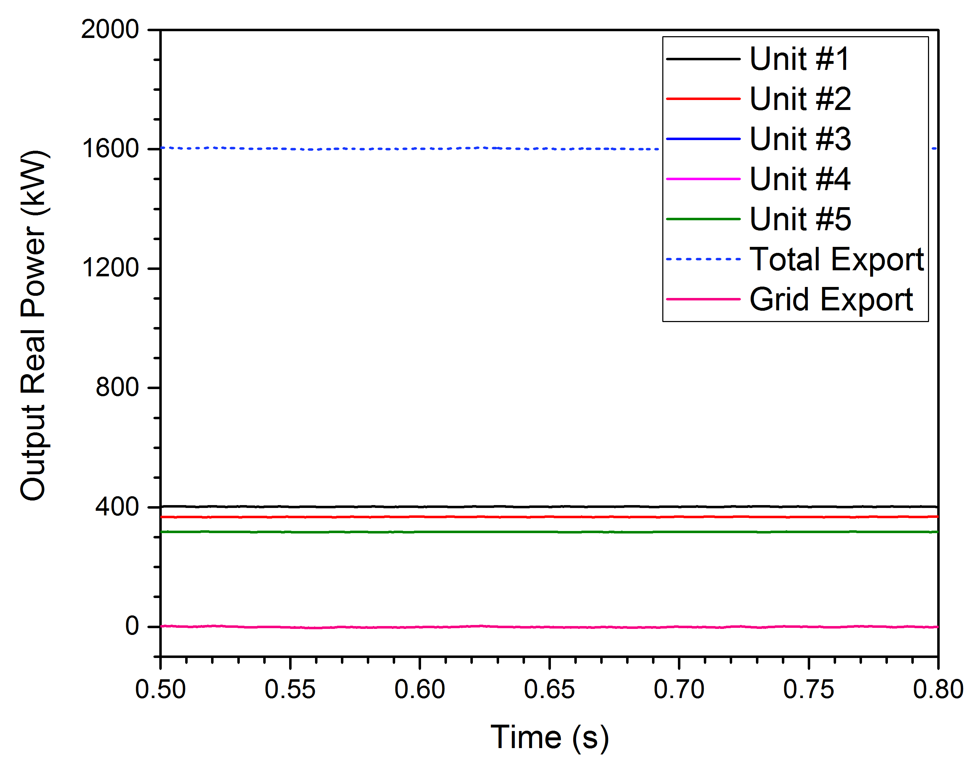
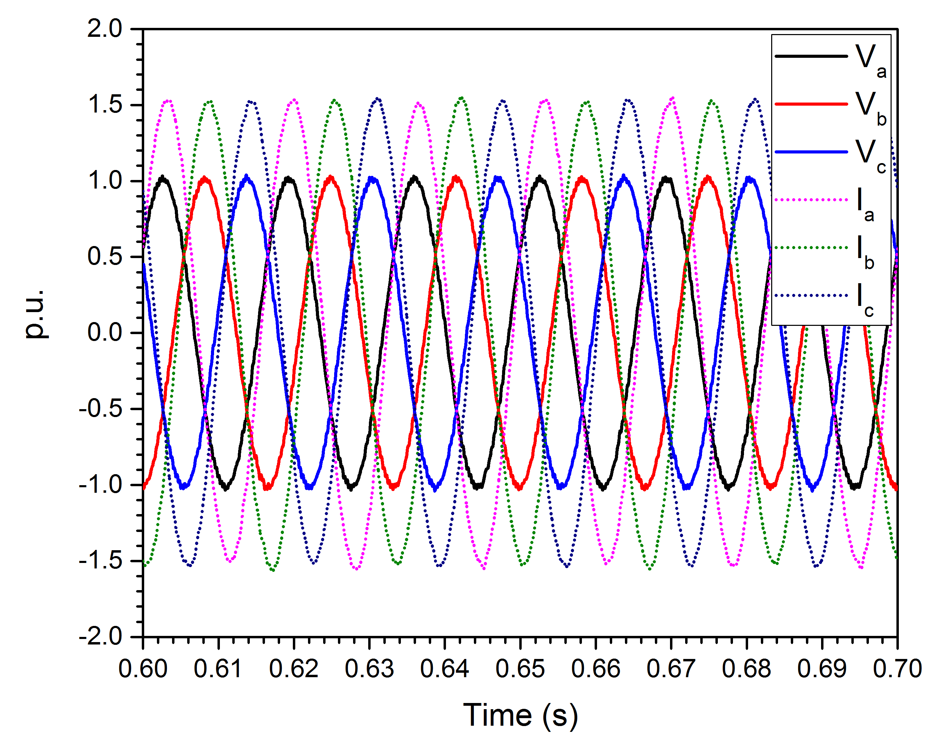
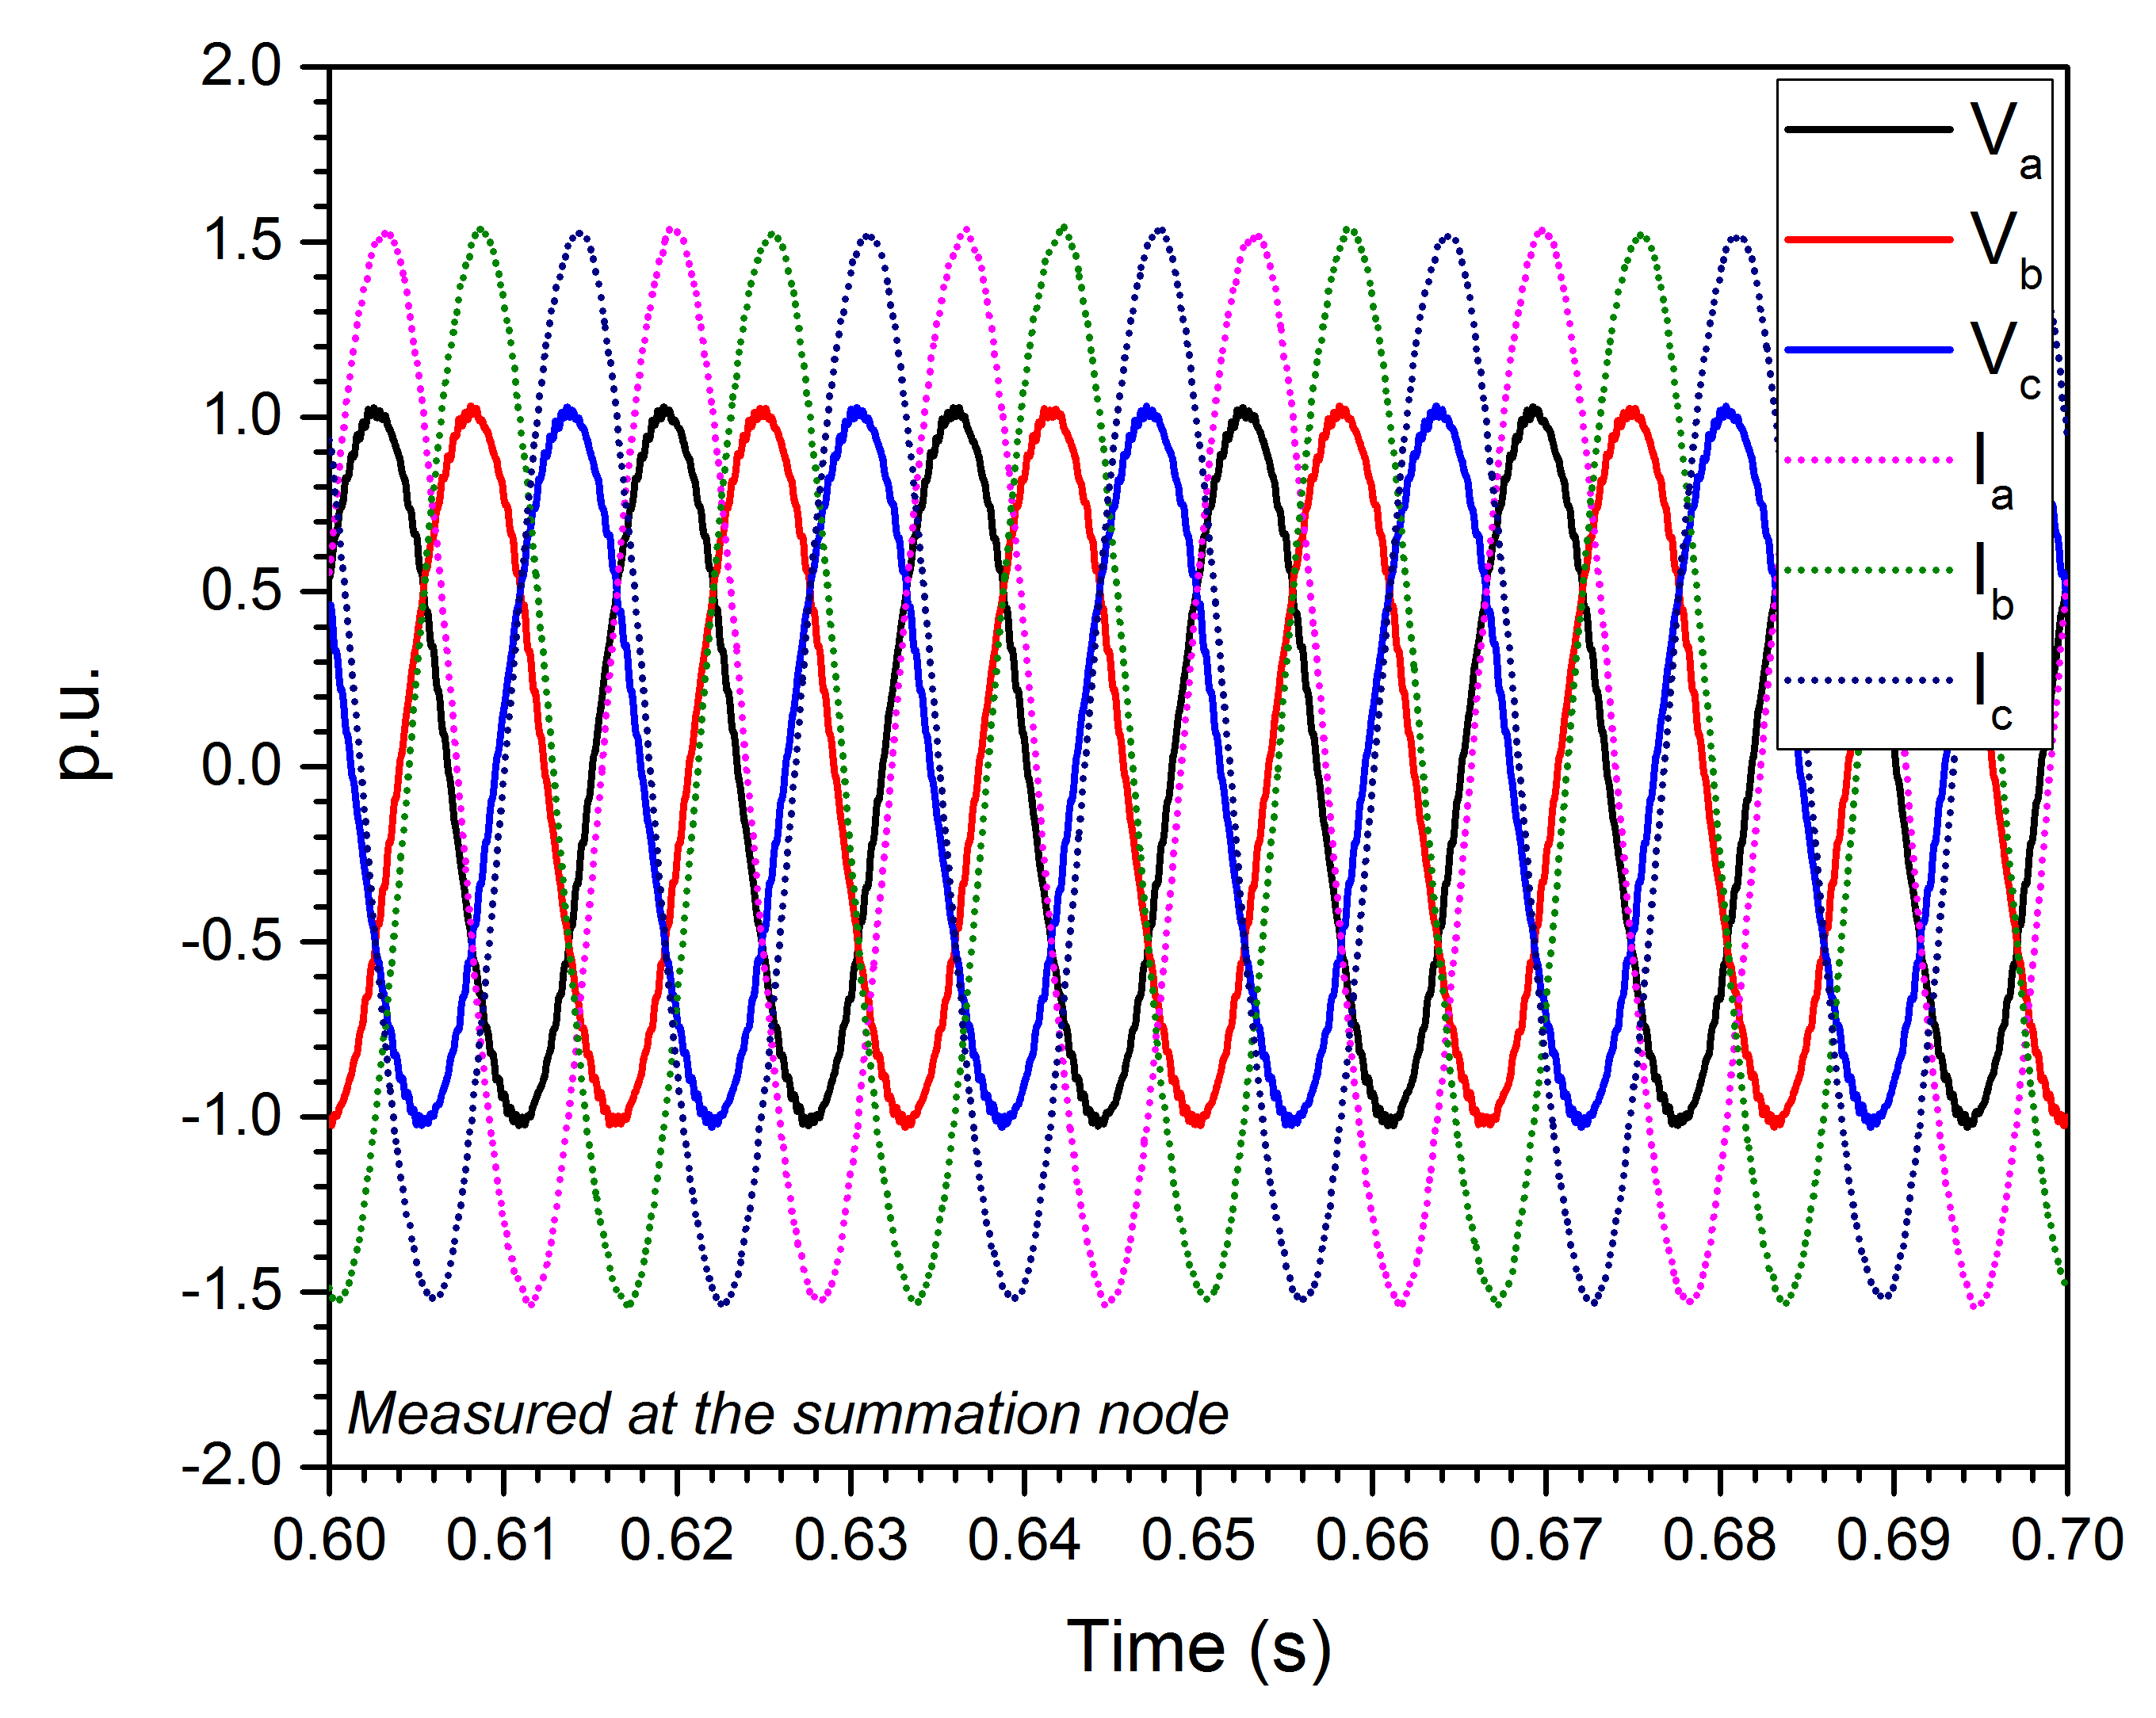
D-Q Mode Operation
Equal Inverter Outputs
Unequal Inverter Outputs

Slide 7
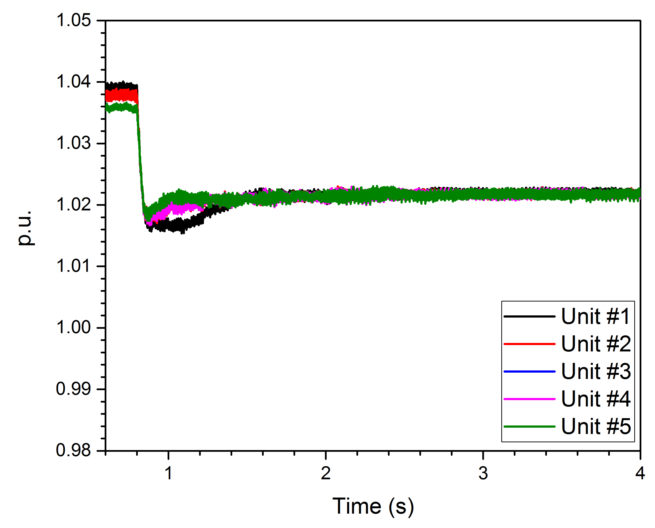
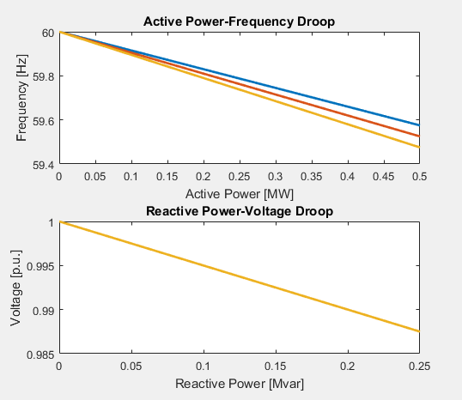
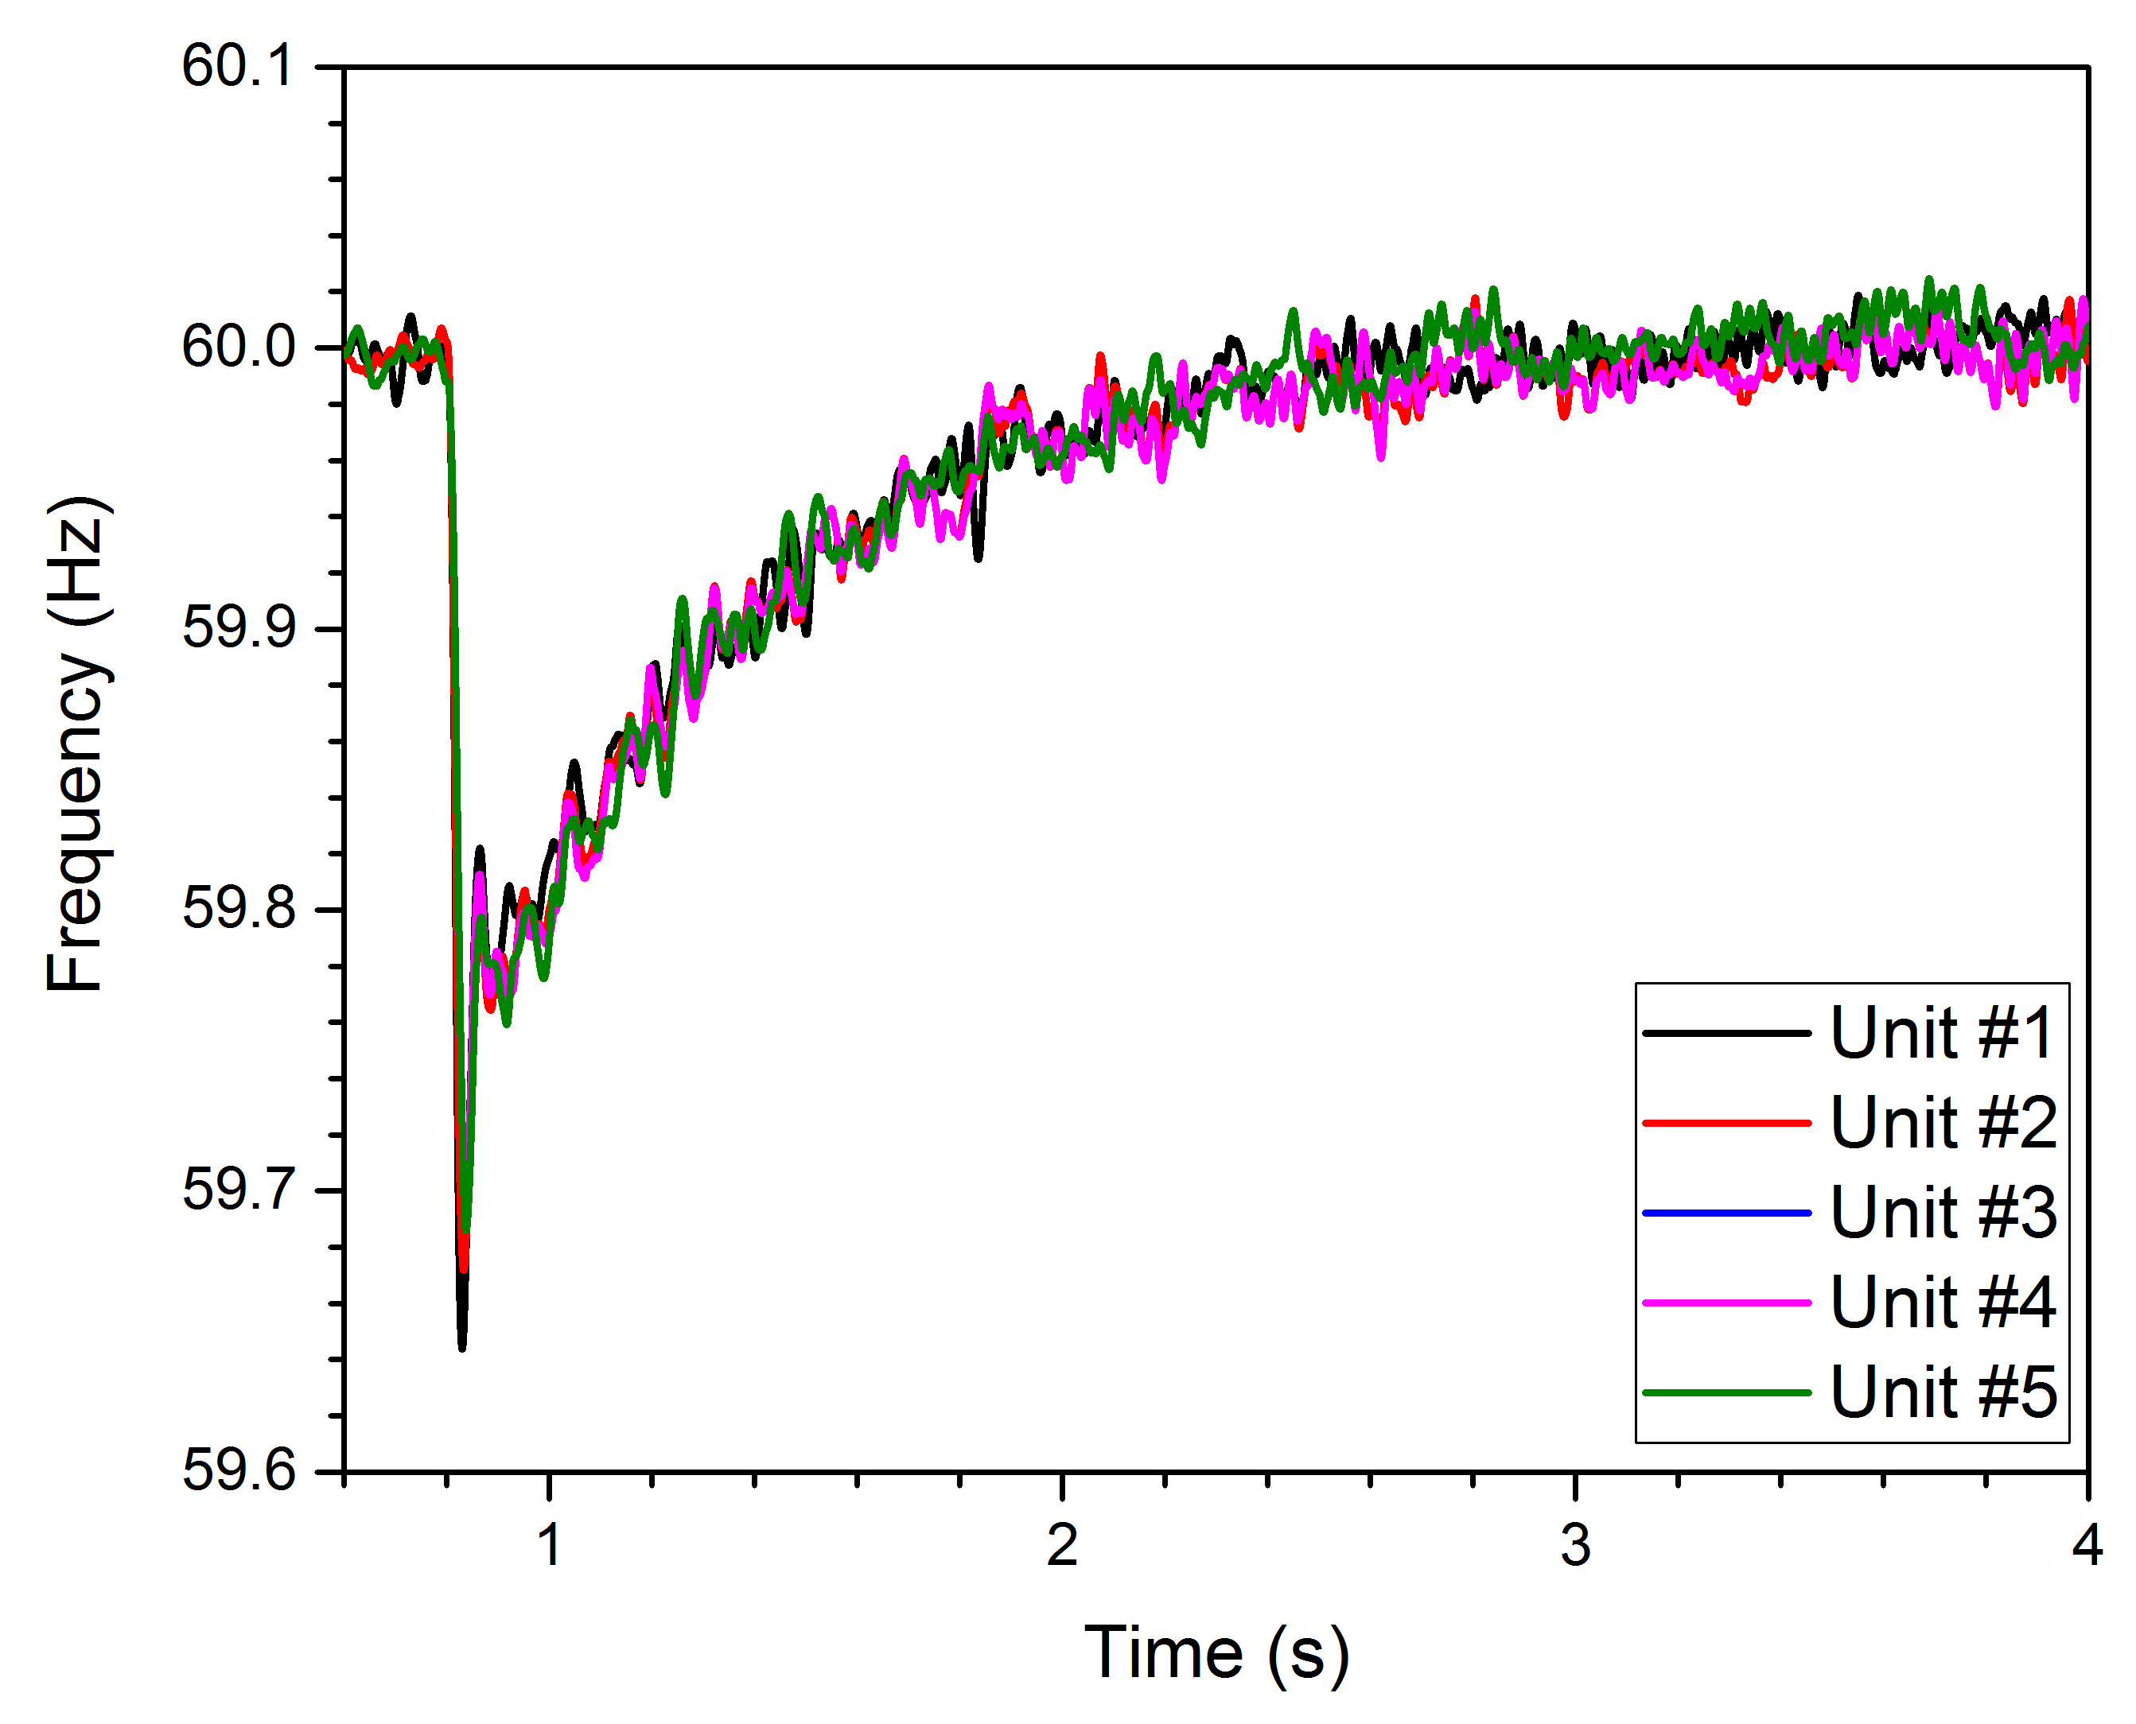
V-f Droop Mode Operation
Frequency and voltage droop characteristics shown below
At top right the voltage droop is shown with secondary control
At bottom right the frequency droop is shown also with secondary control

Slide 8
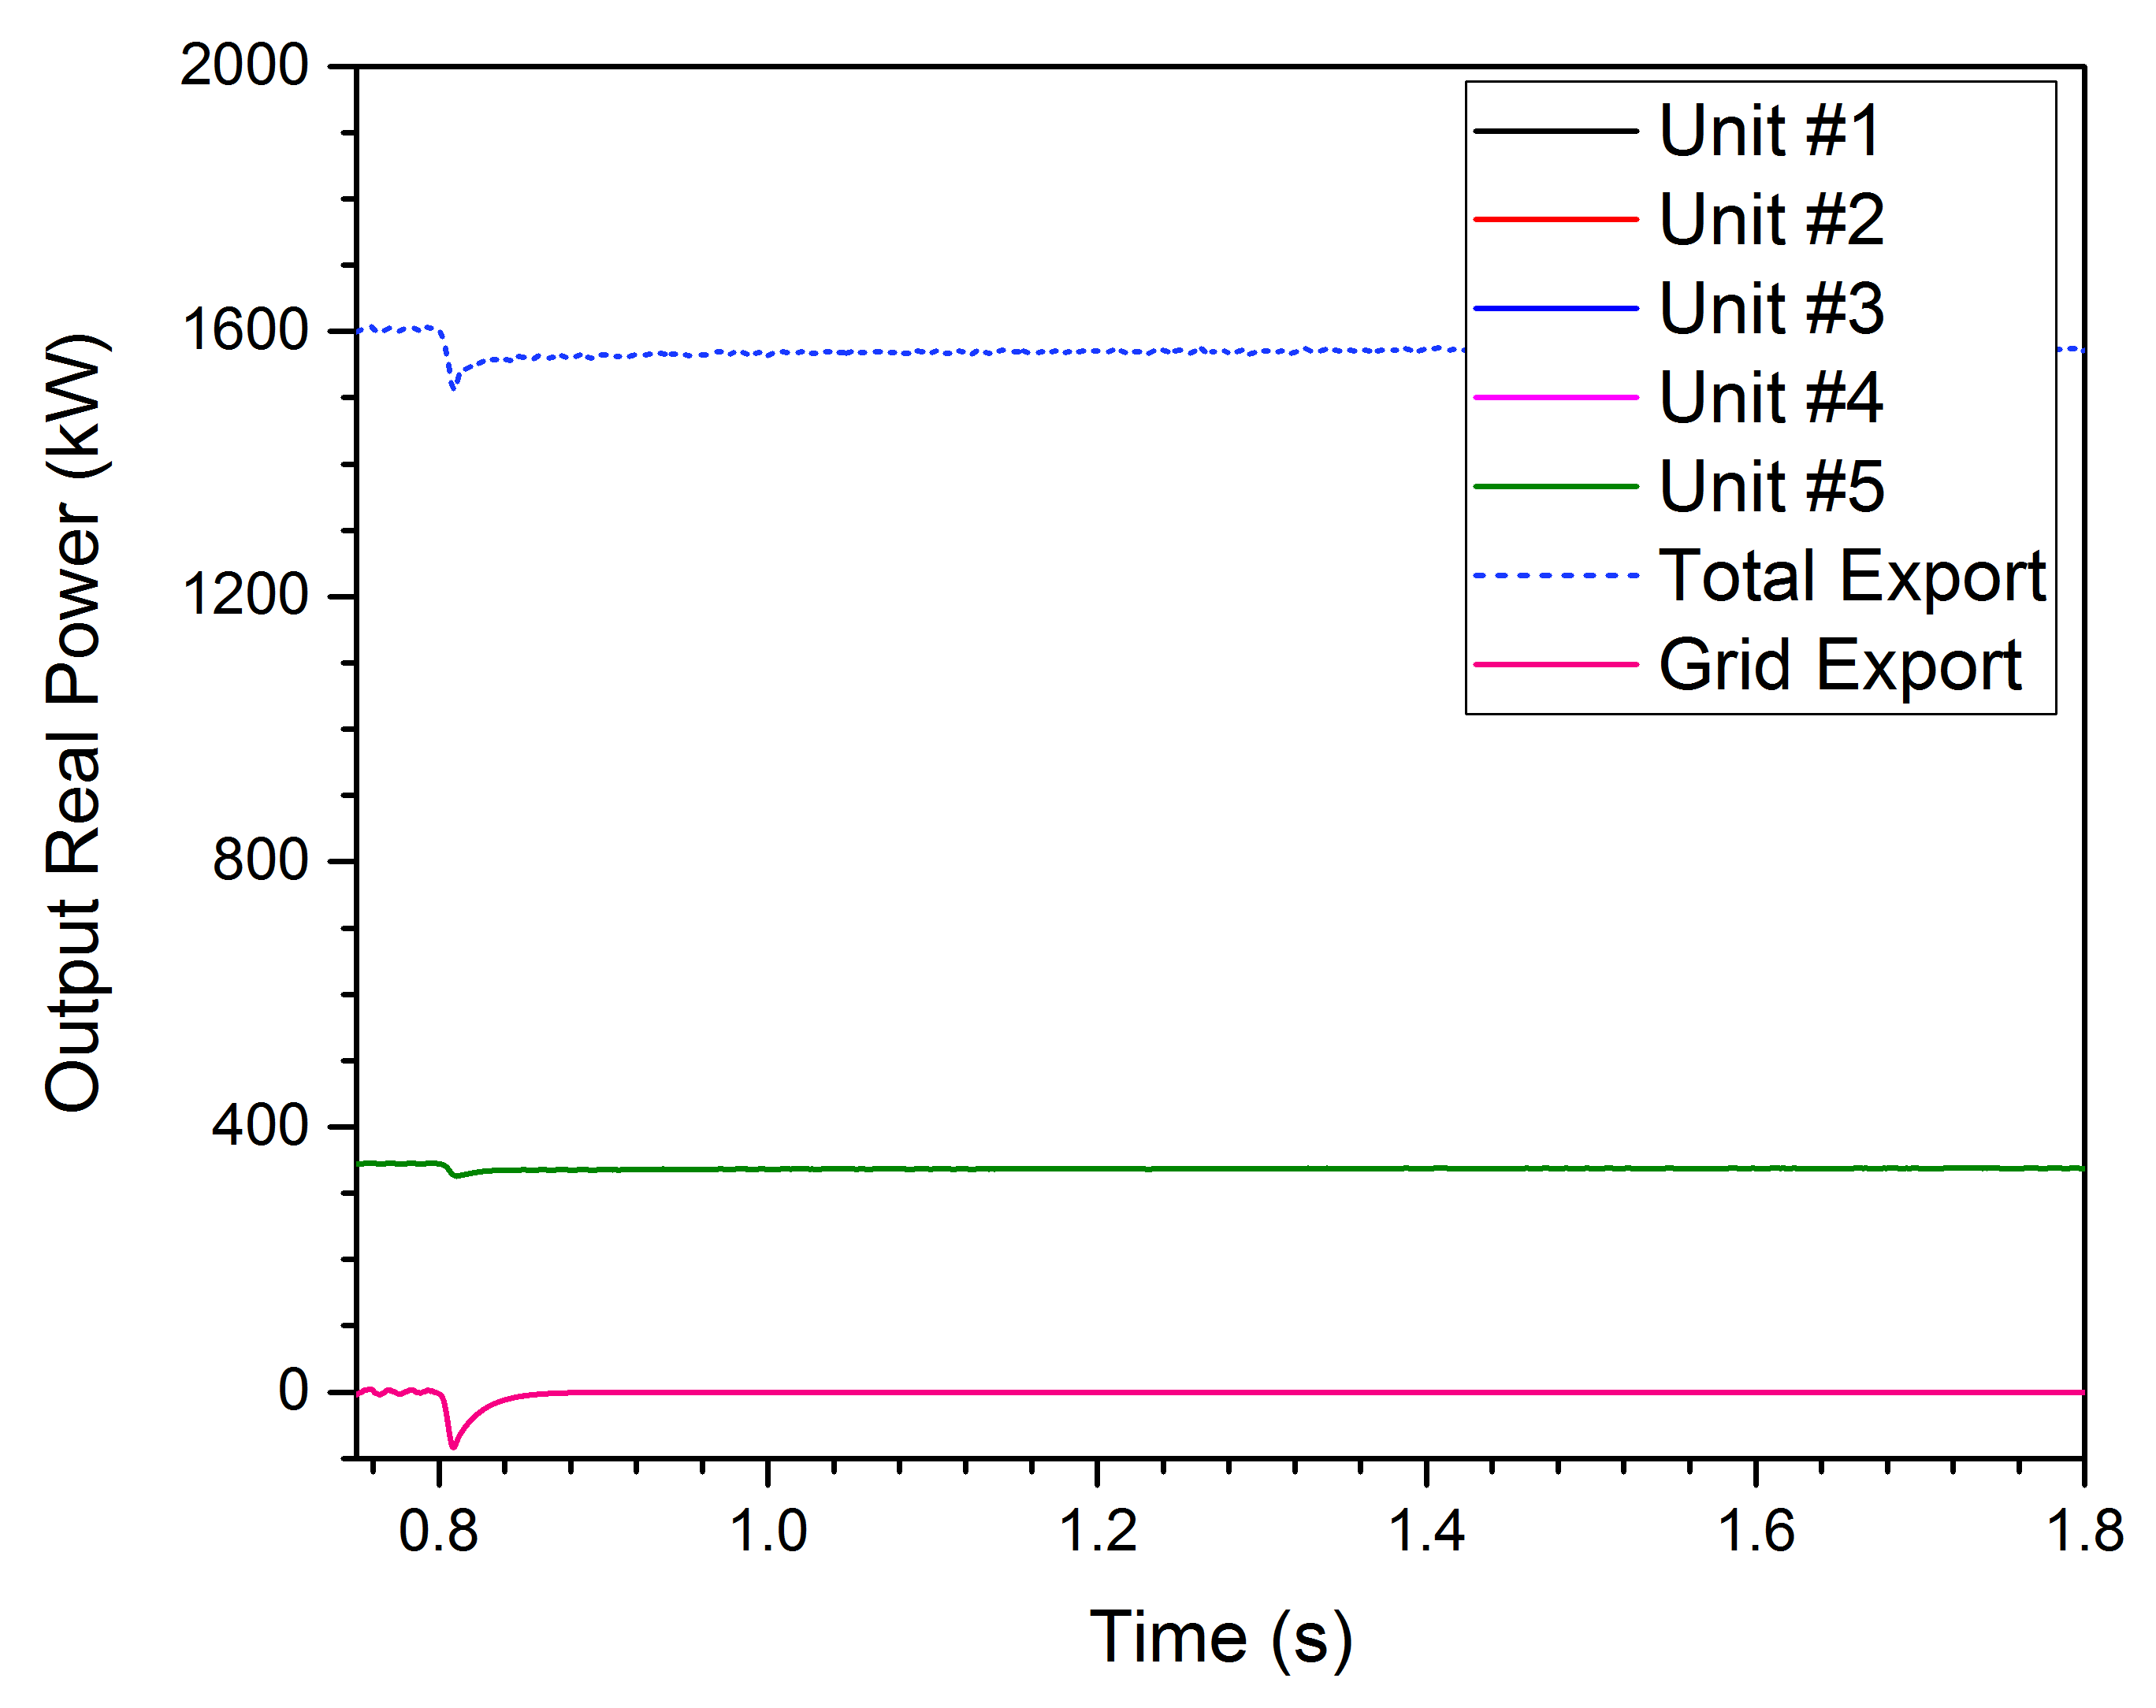
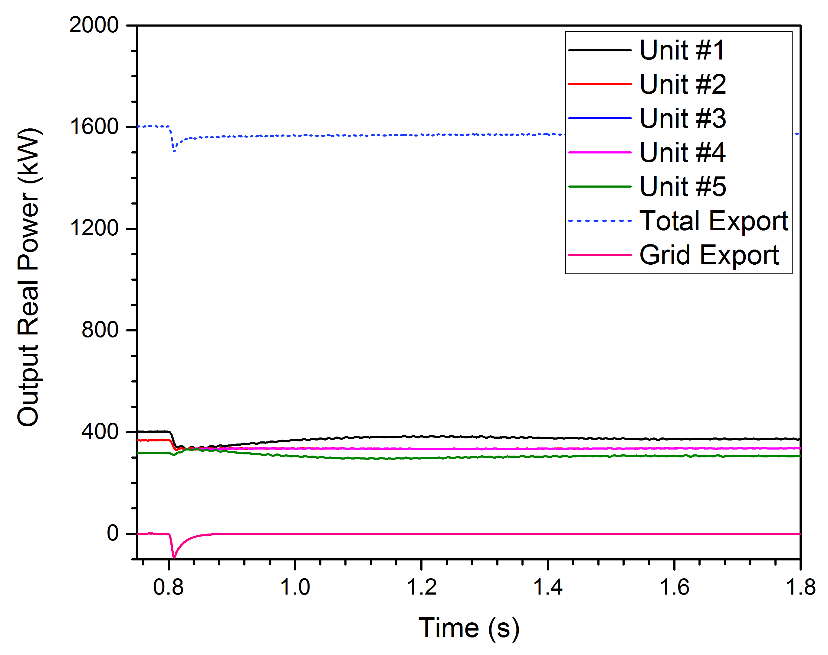
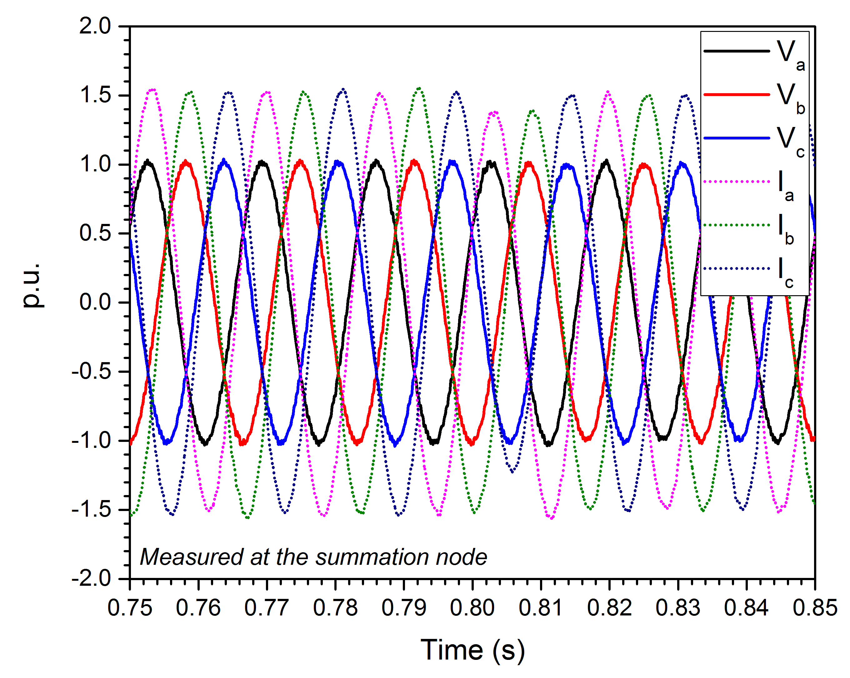

Grid-Tied to Islanded Mode
Equal Inverter Outputs
Unequal Inverter Outputs

Slide 9
Conclusions
In this paper we have shown simulations of smooth transition to islanded mode from grid-tied operation.
D-Q mode was selected during grid-tied operation and was shown with equal and nonequal setpoints.
Droop mode operation was presented with secondary control for voltage and frequency restoration.
Transients during simulated transition are shown to be minimal during both test cases – equal and nonequal D-Q and droop mode coefficients.

Slide 10
References
Jeferson M. Corrêa, Felix A. Farret, Luciane N. Canha, and Marcelo G. Simões, “An Electrochemical-Based Fuel-Cell Model Suitable for Electrical Engineering Automation Approach”, IEEE Transactions on Industrial Electronics, Vol. 51, No. 5, October 2004.
Fuel Cell Handbook, 7th ed., vol. US Department of Energy, Contract No. DE-AM26-99FT40575, Nov. 2004.
James Larminie, Andrew Dicks, “Fuel Cell Systems Explained”, John Wiley & Sons Ltd, The Atrium, Southern Gate, Chichester, West Sussex PO19 8SQ, England, © 2003
J. M. Guerrero, J. C. Vasquez, J. Matas, L. G. de Vicuna, and M. Castilla, "Hierarchical control of droop-controlled AC and DC Microgrids—A general approach toward Standardization," IEEE Transactions on Industrial Electronics, vol. 58, no. 1, pp. 158–172, Jan. 2011.
T. L. Vandoorn, J. C. Vasquez, J. De Kooning, J. M. Guerrero and L. Vandevelde, "Microgrids: Hierarchical Control and an Overview of the Control and Reserve Management Strategies," in IEEE Industrial Electronics Magazine, vol. 7, no. 4, pp. 42-55, Dec. 2013.
Wenlei Bai, M. Reza Abedi, Kwang Y. Lee, Distributed generation system control strategies with PV and fuel cell in microgrid operation, Control Engineering Practice, Volume 53, 2016, Pages 184-193.
Q. Shafiee, J. M. Guerrero and J. C. Vasquez, "Distributed Secondary Control for Islanded Microgrids—A Novel Approach," in IEEE Transactions on Power Electronics, vol. 29, no. 2, pp. 1018-1031, Feb. 2014.

