Slide 1


IPMHVC 2018
Study on the Nonlinear Vibration Characteristic of Dry-Type Air-Core Reactor
Zhitong Jiang*, Lingyu Zhu, Hang Yang，Shengchang Ji, Xinqian Xia,
Jinyu Li and Hantao Cui
Xi’an Jiaotong University
Jackson Lake Lodge, WY
June 5th, 2018
Notes:
Good afternoon everybody!
I am a master student in xianjiaotong university.
It's my great honor to speak here, and I am very glad to share our research with you.
today I'd like to talk something about the nonlinear vibration characteristic of dry-type air-core reactor.

Slide 2
Introduction
Theoretical analysis
content
Experimental analysis
Conclusions
Notes:
I will give my presentation from the following 4 parts.
Introduction, theoretical analysis, experimental analysis and conclusions.

Slide 3
1
Introduction
Notes:
First, introduction

Slide 4
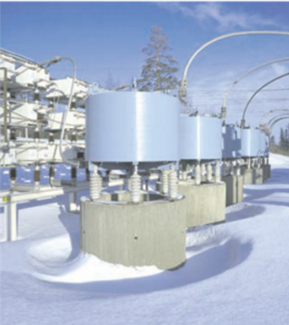
I
Introduction
PART
Dry-type air-core reactor
one of the main noise sources in HVDC convertor stations.
AC filter reactor
Structure of dry-type air-core reactor
Notes:
The figure is the structure of dry-type air-core reactor.
We can see that The dry-type air-core reactor is composed of spiders, windings, stick and support insulator.
The fiberglass insulation and the conductors composes the windings.
The whole reactor is constructed by coaxially paralleled windings.
The spiders are also utilized as busbar and support the windings.
Without iron core, magnetostriction does not exist. So the vibration of dry-type air-core reactor is also seen as a linear system.

Slide 5
II
Commonly accepted linear model
PART
The vibration of dry-type air-core reactor is proportional to the electromagnetic force and the square current.
IEC60076-6:2007 standards suggests to decomposite multiple frequency excitation into sum frequency, difference frequency and double frequency.
Notes:
The electrical vibration system of dry-type air-core reactor is considered as a linear system in previous research.
The vibration amplitude and velocity are directly proportional to the force and the forces in windings are proportional to the current’s square.

Slide 6
III
Research gap
PART
However, the coupling of magnetic field and vibration is not considered, which cause the nonlinear relationship between magnetic force and square current.
When the vibration happens, the magnetic field generated by the current in wires will be changed.
In this paper：
The problem is mathematically modeled
The resulting vibration spectrum is analyzed.
The actual vibration is measured and make the comparison.
Notes:
As we can see, when the vibration happen, the wires moves, the magnetic field caused by the current in wires will be changed.

Slide 7
2
Theoretical Analysis

Slide 8
I
Basic two-wire model
PART
Two-wire model
Lagrangian function
is the kinetic energy.
is the potential energy of the system.
is the elastic potential energy of the system.
is the magnetic potential energy.
Notes:
In theoretical analysis, we establish the two wire model.
We consider the problem from the view of energy.
In order to use the principle of least action, the lagrangian function is built here.
In this function, the energy stored in magnetic field is considered as magnetic potential energy.

Slide 9
I
Basic two-wire model
PART
Vibration equation
Equilibrium position
As the Taylor expansion of the elastic potential energy and the magnetic field potential energy at equilibrium position can be written as:
Then we get the vibration equation of the two-wire model:
Notes:
Taylor expand the expression of the magnetic potential energy and the elastic potential energy,
The function is shown above.
In order to make the equation simple.
We will expand the expression at equilibrium position the elastic potential energy is defined as 0

Slide 10
I
Basic two-wire model
PART
Let , the vibration equation can be rewritten as :
where,
Inherent frequency
Parameter-change vibration equation
Small quantity
Notes:
The lagrangian equation is shown in the first formula.
And the vibration equation will be founded here.
We can found it is a parameter-change vibration equation..

Slide 11
II
Solution of vibration equation
PART
Method of perturbation is used here.
Taylor expansion y to the third power of β can be expressed as:
Apply single frequency current
Notes:
Method of perturbation is used here to solve the equation.
Taking as a small quantity, Taylor expansion of y to the third power of b can be expressed as this
Then using the undetermined coefficient method to solve the equations.
The solution is here. We can find that there are frequencies out of standard, which are caused by nonlinear characteristic of vibration system.

Slide 12
II
Solution of vibration equation
PART
Expression
Frequency components
0
Current frequency
Vibration frequency
Notes:
The frequency component of current square is 2ws.
According to the first equation , the frequency component is 0.
Then from the second equation, the component of y2 is here. It is 2ws.
Then the frequency component of y2, is 4ws
Then the frequency component of y3 is 6ws and 2ws.

Slide 13
II
Solution of vibration equation
PART
Loading multiple frequency current, take double frequency as an example:
Current frequency
Vibration frequency
Notes:
Similarly, when applying multiple frequency current, the calculation method is the the same. B
the calculated expression is too complex, the specific expression of formula is not shown here.
So I present the frequency component.
The frequency components in red circle represent typical nonlinear system characteristics.

Slide 14
3
Experimental Analysis

Slide 15
I
The experimental setup
PART
The inductance value of reactor is 1.97 mH.
The test reactor rated current is 270 A.
Notes:
The experimental circuit is shown here.
the harmonic source outputs harmonic current as a current source.
The medium frequency transformer boosts the voltage of the harmonic source.
The output of the transformer directly connects with the dry-type air-core reactor.
The inductance value of reactor is 1.97mH. The test reactor rated current is 270A.
The radical vibration of the tested reactor was measured by a laser Doppler vibrometer (PDV-100).
The measuring point is shown in red circle.
The vibration of winding will not be affected by non-contact measurement.

Slide 16
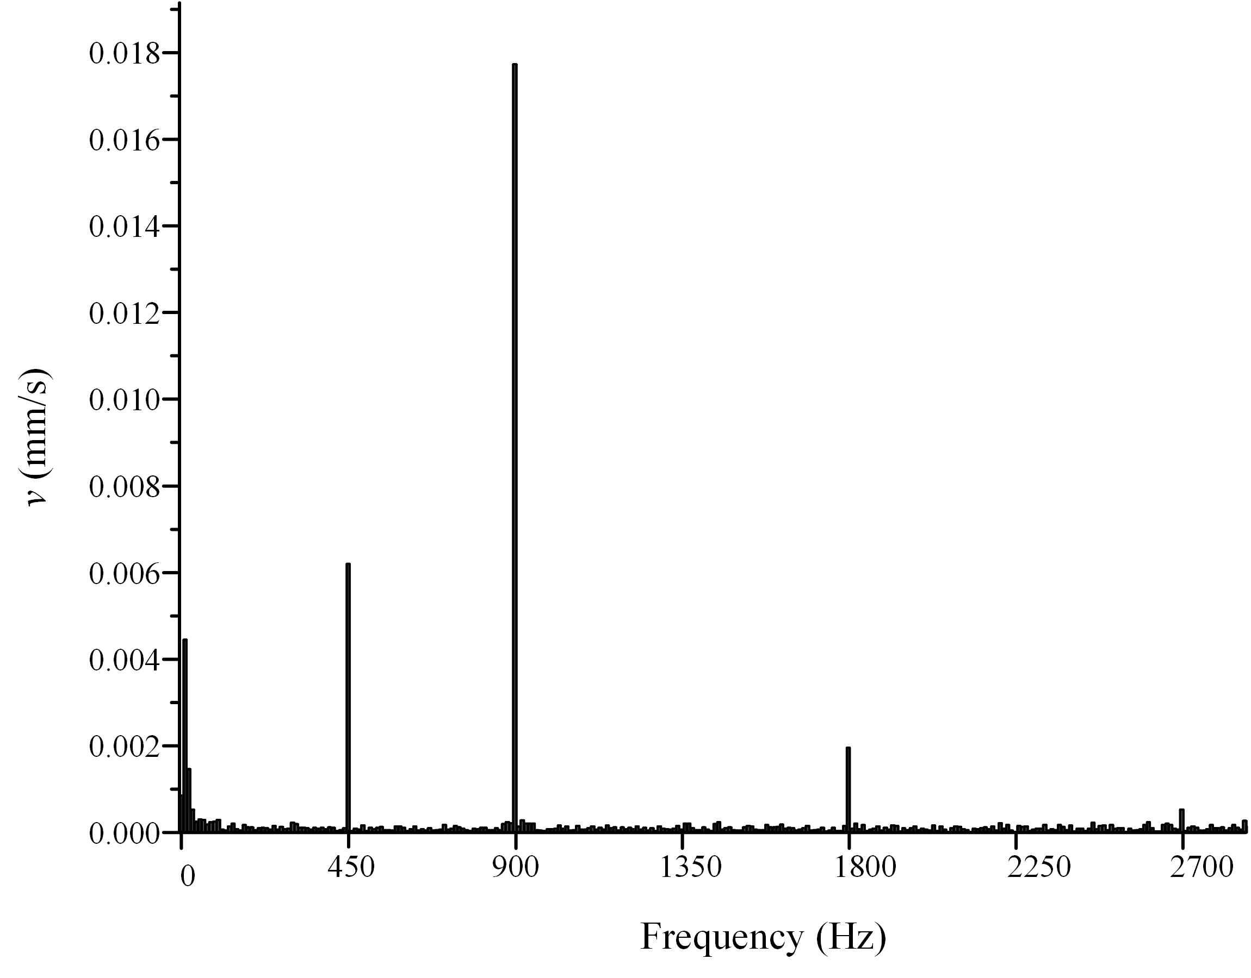
II
Vibration spectrum of reactor
PART
Single frequency current: 450Hz 80A
Loading single frequency current
Other than double frequency component, there are still higher harmonic components in the spectrum

Slide 17
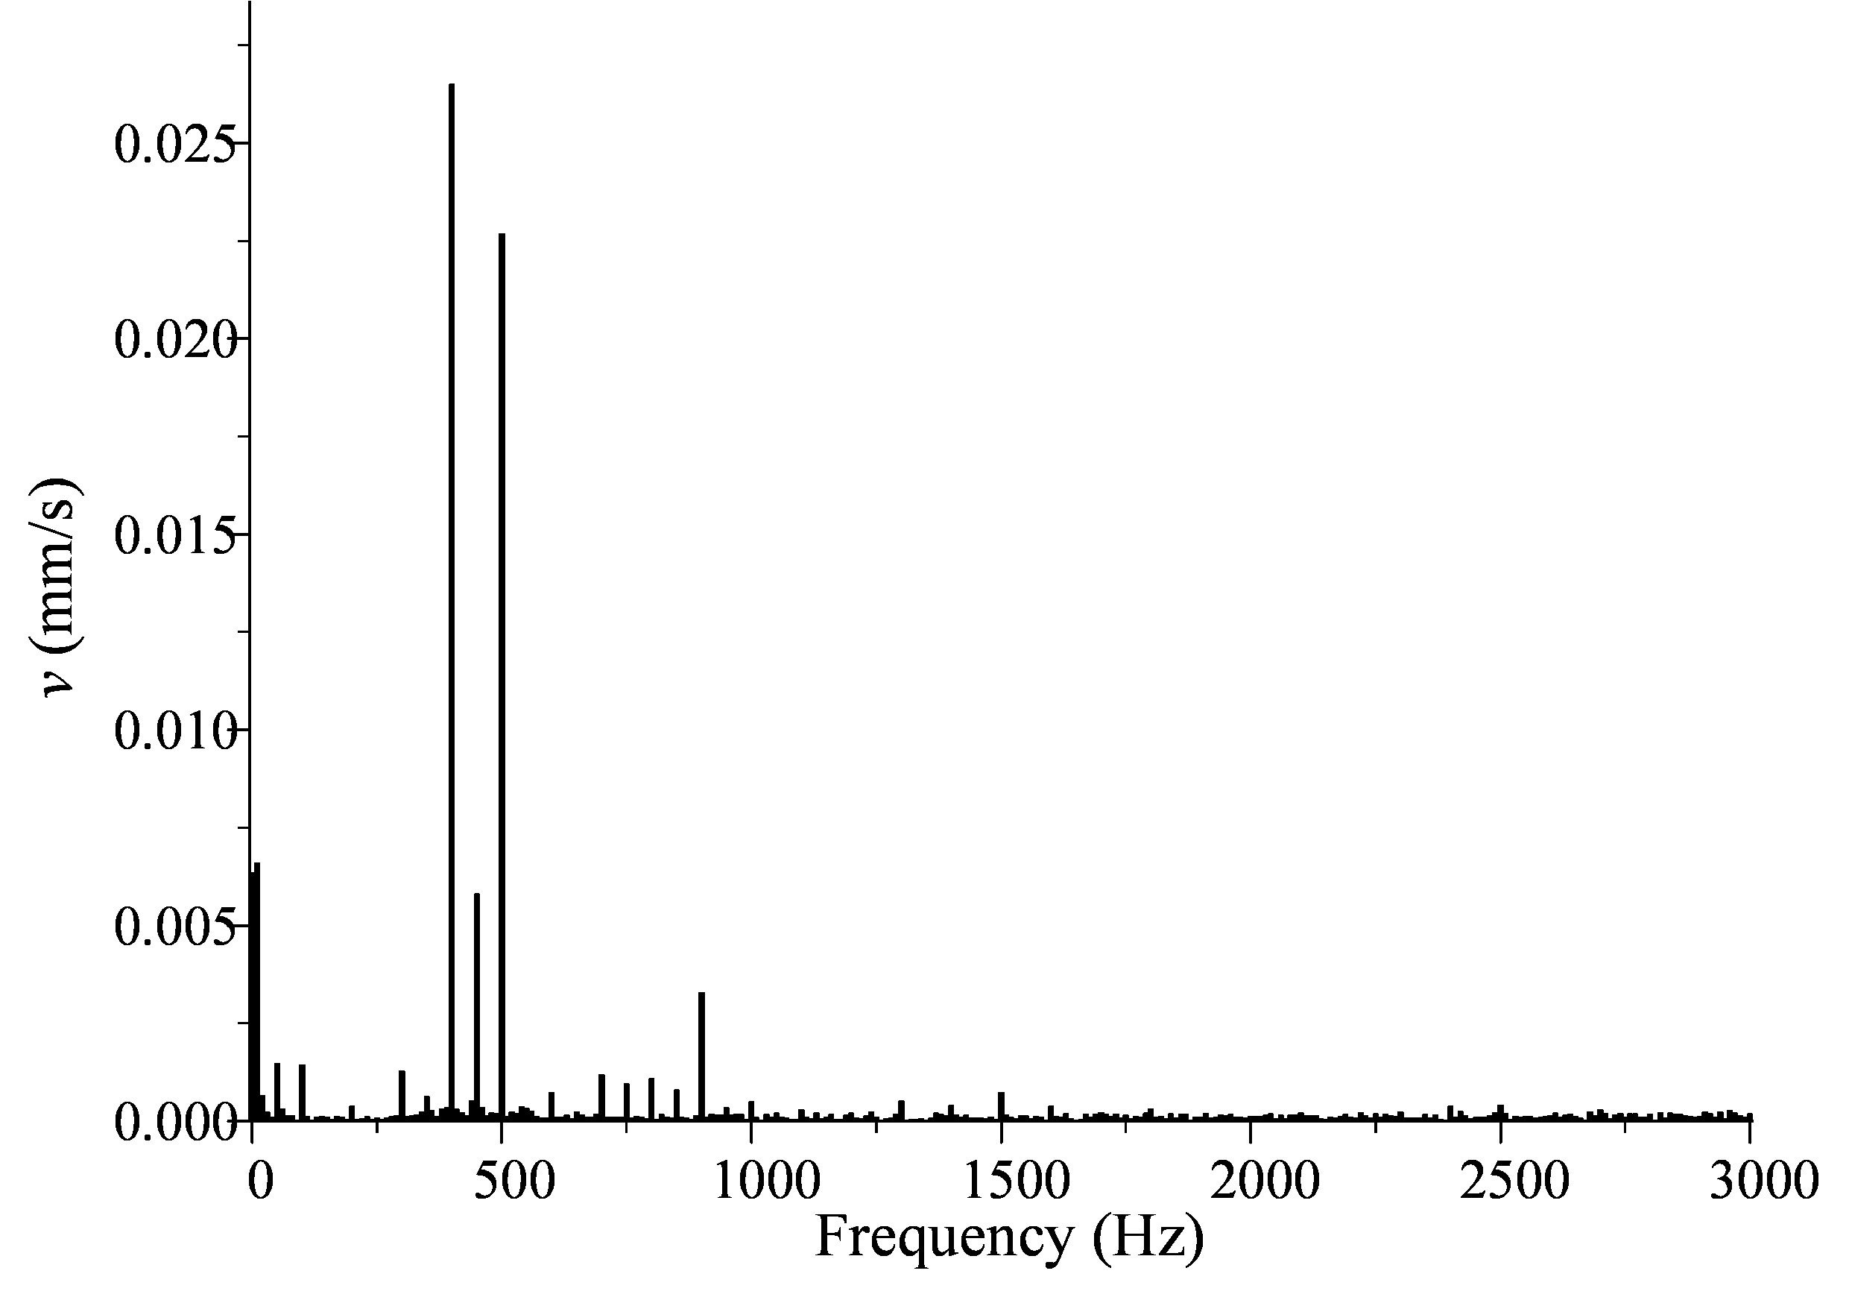
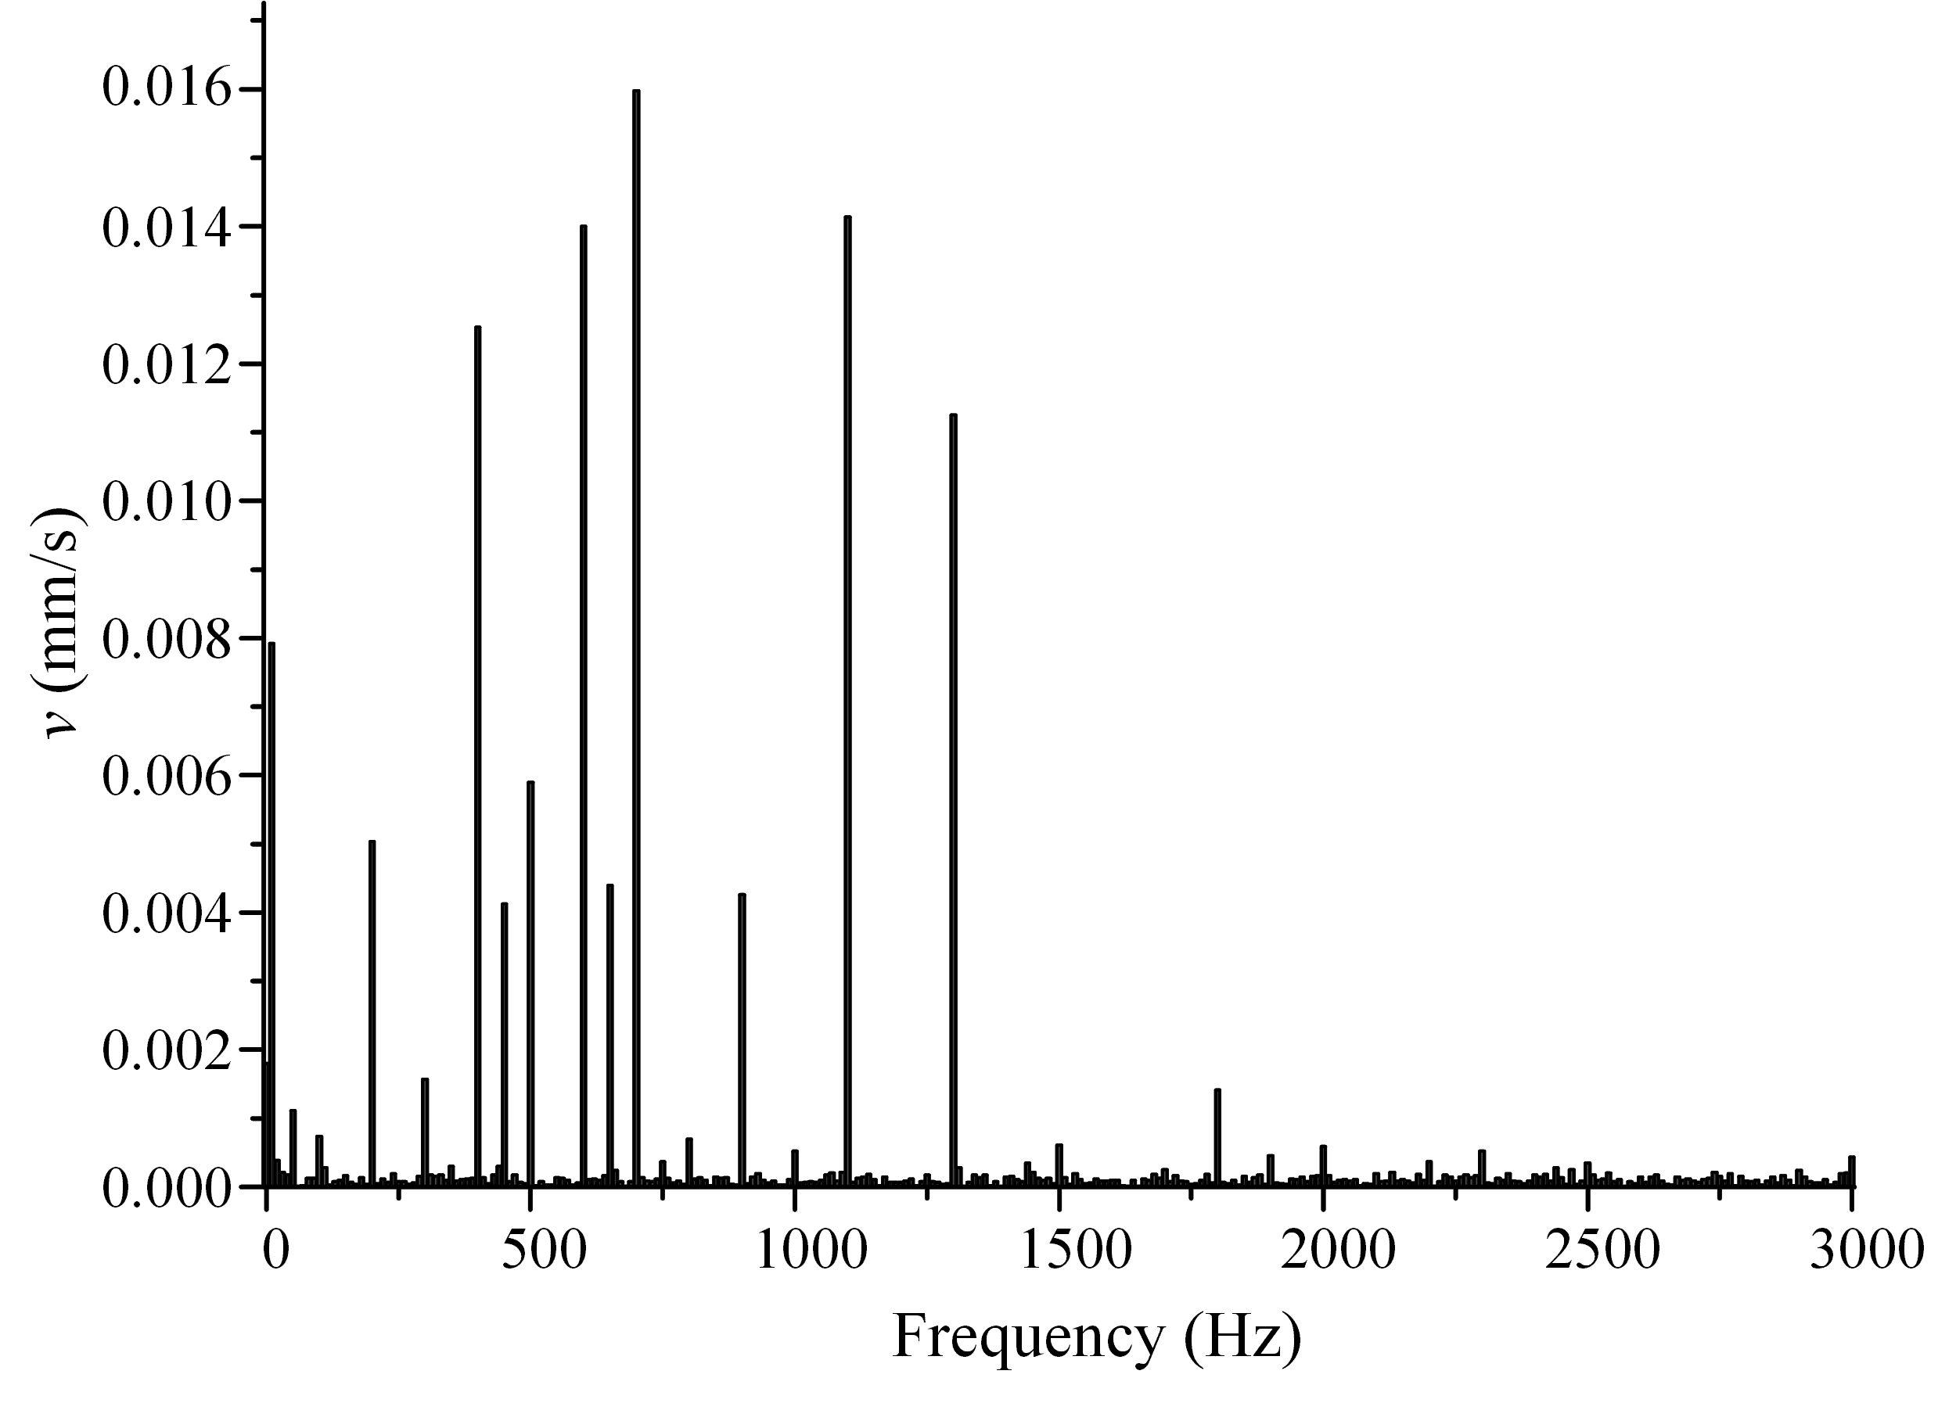
II
Vibration spectrum of reactor
PART
Double frequency current:
50Hz 80A&450Hz 80A
Loading double frequencies current
Triple frequency current:
50 Hz 60 A & 450 Hz 60 A & 650 Hz 60 A
Loading triple frequencies current
The spectrum contains more components than the linear model and is consistent with our theoretical analysis.
Notes:
The experimental circuit is shown here.
the harmonic source outputs harmonic current as a current source.
The medium frequency transformer boosts the voltage of the harmonic source.
The output of the transformer directly connects with the dry-type air-core reactor.
The inductance value of reactor is 1.97mH. The test reactor rated current is 270A.
The radical vibration of the tested reactor was measured by a laser Doppler vibrometer (PDV-100).
The measuring point is shown in red circle.
The vibration of winding will not be affected by non-contact measurement.

Slide 18
III
Impact of nonlinearity
PART
Applied with the same current square of 900Hz
Convert from 3600A² to 6400A² as a linear system
Vibration component of 900Hz with different applying way
If the nonlinearity is not considered, huge deviation could be introduced.
Notes:
The experimental circuit is shown here.
the harmonic source outputs harmonic current as a current source.
The medium frequency transformer boosts the voltage of the harmonic source.
The output of the transformer directly connects with the dry-type air-core reactor.
The inductance value of reactor is 1.97mH. The test reactor rated current is 270A.
The radical vibration of the tested reactor was measured by a laser Doppler vibrometer (PDV-100).
The measuring point is shown in red circle.
The vibration of winding will not be affected by non-contact measurement.

Slide 19
4
Conclusions

Slide 20
Conclusions
One of the main cause of the nonlinearity of dry-type air-core reactor is the coupling of the magnetic field and the motion of the reactor.
Other frequency exists besides the sum, difference and double components of the current frequency.
Applied with the same current square of one frequency component, the vibration of dry-type air-core reactor verifies greatly with the change of the applying way.

Slide 21
Thanks for your attention!

