Slide 1
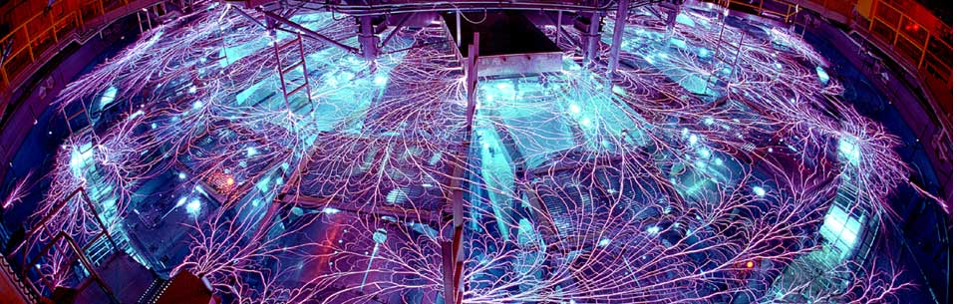
Redesign of a High Voltage Test Bed for Marxes on Z
W.M. White, M.E. Savage, M. McCarthy, S. Divett, S.W. Roundy, D. Spencer, A. Lombrozo, R. Speas, A. Jojola, R. Kamm, J. Mignon, S. Porter, W.Z. Salas, S. Radovich, J. Georgeson, L. Cortez, S. Ploor, D. Johnson, S. Wood; Sandia National Laboratories
J. Rathbun; Imagineering
Tuesday, 5 June, 2018, 3:30 pm
High Voltage Design Session, 7O1 – 7O2, invited talk
Notes:
Invited Presentation: 25 min + 5 min for questions; 30 min total time limit. 13 min + 2 min for questions; 15 min total limit. Originally slated for a regular 15 min talk.
Abstract: The Sandia National Laboratories Z machine is the world’s most powerful and efficient laboratory radiation source, capable of producing over 2 MJ and 300 TW of x-rays. For primary energy storage, Z uses thirty-six separate Marx banks, each comprised of sixty 2.6 µF capacitors rated for up to 100 kV. The total energy storage on Z is 25 MJ at maximum operating voltage (95 kV). Regular operation of Z requires high reliability of these sub-systems – a failure rate of only 1% would imply a malfunction about every three shots. One way to ensure the reliability of the Marxes is to charge them to high voltage and trigger them into a dummy load to ‘certify’ them before installation on Z.
The Marx Test Bed is the system that allows Z operations to conduct this testing. After many years, we have upgraded the Test Bed with new charging supplies and an updated gas handling and control system. In addition to making the Test Bed itself easier to maintain, the upgrades will allow for more operational flexibility going forward. A further consideration during the upgrade is to provide the Z facility with a more general high voltage testing environment – opening up the opportunity to conduct small-scale high voltage testing on components besides Marxes. Here we present an overview of the Test Bed system, as well as a discussion of the protection and filtering required for the HVAC and HVDC portions of the new charging circuit.
Sandia National Laboratories is a multimission laboratory managed and operated by National Technology and Engineering Solutions of Sandia LLC, a wholly owned subsidiary of Honeywell International Inc. for the U.S. Department of Energy’s National Nuclear Security Administration under contract DE-NA0003525.

Slide 2
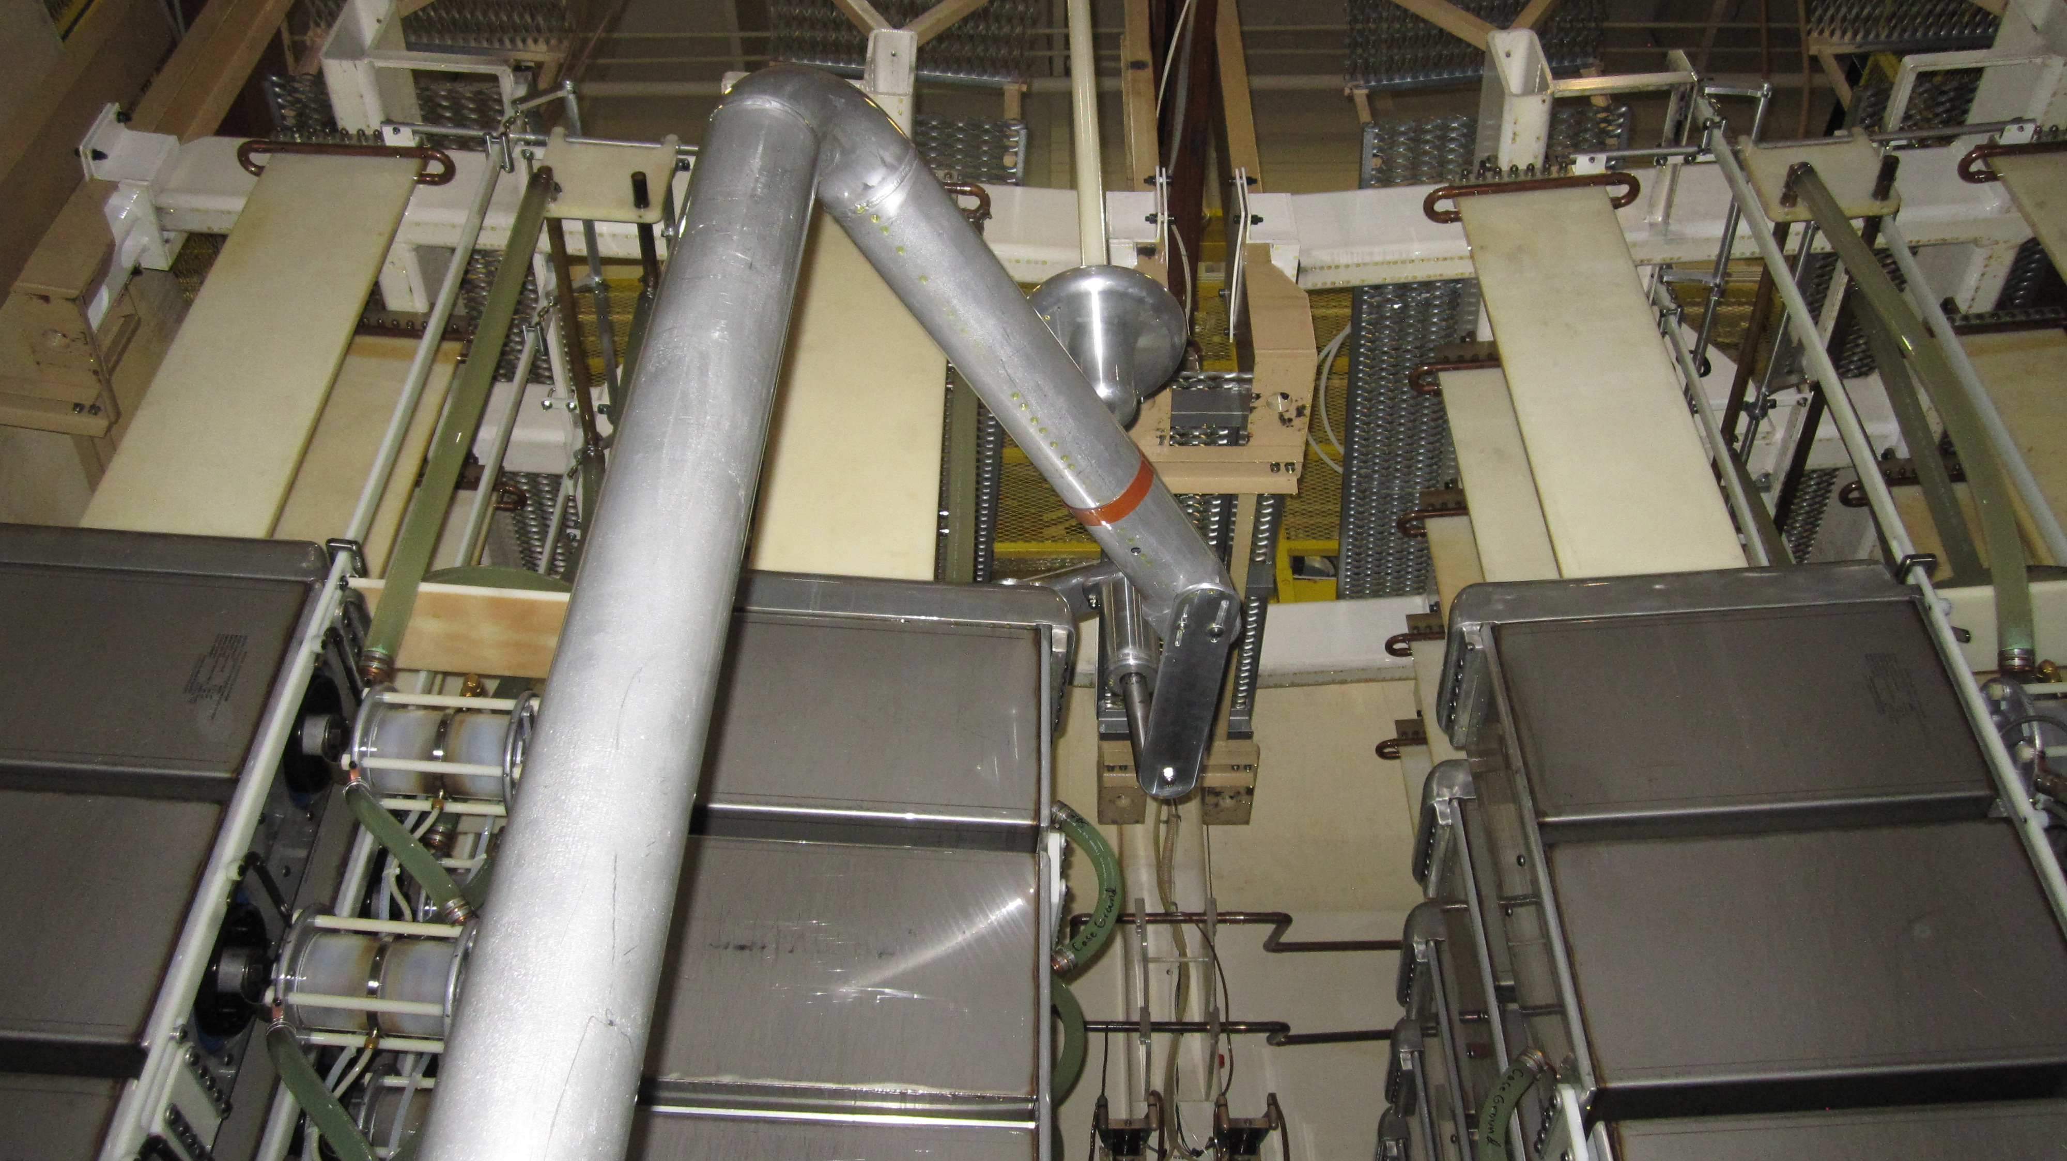
Outline
Sandia National Laboratories’ Z Machine
Marx/Marx Test Bed Overview
Test Bed Modifications
Review of Electrical Interference
Protection of Electronics on Z/Marx Test Bed
In-Tank Modifications
Test Bed Marx Trigger Generator (MTG) Modifications
Future Capabilities
Notes:
Outline slide with a picture of the connection to the Marx Tet Bed dummy load.

Slide 3
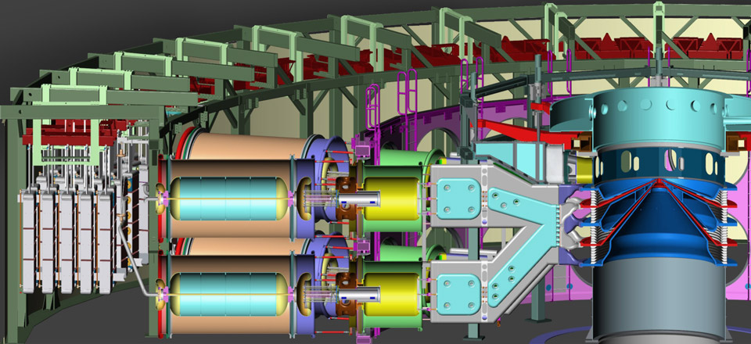
Sandia National Laboratories
Z Machine
Target
OTLs
Main Marx Bank
I-Store Capacitor
LTGS
Water Convolute
MITLs
Vacuum Stack
PFL
Oil Section (ESS)
Water Section (PFS)
Vacuum Section (Center)
Notes:
This is a cross-sectional diagram of the Z machine. The major sections are indicated, as well as the primary components and their relative locations to each other. I-Store means intermediate store. LTGS means laser-triggered gas switch. PFL means pulse-forming line. OTL means output transmission line. MITL means magnetically-insulated transmission line. ESS means energy storage section. PFS means pulse-forming section.

Slide 4
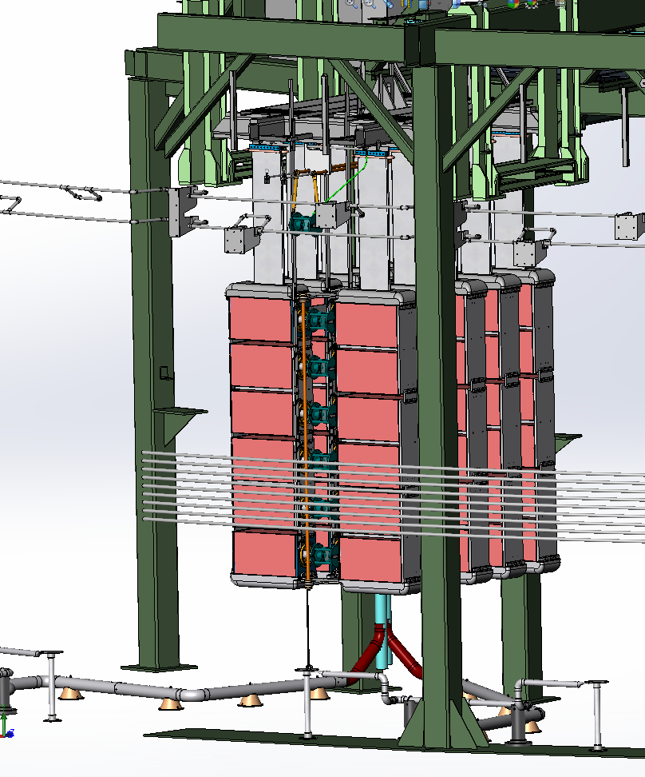
Z Marx Bank Description
36 Marxes
Sixty, 2.6 µF capacitors
~±55 to ±95 kV charge voltage
10% to 90% risetime is ~850 ns
  ~1.5 µs to peak
6.1 MV peak voltage; 20.3 MJ stored energy
  (at 85 kV charge)
Notes:
Each of the 36 Marxes are themselves triggered by smaller Marx banks called Marx Trigger Generators (MTGs).
This is a diagram of a Z Marx in SolidWorks.

Slide 5
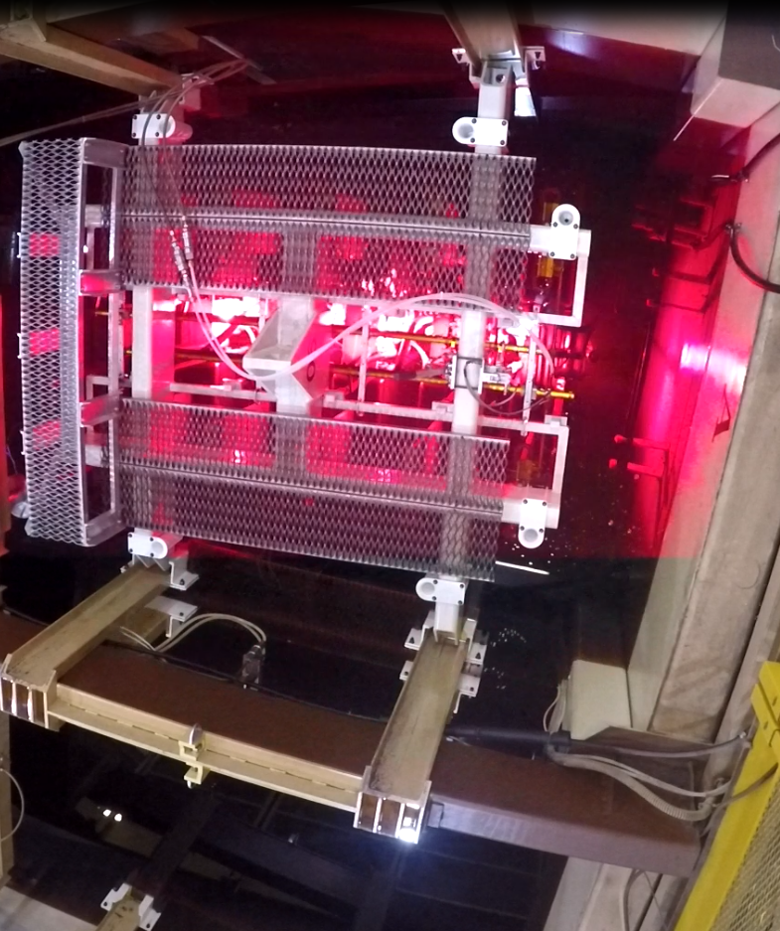
Marx Test Bed Overview
Physically separate oil tank from main Z
  Used to verify operation of newly-assembled Marxes
The HVDC supply system dates back to Feb 1983
  SCR controlled, constant-current power supply
  Dual polarity, up to 110 kV each
Storage capacity for two Marxes
Erected Marxes are discharged into a resistive load
Notes:
The Marx test bed is a separate oil tank where we can store up to two Marxes, and test one of them before installation on Z. It is equipped with a large water resistor dummy load for absorption of the energy of an erected Marx.
This is a single frame from a video of a Marx erecting inside the Test Bed.

Slide 6
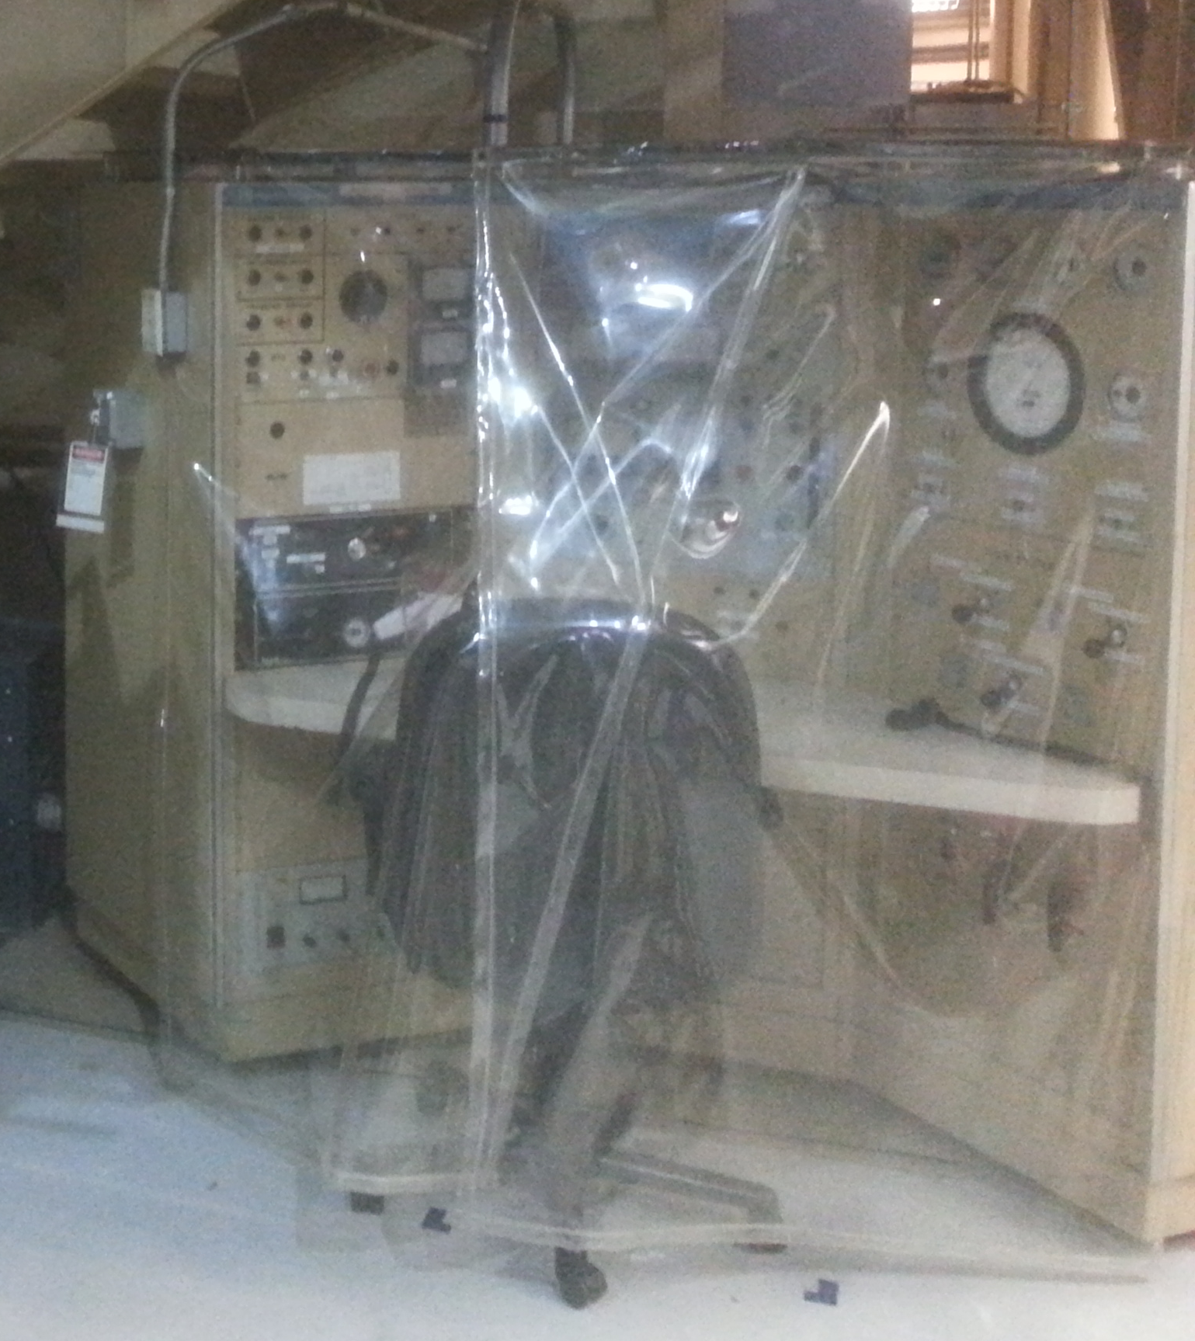
Test Bed Modifications Required
Introduction of a new diagnostic on Z required additional space
Opportunity used to upgrade the charging and control system for the test bed
  New high voltage power supplies
  Improved trigger generator
  New control system
    Allows remote control and diagnostics
    Automated testing sequences
  New gas-handling manifold system
  Replacement of obsolete MTG spark gaps
  Improved accessibility for maintenance
  Improved grounding relays
  Testing of new Marx current monitor
Notes:
A (otherwise unrelated) modification to the facility provided the impetus to move the primary charging supply on the Test Bed. This led to an opportunity to upgrade, as opposed to just moving, the existing system.
This is a photograph of the current Test Bed control panel. Lots of fun to use, but time to upgrade.

Slide 7
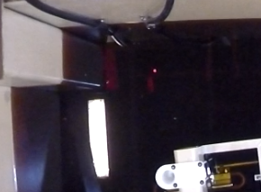
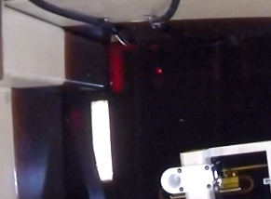
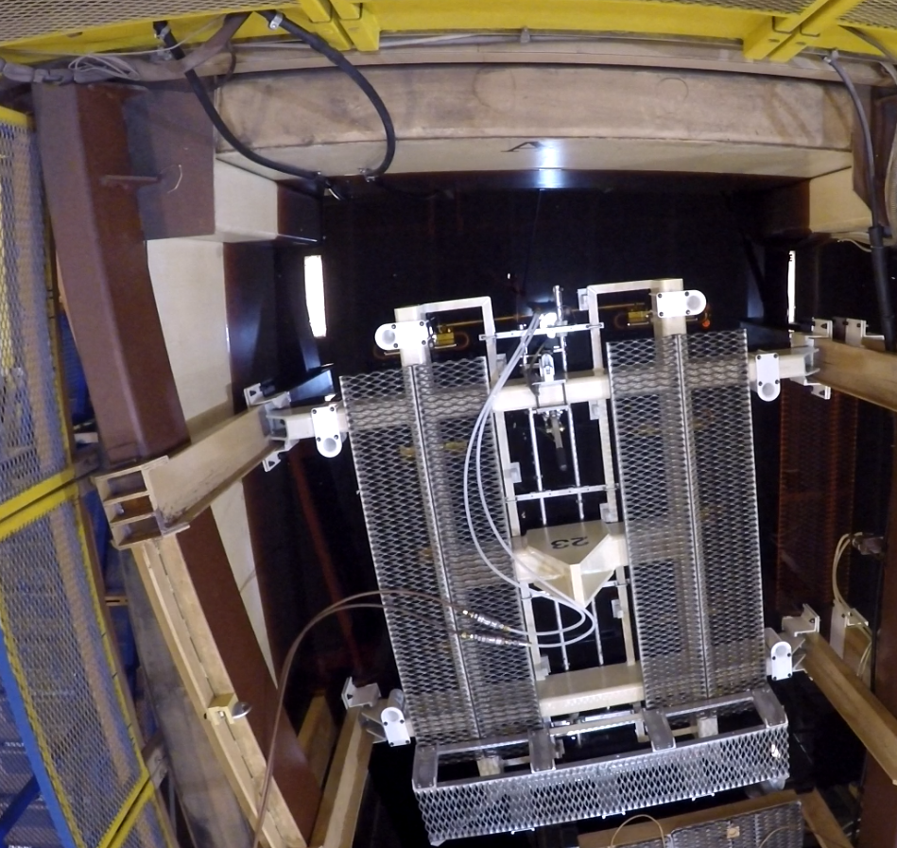
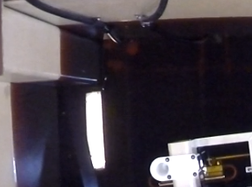
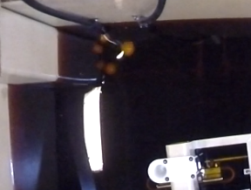
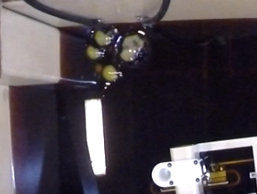
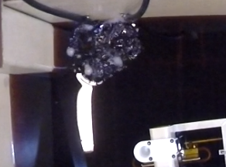
Example of a Test Bed Fault
1
2
3
4
5
6
Notes:
I would prefer to show a movie of this event, but those rarely work in powerpoint presentations. The six photos at right show a zoomed-in region of the test bed when we had a fault at the connection to the filter capacitors. (Frame 1) You can just see the bright light of an arc a few feet under the oil; this is more visible in (Frame 2) and includes glow from the wall nearby. In (Frame 3), (Frame 4), and (Frame 5) you can see the expansion bubbles form under the oil, arrive at the surface, and just start to break the surface respectively. (Frame 6) shows the smoke and other discharge products, churning up the surface of the oil as they evacuate into the air. The sequence of photos takes place over ~2 seconds of time (not all frames are shown).

Slide 8
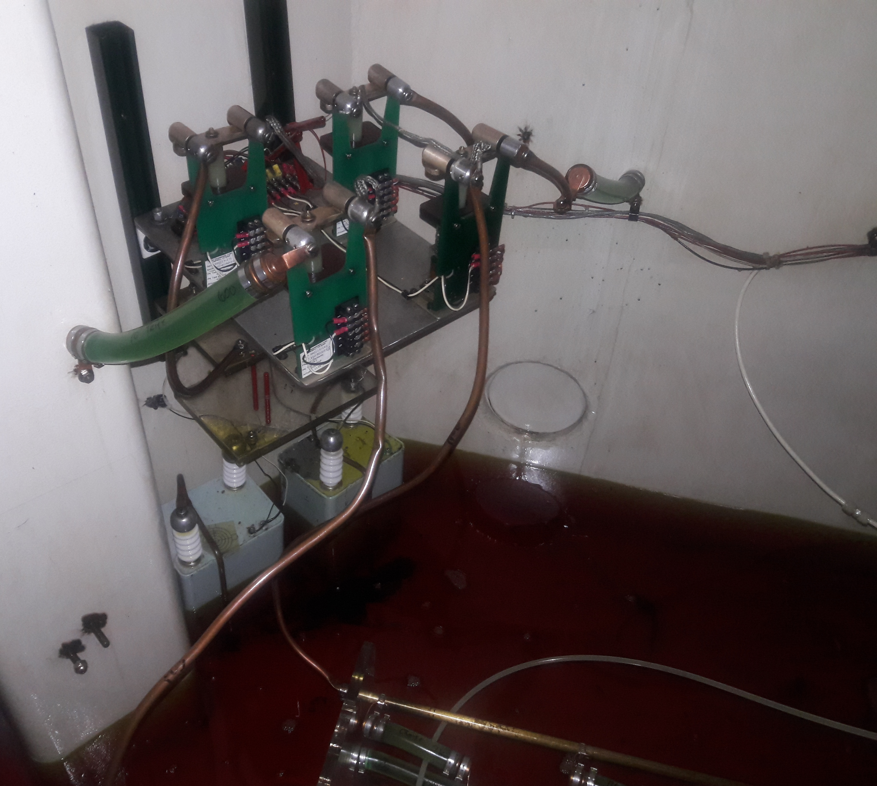
High Voltage Power Supplies
Existing Test Bed HVU can produce 100 mA charging current up to ±110 kV to charge a single Marx
Existing power supplies inside the tank charged the MTG to ±50 kV
  Location makes them difficult to trouble-shoot in case of failure
Purchased four Glassman HVPSs
  One for each polarity, for the Marx and MTG
  Marx supplies provide ±125 kV; 30 mA
  MTG supplies provide ±60 kV; 10 mA
The reduced charging current is closer to Z charging rate of 42 mA per Marx (1.5 A for the entire machine)
Notes:
The Test Bed is a Confined Space, with associated hazards: high voltage, SF₆ oxygen displacement, slips/trips/falls, etc.
We prefer to charge Z slowly, this seems to provide us with better reliability overall.
This is a photo of the MTG charging supplies, dump relays, and dump resistors inside the Test Bed.

Slide 9
Review of Electrical Interference
Z Marxes, Switches generate a lot of Electrical Noise
There are only 4 mechanisms to couple noise from one system to another :
  Direct conduction
  Mutual Inductance (dominated by magnetic fields)
  Mutual Capacitance (dominated by electric fields)
  Electromagnetic Waves
Near Field regions are dominated by Electric/Magnetic Fields
Far Field regions are dominated by Electromagnetic Waves
We can look at the specifics of Z waveforms to determine what we need to be concerned with
(A great reference for this topic is the short course: Grounding and Shielding of Electronic Systems, taught by Prof. T. Van Doren, Missouri University of Science & Technology)
Notes:
Here is a brief introduction to EM Noise and ways that it causes us headaches. I highly recommend the short course by Prof. Van Doren, but I think unfortunately he has retired. Perhaps one of his other colleagues at MUST will pick up the torch.

Slide 10
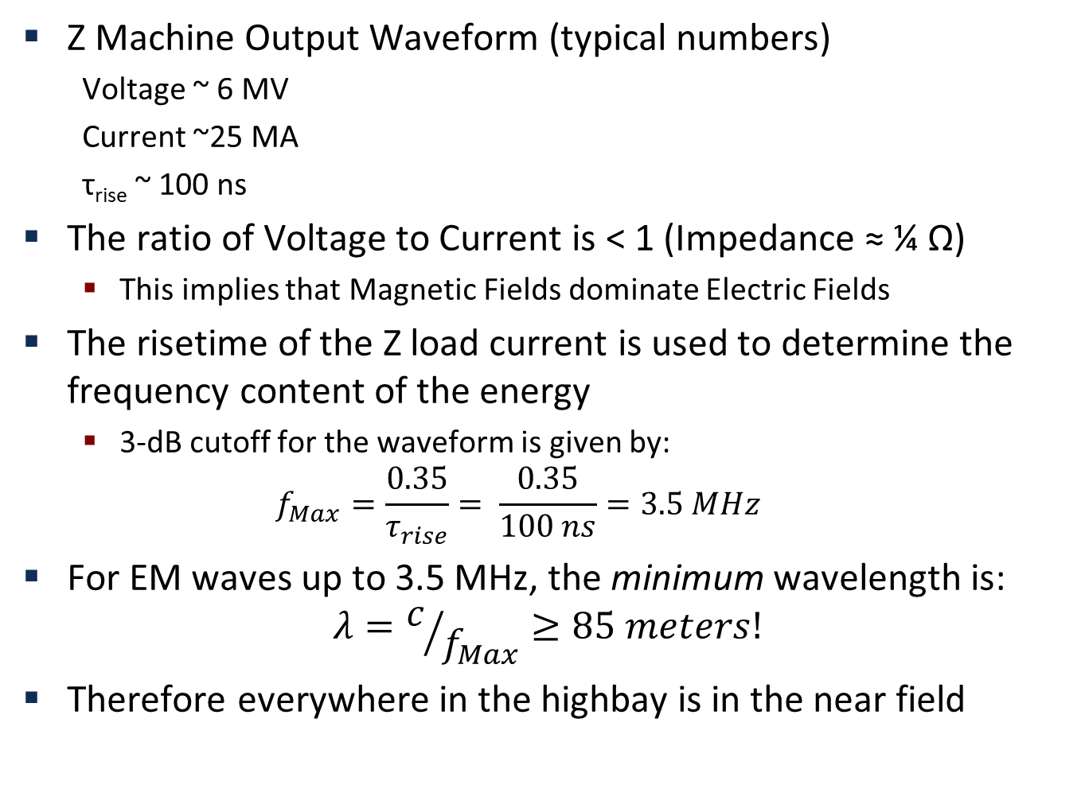
Electrical Interference on Z Machine
Z Machine Output Waveform (typical numbers)
  Voltage ~ 6 MV
  Current ~25 MA
  τ_{rise} ~ 100 ns
The ratio of Voltage to Current is < 1 (Impedance ≈ ¼ Ω)
  This implies that Magnetic Fields dominate Electric Fields
The risetime of the Z load current is used to determine the frequency content of the energy
  3-dB cutoff for the waveform is given by:
  $$f_{Max}=\frac{0.35}{τ_{rise}}= \frac{0.35}{100 ns}=3.5 MHz$$
For EM waves up to 3.5 MHz, the minimum wavelength is:
$$λ=c/{f_{Max}}≥85 meters!$$
Therefore everywhere in the highbay is in the near field
Notes:
Different numerators may be used to calculate the bandwidth, depending upon the exact shape of the waveform, but this gives the order of magnitude of the answer.

Slide 11
Electrical Interference in Marx Test Bed
This very basic analysis indicates that noise on Z is dominated by Magnetic Fields (not RF or E-fields)
This is true for the entire Z Machine, but we are more concerned here with a single Marx in the Test Bed:
  Voltage ~ 6 MV
  Current ~ 160 kA
  τ_{rise} ~ 850 ns
  Impedance ~ 40 Ω
  Bandwidth ~ 411 kHz (wavelength λ ≥ 720 meters)
Noise in the Test Bed should be more dominated by E-fields…
  Don’t Forget Direct Coupling of Interference!
How to shield the control system/HVPSs from this interference?
Notes:
The Test Bed is likely more a generator of E-field noise than the Z tank, but these are order of magnitude calculations only and should not be considered exhaustive. Also, as stated above, don’t forget directly coupled noise/interference. After all, the HVPSs are directly plugged into the Marx charge buss.

Slide 12
Protection for Test Bed Electronics
Since EM waves are not a concern, a shielded screen box is NOT required for the power supplies
  As confirmation of this, we already have ‘unshielded’ power supplies operating in the Z highbay during experiments
Therefore we are primarily concerned with noise:
  Being induced on the power lines coming into the HVPSs
  Being directly coupled back from the MTG/Marx into the HVPSs
  Being induced onto control wires/monitor wires
How do we shield each of these?
  Surge protectors and power line filters for the AC input power
  HV diodes and filter networks to protect the HPVSs at their DC output
  Careful use of twisted, shielded pair (TSP) wire for control and monitor signals
(My thanks to Steve DeClario, Chief Engineer at Glassman for his help and suggestions about protecting their power supplies)
Notes:
This slide summarizes the protective measures that we are taking, and indeed have taken, to protect critical systems on Z.

Slide 13
Protection for Test Bed Electronics
We have prior experience doing TSP wiring badly…
MUST have the signal and return on the same pair in the bundle
The effective ‘area’ enclosed by each signal path can be large
This area can easily induce large voltages on the conductors from stray time-varying magnetic fields
The effective ‘area’ enclosed by each signal path is minimized
Susceptibility to nearby Magnetic fields is minimized
Shields around the cabling prevent E-field coupling
Notes:
We have a burned-out CompactRIO card that demonstrates the very high voltages can be induced on control wires near operating Marxes.

Slide 14
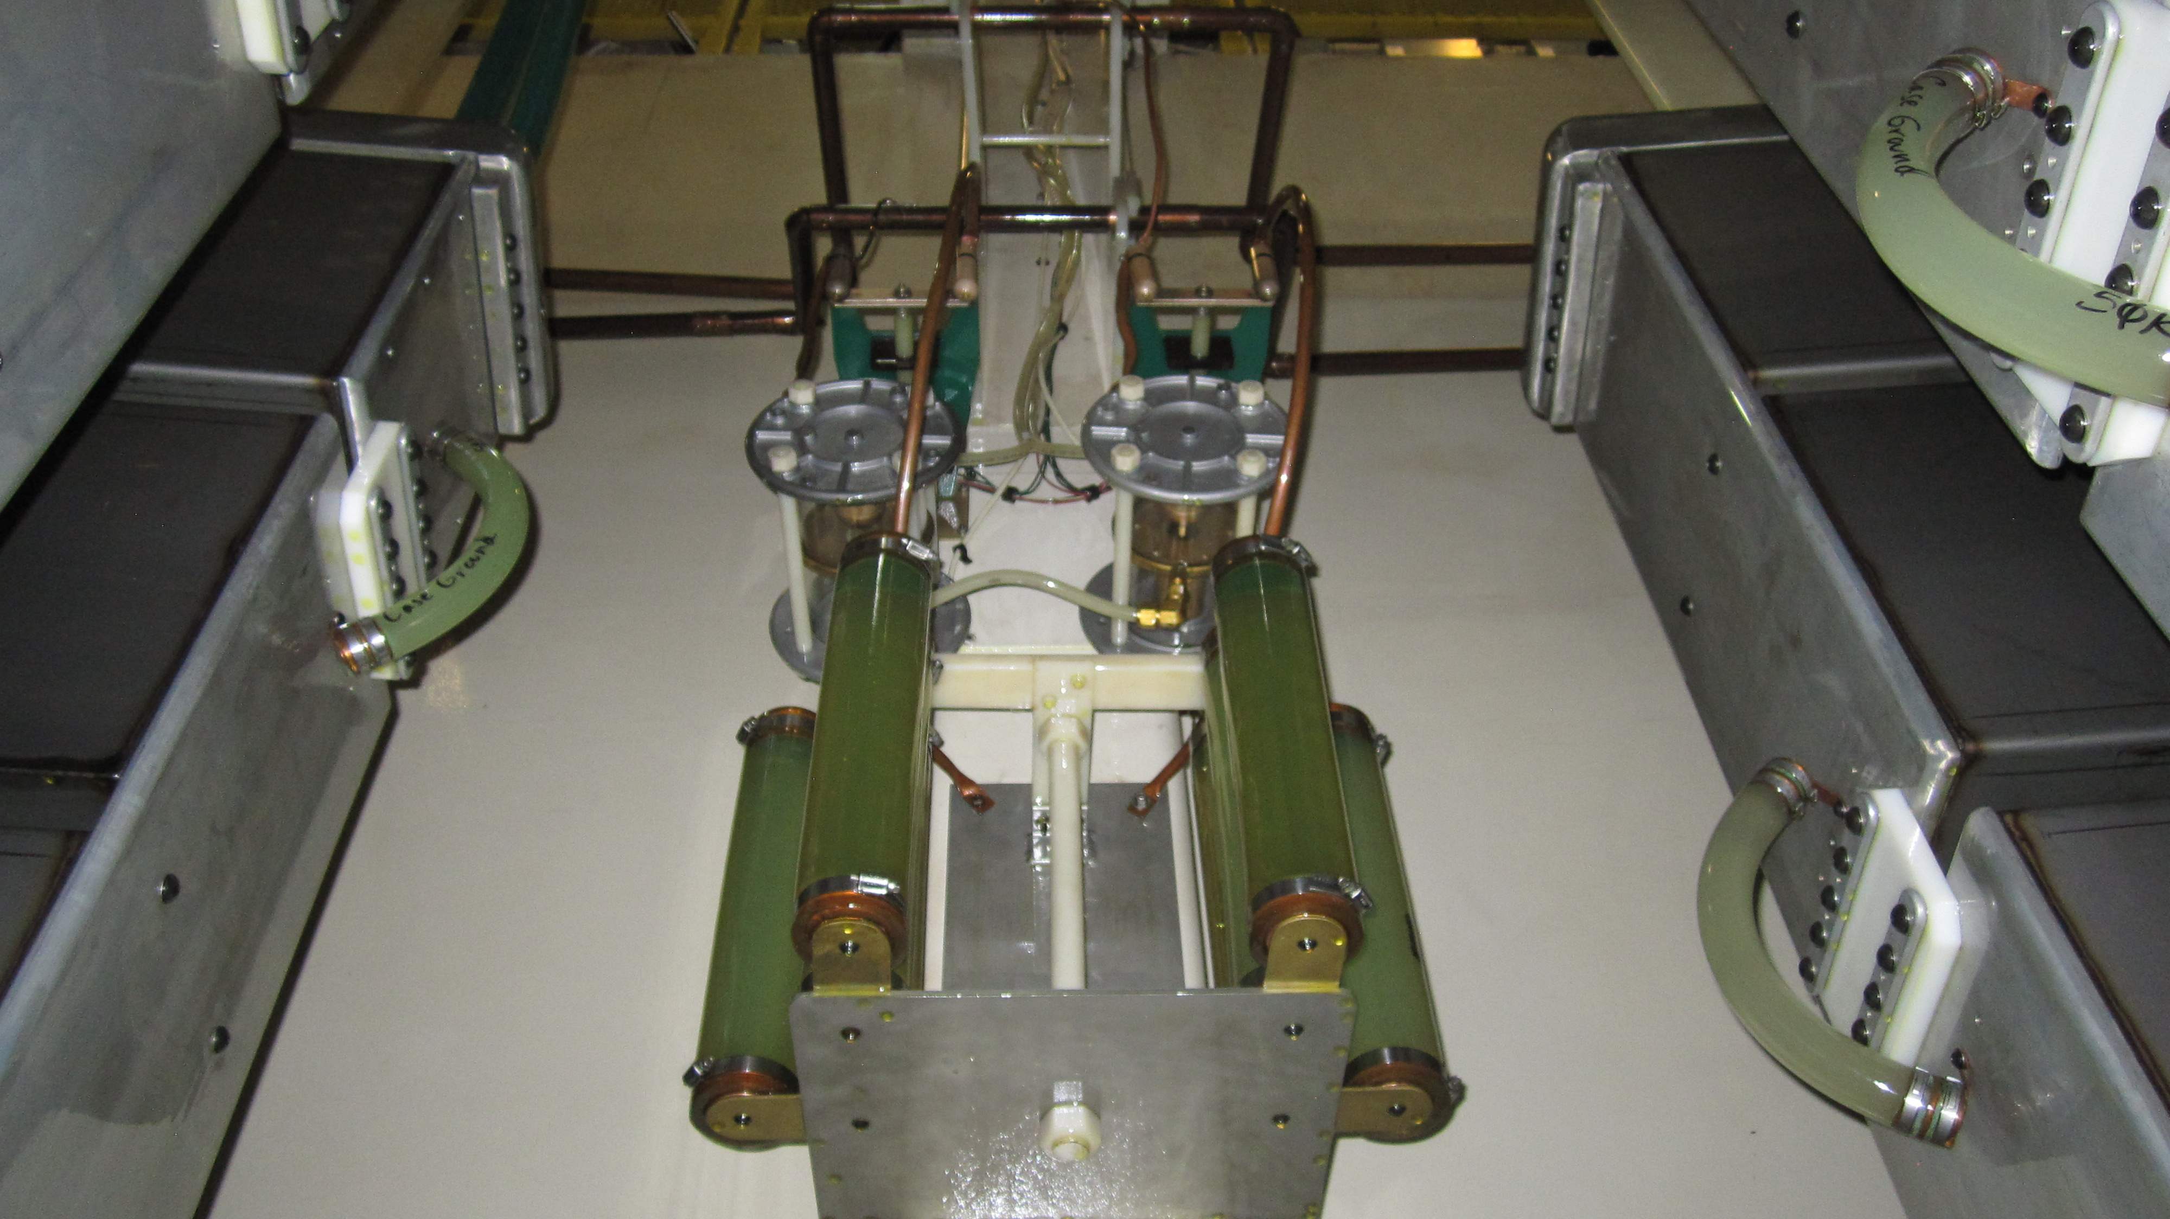
Protection for HVPSs
Glassman recommends protecting their power supplies from transients on the Marx/MTG charge buss
We do this through a combination of:
  Series HV diodes to protect the HVPS from over-voltage conditions on forward surges
  Parallel HV diodes to limit the current on reverse surges
  RC filters to limit microsecond transients to levels that the diodes can handle when the Marx erects
  Self-break spark gaps limit charge bus voltage excursion when the Marx erects
These protective measures have been
used for many years in the Test Bed and
on the Z Machine itself
Notes:
When the Marx erects, it tries to drive each side of the charge buss up to half the Marx output voltage through the drop-charge resistors.
This is a picture of the spark gaps, grounding relays, and dump resistors on the Test Bed Marx charge buss. It may not be obvious but these are way up off the ground and difficult/dangerous to work on.

Slide 15
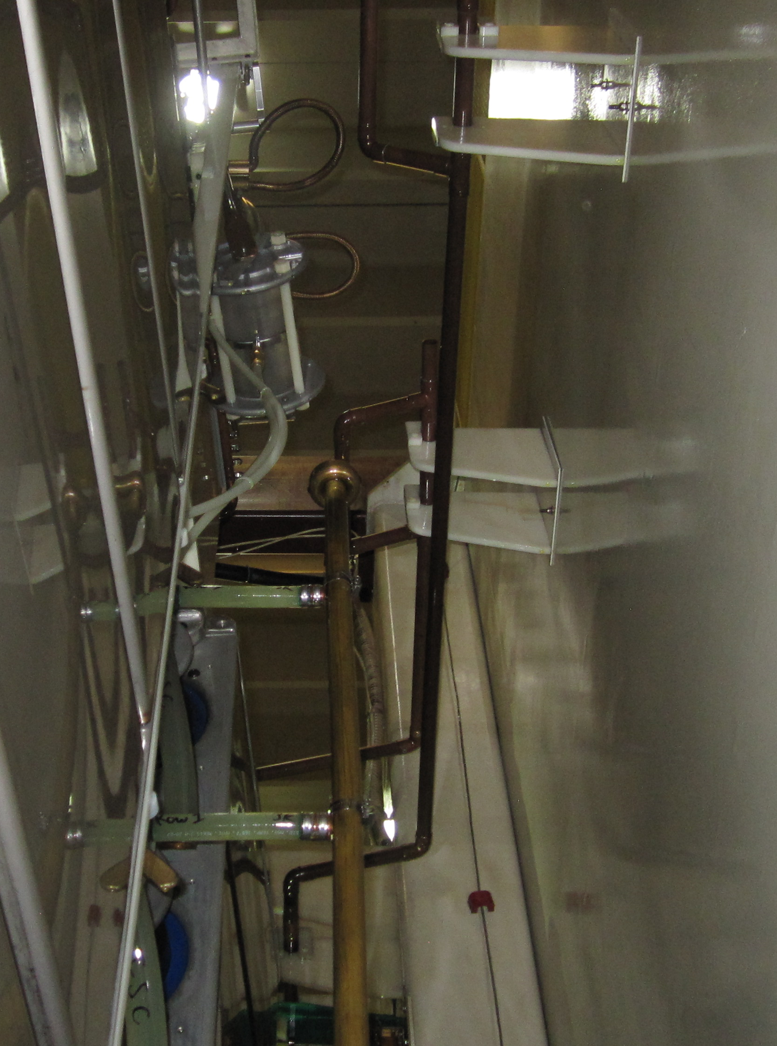
In-Tank Modifications
Several of the high voltage components are mounted high above the tank floor
  Requires access from an oil-covered, 6 ft ladder
  Inspection, trouble-shooting, and repair are all complicated by this
Where possible, components will be mounted lower, and more ergonomically
  High voltage relays
  Dump resistors
  Filter resistors
The main charge buss connections will remain in place
Notes:
Here is a picture showing the mounting brackets for the Marx charge buss in the Test Bed. This needs to be located well above the ground to make the connections as in the main Z tank.

Slide 16
Marx Test Bed Circuit Diagram
Series combinations of relays are used to ensure personnel safety – both the Marx (or MTG) can be shorted through dump resistors to ground; as well as the power supply system.
Notes:
We use a combination of two series relays for personnel safety. It turns out that the power supplies, and even in some instances the capacitance of the HV cabling, can store enough energy to exceed the criteria for doing energized work at Sandia. With the use of two relays, we can short each side of the Marx charge buss through the dump resistors; and we can also dump the power supply and HV cables through the filter resistors directly to ground. This ensures that personnel cannot be exposed to high voltage hazards when the system is de-energized.

Slide 17
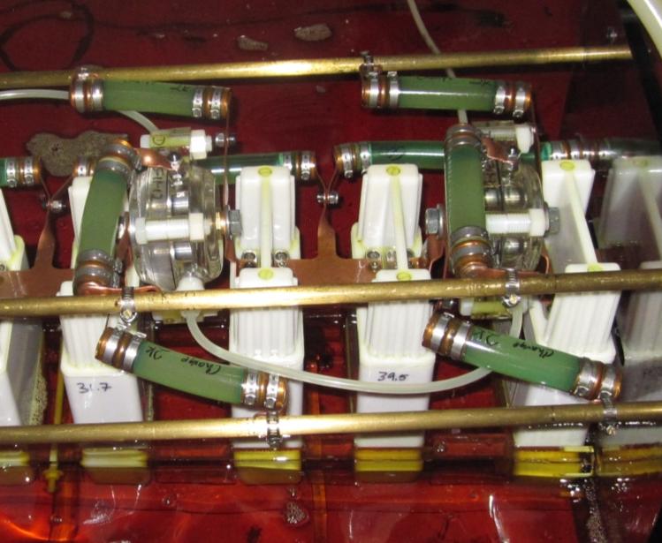
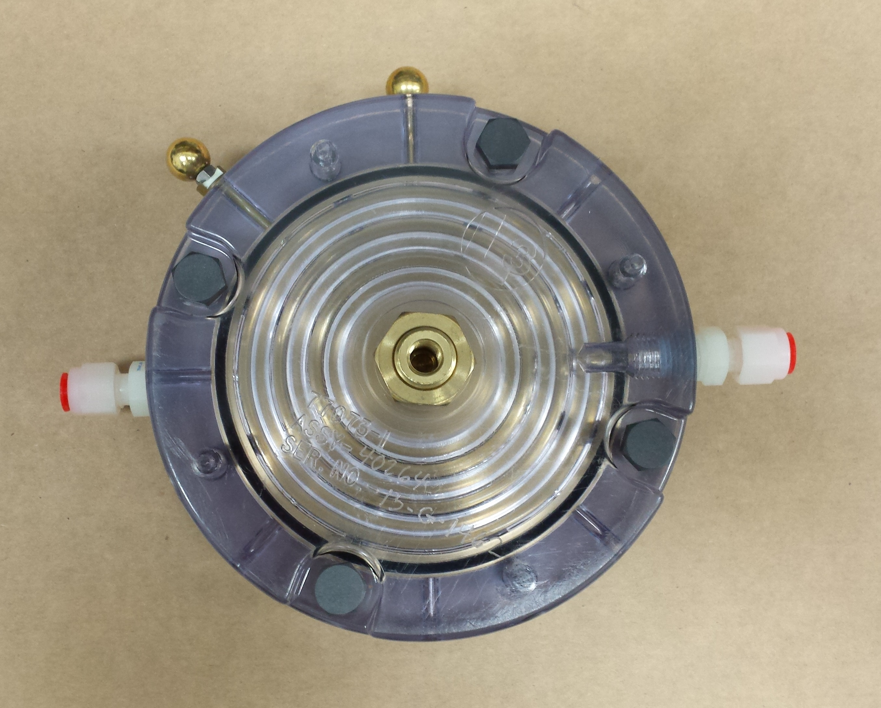
Test Bed MTG Modifications
Spark gaps used on Marxes and MTGs are Sandia-modified versions of L-3 Communications T-670 switches
Those used in the MTGs are obsolete, need to transition to 50264 models
  Need to verify operation of the new spark gap designs before transitioning main Z tank!
We prefer to operate well away from self-break
  Use a high-voltage trigger to gain reliable triggering/breakdown of the spark gap…
  We are upgrading the primary trigger generator in the Test Bed as well
Notes:
Again, we will use this opportunity to modify the MTG in the test bed for testing that we need to conduct going forward anyway.
Pictured above is a shot of the MTG in the Test Bed with the old spark gaps, as well as one of the new L-3 switches, this one is actually last years’ model: a 40264.

Slide 18
Control System
CompactRIO-based, LabVIEW-coded control system
Remote control of:
  Gas handling
  Charging
  Triggering
  Data Acquisition
  Interlocks/Safety Features integrated
New operational modes are available:
  Can operate while under high-voltage lockup in the highbay
  Remove human error during testing
Notes:
The control system is being built in-house using COTS LabVIEW controller software and CompactRIO modules. This will greatly simplify the operation of the system going forward. Also perhaps make things less fun…
The diagram here is an abbreviated schematic of the SF₆ gas handling manifold.

Slide 19
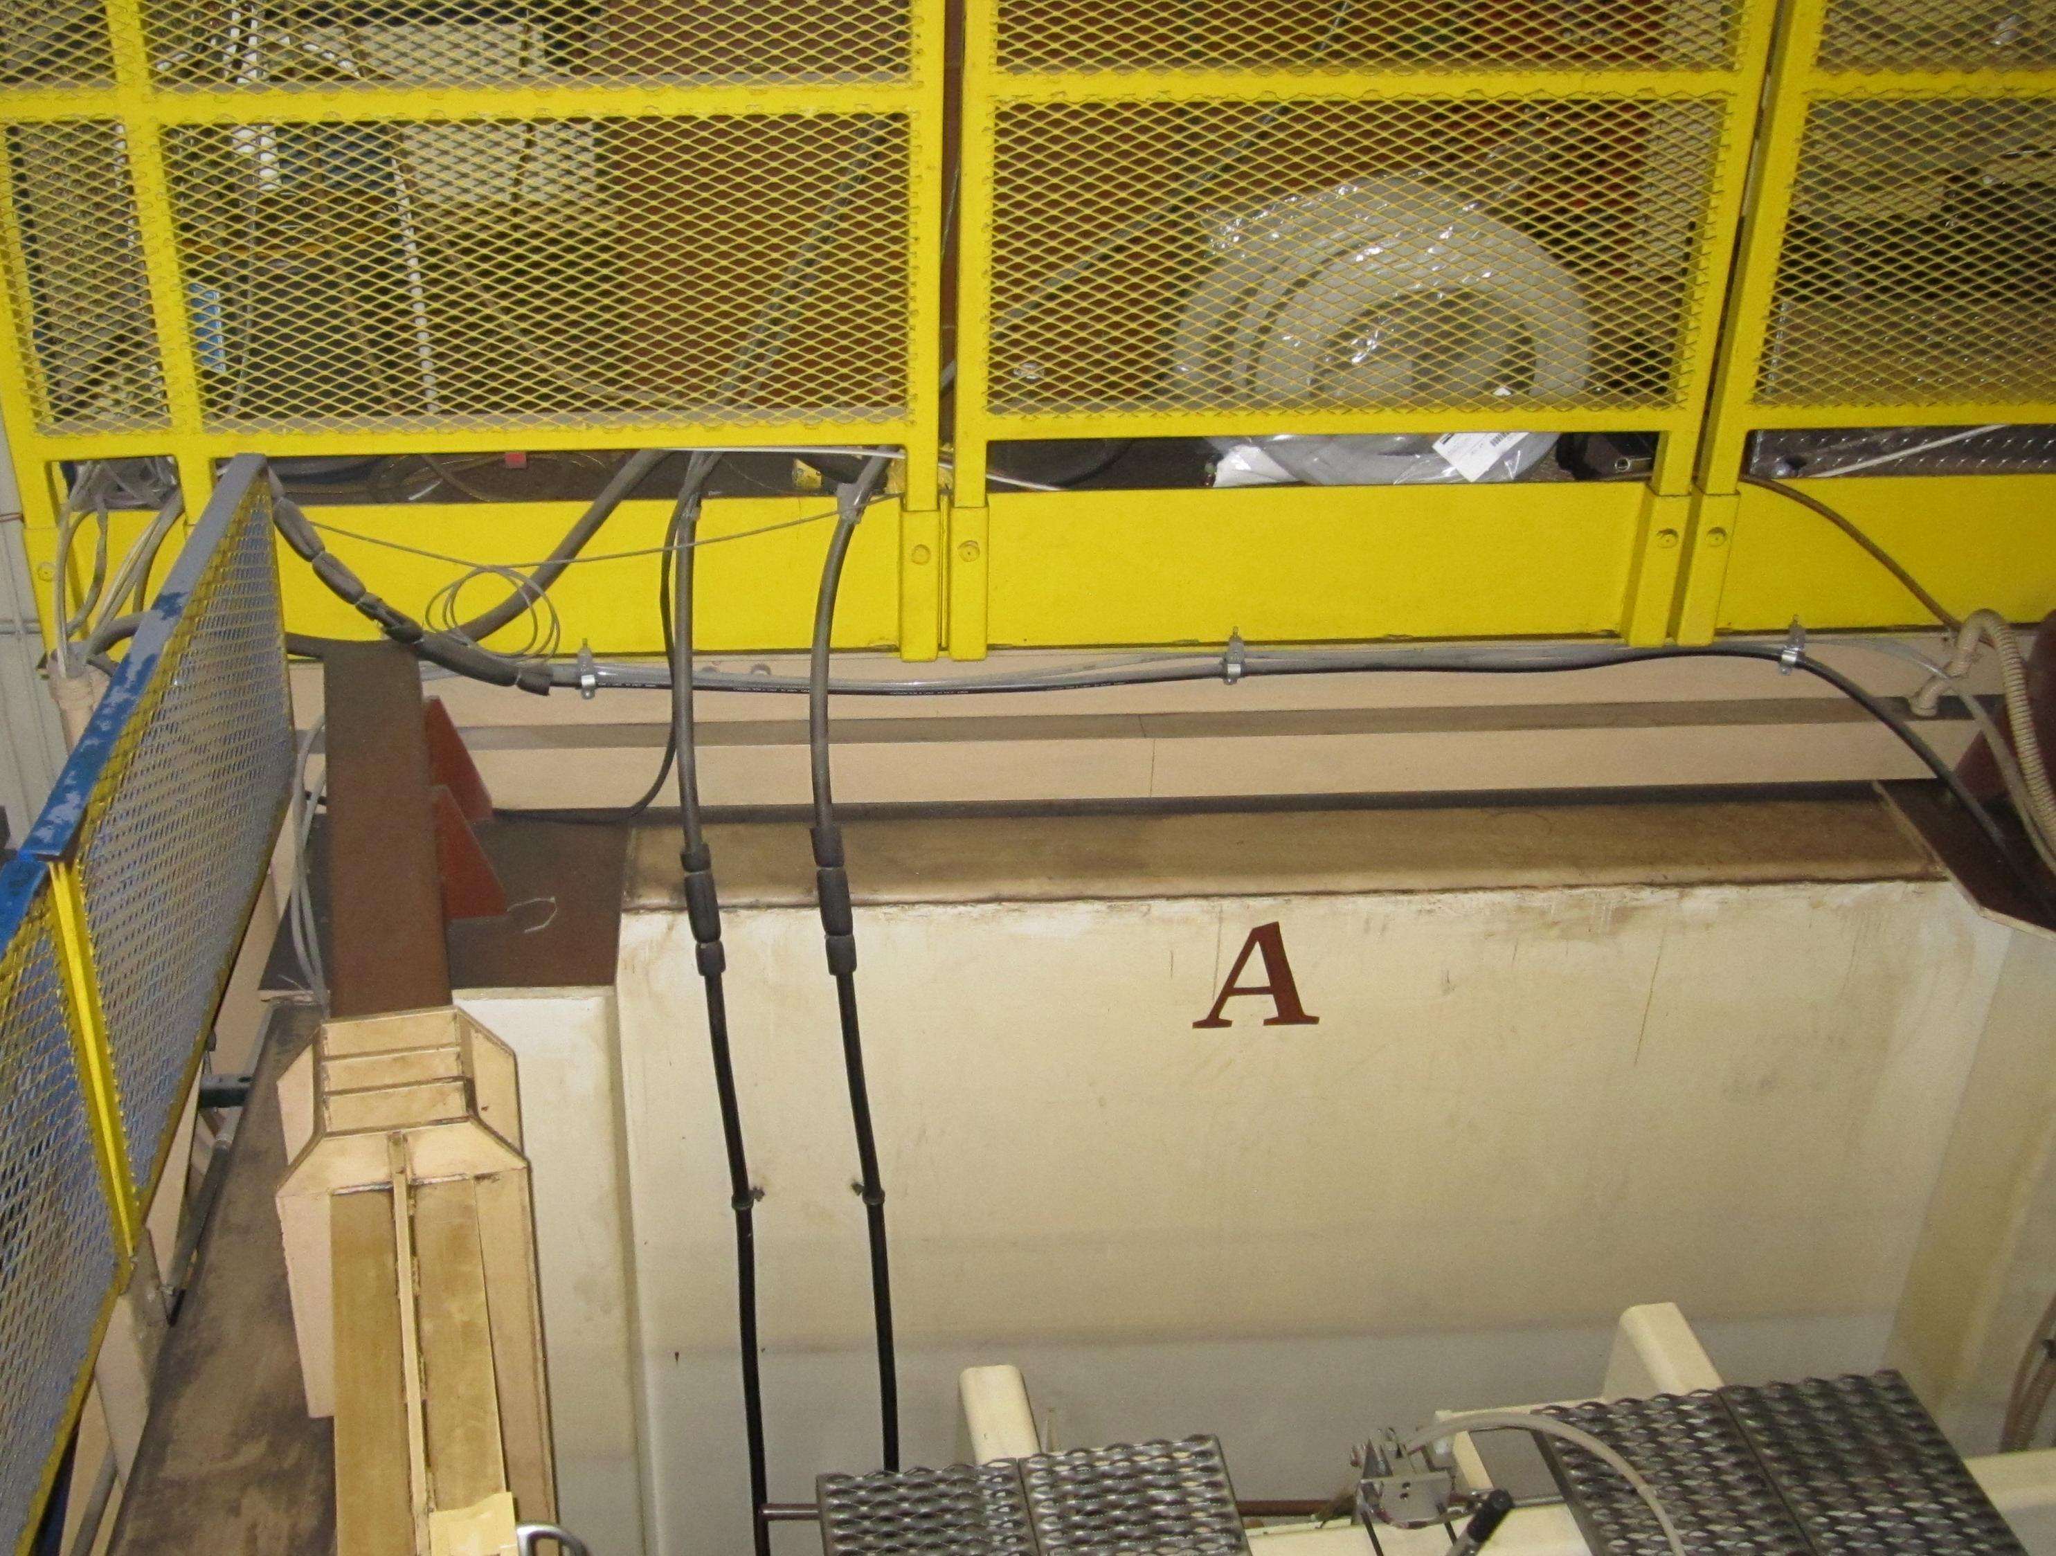
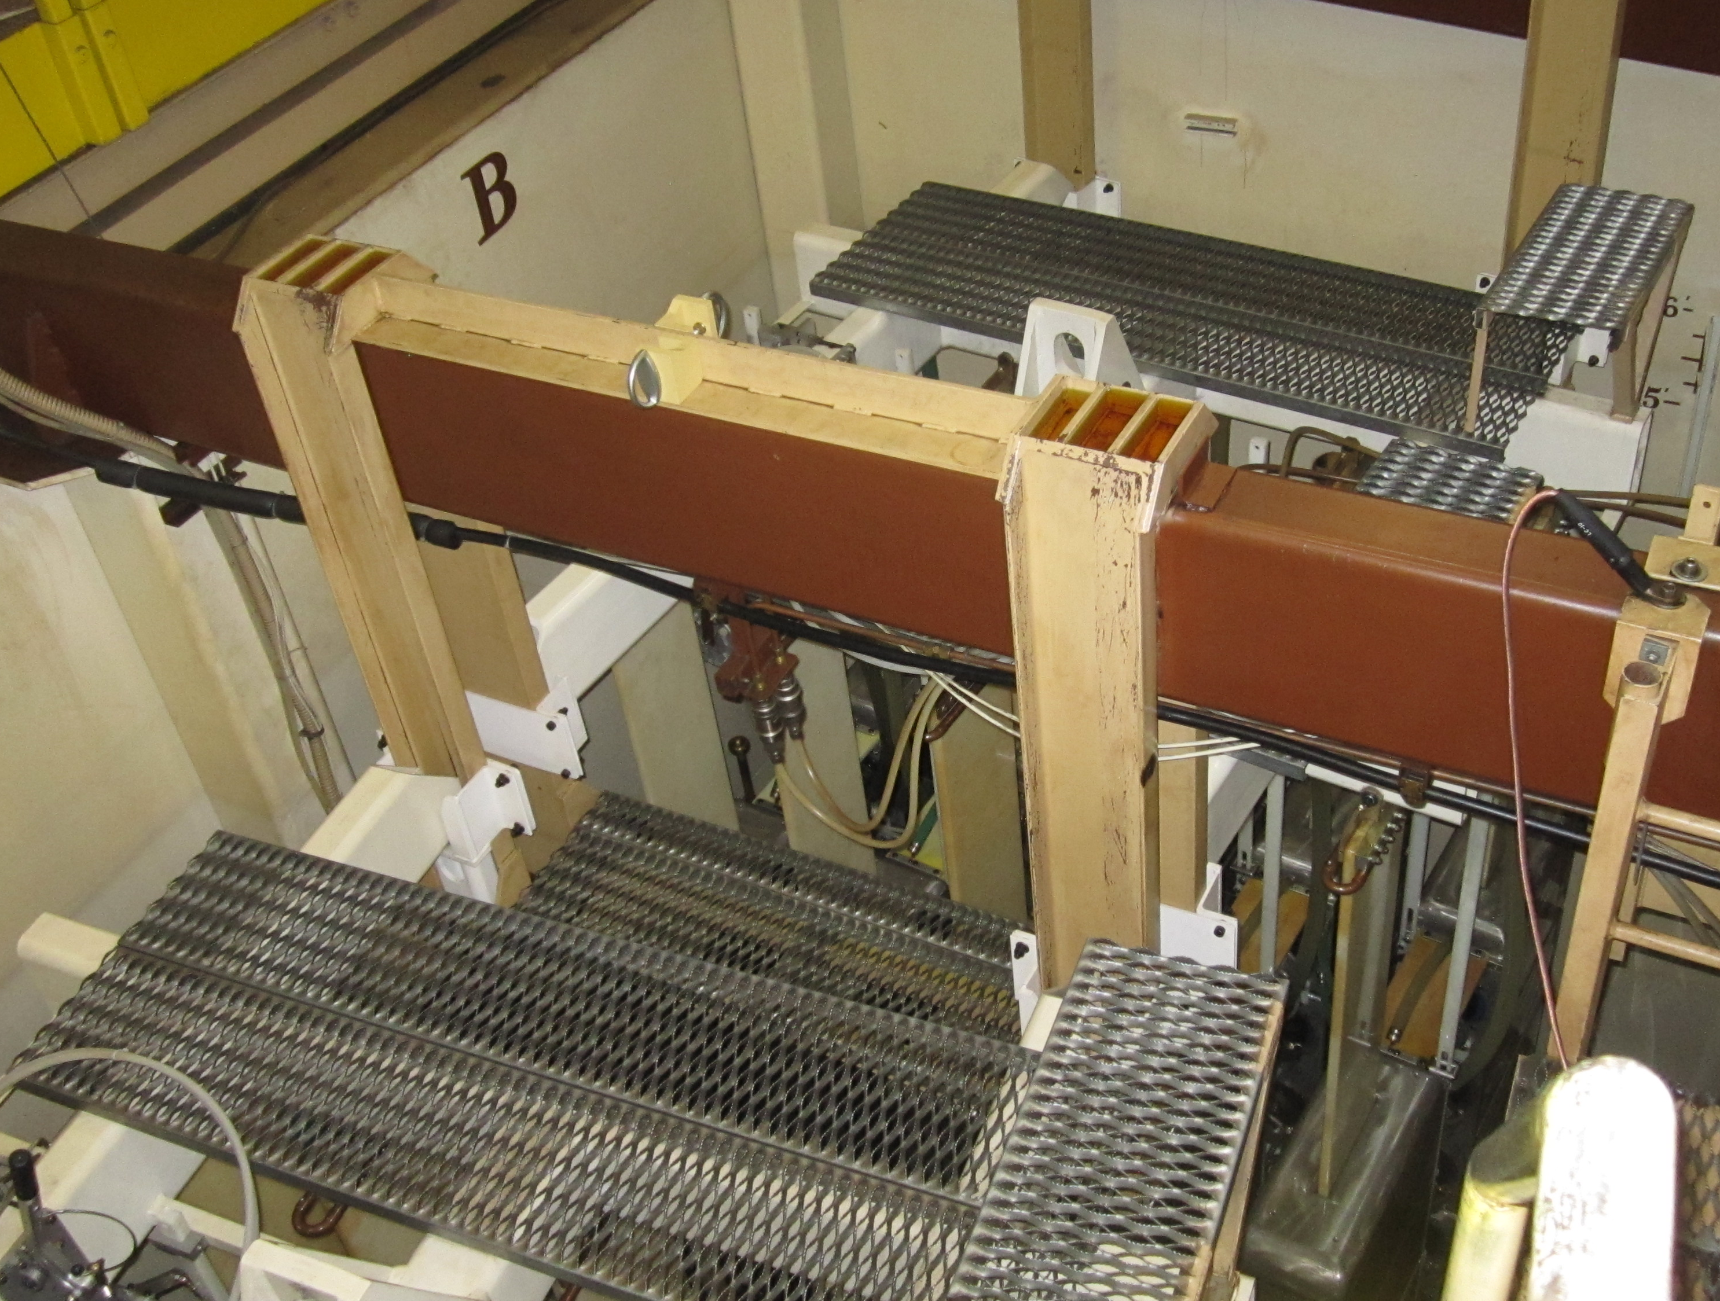
(Potential) Future Capabilities
Add a Swingarm for the Dummy Load
  Enable testing of Marxes in Either ‘A’ or ‘B’ slots
  Operationally saves time in some circumstances
Automated analysis of Waveforms
Z MTG Testing Capability
  More Generic HV testing Capability
Imaging of Marx in Test Bed during HV Operations
Testing of other gases in Spark Gaps
  SF₆ is our workhorse:
  Expensive
  Environmentally unfriendly
Notes:
SF₆ leaks are being scrutinized now more than in the past – it is a powerful greenhouse gas; additionally electrical breakdown generates toxic by-products.
Photos here are of the two slots in the Test Bed.

Slide 20
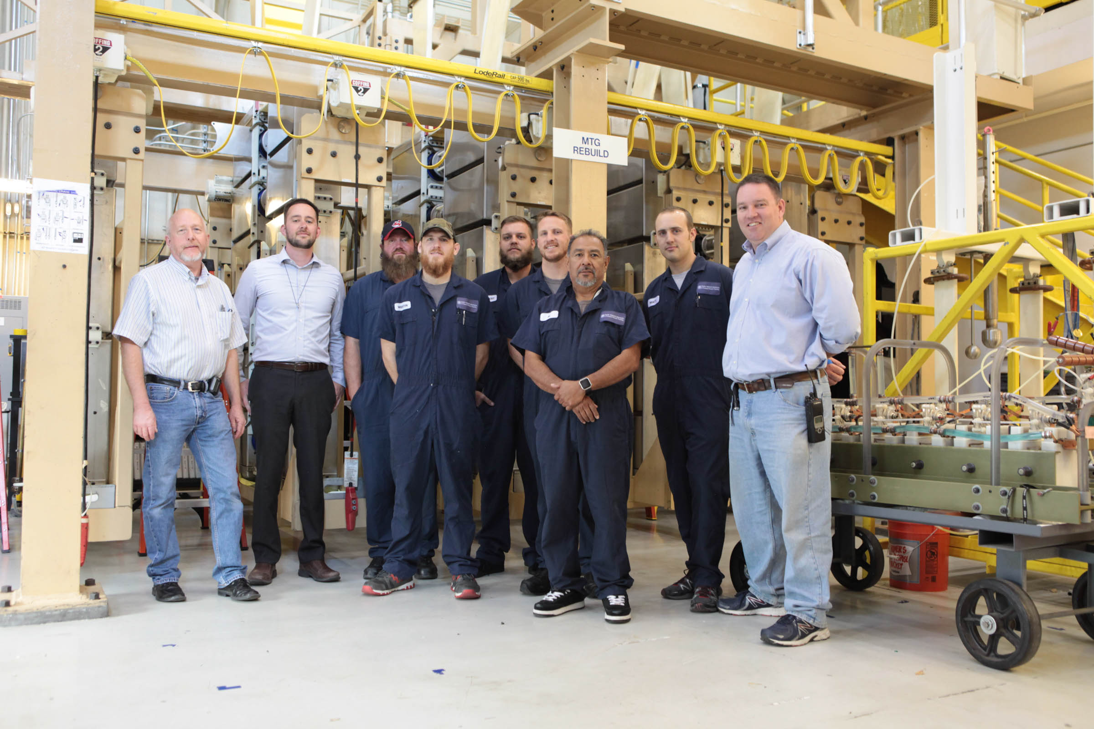
Questions?
Notes:
Thank you for your time. Pictured here are several members of the team as of a year ago.

