Slide 1
Ozone Generation with a
Flexible Solid-State Marx Generator
J. J. van Oorschot¹
T. Huiskamp¹
M. Pereira²
L. M. Redondo³
¹Eindhoven University of Technology
²Energy Pulse Systems
³Instituto Superior de Engenharia de Lisboa

Slide 2
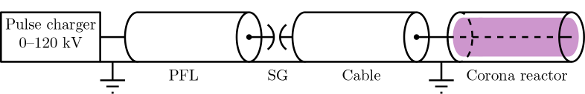
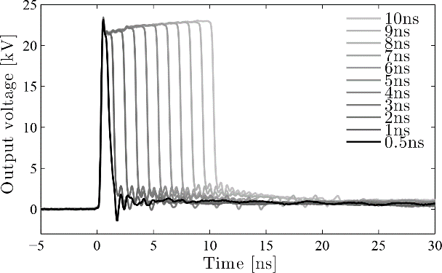
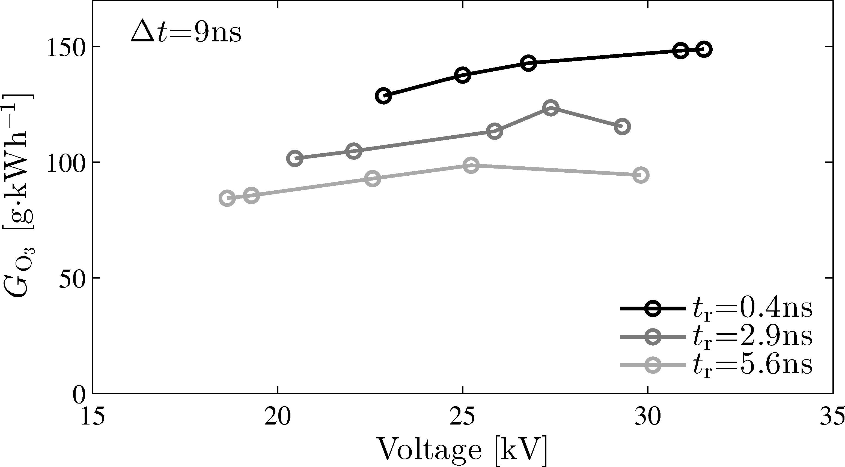
Previous results: high-efficiency ozone generation
Specifications
Up to 50 kV (pos and neg)
0.5-10 nanosecond
<200 ps rise time
Up to 1 kHz
Flushed oil spark gap
Results
Up to 160 g/kWh ozone production
Very efficient, but not a practical system!
New project:
Use flexible solid state Marx generator for robust, practical ozone generation
Huiskamp et al., IEEE T Plasma Sci, vol. 43, pp. 444-451, 2015
Huiskamp et al., J. Phys. D: Appl. Phys., vol. 50, 405201 [16pp], 2017
Notes:
Ozone: measure of plasma efficiency for air purification, water purification, etc.
Eindhoven work: good results, but not a practical systems
New project together with ISEL (Luis Redondo) and Energy Pulse Systems

Slide 3
Solid-state Marx generator
Marx generator developed at Energy Pulse Systems:
Up to 15 kV pulses (15 stages of 1 kV)
Pulse duration: variable from 200 ns to 100 µs
Repetition rate up to several kHz
Burst mode operation possible (burst frequency up to 200 kHz)
Redondo, L. M., et al. "Solid-state Marx generator for the compact linear collider breakdown studies." IPMHVC 2016, 187-192, 2016

Slide 4
Solid-state Marx generator circuit operation
1kV per stage charging through diodes (and switches)
1.2 kV SiC MOSFETs for fast, efficient switching
  Tpi: discharging capacitors over load
  Tci: discharging load and charging capacitors between pulses
Series resistors for damping and current limiting
Redondo, L. M., et al. "Solid-state Marx generator for the compact linear collider breakdown studies." IPMHVC 2016, 187-192, 2016

Slide 5
Total system
DC PSU decoupled with filter (and with Taux during pulsing)
Marx controlled with µP (programmed from PC)

Slide 6
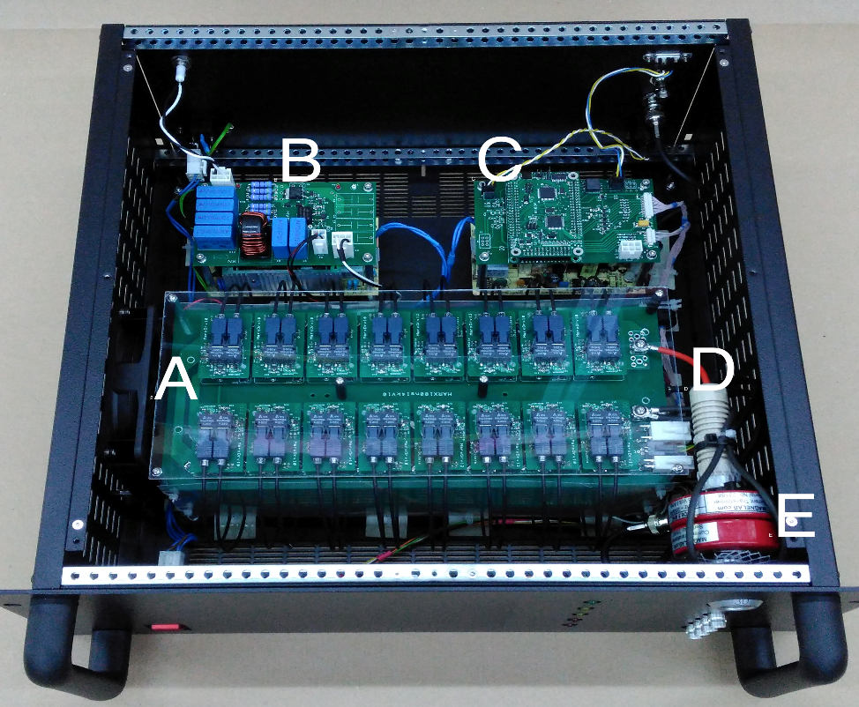
Practical implementation
A: Marx generator
B: Input filter
C: Control board
D: HV connector
E: Current sensor
Notes:
- Fibre connections for the gate drivers

Slide 7
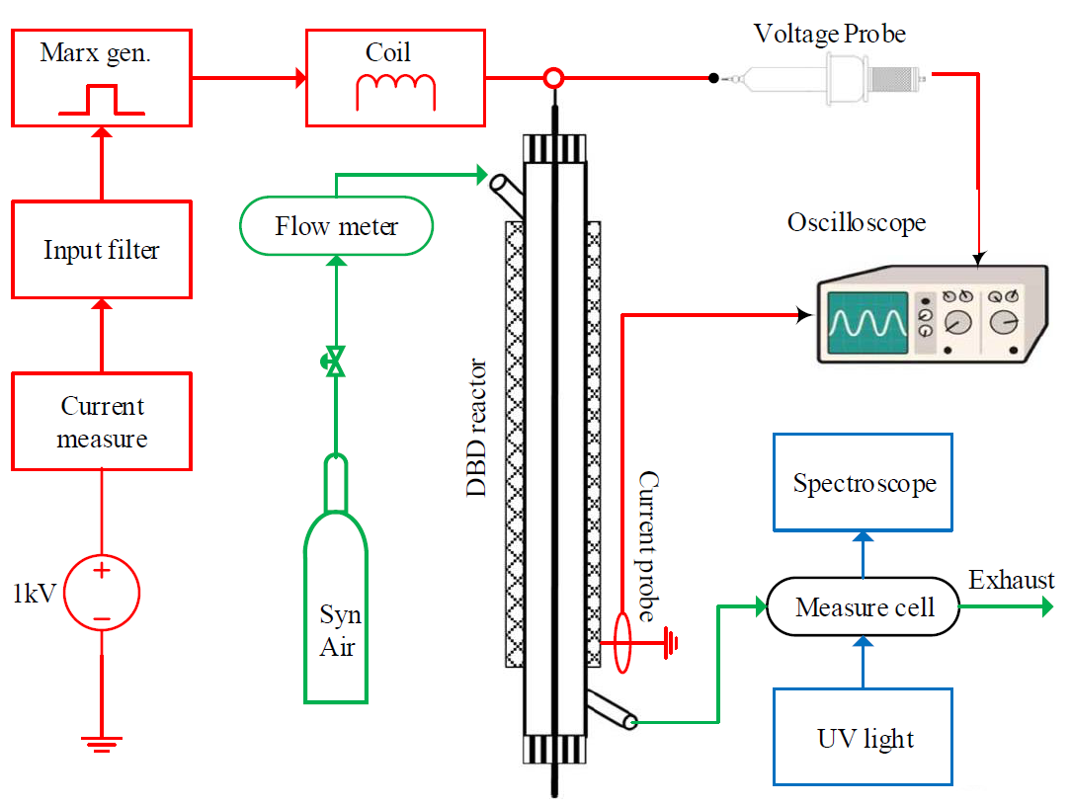
Experimental setup
Notes:
Note:
DBD reactor (glass tube with stainless steel inner electrode and mesh outer electrode)
Synthetic air
Ozone measured with UV absorption spectrometry
Plasma energy measured calculated from measured voltage and current
Inductor benoemen

Slide 8
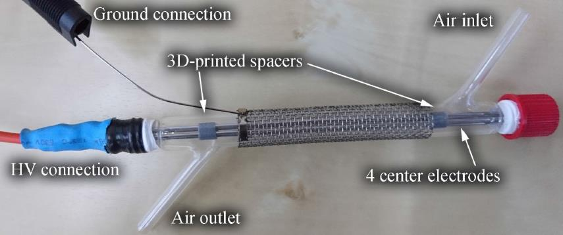
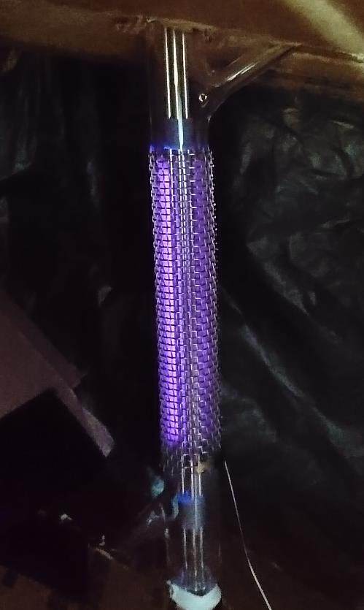
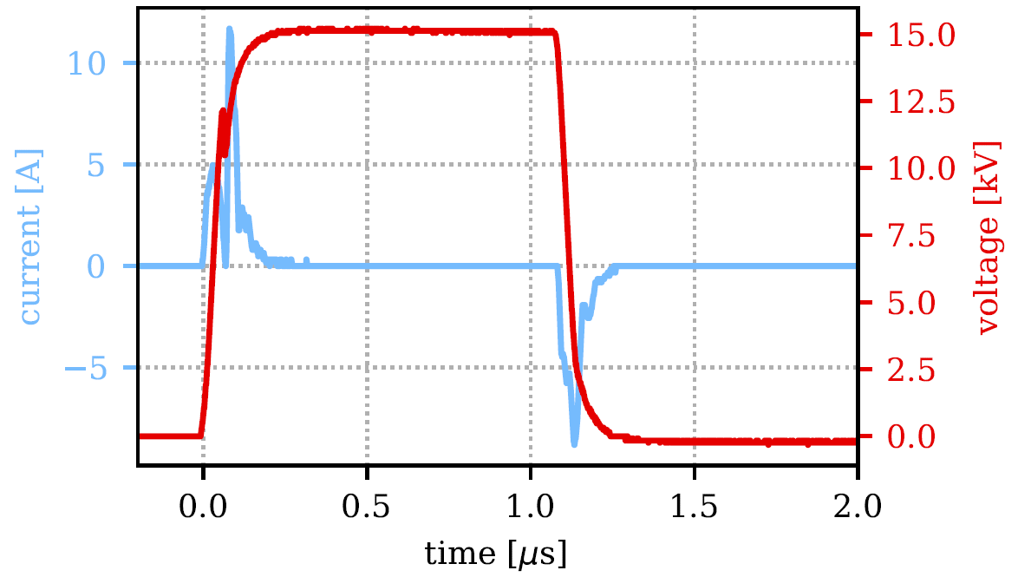
DBD plasma
Notes:
Note: several types of reactor were used, with and without series inductance (to resonantly charge the plasma reactor, thereby increasing the peak voltage)

Slide 9
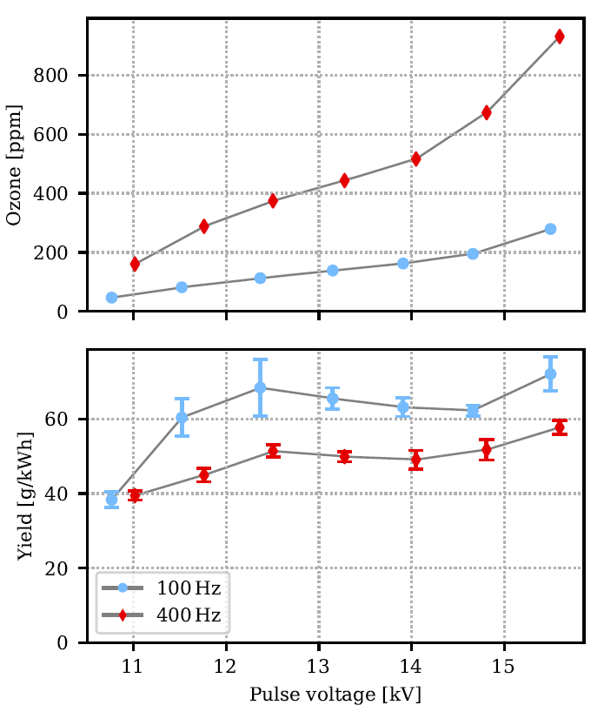
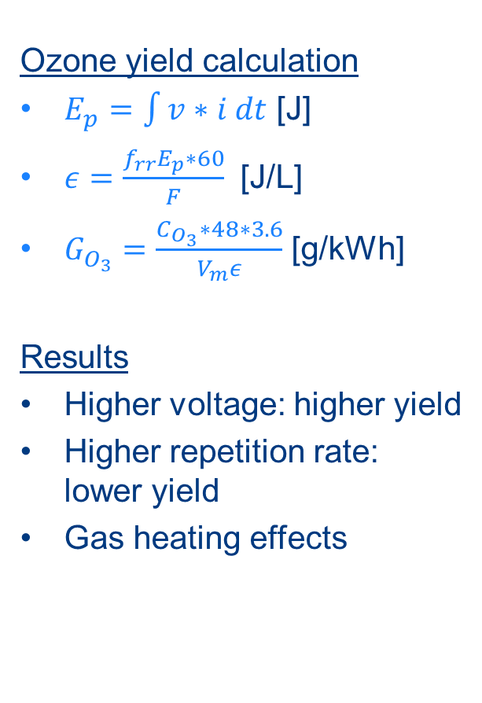
Results: voltage
Ozone yield calculation
$E_{p}=\int{v∗i dt}$ [J]
$ε=\frac{f_{rr}E_{p}∗60}{F}$ [J/L]
$G_{O_{3}}=\frac{C_{O_{3}}∗48∗3.6}{V_{m}ε}$ [g/kWh]
Results
Higher voltage: higher yield
Higher repetition rate: lower yield
Gas heating effects
Notes:
Long glass reactor with inductor

Slide 10
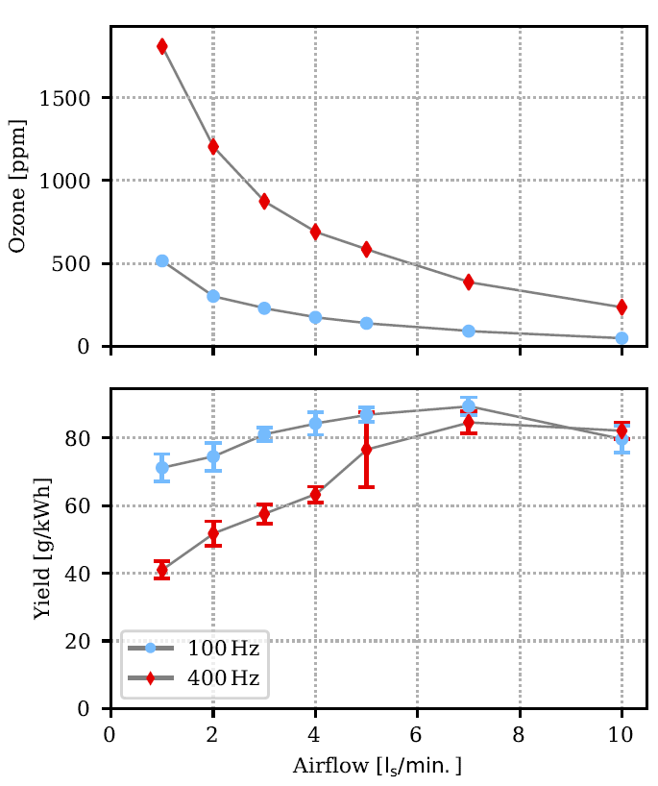
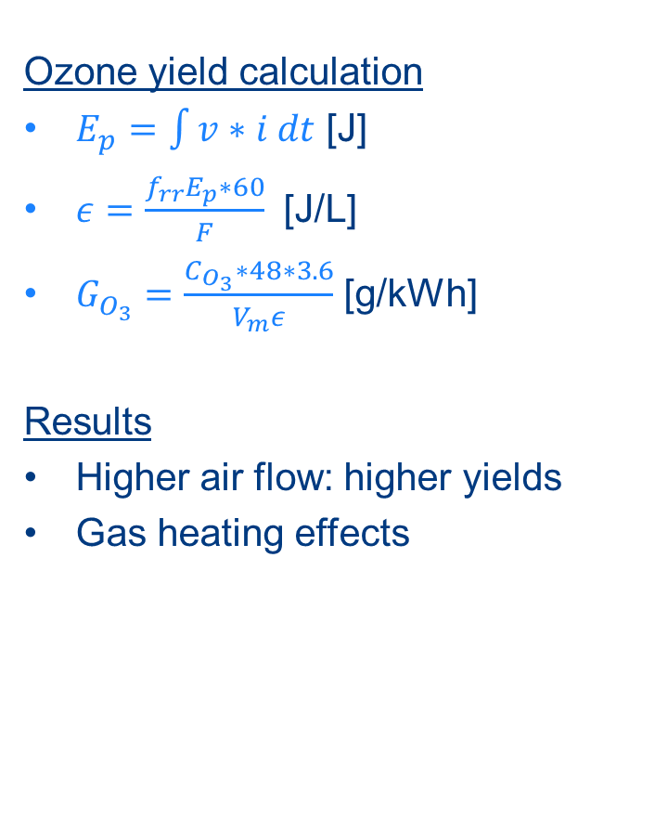
Results: air flow
Ozone yield calculation
$E_{p}=\int{v∗i dt}$ [J]
$ε=\frac{f_{rr}E_{p}∗60}{F}$ [J/L]
$G_{O_{3}}=\frac{C_{O_{3}}∗48∗3.6}{V_{m}ε}$ [g/kWh]
Results
Higher air flow: higher yields
Gas heating effects
Notes:
Long glass reactor with inductor

Slide 11
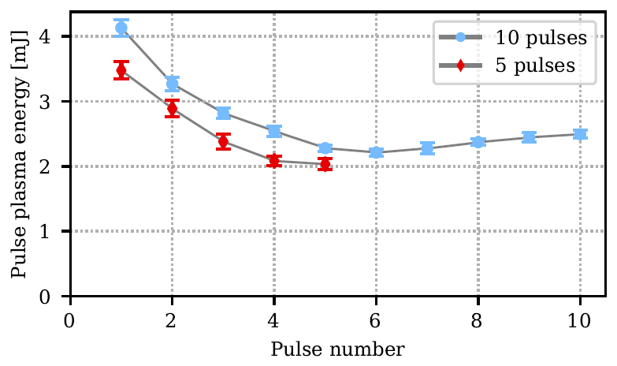
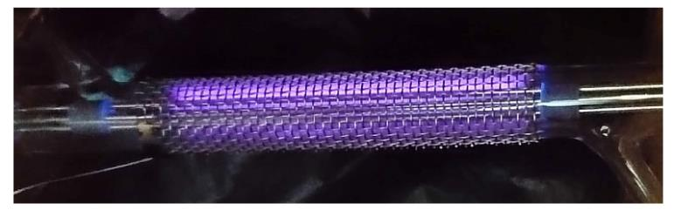
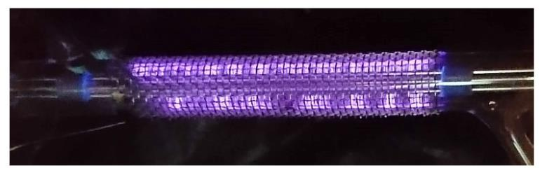
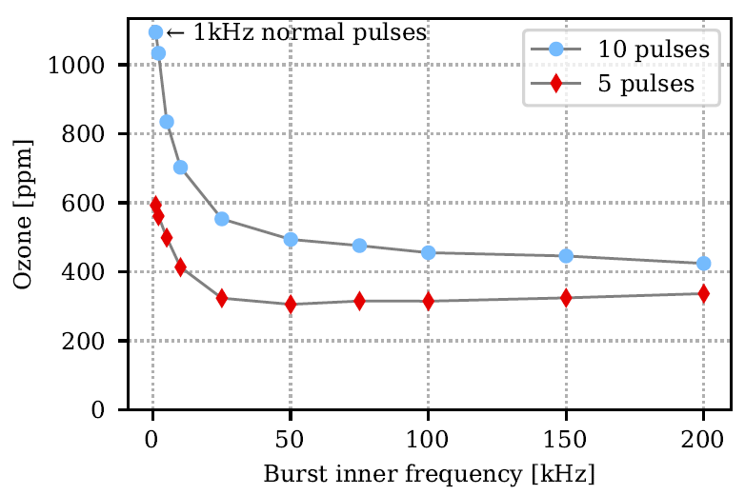
Results: burst mode
Normal operation
Burst mode operation
Notes:
In DBD operation, surface and space charges dominate the discharge, so successive pulses won’t dissipate as much energy as the first pulse

Slide 12
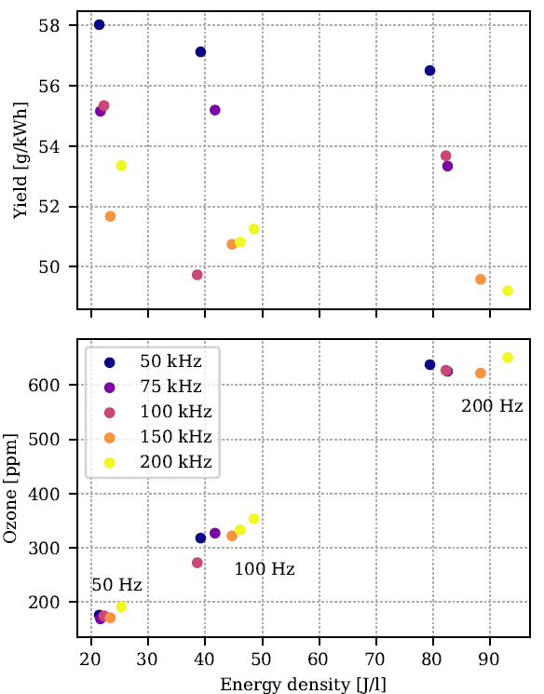
Results: burst mode
Results
Higher burst frequency: lower ozone yield
Higher repetition rate: lower ozone yield
Explanation
Space and surface charges dominate the discharge
Gas heating effects
Conclusion
Burst rate operation not efficient for ozone generation

Slide 13
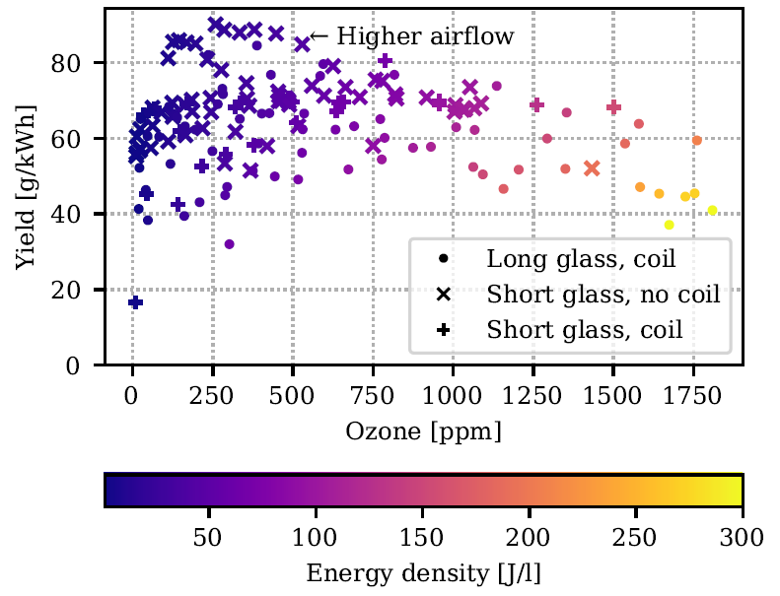
Overall results
Solid state (this work)
Spark-gap based (previous work)
Conclusions
Maximum yields around 80 g/kWh vs. 160 g/kWh for faster pulses
Promising practical application with solid-state
Thank you for your attention

