Slide 1
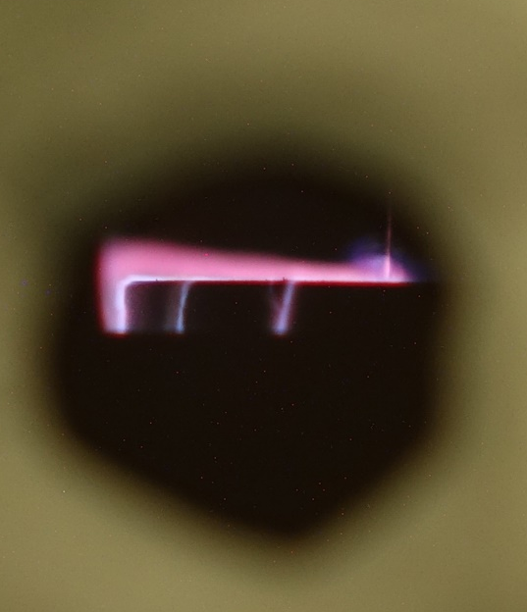
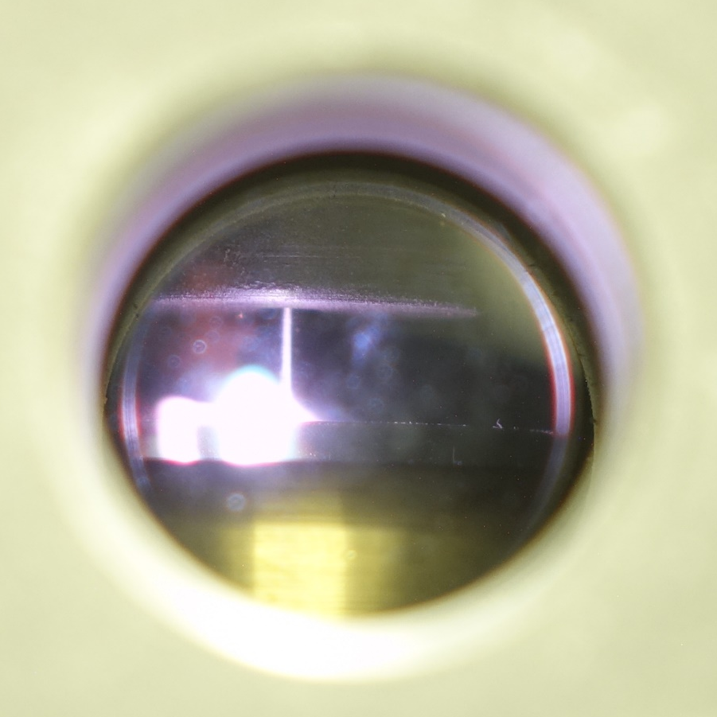
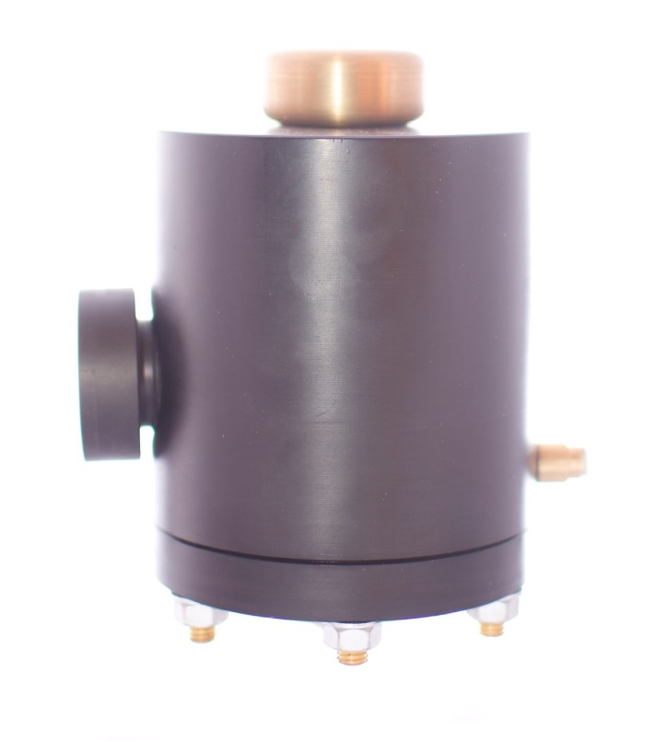
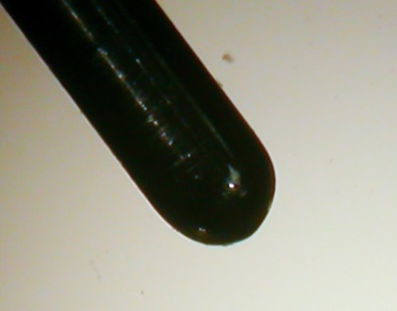
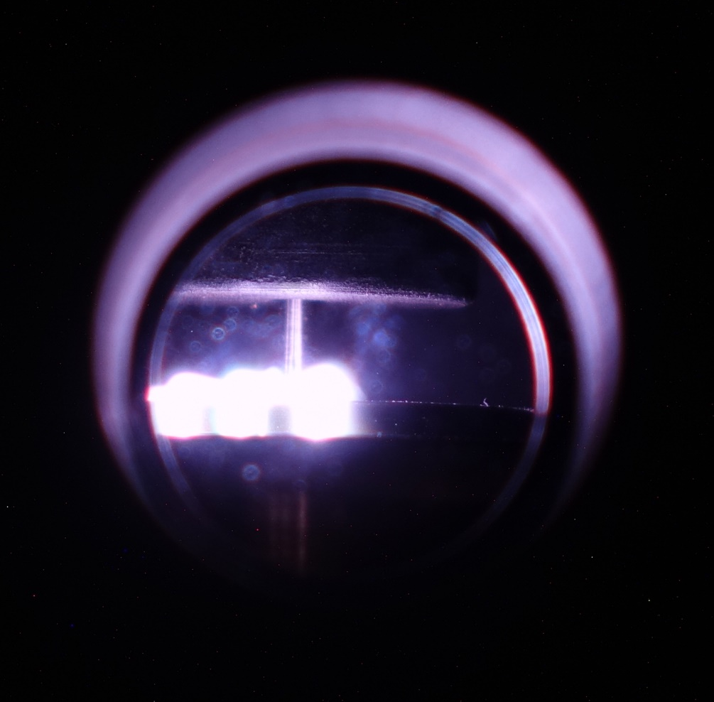
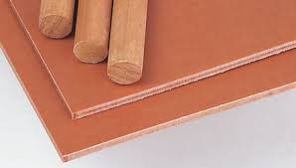
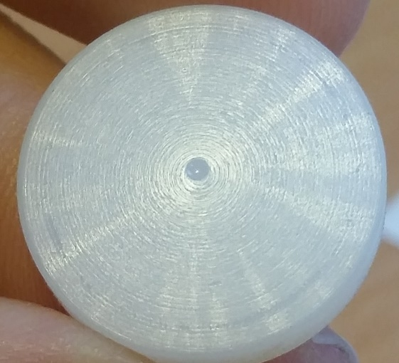
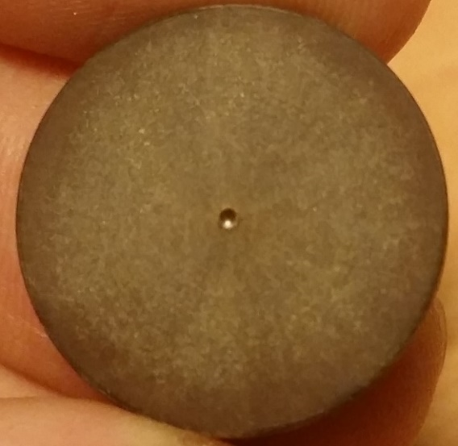
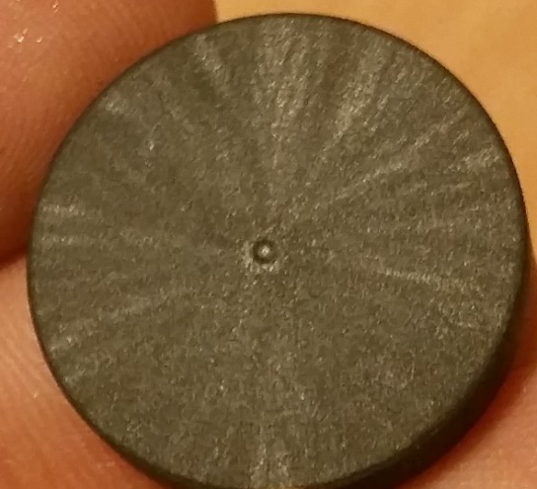
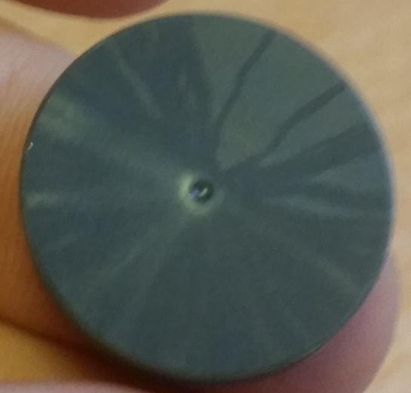
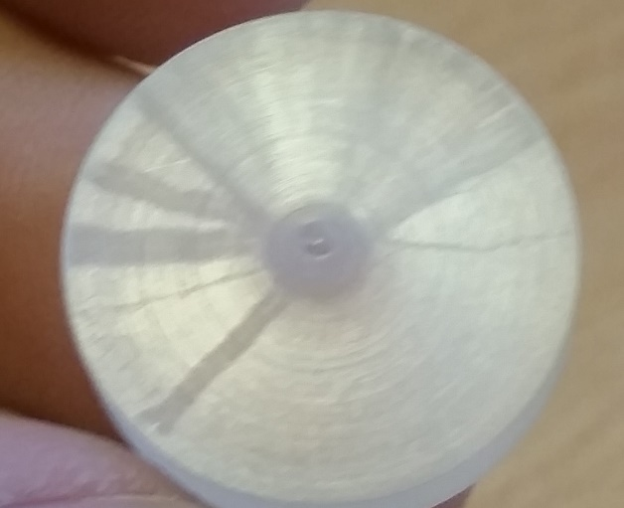
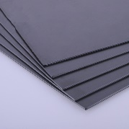

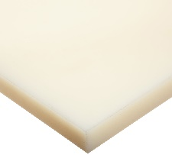
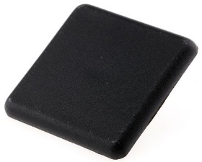
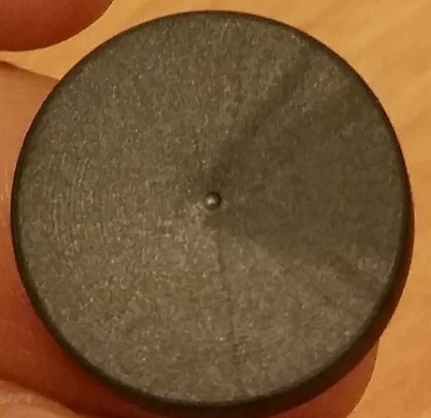
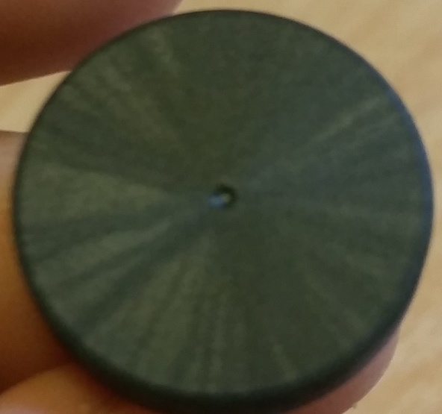
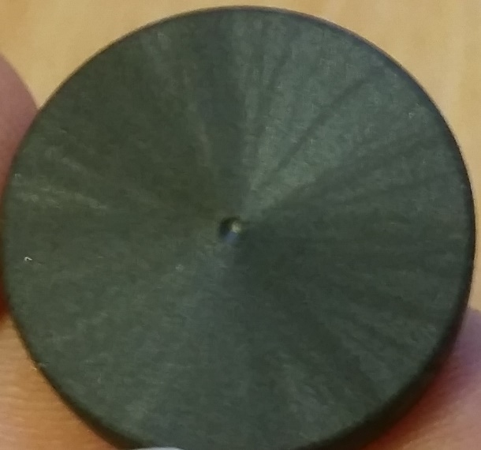
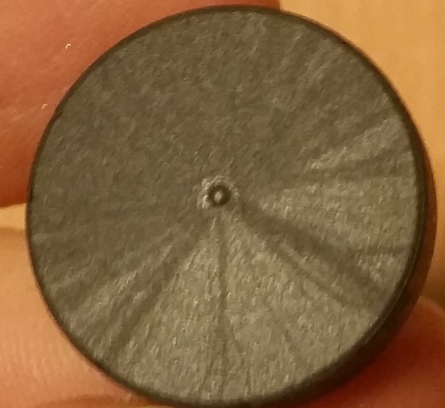
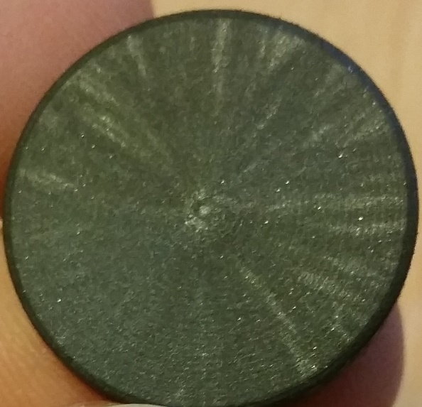
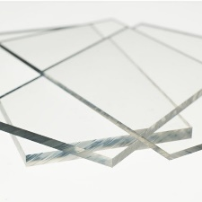
Breakdown strength, time to breakdown and jitter for all materials as a function of pressure. Error bars represent ±1 σ of breakdown voltage and jitter respectively.
Surface Flashover Behaviour of Insulating Materials under Impulsive Electric Fields in Environmentally Friendly Gases
Athanasios C. Mermigkas ; Igor V. Timoshkin; Scott J. MacGregor; Martin J. Given; Mark P. Wilson; Tao Wang;
High Voltage Technologies group (HVT), Institute for Energy and Environment, Department of Electronic and Electrical Engineering, University of Strathclyde, 204 George Street, Royal College Building, Glasgow, G1 1XW, United Kingdom
The insulating level of a pulsed-power system is usually limited by the voltage that initiates flashover over the surface of its solid insulators, rather than by the bulk solid breakdown strength. Due to environmental concerns, the use of SF₆ is being reduced and it is therefore imperative to investigate the surface flashover performance of various commonly used solid insulating materials, in conjunction with the use of more environmentally friendly gases for compact pulsed power systems. Gases like nitrogen and carbon dioxide, that are proven to have desirable dielectric strength under pulsed conditions, are being considered as potential insulating gases for pulsed power systems and applications. Such gases can potentially be mixed with 4th generation refrigerants that exhibit high dielectric strength while having low global warming potential, ~5 orders of magnitude lower than that of SF₆.
In this work, the flashover characteristics of solid dielectrics in a gaseous CO₂ environment were studied. Disc shaped solid dielectric samples (20 mm diameter and 2 mm thickness) were subjected to high voltage impulses in the gas pressure range of 1-5 atm (absolute). HV impulses with positive and negative polarities and with rise times in both ns and μs regimes were applied. PVC, Tufnol, Nylon 66, glass reinforced Nylon and Perspex were used as insulating materials. The HV electrode was a 1.6 mm diameter tungsten rod, located at the centre of the samples.
It was observed that flashover strength increases with increasing gas pressure. It was also found that some insulating materials consistently show higher flashover voltage, especially at elevated pressures. Based on the obtained results, recommendations for the use of different solid dielectrics in conjunction with environmentally friendly gases are provided, contributing to insulation coordination for pulsed power systems.
Test cell:
Surface flashover
Breakdown instances from open-shutter camera
Exhaust
HV power supply
Experiments conducted:
Each dot represents the average of 3 tests.
Each test involving 30 surface flashover events.
Gas
Solid dielectric
HV Probe Tektronix 6015A
Alicat Digital
Gas regulator
Bottled gas
Pearson current monitor 6585
Oscilloscope
Objectives:
To investigate the impulsive breakdown properties of carbon dioxide with a non-uniform electrode configuration under elevated pressures.
To investigate flashover properties of different solid dielectrics in carbon dioxide.
High-voltage impulses with two different voltage rates of rise: ∼0.45 kV/µs and ∼1.3 kV/ns.
The gas pressure in the test switch was varied from 1 bar up to 5 bar.
Point electrode: Hemispherical tipped tungsten rod, 0.8 mm radius
Plane electrode: brass disk 25 mm radius
Breakdown strength, time to breakdown and jitter for all pressures examined as a function of material under test. Error bars represent ±1 σ of breakdown voltage and jitter respectively.
Dielectric Materials:
Tufnol - Synthetic Resin Bonded Fabric
PVC
Nylon 66
Glass Reinforced Nylon
Perspex
Gas under pressure: CO₂
Both CO₂ and Air provide stable switching operation
CO₂ provides smaller standard deviation of breakdown voltages
CO₂ provides smaller jitter
HV Tungsten Rod, 0.8 mm diameter
Samples condition after test:
Conclusions:
5 solid dielectric and CO₂ were tested
Standard deviation of both breakdown voltage and time to breakdown was very small, for all materials tested and under all pressures – less than 1 kV and 1 ns in the majority of experiments
The dielectric materials can be grouped in the following order which reflects an increase in the breakdown voltage: Tufnol; Glass Reinforced Nylon; Nylon 66, PVC, Perspex
In some cases, higher gas pressure produced more uniform discharge paths. However this needs to be validated by further tests
Dielectric Disk
20 mm diameter
Grounded Brass Plate
Tufnol
Glass Reinforced Nylon
Nylon 66
PVC
Perspex
V_{br}
Example of an Impulse by the Blumlein impulse generator
Glass Reinforced Nylon
P
1 atm
2 atm
3 atm
4 atm
5 atm

