Slide 2
A Hybrid Bouncer System for Highly Repeatable and Precise Klystron Modulators
Xavier Bonnin and Davide Aguglia
CERN – European Organization for Nuclear Research, Technology department, Electrical Power Converter Group

Slide 3
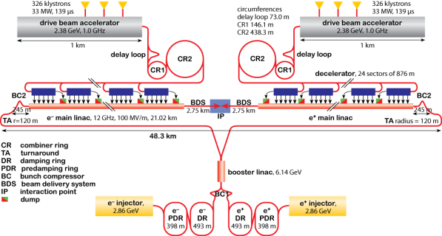
Context: Compact Linear Collider (CLIC)
Parameter | Value | Unit
Nb of klystrons | 1300
Voltage | 180 | kV
Current | 160 | A
Pulse length | 140 | µs
Rep. Rate | 50 | Hz
Stability | 0.85 | %
Repeatability | 10 | ppm
Evaluation of a Hybrid Bouncer System for High Precision Klystron Modulators

Slide 4
Context: Compact Linear Collider (CLIC)
Parameter | Value | Unit
Nb of klystrons | 1080
Voltage | 180 | kV
Current | 160 | A
Pulse length | 148 | µs
Rep. Rate | 50 | Hz
Stability | 0.85 | %
Repeatability | 10 | ppm
Large number of modulators => Reliability
  Capacitor discharge based topology
High level of constraint on the precision
  Compensation techniques are needed (bouncer circuits)
Evaluation of a Hybrid Bouncer System for High Precision Klystron Modulators

Slide 5
Capacitor discharge based modulator
Evaluation of a Hybrid Bouncer System for High Precision Klystron Modulators

Slide 6
Capacitor discharge based modulator
Bouncer circuit:
  Goal: compensating the cap. bank voltage droop
  Variety of technical solutions
    Active switch(es)
      Linear mode / switching mode / both
    Passive resonant bouncer topologies
Evaluation of a Hybrid Bouncer System for High Precision Klystron Modulators

Slide 7
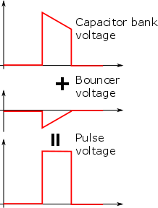

Bouncer circuits examples
 | Corr | Ripple | Flex. | Robust | Eff
Linear | ++ | No | + | + | -
Evaluation of a Hybrid Bouncer System for High Precision Klystron Modulators

Slide 8
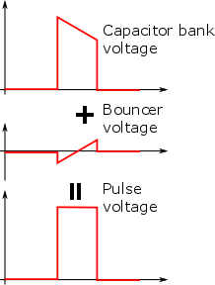
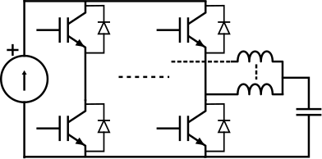
Bouncer circuits examples
 | Corr | Ripple | Flex. | Robust | Eff
Linear | ++ | No | + | + | -
Switching | + | Yes | ++ | - | +
Evaluation of a Hybrid Bouncer System for High Precision Klystron Modulators

Slide 9
Bouncer circuits examples
 | Corr | Ripple | Flex. | Robust | Eff
Linear | ++ | No | + | + | -
Switching | + | Yes | ++ | - | +
Hybrid | + | No | ++ | - | +
Evaluation of a Hybrid Bouncer System for High Precision Klystron Modulators

Slide 10

Bouncer circuits examples
 | Corr | Ripple | Flex. | Robust | Eff
Linear | ++ | No | + | + | -
Switching | + | Yes | ++ | - | +
Hybrid | + | No | ++ | - | +
Passive | - | No | - | ++ | ++
 | Corr | Ripple | Flex. | Robust | Eff
Linear | ++ | No | + | + | -
Switching | + | Yes | ++ | - | +
Evaluation of a Hybrid Bouncer System for High Precision Klystron Modulators

Slide 11
Passive bouncer with linear switches
Requirements:
Vb < 0 or >0
ic < 0 or >0
=> 4-Q topology is needed
Evaluation of a Hybrid Bouncer System for High Precision Klystron Modulators

Slide 12
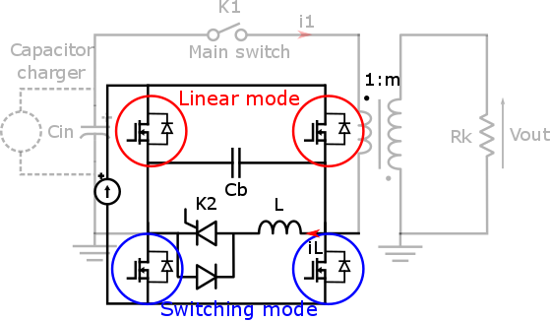
Passive bouncer with linear switches
Requirements:
Vb < 0 or >0
ic < 0 or >0
=> 4-Q topology is needed
Possible solution
4 switches
  2 in linear mode
  2 in switching mode
Additionnal insulated power supply
Evaluation of a Hybrid Bouncer System for High Precision Klystron Modulators

Slide 13
Passive bouncer with linear switches
Requirements:
Vb1 > 0
ic < 0 or >0
=> 2-Q topology is needed
Other solution
2 switches in linear mode
Additionnal grounded power supply
Evaluation of a Hybrid Bouncer System for High Precision Klystron Modulators

Slide 14
Passive bouncer with linear switches
Other solution
Evaluation of a Hybrid Bouncer System for High Precision Klystron Modulators

Slide 15
Designing procedure
Linear analysis:
Real Time compensation by the linear circuit
« Feedforward » compensation by the passive bouncer
Evaluation of a Hybrid Bouncer System for High Precision Klystron Modulators

Slide 16
Designing procedure
Linear analysis:
Real Time compensation by the linear circuit
« Feedforward » compensation by the passive bouncer
Optimize this term in order to minimize the pulse error
Evaluation of a Hybrid Bouncer System for High Precision Klystron Modulators

Slide 17
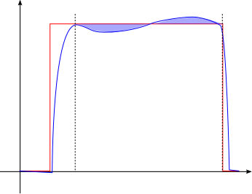
Designing procedure
Linear analysis:
Real Time compensation by the linear circuit
« Feedforward » compensation by the passive bouncer
Optimize this term in order to minimize the pulse error
Evaluation of a Hybrid Bouncer System for High Precision Klystron Modulators

Slide 18

Designing procedure
Linear analysis:
Real Time compensation by the linear circuit
« Feedforward » compensation by the passive bouncer
Optimize this term in order to minimize the pulse error
Evaluation of a Hybrid Bouncer System for High Precision Klystron Modulators

Slide 19
Designing procedure
Linear analysis:
Real Time compensation by the linear circuit
« Feedforward » compensation by the passive bouncer
Optimize this term in order to minimize the pulse error
New set of components and initial values
Evaluation of a Hybrid Bouncer System for High Precision Klystron Modulators

Slide 20
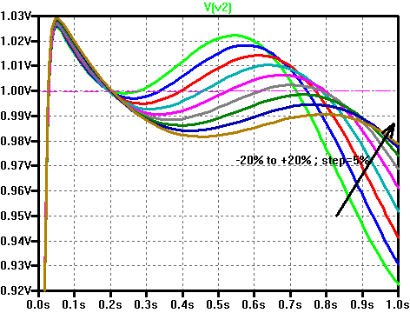
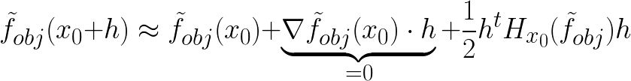
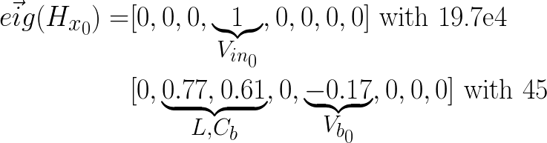
Designing procedure
Parameters:
Components: C_{b}, L, L_{transfo}
Initial conditions: V_{in0}, iL₀ and V_{b0}
Constraints (equality):
Energy conservation in the bouncer (=steady state)
Sensitivity analysis (normalized function):
1% of error ➔100% deviation
10% of error ➔ 60% deviation
Evaluation of a Hybrid Bouncer System for High Precision Klystron Modulators

Slide 21

Designing procedure
Linear analysis:
Real Time compensation by the linear circuit
« Feedforward » compensation by the passive bouncer
Evaluation of a Hybrid Bouncer System for High Precision Klystron Modulators

Slide 22


Designing procedure
Linear analysis:
Real Time compensation by the linear circuit
« Feedforward » compensation by the passive bouncer
LF compensator
HF compensator
Evaluation of a Hybrid Bouncer System for High Precision Klystron Modulators

Slide 23
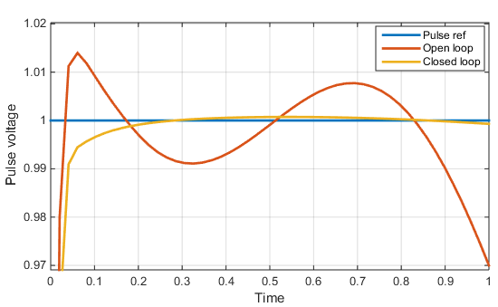
Performances
RMS error: 1500ppm
Losses: 0.9% of Wpulse
Simulation results
Evaluation of a Hybrid Bouncer System for High Precision Klystron Modulators

Slide 24
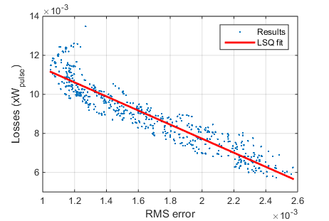
Performances
Sensitivity analysis:
  500 runs
  Parameters are randomly chosen in a +/-10% range around the optimal solution (bouncer components only)
  Impact on precision and losses ?
Worst accuracy: 2600ppm
With only passive bouncer: 9700ppm
Highest losses: 1.3% of Wpulse
With only linear ballast: >5% of Wpulse
Monte Carlo simulation results
Evaluation of a Hybrid Bouncer System for High Precision Klystron Modulators

Slide 25
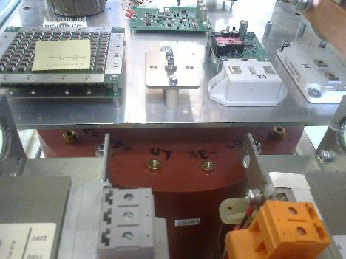
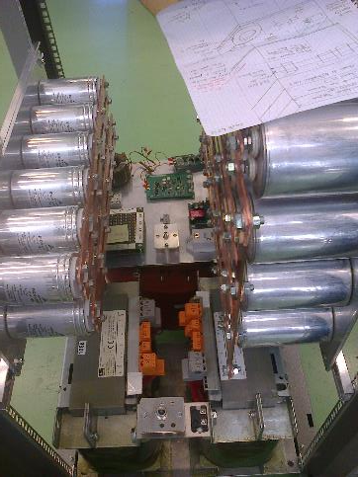
Experimental set up
Evaluation of a Hybrid Bouncer System for High Precision Klystron Modulators

Slide 26
Conclusion
Capacitor discharge based modulators need a compensation circuit (bouncer)
The presented topology aims at merging the advantages of a passive bouncer and an active linear stage
  Acceptable level of losses
  Fairly simple topology and control strategy
  High bandwidth (linear)
  Compensation of spread thank to a high bandwidth feedback control
Evaluation of a Hybrid Bouncer System for High Precision Klystron Modulators

