Slide 1
Modular Highly Dynamic and Ultra-Low Ripple Arbitrary Current Source for Plasma Research
Georgios Tsolaridis and Jürgen Biela
Laboratory for High Power Electronics, ETH Zürich

Slide 2
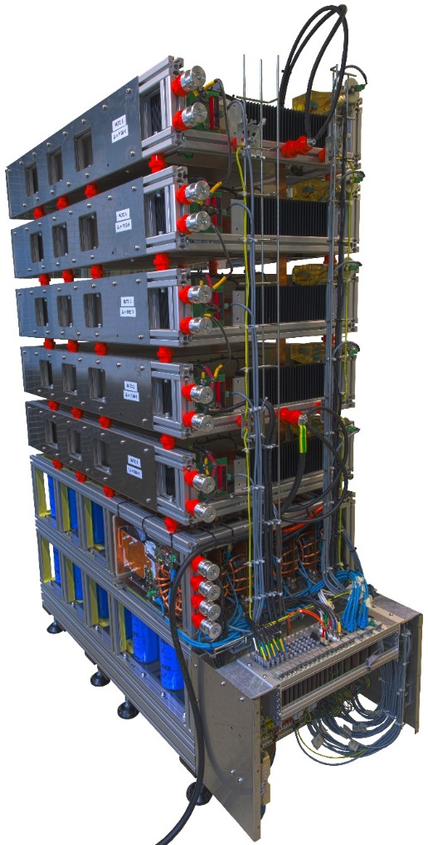
Introduction
Multi-purpose, flexible, modular current source
Applications:
  DC-arc research for HVDC circuit breakers
  Bumper/Septum magnets
  Plasma sources
Requirements:
  High dynamic
  Low ripple
  Arbitrary current waveform
  High modularity
Outline
Introduction
Proposed Topology
Design Considerations
Control System
Simulation Results
Photo of the first prototype of the modular current source. The prototype was designed and built at the HPE laboratory, ETH Zurich.

Slide 3
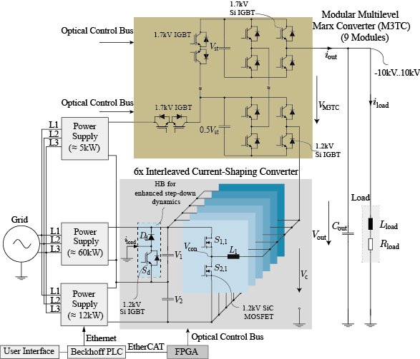
Proposed Topology
Multi-phase buck-type current shaping converter
  Iout : 0 .. 1.5kA
  Vout : 0 .. 600V
  Interleaving ➔ current ripple reduction
  High fs ➔ SiC MOSFET
  Additional HB ➔ enhanced step-down dynamics

Slide 4
Proposed Topology
Modular Multilevel Marx Converter M3TC
  Staircase voltage
  H-bridge ➔ Bipolar voltage ±10kV
  Low fs➔ slow dynamics

Slide 5
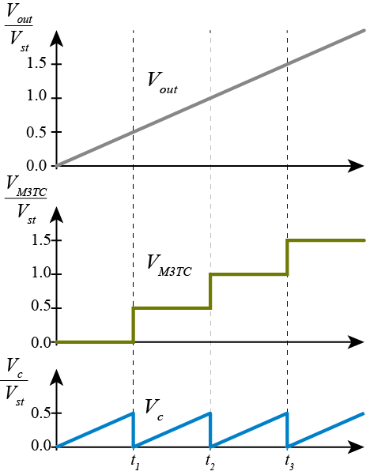
Proposed Topology
Single stack source:
  Vout : ±10kV
  Iout : 1.5 kA
  di/dt : >10A/μs
  Δipp : <1%
Full-scale source:
  20 parallel single stacks
  Iout : 30kA
  di/dt : >200A/μs
  Δipp : <0.1%

Slide 6
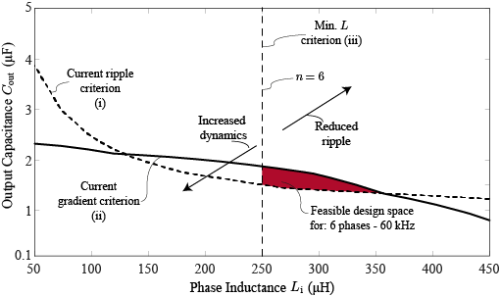
Design Considerations
Design parameters
  Number of modules : n
  Switching frequency : fs
  Inductance : Li
  Output capacitance: Cout
Design constraints:
  i) Δipp < 1%
  ii) di/dt >10A/μs
  iii) Min. Li for robustness
Resulting parameters of a single stack
n | 6
fs | 60kHz
Li | 250μH
Cout | 2μF

Slide 7
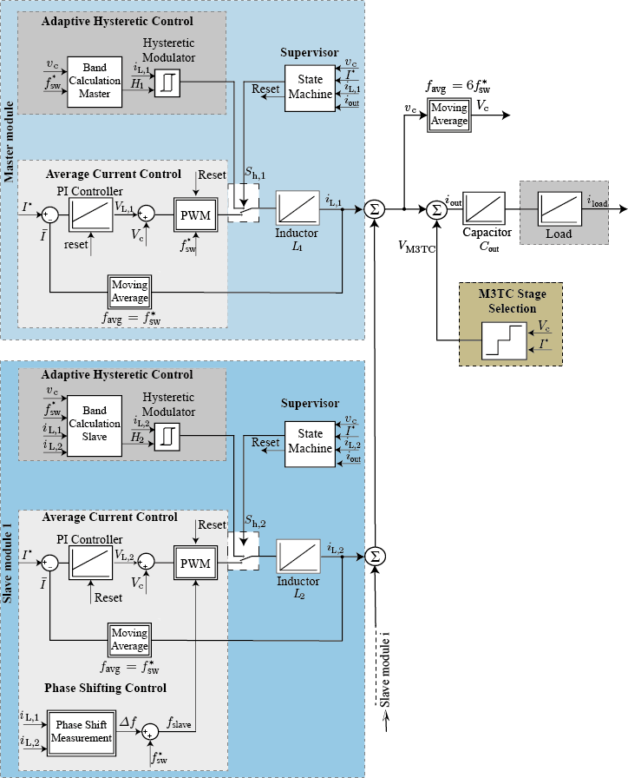
Control System
New adaptive hybrid control concept
  Adaptive hysteretic controller
    Time-optimal transient response
    Excellent disturbance rejection
    Design simplicity
    Poor steady state performance

Slide 8
Control System
New adaptive hybrid control concept
  Average Control Mode
    Good steady state performance
    Phase-shifting control➔ optimal interleaving
    Design simplicity
  M3TC Stage Selection

Slide 9
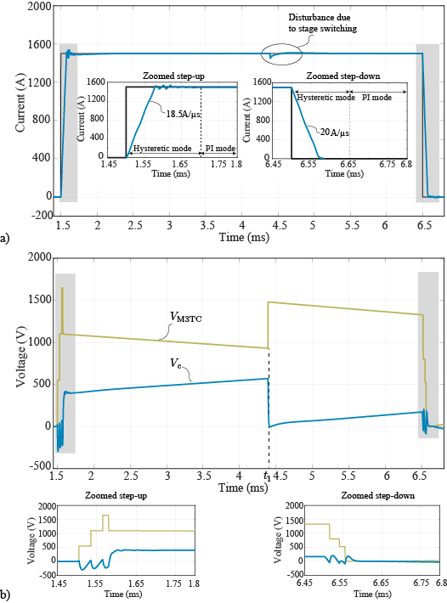
Simulation Results : Nominal Pulse (RL load: 1Ω – 10μH)
  Step-up/down transient
    Hysteretic mode
    High current gradient
  Steady State
    M3TC stage capacitor discharges ➔ additional stage inserted

Slide 10
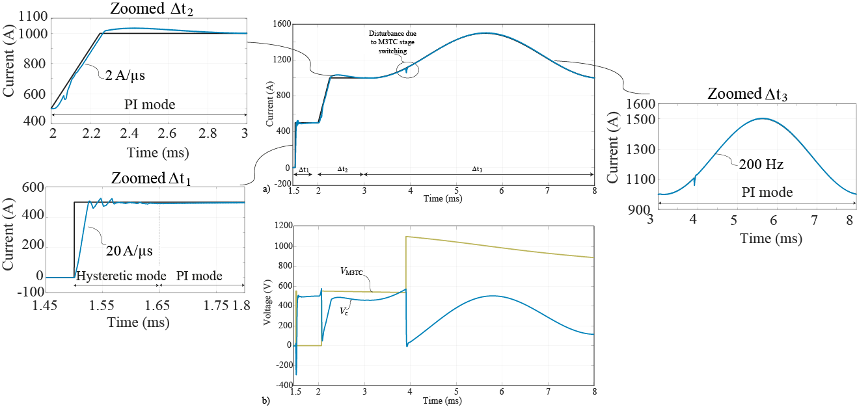
Simulation Results : Arbitrary waveform generation (RL load: 1Ω – 10μH)
  Pulse transient
    Hysteretic mode
    Max. achievable current gradient
  Slow ramp/Sinusoidal 200Hz
    PI mode enabled
    Min. ripple during the transient

Slide 11
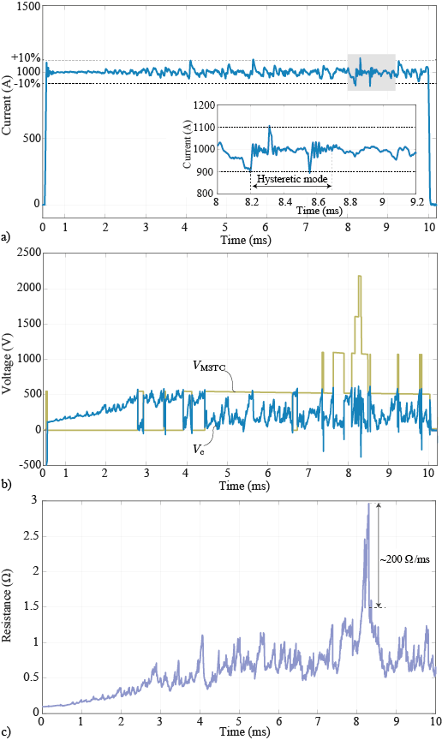
Simulation Results: Performance under highly fluctuating load
  Behavioral arc model based on measurements
  Arc voltage stochastically changing
  >500V in 2μs
  Current : ±10%

Slide 12

Conclusions
Flexible modular arbitrary current source
High dynamic and robustness
New advanced controller
Simulations verify the suitability of the topology

Slide 13
Thank you for your attention!

