Slide 1









High-Power Switching using Super-Critical Fluids
TU/e
Bert van Heesch
Jin Zhang, Frank Beckers, Guus Pemen,
Tom Huiskamp, Wilfred Hoeben
CWI
Ute Ebert, Aram Markosyan
e.j.m.v.heesch@tue.nl

Slide 2
High-voltage switch
For industrial applications
Challenges:
High hold-off voltage
Large current
Nanoseconds rise time
Fast recovery
High repetition rates
Very low on resistance
Accepting overload
Self healing
Environmentally safe
Long lifetime

Slide 3
Breakdown in Super Critical Fluid
Approach to meet the challenges
Liquid but no vapor bubbles
Self healing
solid
Very high E-field
High heat conductivity
High heat capacity
Low viscosity
Pressure →
Super
critical
gas
liquid
Phase diagram
Fluid above critical
pressure + temperature
CO₂: 74 bar 31C
N₂: 34 bar -147C
Liquid
Unlike oil or water
Temperature →

Slide 4
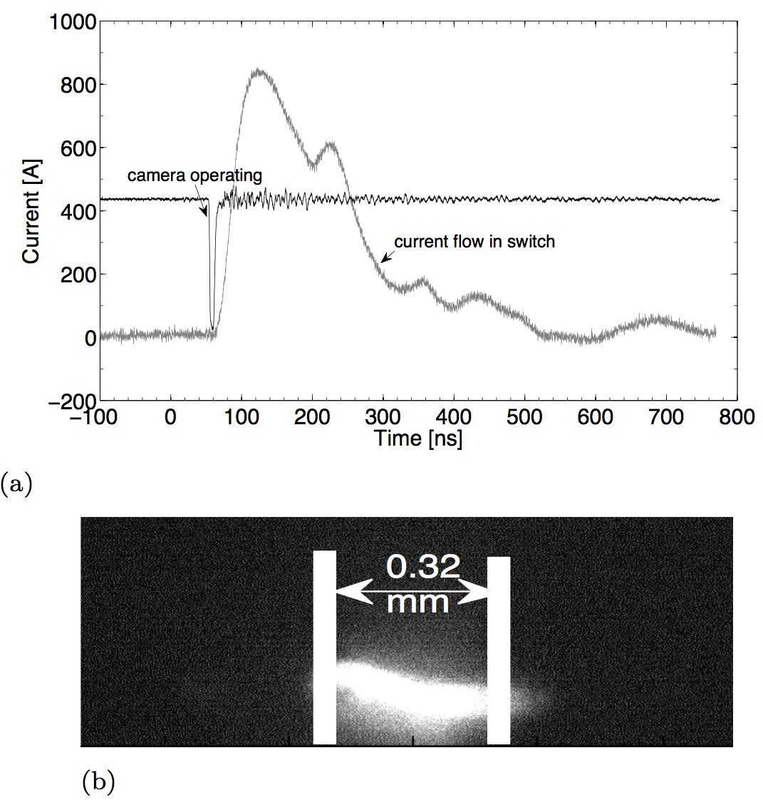
Discharge current and
CCD picture
Pulse Source
SC Switch

Slide 5
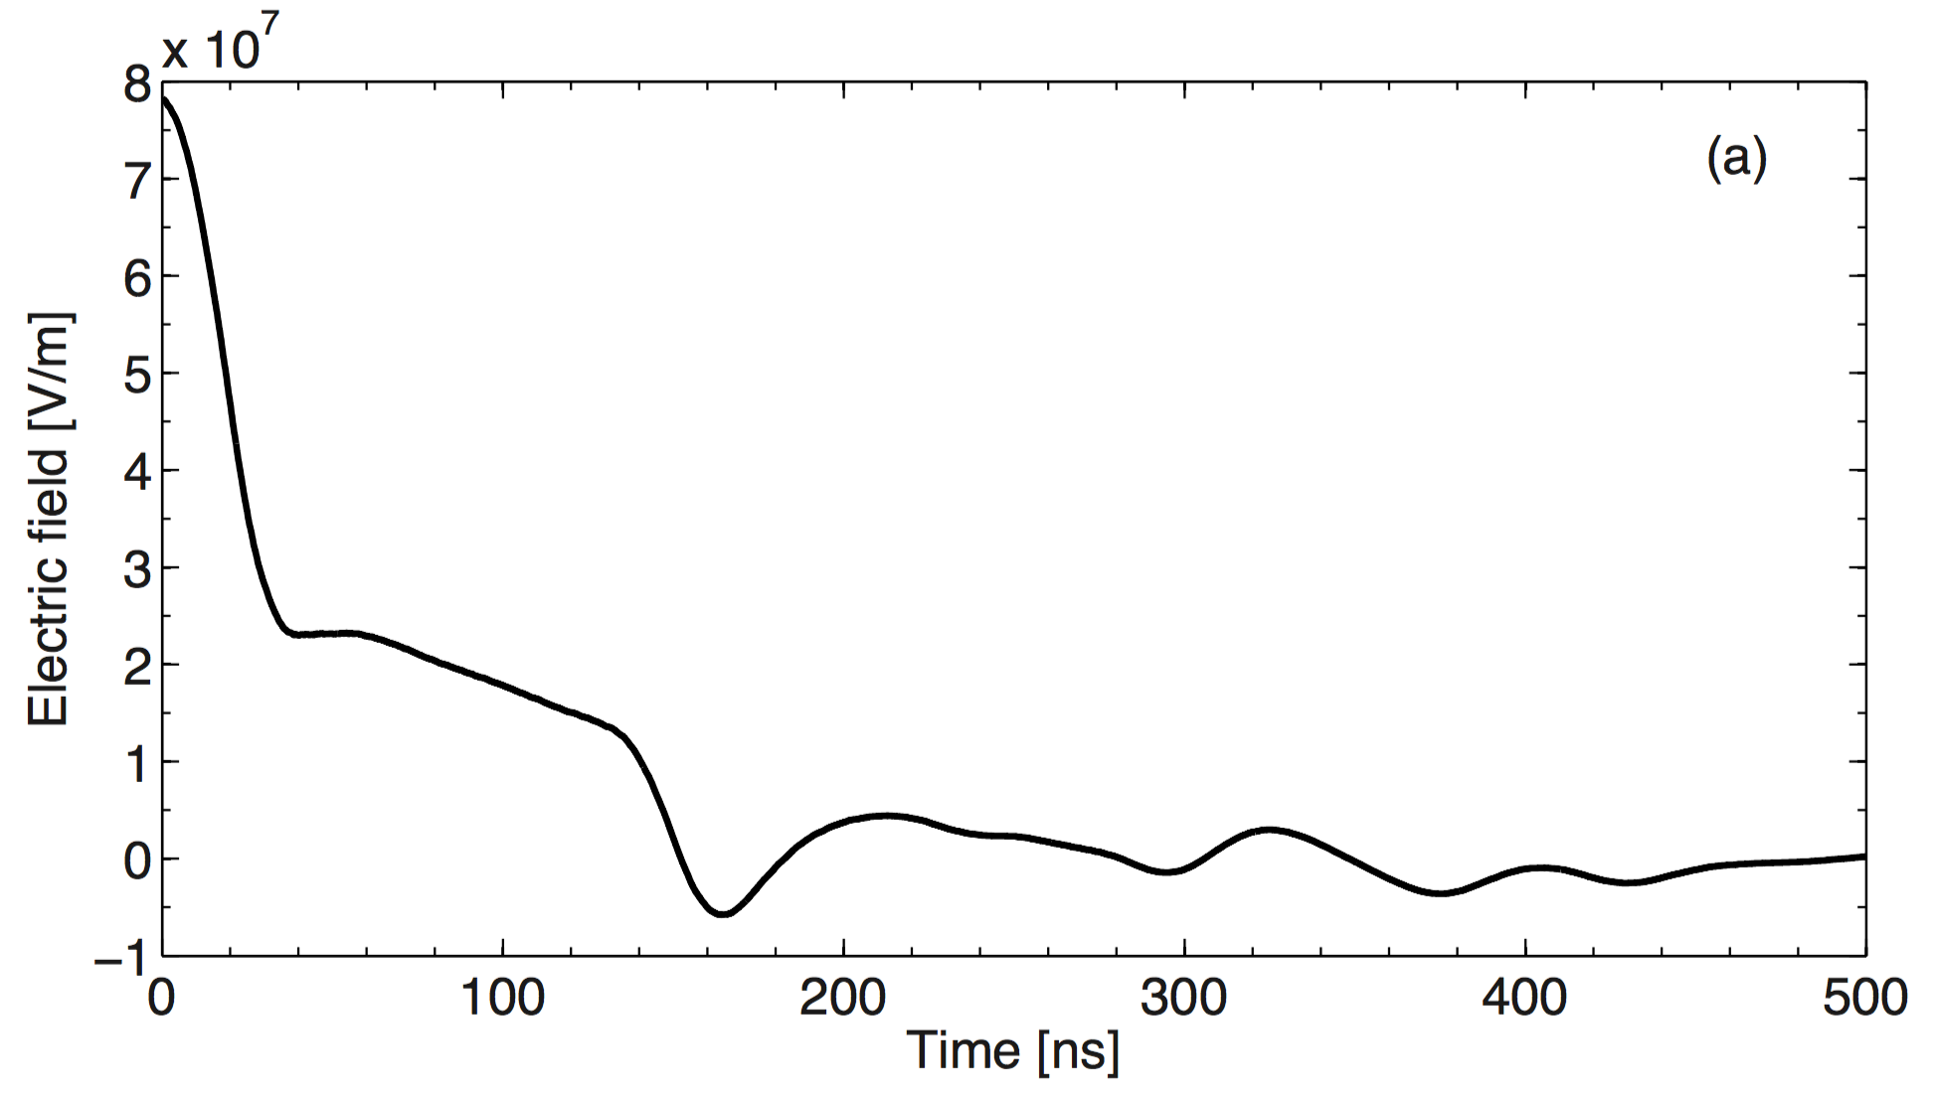
Arc Voltage is High during first 150 ns current flow
24 kV
Arc voltage ⬆
6 kV
0
E field and voltage, gap of 0.3 mm in 80 bar Nitrogen after breakdown from 25 kV open gap voltage

Slide 6
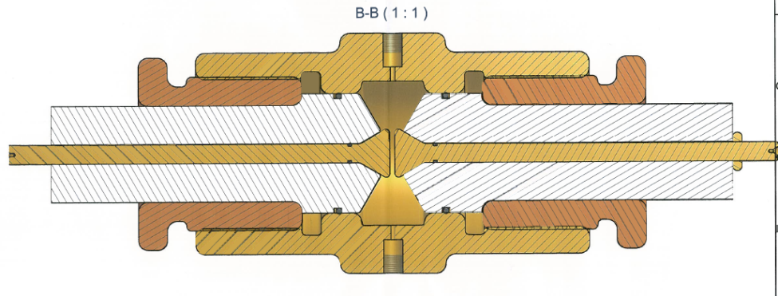
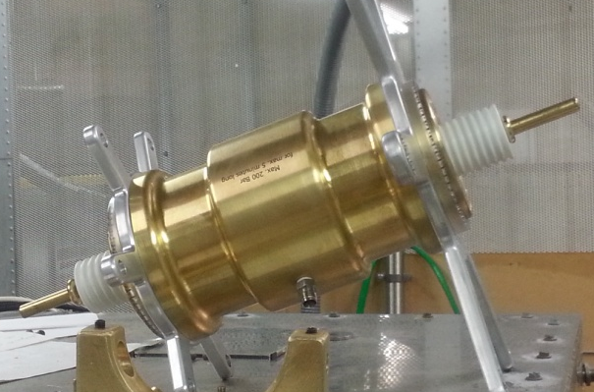
120 kV super-critical
switch device
25 cm

Slide 7
Comparison with existing CO₂ and SF₆ switching performance
 | Parameters at existing switch conditions
 | Breakdown | Arc Voltage | Switch condition
Supercritical N₂ [4,10] | 180 kV/mm @80bar | 6 kV | Supercritical, pulsed V
CO₂ [9] | 2 kV/mm @1 bar | 2 kV @14 bar | 14 bar, 50 Hz
SF₆ [8] | 9 kV/mm @1 bar | 1 kV @14 bar | 14 bar, 50 Hz
Paschen’s curve: ratio SF₆ to air is 2.5
but this only holds for (non-streamer-like) homogeneous discharge situations
At very high pressures the situation is always inhomogeneous since breakdown is streamer like
Very high pressure → Ratio between SF₆ and air is 1 [11]
Indication: at SC pressures SF₆ and N₂ have similar BD strength

Slide 8
Conclusions
Design and operation of reliable SCFs insulated switches
Two models for switching & recovery in SCFs
Experimental & theoretical analysis of plasmas in SC N₂
Very high dielectric strength: ≤ 180 kV/mm, comparable with solid dielectrics
Fast dielectric recovery: ≤ 200 μs in both experiment and model
Successful current interruption for t > 2 ms, gap width ≈ 2 mm

Slide 9
