Slide 1
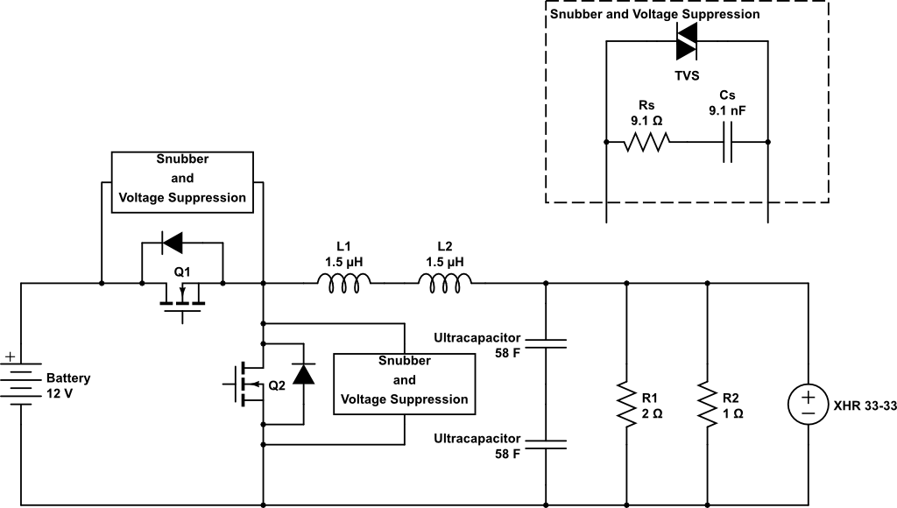
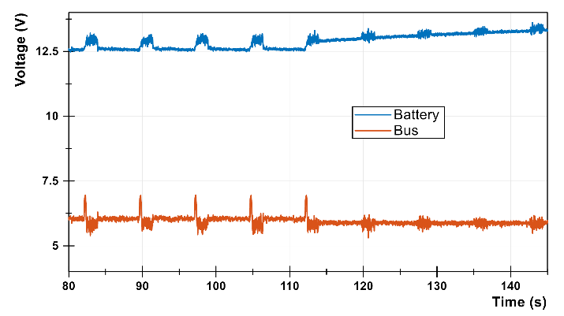
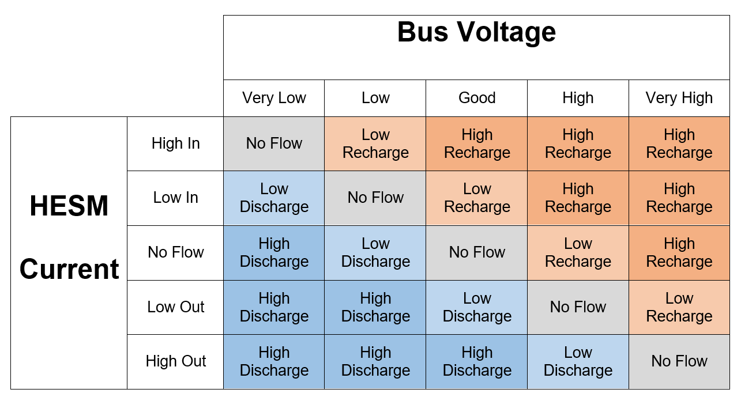
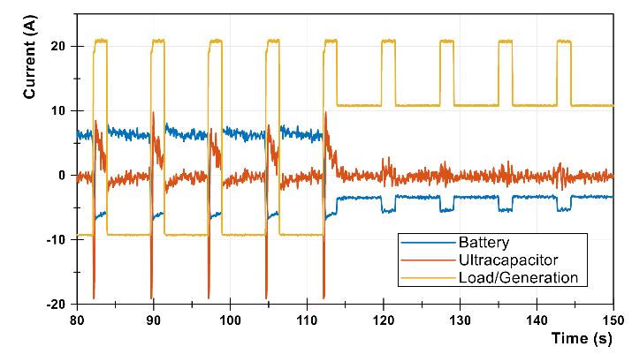
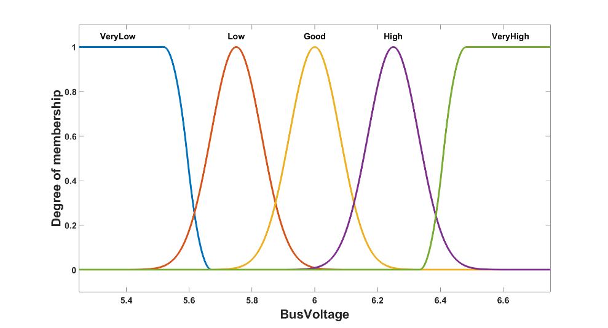
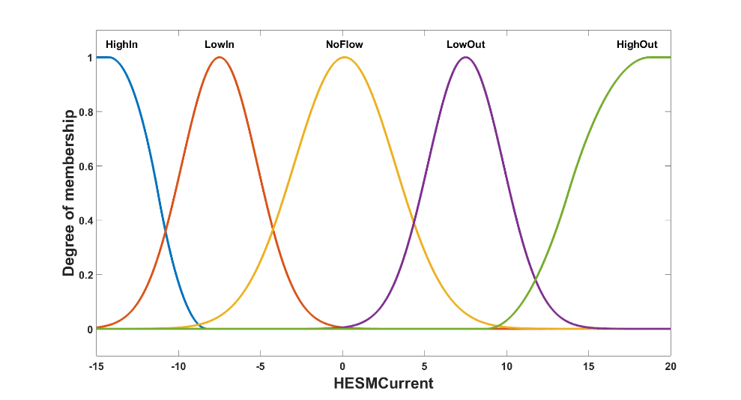
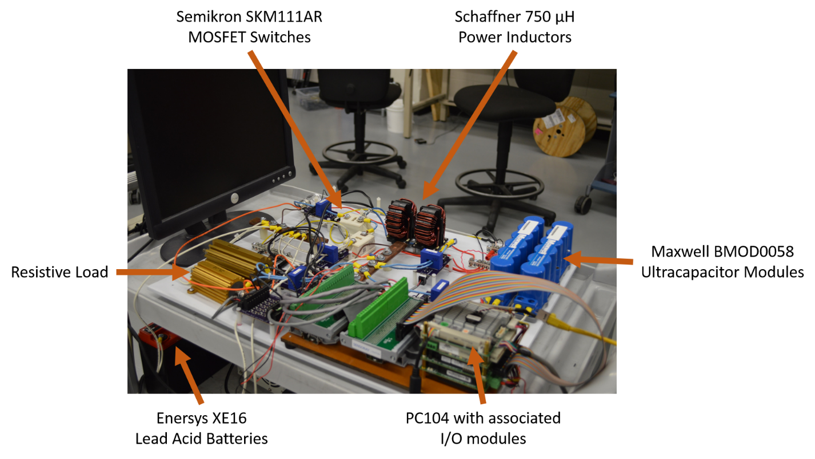
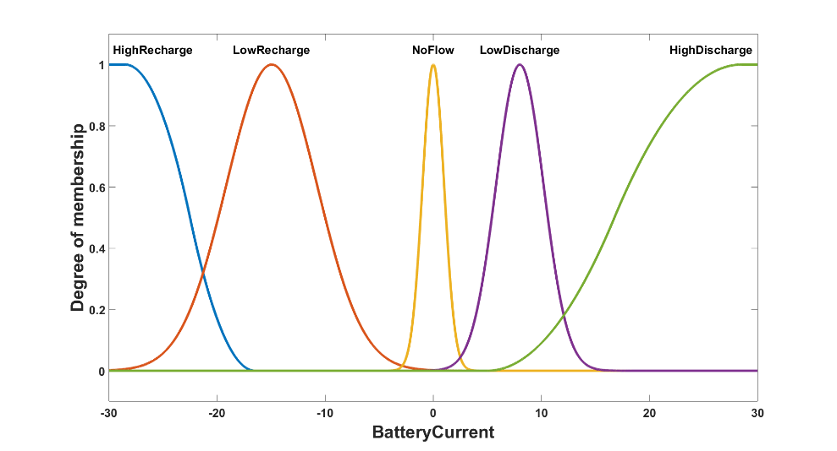
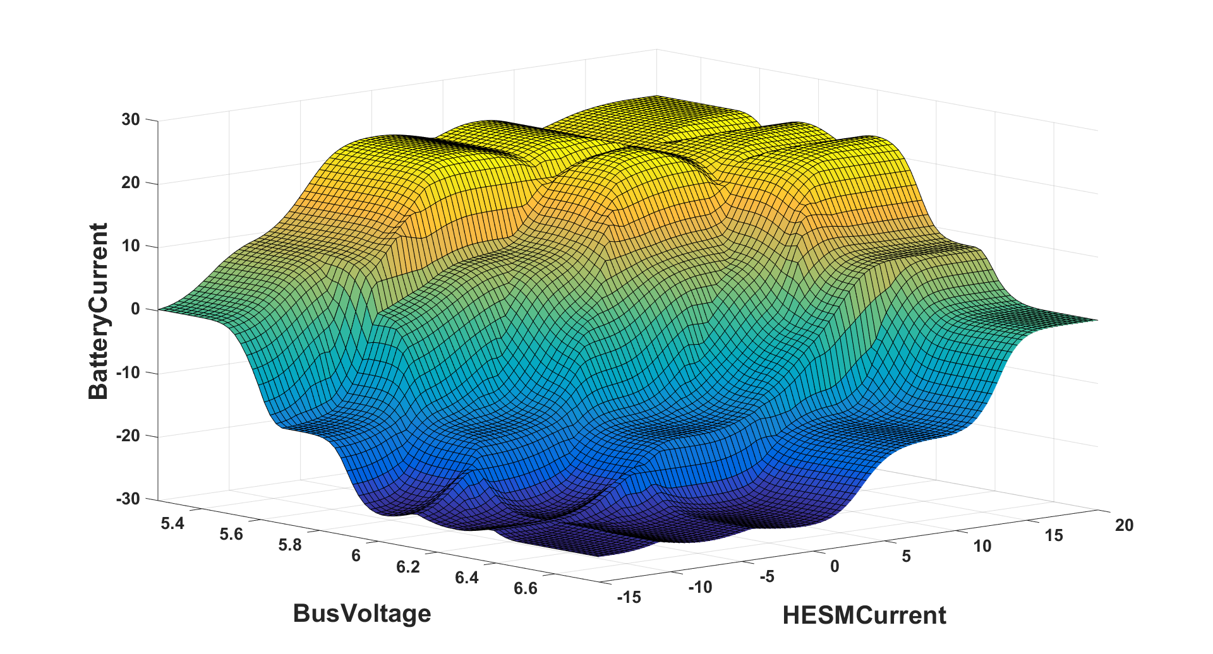
Fuzzy Logic Control of a Hybrid Energy Storage Module for Pulsed Power Naval Applications Using a Hardware-in-the-Loop Testbed
Isaac J Cohen¹, David A Wetz¹, John M Heinzel², Qing Dong², Brian McRee¹, and David Dodson¹,
¹ University of Texas at Arlington, Arlington, TX 76019, USA, ² Naval Surface Warfare Center, Philadelphia Division, 5001 S. Broad St., Philadelphia, PA, 19112, USA
Abstract
Experimental Setup
Fuzzy Logic Controller
Results
As the Navy transitions to a more electrical fleet, the electrical architectures must adapt to the changing load profiles. With the introduction of electrical propulsion, new types of electrical energy based weapons, and energy storage backups for these devices, load profiles have become higher power and more transient than ever seen before – especially during directed energy weapon operation. One issue that has become apparent with the introduction of these transient loads is the ability of traditional generation sources, such as fossil fuel generators, to power them. Although generators are stiff sources of power, they suffer efficiency losses when they deviate from operating at a constant maximum load. Previous research has shown that it is possible to integrate hybrid energy storage modules (HESMs) in order effectively filter out the power transients seen by the generators while preserving the lifetimes of the energy storage devices used in the module. Although the topology has been verified, there still exists some concern about the method of controlling the system level power flow in order to meet the unique demands of this naval application while preserving energy storage device lifetimes. This paper proposes to utilize fuzzy logic control in order to intelligently govern the flow of power throughout the system. A small-scale testbed has been constructed using a custom designed power converter capable of bi-directional power flow between a battery and supercapacitor to feed a dynamic pulsed power load through several operational scenarios. The system utilizes a PC104 running Simulink RTOS to impose fuzzy logic control on the system. This testbed will demonstrate the effectiveness of fuzzy logic control to act as a system level controller for a HESM in naval pulsed power applications.
Fuzzy logic control (FLC) mimics an “expert response” to a given set of linguistic inputs
  This offers a human response in a digital controller
FLC uses a rule base to determine the response condition
“Fuzzification” utilizes a center of mass calculation on input membership functions
“Defuzzification” utilizes a center of mass calculation on the output membership function
Figure 1: Schematic of HESM testbed
Table 3: Fuzzy logic rulebase
Figure 5: Voltage plot of fuzzy logic experiment
Table 1: Equipment used in experiment
Battery | Enersys XE16 12V Batteries Capacity = 16 Ahr, V = 12 V, 1s2p
Switches (Q1, Q2) | Semikron SKM111AR MOSFETs V_{DS} = 100 V, I_{D} = 200 A, R_{DS(ON)} = 7 mΩ
Inductors (L1, L2) | Schaffner L = 750 µH, I_{max} = 50 A
Ultracapacitors | Maxwell BMOD0058 V_{max} = 16 V, C = 58 F, RESR = 22 mΩ
Power Supply | Xantrex XHR 33-33 V_{max} = 33 V, I_{max} = 33 A, GPIB
Snubbers | R = 9.1 Ω, C = 9.1 nF V_{TVS} = 35 V
Figure 6: Current plot of fuzzy logic experiment
Comparing these results to [1] - both waveforms are very similar in performance
The major difference is the presence of spikes early in the test and absence in the latter portion of the test
  This is due to imperfect FLC tuning and can be regarded as random error
Overall, both the DC Bus voltage is maintained throughout the test and the battery current is minimized as it only flows when necessary to meet the demands of the main directive.
Figure 3: Input and output membership functions of FLC
Conclusions
Background
Although comparing these results to the simulation results shown in [1] have some differences, overall they produce largely the same result and as such can be regarded as a validation of the model. Some minor changes were necessary to get the results desired, but no major changes were made to the system. These results show that not only is fuzzy logic control a viable method for controlling this type of system, but that the simulation results very closely follow what would be seen in the real world as well. This testbed will allow further testing into the Hardware-In-The-Loop (HIL) realm by allowing the PC-104 or another HIL target to simulate shipboard power systems while utilizing real HESM hardware components for response analysis.
Figure 2: Photo of HESM testbed
Previous work completed by UTA focused on modeling a HESM in Simulink’s SimPowerSystems toolbox, designing low level PI controllers for the voltage control and current limiting, and designing a fuzzy logical controller to enforce a system-level control of this system [1]. With this in mind, the next logical step in the process of designing a HESM was to construct a real-world system that closely resembled the simulation conditions in order to validate the model and lend credibility to the capability of a fuzzy logic controller to perform the necessary functions in this type of application.
Table 2: Load Profile
Period | Time | Load/Generation
First half of test
High Power | 5 seconds | -9 A
Low Power | 1 second | 21 A
Second half of test
High Power | 5 seconds | 11 A
Low Power | 1 second | 21 A
Experiment was designed to follow a popular naval load profile – 5 seconds on and 1 second off
Load and Generation are summed together as a disturbance to the system
Figure 4: Input vs Output relationship of FLC
First directive of this FLC is to maintain the “DC Bus” Voltage
Second directive is to minimize the amount of current that flows through the batteries
[1] I. J. Cohen, D. A. Wetz, S. Veiga, Q. Dong and J. M. Heinzel, "Fuzzy Logic Control of a Hybrid Energy Storage Module for Naval Pulsed Power Applications," International Journal of Fuzzy Logic Systems, vol. 6, no. 1, 2016.
* This work is supported by the US Office of Naval Research under grant N00014-14-1-0267. The opinions and findings are those of the authors and are not necessarily those of the US Office of Naval Research.

