Slide 1
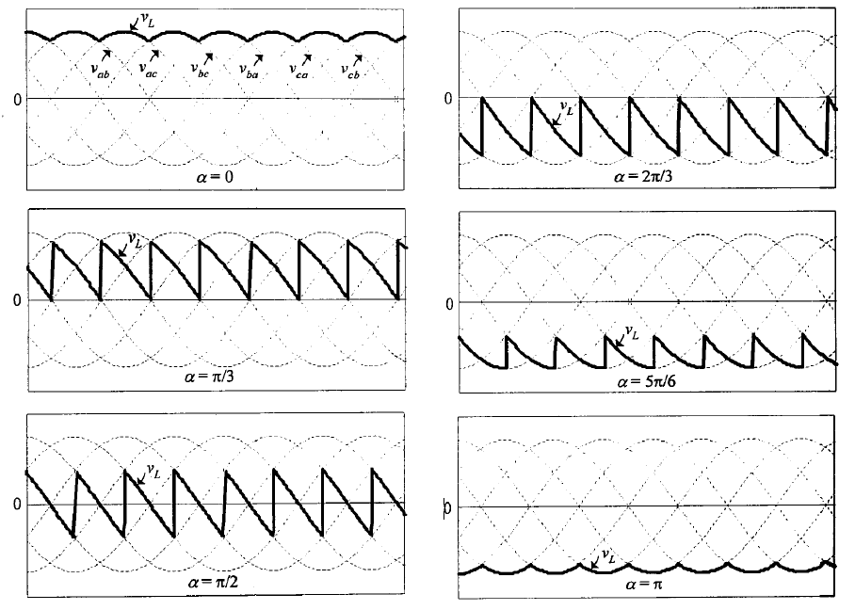
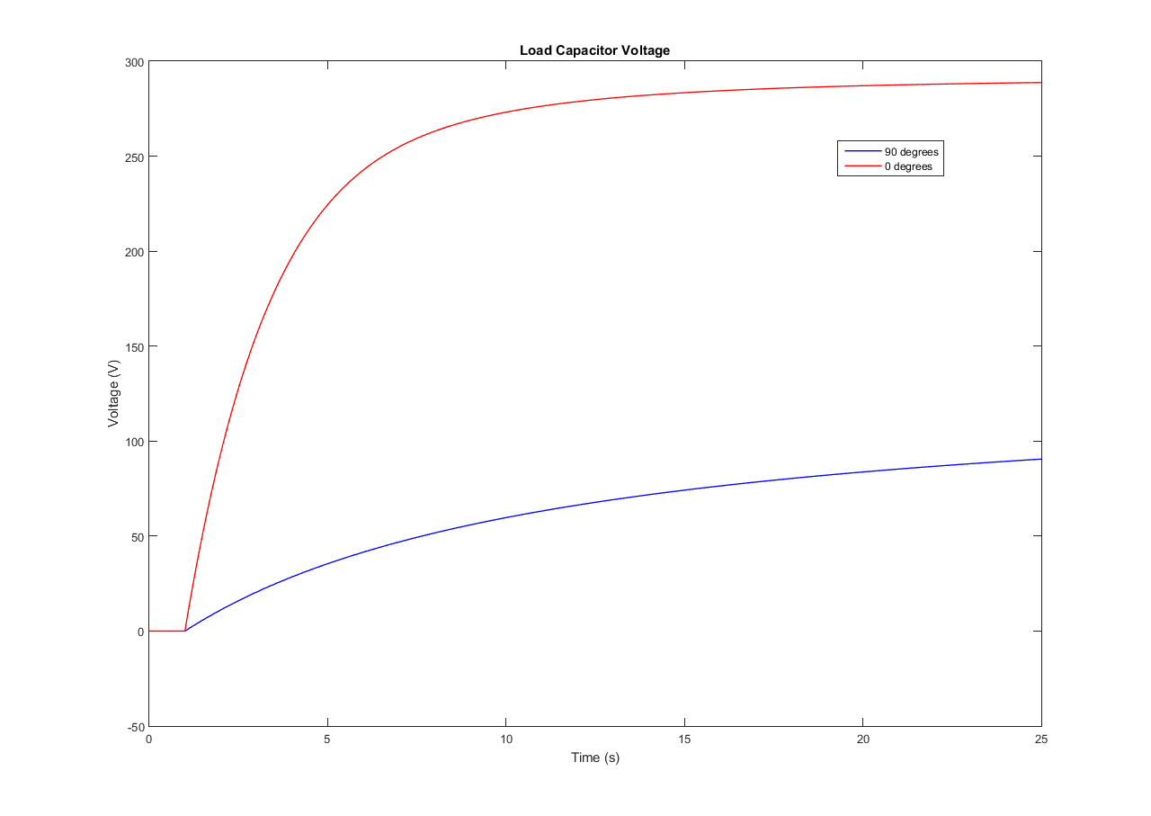
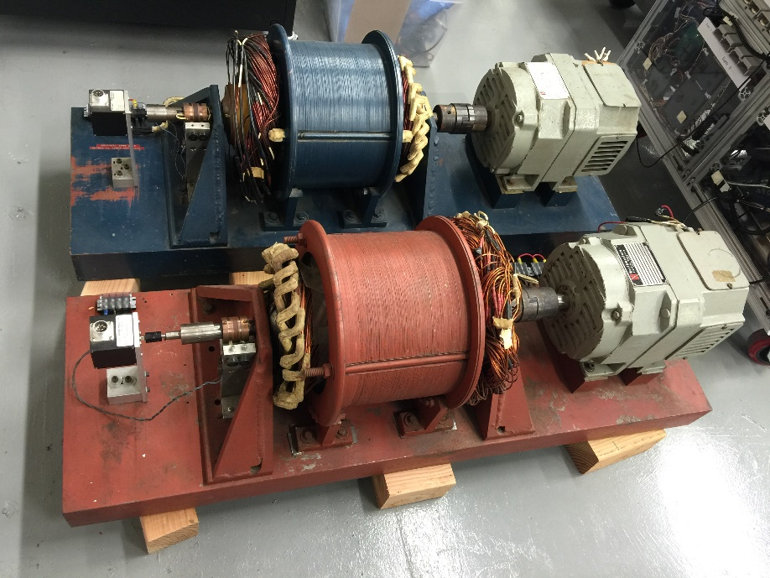
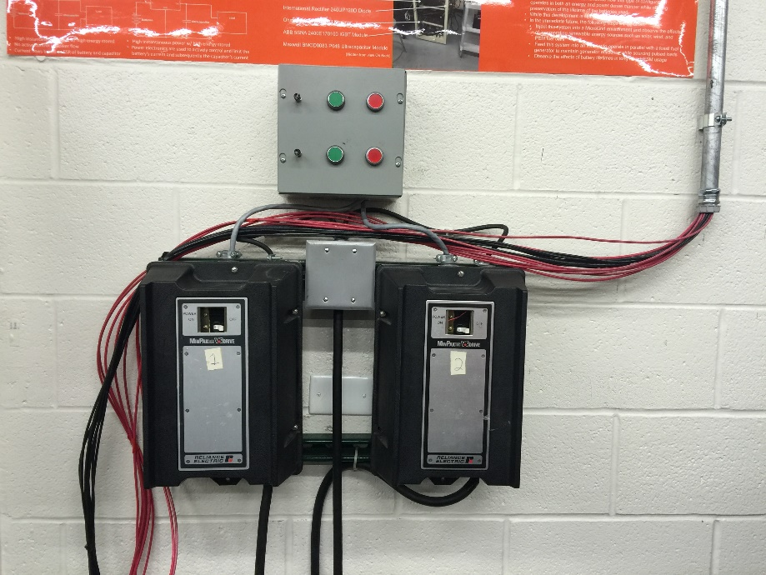
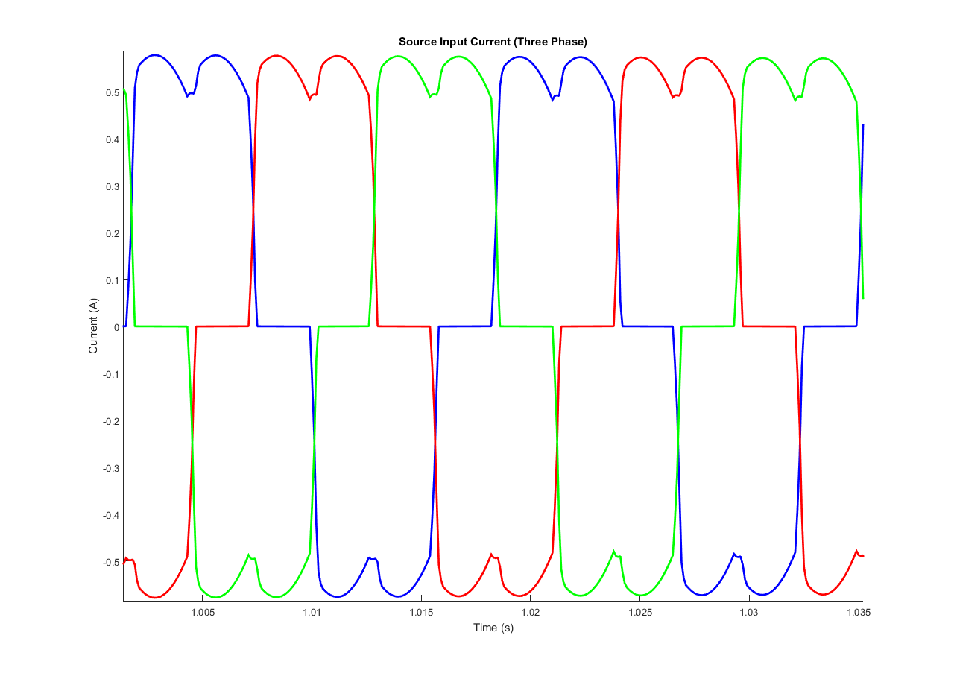
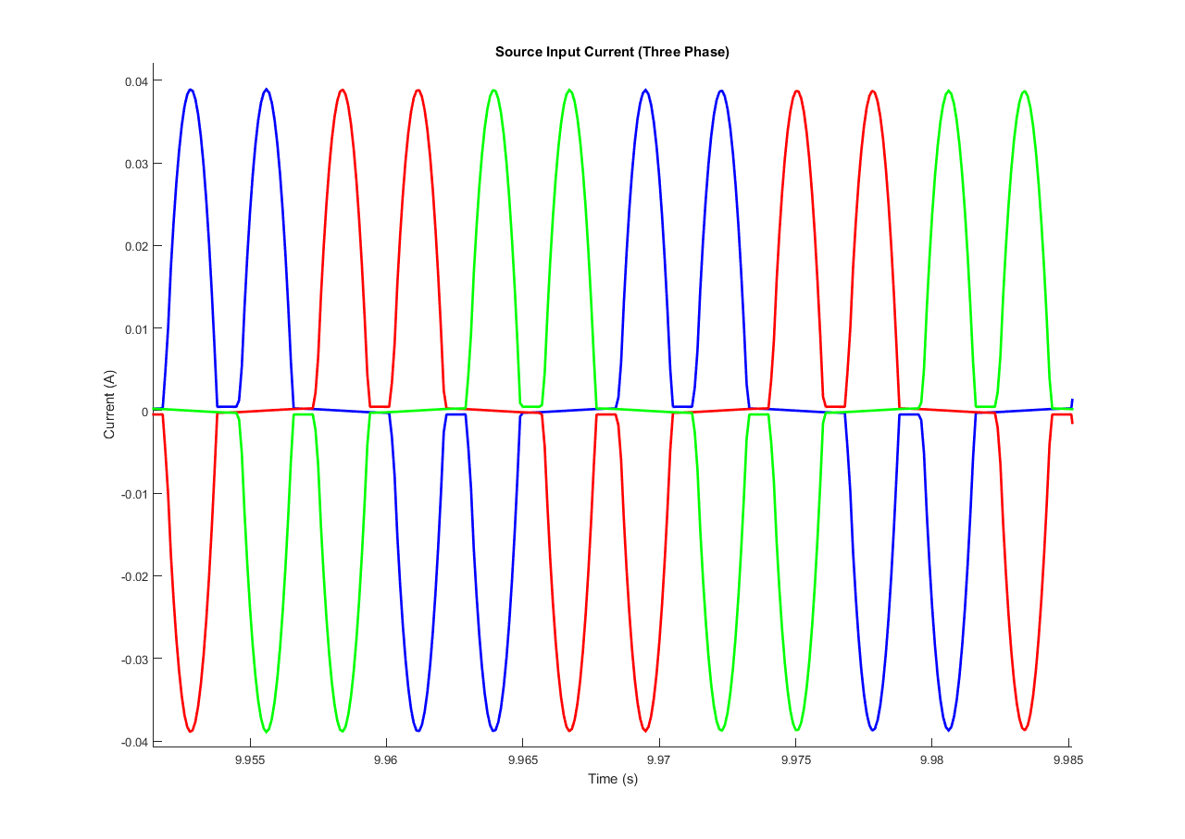
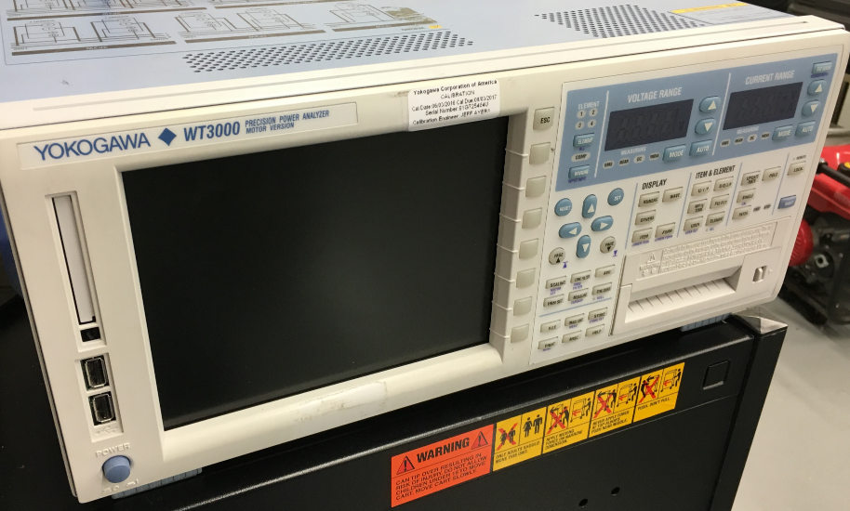
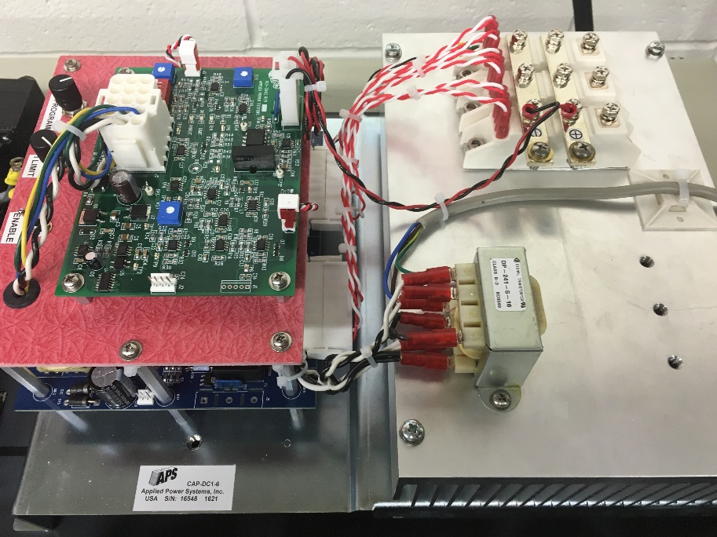
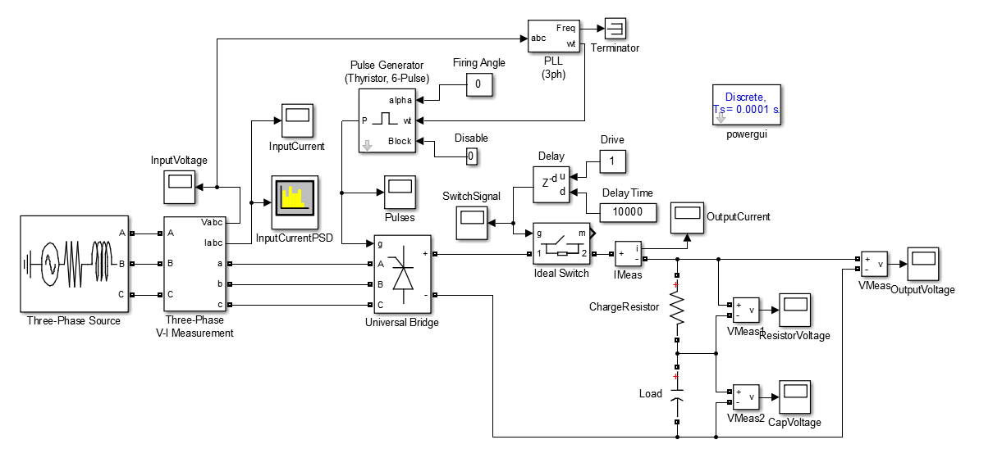
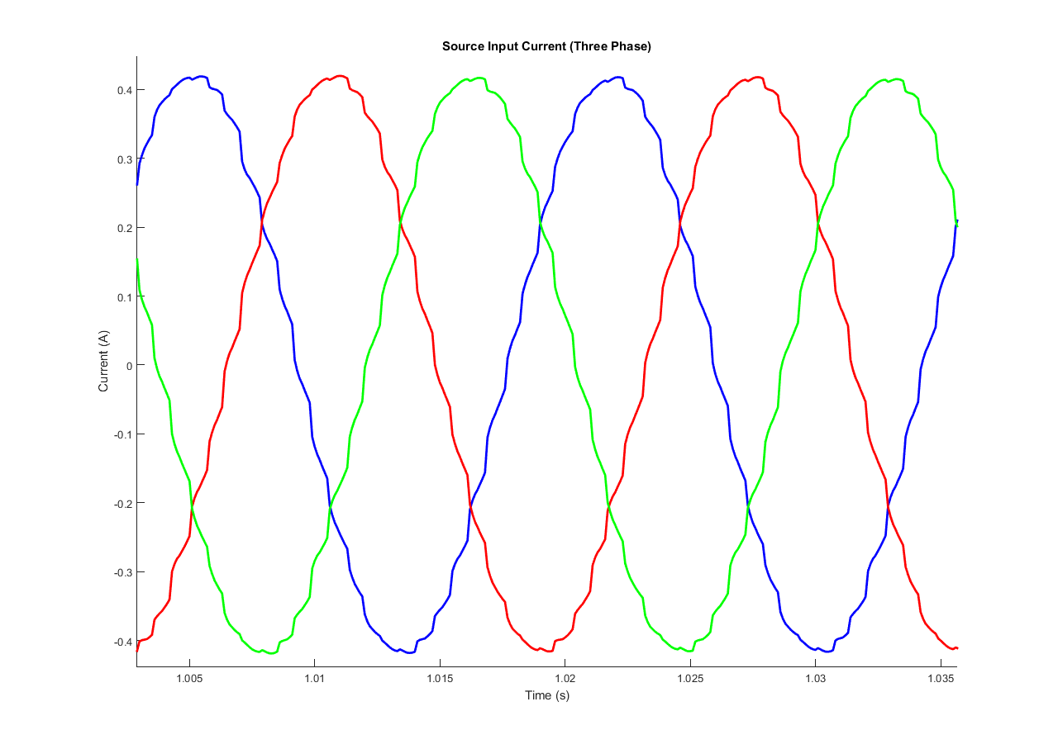
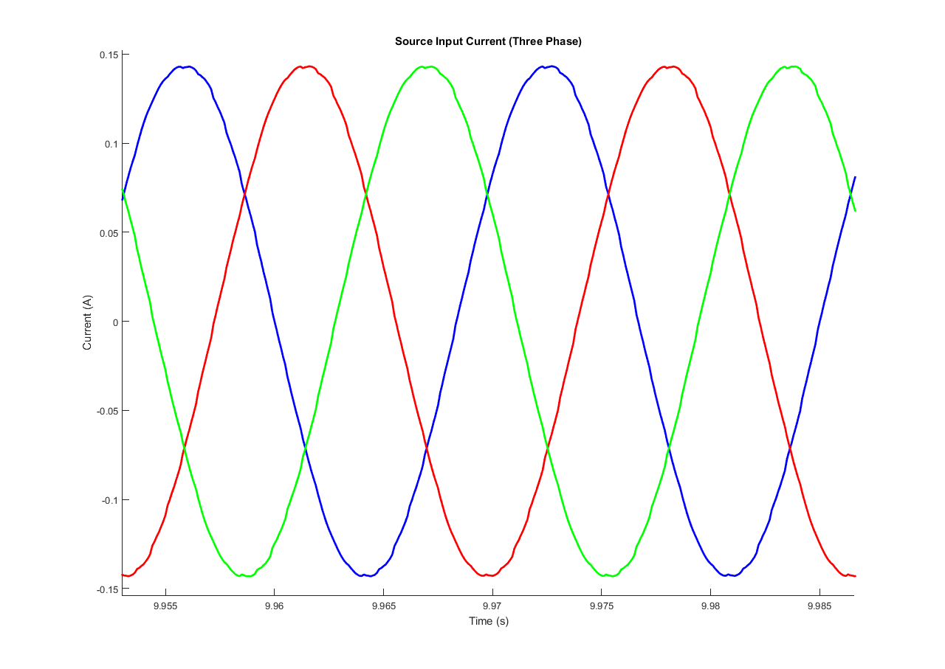
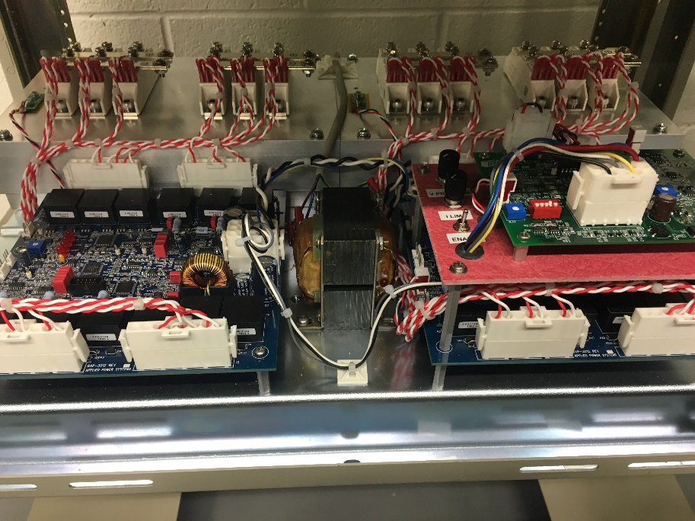
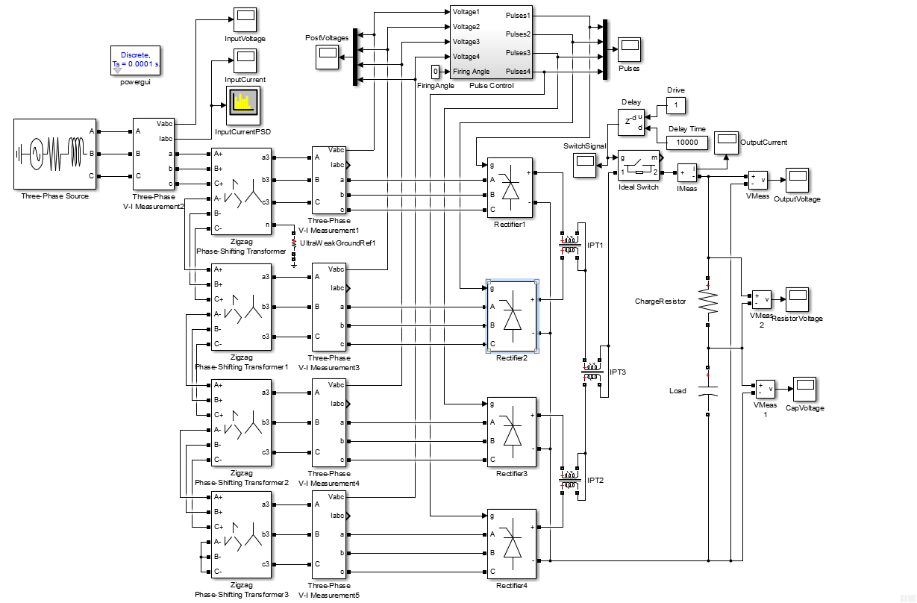
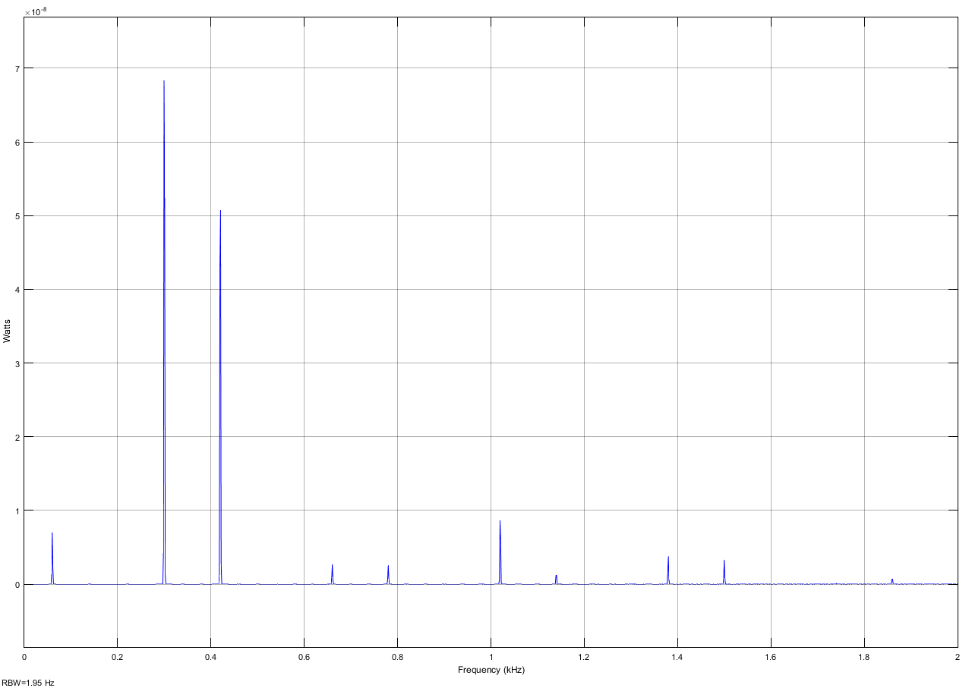
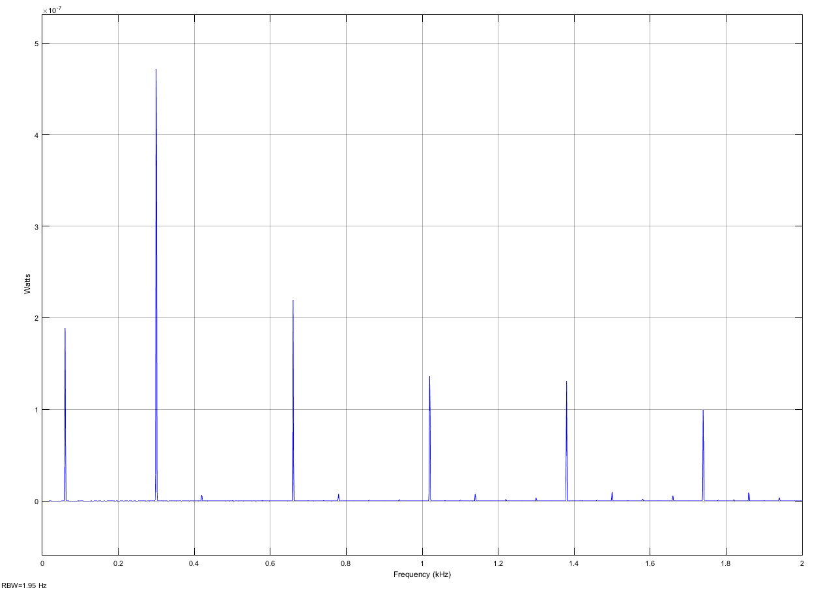
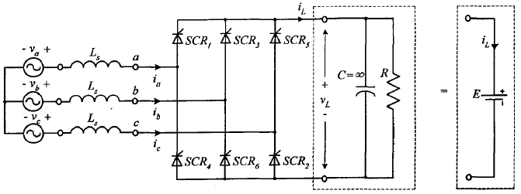
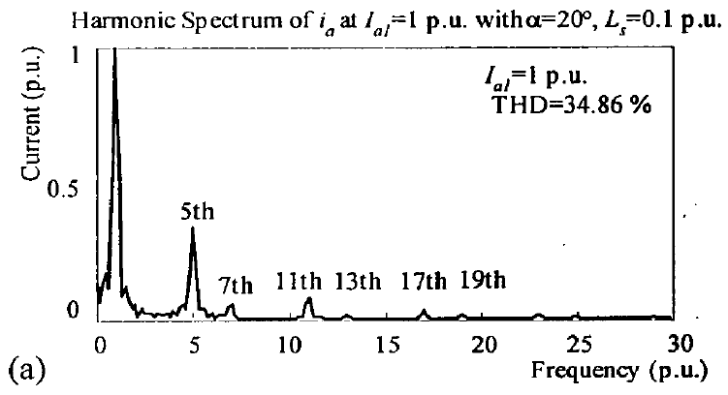
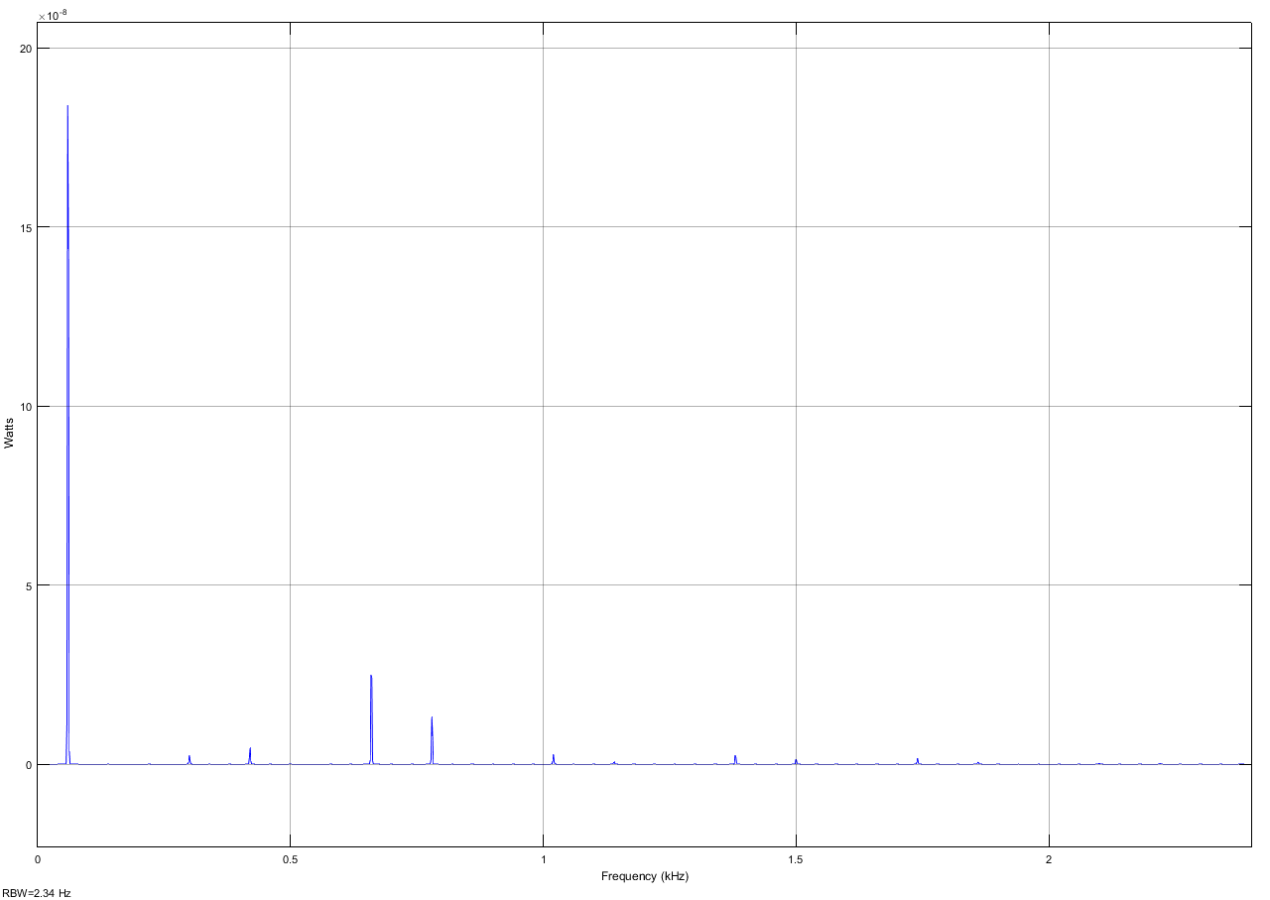
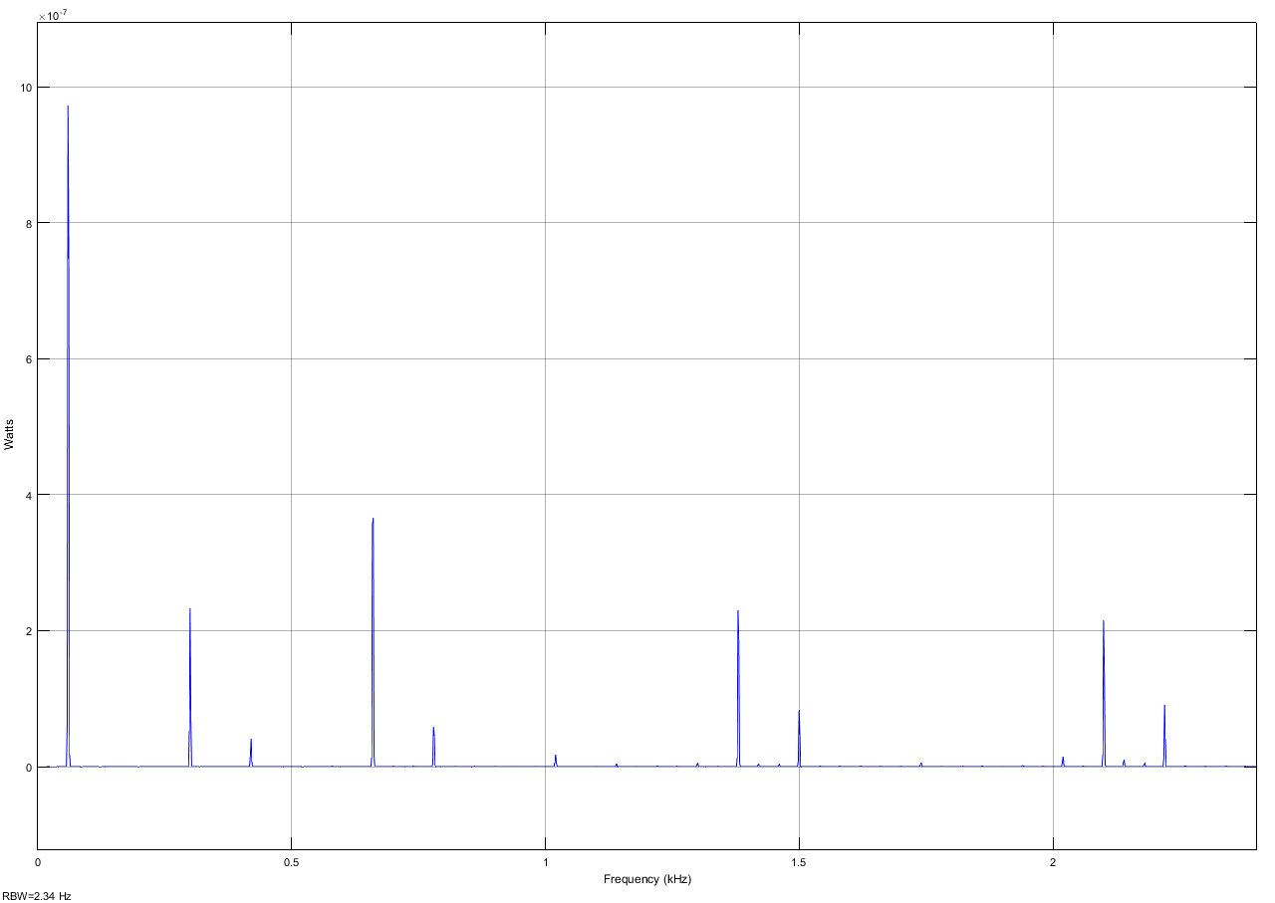
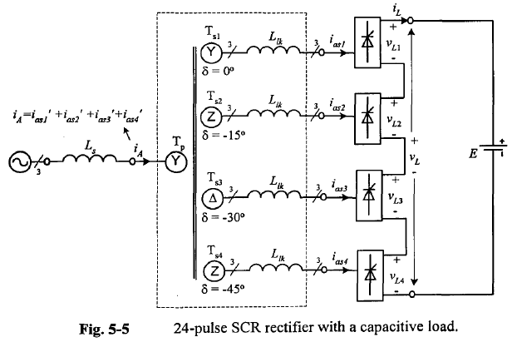
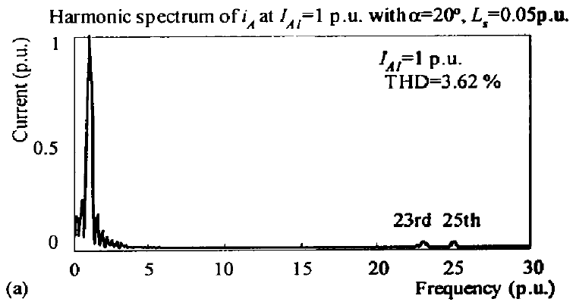
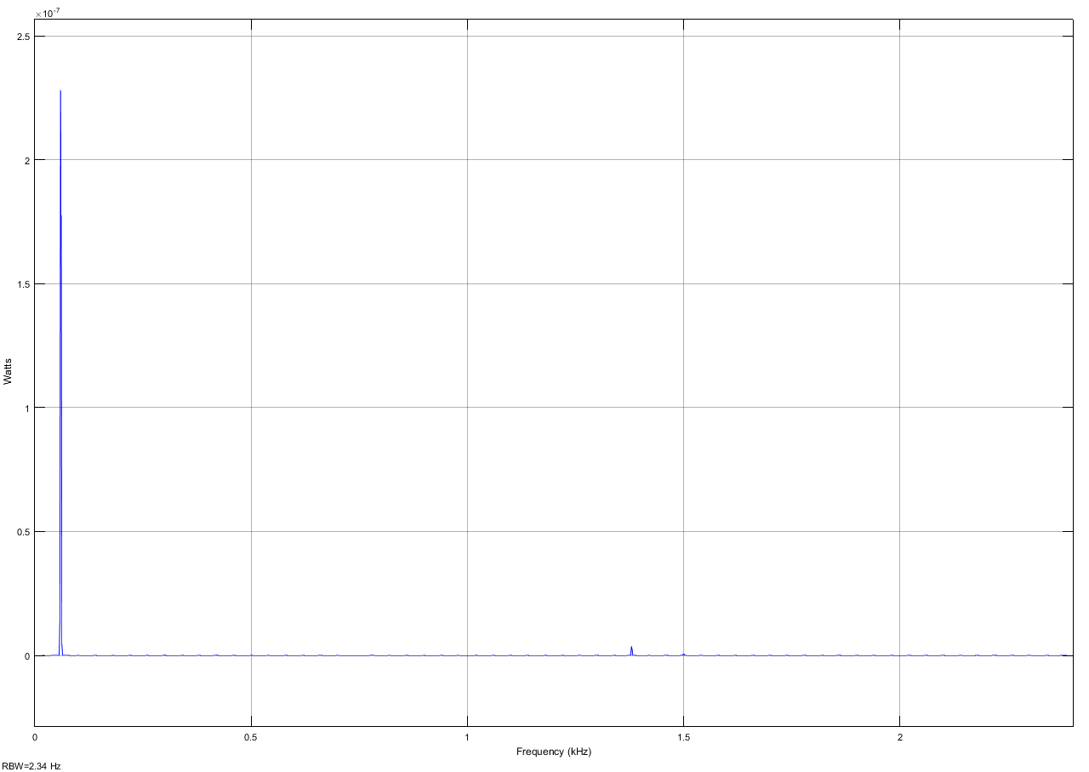
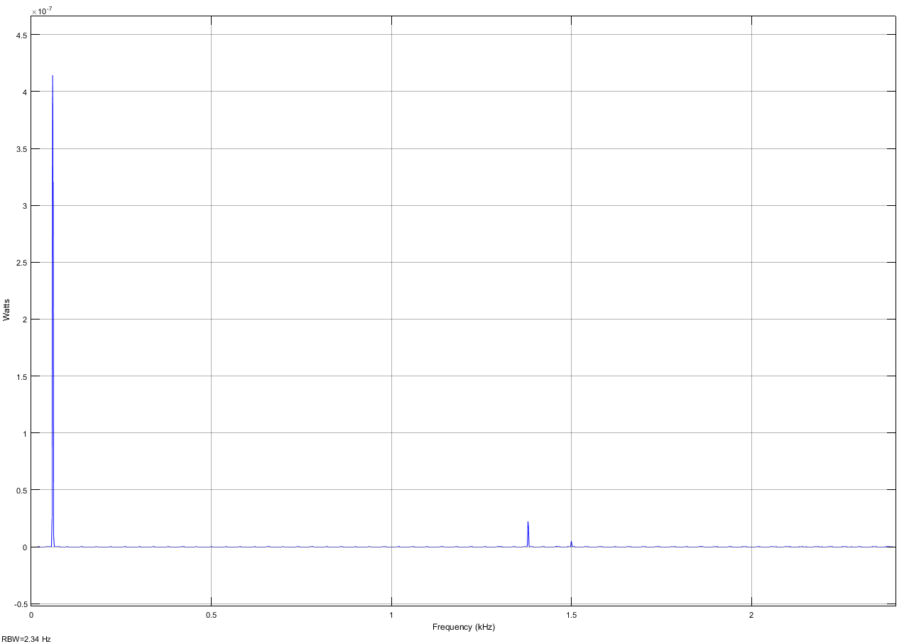
Investigation of Harmonic Distortion in Multi-Pulse Rectifiers for Large Capacitive Charging Applications
David A. Dodson¹, Brian J. McRee¹, David A. Wetz¹, Qing Dong², and John M. Heinzel²
¹ University of Texas at Arlington, Arlington, TX 76019, USA, ² Naval Surface Warfare Center, Philadelphia Division, 5001 S. Broad St., Philadelphia, PA, 19112, USA
Abstract
Passive Vs. Controlled rectifier
Model Considerations
SIMULATION %THD
# of Pulses | 95% Charge
6-Pulse | 453.1874%
12-Pulse | 74.6456%
18-Pulse | 18.4683%
24-Pulse | 12.6896%
Aboard the future fleet of the United States Navy, there will be several large capacitive loads that must be operated in a heavily transient manner. Rectifying AC power into DC power can be very inefficient due to the presence of harmonics within the DC output. Previous work has shown that by generating additional input phases for rectification, harmonics can be canceled and efficiency can be improved. However, in nearly all of these previously documented efforts, the load has been assumed to be purely resistive or slightly inductive. This work proposes to investigate the effect of harmonics on large capacitive loads, similar to what could be seen in future naval applications. Simulink® model has been developed of 6, 12, 18, and 24 pulse SCR rectifiers, respectively, and hardware versions of each respective topology have been procured from Applied Power Systems so that the models can be validated when capacitively loaded. Through the validation exercise, a preliminary understanding will be obtained as to how increasing the number of phases rectified by multi-pulse rectifiers affects power quality and total harmonic distortion. This work is expected to provide insights into the issues that may arise when converting high power AC to DC for sourcing large capacitive loads. The validated models will eventually be implemented on a hardware in the loop (HIL) platform to study their deployment in future shipboard power systems.
  Passive diode rectifiers can be used for full-wave rectification but the angle at which rectification begins cannot be controlled
  The firing angle of actively controlled SCR rectifiers can be adjusted throughout the wave allowing the DC output voltage to be varied.
  Comparison of passive to SCR fired rectifiers is not simple since sophisticated circuitry as a control schemes are needed to properly fire the SCRs
The source fed into the rectifier was modeled as a motor-generator with a series resistance of 2.7 ohms and 11.9mH of inductance [7]
The simulation waits 1 second for the PLL to lock before loading the rectifiers to ensure harmonic content being analyzed is valid
The phase generating and inter-phase transformers are modeled as ideal transformers to directly study the effect of rectifier topologies on THD and power quality
Physical Model Verification
Results from simulation study
Input Current Waveforms
Figure 5: Controlled rectifier output voltage waveforms for various firing angles. [6]
Figure 6: Load capacitor voltage for 0 degrees (red) and 90 degrees (blue) after 24s charge.
Figure 20: 3-phase 120VAC Motor-generators emulating shipboard diesel generators
Figure 21: Control box for the DC motor portion of the motor-generators
Simulink® Simulation Models
Figure 9: 6-pulse input current waveform at beginning of charge
Figure 10: 6-pulse input current waveform at end of charge
Introduction
Figure 22: Yokogawa WT3000 precision power analyzer
Figure 23: APS 6-pulse rectifier and control system
Typical motor driven generators aboard naval vessels generate 3-phase, 60 Hz power at 4 kV to 13 kV [1]
Many proposed loads are capacitive in nature including and include electromagnetic railguns, solid state lasers, and high power microwaves generators, among others
6-pulse rectifiers act as an AC to DC converter for 3-phase power; however, they introduce high magnitudes of harmonic distortion, leading to the generator having a low power factor [2]
Many researchers have presented methods of increasing the number of pulses in the rectifier. Most, if not all, have been shown to be loaded by either resistive or inductive loads [3, 4, 5] while the impacts on capacitive loads have not been very well characterized
Motor-generator pairs seen above will be used to emulate shipboard generators
6, 18, and dual 12/24 pulse SCR rectifier systems from Applied power systems have been procured
A Yokogawa precision power analyzer will be used to directly measure power quality parameters
Figure 11: 24-pulse input current waveform at beginning of charge
Figure 12: 24-pulse input current waveform at end of charge
Figure 7: 6 Pulse simulation model
Input Current PSD
Figure 24: APS 12-pulse/24-pulse rectifier and control system
Figure 13: Harmonic content in watts of 6-pulse rectifier at ~95% max capacitor voltage
Figure 14: Harmonic content in watts of 6-pulse rectifier at ~80% max capacitor voltage
Future Plans
background
Validation of simulation through results in hardware
Further non-idealities will be built into the model as hardware is brought up operational
The load will be adjusted to better represent those of interest to the US Navy
Conclusions
Figure 8: 24 Pulse simulation model
In simulation, charging the load capacitor to different levels of energy stored results in variation in the relative magnitudes of the harmonics generated
In general, increasing the number of phases (pulse) being rectified rectifier significantly reduces the total harmonic distortion of the source current
The cancellation of harmonics allows filters with a higher frequency passband to be used, reducing its size
Multi-pulse rectifiers require additional components, such as large/heavy phase generating transformers, inter-phase transformers, controllers, and power electronics
This work seeks to evaluate the advantages and disadvantages of this the added complexity
Figure 1: 6-pulse diode bridge rectifier [6]
Figure 2: 6-pulse diode bridge harmonic spectrum [6]
Three-phase source modeled as a motor generator pair
Phase shift transformers create additional phases
6, 12, 18, and 24-pulse full-wave rectifier topologies, respectively, have been simulated
Control of the SCRs firing angle is achieved using a phase-locked-loop (PLL) and a full-wave SCR pulse generator already in Simulink®
Rectifier bridges are put in parallel using inter-phase transformers
The load simulated was a 4.8 mF capacitor that was charged through a 500 Ω charge resistor
Control of firing angle is accomplished through a PLL and built-in full-wave SCR pulse generator
Figure 15: Harmonic content in watts of 12-pulse rectifier at ~95% max capacitor voltage
Figure 16: Harmonic content in watts of 12-pulse rectifier at ~80% max capacitor voltage
Figure 3: 24-pulse diode bridge rectifier [6]
Figure 4: 24-pulse diode bridge harmonic spectrum [6]
Increasing the number of phases (pulses) the rectifier uses, in theory, cancels harmonic distortion of the source current, making them a viable solution for meeting MIL-STD-1399
Figure 17: Harmonic content in watts of 24-pulse rectifier at ~95% max capacitor voltage
Figure 18: Harmonic content in watts of 24-pulse rectifier at ~80% max capacitor voltage
[1] N. Doerry, "Next Generation Integrated Power System NGIPS Technology Development Roadmap," Naval Sea Systems Command, Washington Navy Yard, 2007.
[2] R. W. Erickson and D. Maksimovic, Fundamentals of Power Electronics, 2 ed., Norwell: Kluwer Academic Publishers, 2001, pp. 615-616.
[3] A. O. Monroy, L.-H. Hoang and C. Lavoie, "Modeling and Simulation of a 24-pulse Transformer Rectifier Unit for More Electric Aircraft Power System," in Electrical Systems for Aircraft, Railway and Ship Propulsion (ESARS), Bologna, 2012.
[4] K. M. Hink, "18-Pulse Drives and Voltage Unbalance," MTE Corporation, Menomonee Falls, 2002.
[5] S. Kocman and S. Vitezslav, "Reduction of Harmonics by 18-Pulse Rectifier," Advances in Electrical and Electronic Engineering, vol. 7.1, no. 2, pp. 137-139, 2011.
[6] M. Li, “Multi-pulse SCR Rectifiers,” Ryerson University, Toronto, Ontario, Canada, 2005
[7] Y. Y. Chen, “Experimental Results from a Physical Scale Model Alternator Pair as a Pulsed Power” IEEE Transactions on Magnetics, vol. 40, no. 1, pp. 1, Jan. 2007.
* This work is supported by the US Office of Naval Research under grant N00014-16-1-2248. The opinions and findings are those of the authors and are not necessarily those of the US Office of Naval Research.

