Slide 1

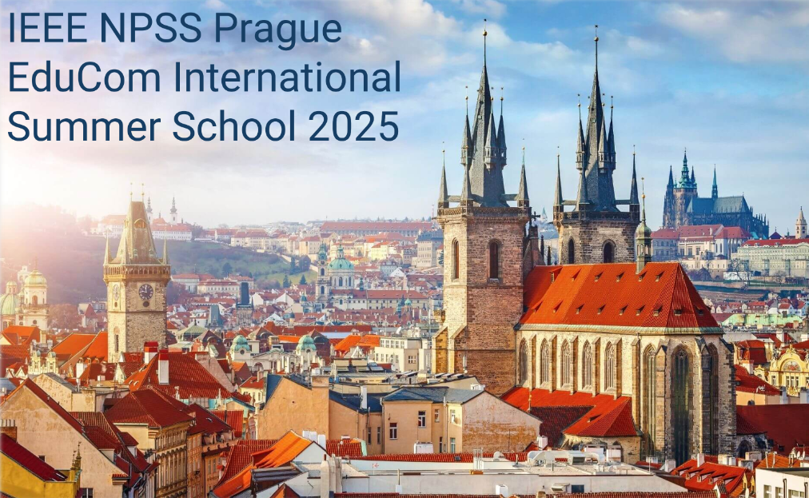

Building Bridges:
My Journey in Professional Development and International Networking
Trang Hoang
University of Science, Vietnam National University Ho Chi Minh City, Vietnam

Slide 2
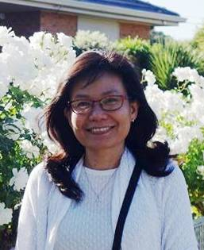
Hoang Thi Kieu Trang (Trang HOANG)
Education
  1998: Bachelor in Nuclear Physics, University of Science, Vietnam National University, Vietnam
  2003: Master in Nuclear Physics, University of Science, Vietnam National University, Vietnam
  2012: Ph.D. in Experimental High Energy Physics, Florida State University, USA
Professional Experience
  1998 – 2005: Teaching Assistant, University of Sciences HCMC, Vietnam
  2005 – 2007: PhD Student, Teaching Assistant, Florida State University, United States
    2007 – 2012: PhD Student, Research Assistant based at Fermilab, Florida State University, United States
  2013 – Present: Lecturer, University of Science, Vietnam National University Ho Chi Minh City
    Research Interests: Medical Image Processing, Nuclear Medicine, Monte Carlo Simulation, Web Application Development
    Courses: Medical Image Processing, Nuclear Medicine, Modern Physics, Radiation Physics, Quantum Mechanics

Slide 3
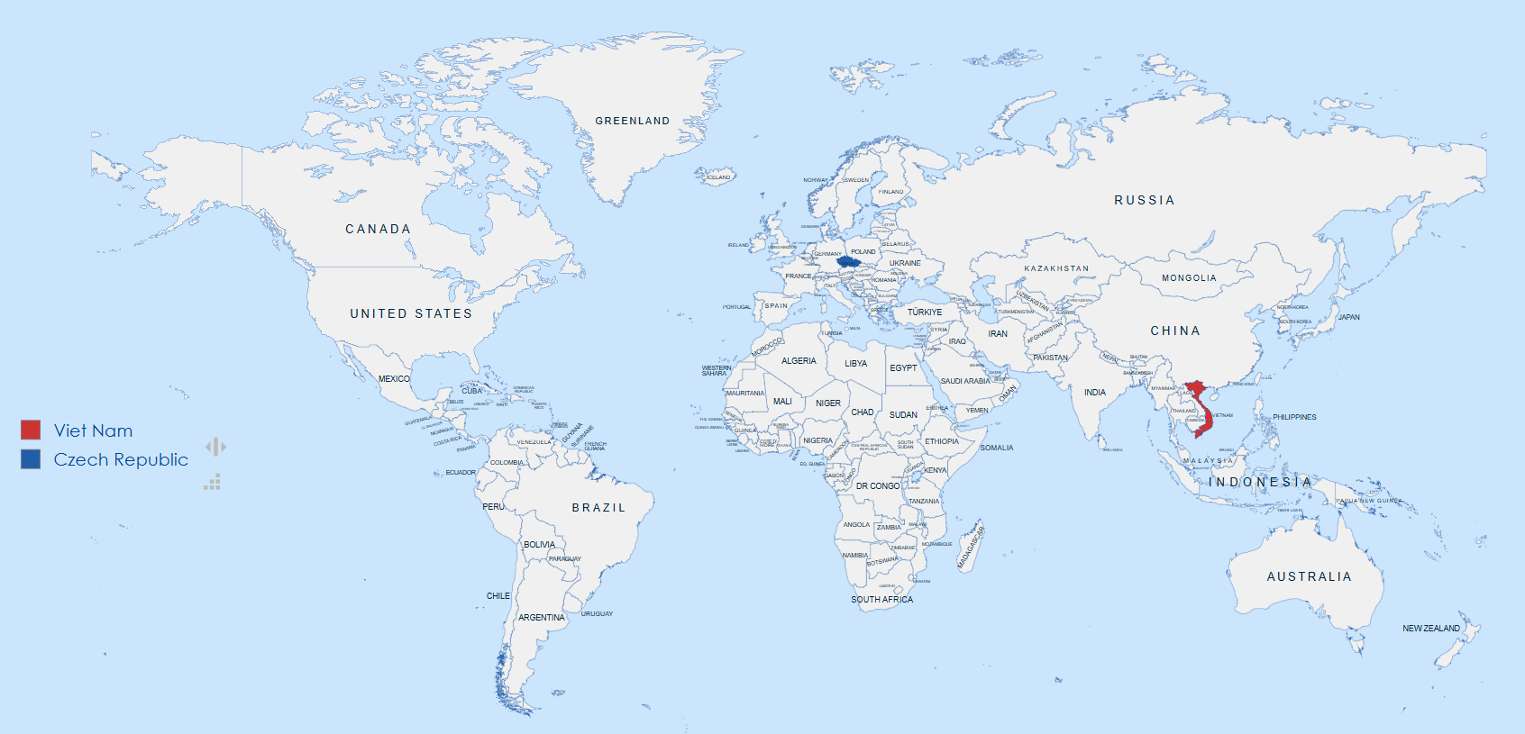
Hoang Thi Kieu Trang (Trang HOANG)
Education
1998: Bachelor in Nuclear Physics, University of Science, Vietnam National University, Vietnam
2003: Master in Nuclear Physics, University of Science, Vietnam National University, Vietnam

Slide 4
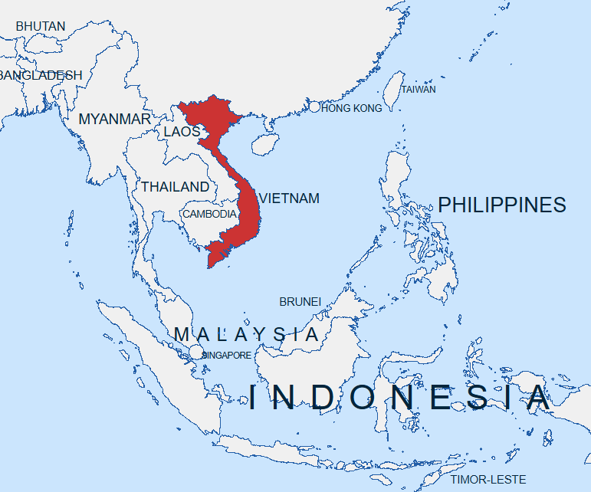
SOUTHEAST ASIA COUNTRIES
GDP per capita according to IMF for 2025.
Rank | Country | Population in million | GDP Nominal per capita USD (thousand)
1 | Indonesia | 284.44 | 5.03
2 | Philippines | 114.37 | 4.35
3 | Vietnam | 102.16 | 4.81
4 | Thailand | 70.33 | 7.77
5 | Myanmar | 55.18 | 1,18
6 | Malaysia | 33.85 | 13.14
7 | Cambodia | 17.35 | 2,87
8 | Laos | 7.79 | 2.1
9 | Singapore | 6.08 | 92.93
10 | Brunei | 0.46 | 34.97

Slide 5
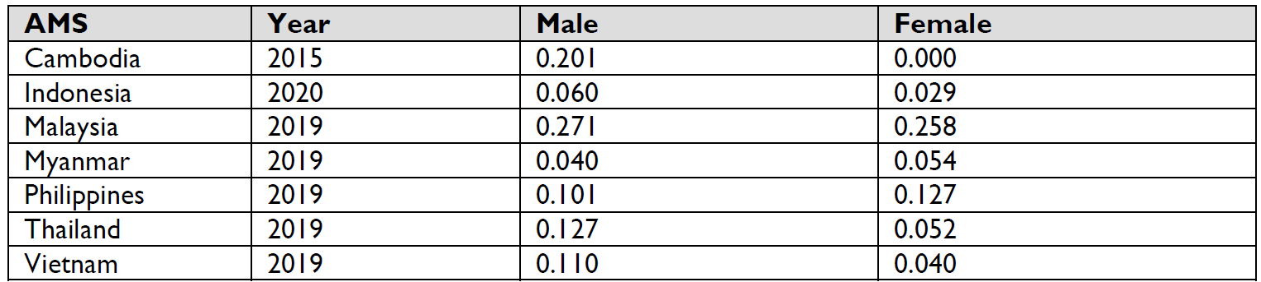
THE STATUS OF WOMEN’S PARTICIPATION IN STEM
- STEM stands for science, technology, engineering, and math -
HIGHER EDUCATION
Many women holding doctoral degrees do not continue to jobs in their doctoral field of study.
Gender norms around working in STEM fields, family obligations, and the working environment and conditions impact women’s transition into STEM careers from doctoral studies (UNESCO 2017).
Percentage of Population Ages 25 and Over that Attained or Completed a Doctorate or Equivalent, Disaggregated by Sex (2022 data) (World Bank n.d.)
Ref: USAID, STRENGTHENING ASEAN WOMEN’S PARTICIPATION IN STEM, December 2022

Slide 6
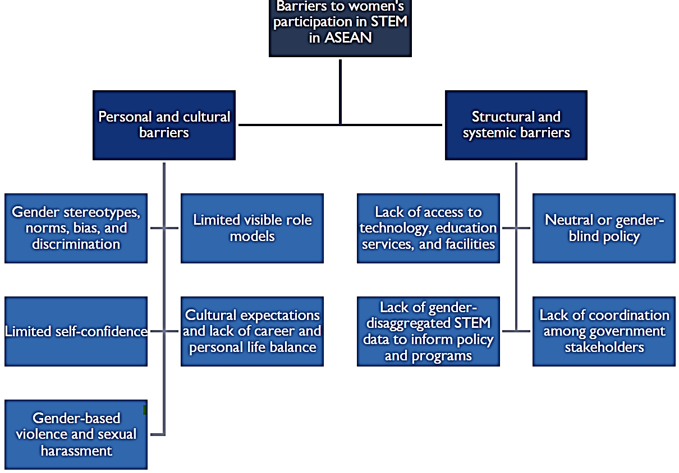
Barriers to women’s participation in STEM in ASEAN
Ref: USAID, STRENGTHENING ASEAN WOMEN’S PARTICIPATION IN STEM, December 2022

Slide 7
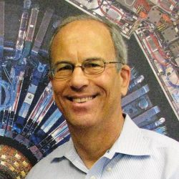
Hoang Thi Kieu Trang (Trang HOANG)
Opportunity
2000: Attended The 5th International Winter School on High Energy Physics and Condense Mater Physics, Vietnam
Dr. Boaz Klima, Fermilab

Slide 8
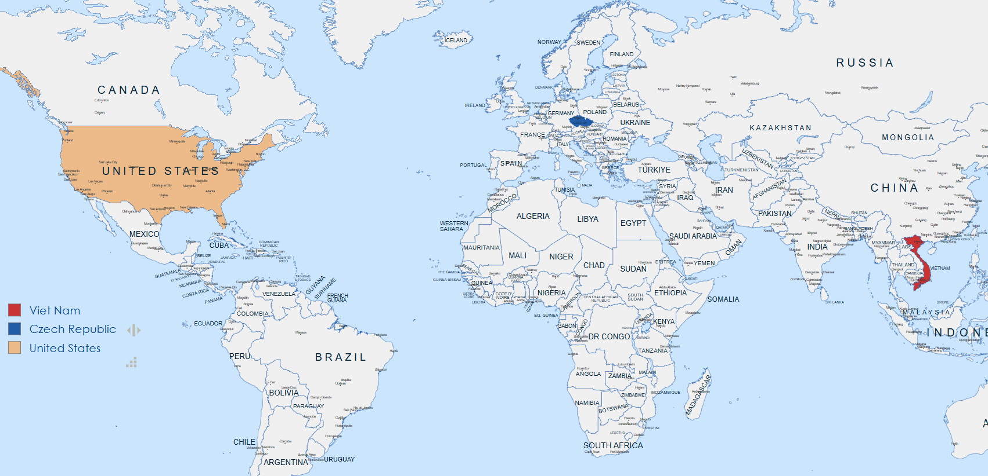
Hoang Thi Kieu Trang (Trang HOANG)
Opportunity
2001: Visitor at D0 experiment, Fermilab

Slide 9
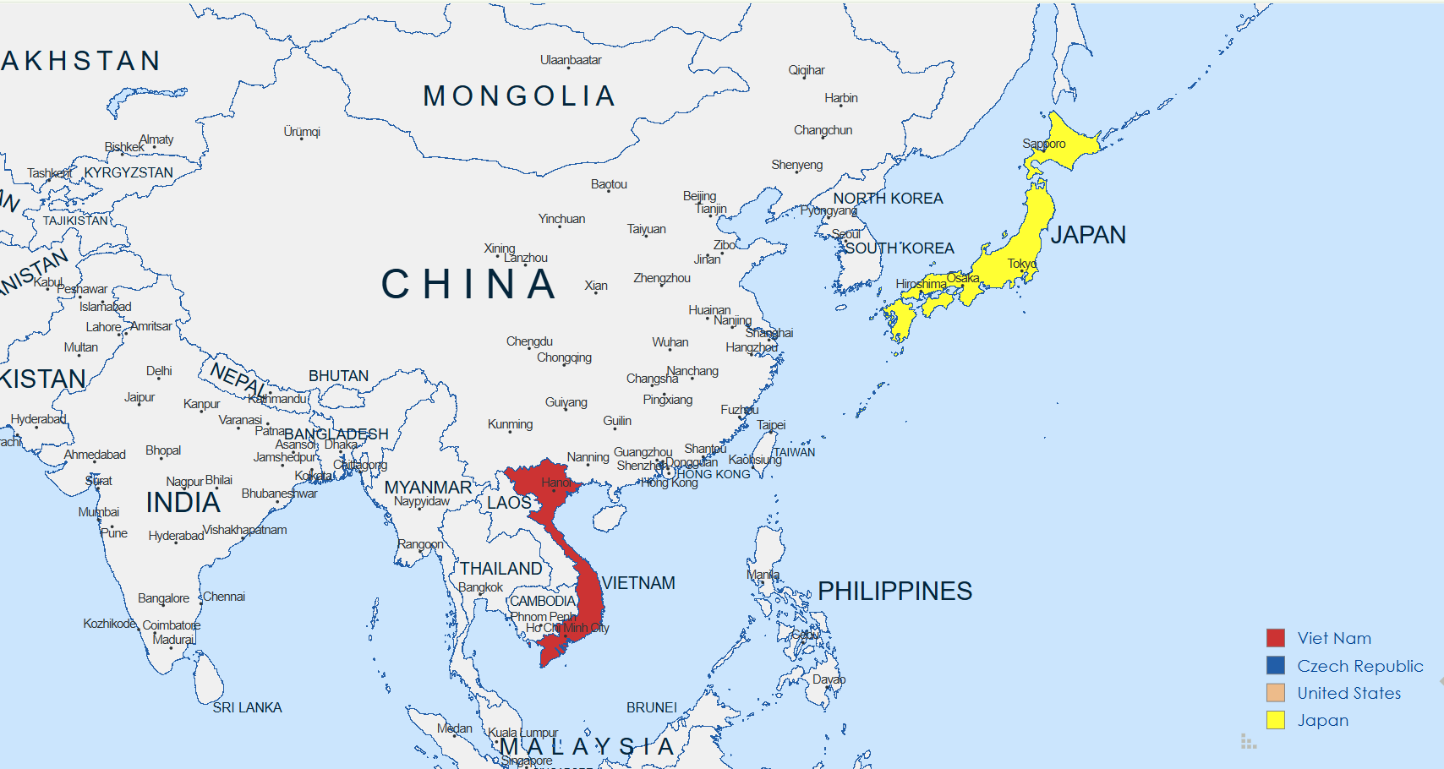
Hoang Thi Kieu Trang (Trang HOANG)
Opportunity
2004: MEXT nuclear researcher exchange program, Tokai Research Establishment, Japan

Slide 10
Hoang Thi Kieu Trang (Trang HOANG)
Education
2005 Ph.D. in Experimental High Energy Physics, Florida State University, USA:

Slide 11
Hoang Thi Kieu Trang (Trang HOANG)
Experience
2007 Joined the D0 Experiment, Fermilab, Chicago, USA

Slide 12
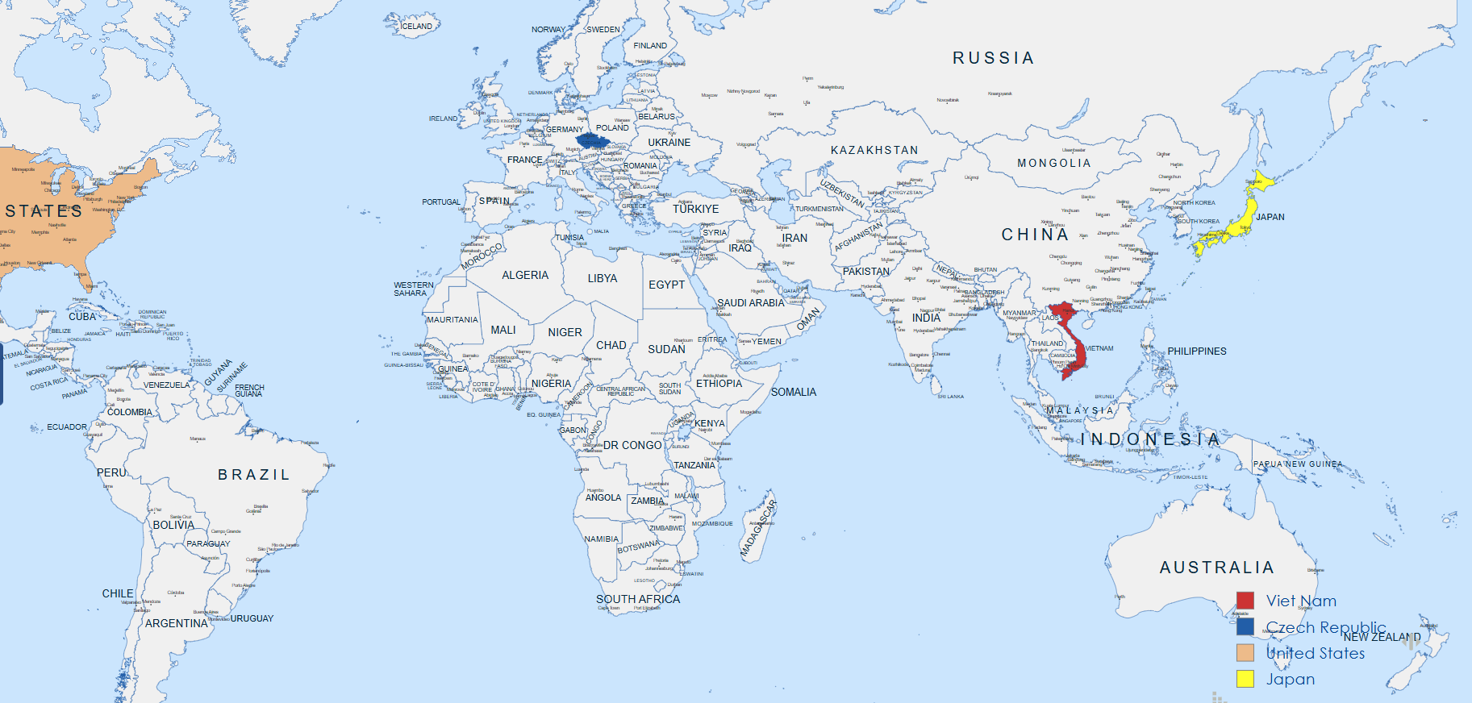
Hoang Thi Kieu Trang (Trang HOANG)
Experience
2013 Lecturer, University of Science, Vietnam National University Ho Chi Minh
City

Slide 13
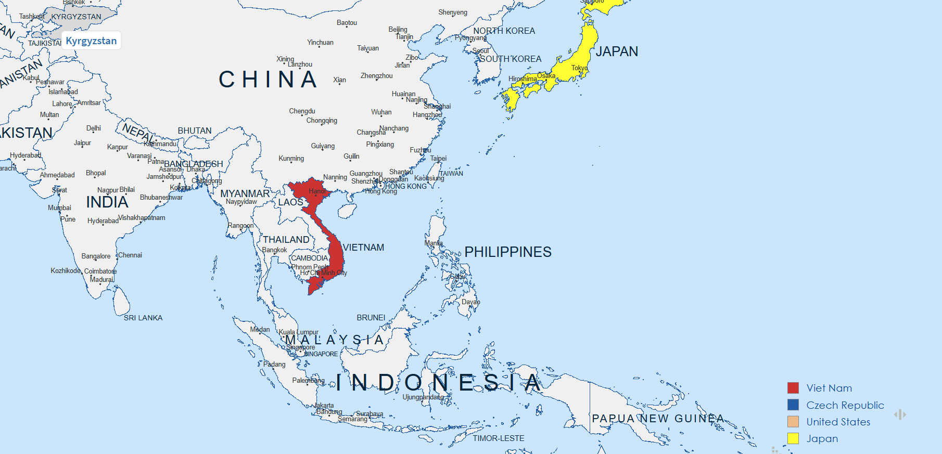
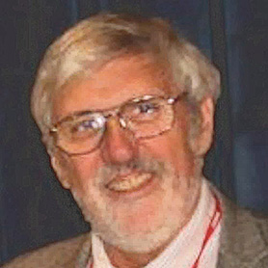
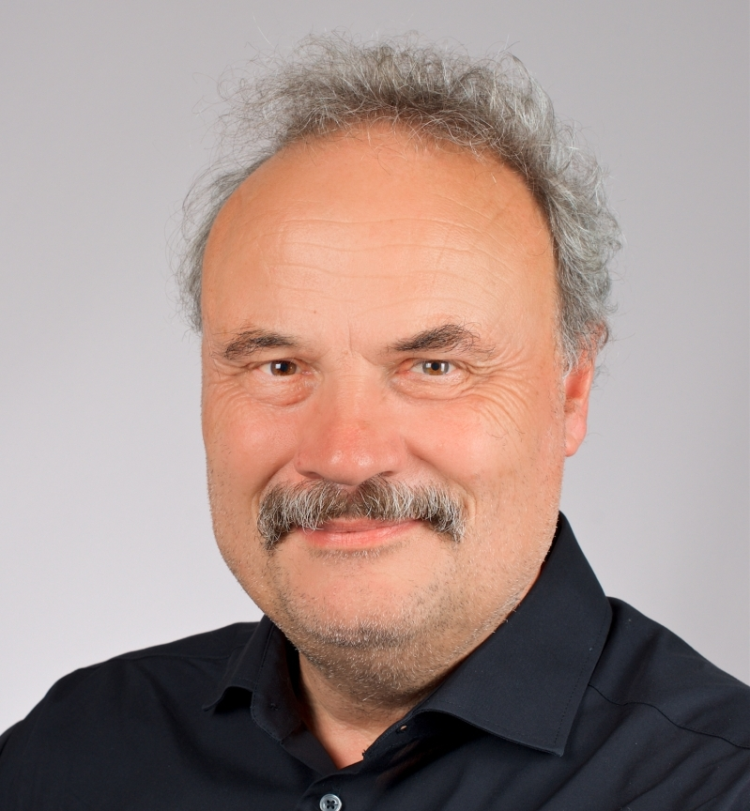
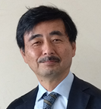
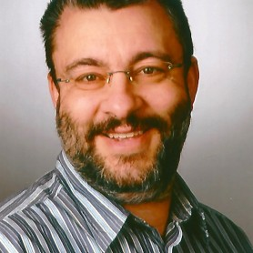
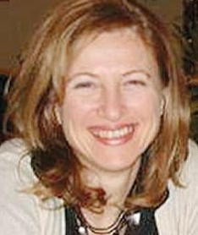
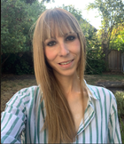
Hoang Thi Kieu Trang (Trang HOANG)
Networking
2019: The 15th Rencontres du Vietnam - International Conference on Medical Physics and School, 28/7-3/8/2019, ICISE, Quy Nhon, Vietnam (Lecturer)
2019: IEEE NPSS International School for RealTime Systems,10-15/11/219, Kuala Lumpur, Malaysia (Lecturer)
2022: ICISE school for Medical Physics, September 4-9, 2022, Quy Nhon, Vietnam, (Local Organizing Committee)

Slide 14
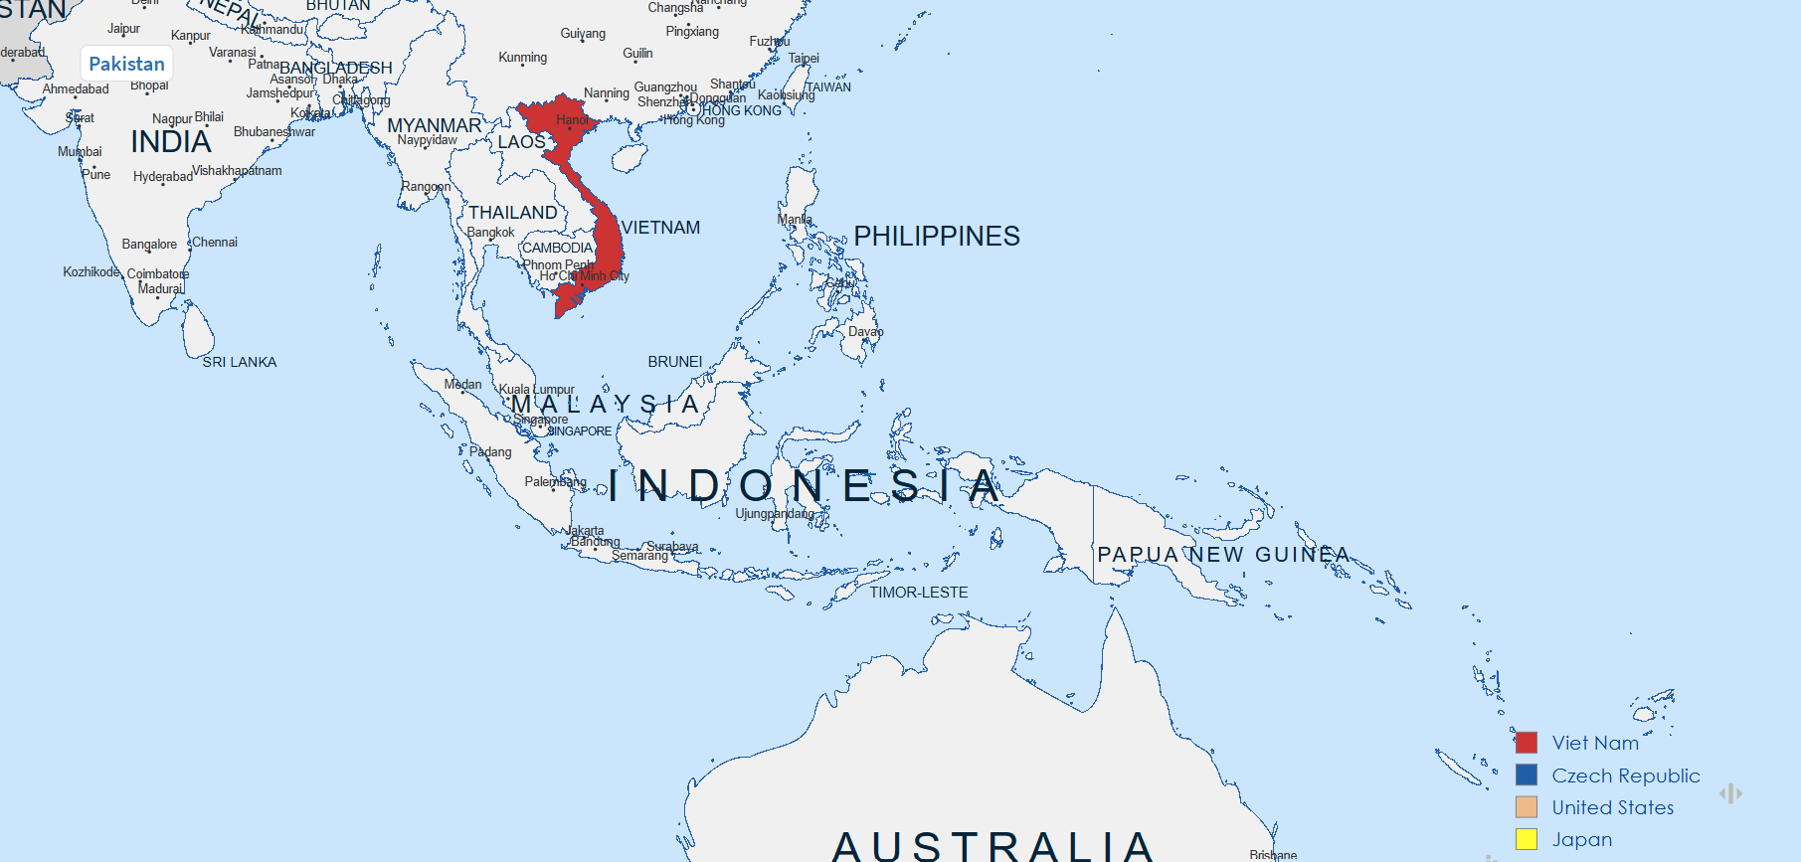
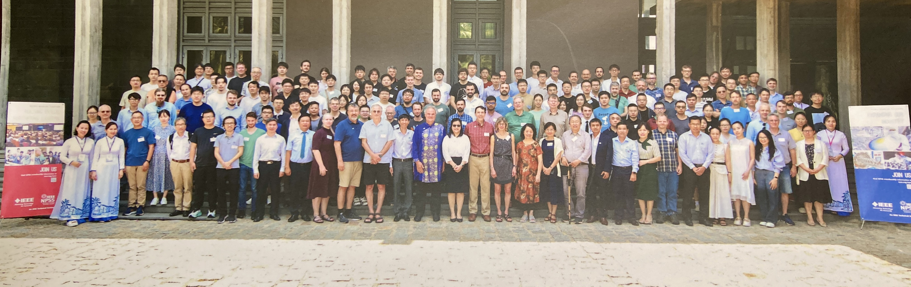
Hoang Thi Kieu Trang (Trang HOANG)
Networking
2024: 24th IEEE Real Time Conference, Apr 20-26, 2024, ICISE, Quy Nhon, Vietnam (Local Organizing Committee)
Become an active member of IEEE-NPSS

Slide 15
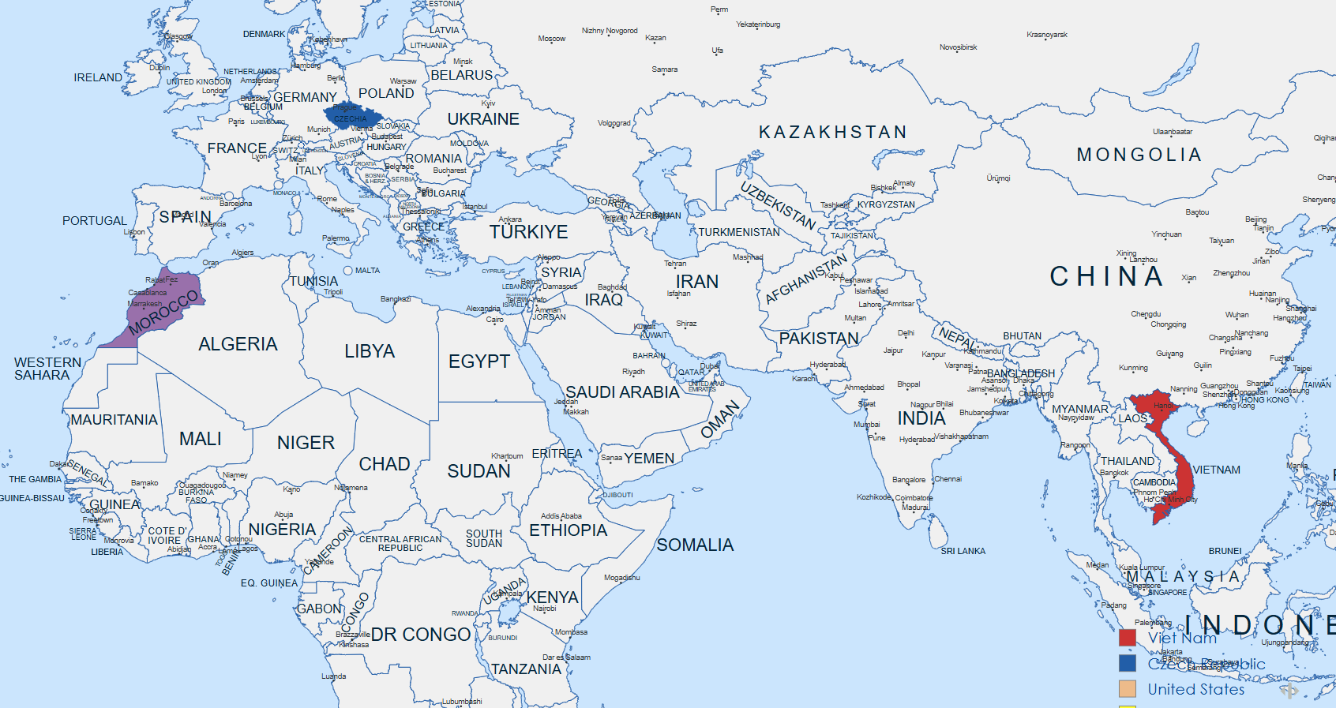
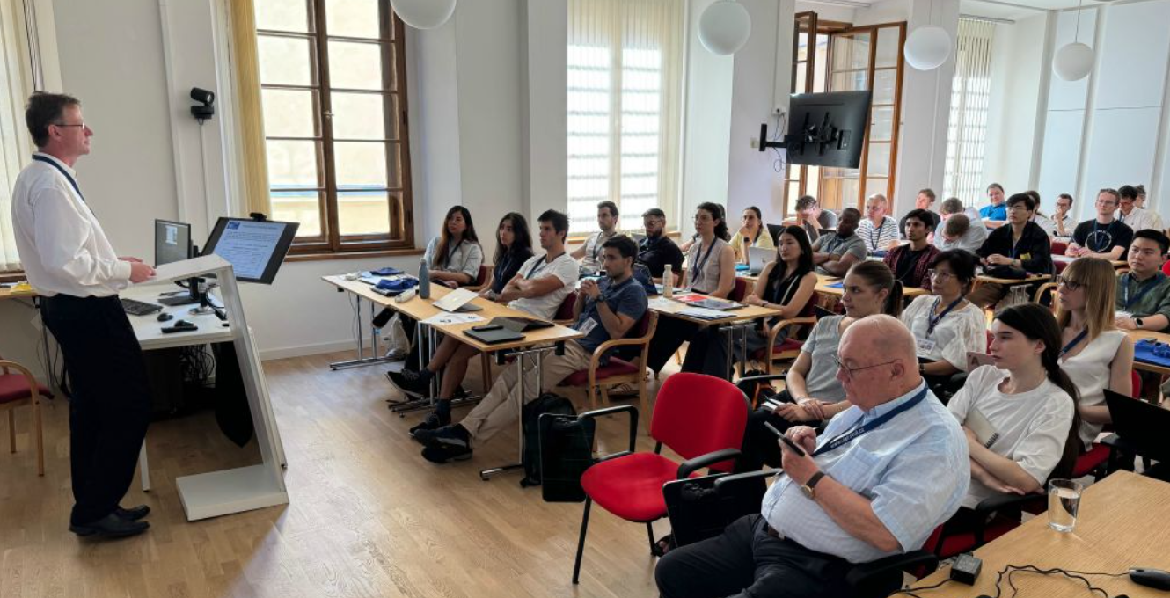
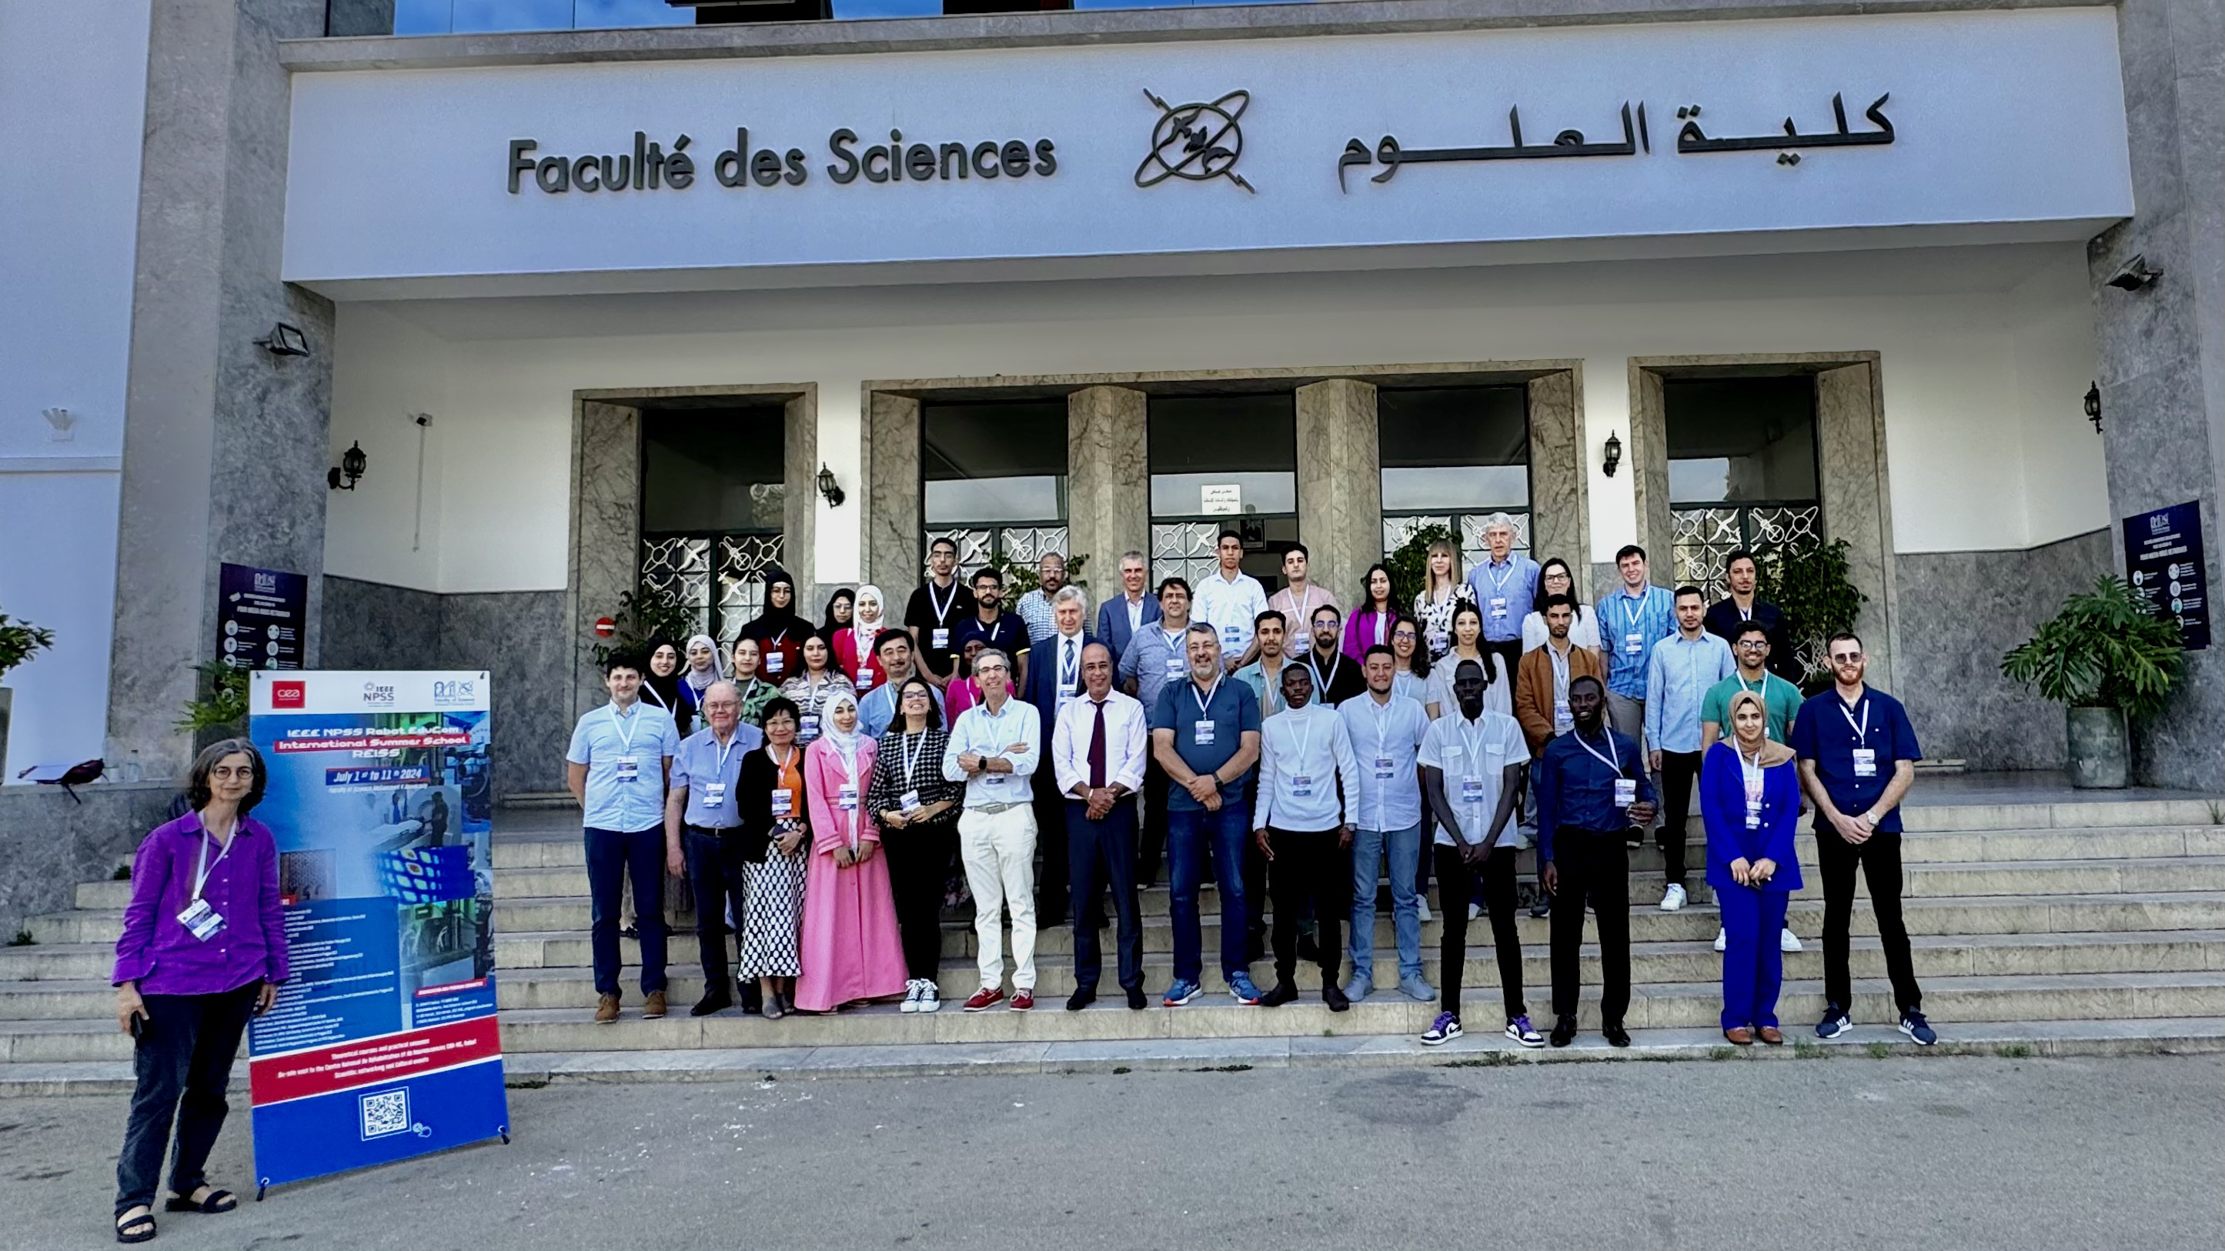
Hoang Thi Kieu Trang (Trang HOANG)
Networking
2025: IEEE NPSS Prague EduCom International Summer School (PEISS)
2024: RABAT IEEE NPSS EDUCOM International Summer School, Jul 1-10, 2024, the University Mohamed V of Rabat, Morocco (Lecturer)

Slide 16
Hoang Thi Kieu Trang (Trang HOANG)
Education
  1998: Bachelor in Nuclear Physics, University of Science, Vietnam National University, Vietnam
  2003: Master in Nuclear Physics, University of Science, Vietnam National University, Vietnam
  2012: Ph.D. in Experimental High Energy Physics, Florida State University, USA
Professional Experience
  1998 – 2005: Teaching Assistant, University of Sciences HCMC, Vietnam
  2005 – 2007: PhD Student, Teaching Assistant, Florida State University, United States
    2007 – 2012: PhD Student, Research Assistant based at Fermilab, Florida State University, United States
  2013 – Present: Lecturer, University of Science, Vietnam National University Ho Chi Minh City
Education broadens my perspective
Experience deepens my understanding, and
Networking advances my career.

Slide 17
Get Involved and action !!!

