Slide 1

Medical Imaging:
PET
July 2nd 2025
Andrea Gonzalez-Montoro, PhD
andrea.gm@i3m.upv.es

Slide 2

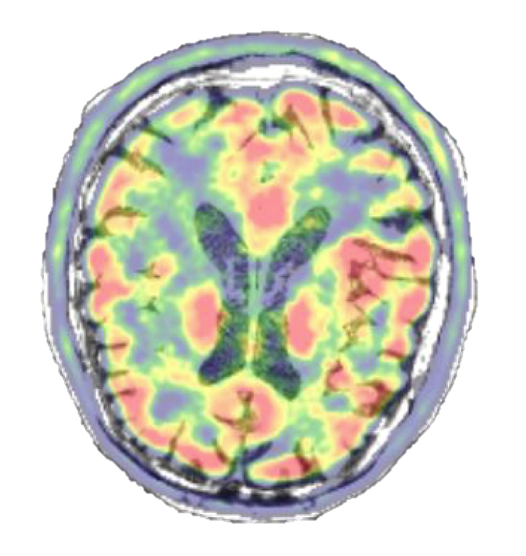
Outline
PET History & Evolution
PET Detector → PET scanner
PET system technology requirements
  Pre-clinical PET
  Clinical PET
State-of-the-art
  Dedicated-, WB-, and TB-PET
Conclusion

Slide 3
About me
Andrea Gonzalez-Montoro, PhD in Physics
Born in Valencia, Spain, on December 13th 1992
2021Young Scientific Female Talent. aRac y MasterCard España
Postdoctoral Fellow at
Stanford University 2018-2023
2023-Actualidad
i3M-CSIC-UPV
Ramón y Cajal, Postdoc
School:
C.P. José Sotó Micó
1996-2006
Highschool:
I.E.S. Juan de Garay
2006-2010
Degree in Physics
2010-2014
Master in Medical Physics
2014-2015
PhD in Physics
2015-2018
ERC Stg Grant
December 2024 – 2029
PHOENIX
Qualification: Cum Laude
December 2018
Medical and technological sciences
Decisions, doubts, fears…
Darmstadt, Germany
1st international experience
Permanent position at i3M
February 2025

Slide 4
Outline
PET History & Evolution
PET Detector → PET scanner
PET system technology requirements
  Pre-clinical PET
  Clinical PET
State-of-the-art
  Dedicated-, WB-, and TB-PET
Conclusion

Slide 5
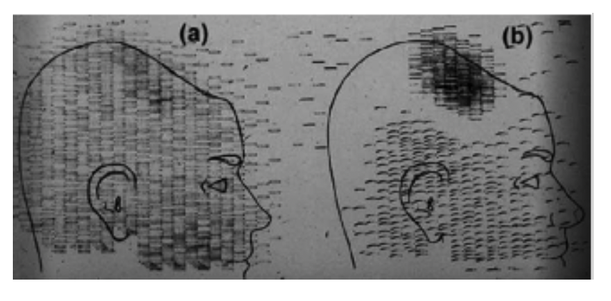


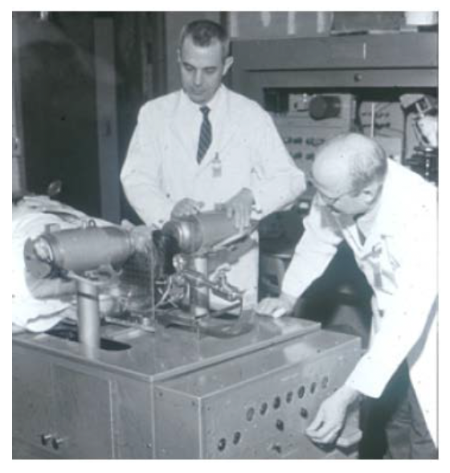
PET: History & Evolution
PET → uses radiotracers for the detection, diagnosis, monitoring and treatment of numerous medical conditions. It is the most widely used molecular imaging technique in the clinical field and also in preclinical research.
Historical facts contributing to the development of PET:
1929
1948
1952
1953
1932
1934
1945
Theoretical prediction of the positron by Dirac
Experimental discovery of the positron by
Anderson
Discovery of radioactive elements,
Curie y Joliot
First use of radiotracers in humans
Detector improvements, launch of the
PMT
Brownell y Sweet (MGH), radiation
to visualize and
treat tumors
Construction of the first PET, brain studies
Use of the cyclotron to generate artificial radionuclides. Univ, California Berkeley
Notes:
Massachusetts General Hospital

Slide 6
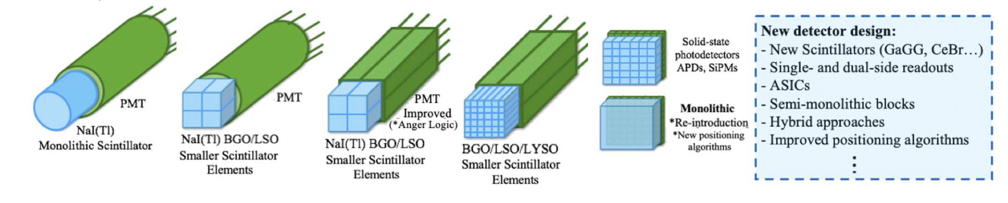
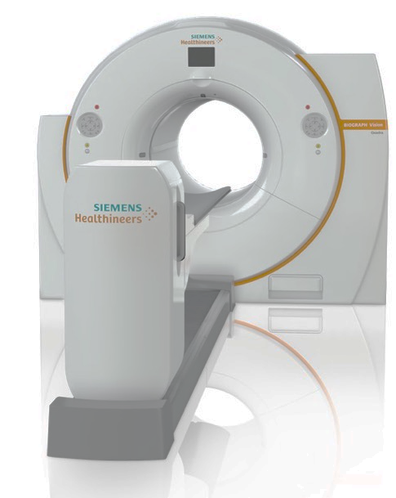
PET: History & Evolution
DEVELOPMENTS IN THE DETECTOR TECHNOLOGY
1953
1970
1990
2000
2010
Present
First completed PET scanner: Positome.
Robertson and Thompson
New scintillators: BGO y LSO.
Improved PET
Solid-state detectors: SiPMs.
Image improvements: DOI & TOF
Introduction of AI in PET
State-of-the-art
1978
Synthesis of new radiotracers
18F-FDG
1993
pre-clinical PET,
research with animals

Slide 7
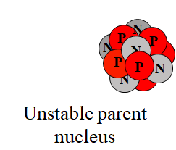

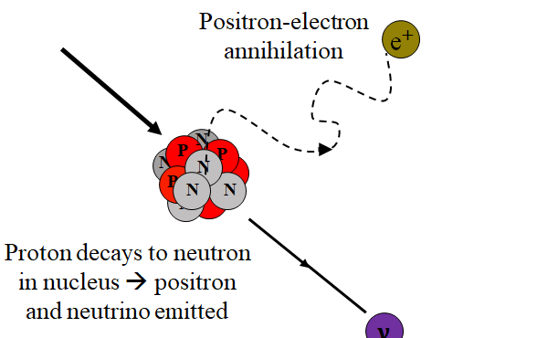

PET: Basics
Positron-electron annihilation
Positrons have very short lifetime, annihilate with electrons and produce two 511 keV photons that are detected.
Common isotopes for positron imaging: ¹⁸F(~H), ¹³N, ¹⁵O, ¹¹C.
𝛾
Positron-electron annihilation
Unstable parent nucleus
𝛾
Two anti-parallel 511 keV
Photons produced
Proton decays to neutron in nucleus → positron and neutrino emitted
$$ν$$
Talk: PET Detector Developments
gkjdsh

Slide 8

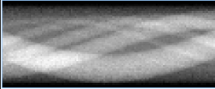
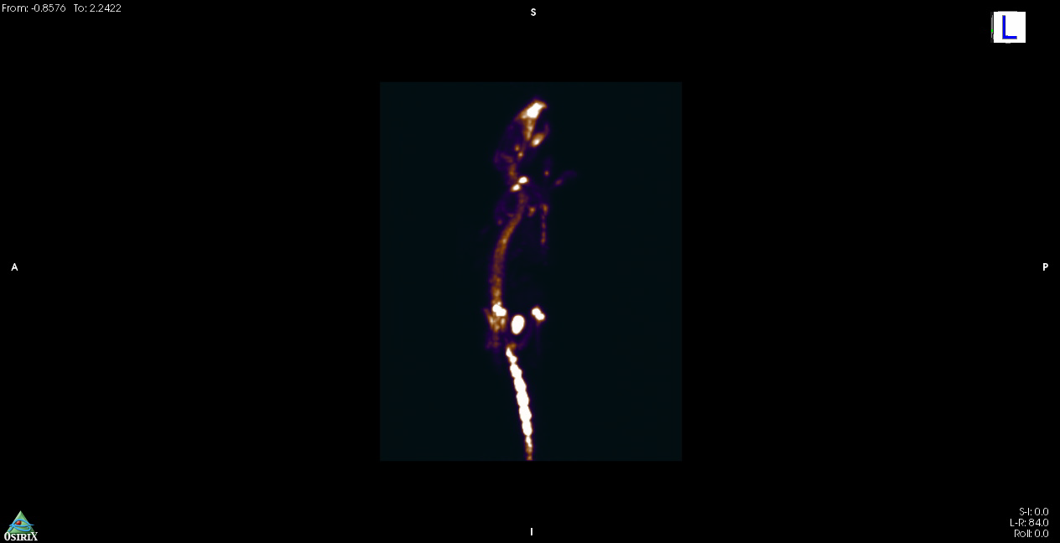
PET basics
LOR (“line of response”)
DET 1
DET 2
TC Window ~ few ns
Pulse Processing
Pulse Processing
AND
ev1
ev2
ev3
+1
t
From List-mode data or Sinograms, and “After complex software manipulation of the signal, a visual representation is reconstructed”.
Q.C. Black et al., “Radiotherapy target,” I.J. Rad. Oncol. Biol. Phys., 2004.
8
Notes:
Ventana de coincidencias < 5-10 ns
Sinograma: forma de alamcenaje más estandarizada.

Slide 9
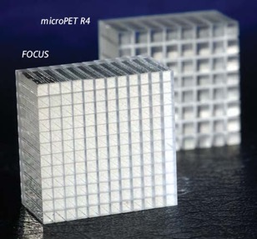
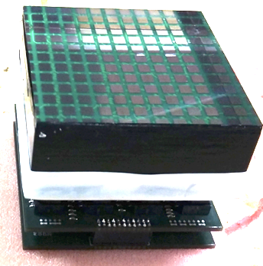
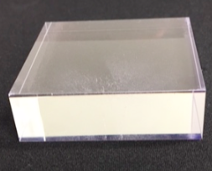
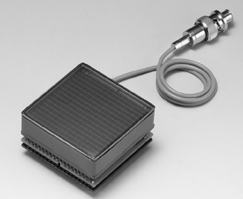
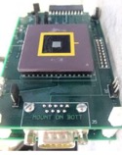
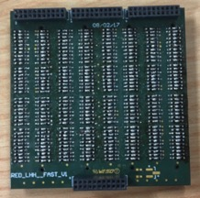
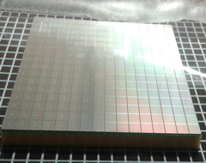
Gamma ray detectors
Scintillator block
Properties:
Dense $ρ$ (g/cm³) and high Z_{eff}
High Light Yield (32k ph/MeV)
Transparent to their own wavelength 420 nm
PET detector block
Monolithic
Pixellated
Photosensor
Readout
Analog
PMTs
Solid State
SiPMs
ASIC
Notes:
Propiedades de los cristales:
-Generar muchos gammas, de menos energía
-ser transparentes a su propia longitud de onda
-high LY
Freno los gamma de 511 leV → Genero una señal medible en el fotosensor transformande la luz visible en un impulse electrico. Ganacia appr. 1000000 → acondiciono la señal (signal shaping)
PMT
GENERATING!!
MOST USED IN MEDICAL IMAGING

Slide 10
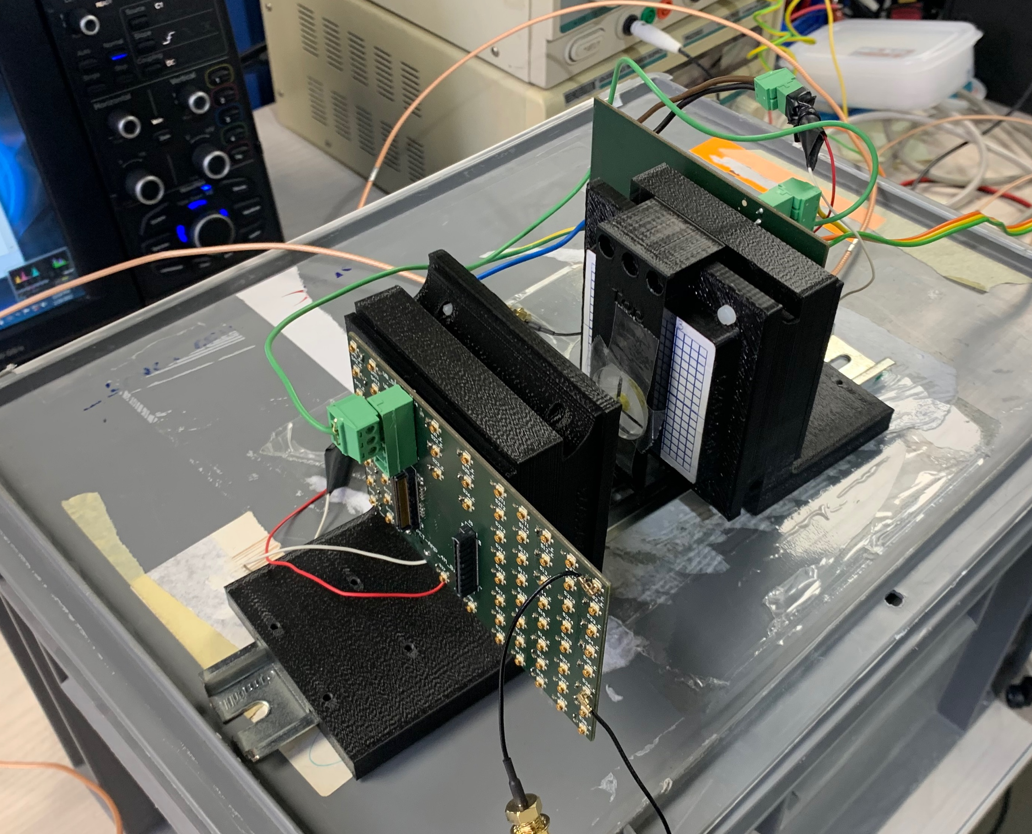
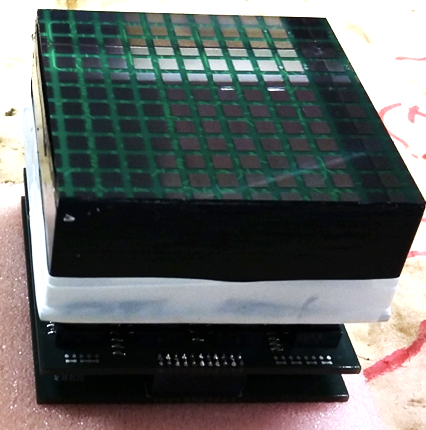
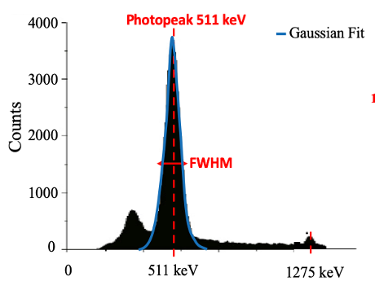
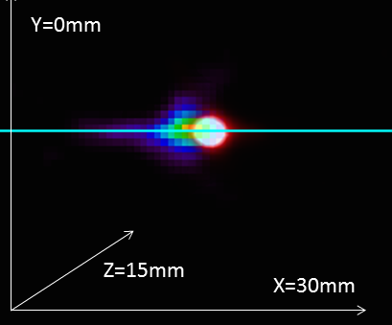
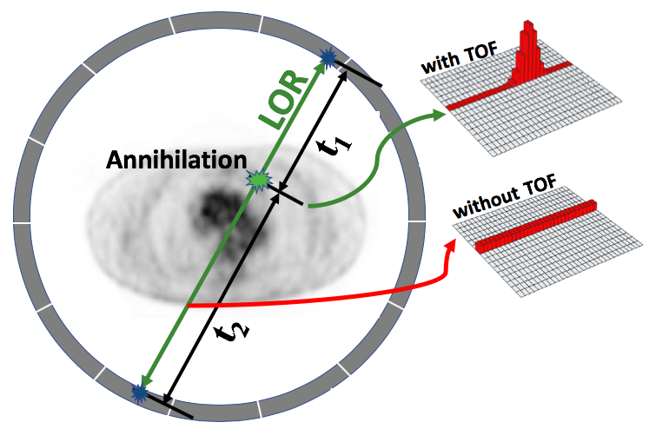
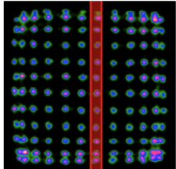
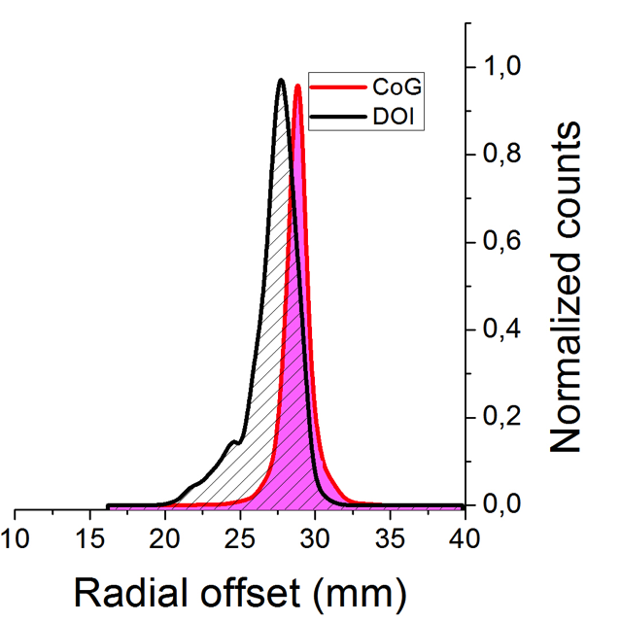

PET: Parameters
Detector level evaluation
$γ$-ray 511 keV
²²Na source
Acquisition of coincidence data to study the Influence of bias voltages, threshold levels, temperature drifts and other factors
are also evaluated
Detectors
Energy Resolution
CTR Resolution
Spatial Resolution
DOI Resolution
∆E/E x 100% , ∆E is the FWHM and E the centroid of the 511 keV photopeak
The coincident photons arrival time to the detector is recorded and histogram.
Average FWHM and FWTM of the the light distribution profiles obtained using radioactive sources
Side irradiation experiments at known depths. Average FWHM of the profiles
Wrong LOR
Corrected LOR
10

Slide 11
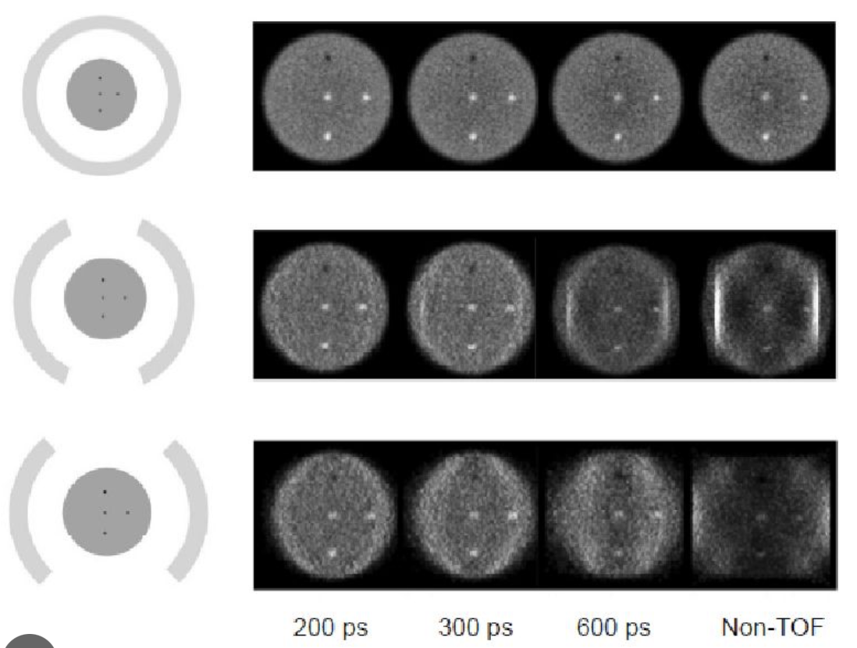
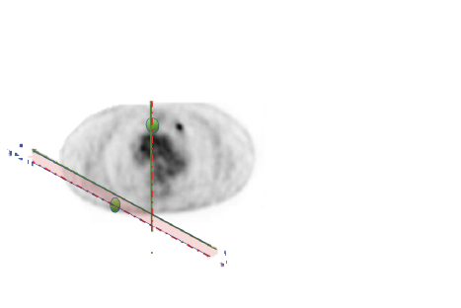
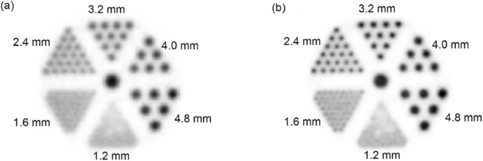
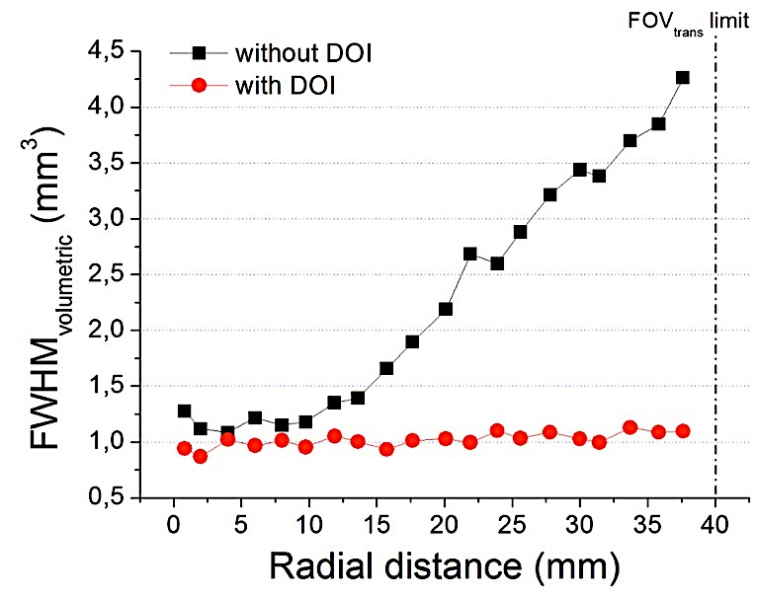
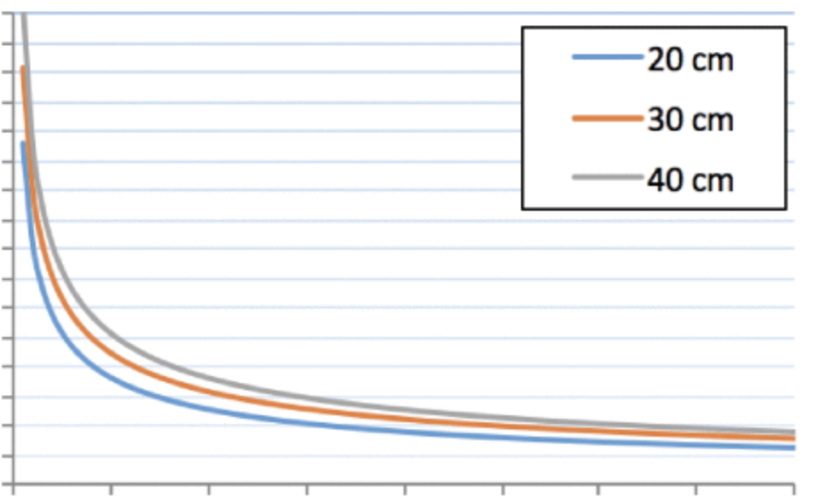
PET: DOI & TOF
DOI
TOF
Wrong LOR
Corrected LOR
Non-DOI
DOI
16
12
8
4
0
FOV Diameter
DOI
No DOI
SNR gain
!!
- 100. 300 500 700
CTR (ps)
11

Slide 12
Outline
PET History & Evolution
PET Detector → PET scanner
PET system technology requirements
  Pre-clinical PET
  Clinical PET
State-of-the-art
  Dedicated-, WB-, and TB-PET
Conclusion

Slide 13
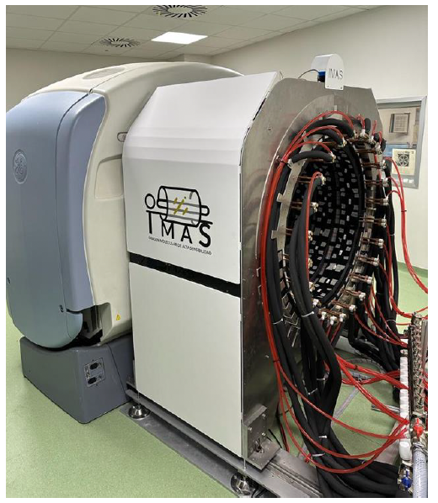

Scaling-up process
…to the system assembly
and validation
$γ$-ray 511 keV
Factors to consider for the scaling-up :
Scintillator material and surface treatment
Photodetector and arrangement
Number of elements (per module)
Number of modules
Their arrangement to minimize gaps
  High packing fraction and sensitivity
  Scintillator-photodetector coupling
Electronic readout
  Trade-off between performance,
  power consumption, and number
  of output signals
From the
detector level…

Slide 14
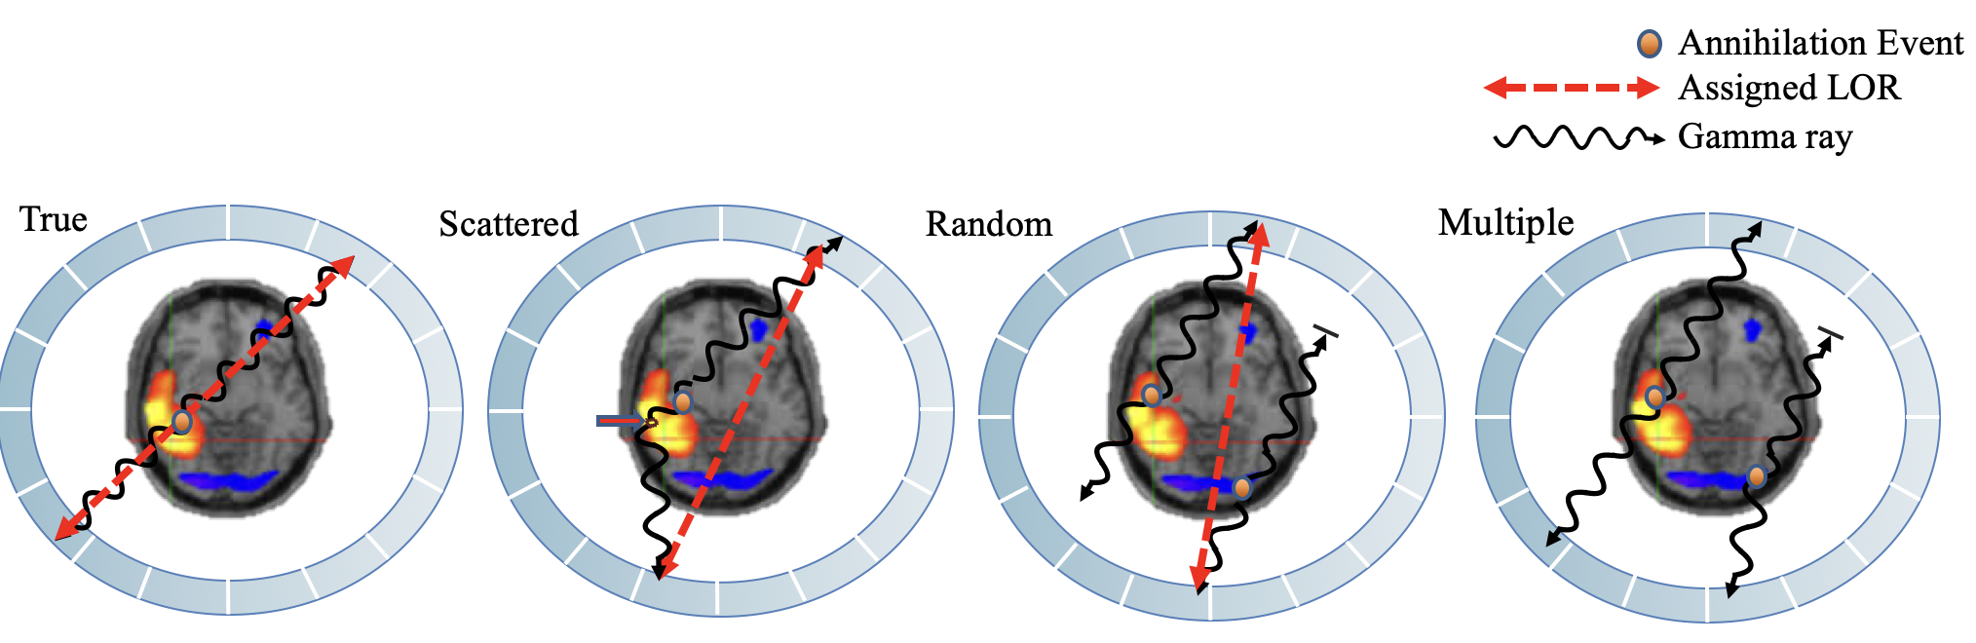
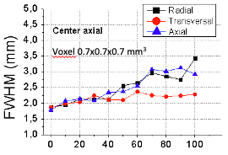
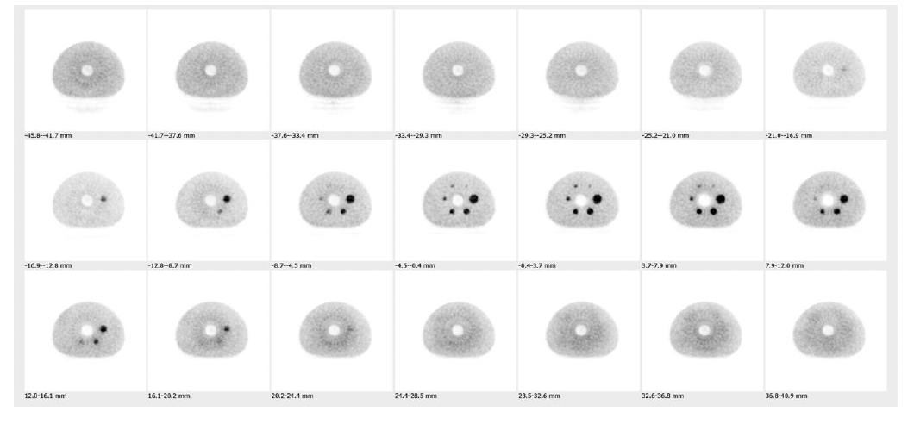
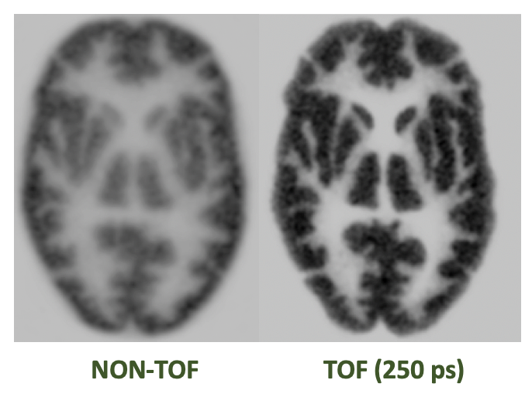
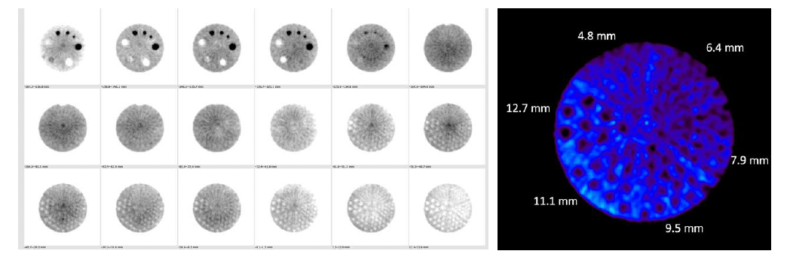
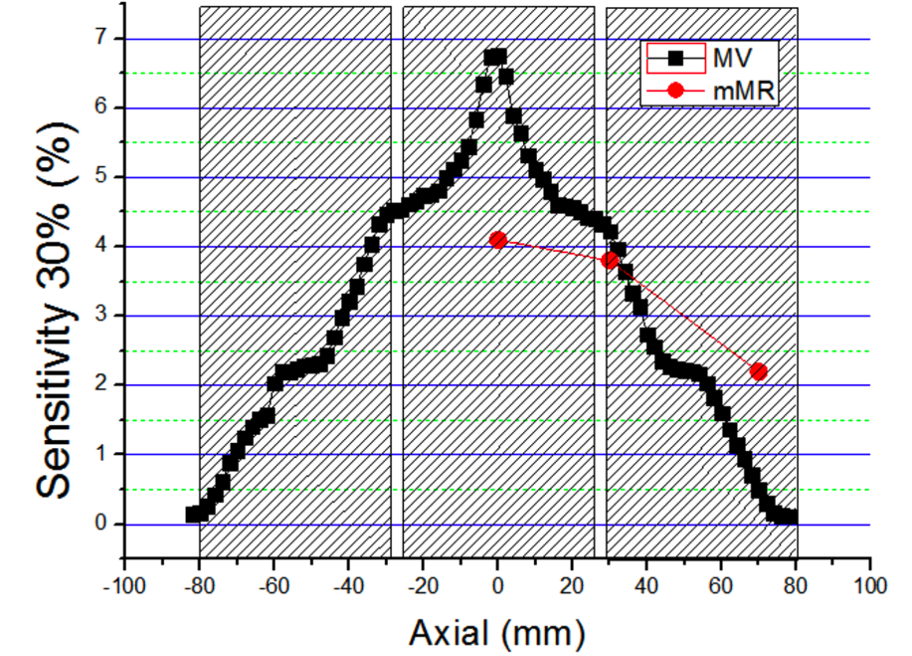
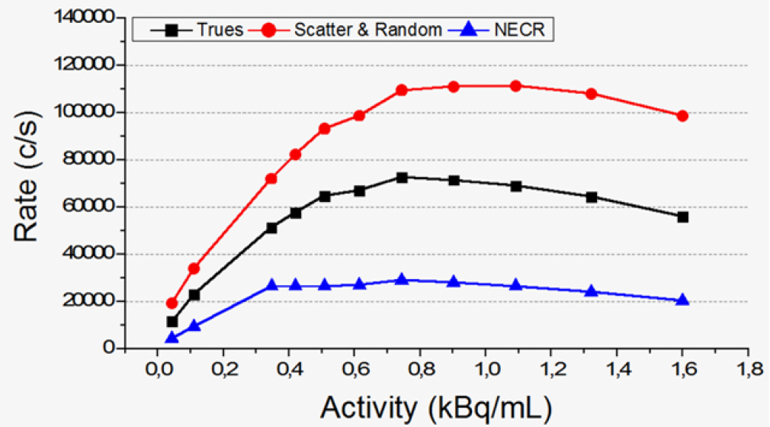
Scaling-up process
System level evaluation
Once the PET scanner has been assembled, several parameters are evaluated usually following the NEMA Standards
Spatial Resolution
Determined as the FWHM and FWTM of the reconstructed source profiles.
Image Quality
The IQ phantom is used to observe different spheres
Sensitivity and NECR
TOF imaging
Different phantoms are used. These parameters determine the system ability to handle high rates
Implementation of TOF information to improve image SNR

Slide 15
Outline
Outline
PET History & Evolution
PET Detector → PET scanner
PET system technology requirements
  Pre-clinical PET
  Clinical PET
State-of-the-art
  Dedicated-, WB-, and TB-PET
Conclusion

Slide 16
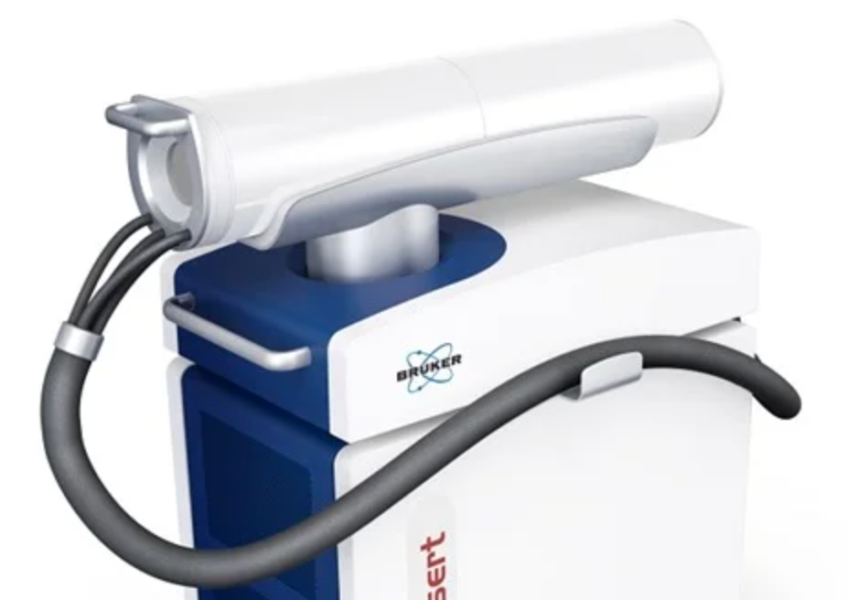
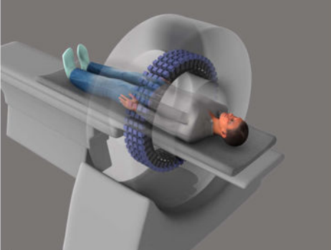
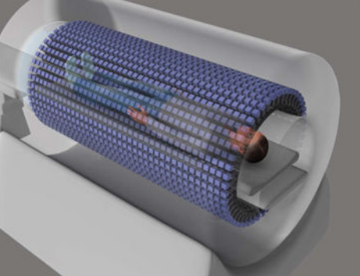
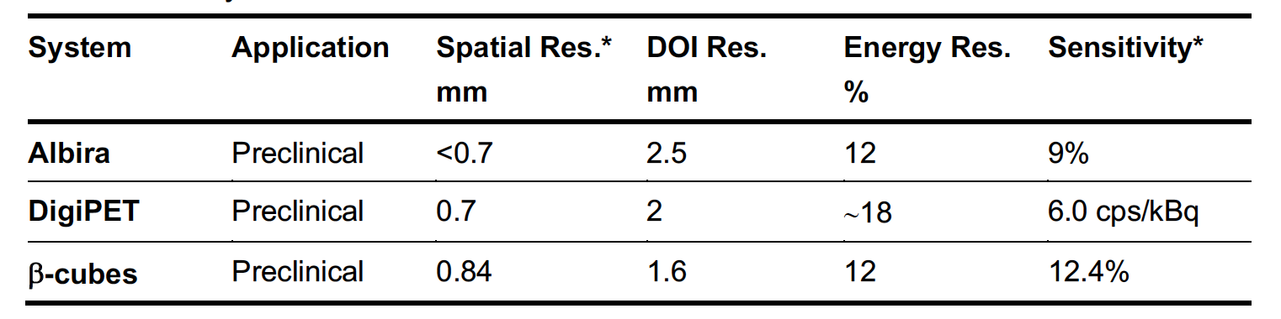
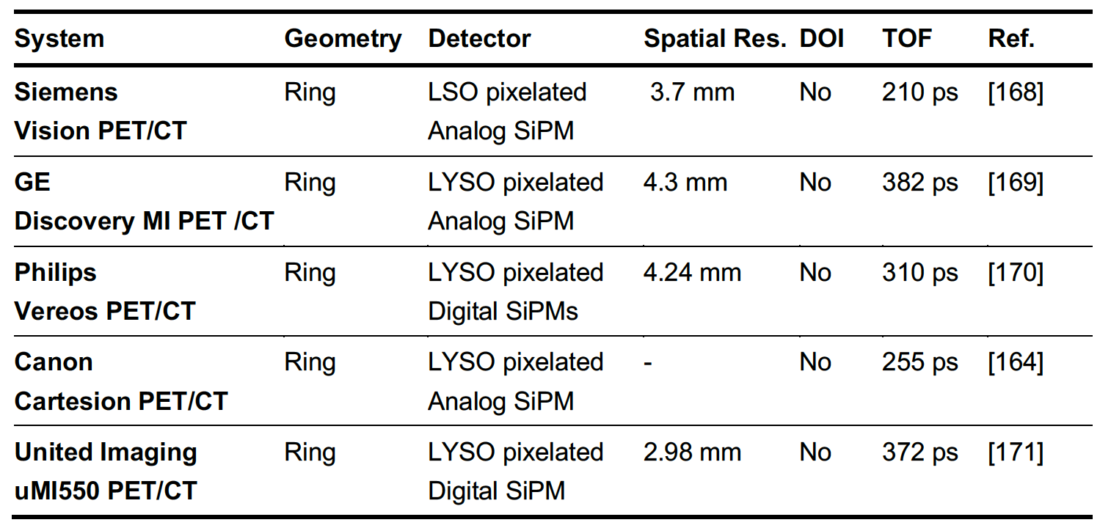
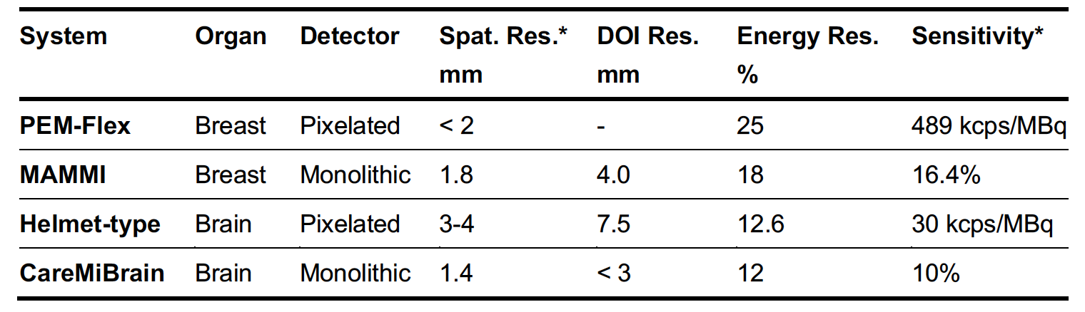
PET: Requirements
Preclinical PET
Organ-dedicated PET
WB-PET
TB-PET

Slide 17
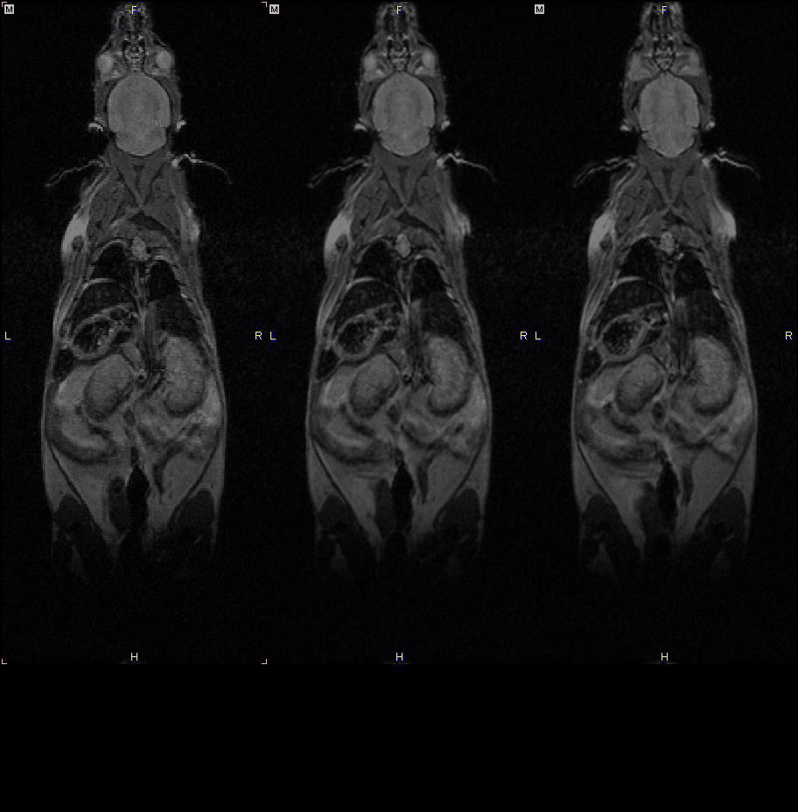

Preclinical Dynamic PET
PET Dynamic Imaging
Quantitative Cardiac Imaging in Rats
PET/MRI (FDG) Mouse - whole body. Courtesy of Dr W Gsell and Pr U Himmelreich, KU Leuven, Belgium
Large FOV allows for simultaneous whole body mouse imaging
1.5
1.2
0.7
1.0
0.8
0.9
17

Slide 18
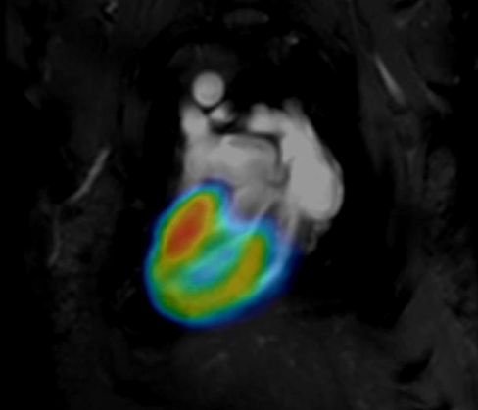
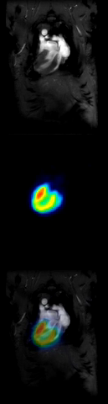
Preclinical MR-gated PET
Simultaneous PET/MR allows for MRI guided PET motion correction
Cardiology: IntraGate/PET.
IntraGate / PET cardiac imaging:
  Works in diseased heart models
  Fast, simple and reliable animal preparation
  Multiple cardiac/respiration movie reconstruction
  No ECG electrodes, no trigger levels or timing synchronization
  Inherently avoids MRI induced noise in PET gating signal
  Outlook: this is the pathway for multi-mouse PET/MR cardiac studies
Healthy Rat Injected with FDG
Collaboration KU Leuven / Bruker:
Courtesy: Dr. W. Gsell, Prof. C. Deroose and Prof. U. Himmelreich
18
Notes:
MRI guided mage correction could be static or dynamic
Cardiac is a dynamic example, it’s not correction but image reconstruction based on MRI navigators

Slide 19

Clinical PET/CT
Oncology:
  Cancer Detection and Staging
  Treatment Response Monitoring
  Recurrence Detection
Cardiology:
  Coronary Artery Disease
  Myocardial Viability
  Inflammatory Myocardial Diseases
Neurology:
  Alzheimer's Disease and Cognitive Impairment
  Epilepsy
  Other Neurological Disorders: diagnosis and management of Parkinson's disease, stroke, and other neurological conditions.

Slide 20
Clinical PET/CT
CT → uses x-rays, and in some cases a contrast material, to produce images of the inside of the body. Provides excellent anatomic information
PET → based on the coincidence detection of annihilation photons. measures body functions, such as metabolism. Provides functional information
PET/CT → help pinpoint abnormal metabolic activity and may provide more accurate diagnoses than the two scans performed separately

Slide 21
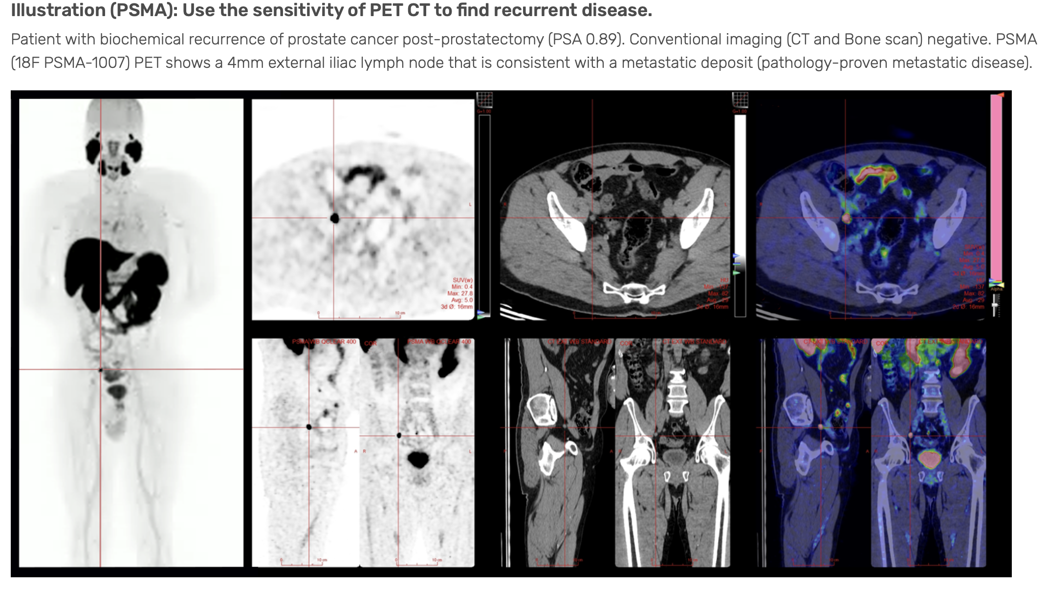
Clinical PET/CT
Source: https://www.mic.ca/pet-ct-practitioner-applications/#/

Slide 22
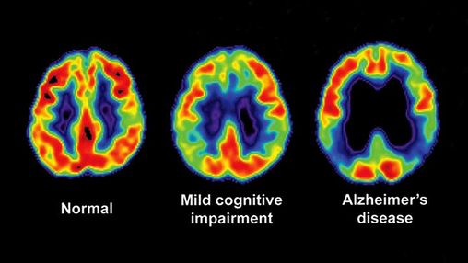
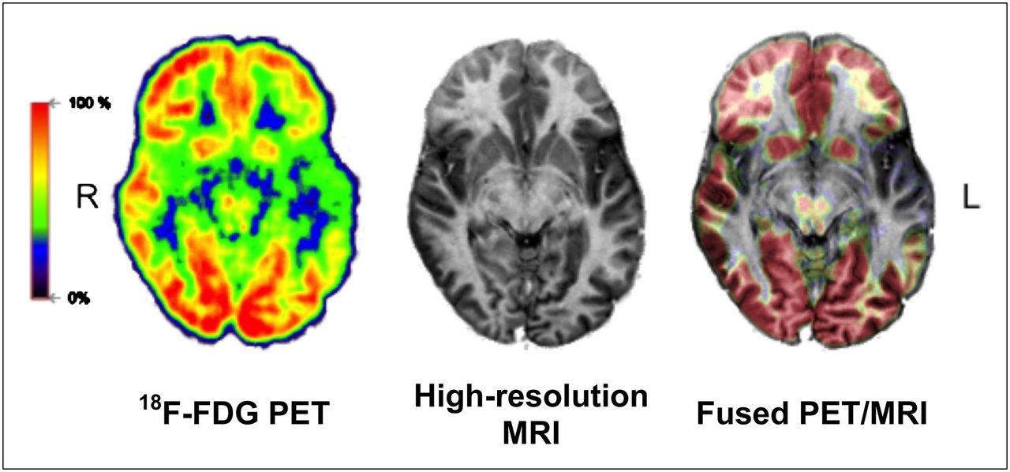
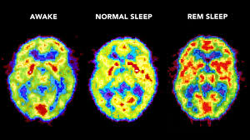
Clinical Brain PET
Sources:
https://www.everydayhealth.com/alzheimers-disease/
https://www.britannica.com/science/brain-scanning/

Slide 23
Outline
Outline
PET History & Evolution
PET Detector → PET scanner
PET system technology requirements
  Pre-clinical PET
  Clinical PET
State-of-the-art
  Dedicated-, WB-, and TB-PET
Conclusion

Slide 24
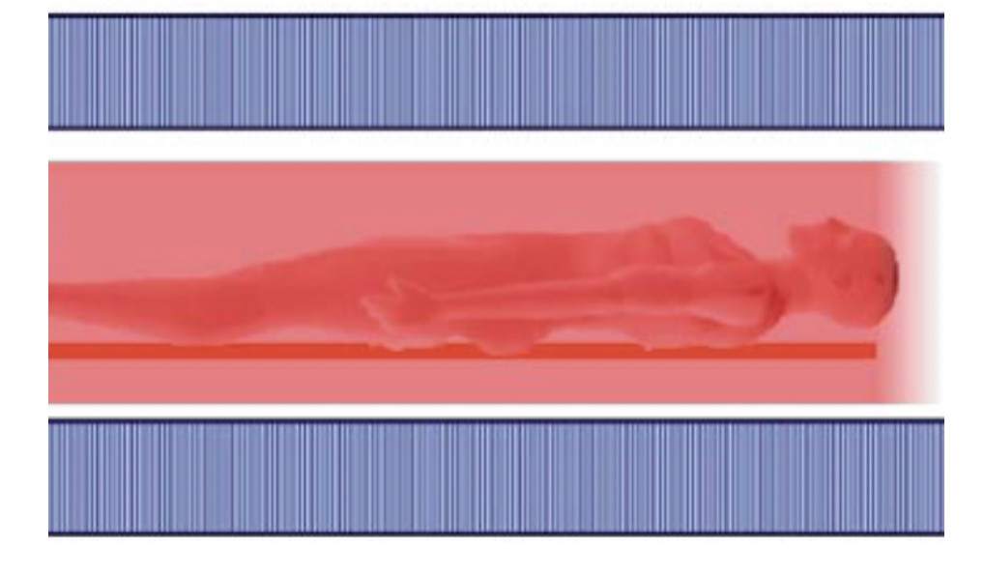



PET: State-of-the-art
PET is the most sensitive (at the picomolar level) non-invasive molecular imaging system. However, PET studies are still limited by statistics (long scanning times), dose delivered to the patient (and clinicians), or both.
PET
Increase in sensitivity
Clinical scanners only collect about 1% of the emitted signals. Every count counts.
Notes:
Pixelated detectors:
Coincidence data is acquired, and positioning algorithms are applied to generate 2D Flood maps.
Pixel profiles are extracted, and Gaussian fitting is applied.
Monolithic detectors:
Same procedure but, a collimator is used to generate the flood maps and extract the sources profiles.
Pixelated detectors: discrete DOI information (usually)
Monolithic detectors: continuous DOI information

Slide 25


PET: State-of-the-art
State-of-the-art
Total-Body PET
Medical Imaging breakthroughs provided by an increased sensitivity
Dynamic and Simultaneous studies
of several organs
Dose reduction
  Paediatric imaging/Follow up
Imaging Faster
Imaging Tumour Heterogeneity
Non-malignant diseases imaging
Notes:
Pixelated detectors:
Coincidence data is acquired, and positioning algorithms are applied to generate 2D Flood maps.
Pixel profiles are extracted, and Gaussian fitting is applied.
Monolithic detectors:
Same procedure but, a collimator is used to generate the flood maps and extract the sources profiles.
Pixelated detectors: discrete DOI information (usually)
Monolithic detectors: continuous DOI information

Slide 26






PET: State-of-the-art
Siemens Quadra
PennPET EXPLORER
EXPLORER
Recently announced → Biograph Vision.X
achieves a CTR of 178 ps
High TOF resolution (214 ps)
1m06 long
Siemens Vision technology
PIXELS, no DOI
High TOF resolution (close to 200 ps)
70cm-1m40 long
Philips technology platform
PIXELS, no DOI
Highest sensitivity,
2m long
United imaging Healthcare
PIXELS, no DOI
Notes:
Pixelated detectors:
Coincidence data is acquired, and positioning algorithms are applied to generate 2D Flood maps.
Pixel profiles are extracted, and Gaussian fitting is applied.
Monolithic detectors:
Same procedure but, a collimator is used to generate the flood maps and extract the sources profiles.
Pixelated detectors: discrete DOI information (usually)
Monolithic detectors: continuous DOI information

Slide 27

PET: State-of-the-art

Slide 28

PET: State-of-the-art
*However, its high price and the requirement for large hospital footprints is a challenge for its clinical deployment as well as research use.
SiPM
S. Vandenberghe, EJNMMI 7, 2020
Notes:
Pixelated detectors:
Coincidence data is acquired, and positioning algorithms are applied to generate 2D Flood maps.
Pixel profiles are extracted, and Gaussian fitting is applied.
Monolithic detectors:
Same procedure but, a collimator is used to generate the flood maps and extract the sources profiles.
Pixelated detectors: discrete DOI information (usually)
Monolithic detectors: continuous DOI information

Slide 29
PET: Limitations
PET limitations:
﻿Time-consuming
Low sensitivity and non-uniform spatial resolution
  Advancements in instrumentation
Lack of anatomical information
  Specially trained personnel required to interpret reports
﻿False positives
  ﻿﻿Can show up areas of high activity which may be mistake for cancers
  Reduces specificity
Radioactive substance has a very short
  Appointments must run on schedule
  Cyclotron is required for generating the radiotracers ﻿﻿
PET scans are expensive, and are not available all the time

Slide 30

Challenges and limitation of Pediatric PET imaging
Andrea Gonzalez-Montoro
Positron Emission Tomography (PET): the imaging modality of excellence in nuclear medicine
  Key in the diagnose and follow up of severe medical conditions
  Used for both adult and pediatric studies
Pediatric PET unique challenges
Since Conventional WB-PET scanners:
Limited axial coverage
Low Spatial resolution > 3-5 mm
Low sensitivity:
  High radiotracer doses
  Long scan times
Expensive
Potential Solution: PHOENIX
TB-PET for pediatric patients
High-performance < 3 mm
High sensitivity:
  Dose reduction
  Fast imaging
Affordable
cm
Diagnostic quality compromised!
!
PHOENIX Keys:
Detector block
System implementation
15-32 cm
54.5 cm
Notes:
radiation effects than adults and have a longer post-exposure life expectancy in which to exhibit adverse radiation effects
Developing the PHOENIX scanner constitutes major research and technological challenges. If successful, will promote PET imaging of children, improve its diagnostic capabilities, staging and response assessment.
Pediatric PET imaging research focusses on reducing patient dose whenever possible and on minimizing exam durations as well as sedation times → still requires several technological advancements.
-without becoming claustrophobic- and,
uniform spatial resolution in the range of 2-3 mm (current WB-PET scanners: 3-6 mm¹⁰; organ dedicated PET scanners: 1.5-3 mm¹⁹) in the entire FOV by enabling depth of interaction (DOI) resolution < 4 mm. The PHOENIX large FOV combined with the Signal to Noise (SNR) gain resulting from the inclusion of Time Of Flight (TOF) information will permit for a significantly increased in sensitivity of $×$30, when compared to conventional PET.

Slide 31





PHOENIX: Technical objectives and breakthroughs
Andrea Gonzalez-Montoro
(1/5) 3D photon positioning using BGO slabs
Uniform 3D resolution < 2-3 mm
(2/5) TOF exploiting BGO’s Cherenkov yield
<350 ps CTR. Boost in image SNR
(3/5) Reaching ultra-high sensitivity
Exploiting Compton kinematics
TOF
BGO → Hybrid scintillator
Scintillation + Prompt (Cherenkov) Light
Geom_{sensitivity} gain ×10
DOI
16
12
8
4
0
FOV Diameter
Wrong LOR
Compton Kinematics (BGO)
SNR gain
Photoelectric interaction ~30-40%
Compton scatter ~70-60%
Corrected LOR
TOF_{sensitivity} gain × 3
!
Effective sensitivity ×30
- 100. 300 500 700
CTR (ps)
Notes:
, BGO is more suitable for boosting timing performance by properly exploiting the low Cherenkov yield²⁴. Unfortunately,
Once the events are classified based on its nature, data will be post-processed to convolve the different contributions encountered in the coincidence time resolution (CTR) spectra: (i) each of the four categories will be fitted using a double Gaussian distribution^{29,30}; (ii) the centroid of the distribution (μk) will be considered as the time bias for each category and will be used to correct each measured time-stamp (tik) as: tik= tik-μk; (iii) the corrected CTR profile, which is the convolution of all detected coincidences, will be fitted again providing an accurate CTR value that will be implemented as the TOF-kernel during reconstruction^{31, 32}.
Based on previous evidence, properly exploiting the low Cherenkov yield may be the key to unlock precise estimation of the TOF kernel using BGO and thus, constructing affordable high-efficiency PET scanners such as PHOENIX which targets for a CTR value < 350 ps
Extending the axial length of the scanner (TB-PET²⁸).
Placing the detectors closer to the area under study
iii) Enabling TOF information during the image reconstruction provided

Slide 32



PHOENIX: Technical objectives and breakthroughs
Andrea Gonzalez-Montoro
(4/5) Robust readout electronics for BGO TOF-PET
First low-cost, scalable and robust electronics for BGO
(5/5) PET system calibration using NN
Fast and easy calibration procedure. Better image quality
PHOENIX: The first scalable solution for BGO-PET
Fast pediatric TB-PET (avoid sedation)
Ensuring children comfort and safety
Enhanced SNR, better image quality
Reduced dose exposure
New clinical studies
Affordable → transference to industry
Unique circuit. No scalable technology yet developed!
Notes:
, BGO is more suitable for boosting timing performance by properly exploiting the low Cherenkov yield²⁴. Unfortunately,
Once the events are classified based on its nature, data will be post-processed to convolve the different contributions encountered in the coincidence time resolution (CTR) spectra: (i) each of the four categories will be fitted using a double Gaussian distribution^{29,30}; (ii) the centroid of the distribution (μk) will be considered as the time bias for each category and will be used to correct each measured time-stamp (tik) as: tik= tik-μk; (iii) the corrected CTR profile, which is the convolution of all detected coincidences, will be fitted again providing an accurate CTR value that will be implemented as the TOF-kernel during reconstruction^{31, 32}.
Based on previous evidence, properly exploiting the low Cherenkov yield may be the key to unlock precise estimation of the TOF kernel using BGO and thus, constructing affordable high-efficiency PET scanners such as PHOENIX which targets for a CTR value < 350 ps
Extending the axial length of the scanner (TB-PET²⁸).
Placing the detectors closer to the area under study
iii) Enabling TOF information during the image reconstruction provided
The most defiant goal → development of the required readout and frontend electronics in a scalable format

Slide 33
Outline
Outline
PET History & Evolution
PET Detector → PET scanner
PET system technology requirements
  Pre-clinical PET
  Clinical PET
State-of-the-art
  Dedicated-, WB-, and TB-PET
Conclusion

Slide 34





Take home message
Advancements in nuclear imaging:
High performance PET systems →
  Novel Scintillators; Enhanced Photosensors; Fast Electronics; More Efficient Algorithms (AI)
  Higher sensitivity x 2-4 → (Large coverage PET (TB) or/and TOF)
  Homogeneous spatial resolution < 2mm in the entire FOV → Accurate 3D positioning (DOI)
  Better SNR → Medical breakthroughs
Lower statistics required → Shorter scan times / Dose reduction / A combination of both
Follow-up studies and better assessment of treatments
Dynamic studies
New categories of patients (pediatric-PET)
High dynamic range
3-5 times longer acquisitions than the half-life of the isotopes
¹¹C
Screening
Low dose
WB- and TB-PET →
  Larger Axial Coverage; Simultaneous Multi-organ Studies; Intratumor Homogeneity Studies
  → Improved diagnostic quality

Slide 35


PET technology in Prague
Almost 26 years already

Slide 36
Advice
10 years ago…
Still have Good Friends from then!
Darmstadt, Germany
1st international experience → 2015 (as a Master Student)
YOUR TASKS:
Take out the most of this experience
Enjoy the school
Interact with the lectures
Make new Friends
This is an unique experience!!

Slide 37


Slide 38

Medical Imaging:
PET
July 2nd 2025
Andrea Gonzalez-Montoro, PhD
andrea.gm@i3m.upv.es

