Slide 1

Introduction to Medical Imaging:
X-ray – CT - MRI
July 8th 2025
Andrea Gonzalez-Montoro, PhD
andrea.gm@i3m.upv.es

Slide 2

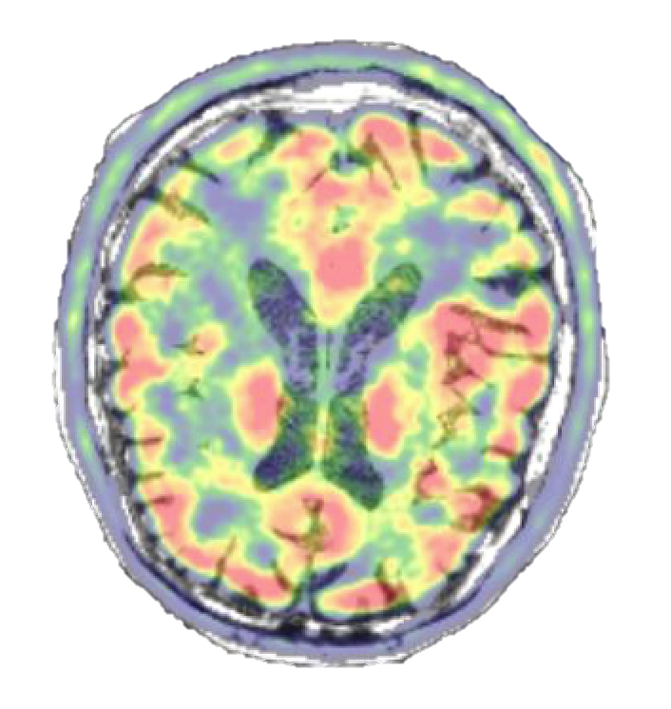
Outline
Principles of Medical Imaging
X-rays
  Computed Tomography (CT)
Anatomical Imaging
  Magnetic Resonance Imaging (MRI)
  Ultrasounds (US)
Molecular Imaging
Final Remarks

Slide 3
Outline
Principles of Medical Imaging
X-rays
  Computed Tomography (CT)
Anatomical Imaging
  Magnetic Resonance Imaging (MRI)
  Ultrasounds (US)
Molecular Imaging
Final Remarks

Slide 4
Medical Imaging
Medical imaging is the technique and process of creating visual representations of the:
interior of a body for clinical analysis and medical intervention
function of some organs or tissues (physiology)
Before Medical Imaging,
studies were limited to:
external observation
studies of blood and urine
post-mortem dissection
→ Often perceived to designate the set of techniques that noninvasively produce images of the internal aspect of the body

Slide 5

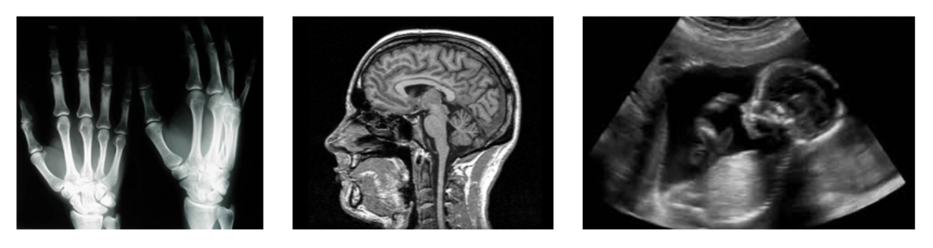
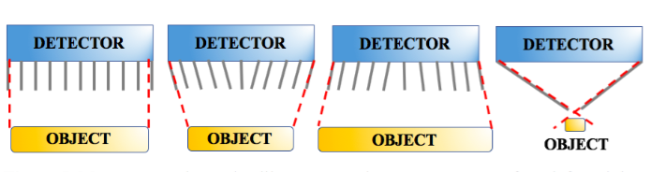
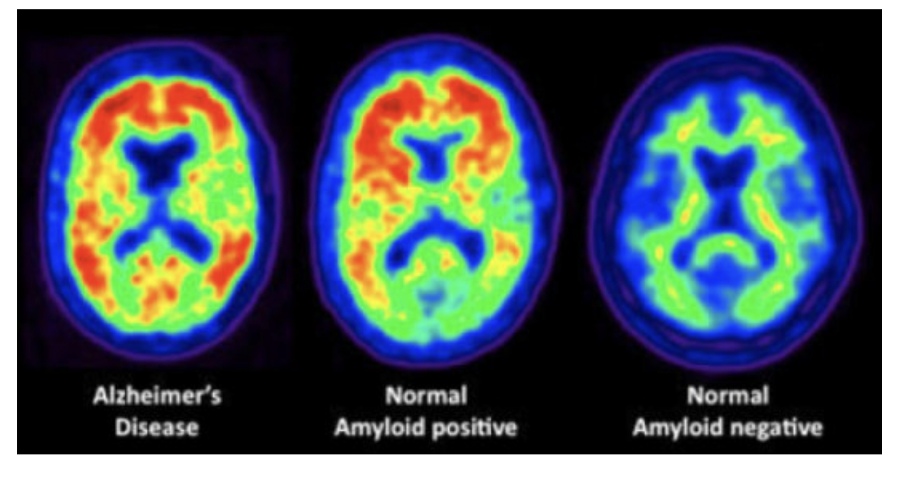
Medical Imaging
Medical Imaging
Noninvasive techniques for generating visual representations of the interior of the human (or animal) body, diagnosing, monitoring, or treating various medical conditions
x
Morphological information Anatomical. External source
Functional information.
Metabolic. Internal source
Imagen molecular
Reflexion/
Refraction
Radiotracers
Transmission
Absorption
Gamma camera
Compton camera
PET
X-rays
MRI
US
SPECT
Single photon emitters: ⁹⁹Tc
Requires collimators
Positron Emission Tomography
Don’t need collimators
Radiography
CT
Hybrid Imagen
Notes:
Di que todas son importantes (imagen funcional digo), que has trabajo sobre todo en PET, pero consideras el resto importantes y que tal vez en el futuro las toques??
Resumir bastante como introduzco el principio.
Campo de investigación: imagen molecular!!

Slide 6
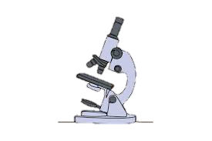
Medical Imaging
Medical imaging refers to several different technologies that are used to view the human body in order to diagnose, monitor, or treat medical conditions
Each type of technology gives different information about the area of the body being studied or treated
16th Century
Invention of the Microscope

Slide 7
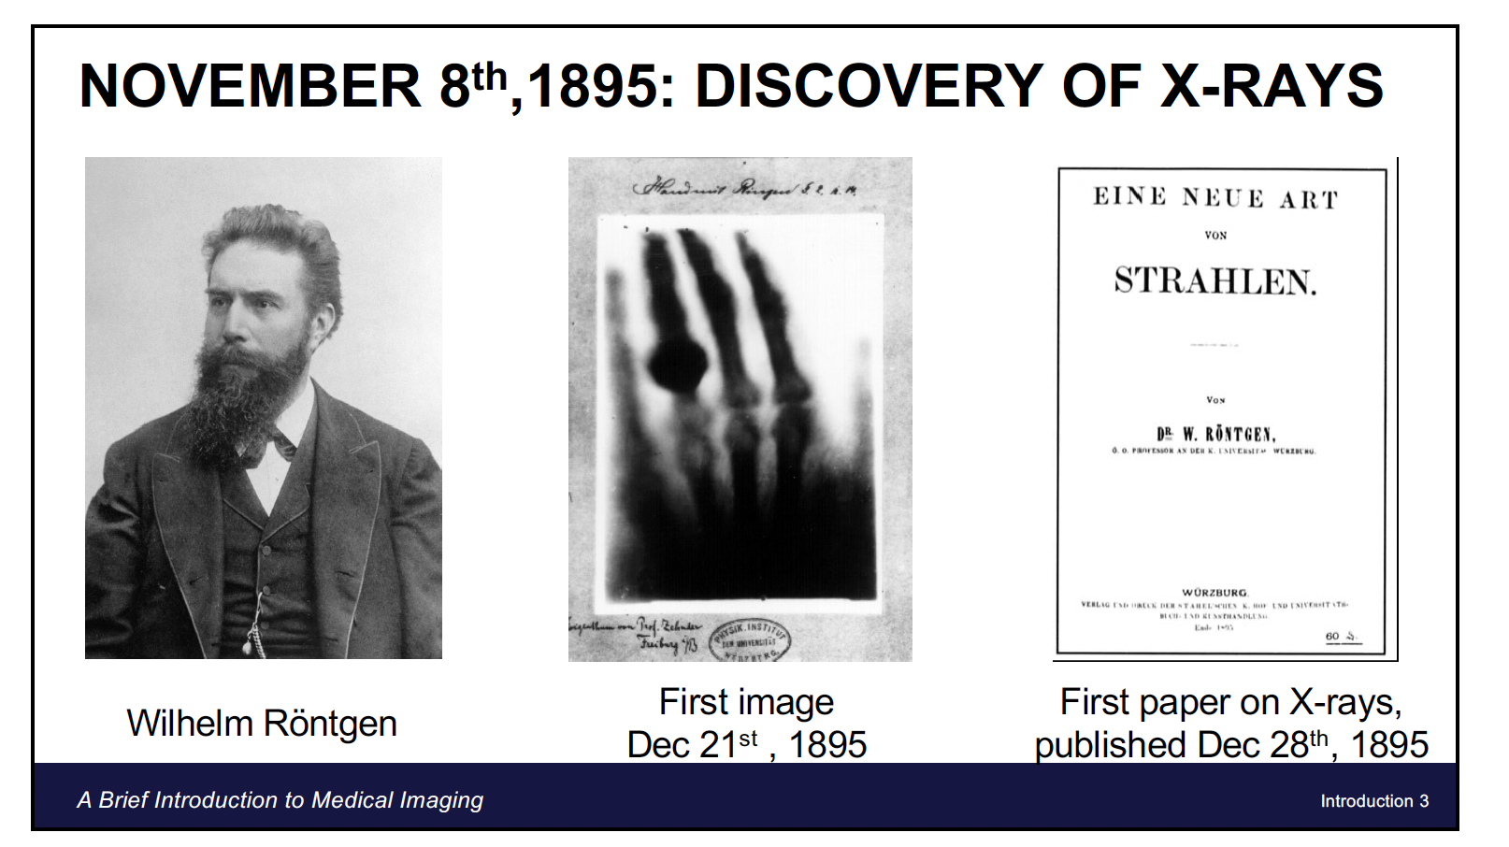
Medical Imaging
Medical imaging refers to several different technologies that are used to view the human body in order to diagnose, monitor, or treat medical conditions
Each type of technology gives different information about the area of the body being studied or treated
1895
Discovery of the X-rays
16th Century
Invention of the Microscope
1956
First Ultrasound devices

Slide 8
Medical Imaging
Medical imaging refers to several different technologies that are used to view the human body in order to diagnose, monitor, or treat medical conditions
Each type of technology gives different information about the area of the body being studied or treated
1895
Discovery of the X-rays
1961
Invention of PET scanners
16th Century
Invention of the Microscope
1956
First Ultrasound devices
1972
Invention of the CT

Slide 9
Medical Imaging
Medical imaging refers to several different technologies that are used to view the human body in order to diagnose, monitor, or treat medical conditions
Each type of technology gives different information about the area of the body being studied or treated
1895
Discovery of the X-rays
1961
Invention of PET scanners
1977
Invention of the MRI
16th Century
Invention of the Microscope
1956
First Ultrasound devices
1972
Invention of the CT

Slide 10
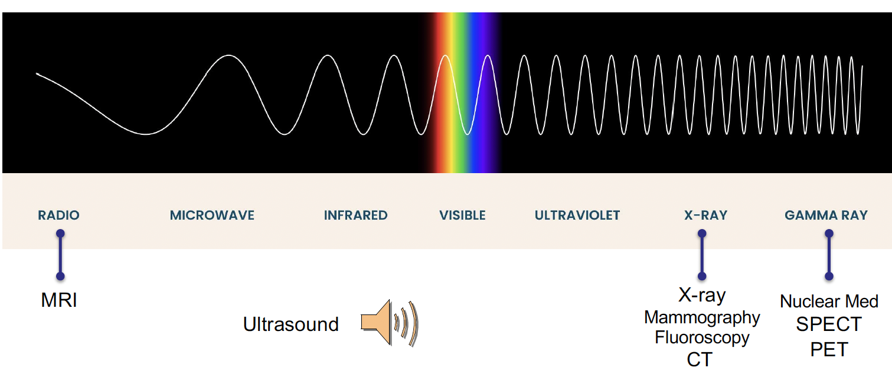
Medical Imaging
Radiation used for Medical imaging

Slide 11
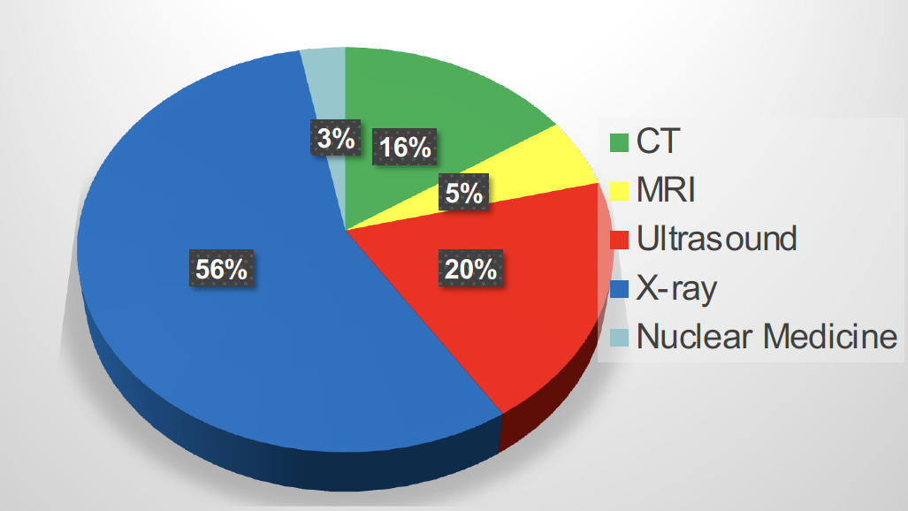
Medical Imaging
Radiation used for Medical imaging
USAGE

Slide 12
Outline
Principles of Medical Imaging
X-rays
  Computed Tomography (CT)
Anatomical Imaging
  Magnetic Resonance Imaging (MRI)
  Ultrasounds (US)
Molecular Imaging
Final Remarks

Slide 13
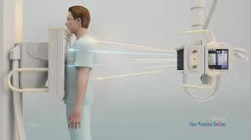

X-rays
General Principles:
Transmission-based technique
X-rays pass through patient and detected by film or detector
Contrast arises from differential attenuation of X-rays in body
Planar radiography, image is a 2-D projection of the present tissues between x-ray source and detector

Slide 14
X-rays
X-ray Tube:
Electrons accelerated in an electric
field (15-150 kV) and strike tungsten anode
Thermionic emission: Electrons produced by heating a filament (cathode) to ~2200°C
X-Ray Tube Current and Output
• Current: Flow of electrons between anode and cathode
• Tube current typically 50-400 mA
• Tube output (power) = tube current x applied voltage
Efficiency of X-Ray Production
Efficiency = Radiated P. / Incident P.
= 0.9 x 10⁻⁹ ZV
Only 0.01% for Tungsten
Electron interacting in tungsten
target produces x-rays, that pass
through exit window and filter

Slide 15
X-rays
Digital Radiography Detectors:
https://www.youtube.com/watch?v=hTz_rGP4v9Y
Large-area flat-panel detectors
Amorphous silicon array layer (light detection and readout)
CsI(Tl) scintillator deposited on top (x-ray conversion)

Slide 16
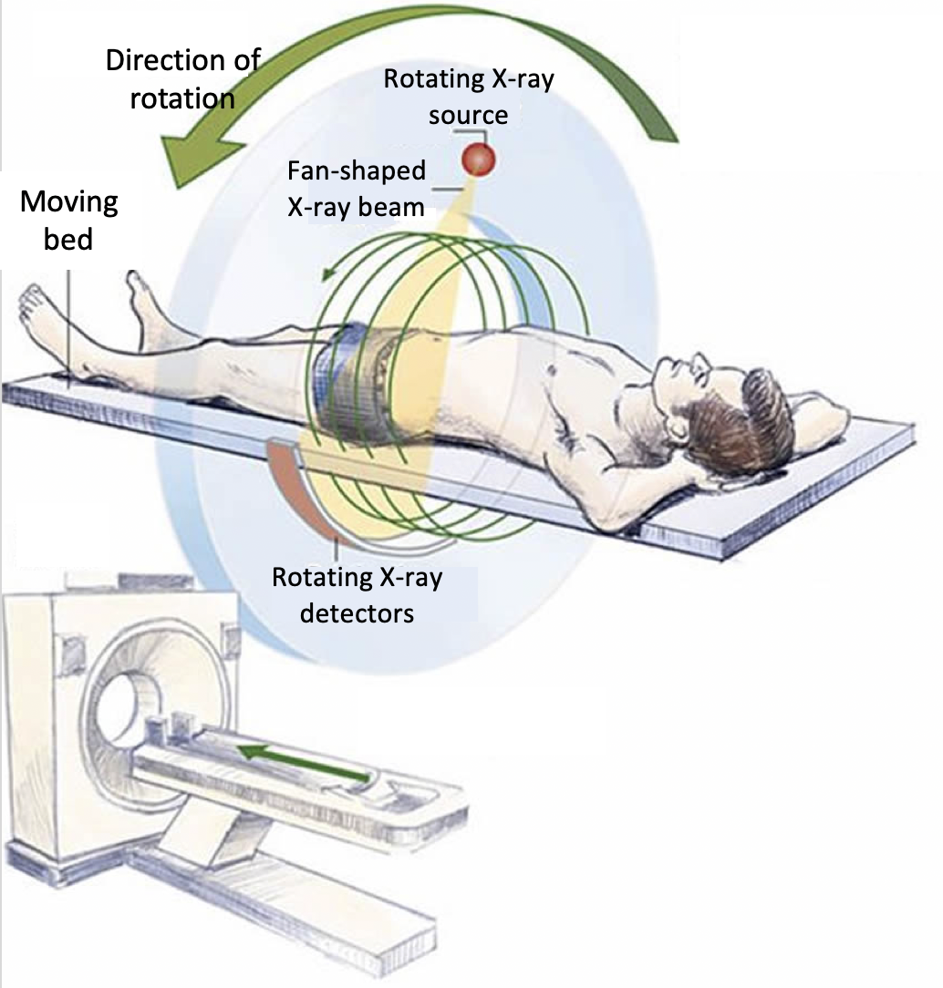
CT: Refreshment
Computed Tomography (CT) is a type of medical imaging that uses X-ray techniques to create detailed images of the distribution of structures inside the body.
→ Anatomic information
Typical X-ray CT Scanner uses Multiple Detector Array
Efficient use of x-ray by acquiring multiple slices at once
https://www.youtube.com/watch?v=K4A7M1GaNGQ

Slide 17
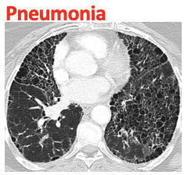
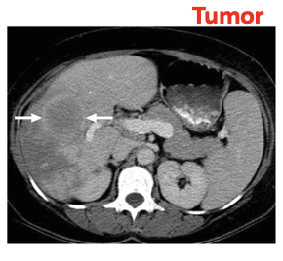
CT: Refreshment
Bones
Why CT is done?
Diagnose muscle and bone conditions:
  → Bone tumors and fractures
Show tumor, infection or blood clot
Guide procedures:
  → Surgery, biopsy and radiation therapy
Follow-up of diseases and conditions:
  Cancer, heart disease
  Lung nodules or liver masses
Treatment assessment
Detection of injuries and bleeding inside the body that can happen after trauma
Guiding biopsy needle
Follow-up

Slide 18
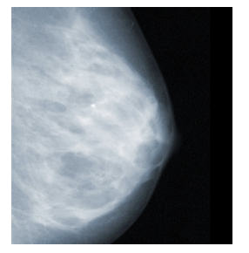
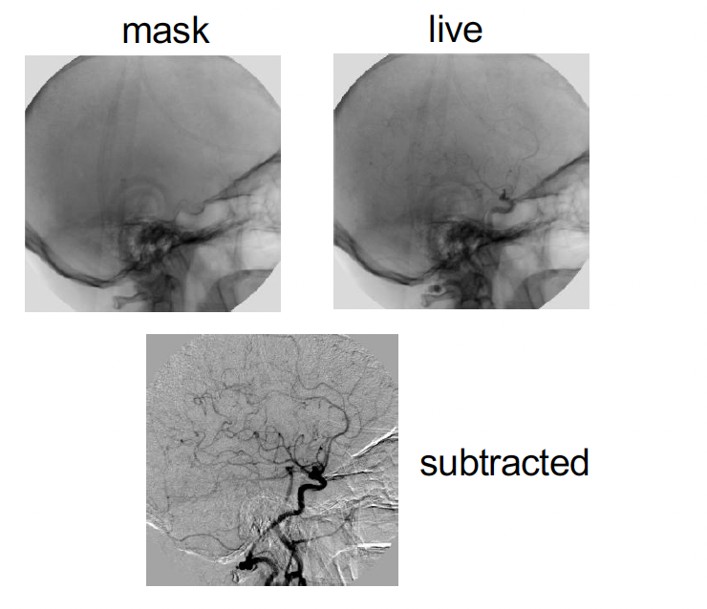
X-rays
Clinical Applications of X-rays:
Dental x-rays
Mammography
Lung disorders and diseases
Orthopedics
Sports injuries and accidents
Angiography: Vascular disease
Fluoroscopy: Image-guided interventions

Slide 19

CT: Refreshment
Advantages
Disadvantages
Better detail compared with ultrasonography
Relatively quick compared with MRI
Most body systems can be scanned, eg, brain to leg.
Requires breath holding
Artefact is common - eg, metal clips.
Brain CT can be affected by bone nearby
Radiation exposure
  *Consensus: exposure in adults are small and less of a risk than withholding CT if it is required for diagnostic purposes
In children, it is preferable using modalities which don’t involve exposure to radiation

Slide 20
Outline
Principles of Medical Imaging
X-rays
  Computed Tomography (CT)
Anatomical Imaging
  Magnetic Resonance Imaging (MRI)
  Ultrasounds (US)
Molecular Imaging
Final Remarks

Slide 21
Magnetic Resonance
Magnetic Resonance Imaging, is a technique used to obtain images of the anatomy and in some cases of the physiological processes occurring in the body.
MRI operation principle → based on using powerful magnets to polarize and excite the Hydrogen nuclei of water molecules present in the human tissue.
MRI scanners use three magnetic fields:
Static field (B₀)
Gradient field
Radio-frequency field (B₁)
Basic Information
• 1 liter water ~ 3x10²⁶ protons
• Human body → 70% is water
• 1 Tesla = 10.000 Gauss
• MRI magnet strengths, 0.2 T up to 11 T
Earths magnetic field: 50 μT

Slide 22
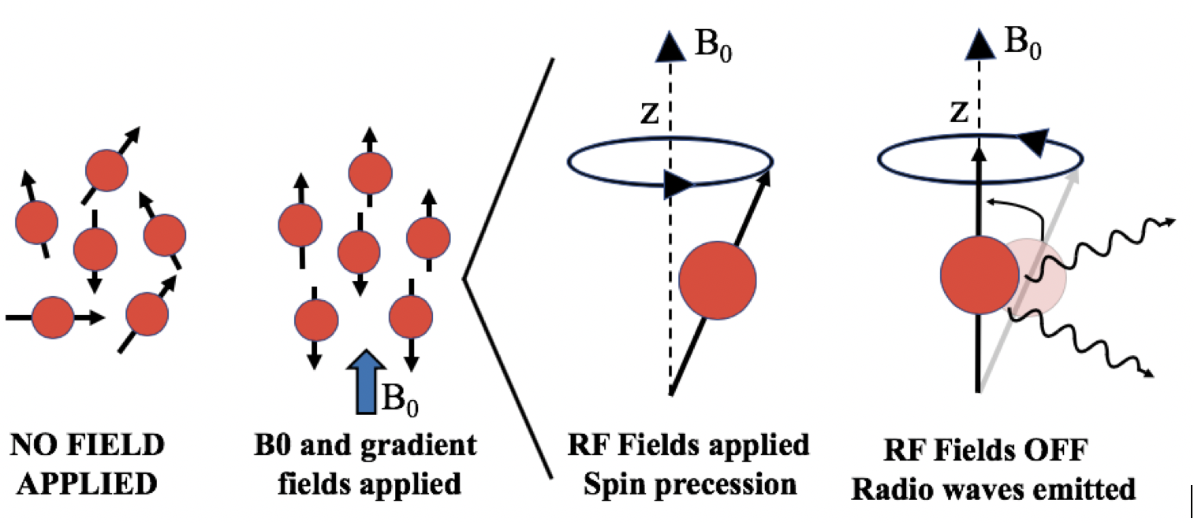
Magnetic Resonance
MRI operation
A strong static field (main field, B₀) polarizes the Hydrogen nuclei. B₀ is constant thus all the Hydrogen nuclei have the same resonance frequency. The emitted signals do not provide any spatial information.
For spatial information, gradient fields are applied producing different spatial encodings on the nuclear spins.
Radio frequency antennas (RF coils) emit a radio frequency pulse at the resonant frequency of the hydrogen nucleus. The RF pulse is absorbed by protons and their direction with respect to B₀ field changes. When the RF pulse is turned off, the direction of the protons comes back to its original position emitting radio-waves.
These radio-waves are detected by the receiver coil (most scanners have transmitter-receiver coils, TR coil) and are used to visualize the information into an image.

Slide 23
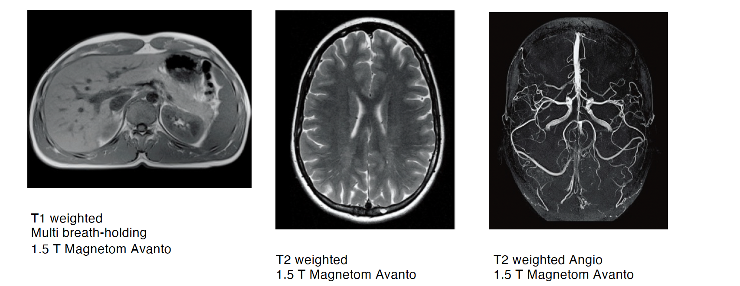
Magnetic Resonance
MRI applications
https://www.youtube.com/watch?v=nFkBhUYynUw
MRI creates detailed images of nearly every structure and organ inside the body. Is used for visualizing:
Anomalies of the brain and spinal cord
Tumors, cysts, and other anomalies in various parts of the body
Breast cancer screening
Study Brain disorders
Injuries or abnormalities of the joints, the back and knee
Certain types of heart problems
Diseases of the liver and other abdominal organ
Evaluation of pelvic pain in women
Suspected uterine anomalies in women

Slide 24
Outline
Principles of Medical Imaging
X-rays
  Computed Tomography (CT)
Anatomical Imaging
  Magnetic Resonance Imaging (MRI)
  Ultrasounds (US)
Molecular Imaging
Final Remarks

Slide 25
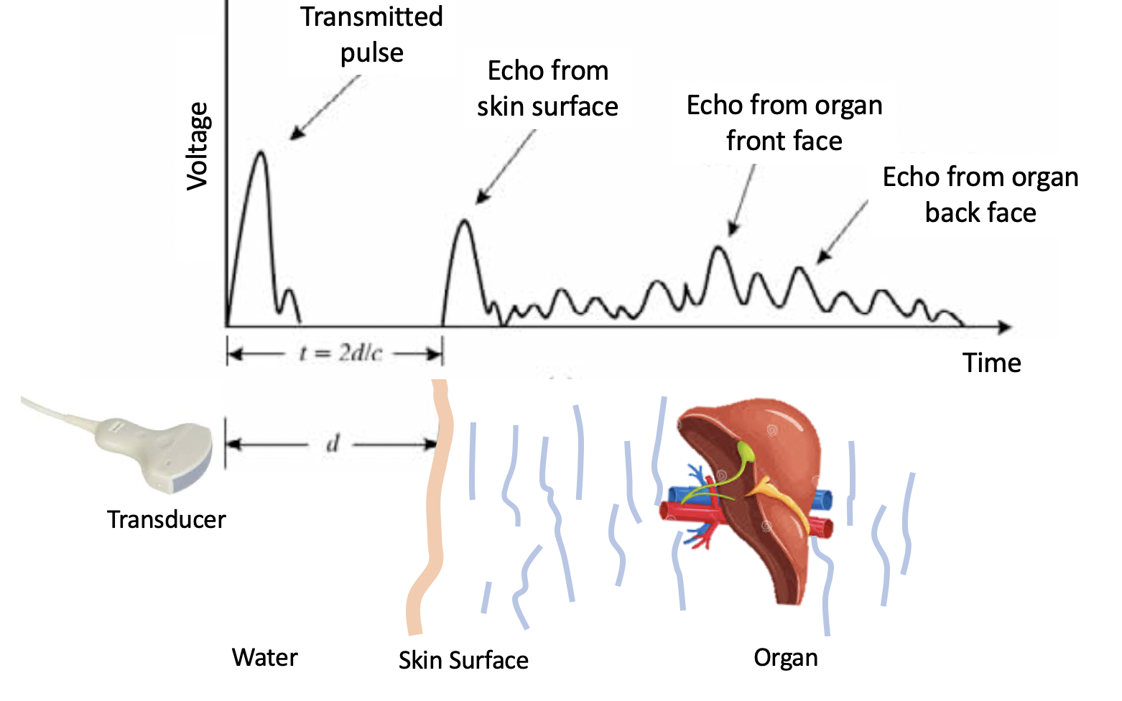
Ultrasounds
Ultrasound Basics
• Produces images via backscattering of mechanical energy from boundaries between tissues
→ Frequency: typically 1 to 10 MHz
• Wavelength = 0.3 mm in water at 5 MHz
Lower frequencies for deep-lying structures
Higher frequencies for superficial structures

Slide 26
Ultrasounds
Ultrasound Transducer
Uses Piezoelectric Crystal → Lead Zirconate Tungstate (PZT)
• Two faces of crystal coated with a thin layer of silver as electrodes
• Usually a disk which is flat or concave (for focused transducer)
Advantages
Portable
Real-time
No ionizing radiation
Fetal imaging
Inexpensive
https://www.youtube.com/watch?v=I1Bdp2tMFsY

Slide 27
Ultrasounds
Application of Ultrasounds
Obstetrics and gynecology
  Fetal health
Cardiac function
Intra-abdominal imaging
  Liver, kidneys, spleen and gallbladder
Musculoskeletal applications
Compromised flow in veins and arteries
Tracking of needle biopsies
Color Doppler Imaging

Slide 28
Outline
Principles of Medical Imaging
X-rays
  Computed Tomography (CT)
Anatomical Imaging
  Magnetic Resonance Imaging (MRI)
  Ultrasounds (US)
Molecular Imaging
Final Remarks

Slide 29

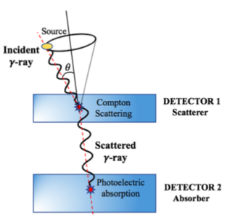
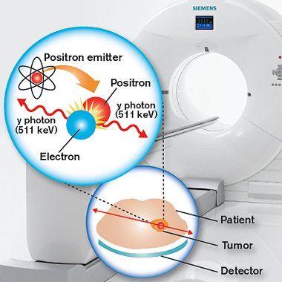
Molecular Imaging
Nuclear Medicine
Functional Imaging using radioactive sources
PET
Positron Emission Tomography
Positron emitters: ¹⁸F, ⁶⁸G…
Does not use collimators
Gamma Camera
Compton Camera
SPECT
Single photon emitters: ⁹⁹Tc
Make use of mechanical or electronic collimators
Notes:
Nuclear Medicine: Uses radioactive substances for diagnostic and therapeutic purposes allowing to visualize physiological and biochemical processes of the human body in vivo.
Maxima cobertura angular con emisión isotrópica
COMPLEMENTARY

Slide 30
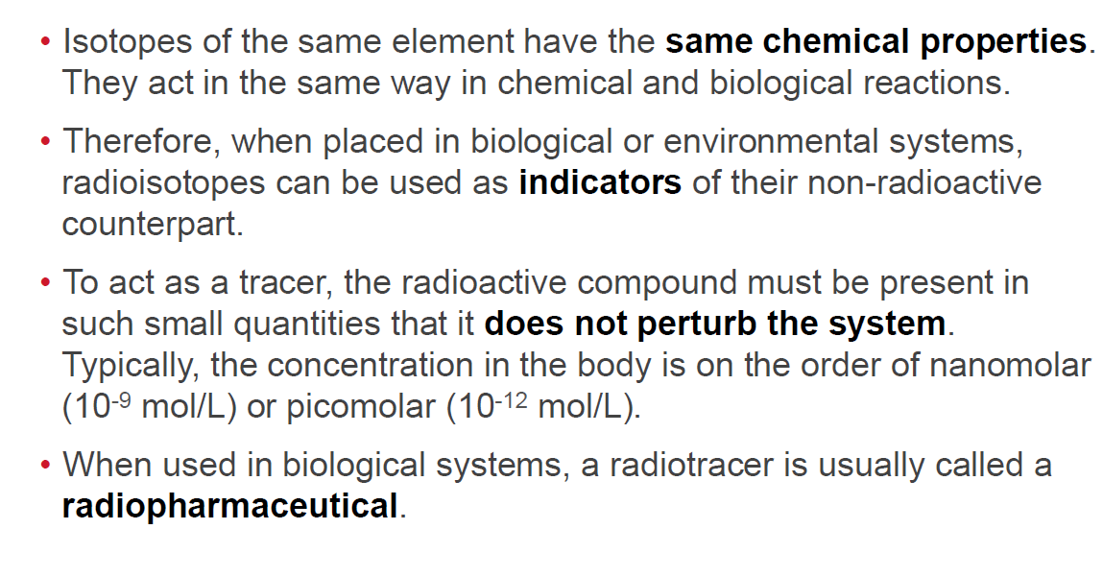
Tracer principle
Production methods:
Nuclear Reactor
  Fission fragments
  Neutron capture
Accelerator
  Cyclotron
Generator
  Long-lived parent decaying into medically useful daughter nuclide
https://www.youtube.com/watch?v=GHLBcCv4rqk
© 2016 Bruker Corporation
26-July-16

Slide 31
Outline
Principles of Medical Imaging
X-rays
  Computed Tomography (CT)
Anatomical Imaging
  Magnetic Resonance Imaging (MRI)
  Ultrasounds (US)
Molecular Imaging
Final Remarks

Slide 32
Remarks
Imaging Technique | Spatial Resolution | Sensitivity | Depth
PET | ≤1-2 mm | 10⁻¹¹ – 10⁻¹² mole/L | No limit, quantitative
SPECT | 0.5-2 mm | 10⁻¹⁰ – 10⁻¹¹ mole/L | No limit, semi quantitative
Optical | 1-3 mm | 10⁻⁹ – 10⁻¹² mole/L | Less 1cm luminescence Less 3cm fluorescence
MRI | 25-100 μm | 10⁻³ – 10⁻⁵ mole/L | No limit
CT | 1-200 μm | n/a | No limit measuring densities
Massoud, Genes & Development, 17:545-580, 2003.
Massoud, Genes & Development, 17:545-580, 2003.
Innovation with Integrity
21-July-16

Slide 33
Clinical PET/CT
CT → uses x-rays, and in some cases a contrast material, to produce images of the inside of the body. Provides excellent anatomic information
PET → based on the coincidence detection of annihilation photons. measures body functions, such as metabolism. Provides functional information
PET/CT → help pinpoint abnormal metabolic activity and may provide more accurate diagnoses than the two scans performed separately

Slide 34
Remarks
Beyond instrumentation challenges
To further extend the clinical use of PET, it is important to consider that:
→ PET provides highly quantitative images for the study of biochemical and functional abnormalities but, the absence of background anatomical information makes it difficult to interpret the radio-tracers distribution, leading sometimes to misinterpretations of the images.
Simultaneous PET/MRI and PET/CT imaging is an
interesting line of research that helps broadening
the scope of PET imaging
Notes:
Pixelated detectors:
Coincidence data is acquired, and positioning algorithms are applied to generate 2D Flood maps.
Pixel profiles are extracted, and Gaussian fitting is applied.
Monolithic detectors:
Same procedure but, a collimator is used to generate the flood maps and extract the sources profiles.
Pixelated detectors: discrete DOI information (usually)
Monolithic detectors: continuous DOI information

Slide 35
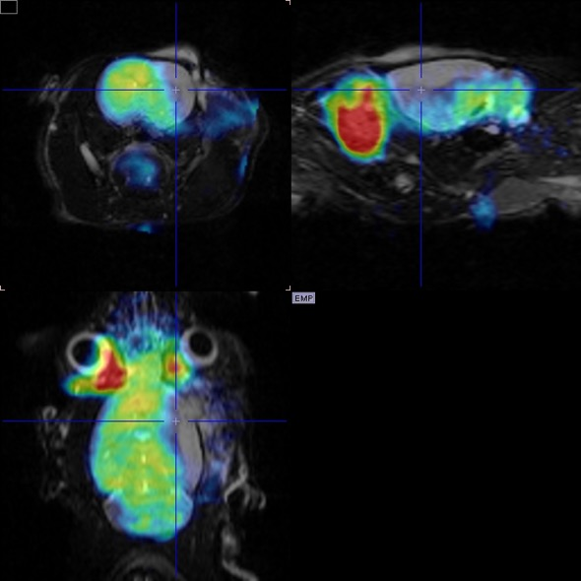
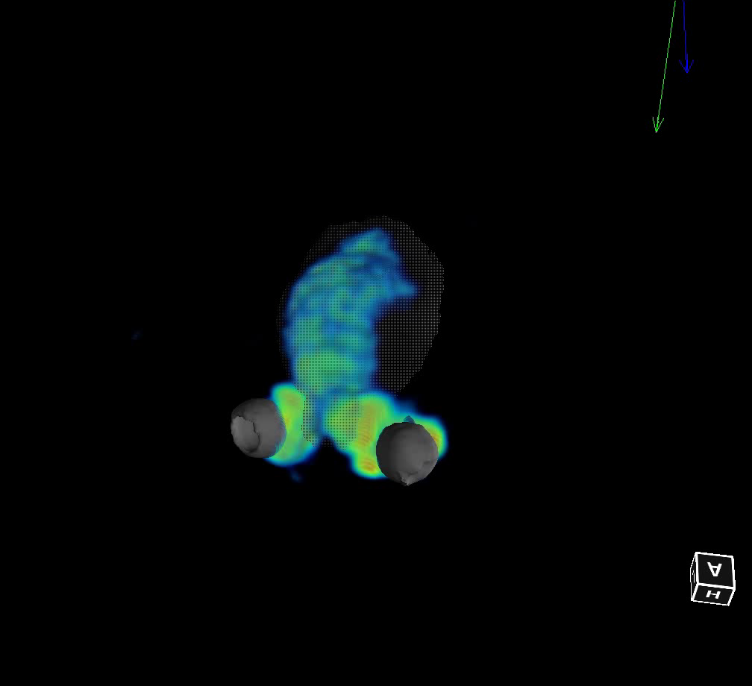
Remarks
Large variety of PET tracers
Sensitivity of PET is in the pico-molar range
MR delivers high resolution and high soft tissue contrast images
PET images may be complemented by additional functional imaging capabilities of MR (spectroscopy, fMRI, etc.)
Simultaneous imaging of PET and MRI save total acquisition time and image multiple dynamic processes
Use MRI to correct for motion in PET data
No additional radiation dose applied by MRI
Sequential Albira PET and Bruker MR fusion of an ischemic rat. Courtesy of Prof. Miguel A. Pozo, U. Complutense Madrid.
Notes:
Porque combinar PET y MRI.
Por ejemplo, actualmente el PET puede diferenciar entre Deterioro Cognitivo Leve y los estadios iniciales de la enfermedad de Alzheimer, pero no puede determinar la reducción del volumen del cerebro causada por la atrofia. Combinando PET y MRI, los clínicos serían capaces de realizar una determinación más precisa tanto del deterioro cognitivo leve como de la atrofia. Combinando el PET y MRI con biomarcadores neurológicos emergentes presenta el potencial de reenforzar la valoración de la condición

Slide 36
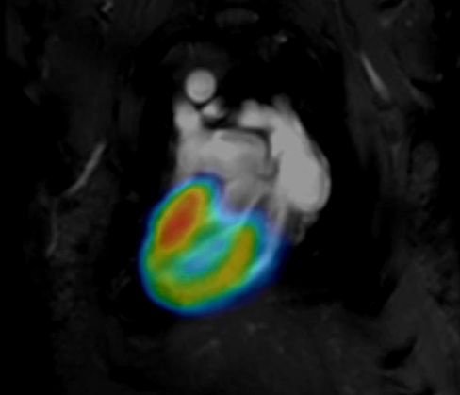
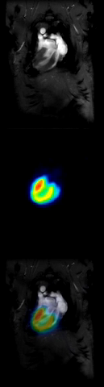

Preclinical MR-gated PET
Simultaneous PET/MR allows for MRI guided PET motion correction
Cardiology: IntraGate/PET.
IntraGate / PET cardiac imaging:
  Works in diseased heart models
  Fast, simple and reliable animal preparation
  Multiple cardiac/respiration movie reconstruction
  No ECG electrodes, no trigger levels or timing synchronization
  Inherently avoids MRI induced noise in PET gating signal
  Outlook: this is the pathway for multi-mouse PET/MR cardiac studies
Healthy Rat Injected with FDG
Collaboration KU Leuven / Bruker:
Courtesy: Dr. W. Gsell, Prof. C. Deroose and Prof. U. Himmelreich
36
Notes:
MRI guided mage correction could be static or dynamic
Cardiac is a dynamic example, it’s not correction but image reconstruction based on MRI navigators

Slide 37
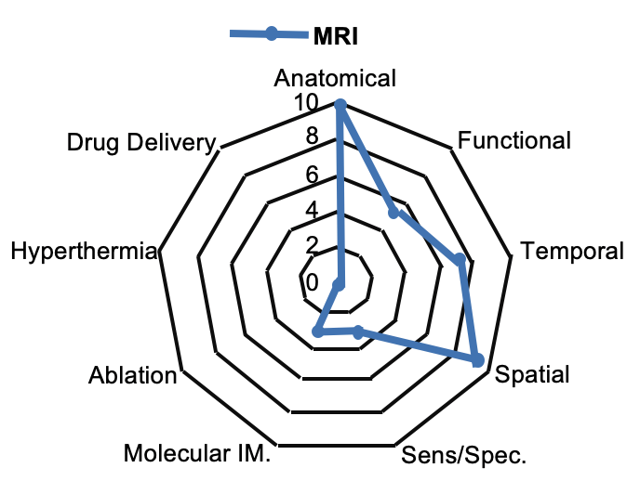
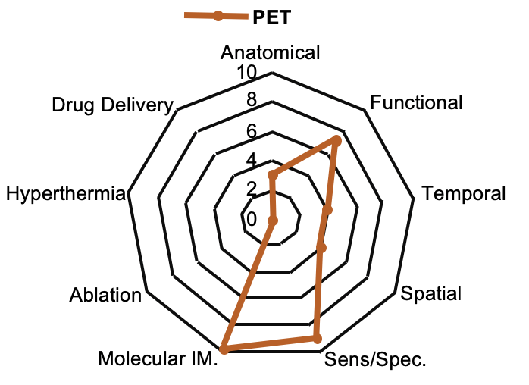
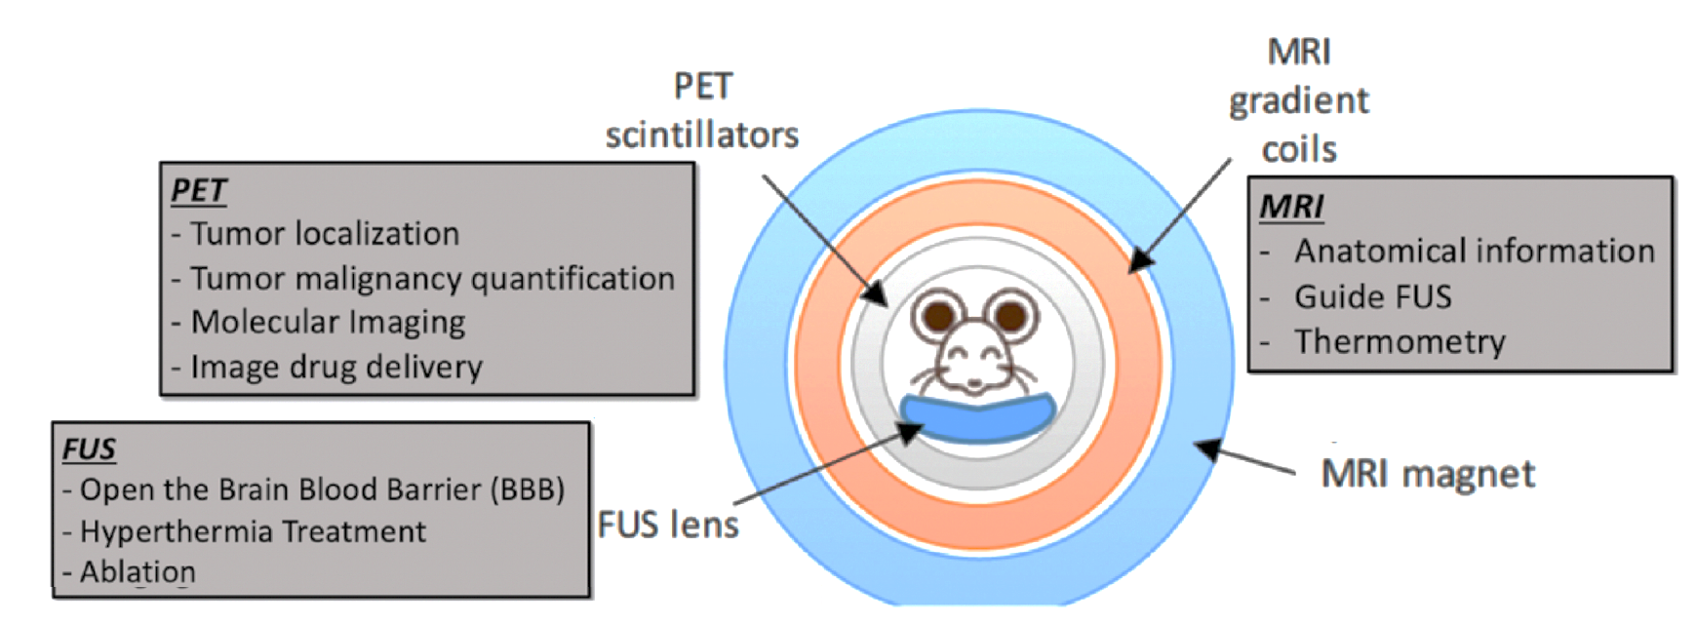
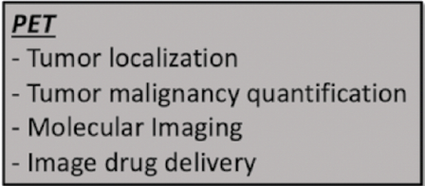
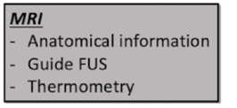
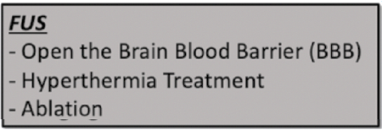
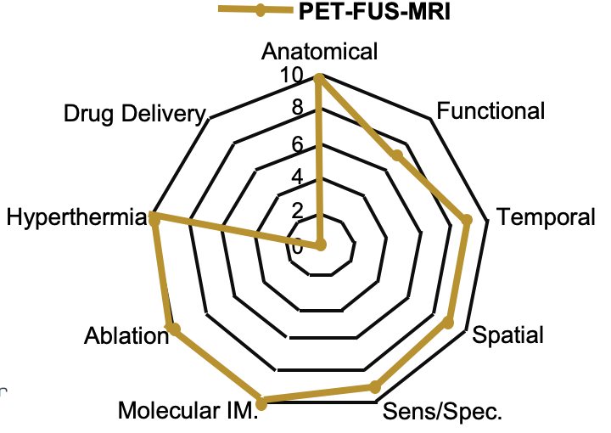
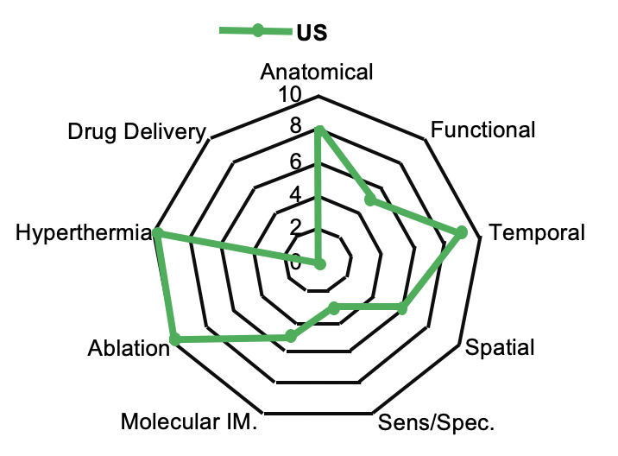
Remarks
Trimodal Imaging → PET-FUS-MRI
37

Slide 38

Introduction to Medical Imaging:
X-ray – CT - MRI
July 8th 2025
Andrea Gonzalez-Montoro, PhD
andrea.gm@i3m.upv.es

