Slide 1
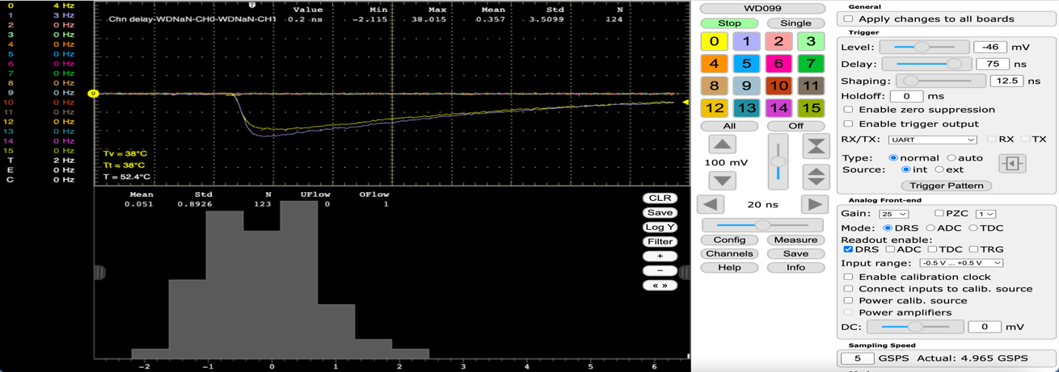
Time-of-Flight Lab Introduction
Stefan Ritt, Paul Scherrer Institute, Switzerland
IEEE NPSS Prague EduCom International Summer School
July 1st, 2025, Prague, Czech Republic

Slide 2
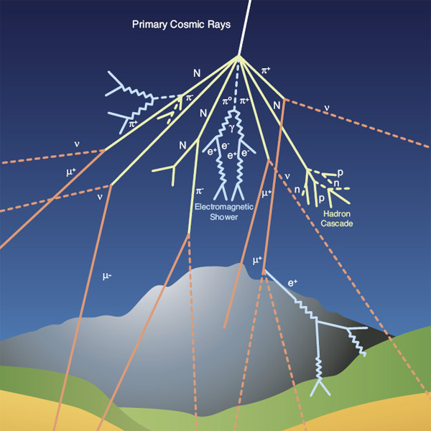
Cosmic rays
Energetic particles (mainly protons and alpha particles) generated in solar eruptions and astrophysical processes even outside our Milky Way
Some particles have much higher energies than those possible with the biggest man-made accelerators.
Used as messengers to understand cosmic processes such as supernovae
Primary cosmic rays generate secondary rays in the upper earth atmosphere
Most showers are absorbed by atmosphere
Some muons (μ) make it down to earth

Slide 3

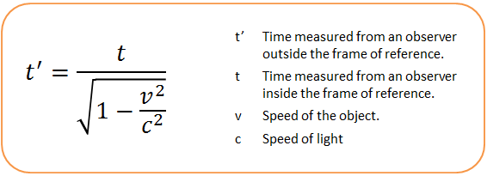
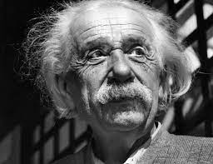
Fun fact: Time dilation
Muon lifetime: t_{1/2} = 2.2 x 10⁻⁶ s
Thickness of earth atmosphere: ~10 km
Average travel distance of a muon having speed of light:
d = t_{1/2} * c = 2.2 x 10⁻⁶s * 3 x 10⁸ m/s = 660 m
Special relativity predicts time dilation
Muon lifetime @99.9% of c:
t’_{1/2} = 2.2 x 10⁻⁶ s / sqrt(1-0.999²) = 49 x 10⁻⁶ s
Modified travel distance:
d = t’_{1/2} * 0.999 * c = 49 x 10⁻⁶s * 3 x 10⁸ m/s = 14.7 km
10 km
Lorentz factor γ = 22.4

Slide 4
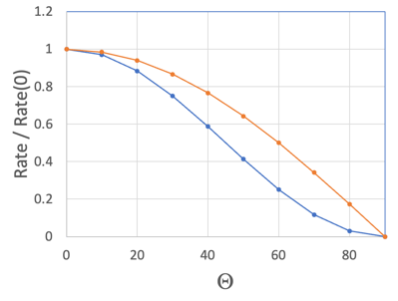
Direction of cosmic muons (CM)
CM are anisotropic
CM loose energy proportional to thickness d of atmosphere
At q=90 deg. rate goes to zero (flat earth approximation)
d₀/d = cos(θ)
→
d = d₀ / cos(θ)
r(θ) = r₀ / d = r₀ * cos(θ)
Better approximation (earth curvature, inhomogeneous atmosphere, muon scattering, …)
r(θ) = r₀ * cos²(θ)
Empirical formula, not exactly derived
d₀
d
θ
~cos(θ)
~cos²(θ)

Slide 5
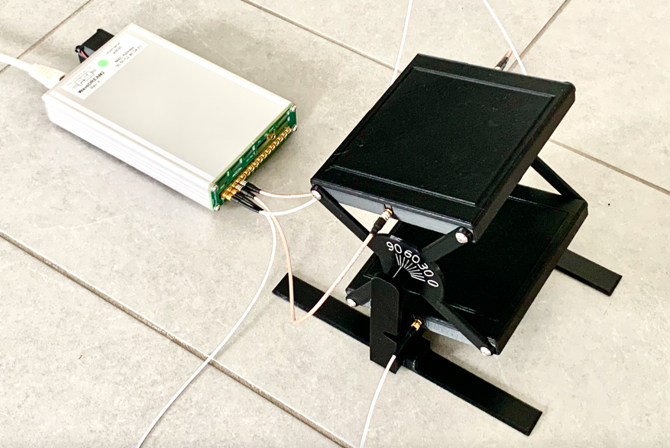
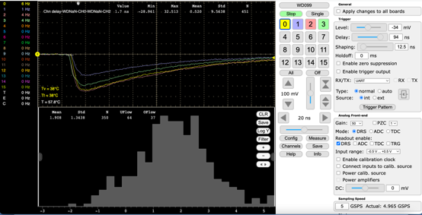
Detection of Muons
Scintillator
BC400
10x100x100 mm³
MCX
Connector
CH3
WaveDREAM
with DRS4 Chip
“Oscilloscope”
SiPM
CH1
CH2
CH0

Slide 6
Lab goals
Configure measurement
Measure speed of cosmic muons
Measure direction of cosmic muons

Slide 7
Connect oscilloscope
CH3
WaveDREAM
with DRS4 Chip
“Oscilloscope”
CH1
CH2
CH0

Slide 8
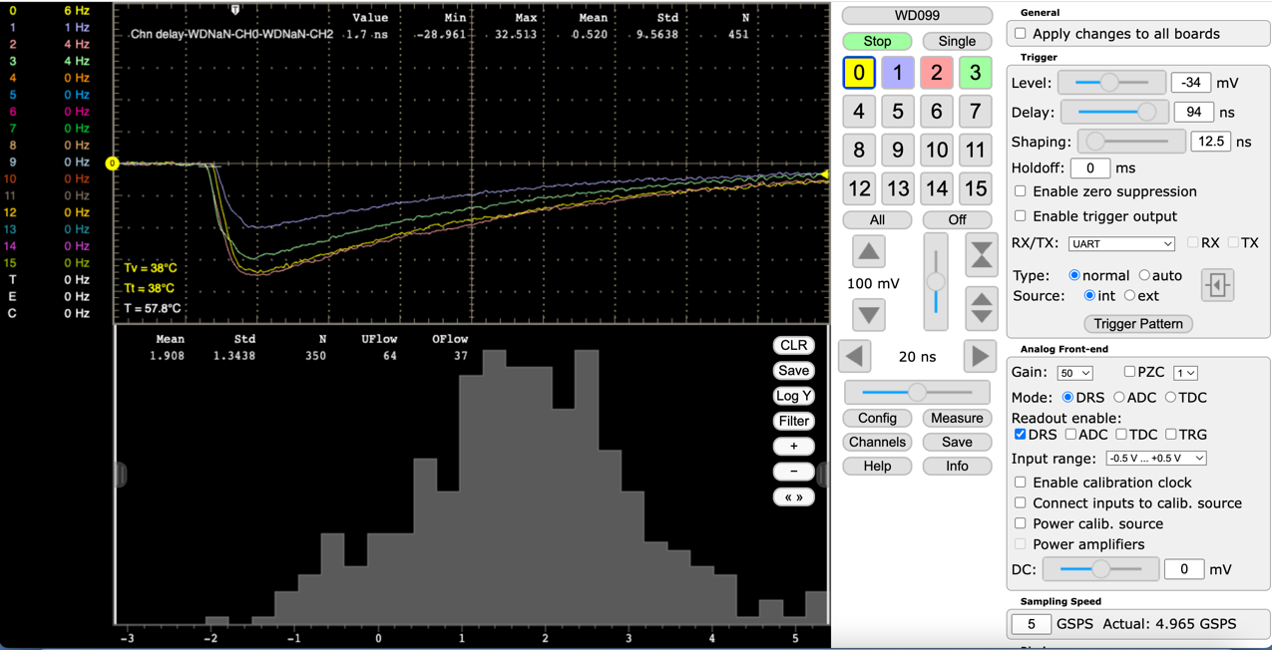
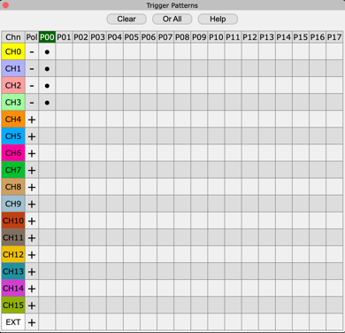
Setting up the oscilloscope
Turn on
channels 0-3
Set
trigger
Set
gain

Slide 9
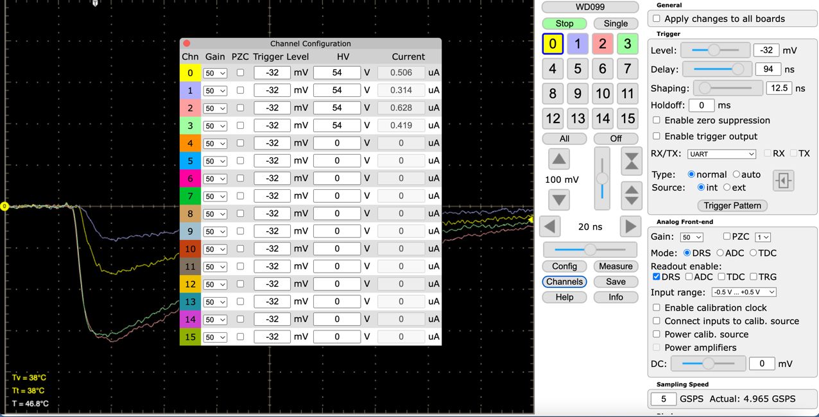
Setting high voltage for SiPM to 54 V

Slide 10
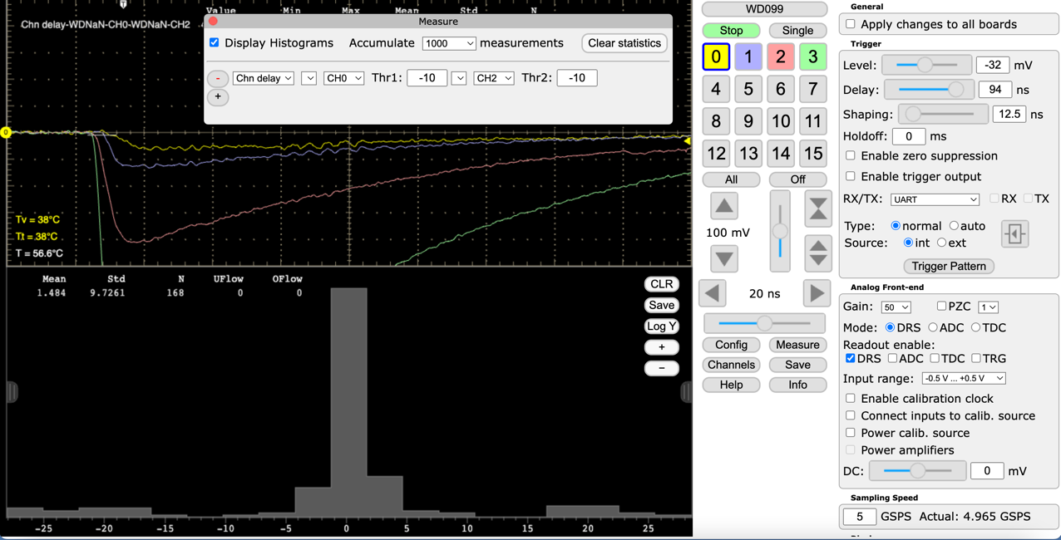
Define time measurement
Number
Measured value

Slide 11
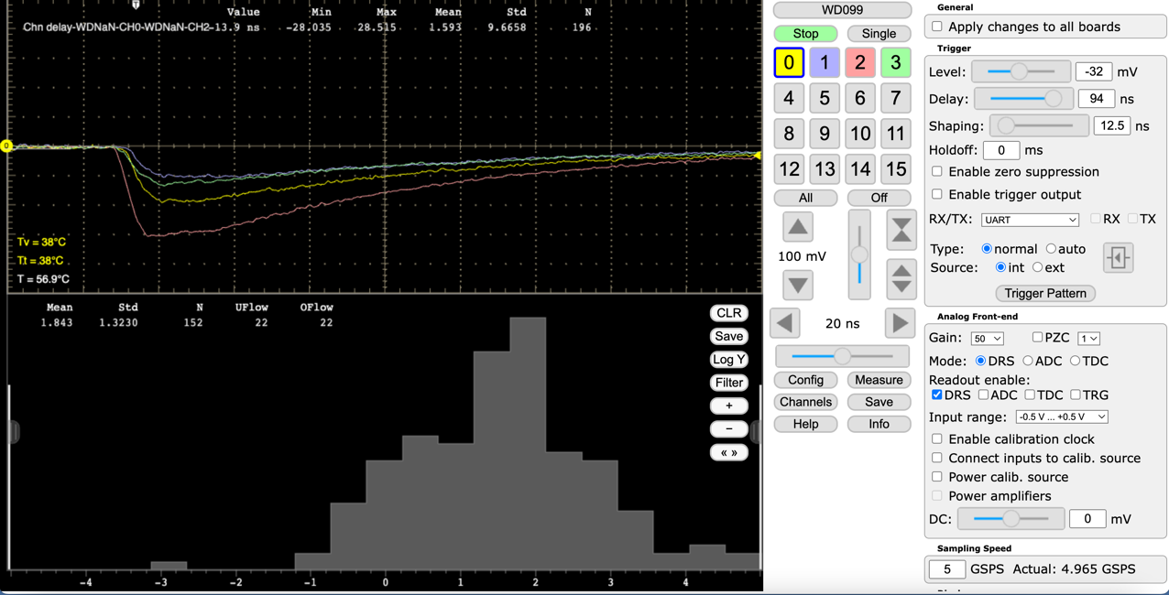
Zoom to -5 ns to +5 ns

Slide 12
Measure Speed of Cosmic Muons

Slide 13
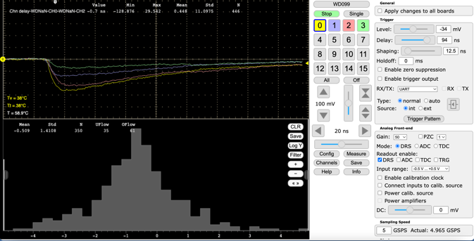
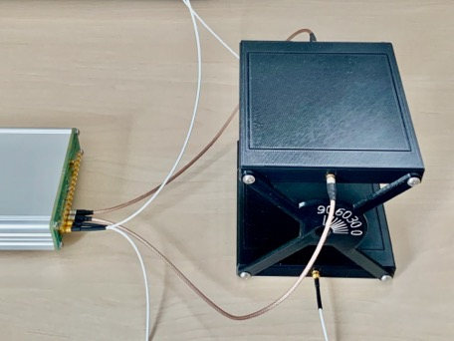
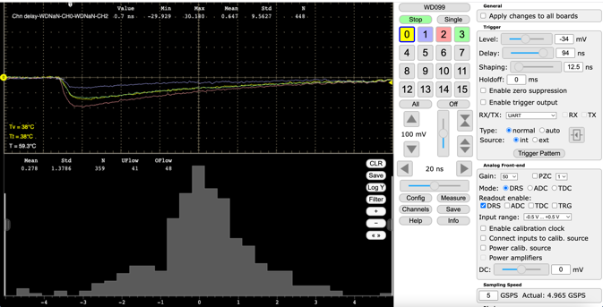
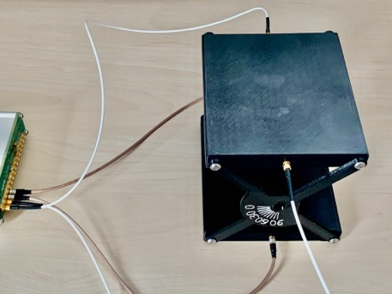
Measure speed of muons
Case A
Measure 300-500 events
write down mean
Rotate
Case B
Measure 300-500 events
write down mean

Slide 14
Difference Measurement
v = ?
t₀
t_{C0}
Case A:
Δt_{A} = (t_{0,A}+t_{c0}) – (t_{2,A}+t_{c2}) = d / v
Case B:
Δt_{B} = (t_{0,B}+t_{c0}) – (t_{2,B}+t_{c2}) = d / (-v)
Difference:
Δt_{A} - Δt_{B} = (t_{0,A}+-t_{0,B})-(t_{2,A}+-t_{2,B}) = 2d / v
v = 2d / (Δt_{A} – Δt_{B})
Task: measure v in % of c (= 3x10⁸ m/s)
d = 0.1m
t_{C2}
t₂
t₀
t_{C0}
t_{C2}
t₂

Slide 15
Measure Direction of Cosmic Muons

Slide 16
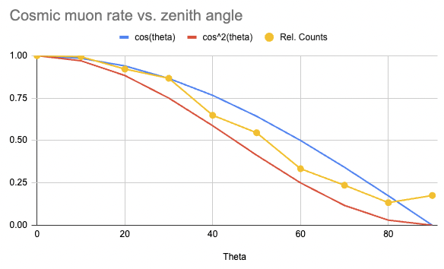
Measure direction of cosmic muons
Set angle = 0,10,20…90 deg.
Measure 5 minutes
Write down counts
Plot normalized
counts vs. angle
~cos(θ)
~cos²(θ)
data
https://docs.google.com/spreadsheets/d/17GKjGK5fU1BGCbbJZV7dLj1fum2MoU38QzSnF404W-o

Slide 17
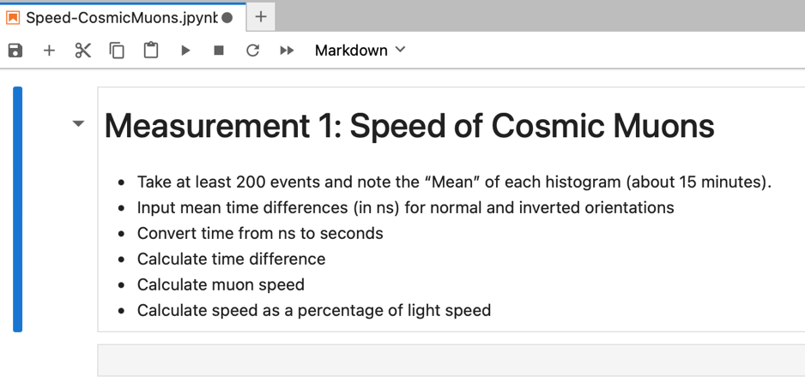
JupyterLab https://jupyter.org
Document your measurement!

Slide 18
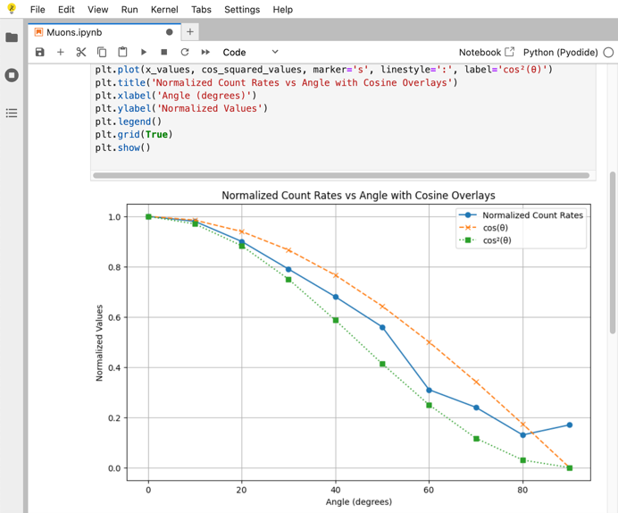
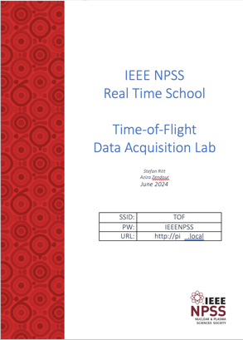
Data Analysis
Write python code to plot your data
Get help from ChatGPT if necessary
Double check the code from ChatGPT!
More details in Lab Script

Slide 19
Questions to ask yourself
Why does the rate do not go to zero at 90 deg.?
Why are the points not on a smooth line?
If I measure again, will I get exactly the same points?
How could the experiment be improved?

Slide 20
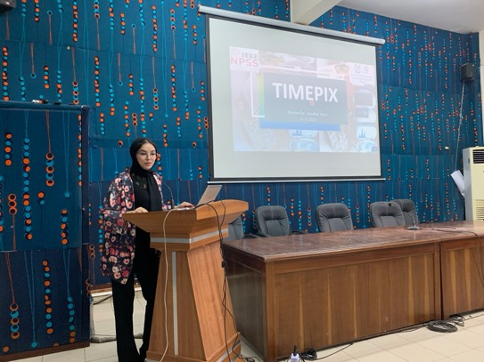
Student Presentations
Next week, every student is supposed to give a ~5 min presentation about one of the four lab courses
Document your
measurements,
save results,
take pictures

