Slide 1

Modern Engineering and AI (ChatGPT for Scientists)
Unveiling the Power and Potential of Large Language Models
Midjourney v5.2
Stefan Ritt :: Head of Muon Physics Group :: Paul Scherrer Institut
IEEE NPSS Prague EduCom International Summer School
July 1st, 2025, Prague, Czech Republic

Slide 2
Engineering and Large Language Models
AI can be used in many ways these days
  Neural Nets (NN) in data analysis
  Data compression in Edge Computing
This talk: Use Large Language Model (LLM) to write Python code for quick data analysis with Jupyter Notebook
  Introduction to Jupyter Notebook
  Ask ChatGPT to write code to plot data and do analysis
  Understand and improve code

Slide 3
Terms
AI - Artificial Intelligence
ML - Machine Learning
DL - Deep Learning
NLP – Natural Language Processing
LLM – Large Language Model
AI
ML
NLP
DL
LLM

Slide 4
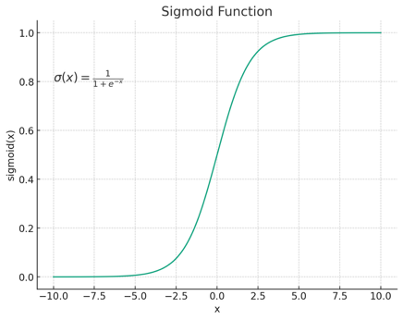




















Neural Net - Polynomial
Polynomials can fit any function
A neural net is a kind of polynomial
  node adds inputs and applies activation function like in our brain
$$f\left(x\right)=a_{0}+a_{1}x+a_{2}x^{2}+a_{3}x^{3}+…$$
$$=f(\left[\sum{{input}_{i}}\right]+bias)$$
$$x$$
$$1$$
$$a_{0}$$
$$x$$
$$x$$
$$0$$
$$1$$
$$a_{1}$$
1
$$1$$
$$x$$
$$x^{2}$$
$$a_{2}$$
1
1
$$0$$
$$a_{3}$$
$$1$$
$$x^{3}$$
$$x$$
$$x^{2}$$
$$bias$$

Slide 5
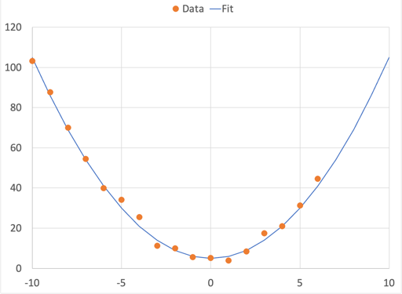
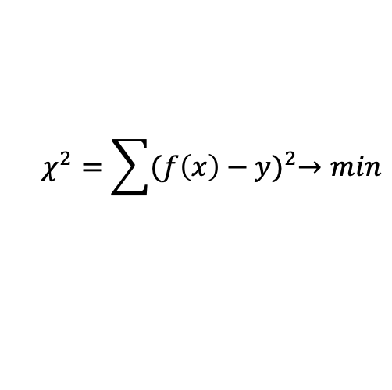
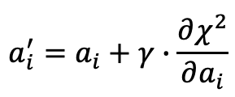
Machine Learning
Extrapolation
Training a Neural Network is very similar to fitting a polynomial to a function:
  Create a χ² and minimize it
  Gradient method: calculate partial derivations of all parameters and adjust them
$$χ^{2}=\sum{{(f\left(x\right)−y)}^{2}→min}$$
$$a_{i}^{′}=a_{i}+γ∙\frac{∂χ^{2}}{∂a_{i}}$$
“learning rate” ~0.001

Slide 6
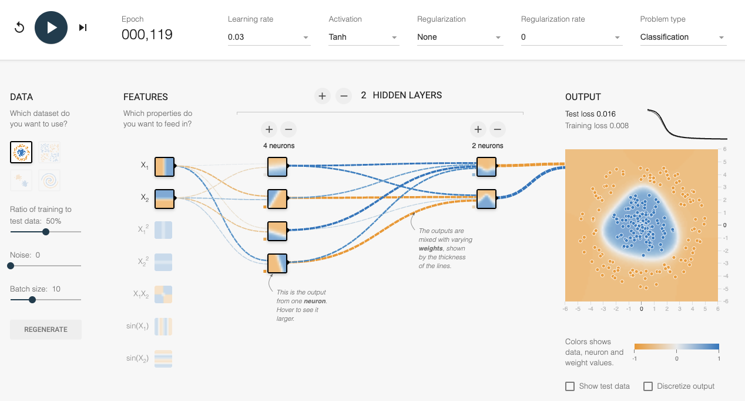
Interactive Training Demo
https://playground.tensorflow.org

Slide 7
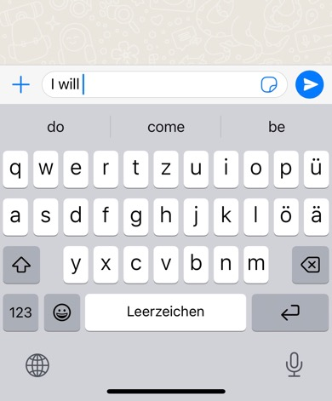
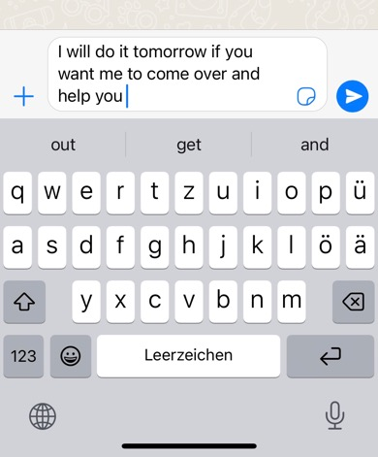
Text generation
Text can be predicted using probabilities, see your smartphones autocomplete function:
do
come
be
13.4 %
11.2 %
8.1 %
I will

Slide 8
Text generation
How big a table with probabilities do we need ?
Assume we have 10,000 words and make a sentence with 10 words:
Probability table with 10⁴⁰ entries is not possible
Most of the 10⁴⁰ sentences make no sense
All meaningful sentences are still too big to fit in a table
→ Approximate the probability table with a Neural Net
word word word word word word word word word word
10⁴ x 10⁴ x 10⁴ x 10⁴ x 10⁴ x 10⁴ x 10⁴ x 10⁴ x 10⁴ x 10⁴ = 10⁴⁰
I
will
I
will
do
do
it

Slide 9
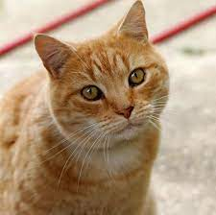


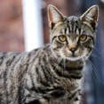


Machine Learning
Labeled learning:
Un-labeled learning:
Cat
Cat
Dog
Cat
I
will
do
Cat
it
→ Basis of Large Language Models

Slide 10
Meaning of words in sentence
Meaning of words in a sentence depend on their order
  Goliath has defeated David
  David has defeated Goliath
Meaning of words in a sentence depend on their context
  I walk across the street to the other bank → financial institution
  I swim across the river to the other bank → land along a river
Words have different weights to influence the context

Slide 11
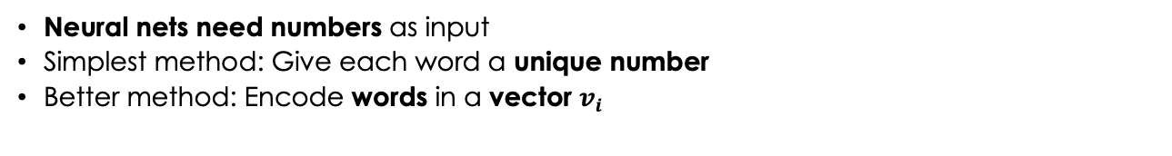
Word embedding
Neural nets need numbers as input
Simplest method: Give each word a unique number
Better method: Encode words in a vector $v_{i}$
man
woman
king
queen
0.72
0.32
…
0.81
0.28
…
0.23
0.63
…
0.32
0.59
…
king
queen
man
woman
king – man + woman = queen
Typical language models use i=512 dimensions
Similar words should have similar vectors
Coordinates are derived from training

Slide 12
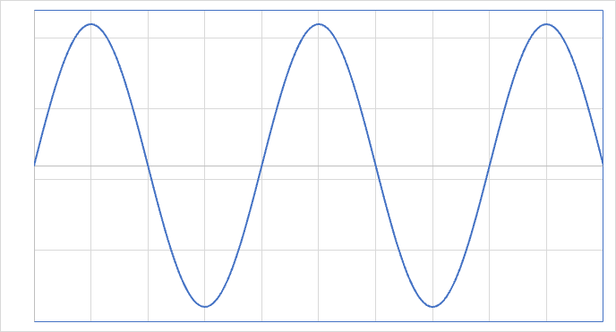
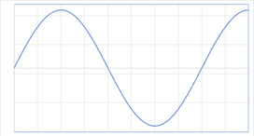
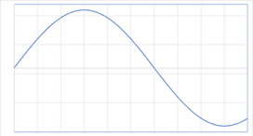
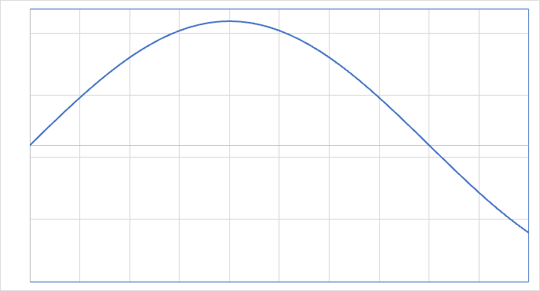
Position encoding
d
=
0
1
2
3
4
David has defeated Goliath
sin(d/p*π)
David has defeated Goliath
0.61 | 0.71 | 0.13 | 0.20
0.08 | 0.01 | 0.15 | 0.80
0.36 | 0.01 | 0.35 | 0.26
0.08 | 0.78 | 0.96 | 0.72
0.57 | 0.62 | 0.66 | 0.59
0.00 | 0.00 | 0.00 | 0.00
0.00 | 1.00 | 0.87 | 0.71
0.00 | 0.00 | 0.87 | 1.00
0.00 | -1.0 | 0.00 | 0.71
0.00 | 0.00 | -0.8 | 0.00
0.61 | 0.71 | 0.13 | 0.20
0.08 | 1.01 | 1.02 | 1.50
0.36 | 0.01 | 1.22 | 1.26
0.08 | -0.22 | 0.96 | 1.42
0.57 | 0.62 | -0.20 | 0.59
+
=
p=1 2 3 4
0.00 | 0.00 | 0.00 | 0.00
0.00 | 1.00 | 0.87 | 0.71
0.00 | 0.00 | 0.87 | 1.00
0.00 | -1.0 | 0.00 | 0.71
0.00 | 0.00 | -0.8 | 0.00
Note:
Current models use alternating sin/cos and different frequencies, so distance of words can be easily calculated from vectors.
https://kazemnejad.com/blog/
transformer_architecture_positional_encoding/

Slide 13
Position encoding
d
=
0
1
2
3
4
David has defeated Goliath
sin(d/p*π)
David has defeated Goliath
0.61 | 0.71 | 0.13 | 0.20
0.08 | 0.01 | 0.15 | 0.80
0.36 | 0.01 | 0.35 | 0.26
0.08 | 0.78 | 0.96 | 0.72
0.57 | 0.62 | 0.66 | 0.59
0.00 | 0.00 | 0.00 | 0.00
0.00 | 1.00 | 0.87 | 0.71
0.00 | 0.00 | 0.87 | 1.00
0.00 | -1.0 | 0.00 | 0.71
0.00 | 0.00 | -0.8 | 0.00
0.61 | 0.71 | 0.13 | 0.20
0.08 | 1.01 | 1.02 | 1.50
0.36 | 0.01 | 1.22 | 1.26
0.08 | -0.22 | 0.96 | 1.42
0.57 | 0.62 | -0.20 | 0.59
+
=
p=1 2 3 4
Goliath has defeated David
sin(d/p*π)
Goliath has defeated David
0.20 | 0.71 | 0.13 | 0.61
0.80 | 0.01 | 0.15 | 0.08
0.26 | 0.01 | 0.35 | 0.36
0.72 | 0.78 | 0.96 | 0.08
0.59 | 0.62 | 0.66 | 0.57
0.00 | 0.00 | 0.00 | 0.00
0.00 | 1.00 | 0.87 | 0.71
0.00 | 0.00 | 0.87 | 1.00
0.00 | -1.0 | 0.00 | 0.71
0.00 | 0.00 | -0.8 | 0.00
0.20 | 0.71 | 0.13 | 0.61
0.80 | 1.01 | 1.02 | 0.79
0.26 | 0.01 | 1.22 | 1.36
0.72 | -0.22 | 0.96 | 0.79
0.59 | 0.62 | -0.20 | 0.57
+
=

Slide 14
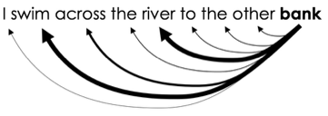


Context encoding
Context matters!
We need a mechanism that considers neighboring words
to enhance the meaning of the word of interest
Idea: use vector dot product of vectors
→ large for similar word
→ zero for perpendicular vectors
I swim across the river to the other bank
fund
river
1 | 0.2 | 0.5 | 0.2 | 0.5 | 0.5 | 0.5 | 0.5 | 0.5
0.2 | 1 | 0.5 | 0.5 | 0.8 | 0.5 | 0.5 | 0.5 | 0.7
0.5 | 0.5 | 1 | 0.5 | 0.5 | 0.5 | 0.5 | 0.2 | 0.2
0.2 | 0.5 | 0.5 | 1 | 0.5 | 0.5 | 0.5 | 0.5 | 0.5
0.5 | 0.8 | 0.5 | 0.5 | 1 | 0.5 | 0.5 | 0.5 | 0.7
0.5 | 0.5 | 0.5 | 0.5 | 0.5 | 1 | 0.5 | 0.5 | 0.5
0.5 | 0.5 | 0.5 | 0.5 | 0.5 | 0.5 | 1 | 0.5 | 0.2
0.5 | 0.5 | 0.2 | 0.5 | 0.5 | 0.5 | 0.5 | 1 | 0.5
0.5 | 0.7 | 0.2 | 0.5 | 0.7 | 0.5 | 0.2 | 0.5 | 1
bank
water
money
$v$: word vector
$s$: similarity
finance
canal
payment
$$s_{ij}=v_{i}v_{j}^{T}$$
I swim across the river to the other bank

Slide 15
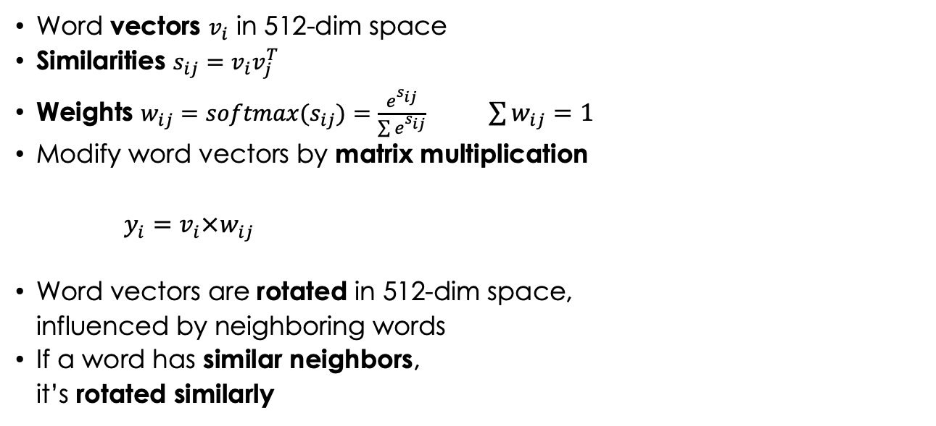
Vector rotation
Word vectors $v_{i}$ in 512-dim space
Similarities $s_{ij}=v_{i}v_{j}^{T}$
Weights $w_{ij}={softmax(s}_{ij})=\frac{e^{s_{ij}}}{\sum{e^{s_{ij}}}}$ $\sum{w_{ij}=1}$
Modify word vectors by matrix multiplication
$y_{i}=v_{i}×w_{ij}$
Word vectors are rotated in 512-dim space,
influenced by neighboring words
If a word has similar neighbors,
it’s rotated similarly
bank
river
bank
money
bank

Slide 16
Self-Attention Mechanism
v1
v2
v3
…
Word vectors
→ Similarity Matrix
→ Rotation (Matrix Multiplication)
→ Normalize Matrix
→ Contextualized representation of word vectors
Add Machine Learning by weighting original words with matrix of weights derived from training
→ Self-Attention Mechanism
Put several Self-Attention Mechanism in parallel
→ Multi-headed Self-Attention Mechanism
Similarity Matrix
Weight Matrix
Weight Matrix
Matrix Multiplication
Normalize
y1
y2
y3
…
v1
v2
v3
…
modifier
v1
v2
v3
…
…
v1
v2
v3
Similarity Matrix
…
v1
v2
v3
Similarity Matrix
Weight Matrix
Weight Matrix
Similarity Matrix
Similarity Matrix
Weight Matrix
Weight Matrix
  I swim across the river to the other bank
Weight Matrix
Weight Matrix
Weight Matrix
Weight Matrix
Matrix Multiplication
Matrix Multiplication
Matrix Multiplication
Normalize
Matrix Multiplication
Normalize
…
Normalize
y1
y2
y3
Normalize
y1
y2
y3
…
y1
y2
y3
…
y1
y2
y3
…
location

Slide 17
Traditional Database Lookup
Lookup for translations
Lookup for text generation
Query
“dog”
“I”
“I”
“will”
. . .
Hash
Hash
Hash
Key
2635
3452
7654256
Lookup
Table / Database
Lookup
Table
Lookup
Table
Value
“Hund”
“will”
“do”

Slide 18
Lookup with Neural Nets
“I”
“will”
Weight Matrix Q
Weight Matrix K
Weight Matrix V
Self-Attention
Mechanism
Query
Key
Value
Matrix Multiplication
Normalize
Matrix Multiplication
Normalize
Feed-forward Network
“do”

Slide 19
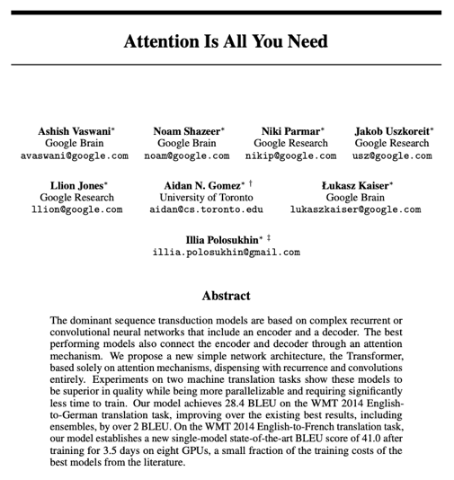
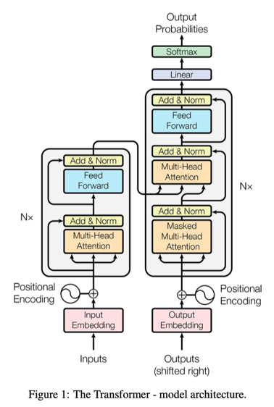
Putting all together: Transformer
Decoder
Encoder
https://arxiv.org/abs/1706.03762 June 2017

Slide 20
ChatGPT 3
Transformer Mechanism + Huge Neural Network + … → Large Language Model (LLM)
https://en.wikipedia.org/wiki/GPT-3
2048 Tokens (2-chars + <EOS> + punctuation)
92 hidden network layers
175 Billion Parameters, 800 GB of storage
Trained with 1.8 PB of text (500 B tokens)
  3% Wikipedia
  16% Books1 & Books2
  81% Common Crawl + WebText2
305 Years for training →
~ months on huge cluster, cost ~5 M$
Training data until Sept. 2021
Pre-training plus fine-tuning:
Generative Pre-trained Transformer 3 (GPT 3)
Free version of ChatGPT at https://chat.openai.com
92
2048
175 x 10⁹ parameters

Slide 21
Hallucination
https://en.wikipedia.org/wiki/Hallucination_(artificial_intelligence)
ChatGPT is good to generate nice text, but NOT to produce correct output
Is 17077 a prime? (correct answer: Yes)
  Solution is not present in training data
  Solutions learned:
    17 is prime since it can only be divided by 1 and 17
    77 is not a prime, it can be divided by 7 and 11
  Hallucination:
  “17077 is not a prime, since it can be divided by 7, 11 and 17”
LLM cannot deal with a situation where it is not trained in

Slide 22
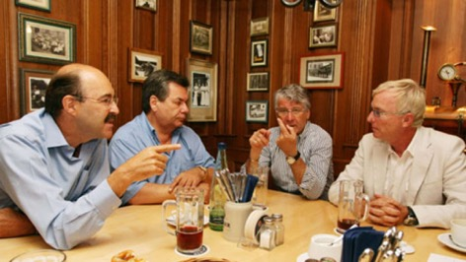
Important Lesson to be learned
The output of a Large Language Model
is “mostly” correct
Use it for cases where you can double check or
do not rely on the correctness of the output
“Stammtisch” (pub)
discussion

Slide 23
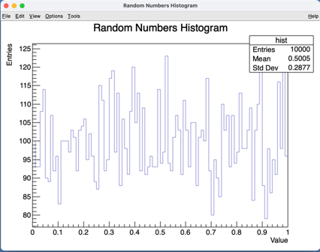
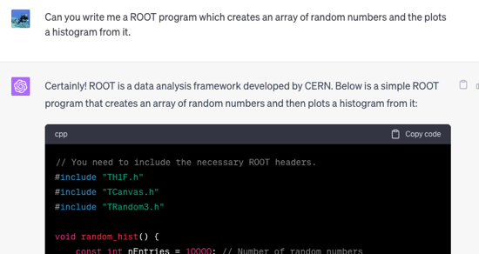

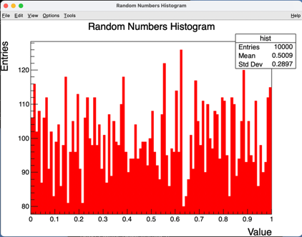
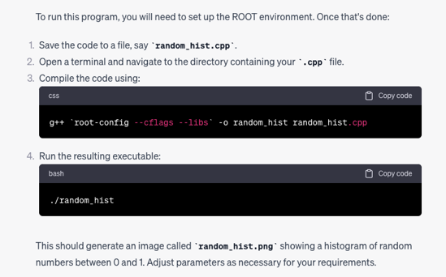
Write code

Slide 24
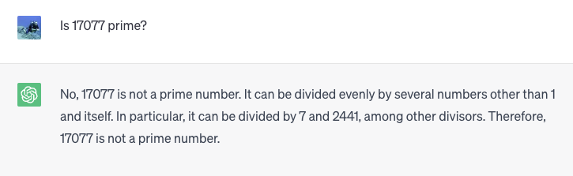
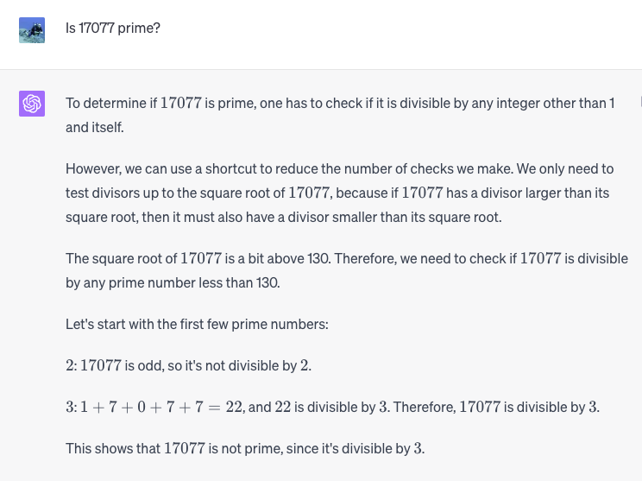
LLM cannot calculate
ChatGPT 3.5
ChatGPT 4
17077 / 3 = 5692.333…

Slide 25
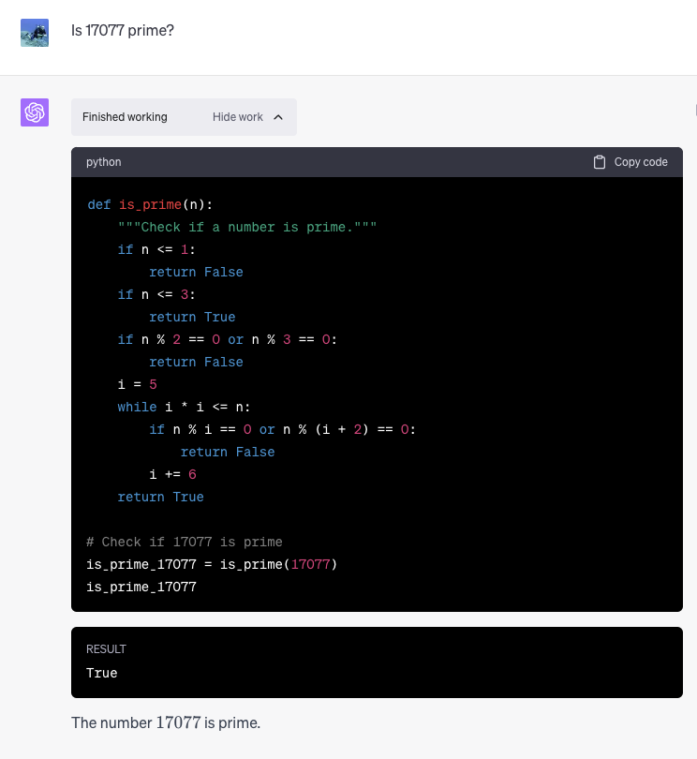
Code plug-in can calculate
Note: Requires paid version of ChatGPT
ChatGPT 4 +
Code Interpreter

Slide 26
Jupyter Notebook

Slide 27
Jupyter Notebook
Jupyter Notebook is an open-source web application for:
  Document your lab work
  Write and run Python code (but others too)
  See graphical outputs immediately
  Mix text, code, math and graphs in one document
  Share and exports notebooks in PDF/HTML
Installation ( https://jupyter.org/install )
  $ pip install jupyterlab (requires Python)
  $ jupyter lab
  Online version: https://jupyter.org/try-jupyter/lab/

Slide 28
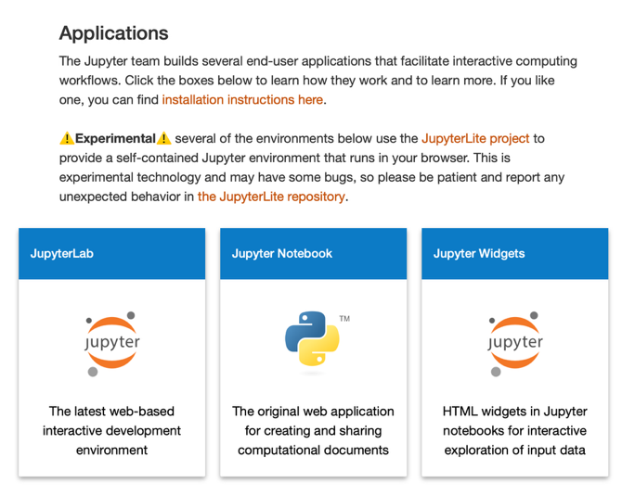
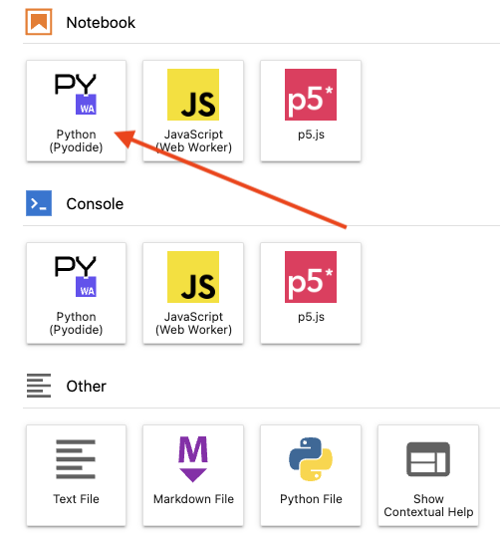
Run JupyterLab

Slide 29
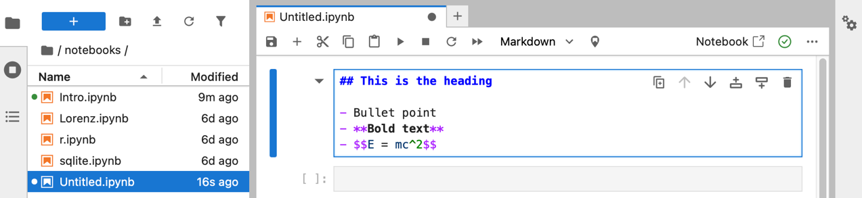
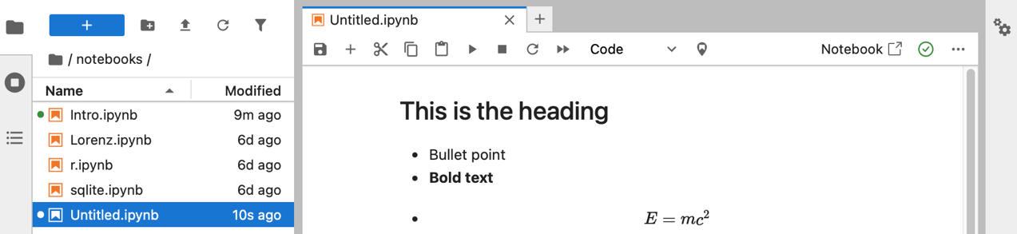
Simple Examples
→ Shift – Return →

Slide 30
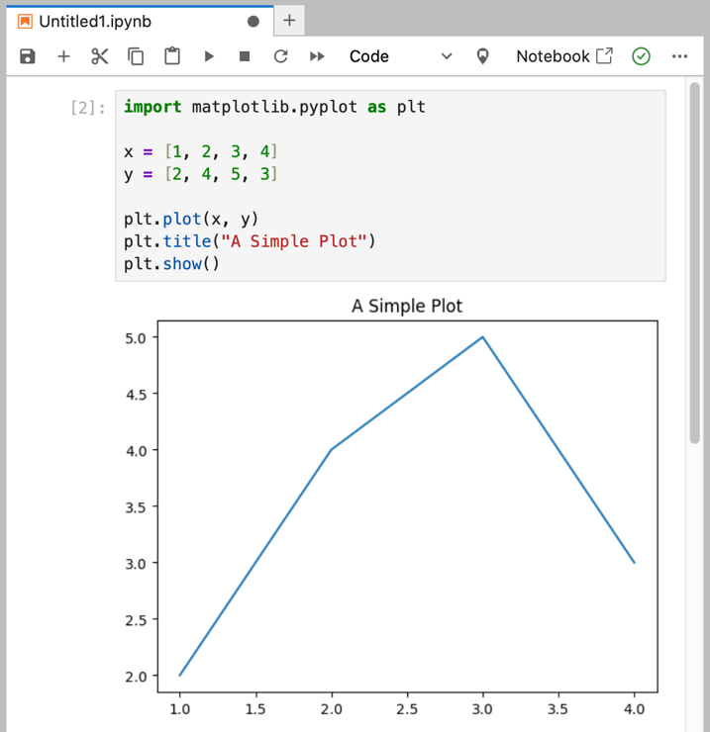
Editor Basics
Shift + Enter =
Run the current cell
Esc + A = Add cell above
Esc + B = Add cell below
Ctrl+S = Save notebook
File → Export as …
to export to PDF/HTML

Slide 31
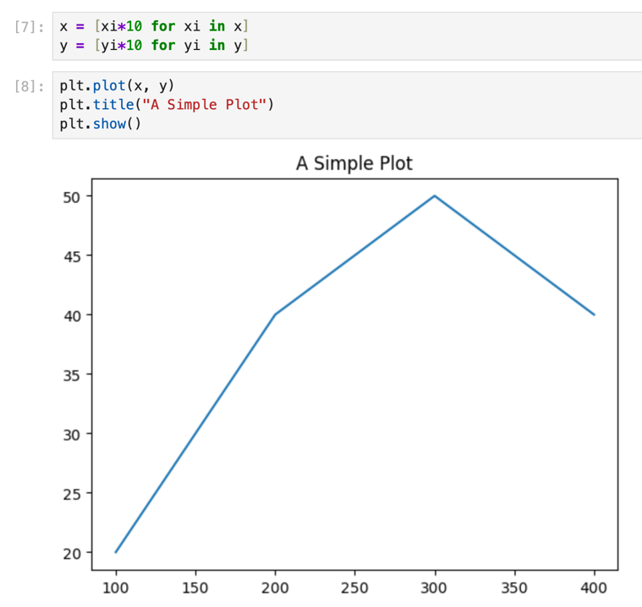
Jupyter variable space
All variables can be used in later cells
One or all cells can be
re-executed

Slide 32
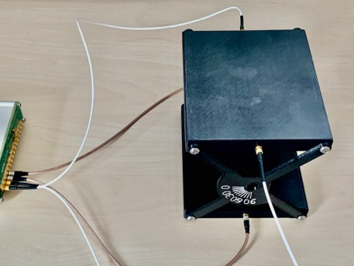
Ask ChatGPT to write Python code
Write me some python code to plot an array of ten X/Y pairs. The X values represent an angle going from 0 to 90 degrees in steps of 10 degrees, the Y values represent count rates. Put ten discrete count rates from 0 to 100 into an array and normalize it from 0 to 1.

Slide 33
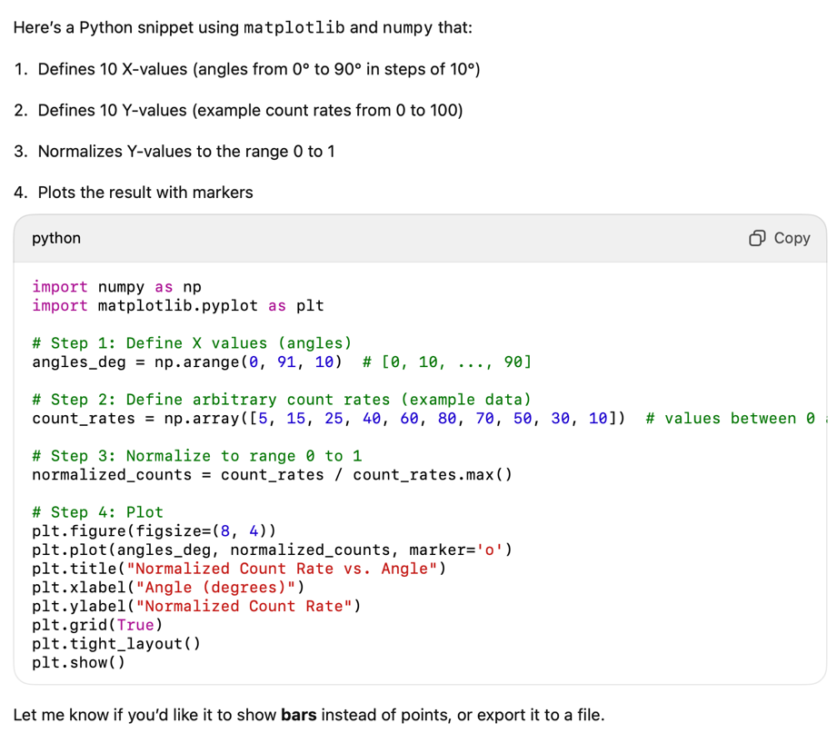
ChatGPT Code

Slide 34
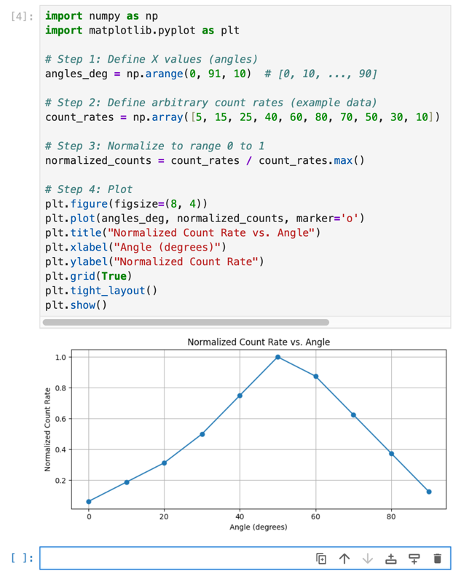
Example data
Never trust output of ChatGPT!
Try to understand code and
correct if necessary
Replace example data with your
real data and re-execute the cell
Change color, labels, …
Ask ChatGTP for details
Never trust output of ChatGPT!

Slide 35
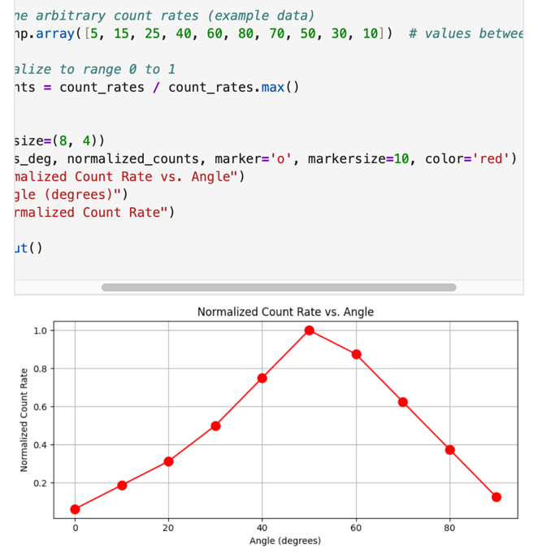
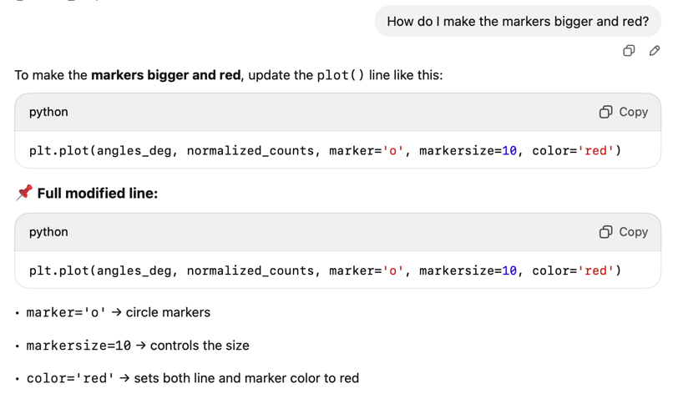
Optimize plot

Slide 36
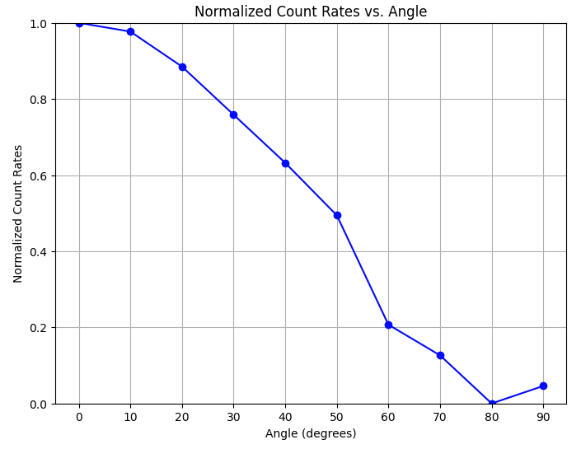
Real measured data

Slide 37
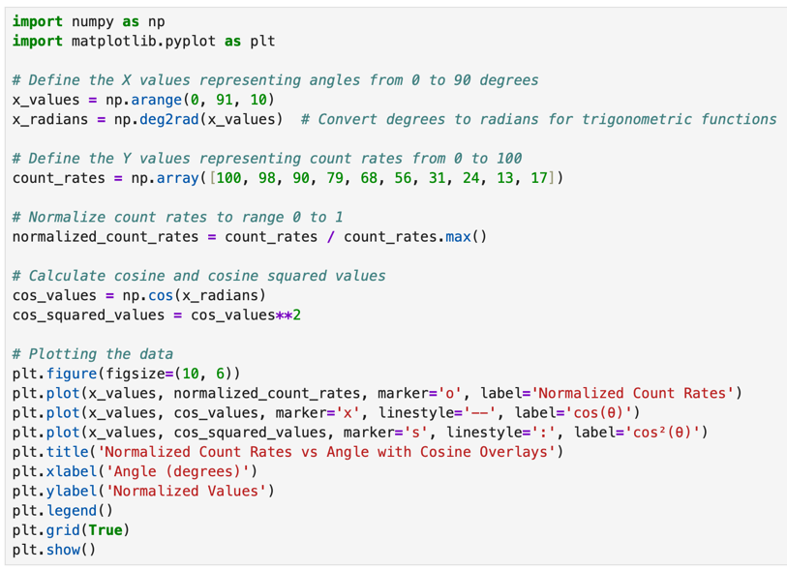
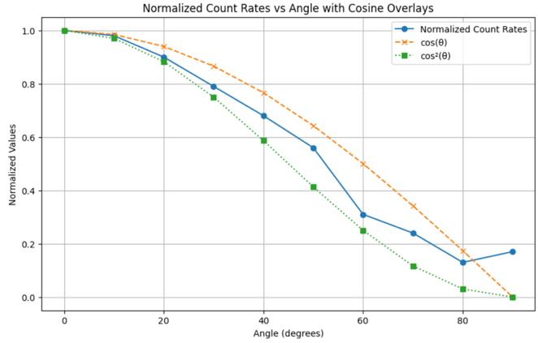
Overlay different models

Slide 38
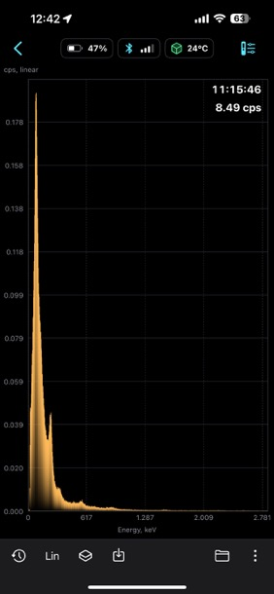
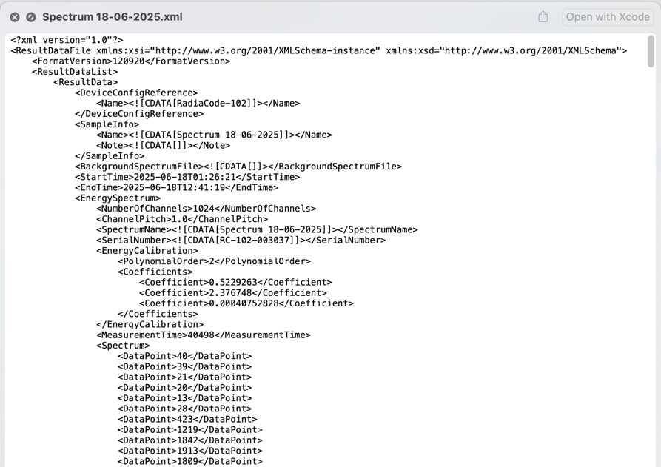
Analyze Radiacode Spectra

Slide 39
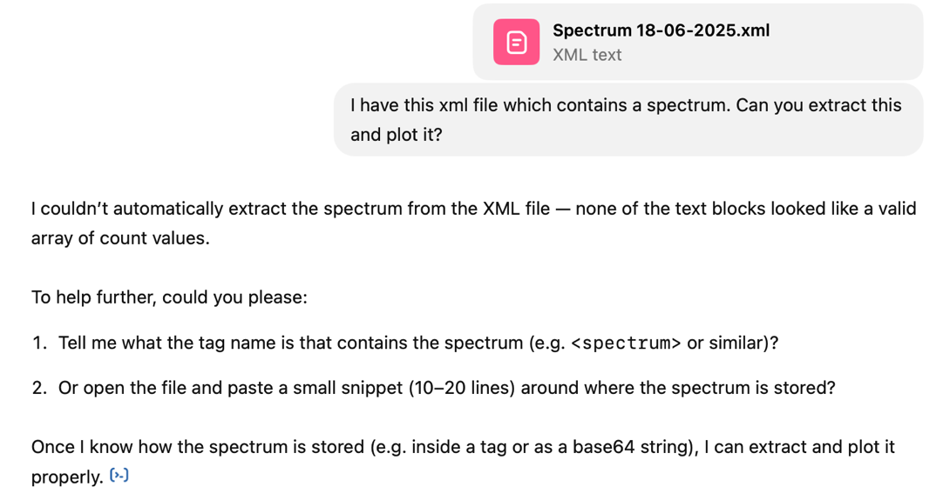
ChatGPT can analyze files!

Slide 40
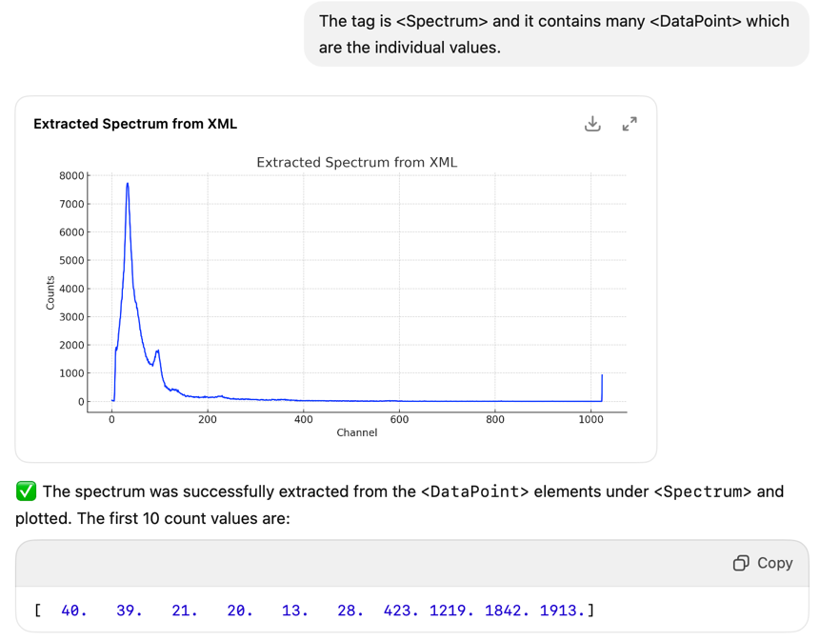
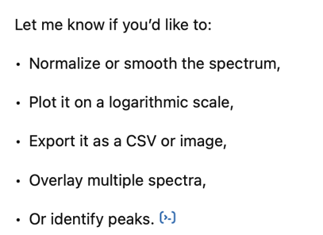
ChatGPT can analyze files!

Slide 41
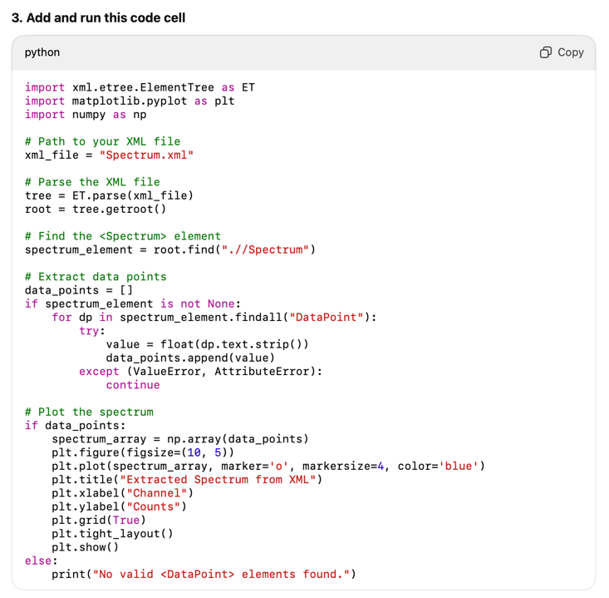
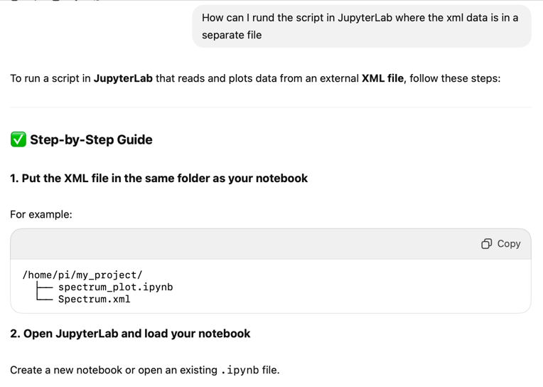
Get spectrum into JupyterLab

Slide 42
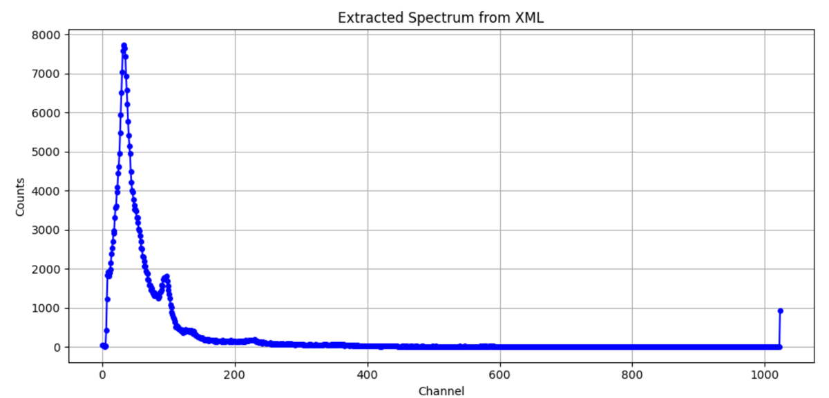
Run inside JupyterLab

Slide 43
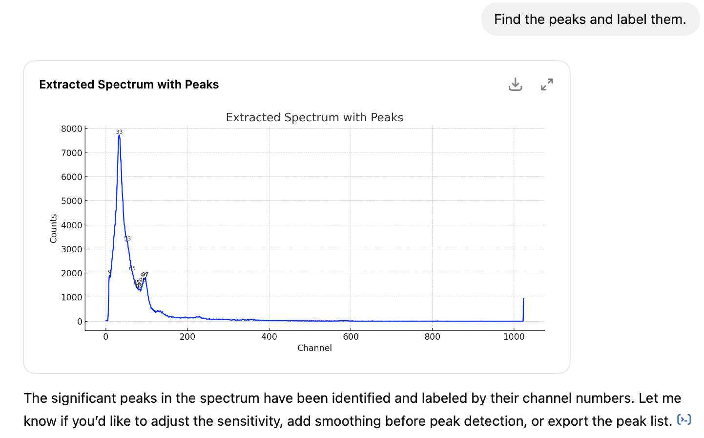
Peak finding

Slide 44

Peak finding

Slide 45

Calibrate spectrum

Slide 46


Fit spectrum
+ hand tuning

Slide 47
Program (just for reference)
import xml.etree.ElementTree as ET
import numpy as np
import matplotlib.pyplot as plt
from scipy.ndimage import gaussian_filter1d
from scipy.optimize import curve_fit
# --- Load and parse XML ---
file_path = "Spectrum.xml" # adjust as needed
tree = ET.parse(file_path)
root = tree.getroot()
# --- Extract spectrum data ---
spectrum_data = []
for spectrum in root.iter('Spectrum'):
for point in spectrum.findall('DataPoint'):
spectrum_data.append(float(point.text))
# --- Energy calibration: channel 95 = 667 keV ---
channel_peak = 95
energy_peak = 667 # keV
energy_per_channel = energy_peak / channel_peak
calibrated_energy = np.arange(len(spectrum_data)) * energy_per_channel
# --- Define fit range: 300–900 keV ---
fit_mask = (calibrated_energy >= 300) & (calibrated_energy <= 900)
fit_x = calibrated_energy[fit_mask]
fit_y = np.array(spectrum_data)[fit_mask]
# --- Define background fit regions: 300–500 keV and 800–1000 keV ---
bg_mask = ((calibrated_energy >= 300) & (calibrated_energy <= 500)) | \
((calibrated_energy >= 800) & (calibrated_energy <= 1000))
bg_x = calibrated_energy[bg_mask]
bg_y = np.array(spectrum_data)[bg_mask]
# --- Fit 3rd-degree polynomial to background regions ---
poly_coeffs = np.polyfit(bg_x, bg_y, deg=3)
background_poly = np.poly1d(poly_coeffs)
# --- Define Gaussian + 3rd-degree polynomial model ---
def gaussian_plus_poly3(x, a, mu, sigma, c0, c1, c2, c3):
gaussian = a * np.exp(-0.5 * ((x - mu) / sigma)**2)
background = c0 + c1*x + c2*x**2 + c3*x**3
return gaussian + background
# --- Initial parameter guesses ---
a0 = max(fit_y)
mu0 = energy_peak
sigma0 = 5
initial_guess = [a0, mu0, sigma0] + list(poly_coeffs)
# --- Fit the combined model ---
popt, _ = curve_fit(gaussian_plus_poly3, fit_x, fit_y, p0=initial_guess)
# --- Extract fit components ---
def gaussian(x, a, mu, sigma):
return a * np.exp(-0.5 * ((x - mu) / sigma)**2)
gauss_params = popt[:3]
poly_params = popt[3:]
gaussian_curve = gaussian(fit_x, *gauss_params)
background_curve = np.poly1d(poly_params[::-1])(fit_x)
fit_curve = gaussian_curve + background_curve
# --- Compute FWHM and energy resolution ---
peak_energy = gauss_params[1]
fwhm = 2.355 * abs(gauss_params[2])
resolution = (fwhm / peak_energy) * 100
# --- Plot everything ---
plt.figure(figsize=(10, 5))
plt.plot(fit_x, fit_y, label="Original Spectrum", color="blue")
plt.plot(fit_x, background_curve, 'g--', label="3rd-Degree Background")
plt.plot(fit_x, gaussian_curve, color="orange", label="Fitted Gaussian")
plt.plot(fit_x, fit_curve, color="red", label="Total Fit")
# Overlay text box with fit results
result_text = (
f"Peak Energy: {peak_energy:.1f} keV\n"
f"FWHM: {fwhm:.1f} keV\n"
f"Resolution: {resolution:.1f} %"
)
plt.text(0.98, 0.70, result_text, transform=plt.gca().transAxes,
fontsize=10, verticalalignment='top', horizontalalignment='right',
bbox=dict(facecolor='white', edgecolor='gray', boxstyle='round,pad=0.4'))
plt.title("Fit to Original Spectrum: Gaussian + 3rd-Degree Polynomial (300–900 keV)")
plt.xlabel("Energy (keV)")
plt.ylabel("Counts")
plt.legend()
plt.grid(True)
plt.tight_layout()
plt.show()

Slide 48


Real power of Jupyter Notebook
Each cell depends on previous ones
Enables easy analysis chain
Example:
  PhD analysis ~50 pages
  with ~20 plots
  Complicated calibration and analysis chain
  After error was found in original calibration, re-generation of plots were instant
Raw Data
Raw Data
Calibration
Calibration
Derived Data
Derived Data
Correlation
Combined Data

Slide 49



Conclusions
LLMs will become part of our life, therefor it’s important to understand it powers and weaknesses
LLMs can write Python code, which can act as a basis for program development
Never trust blindly any code from LLMs
  Understand the code
  Test the code
  Correct the code

Slide 50
References
https://chat.openai.com
https://www.youtube.com/watch?v=bSvTVREwSNw
https://www.youtube.com/watch?v=iR2O2GPbB0E
https://www.youtube.com/watch?v=lnA9DMvHtfI
https://www.youtube.com/watch?v=kCc8FmEb1nY
https://www.youtube.com/watch?v=g2BRIuln4uc
https://www.youtube.com/watch?v=XowwKOAWYoQ
https://www.youtube.com/watch?v=5MaWmXwxFNQ
https://www.youtube.com/watch?v=KmAISyVvE1Y

