Slide 1
Time of flight measurement
Matouš Mišta

Slide 2
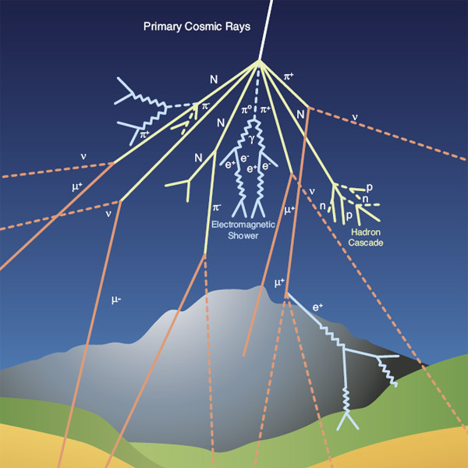
Basic principle
Muons:
  Elementary particles
  Created from cosmic rays in the atmosphere
Goals:
  Measure speed of muons
  Determine how their flux varies with angle
Muon shower (Credit: CERN)

Slide 3
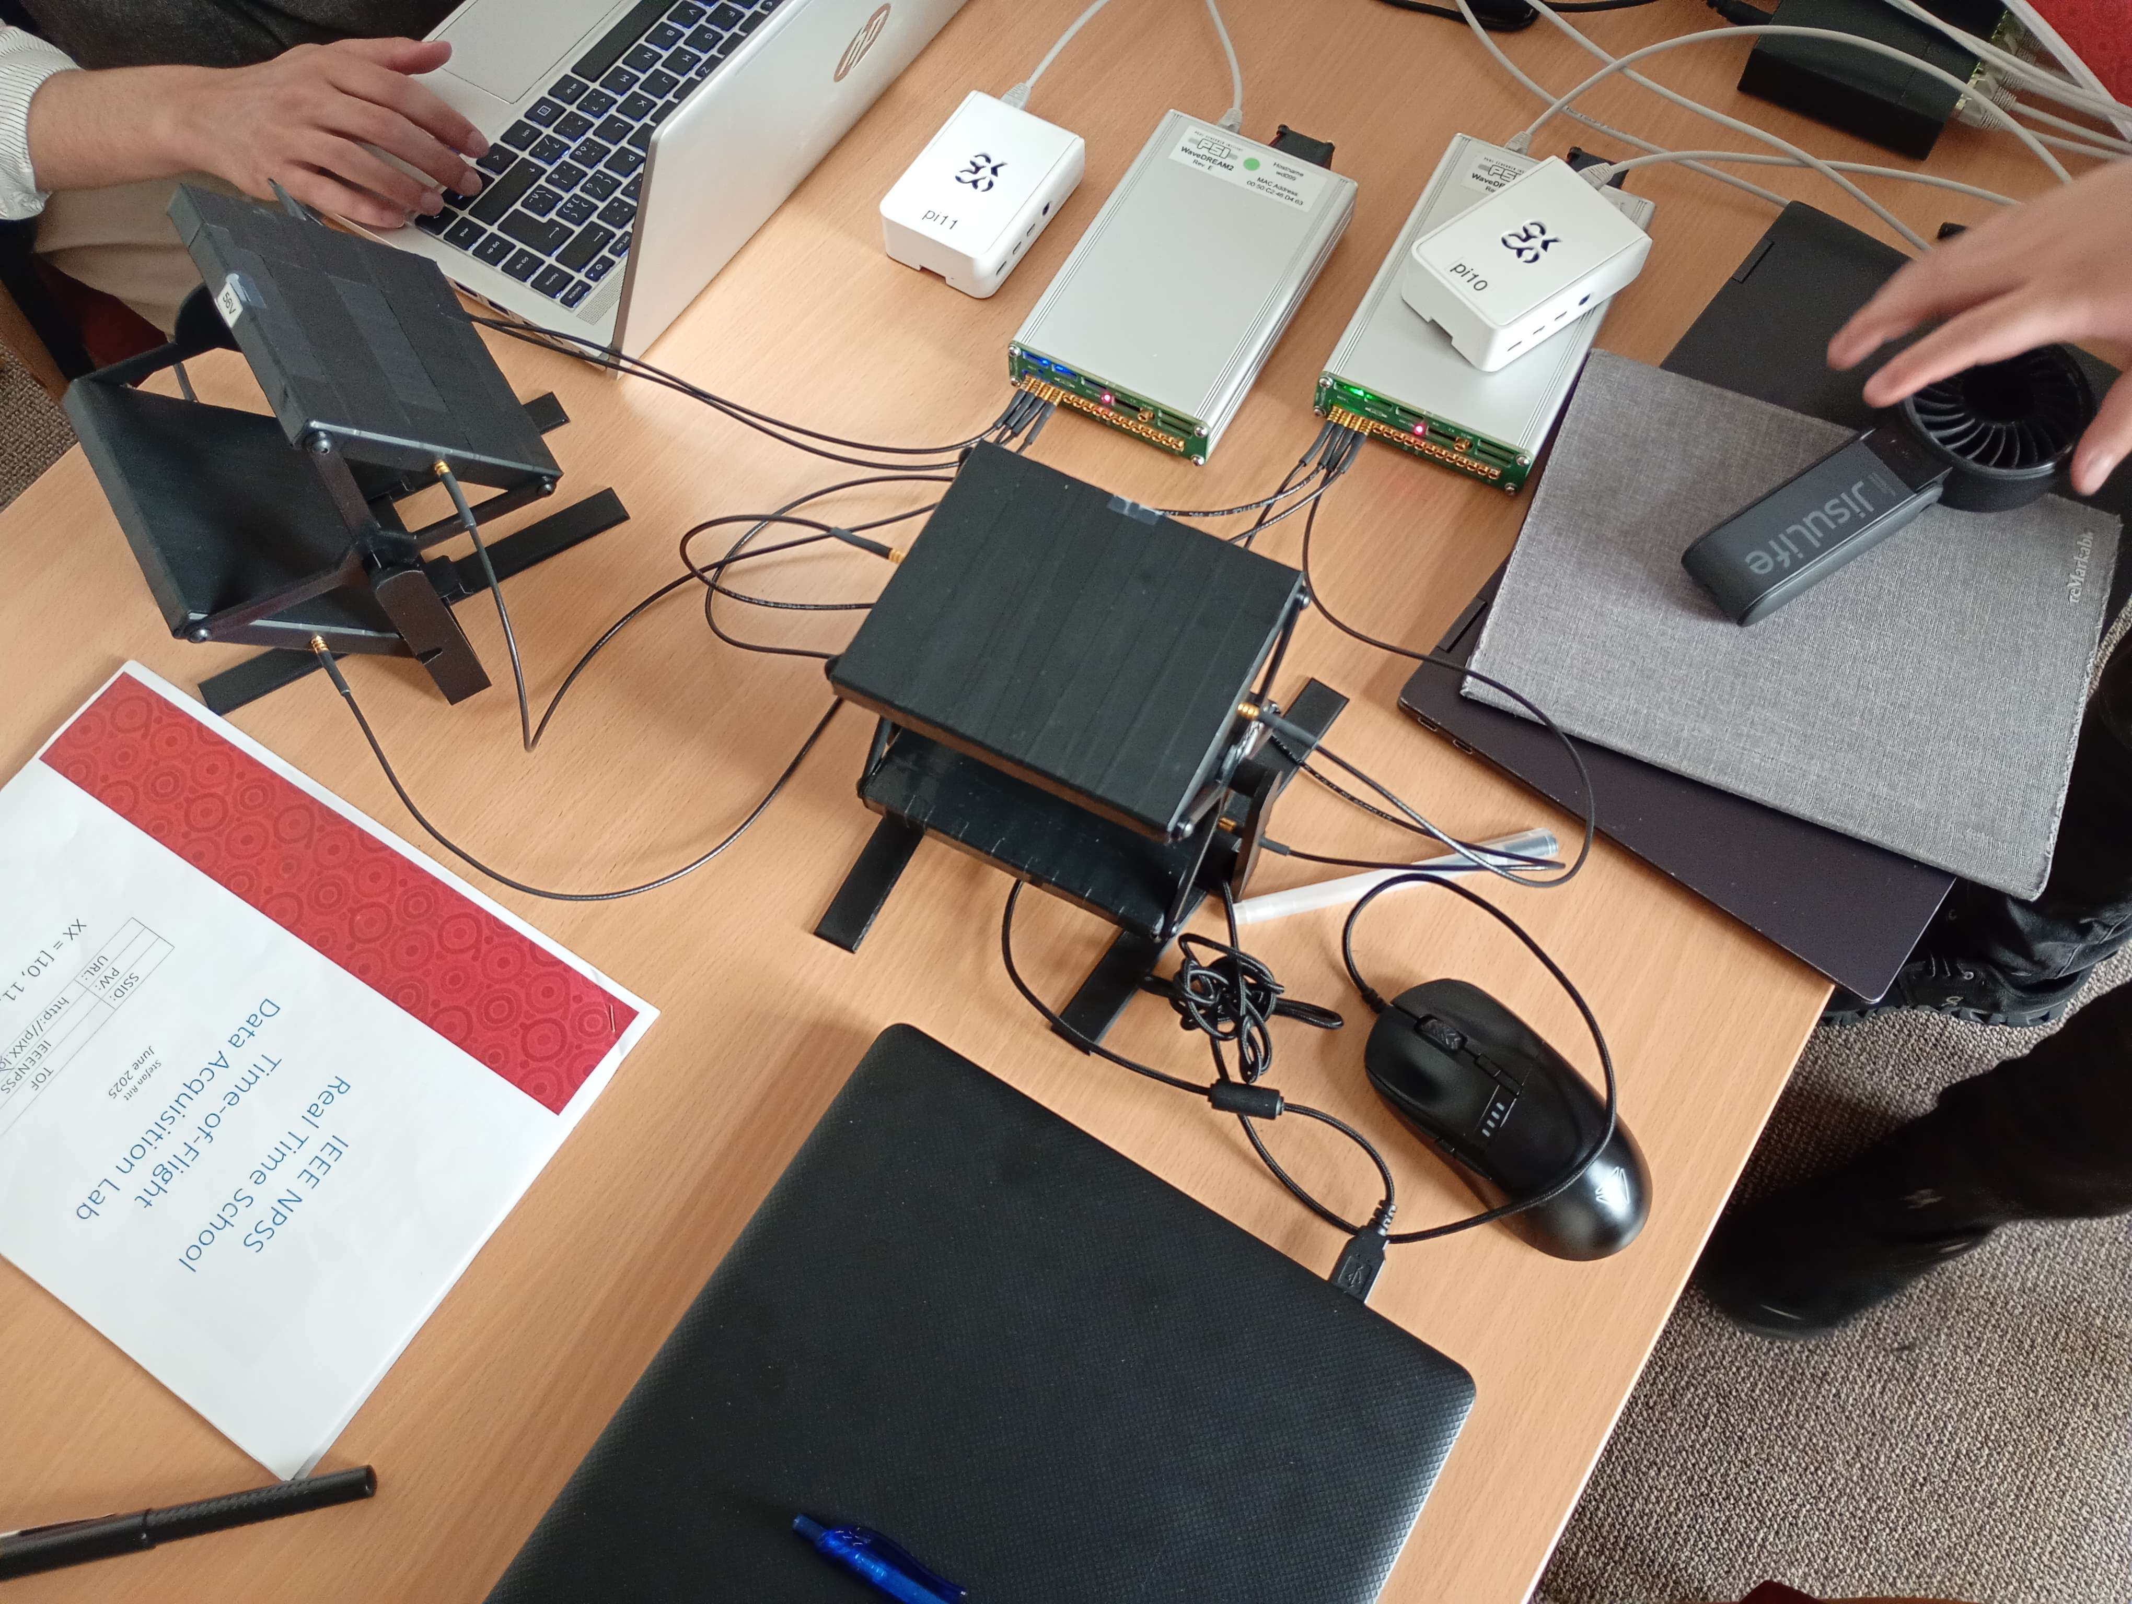
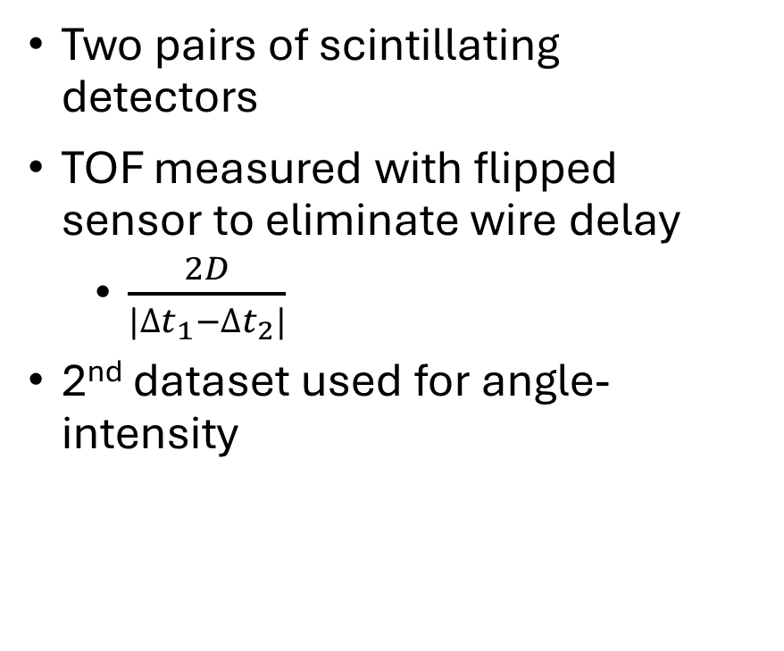
Measurement
Two pairs of scintillating detectors
TOF measured with flipped sensor to eliminate wire delay
  $\frac{2D}{|{∆t}_{1}−{∆t}_{2}|}$
2nd dataset used for angle-intensity
Measuring apparatus(Credit: Dan Theiss)
Notes:
Measurement was done:
- with two pairs of scintillating detectors 10 cm apart
-

Slide 4
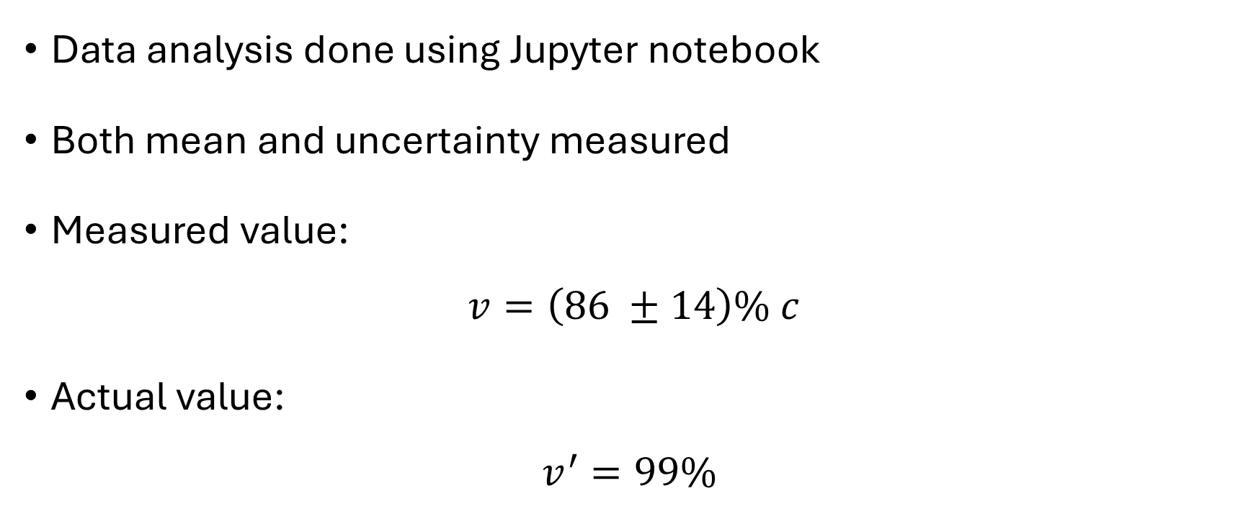
Results: Speed
Data analysis done using Jupyter notebook
Both mean and uncertainty measured
Measured value:
$$v=\left(86 ±14\right)\% c$$
Actual value:
$$v^{′}=99\%$$

Slide 5
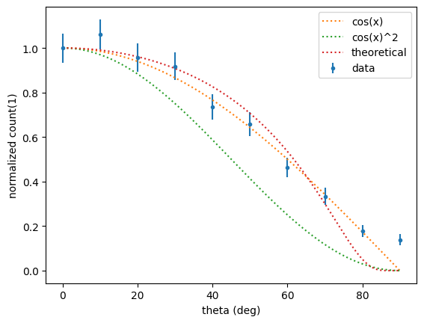
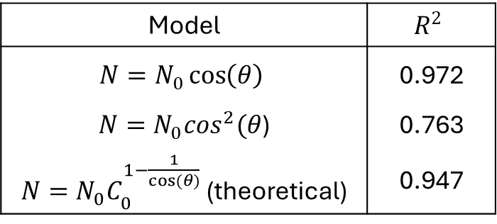
Results: Angle-Intensity
Noise assumed to be poissonian
Model | $$R^{2}$$
$$N=N_{0}\cos\left(θ\right)$$ | 0.972
$N=N_{0}\cos^{2}(θ$) | 0.763
$N=N_{0}C_{0}^{1−\frac{1}{cos⁡(θ)}}$ (theoretical) | 0.947

Slide 6
Sources
https://web.mit.edu/lululiu/Public/8.13/Muons/muons.pdf
https://cds.cern.ch/images/CMS-PHO-GEN-2017-008-1

Slide 7
Thank you for your attention

