Slide 1




PEISS 2025
Zhao-Ming Pan
Department of Nuclear Reactor
Faculty of Nuclear Science and Physical Engineering
Czech Technical University in Prague

Slide 2
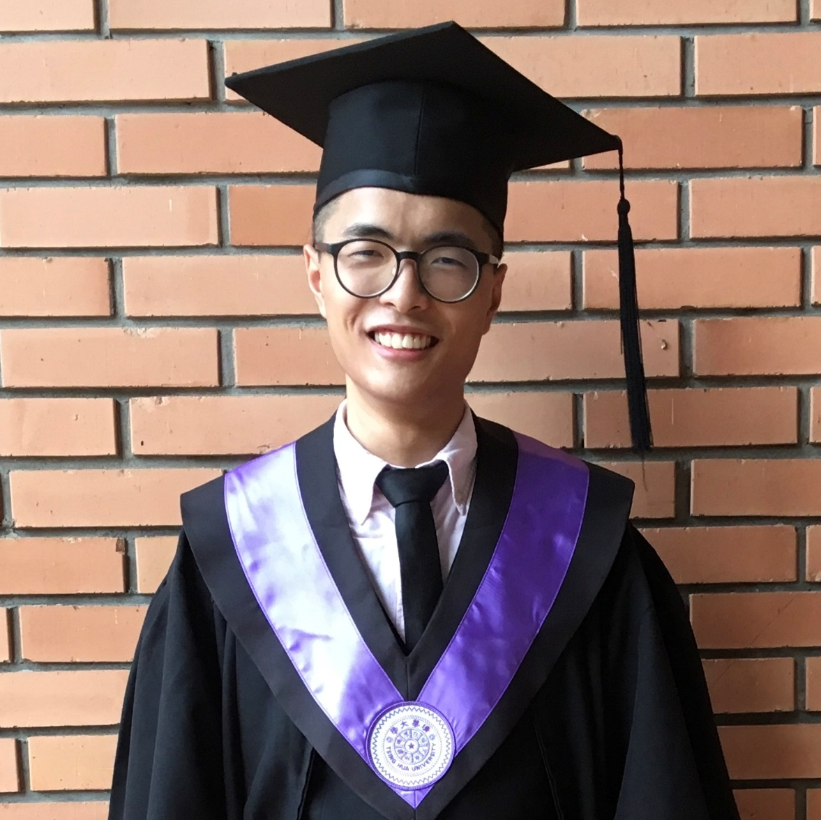

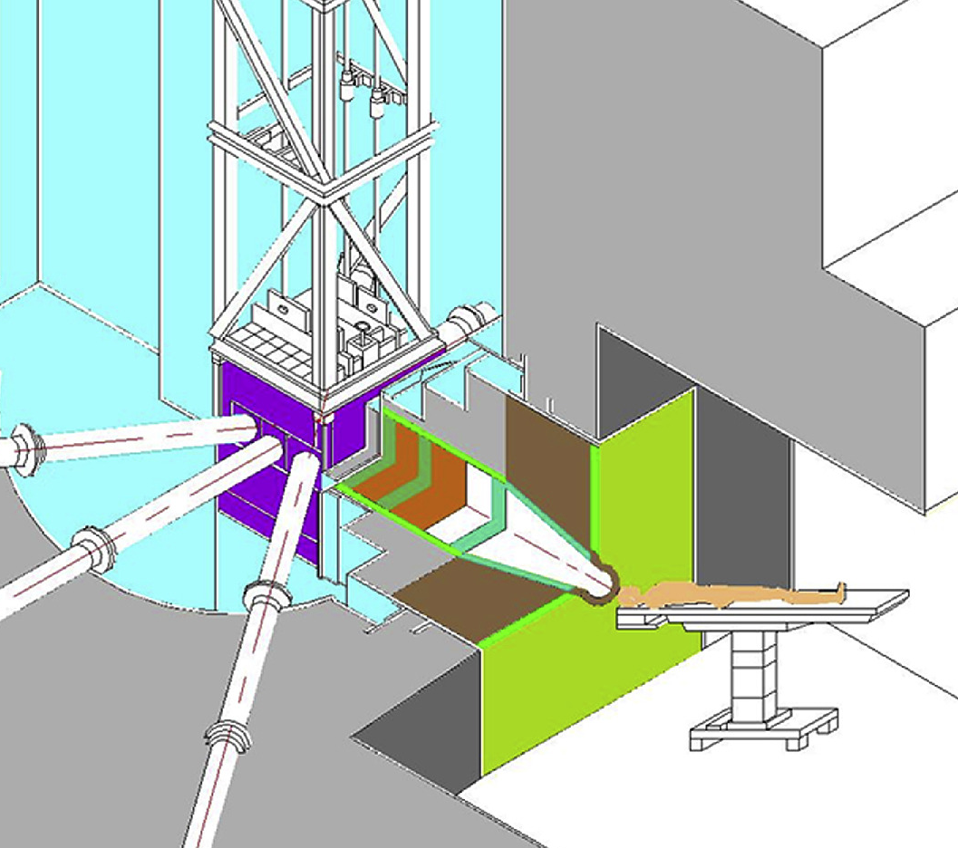

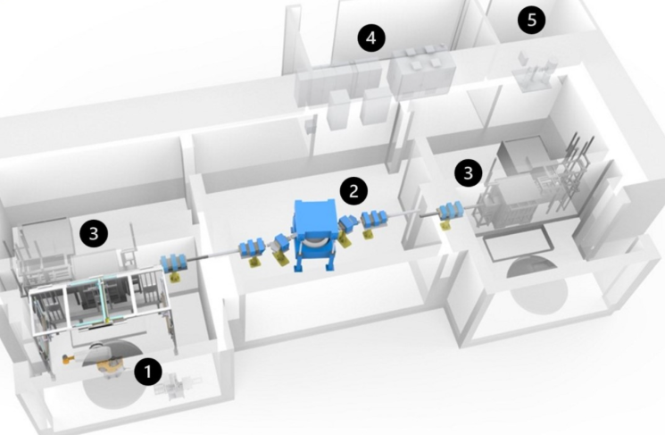
Zhao-Ming Pan
Born 1997, Taichung, Taiwan.
Interdisciplinary program in Nuclear Science, NTHU
Master in Nuclear Engineering and Science, NTHU
Private (artillery surveyor)
Nuclear Physics Engineer, Heron Neutron Medical Corp.
PhD student, Czech Technical University

Slide 3
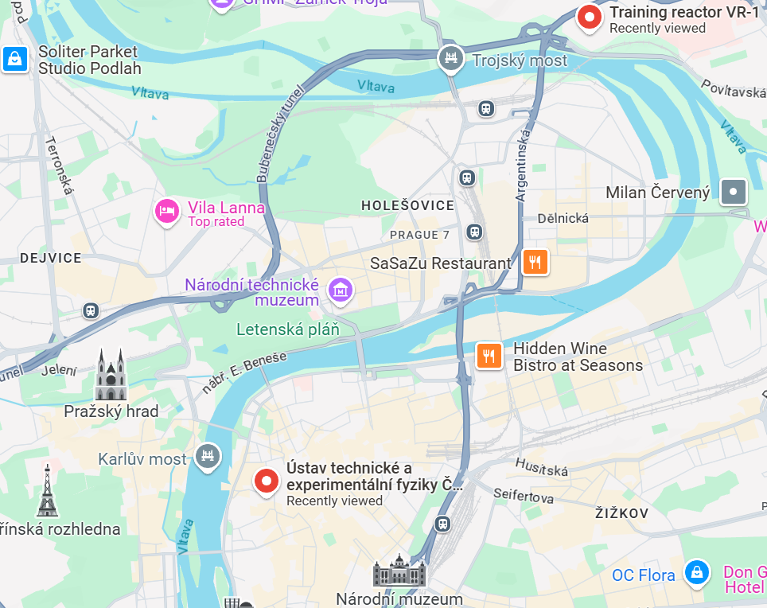

Slide 4


Slide 5
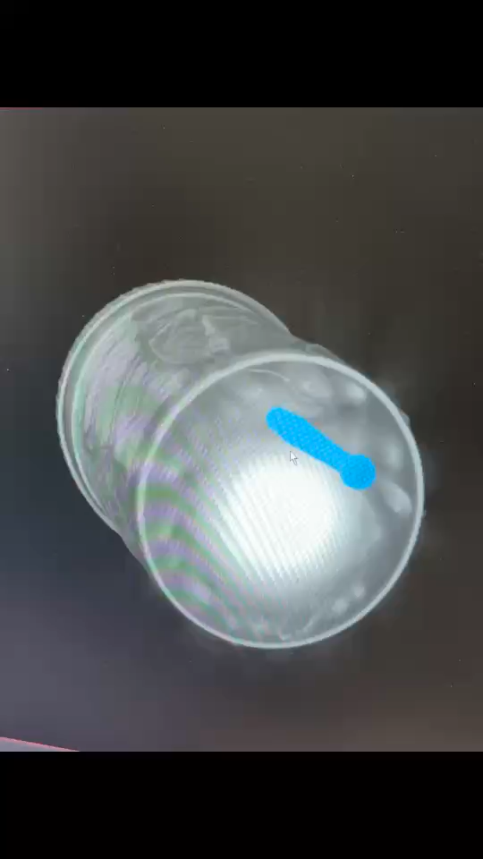
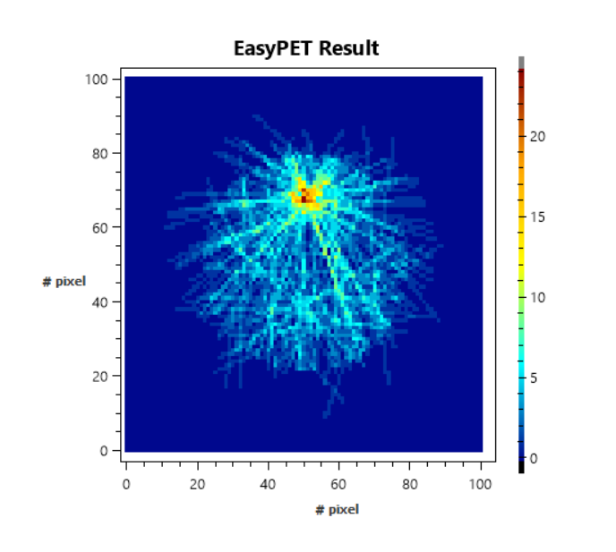
or

Slide 6


Slide 7



Slide 8
 | Active Bckg. | EK10 | natU | ES17
Total counts | 1852 | 6220 | 4716 | 2440
Counts per cycle measured | 1.436E-2 ± 2.32% | 4.527E-2 ± 1.27% | 3.557E-2 ± 1.46% | 1.865E-2 ± 2.02%
Net counts per cycle measured | --- | 3.091E-2 ± 2.15% | 2.121E-2 ± 2.90% | 4.298E-3 ± 11.72%

Slide 9


THANK YOU FOR YOUR ATTENTION

