Slide 1
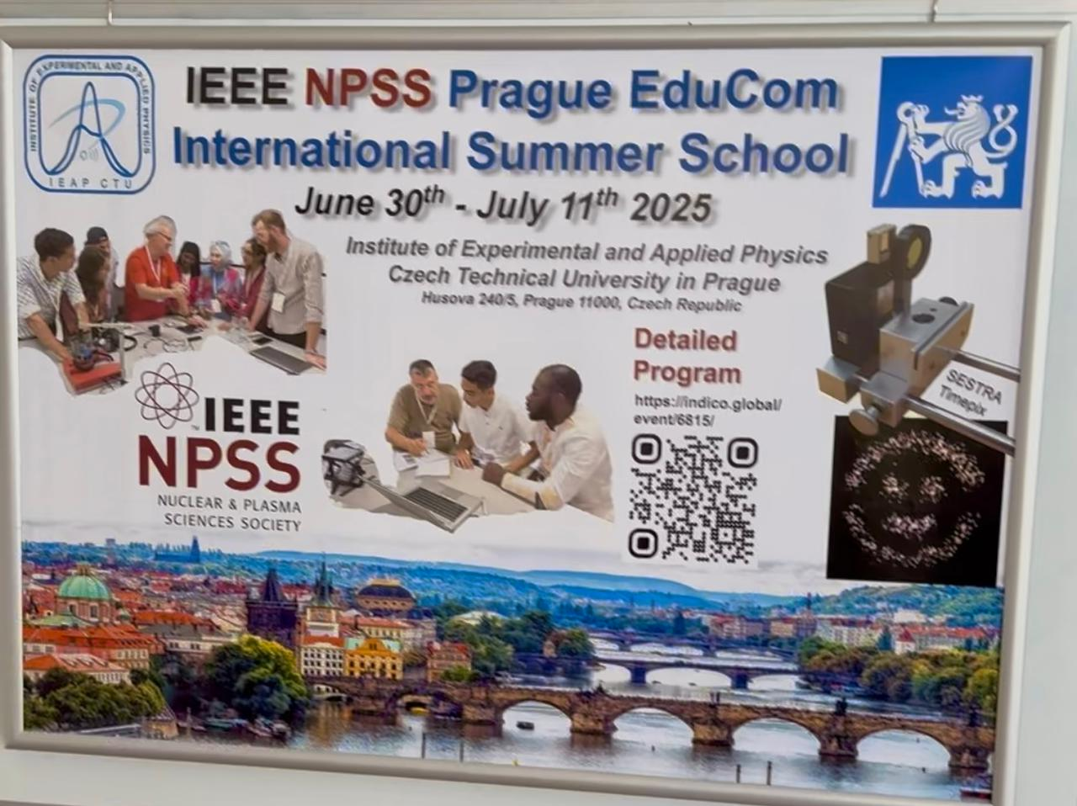
Hi, I'm Yasin Efendiyev.
This summer, I took part in a really interesting summer school program. One of the main things we did was measure radiation levels in our local area.Together with a small group, we went to 15 different spots to check the background radiation and see how it changes from place to place. It was my first time doing something like this — and it turned out to be a great experience!

Slide 2
Here’s what our project looked like:
We learned how to use a dosimeter properly;
Picked 15 points in one area to take measurements;
Went to each point and recorded the radiation levels;
Compared all the numbers and calculated the average.
It was like doing real scientific work — outside the classroom, with actual tools in our hands.

Slide 3
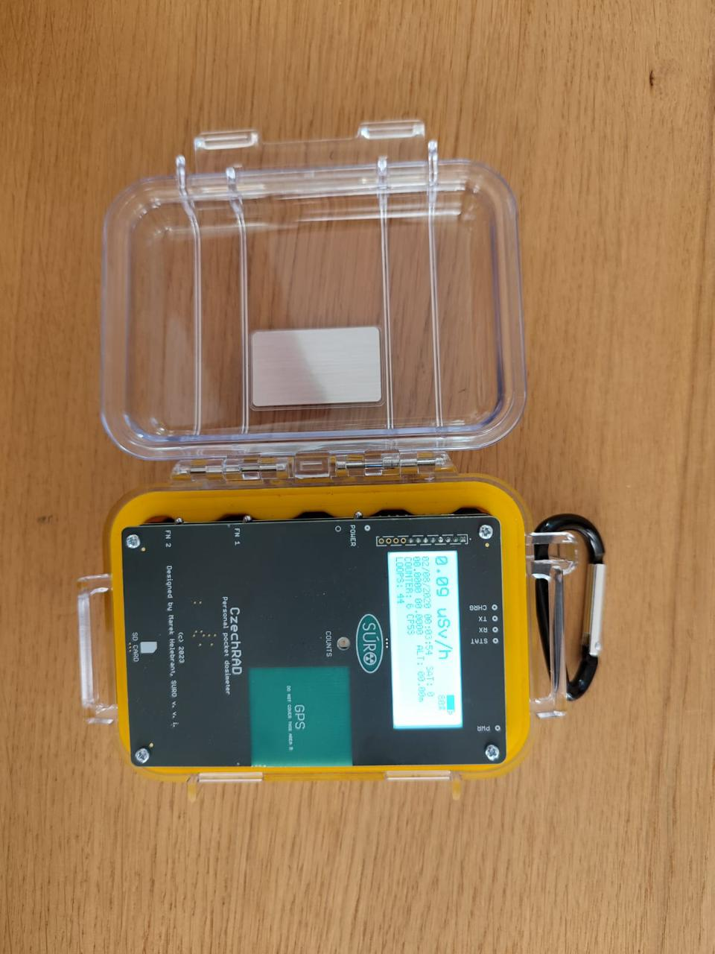
Through this project, I learned such things as:
I figured out how radiation is measured and what’s considered normal;
I got hands-on experience with equipment;
I improved my teamwork skills and learned how to plan fieldwork;
I also saw how important it is to look at data carefully and draw conclusions from it.
It wasn’t just theory — it was something I did myself, and that made it so much more memorable.

Slide 4
This project helped me in a few big ways:
It made me realize how science is all around us — even in things we don’t usually think about, like background radiation;
I got a real sense of how scientists work in the field;
I became more careful and responsible with data and equipment;
And I just felt more confident doing something completely new.
It was exciting to be part of something meaningful and actually useful.

Slide 5
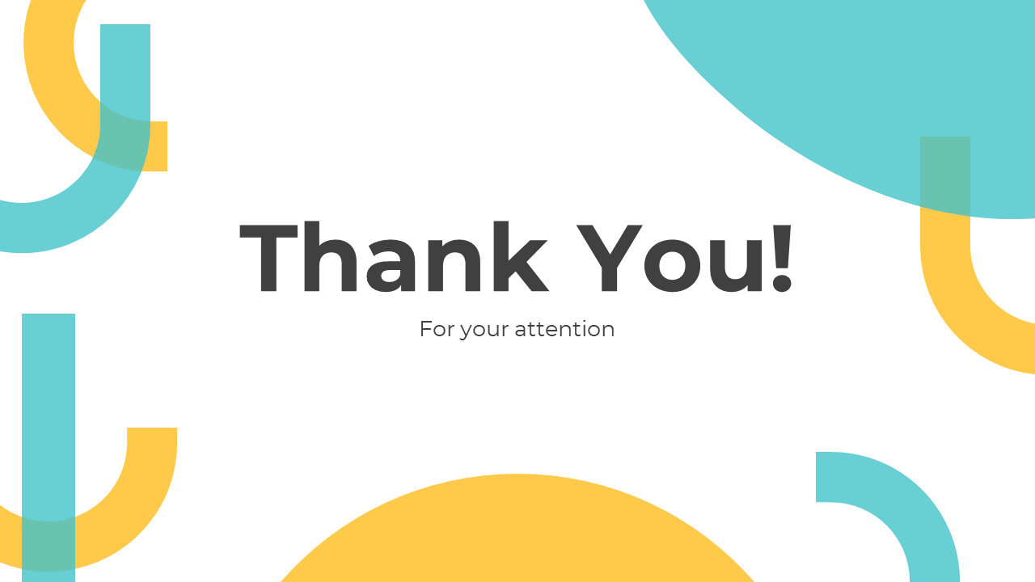
I just want to say a big thank you to the organizers of the summer school.Thanks for putting this together, for teaching us, supporting us, and giving us the chance to try real research. I learned a lot — and I really enjoyed it. Sincerely, Yasin Efendiyev

