Slide 1
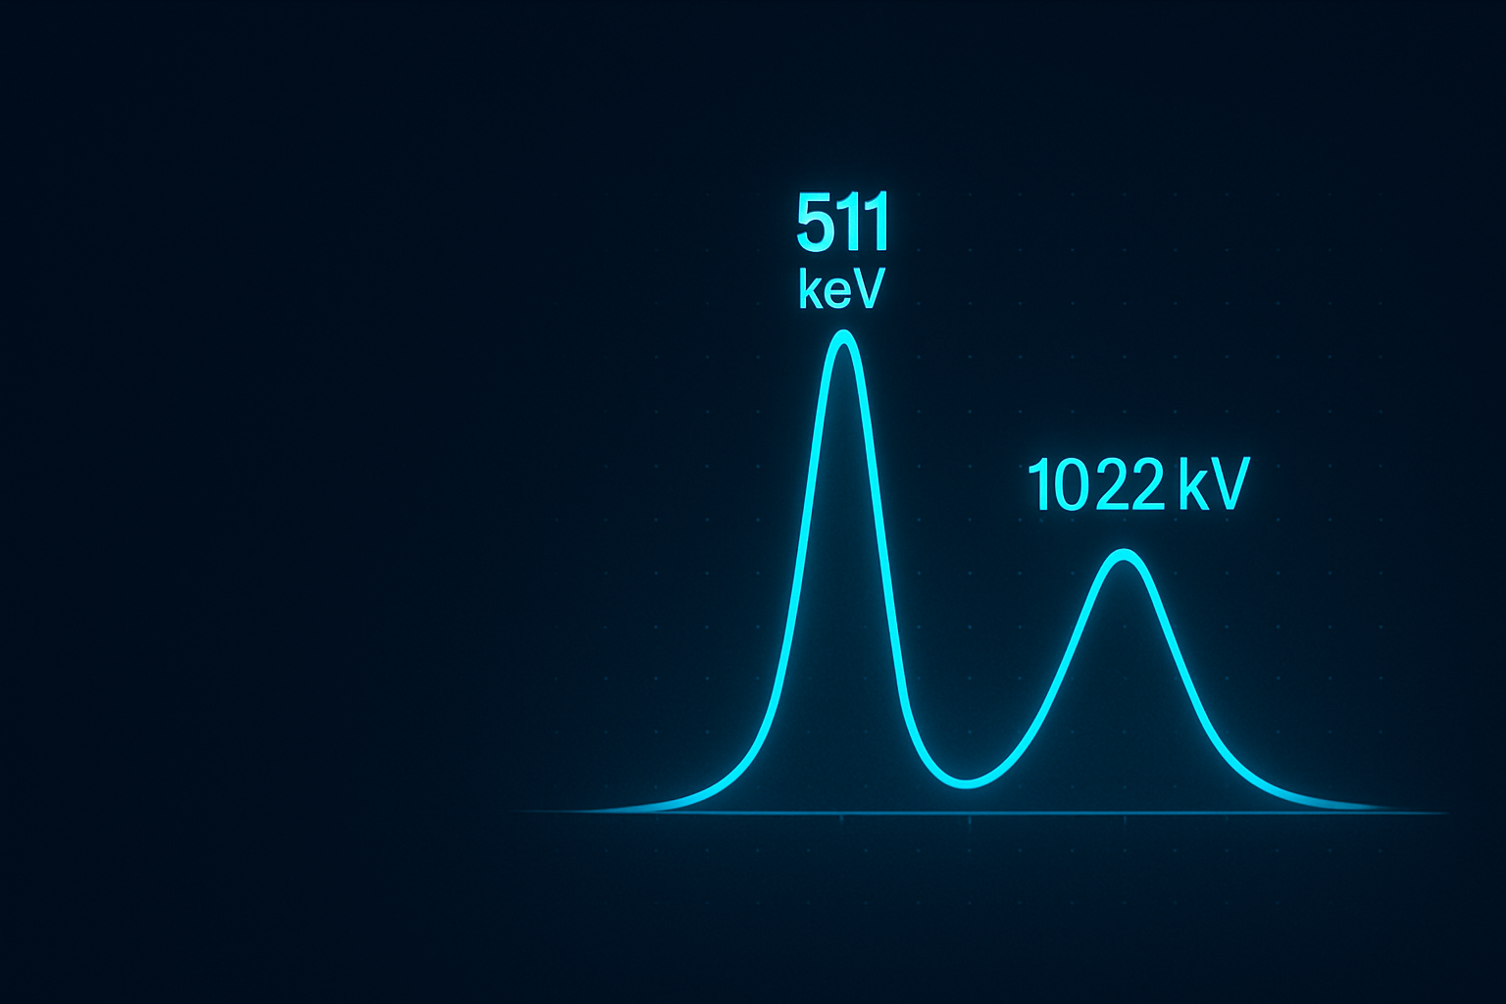
Gamma Spectrometry
Bugaescu Valentin
Physics and Chemistry Lab Assistant
Nuclear Forensis Laboratory
Horia Hulubei National Institute for R&D in Physics and Nuclear Engineering, IFIN-HH
+40790572639

Slide 2

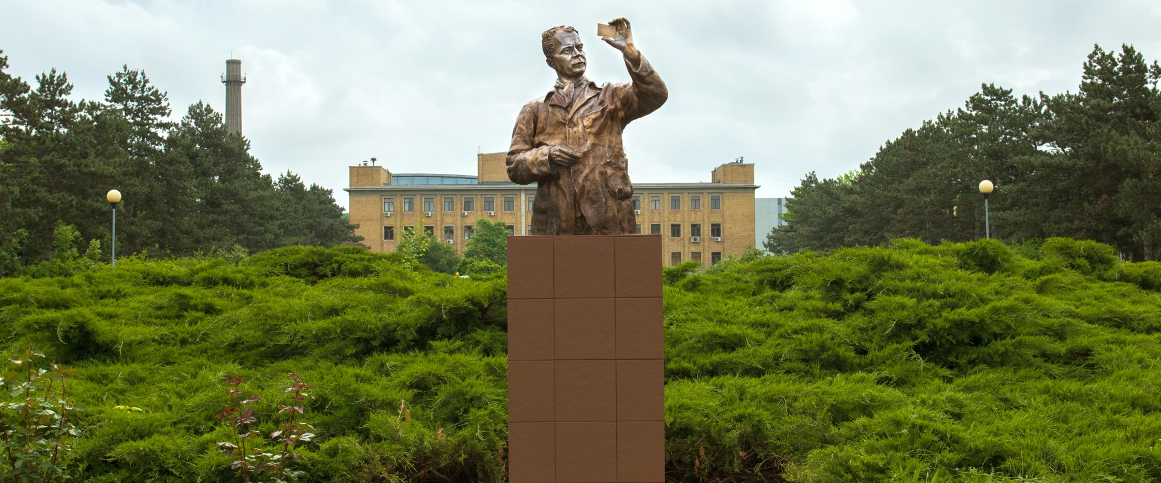
IFIN-HH (Horia Hulubei National Institute for R&D in Physics and Nuclear Engineering)

Slide 3
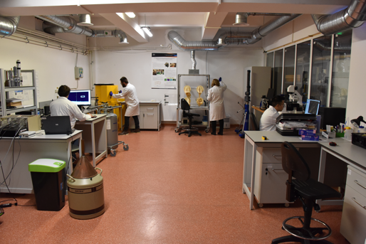
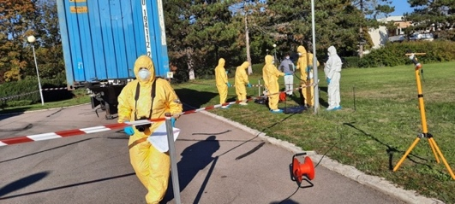
NFL-RO
Contact: nflro@nipne.ro

Slide 4
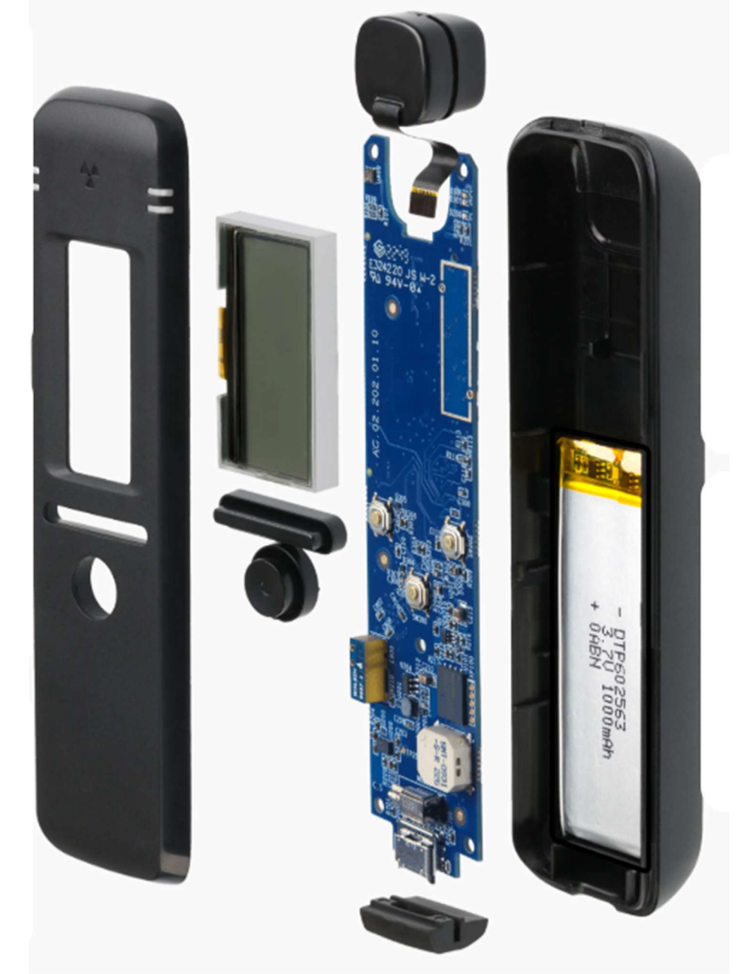
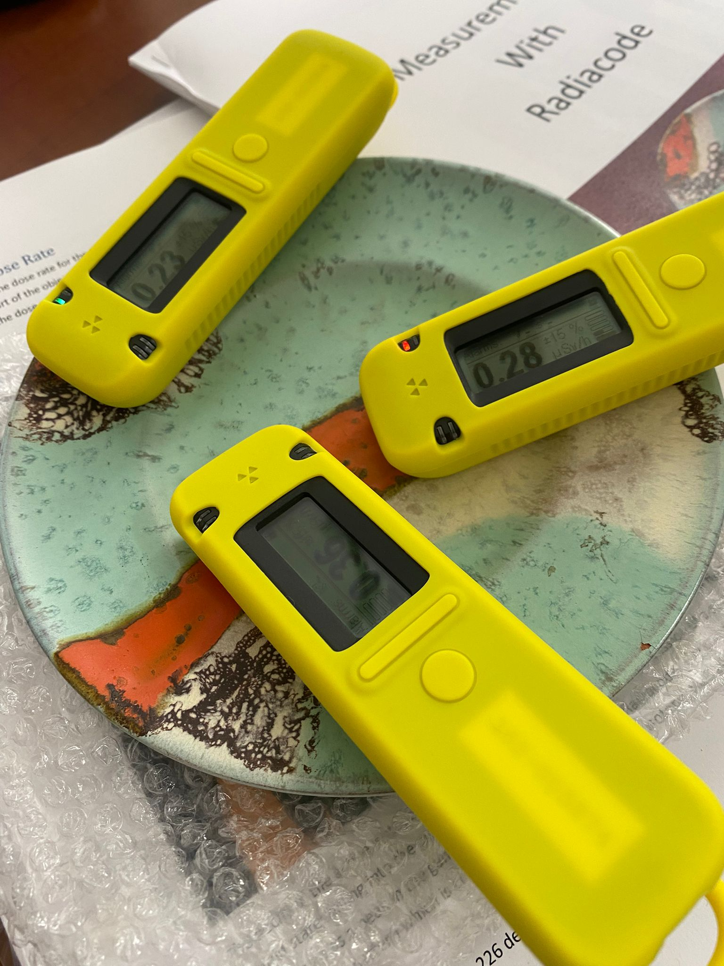
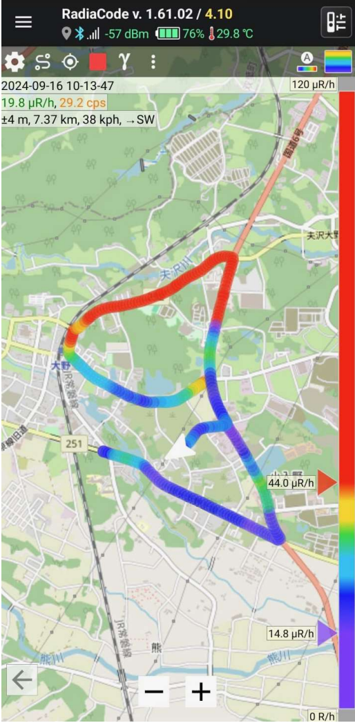
RadiaCode dosimeter

Slide 5
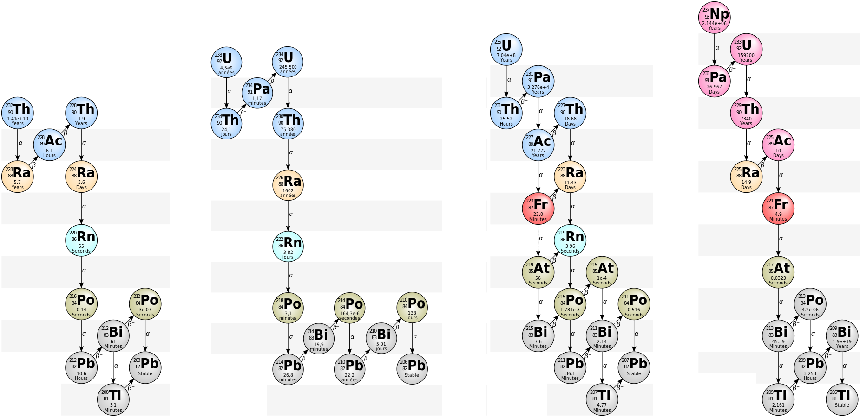
Decay-chain

Slide 6
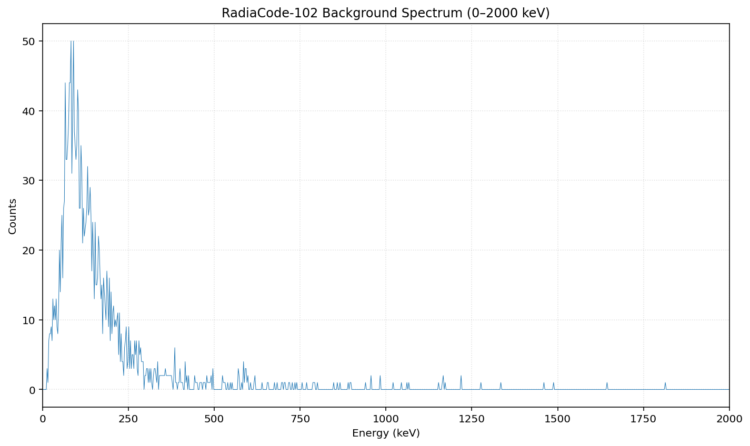
Background spectrum ( 02.07.2025)
Time of measurement: 5 min

Slide 7
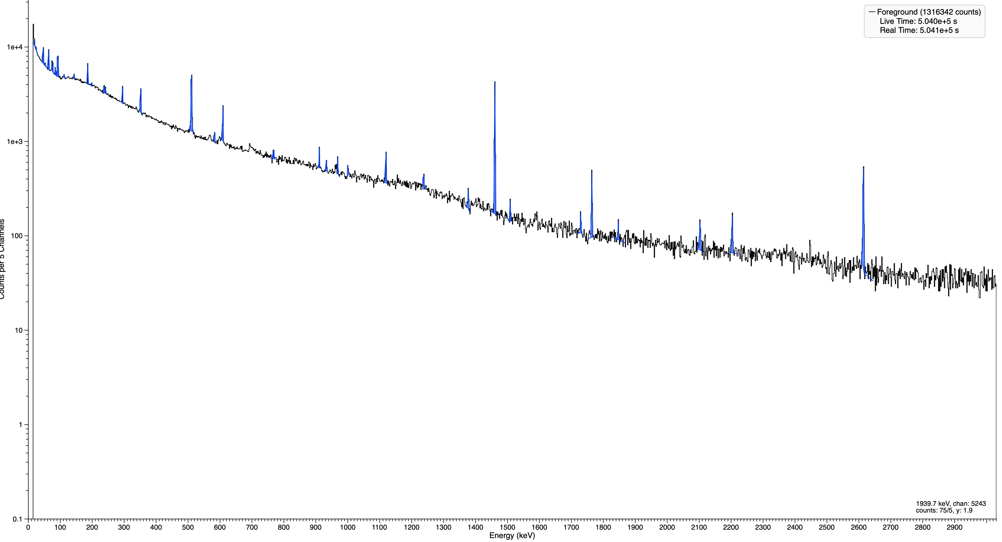
REAL Background spectra

Slide 8
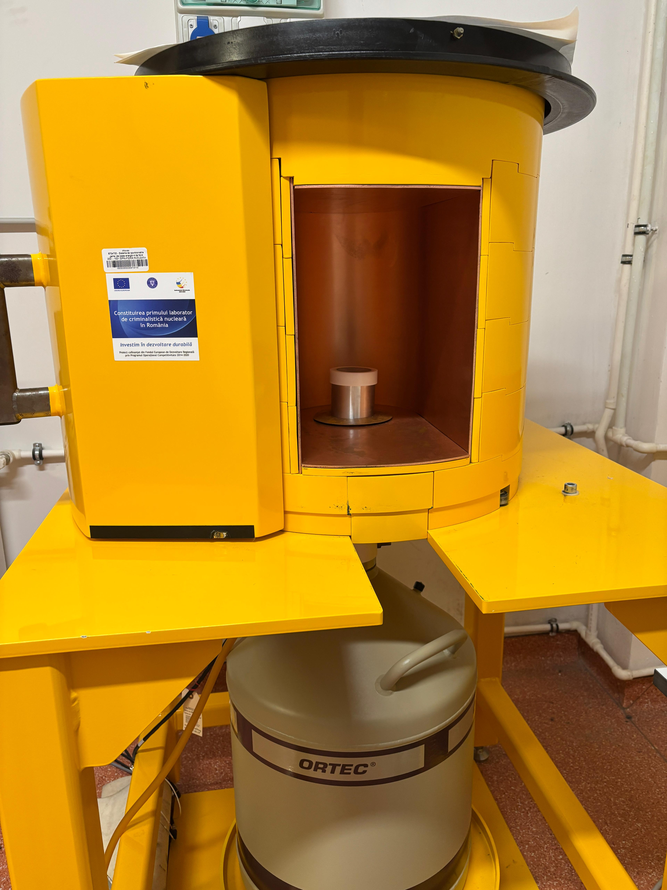
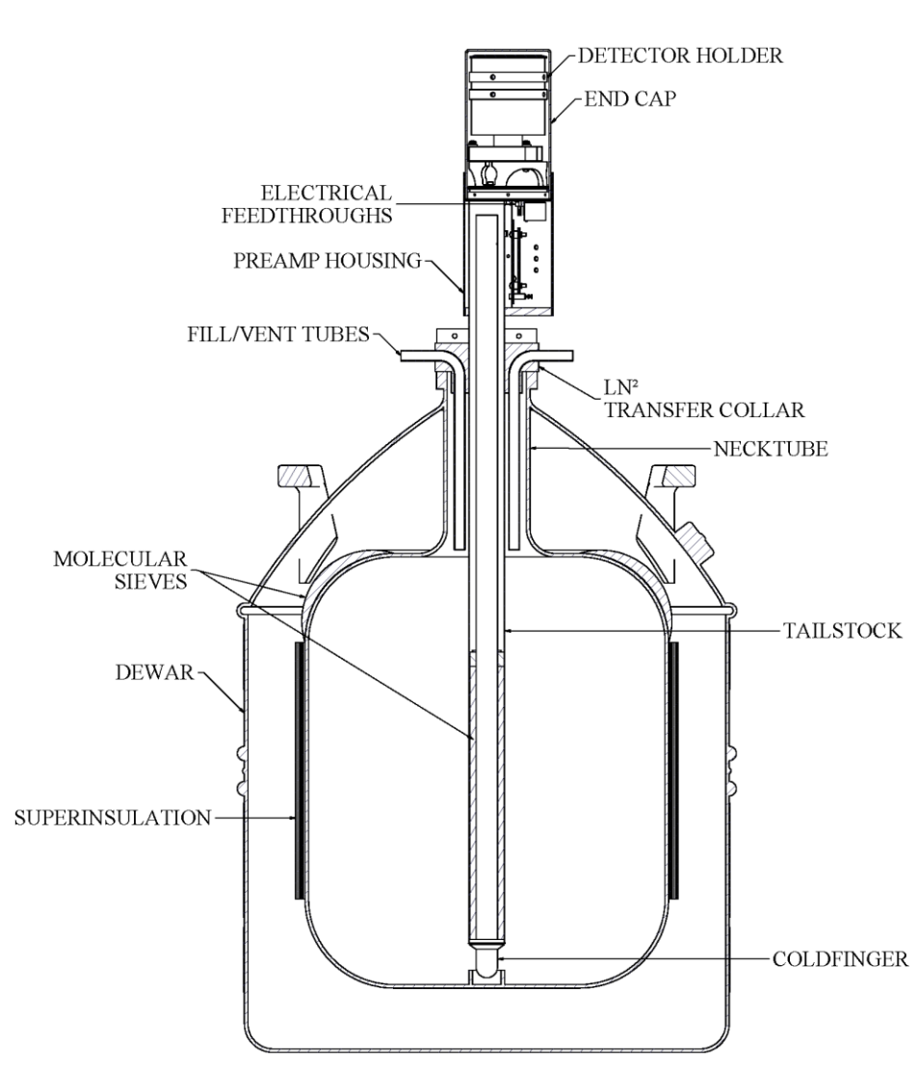
HPGe – High-Purity Germanium Detector
Image: Mirion Technologies (Canberra) Inc., Germanium Detectors User’s Manual, Rev. G, Doc. No. 9231358G, 2017.

Slide 9
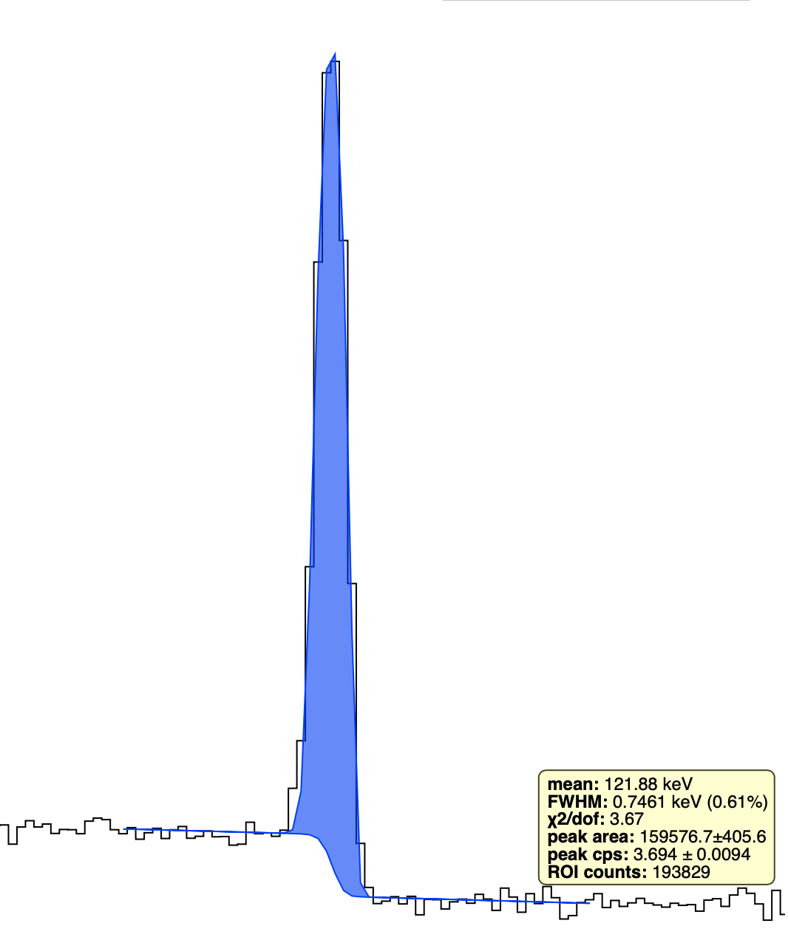
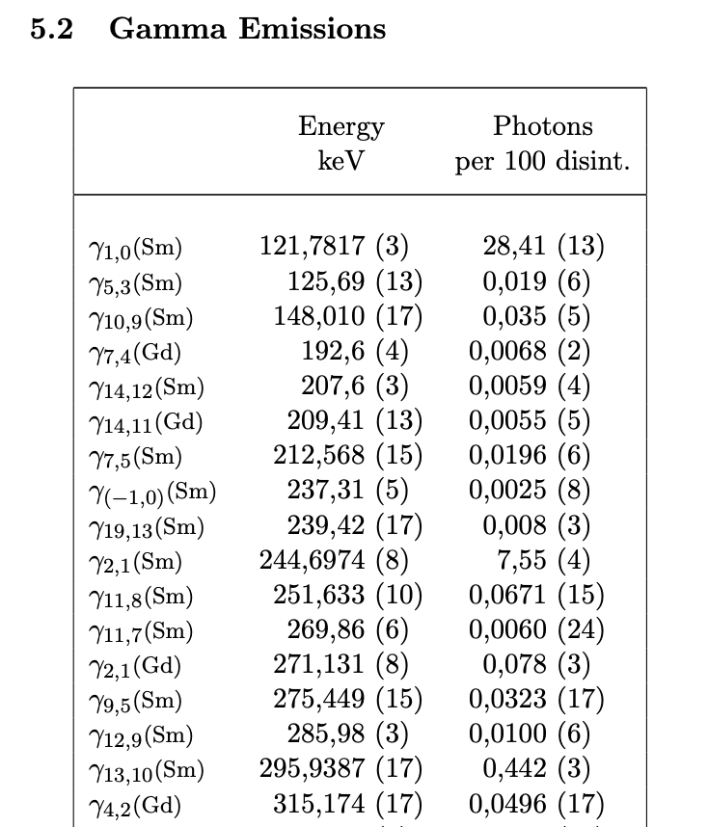
Data analysis

Slide 10
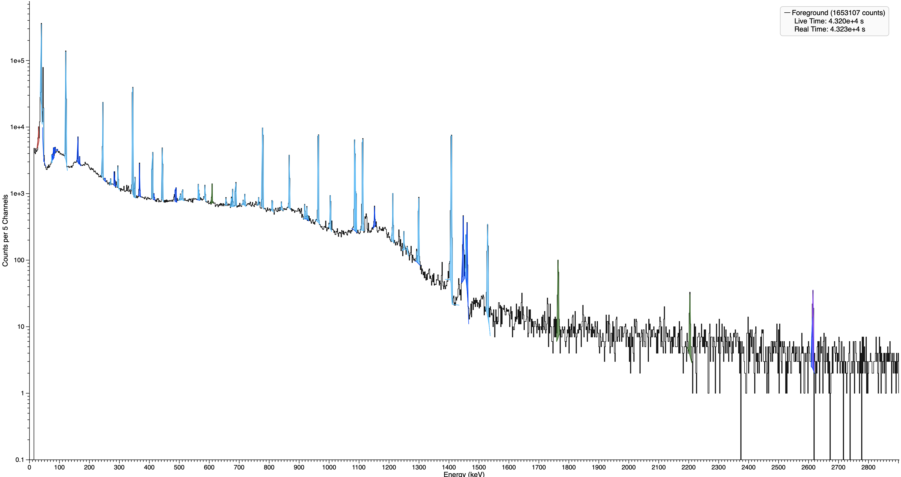

Eu-152 Spectrum

Slide 11
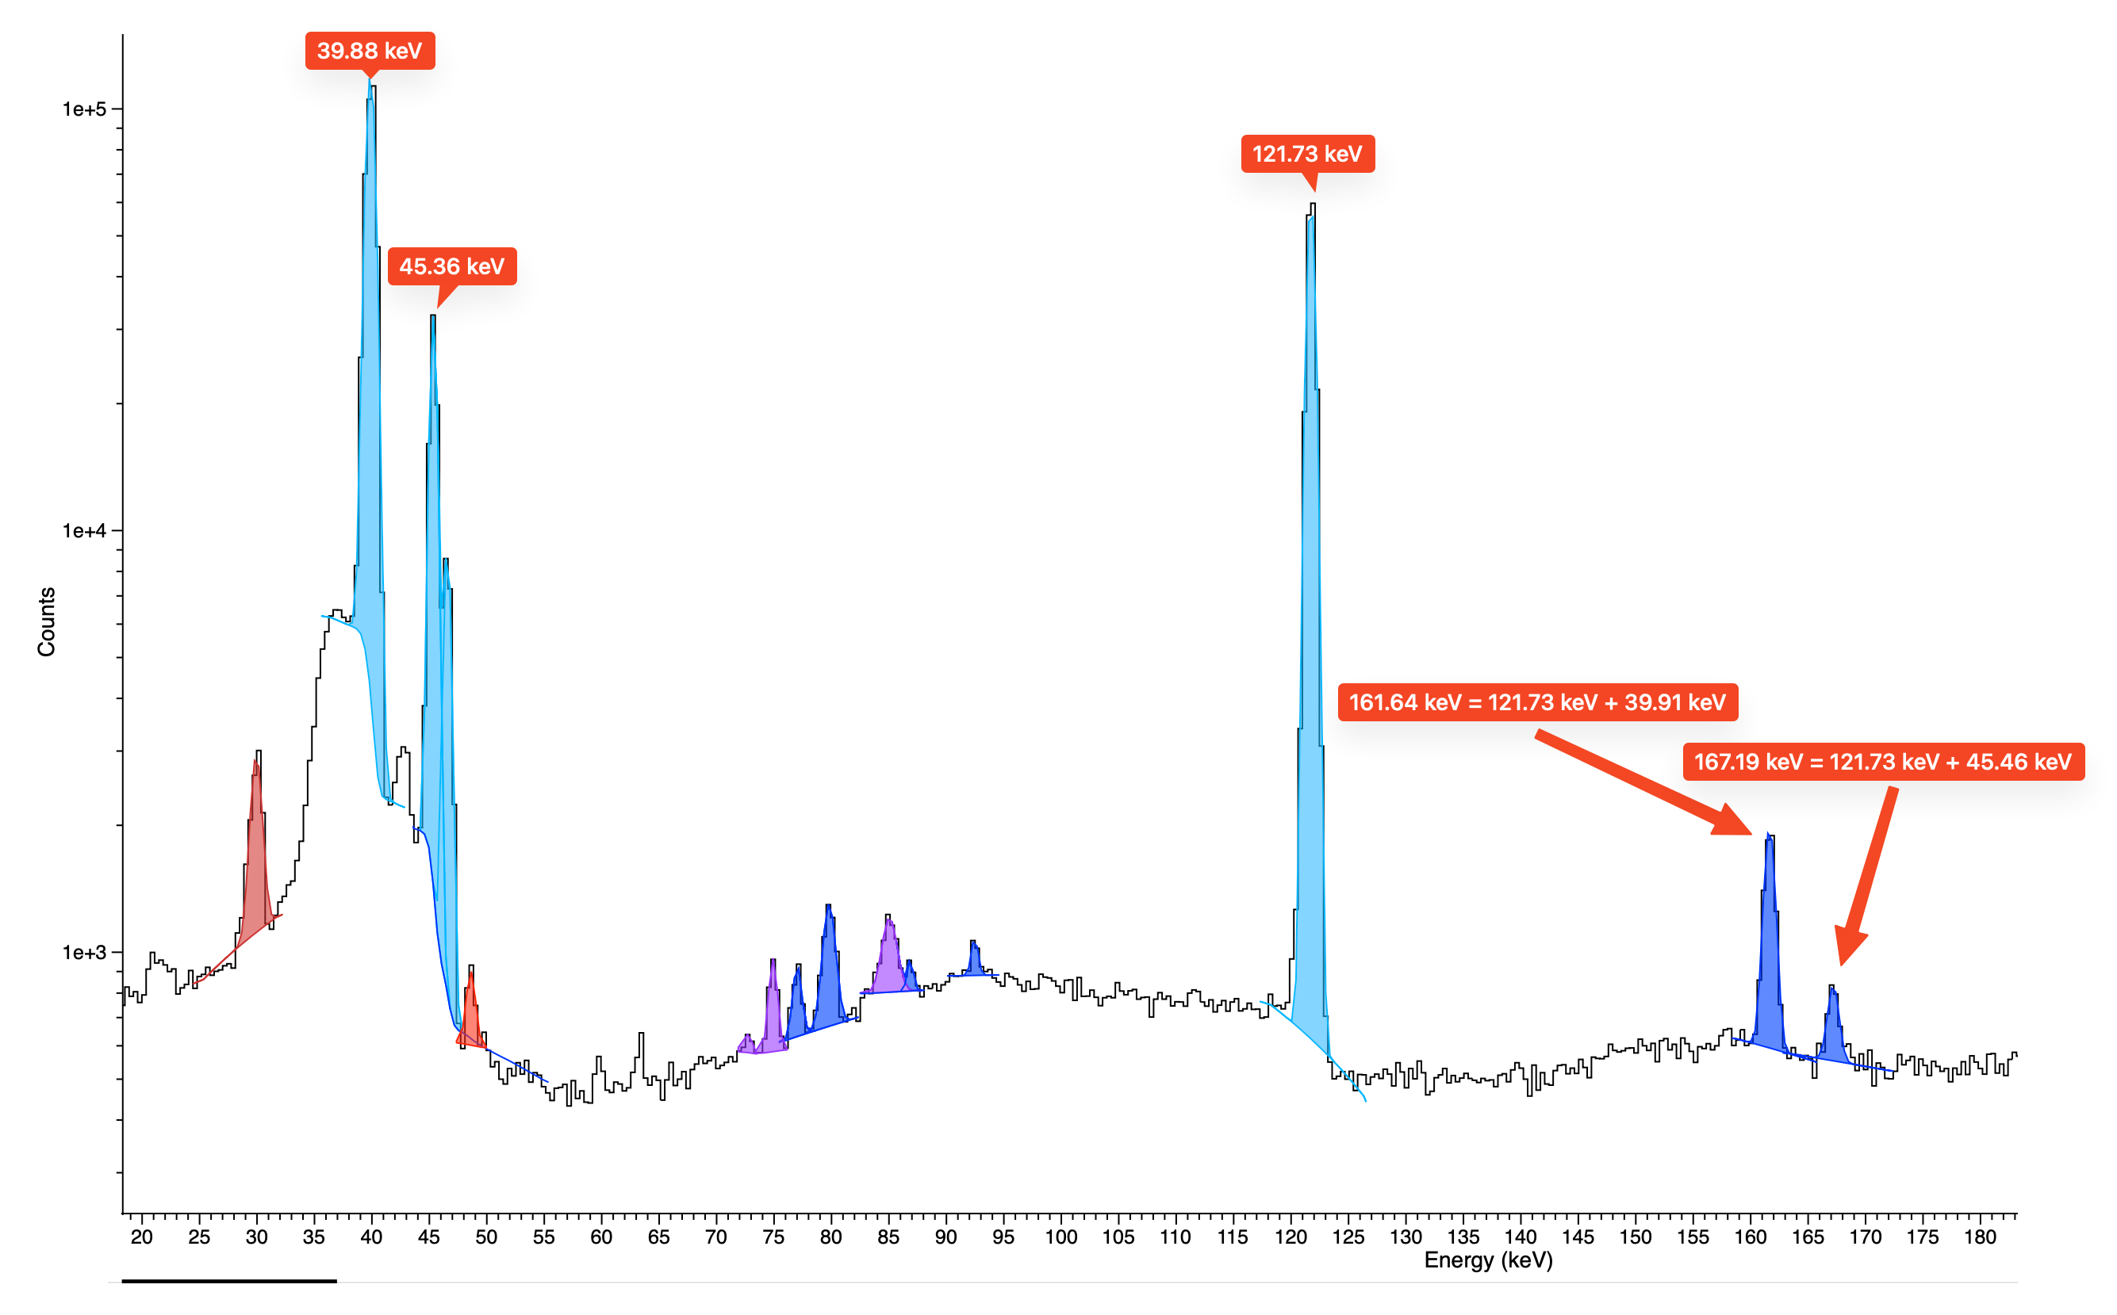
Summing peaks in γ-ray spectrometry

Slide 12
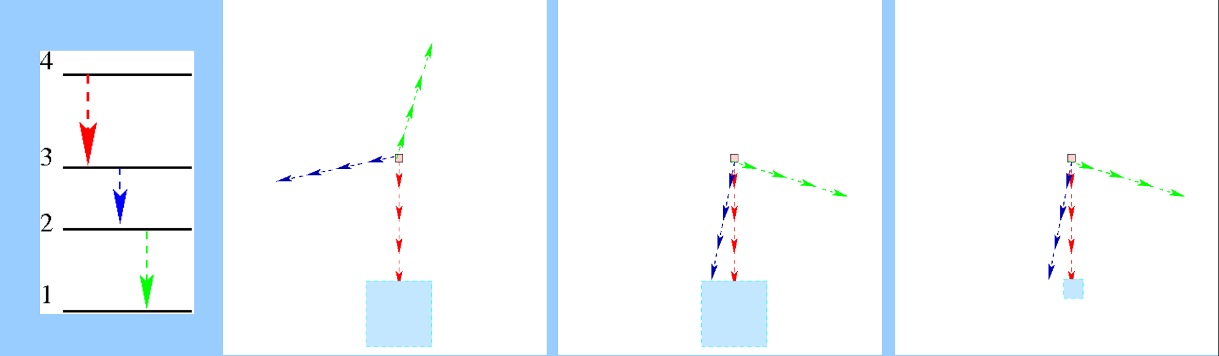
True Coincidences
Image: O. Sima, “Coincidence Summing,” lecture notes, ICRM Gamma-Spectrometry Working Group training course, Laboratoire National Henri Becquerel, 2018.

Slide 13
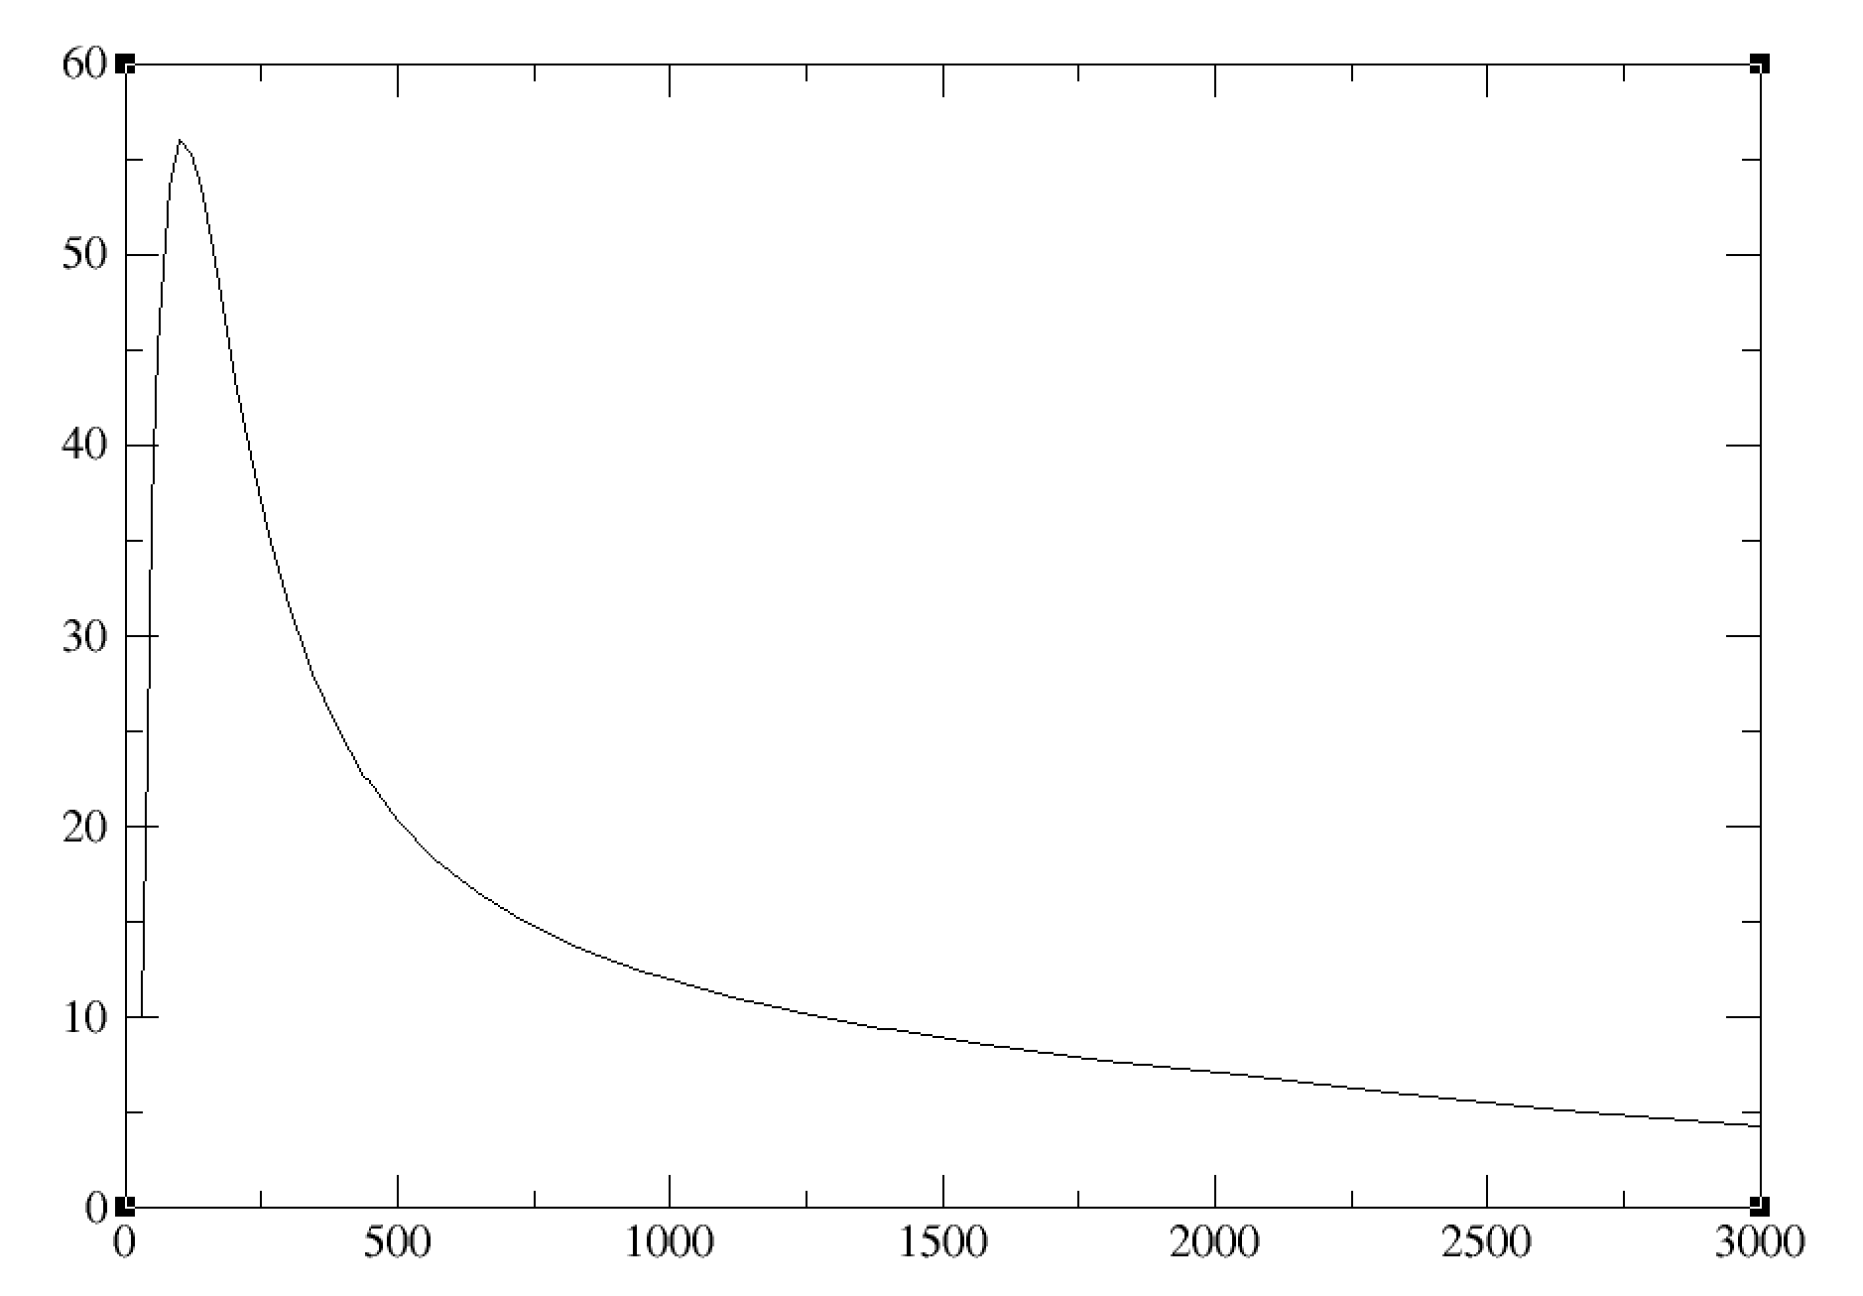
Detector intrinsic efficiency

Slide 14
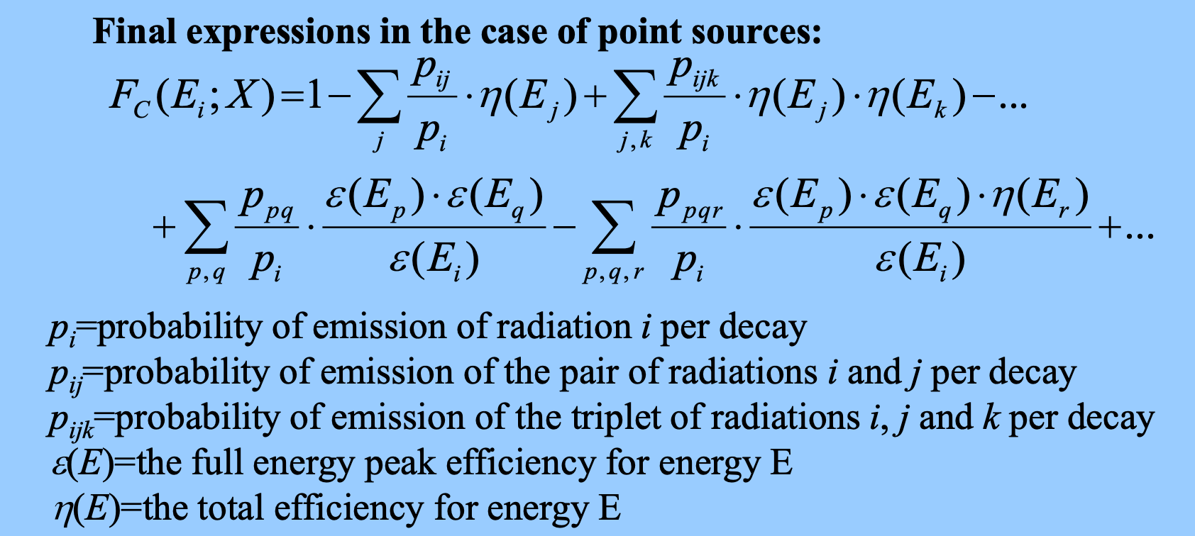

Coincidence-summing correction factor
Image: O. Sima, “Coincidence Summing,” lecture notes, ICRM Gamma-Spectrometry Working Group training course, Laboratoire National Henri Becquerel, 2018.

Slide 15
Conclusion
γ-Spectrometry: High Reward, High Rigor
Thank you for your attention!

