Slide 1
IEEE NPSS 2025 – My Summer School Journey
Sayed El Moutaouakel Berghout
MSc Applied Physics – University of Bologna
Group 3b | CPFA Ambassador

Slide 2
Introduction – Why I Applied
• Master's student in Applied Physics at the University of Bologna
• Interested in detectors, imaging, and medical applications
• PEISS 2025 was a chance to gain hands-on experience
• I wanted to learn in an international, collaborative environment

Slide 3
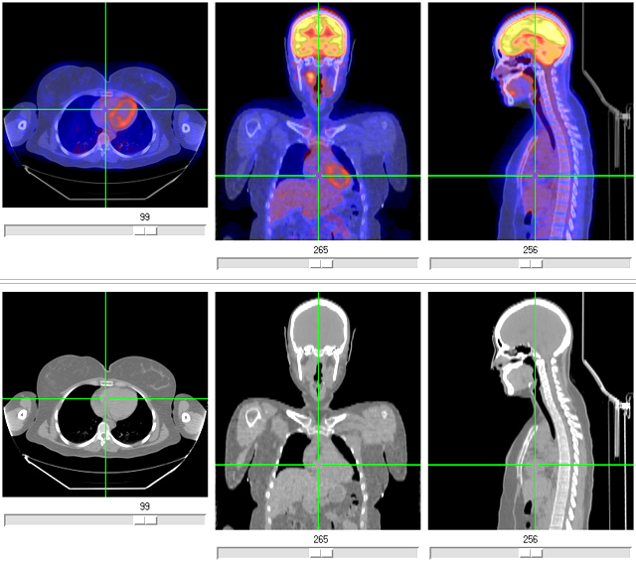
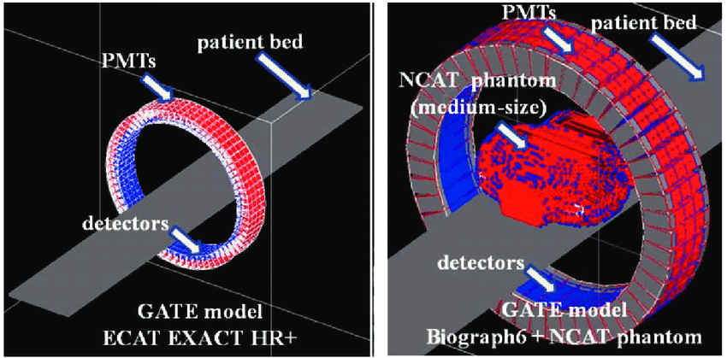
Key Labs and Topics Explored
• PET Lab – Understanding positron annihilation and detectors
• GATE Simulation – Modeling imaging systems
• Time-of-Flight – Precision in timing and distance
• Photon Counting – Advanced detection methods

Slide 4
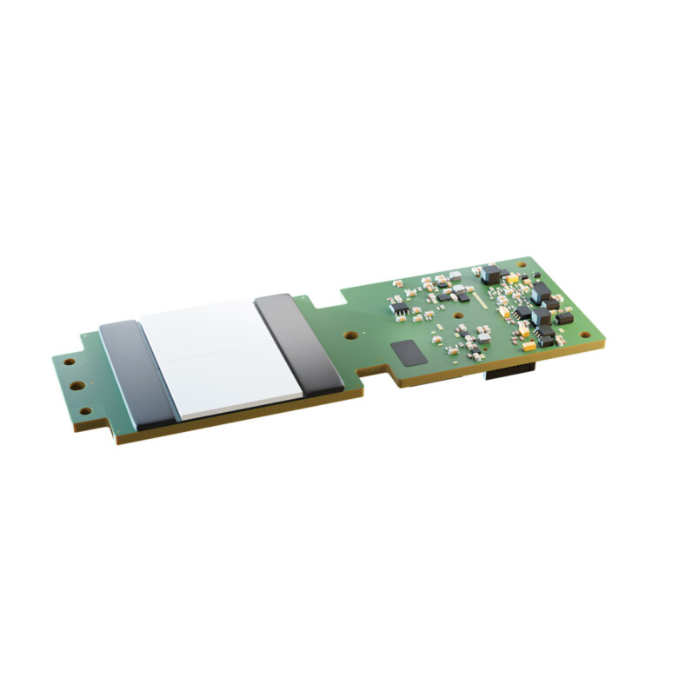
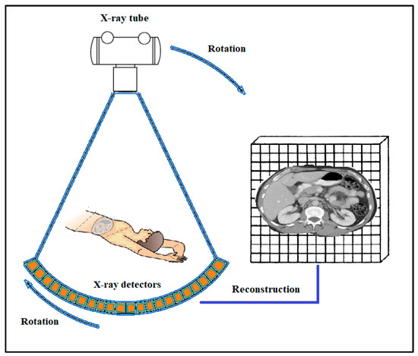
What I Gained
• Practical knowledge of detectors and simulation tools
• Improved understanding of medical imaging physics
• Teamwork with international students
• Confidence and insight into future research directions

Slide 5
Sharing the Experience
• As a CPFA Ambassador, I documented the school with photos
• I will share the experience with students and professors in Italy
• This program will inspire others to engage in hands-on learning

Slide 6
Why I Couldn't Present Live
• I had a cold and sore throat, and my voice was affected
• It was my first time preparing a full scientific presentation
• I preferred to submit this final presentation in writing
• Thank you for understanding and your kind support

Slide 7
Thank You!
• Thank you to Mr. Martin, the organizers, and all lecturers
• I’m grateful for the labs, discussions, and friendships formed
• This experience was truly inspiring
– Sayed El Moutaouakel Berghout

