Slide 1
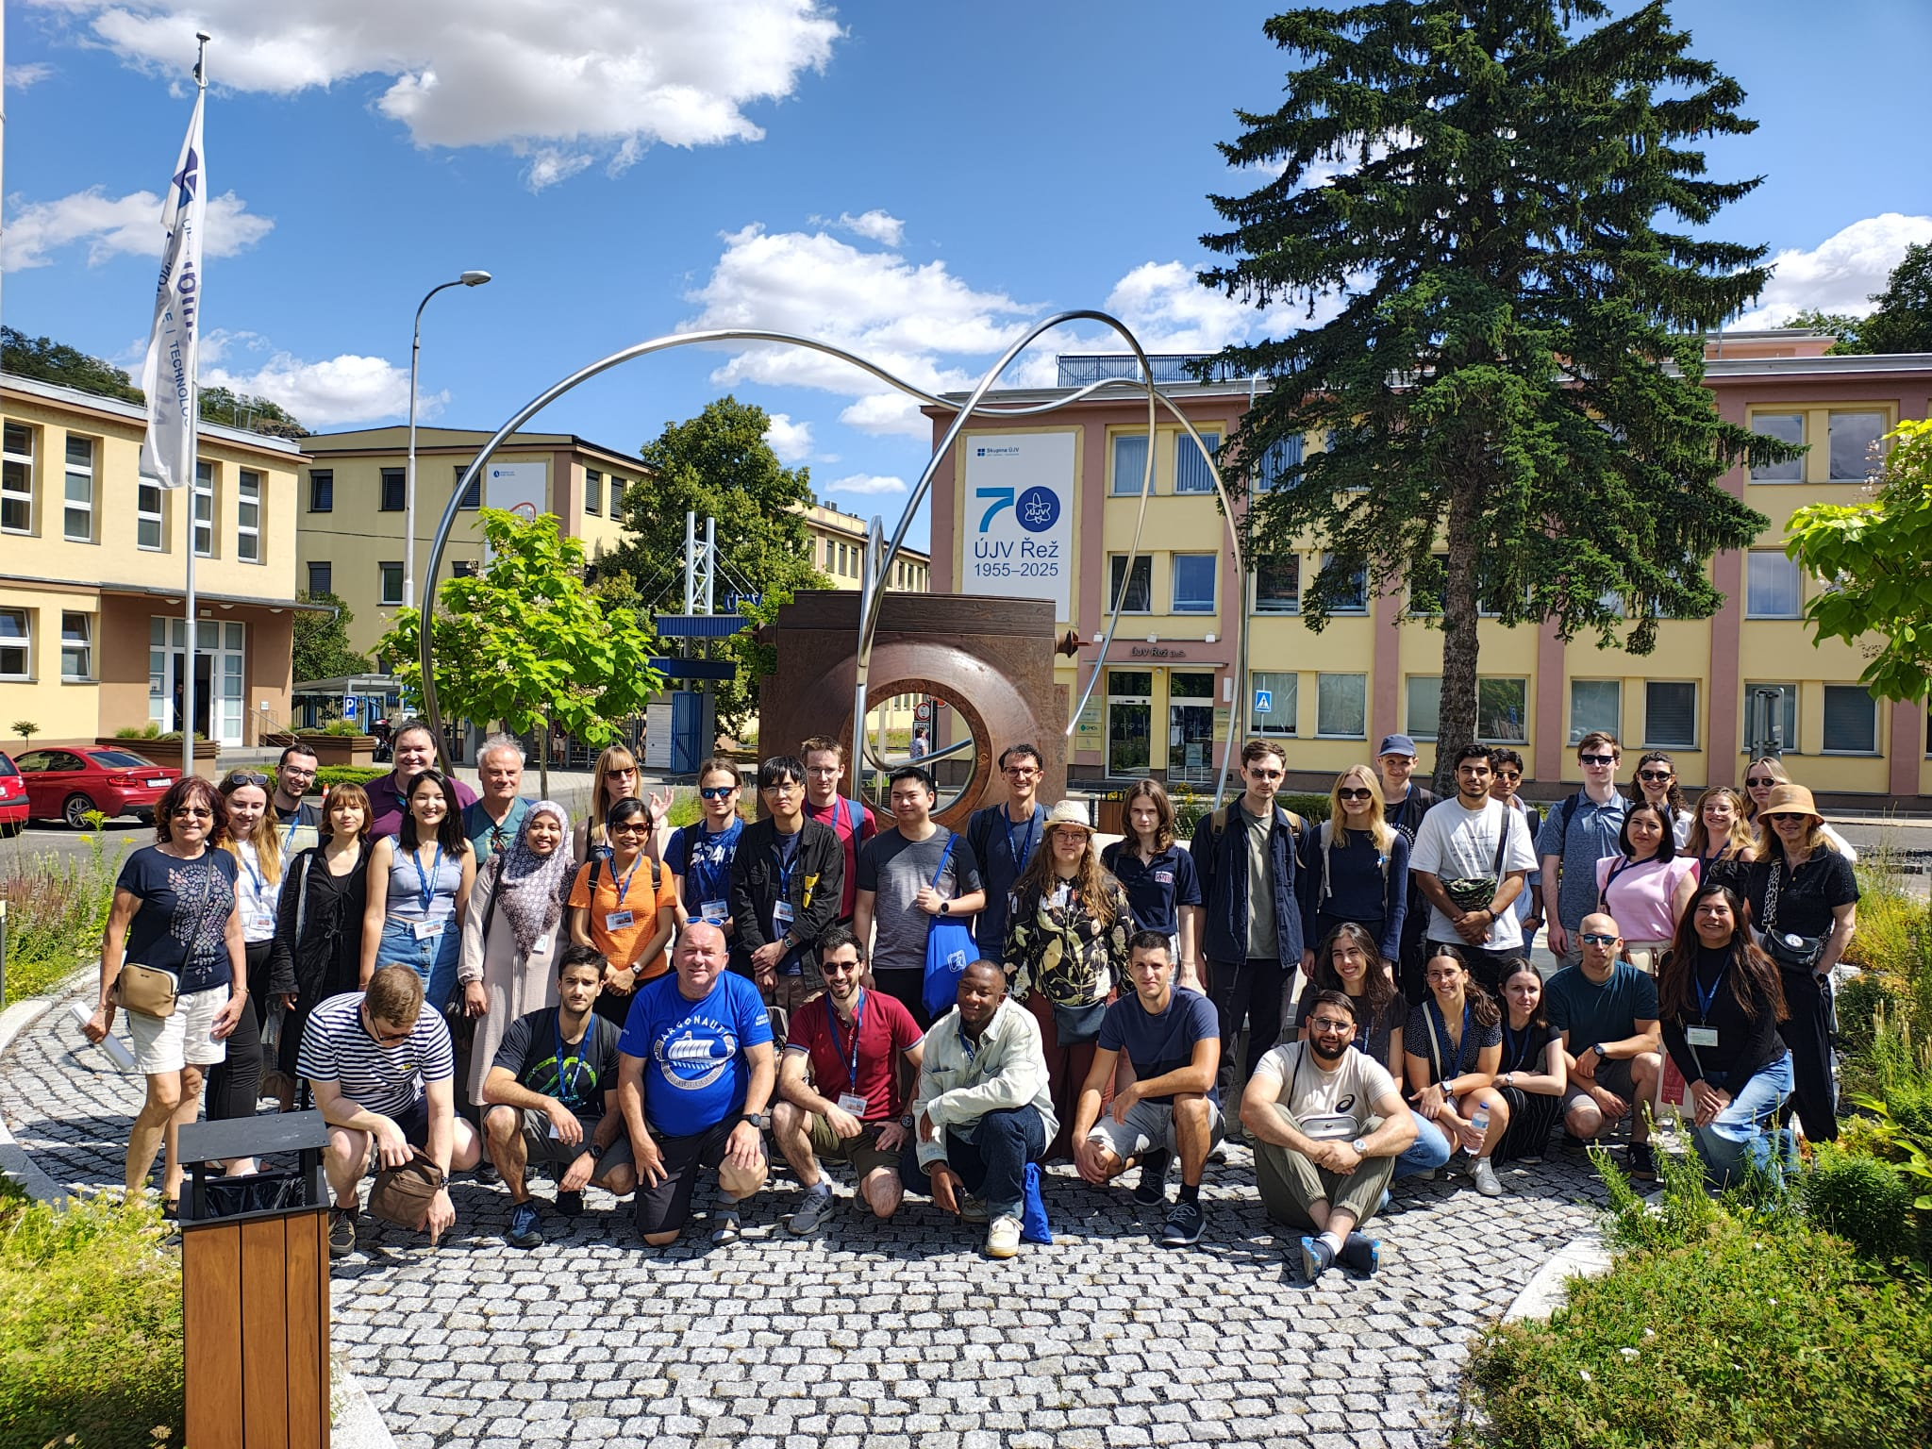

Summer School 2025 - Final Presentation
Sadrack TCHUENKAM KAMDEM, Leprince-Ringuet Laboratory/Ecole Polytechnique, France
IEEE NPSS Prague EduCom International Summer School
July 11th, 2025, Prague, Czech Republic

Slide 2


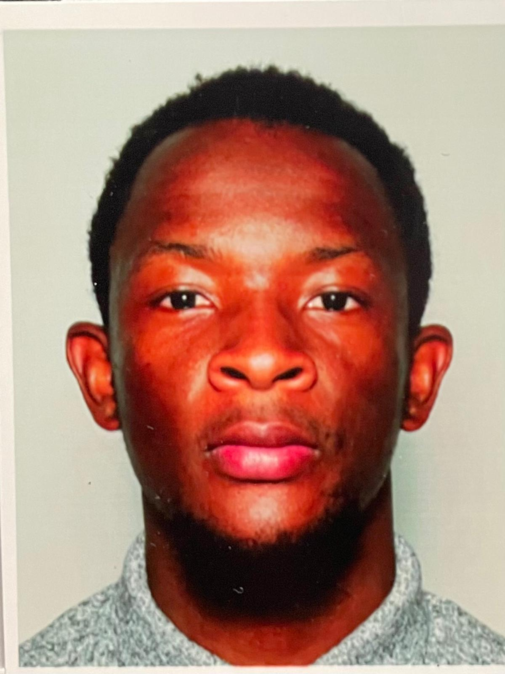



Sadrack Tchuenkam Kamdem
About Me
Maters degree in physics Univ. of Yaounde 1, Cameroon
Masters degree in smart sensors and micro-natechnologies, Univ. of Lorraine, France
Instrumentation and diagnotic Beams engineer, Leprince-Ringuet Laboratory/Ecole Polytechnique, Paris

Slide 3
What I Learned?
Module 1 : Measuring Picoseconds and GHz
DAQ and Electronics
Principle of a DAQ system
DAQ objectives
An acquisition system (DAQ) collects and processes signals from detectors.
Detectors transform particle interactions into measurable electrical signals.
Modes de mesure : courant/charge.
Detector
Precise time synchronisation
Electronic noise reduction
Efficient analogue-to-digital conversion
Front-end electronics
Reading module
Treatment

Slide 4
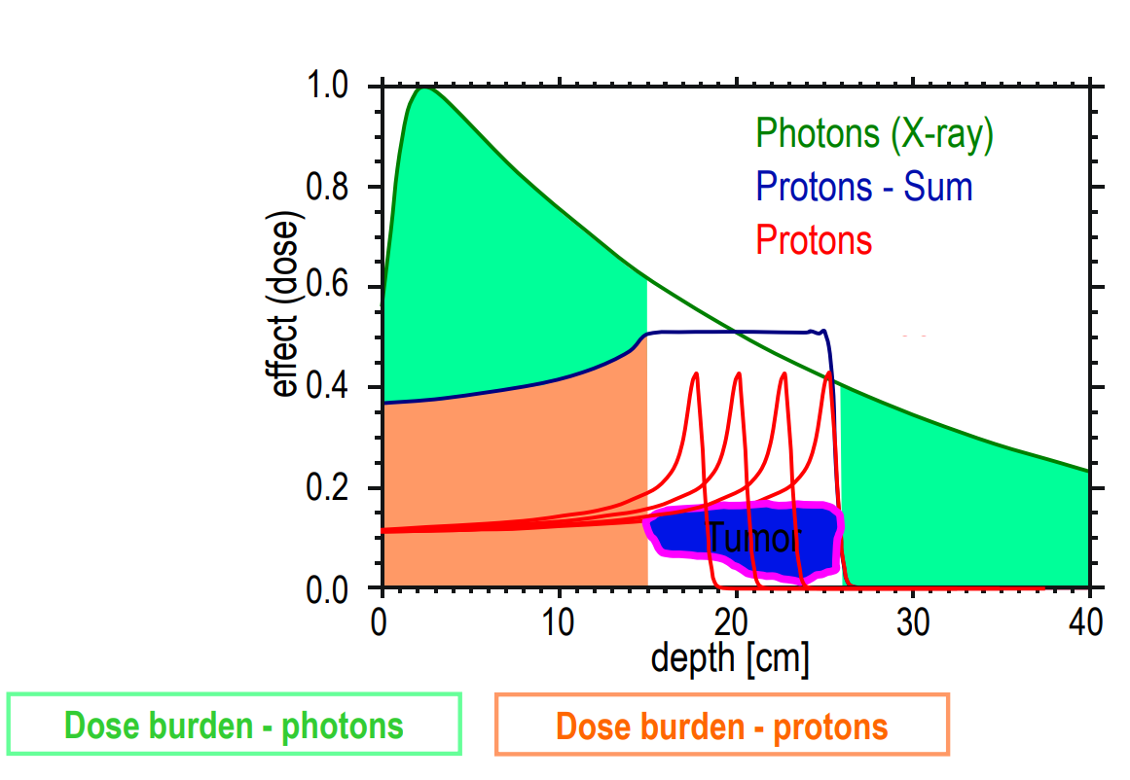
What I Learned?
Module 2 : Protontherapy
Advantages of proton radiotherapy
Concentrated at a defined depth (Bragg peak).
80 % of healthy post-tumor tissue spared
Extremely high accuracy (millimetric precision)
The braag peak curve explains it all

Slide 5
What I Learned?
Module 2 : Protontherapy
2. FLASH with protons
What is FLASH radiotherapy?
FLASH radiotherapy delivers a very high dose of radiation in a fraction of a second, which is 1000 times faster than conventional treatments. This creates a particular biological effect:
Tumour cells are effectively destroyed.
Healthy tissue is spared to a greater extent than in conventional irradiation, for an equivalent dose.
Advantage | FLASH | Protons | FLASH with protons
Spatial accuracy | ❌ | ✅ | ✅
Protection of healthy tissue | ✅ | ✅ | ✅
Speed of irradiation | ✅ | ❌ | ✅
Biological protective mechanism | ✅ | ❌ | ✅
Why use protons in FLASH?
Thanks to their Bragg peak, protons already provide a high degree of spatial precision. By combining them with the FLASH effect, we aim to optimise both the spatial and temporal selectivity of the irradiation.

Slide 6
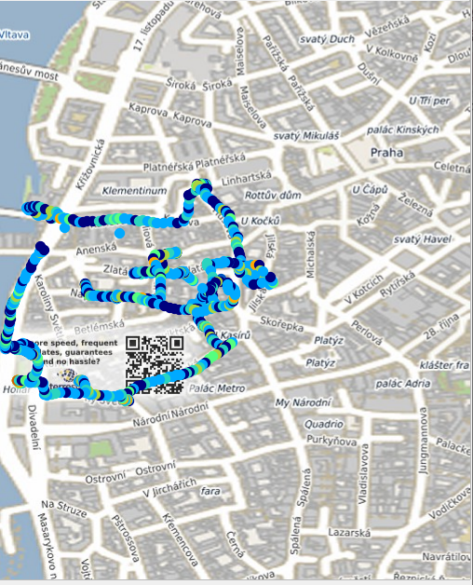
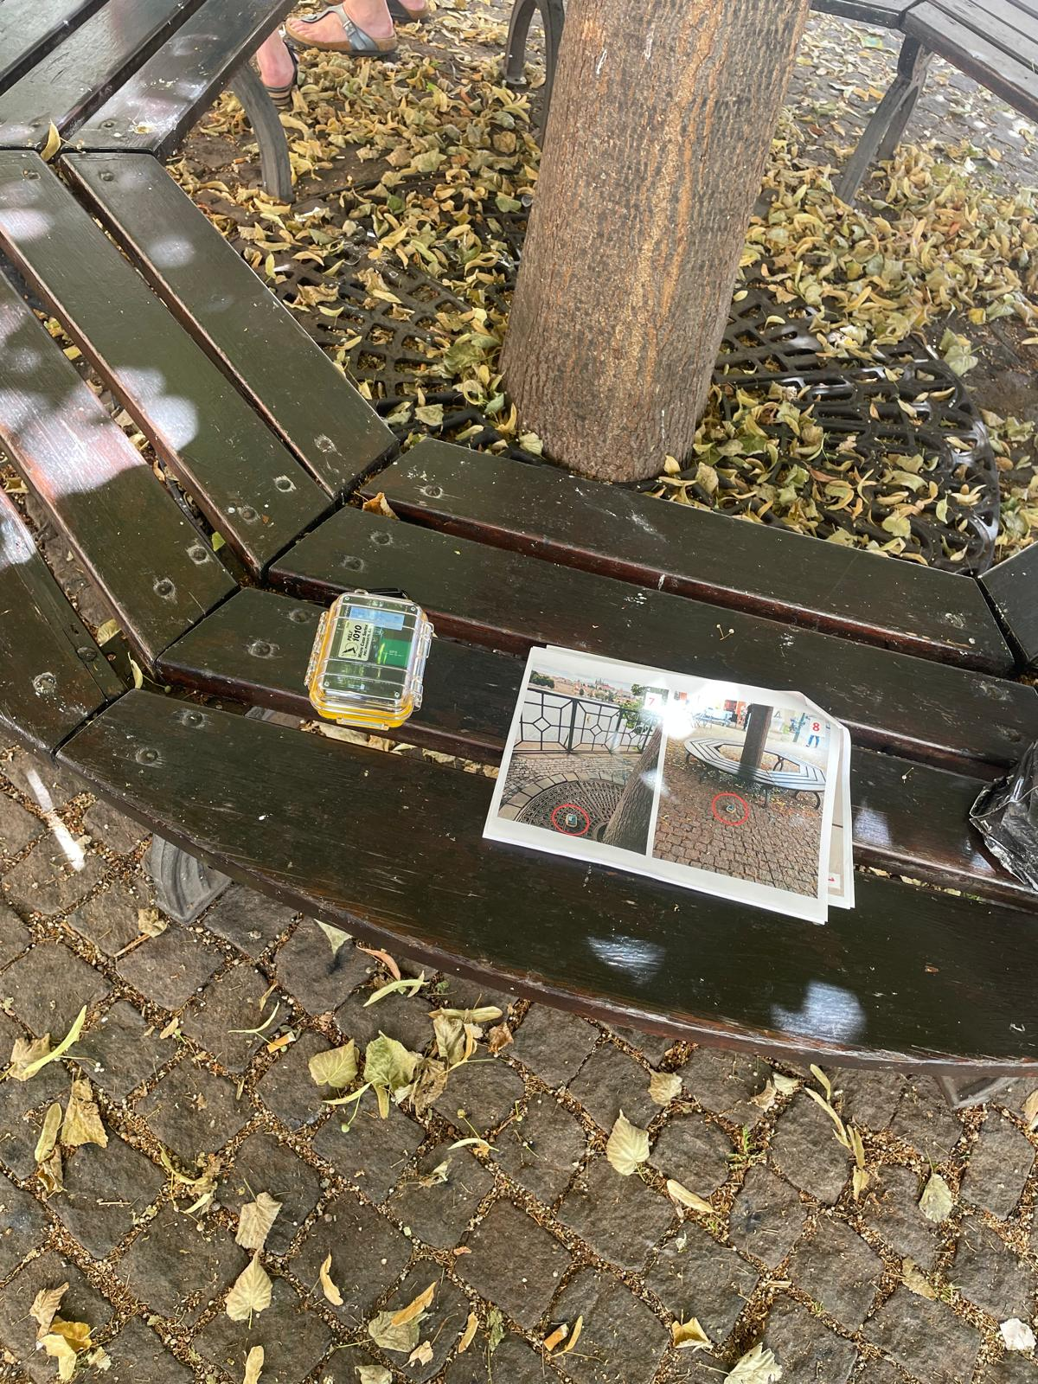
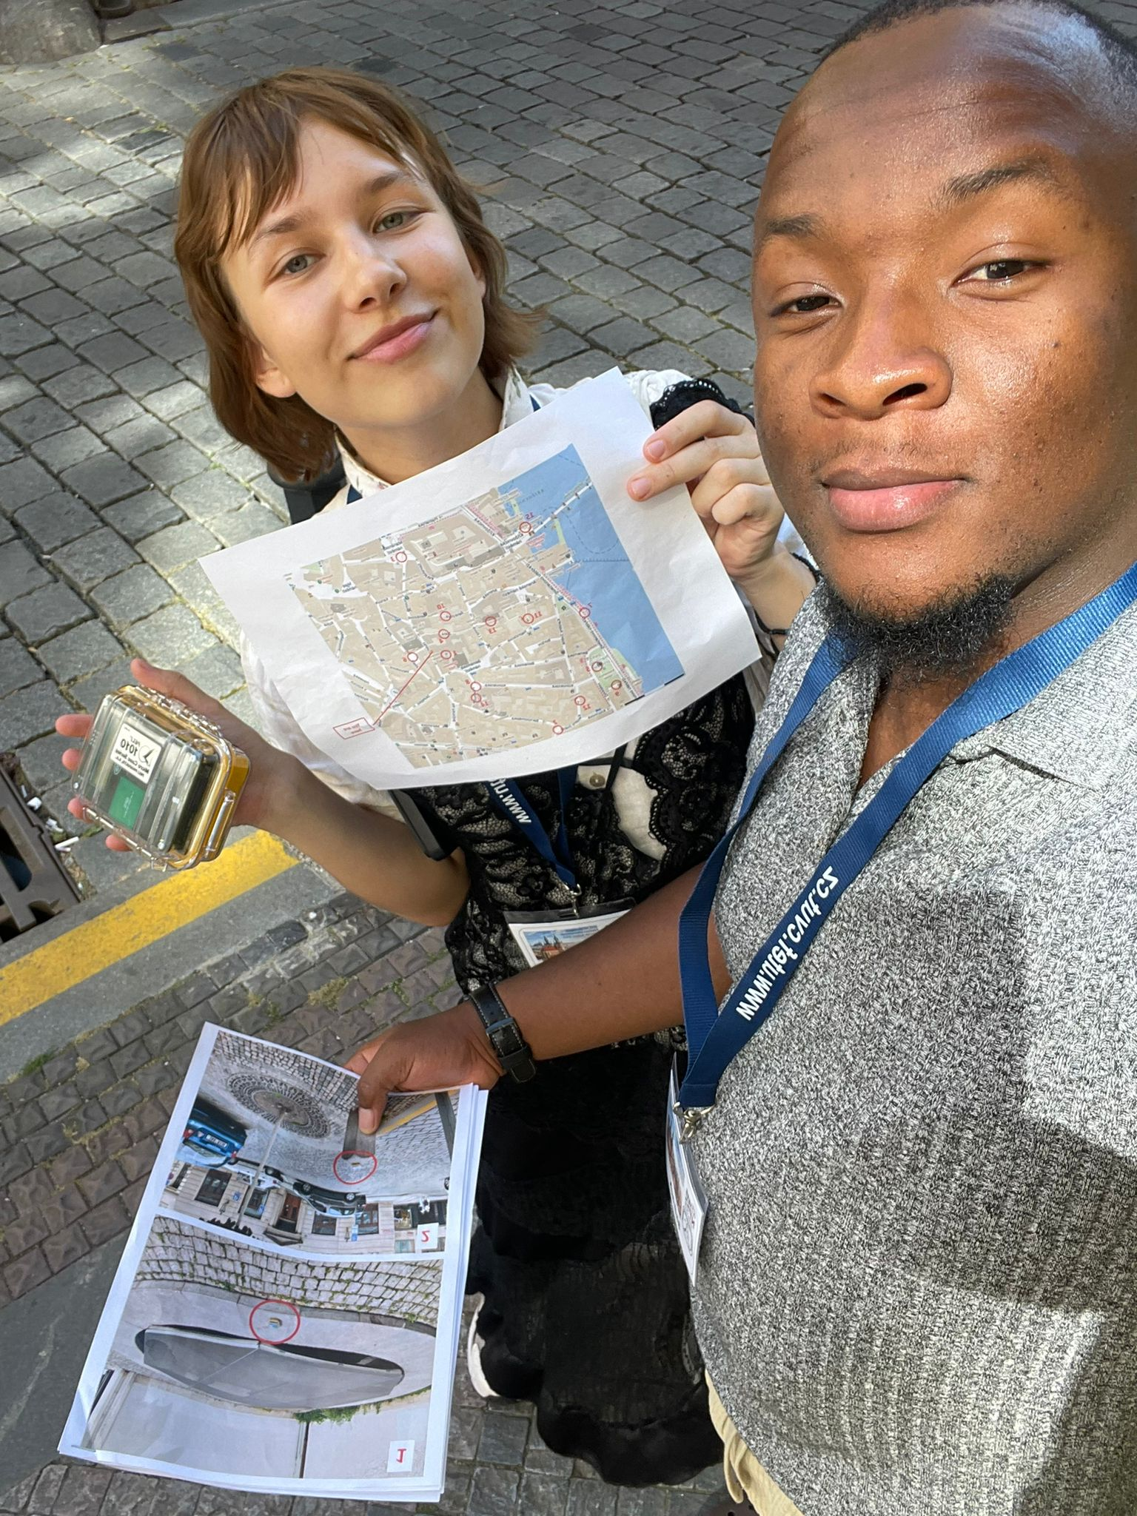
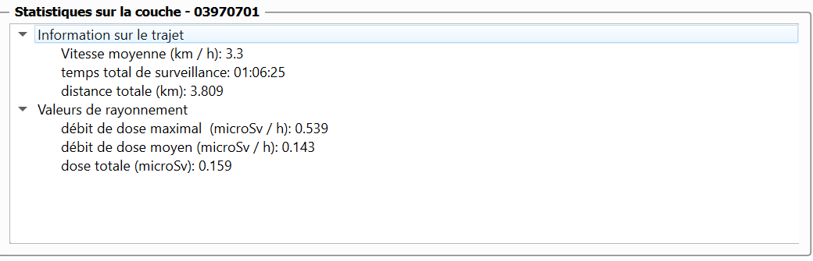
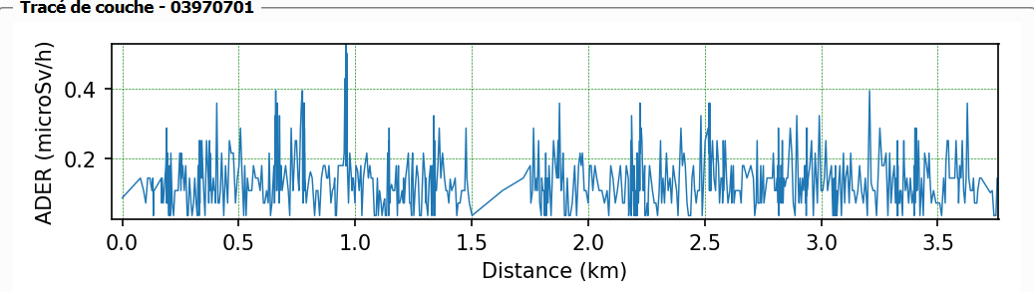
What I Learned?
EXICISE : CzechRad
Work carried out
During this exercise, we used the CzechRad to measure radiation dose rates in several locations in the city of Prague.Using QGIS software, we mapped the ambient radioactivity in the city.
Observation
We observed that there were certain points in the city where the radiation was very high compared to others.

Slide 7
What did the summer school give me that I didn't get?
role & skills
2. Working context
As a beam instrumentation and diagnostics engineer, I work on developing measurement systems to monitor, control and optimise particle beams in medical and research contexts.
✅ Expertise:
Radiation detection (PEPITES, FLASH prototype)
Data analysis and visualisation (Python, Excel)
Beam diagnostics (Electrons,protons, dosimetry, etc.)
✅ Measurement campaign in Prague:
We used a CzechRad detector to measure the dose rate at various points in the city.
Objective: to map radiation levels
Tool: QGIS for geospatial visualisation
Competency demonstrated: data processing + dosimetric interpretation

Slide 8
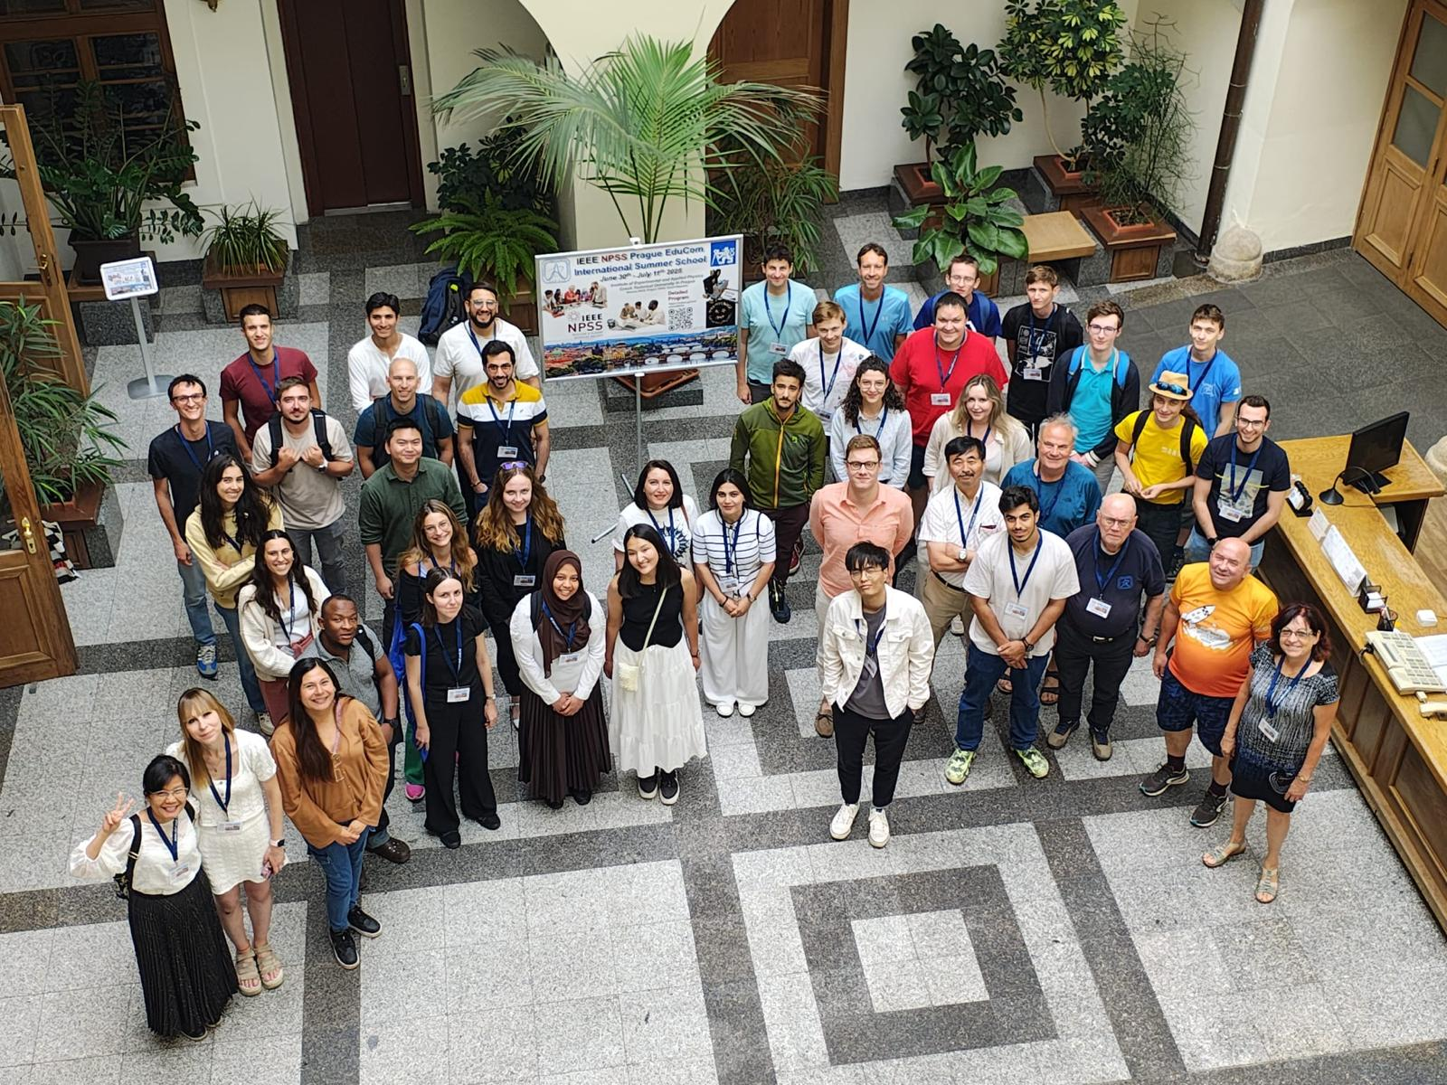
Thank you Everyone

