Slide 1
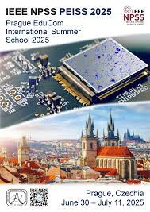
My Experience at IEEE NPSS Prague EduCom International Summer School
Rahida Ibrahimova

Slide 2
What I Learned
Working principles of modern detectors like Timepix sensors
Operating advanced equipment such as the SESTRA system
Practical skills in assembling and testing setups
Importance of data acquisition and analysis

Slide 3
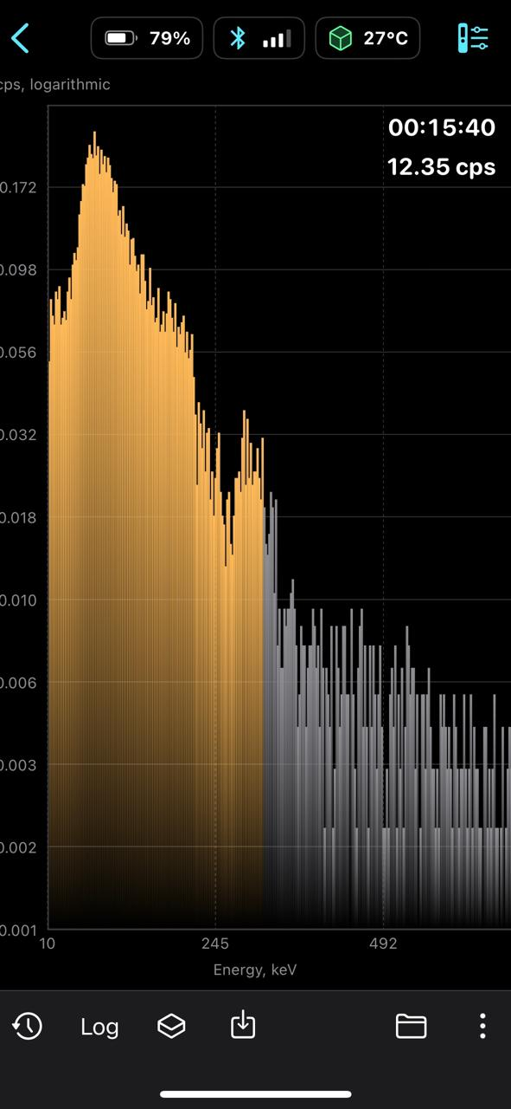
Gamma spectrum explanation
This graph is the output of a radioactivity measurement device.
•Y-axis (vertical): Number of radiation counts per second (cps) — displayed on a logarithmic scale to make weak signals visible.•X-axis (horizontal): Energy level in keV (kilo-electron volts). This shows the strength of the detected radiation.Purpose:Such a spectrum is used to identify the type of radionuclide and measure the intensity of the radiation.By analyzing the positions of the peaks, it is possible to determine the composition of the sample.Tip: Add arrows on your slide to highlight the main peak(s) and label the axes clearly for better understanding!

Slide 4
New Skills and Experience
Improved analytical and problem-solving skills
Hands-on laboratory experience with real instruments
Enhanced teamwork and communication with international peers
Better understanding of research project organization

Slide 5
Conclusion
The IEEE NPSS Prague EduCom Summer School was a great chance for academic and personal growth.
Thank you to the organizers, professors, and participants for this unforgettable experience.
Thank you for listening!

