Slide 1
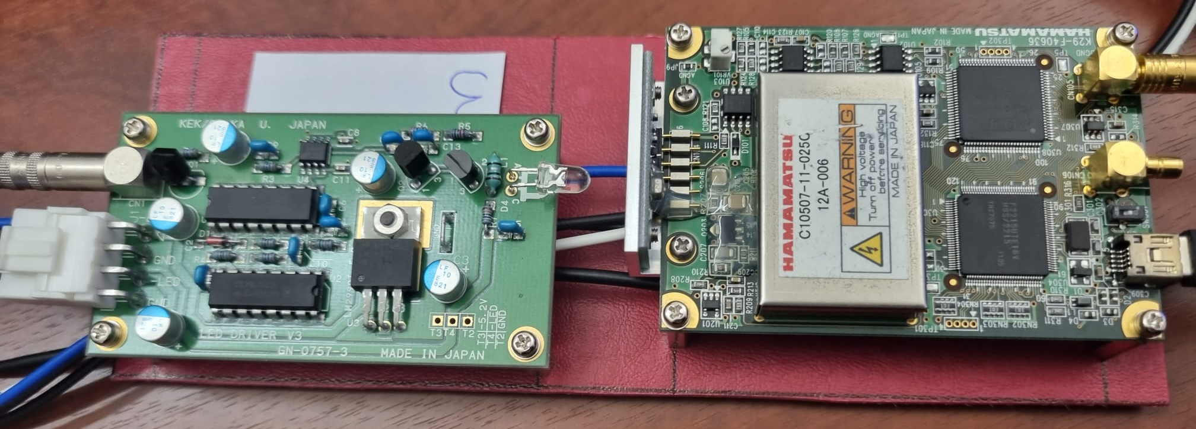





Photon Counting Experiment
Using MPPC and Red-Pitaya
Supervised by Pr. Masaharu Nomachi
Alexandre Esper

Slide 2
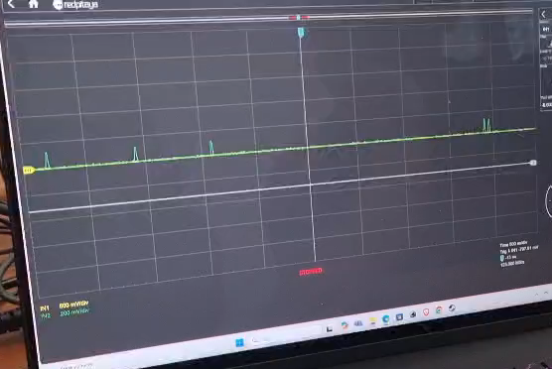
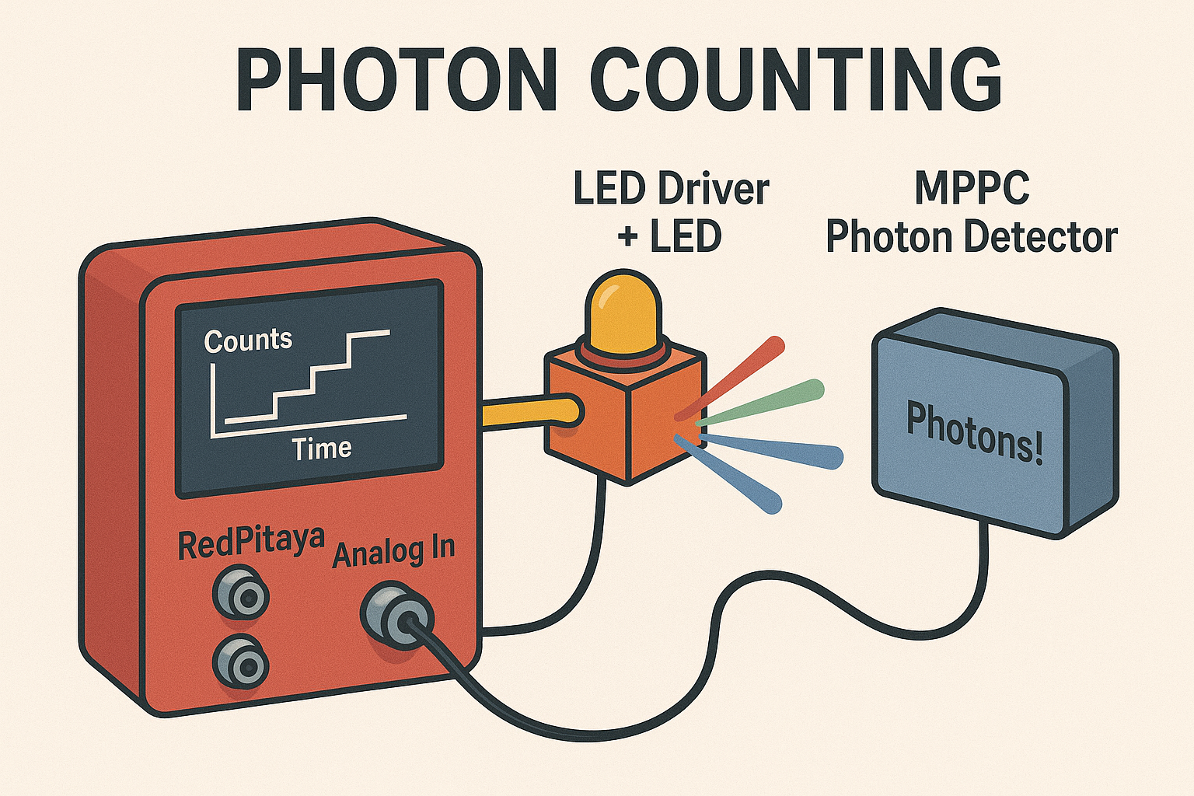
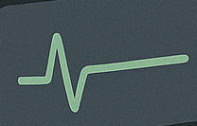
Introduction and Setup
Purpose: investigation of light intensity at the single-photon level using a Multi-Pixel Photon Counter sensor.
Measurements were performed using a RedPitaya (A-I/O) device to trigger a LED and record photon pulses.
Notes:
Dark counts caused by light leak
are random and rarely produce multiple signals at once. However,
LED light produces many photons simultaneously, triggering multiple pixels at once

Slide 3
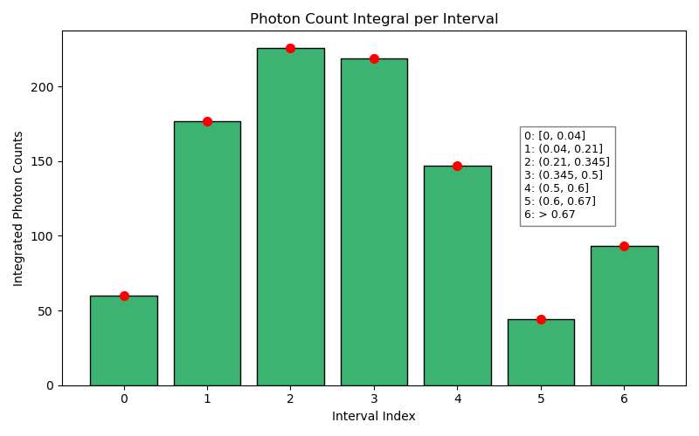
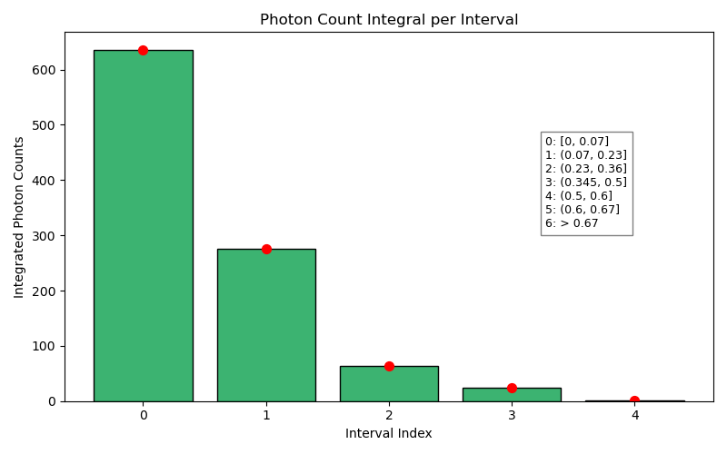
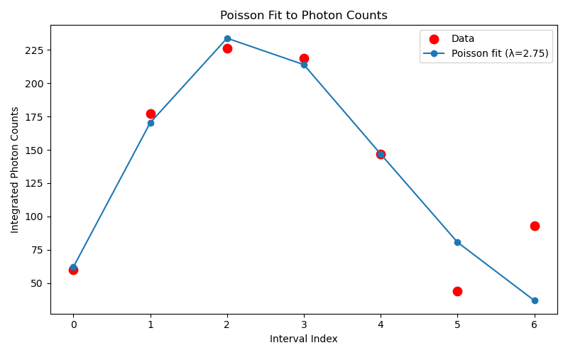
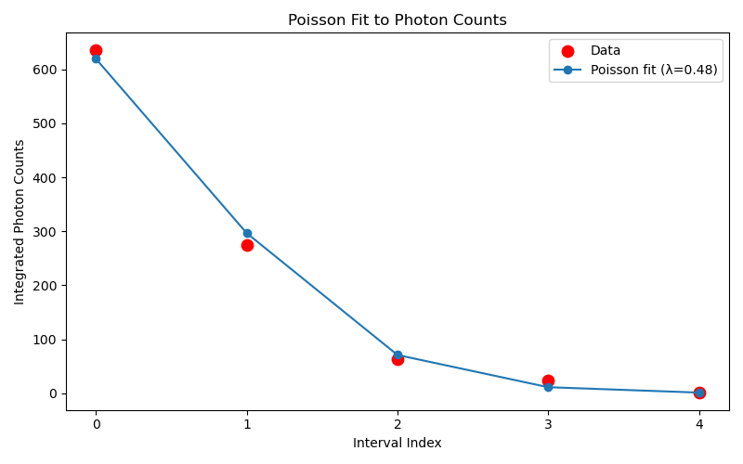

Distribution of detected photon signals
U=6.8 V
U=6.5V
3 photons
2 photons
4 photons
>5 photons
Distinct peaks $→$Quantized steps
0 photon
5 photons
1 photon
λ=2.8
λ=0.5 (light Intensity)
Fit: Poisson distribution
Thanks Arjianna ☺
Notes:
Graph shows the distribution of detected photon signals. Each bar corresponds to an interval of signal amplitude which correspond the number of photons, and the y axis represents the number of events (photon detections).
Then The photon count were fitted to a Poisson distribution.
It shows that for a lower voltage the mean value has decreased indicating lower light intensity.
The distinct peaks, suggest that photon detections occur in quantized steps.

Slide 4
Conclusion
As expected, lower LED voltages yield lower light intensities,
Photon counting statistics follow the expected Poisson distribution,
Below a certain threshold intensity, the light is no longer measured as a continuous wave but as individual photon events
→ fundamental principle of quantum mechanics.
Notes:
At 6.5 V bias, λ decreased to 0.48, indicating lower light intensity.
The photon detection follows Poisson statistics, which is expected in low-light conditions where photons arrive randomly and independently.
At 6.8 V, the mean increased to λ = 3, showing that multiple photons were often detected per pulse. This behavior confirms that the detection process is quantized (individual photons) and follows the statistical behavior of a Poisson process, as expected for independent photon arrivals from a weak light source.
We confirmed that below a certain threshold, the light is no longer measured as a continuous wave but as individual photon events. This illustrates a fundamental principle of quantum mechanics: light behaves both as a wave and as a collection of particles (photons), depending on how it is measured.

Slide 5

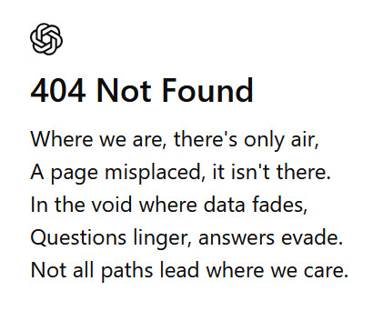

Of course, used the lecture “Modern engineering and AI” by Stefan RITT, here
Prompt to create the ppt

Slide 6
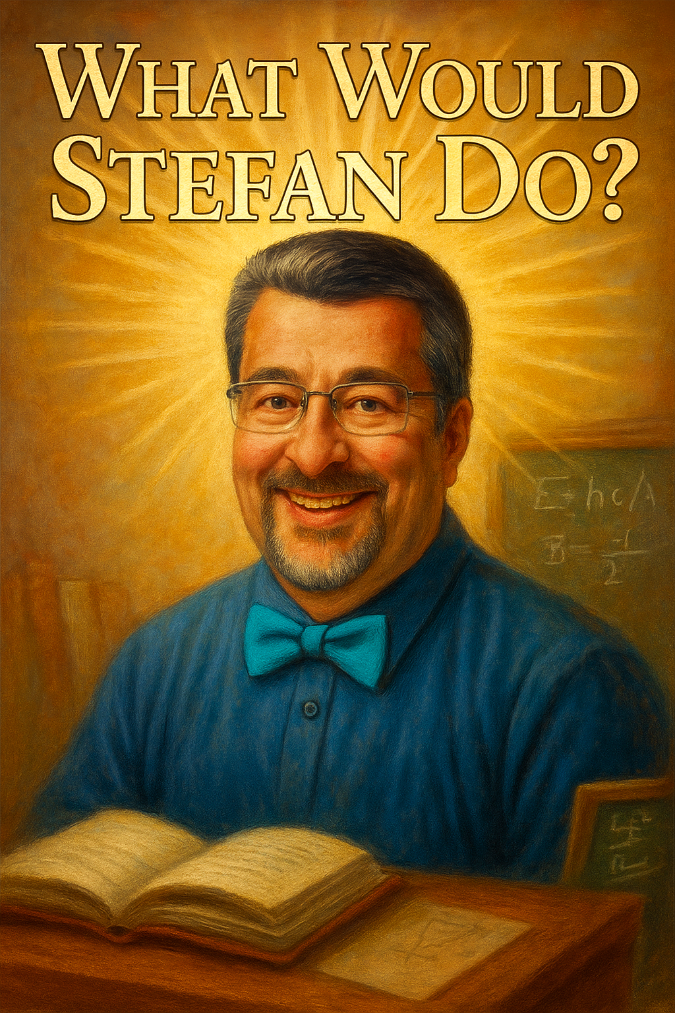


Modern engineering and AI

Slide 7
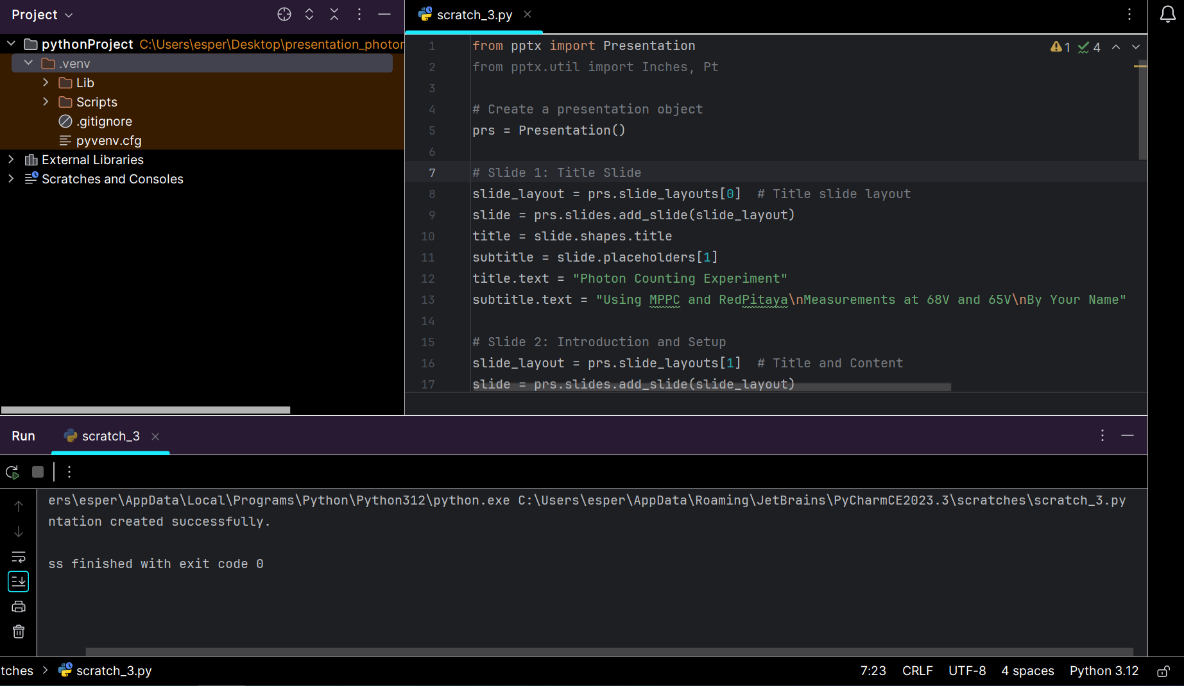
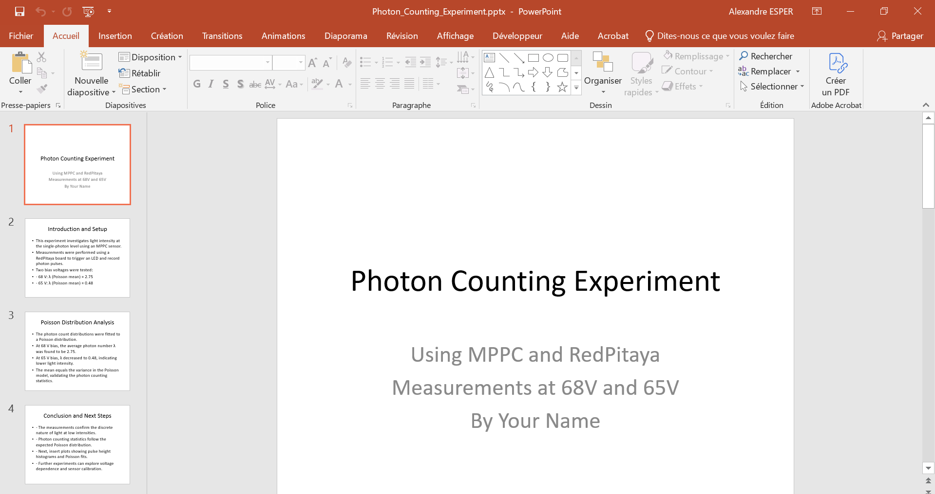
Modern engineering and AI

Slide 8
Final thoughts
Grateful to the organizers for a well-structured and inspiring summer school
All the lectures were very interesting, it was truly difficult to choose one topic to present
Exchanges with experts sparked new ideas that I’m eager to apply to current challenges at my work
A truly enriching experience, both academically and professionally
Notes:
I’m sincerely grateful to the organizers for this exceptional event. The quality of the lectures was outstanding, and the opportunity to interact with experts in the field and that sparked new ideas that I’m eager to apply to few challenges in my own work.

Slide 9
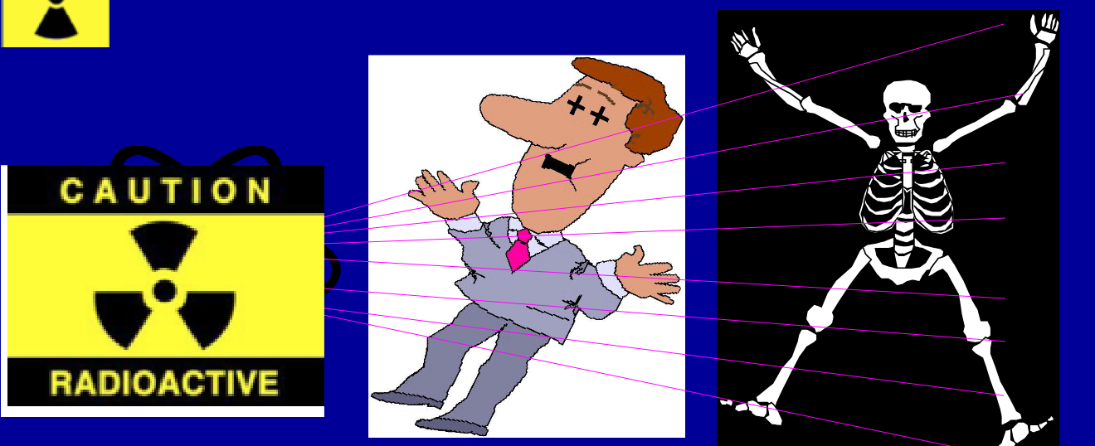
An example (other than medical sector)?
Radiation is harmful, toxic…
BUT, radiation can also save life!

Slide 10
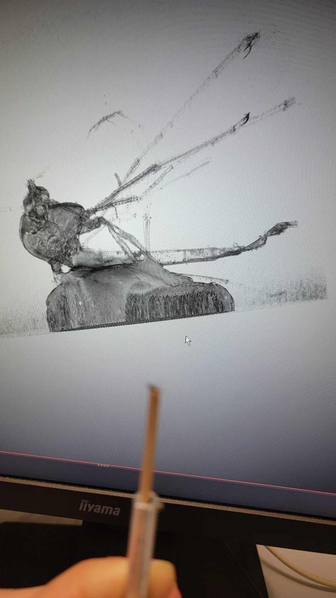
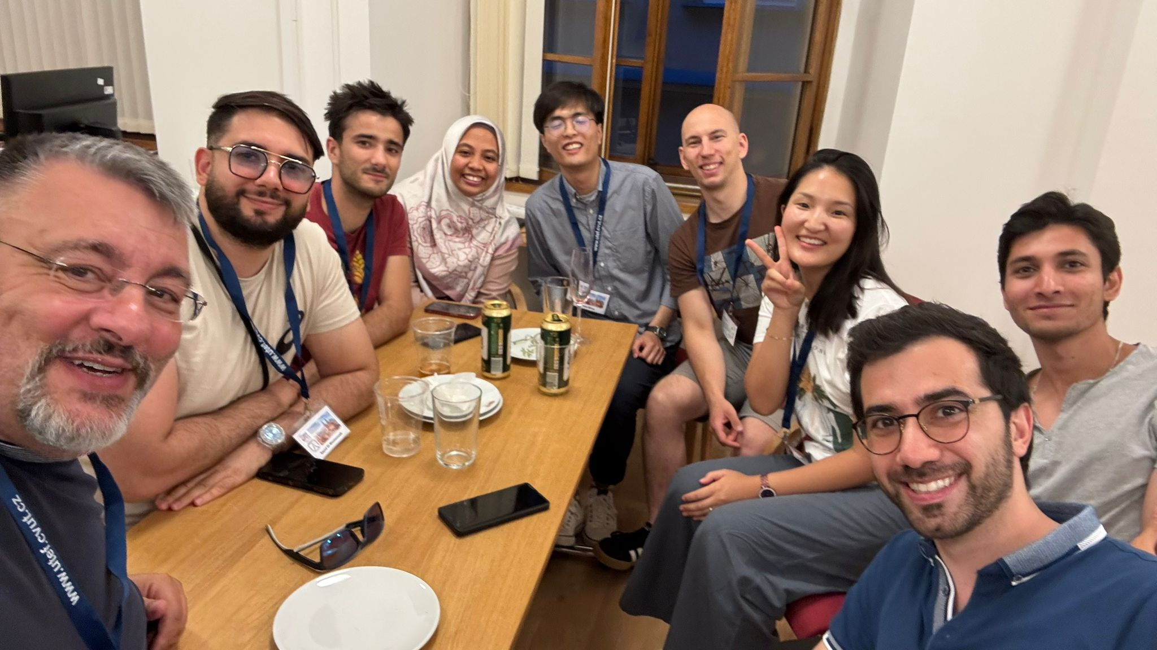
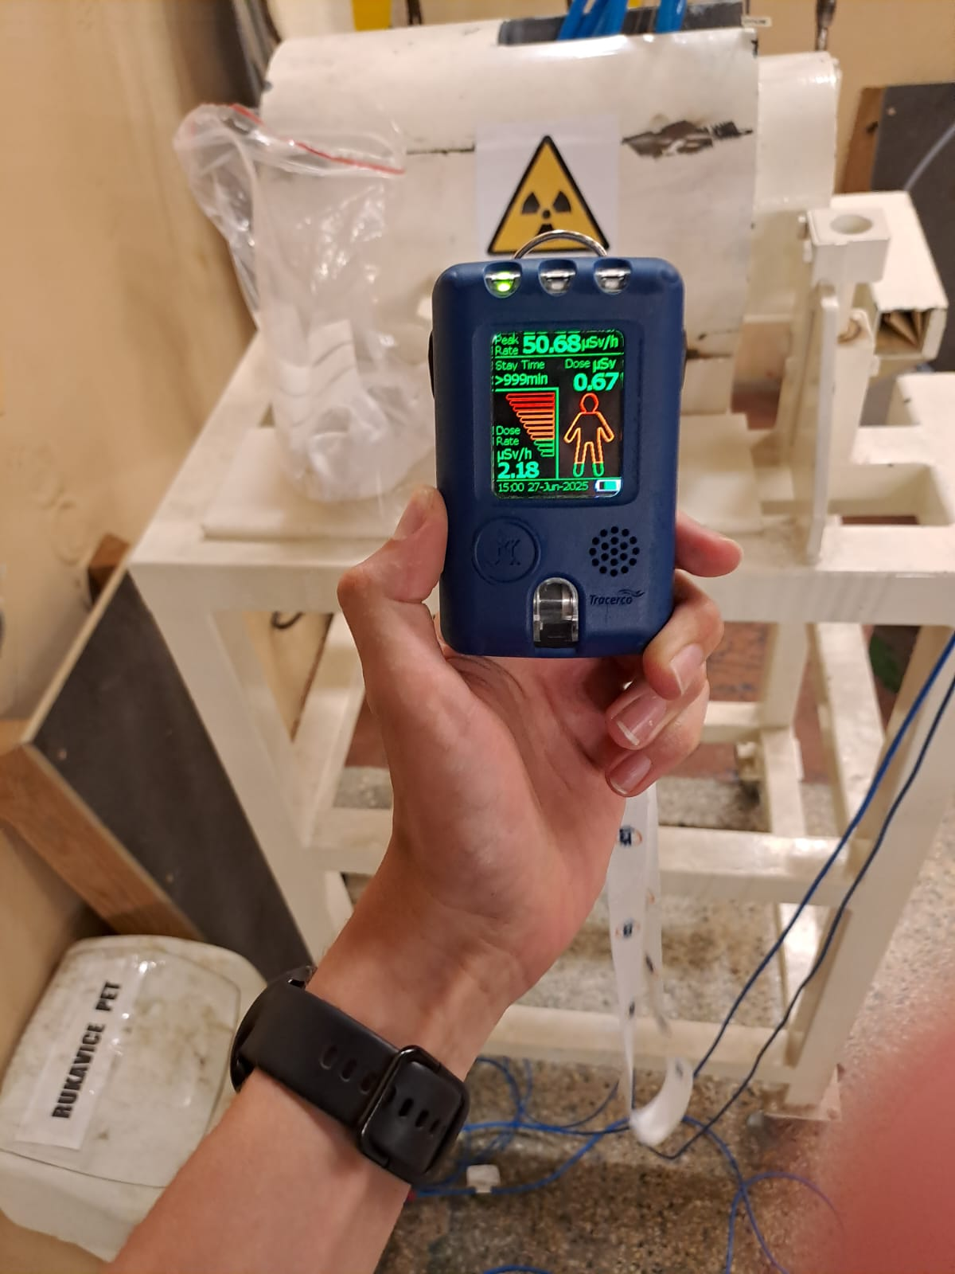
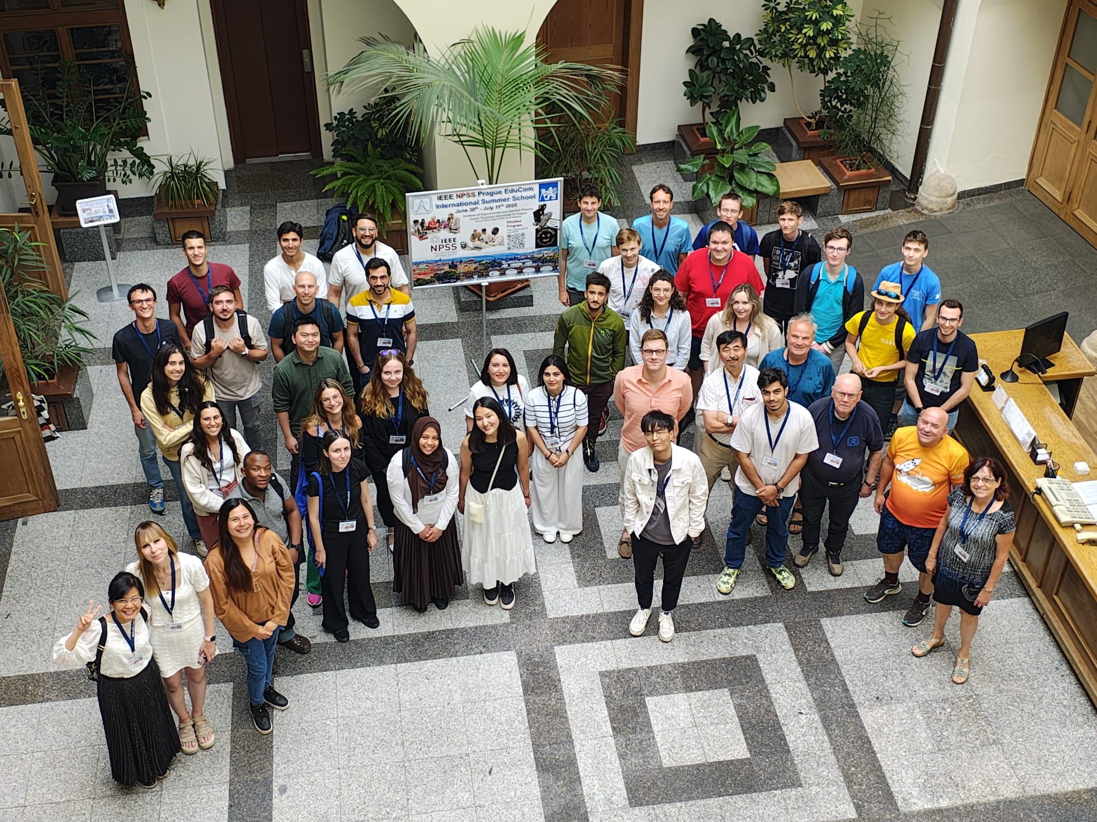
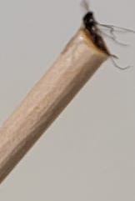
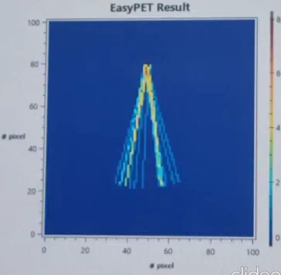
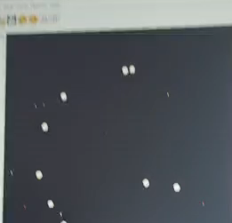
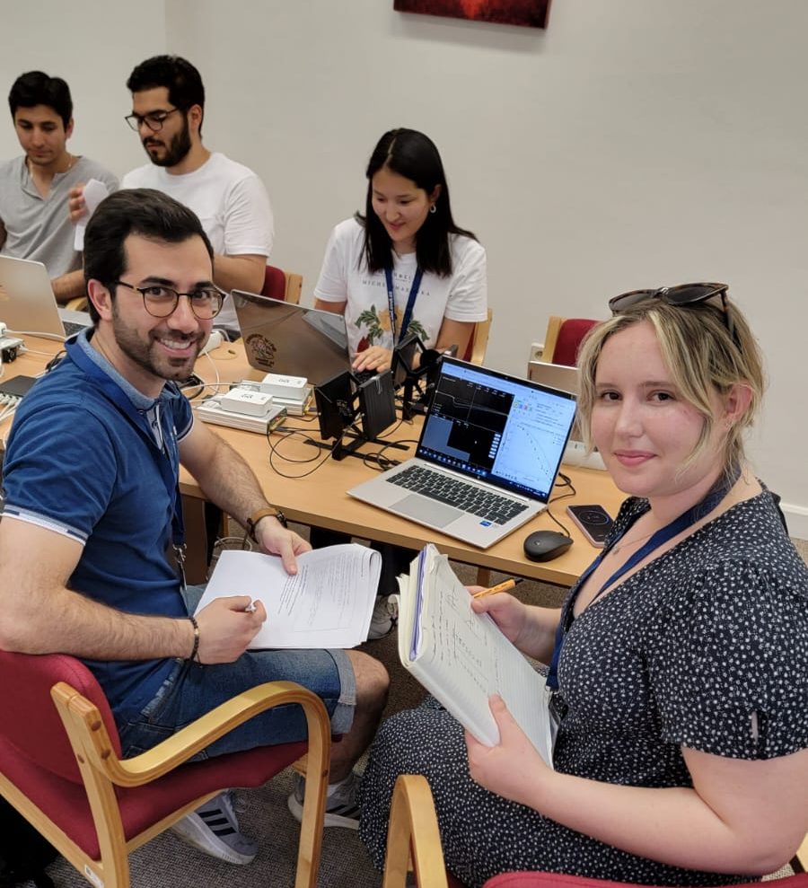


Thank you !!!
8 person: 10 nationalities
Notes:
this summer school has been a truly valuable and wonderfull experience!

