Slide 1
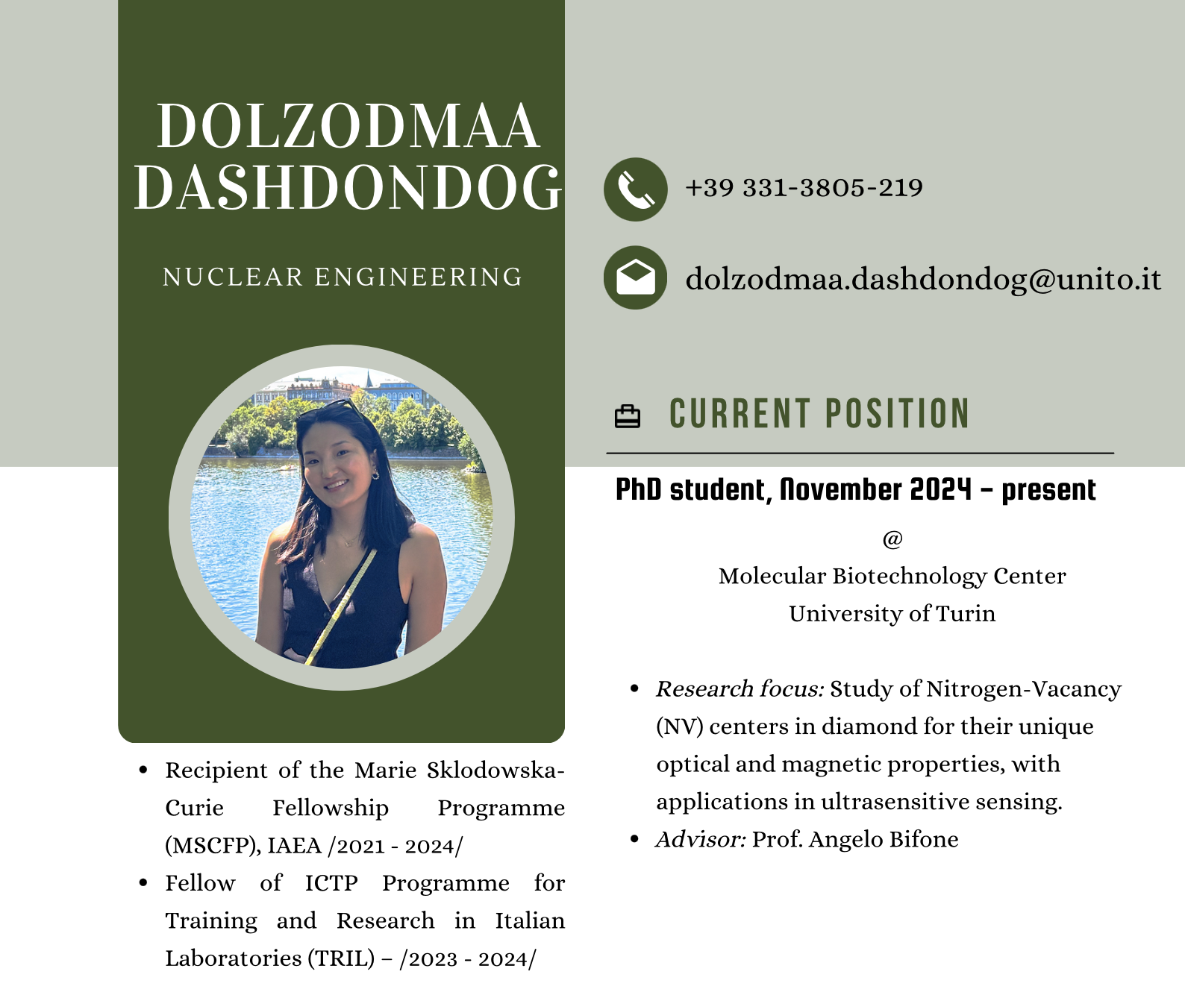
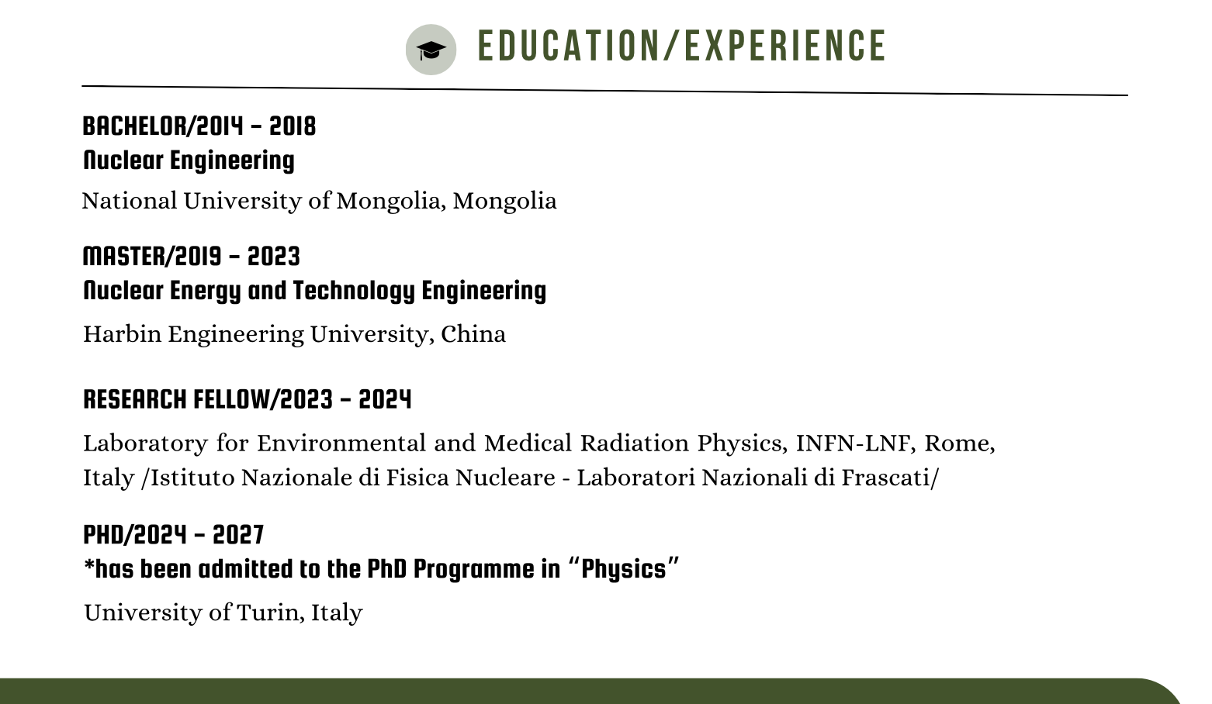

Slide 2


Slide 3

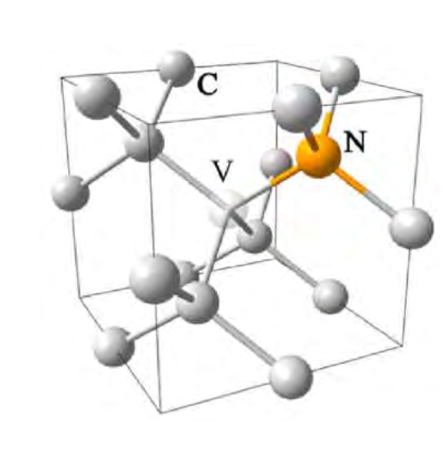
CURRENT POSITION
PhD student, November 2024 - present
@ Molecular Biotechnology Center, University of Turin
Research Focus: Nitrogen-Vacancy (NV) Centers in Diamond
🌟 What Are NV Centers?
Point defects in diamond: Nitrogen atom + vacancy
Quantum systems with stable spin states and optical readout
🔬 Key Capabilities
Optically polarized spin states
Detect:
  Magnetic fields
  Electric fields
  Temperature
Operate at room temperature
🧲 Applications in MRI & Beyond
🧠 High-Sensitivity MRI
Hyperpolarization of surrounding nuclear spins via NV centers
Boosts NMR signal by several orders of magnitude
Enables:
  Low-field MRI
  Faster imaging
  Single-cell or molecular-level sensitivity
💉 Biomedical Imaging & Sensing
Notes:
Research focus: Study of Nitrogen-Vacancy (NV) centers in diamond for their unique optical and magnetic properties, with applications in ultrasensitive sensing.
💡 Broader Impact
Quantum computing: NV centers as scalable qubits
Biosensing & diagnostics
Next-gen MRI contrast agents

Slide 4
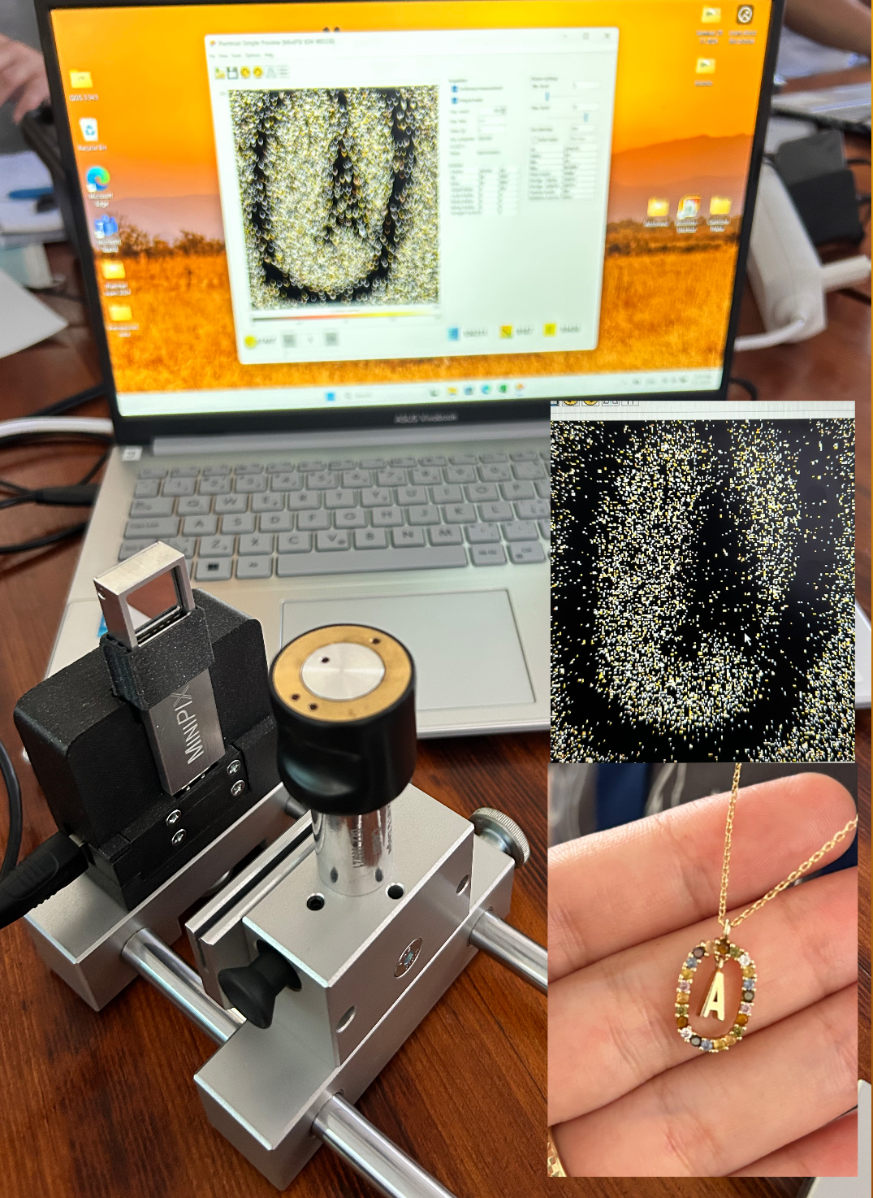
Advantages of the SESTRA
Timepix Detector
Hands-On Perspective
🧪 Real-Time Visualization
🔬 Single-Particle Sensitivity
📸 Visual + Quantitative Output
🖥️ USB & Portable
⚙️ Spectral Discrimination
🌍 Space-Grade Tech - Classroom Friendly
Notes:
School Education Set with Timepix for Radiation Analysis
You will get familiar with the sophisticated pixel detector Timepix through the session of practical hands-on exercises performed with particle camera educational kits. The basic types of radiation of several emitters will be studied and distinguished according to measured tracks via the pixel detector. Further, natural radiation background including cosmic rays and muons will be also examined during the exercises.

Slide 5
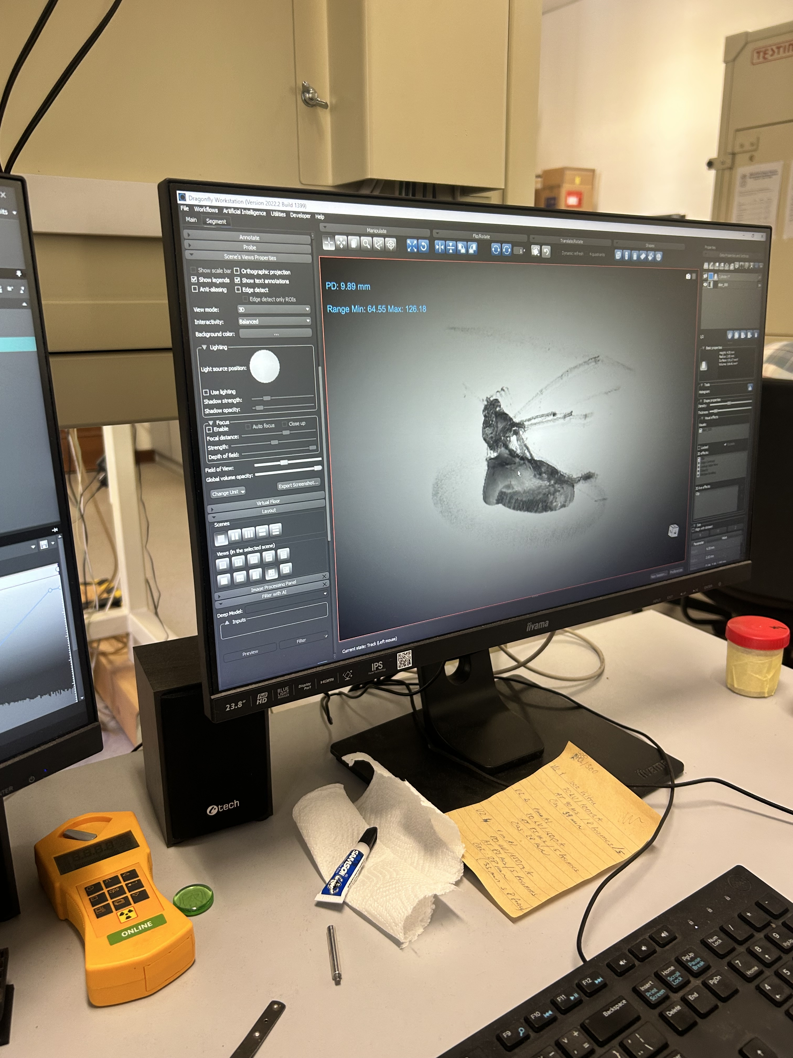
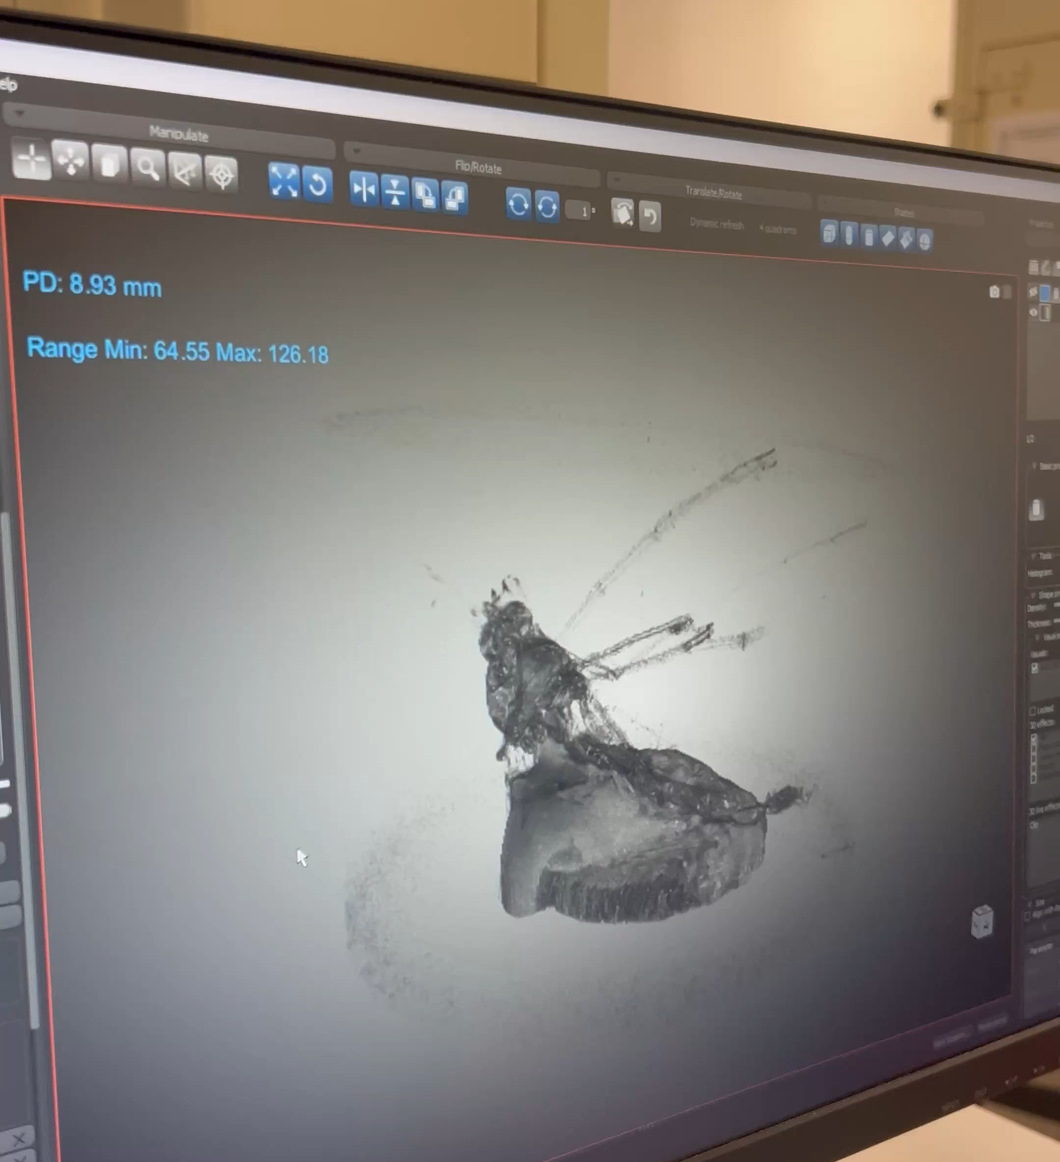

Slide 6
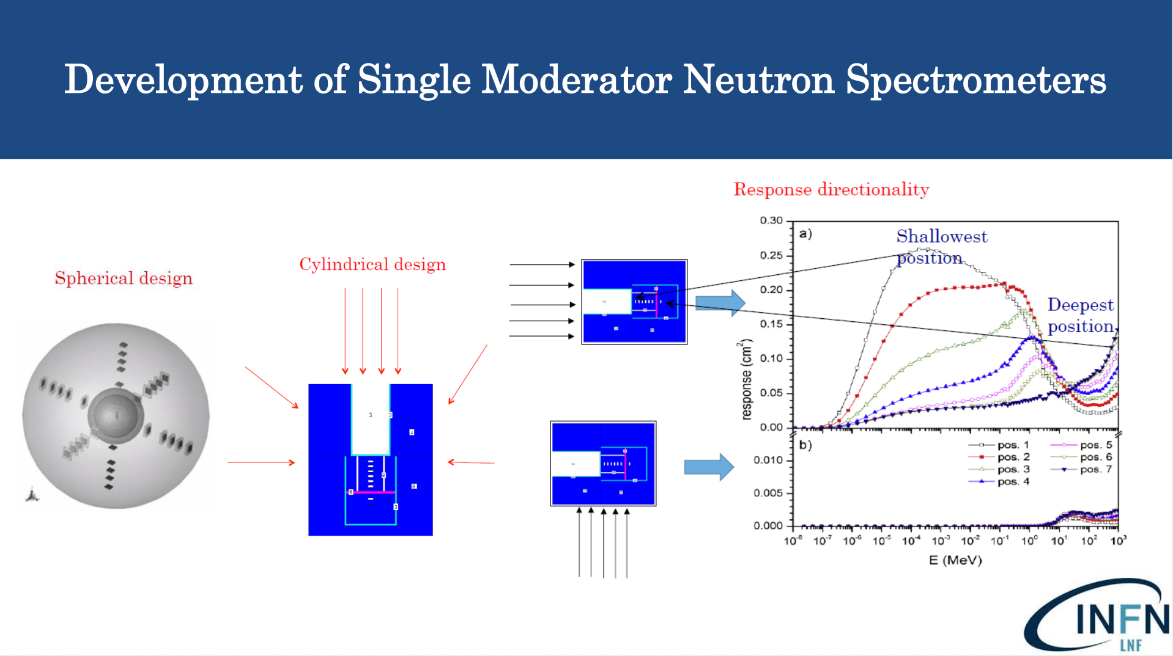
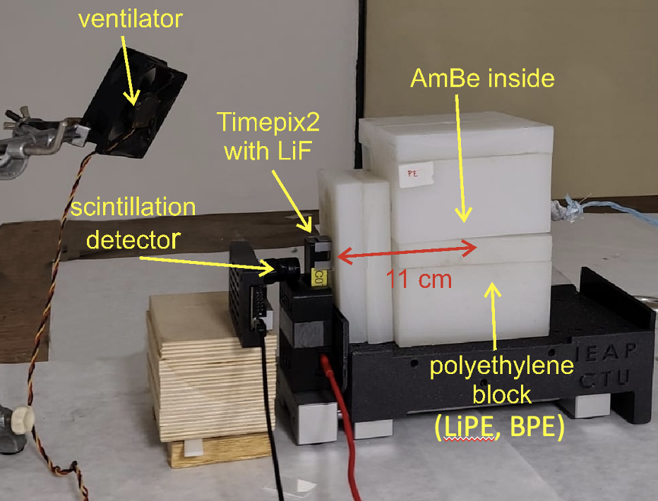

Slide 8
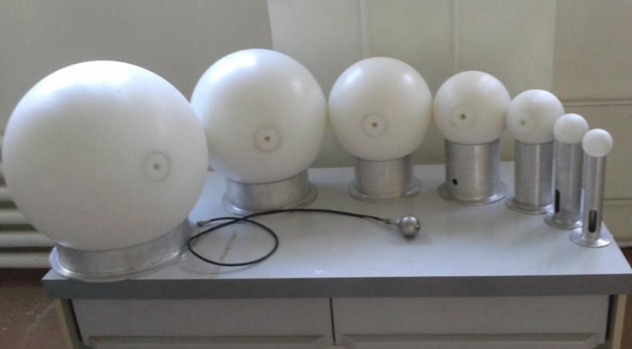
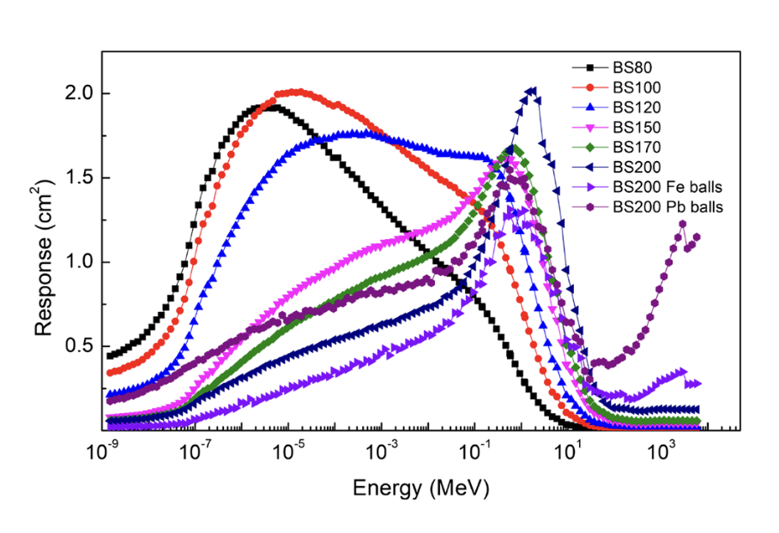
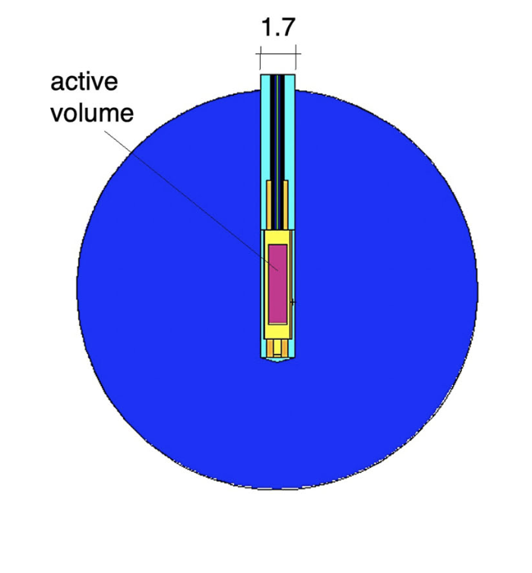
Bonner Sphere Neutron Detection
🧩 What Is It?
A neutron spectrometry system using moderating spheres (Bonner spheres) and a central thermal neutron detector.
Designed to measure neutron energy spectra over a wide energy range (from thermal to GeV).
Notes:
Bonner Sphere Neutron Detection
🧩 What Is It?
A neutron spectrometry system using moderating spheres (Bonner spheres) and a central thermal neutron detector.
Designed to measure neutron energy spectra over a wide energy range (from thermal to GeV).
🛠️ How It Works
Consists of:
Thermal neutron detector (usually a 33He proportional counter)
Surrounded by polyethylene spheres of varying sizes (moderators)
Each sphere slows neutrons to different extents → energy-dependent response
📊 Applications
Radiation protection and dosimetry
Nuclear reactor monitoring
Accelerator facilities
Cosmic ray studies
🔍 Advantages
Wide energy range sensitivity
Well-characterized response functions
Passive and robust setup
⚠️ Limitations
Requires unfolding of measured data to obtain energy spectrum
Bulky for portable use
Low resolution compared to TOF or spectrometer-based systems

Slide 9
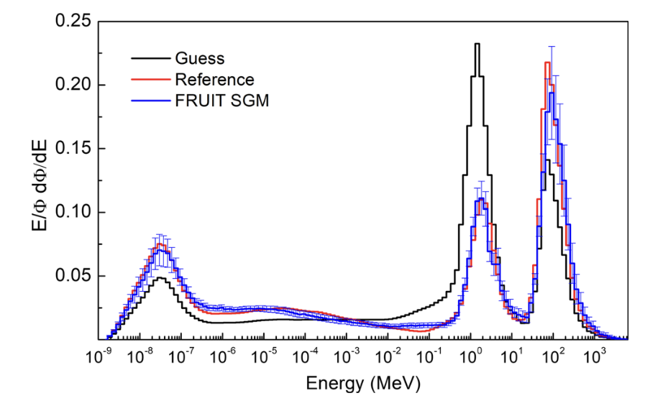
Bonner Sphere Neutron Detection
🛠️ How It Works
Consists of:
  Thermal neutron detector (usually a 3He proportional counter)
  Surrounded by polyethylene spheres of varying sizes (moderators)
Each sphere slows neutrons to different extents → energy-dependent response
📊 Applications
Radiation protection and dosimetry
Nuclear reactor monitoring
Accelerator facilities
Cosmic ray studies
Fontanilla, A., Calamida, A., Castro Campoy, A. I., Cantone, C., Pietropaolo, A., Gómez‑Ros, J. M., Monti Mafucci, V. E., Vernetto, S., Pola, A., Bortot, D., Bedogni, R. (2022). Extended range Bonner sphere spectrometer for high‑elevation neutron measurements. European Physical Journal Plus, 137, Article 1315. https://doi.org/10.1140/epjp/s13360‑022‑03439‑3

