Slide 1





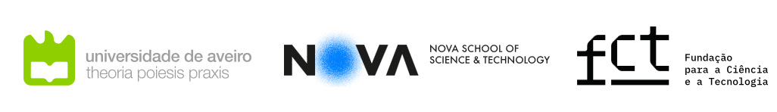
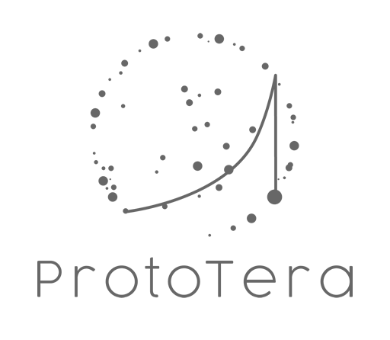


Implementation of easyPET.3D scanner for proton therapy quality assurance
Catarina Magalhães
Notes:
Hello! My name is Catarina Magalhães and I am PhD student at the University of Aveiro. Today I am going to present a bit of my path through my PhD.

Slide 2
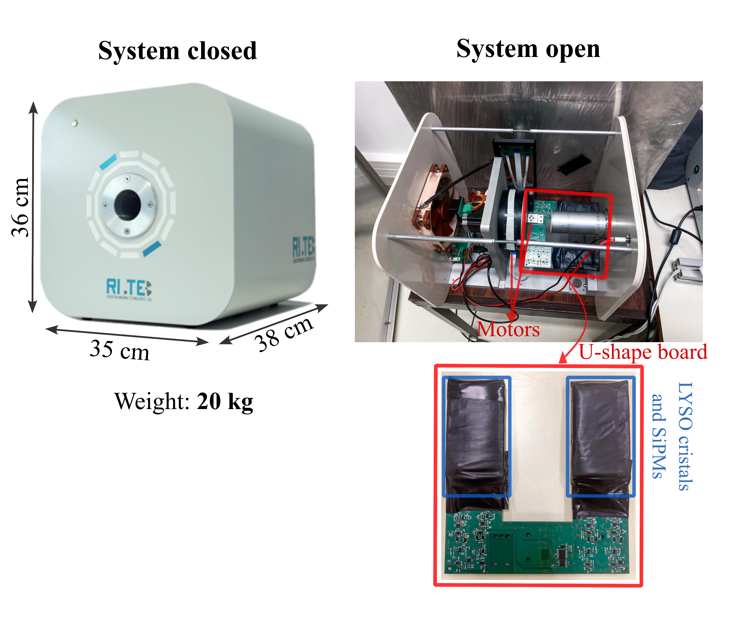


easyPET.3D
compact and high-resolution PET system (based on the easyPET technology).
Predict the 3D distribution of β+ emitters in a phantom after proton irradiation and detecting deviations in proton beam characteristics.
Monte Carlo simulations – proton beam irradiation of phantoms and 3D image acquisition with easyPET.3D.
In situ tests @PSI
Notes:
Let's start by giving you some context. Basically, I am using a PET system called easyPET.3D that it is based on the easyPET technology and has the same working principle as the PET system used in the exercise. So, as you learnt this system is different from a traditional PET, in here the detectors move around the object, this enables a reduction in components and consequently its price. The idea of my project is to use this PET system to access the quality of proton beam. This is possible because the proton beam interacts with the materials and produce positron emitters that can be detected by PET.
The focus lays in predicting accurately the 3D distribution of β+ emitters produced in a phantom after proton beam irradiation, and in detecting potential deviations in the proton beam characteristics.
To achieve this goal, we started by doing some Monte Carlo Simulations in GATE to model proton irradiation of homogeneous and heterogeneous phantoms and 3D image acquisition with easyPET.3D. With the simulations we saw a strong agreement between the β+ production map and acquired images. Therefore, after this we decided to test the PET system in situ at the PSI.

Slide 3
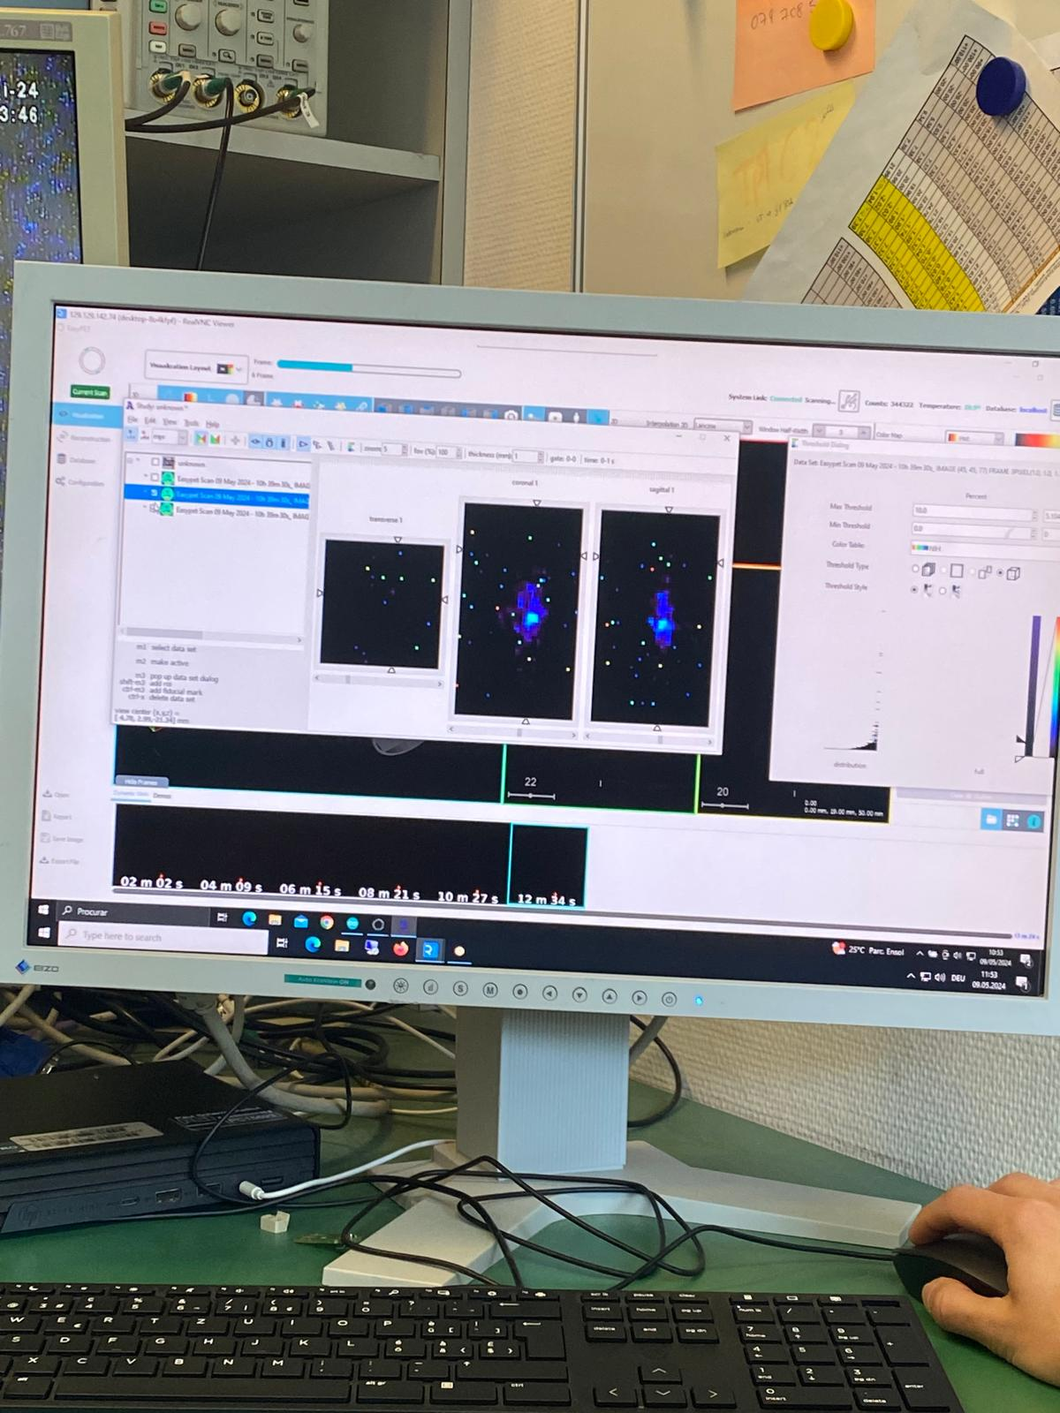
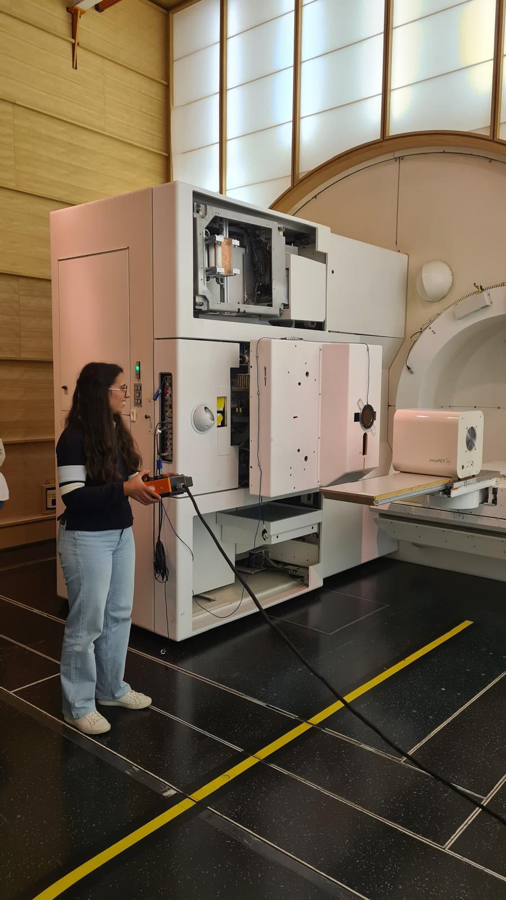
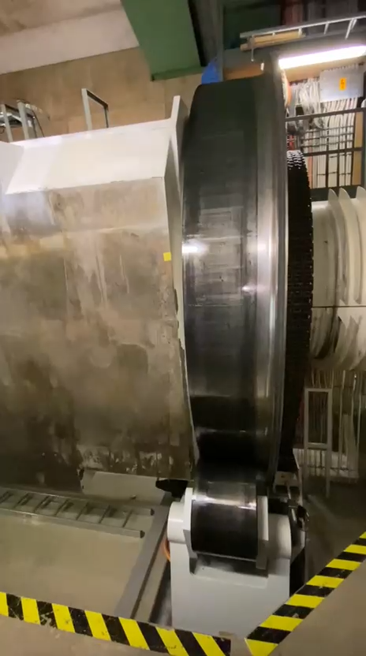
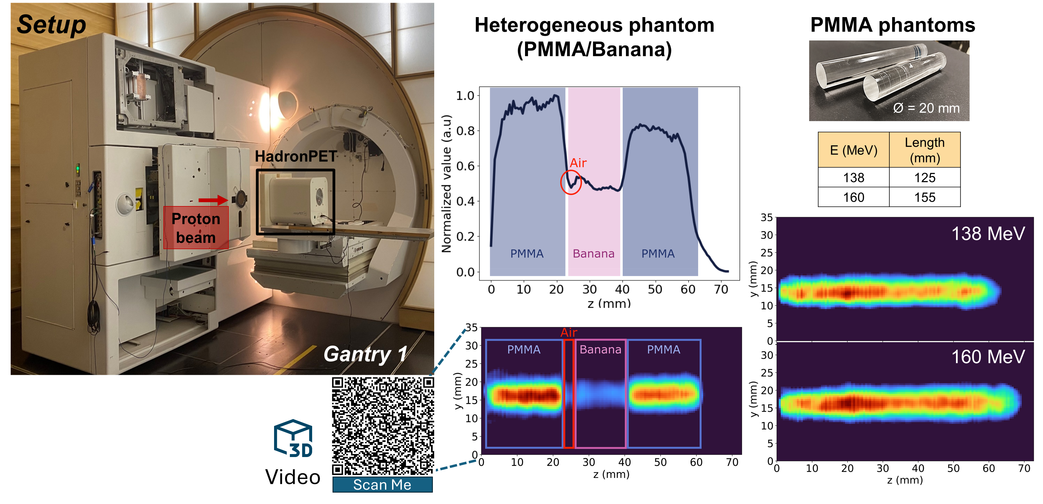
1st Tests performed @Paul Scherrer Institute
Notes:
In the first tests in PSI everything was new to us , and here you can see some photos and vídeos of us very excited and amazed with everything. In this point I only had done simulations and as you know in simulations everything works perfectly, so in this point I was really scared that the system wouldn’t work. But led by the entusiasm we decided to acquire the first image in-beam, which means that the PET was on and acquiring while the beam was irradiating the phantom. In here you can see the first image that we obtained, as you can see it is almost nothing but I was so excited that we were able to something. But after some tests we observed that something was wrong with the system, because we were to ambitious. After this we changed the detectors to news ones and tryed a new approach in room. So the system was near the beam but not in front of it. So we irradiate the phantom and then we went to the room a put the phantom in the PET system and then acquired the image.

Slide 4
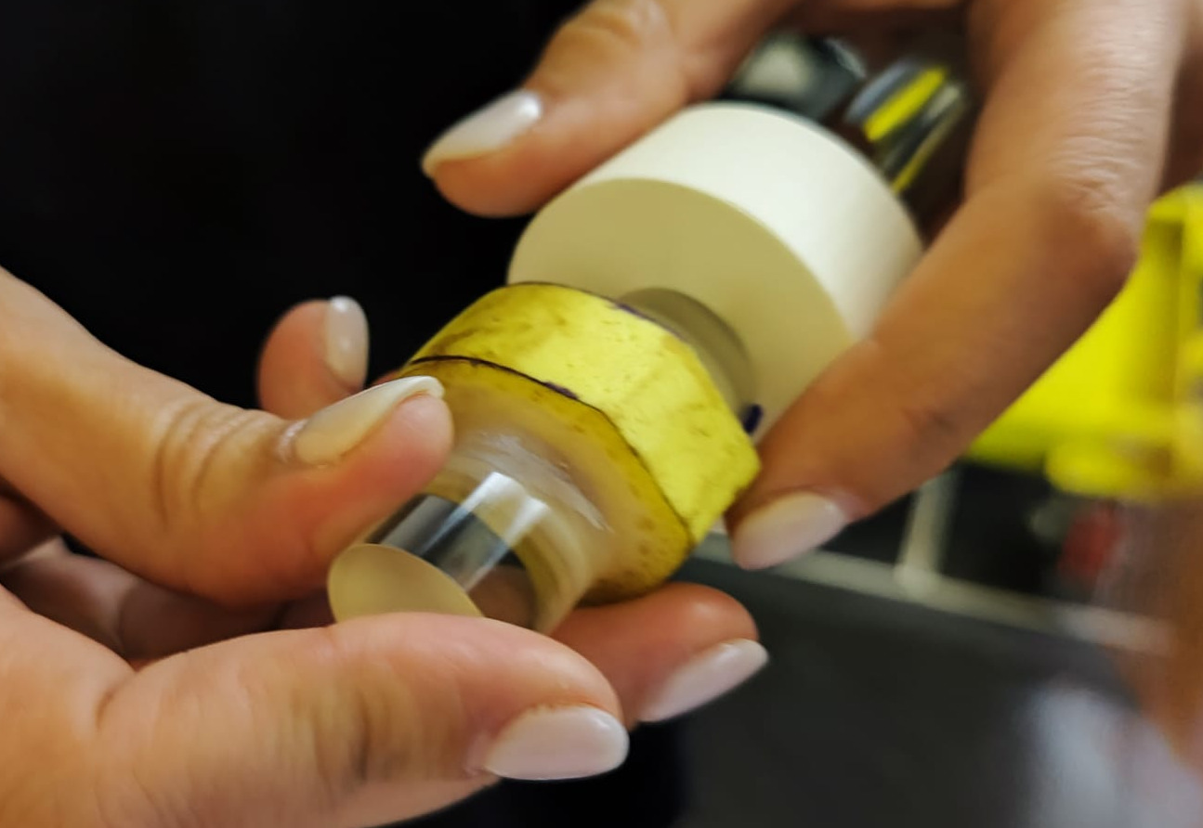
1st Tests performed @Paul Scherrer Institute
Notes:
We also decided to try irradiate a heterogeneous phantom, so we irradiate a phantom with two slices of PMMA and one slice of a banana. Yeah a banana you herd correctly, but it was what we had. In here we saw that the system system was capable to distinguish between two materials. Here are some of the images that we obtained way better than the first one. However, I was still not convinced with them, because for some images it seemed that the beam didn’t stop in the phantom, and I realized that I could have made some wrong calculations or that I should have made a bigger margin.

Slide 5
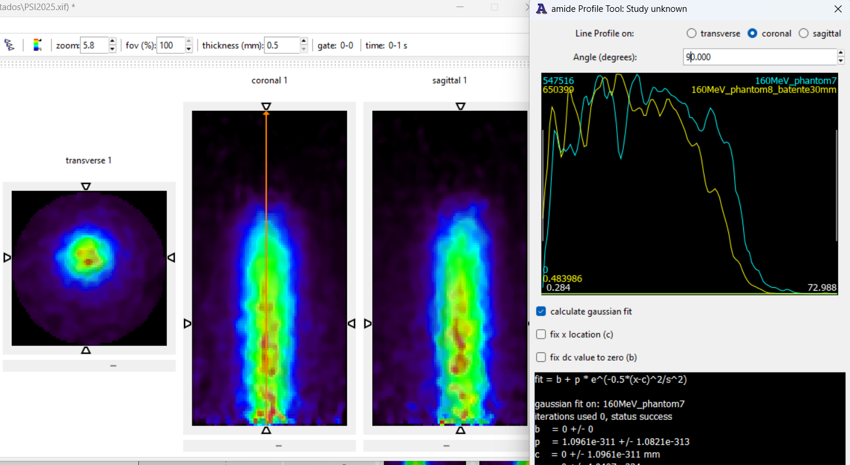

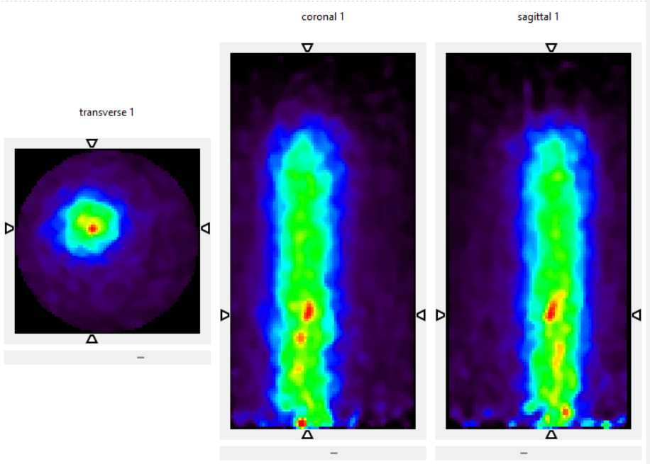
2nd Tests performed @Paul Scherrer Institute
Irradiation of the same phantom with two different energies (160 and 177 MeV)
Single irradiation (160 MeV)
Single irradiation (195 MeV)
Notes:
With the first tests at PSI we learnt a lot and we came back again this year. With the knowledge that we gained we decided to keep the in-room approach for now and here are some images that we obtained for diferente beam energies. Now we were sure that the beam ended inside the phantom.
In the video we are seeing an image of a phantom that was irradiated with two beams with diffent energies and we can see one beam end before the other. In the image of the right, we basically wanted to test the resolution of our system, so we acquired several images with the same beam energy but changed the position of the phantom inside the PET. And as you can see the system was able to distinguish.

Slide 6



Conclusion
The acquisition at PSI confirmed that easyPET.3D system is able to successfully produce 3D images of the interaction between the proton beam and the phantom, demonstrating its potential for proton beam monitoring.
Analyze all data and start writing!
Initial attempts might fail, but if you stay persistent and learn from your mistakes, success will follow.

Slide 7
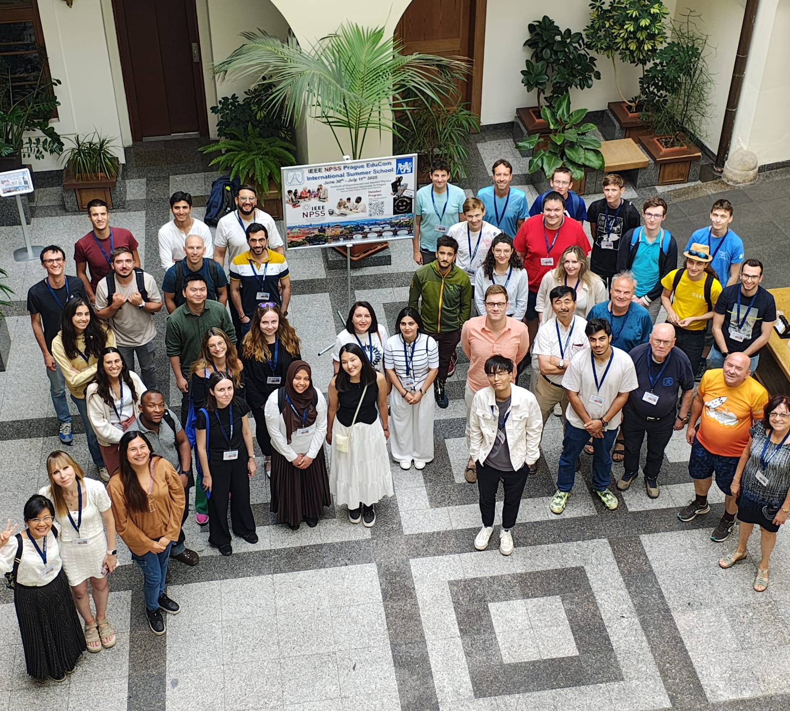
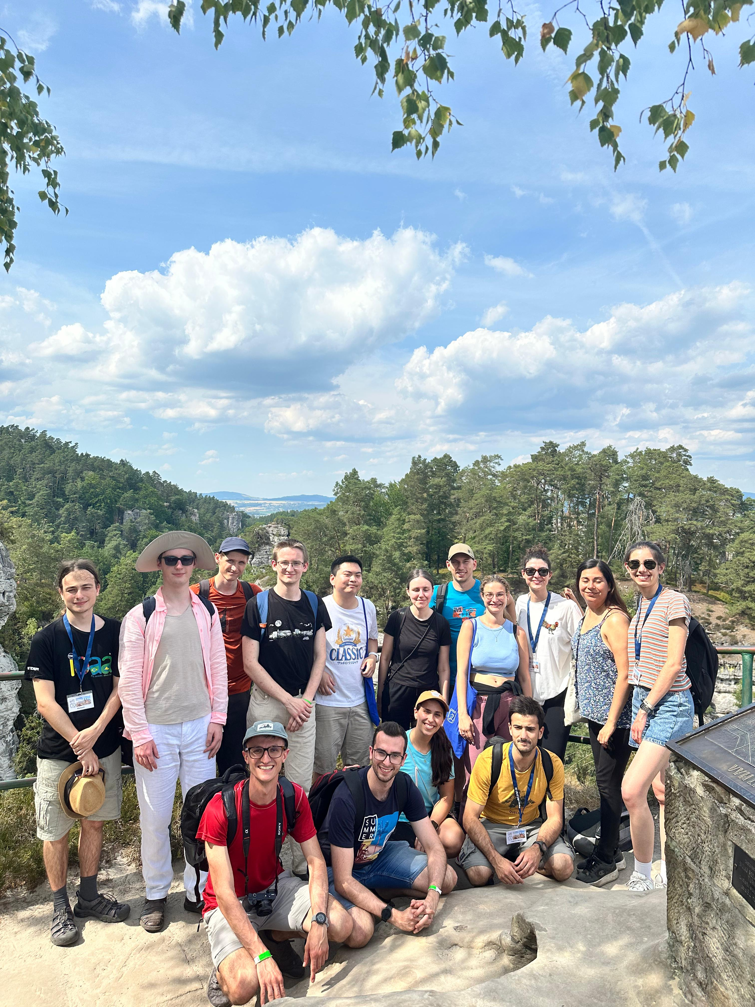
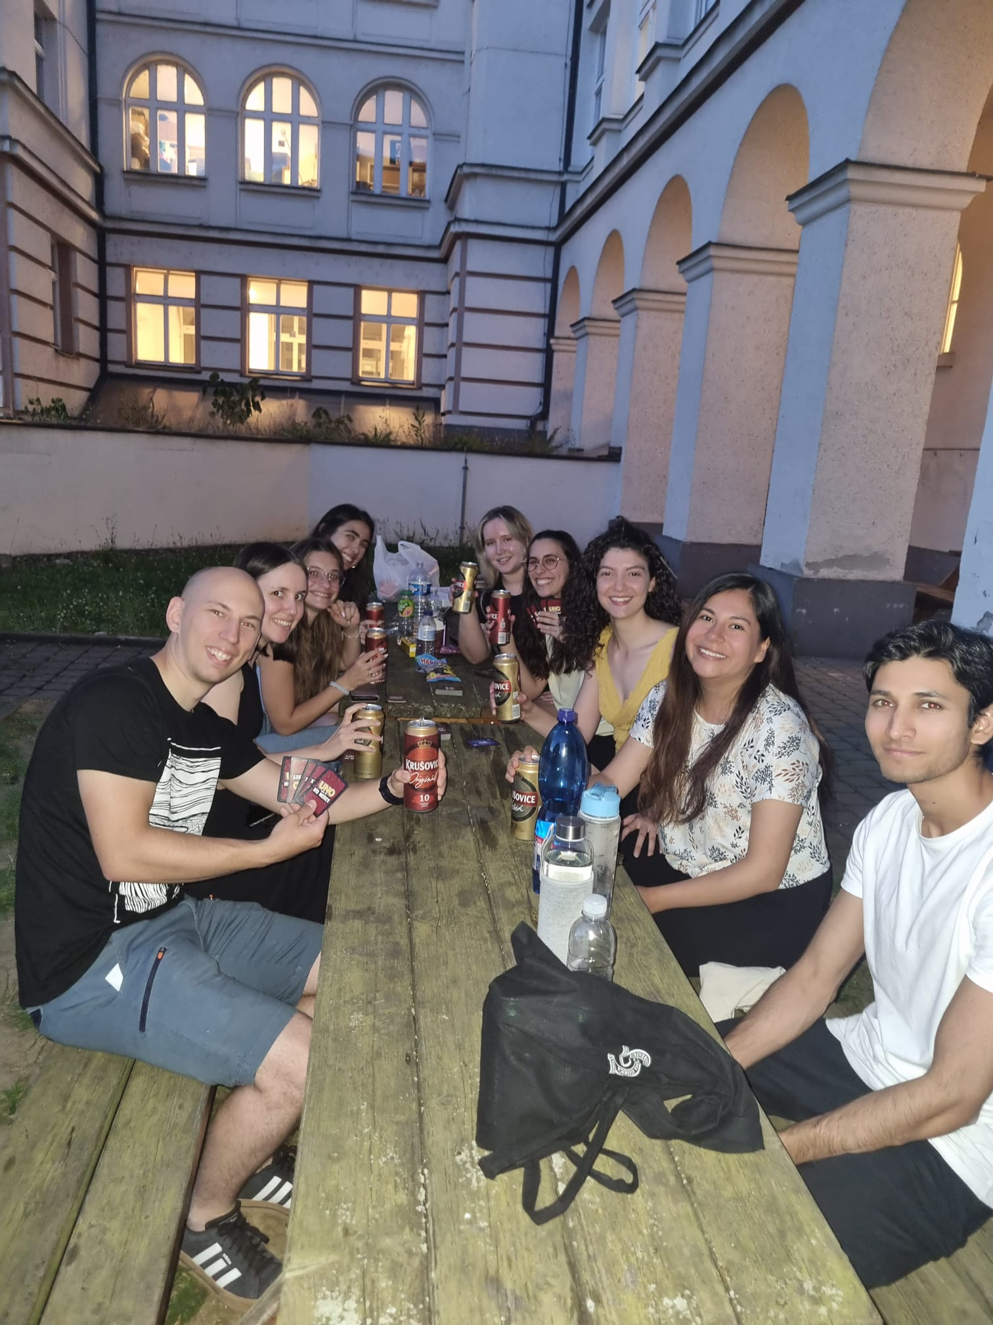

Thank you for your attention!
Contact:
Catarina Magalhães, PhD student
E-mail: anacatarinamagalhaes@ua.pt
Notes:
Thank you for your attention and if you have any questions feel free to contact me.

