Slide 1
PET in GATE
Martin Kudrna
IEEE NPSS School 2025, 11.07.2025

Slide 2
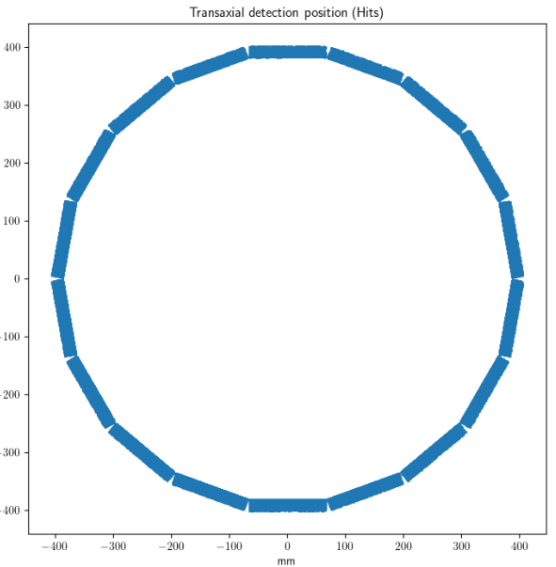
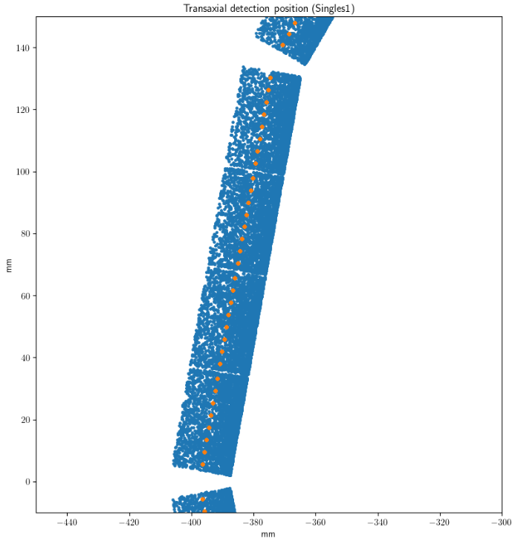

Original task
Geometry -> hits
Get to know GATE
Simulate a PET scan
Do some data analysis

Slide 3
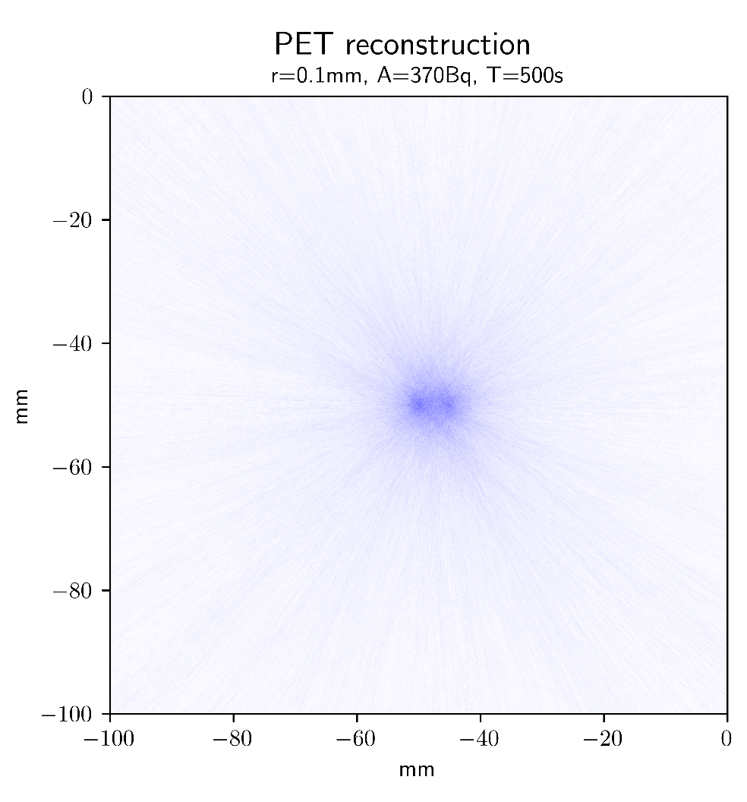
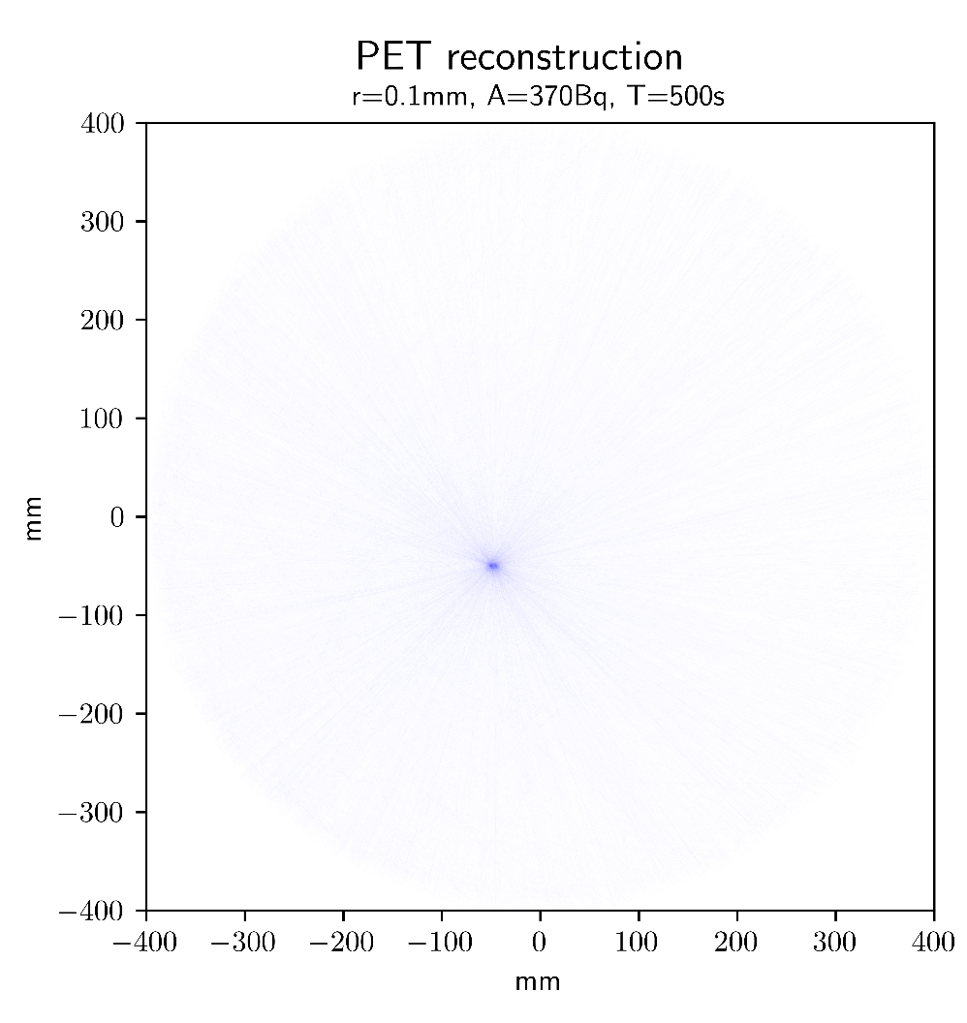
Reconstructing the scan
Hits -> geometry
2 sources
Resolution

Slide 4



Slide 5
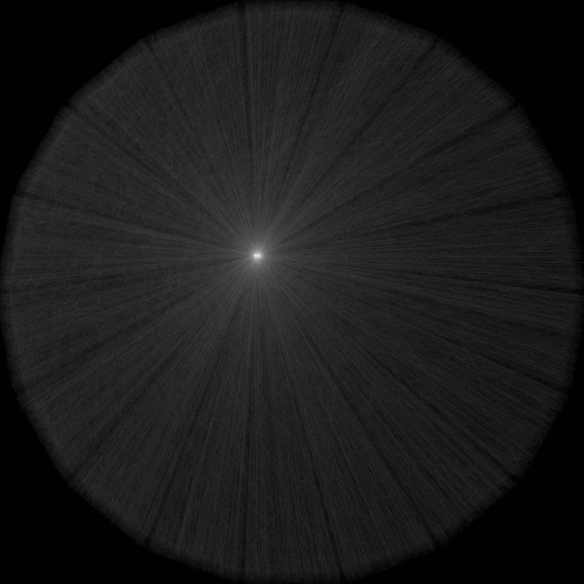
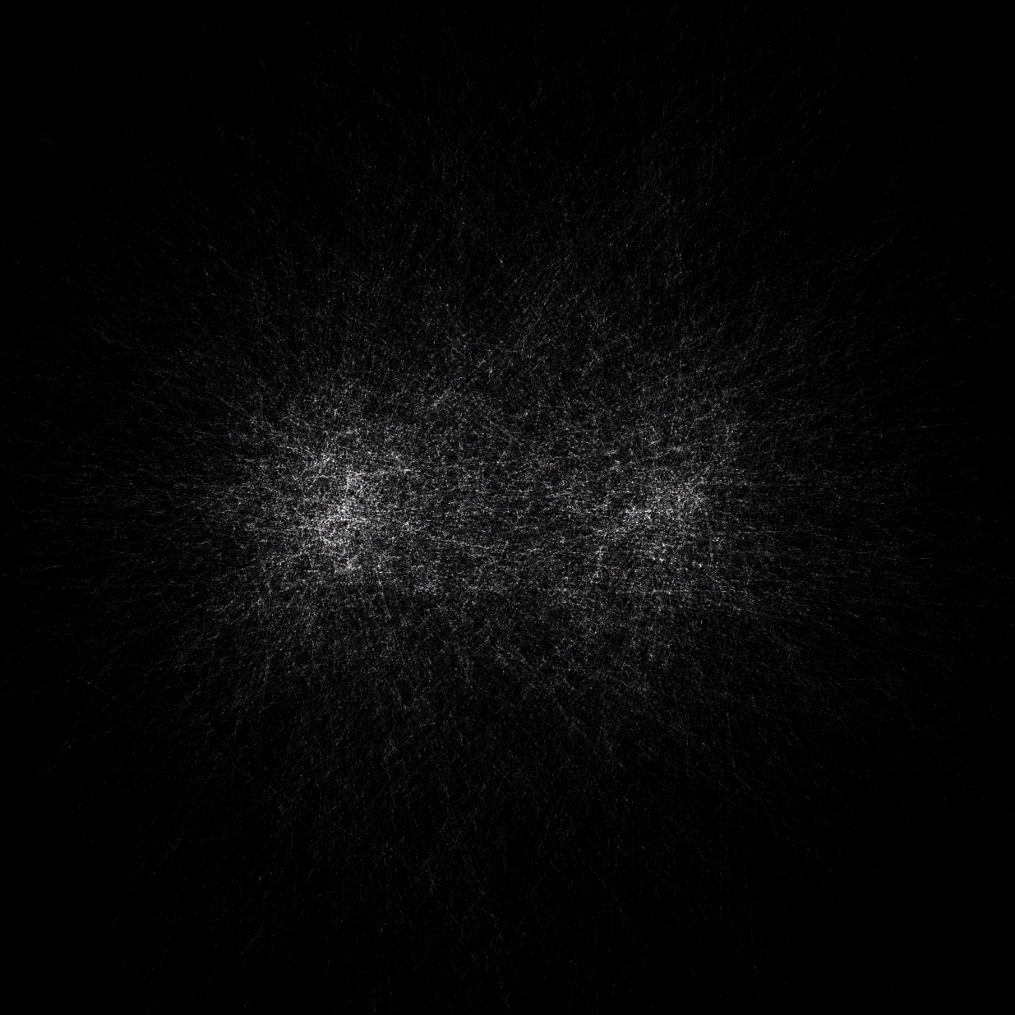
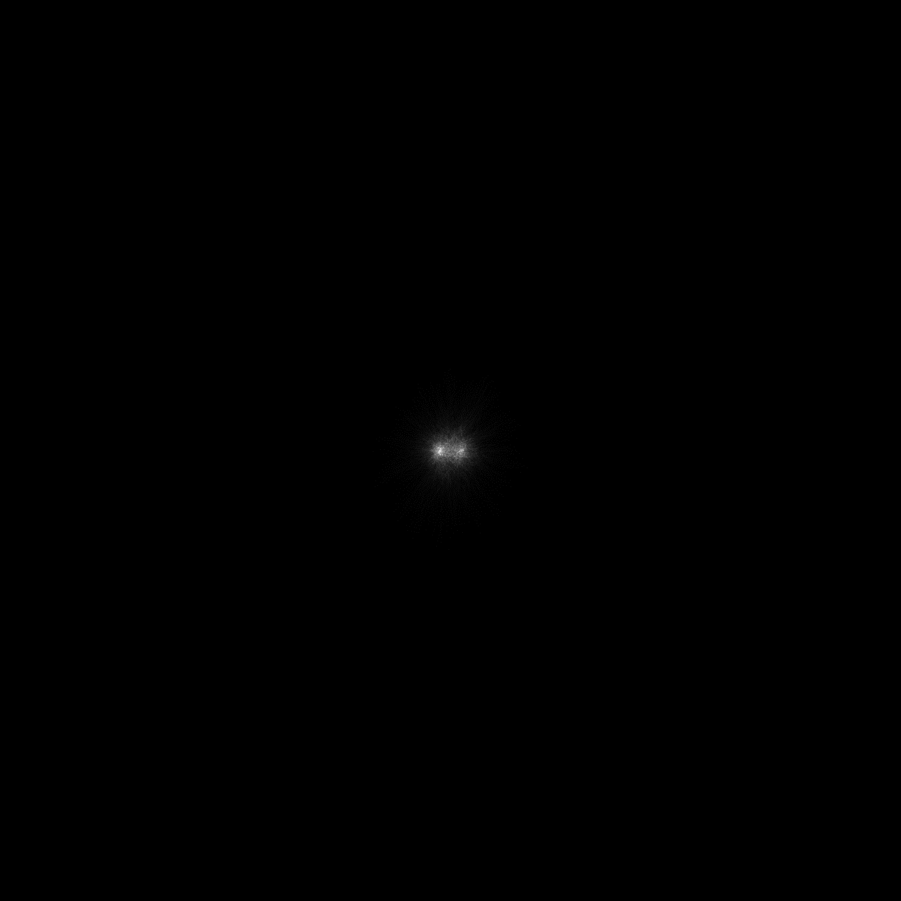

Slide 6

